Slide 1
Can Election Markets Be More Accurate than Polls

Slide 2
COMPARING POLLS AND MARKETS
Firm | When Conducted | Obama | Romney | Ind. | Undecided | Obama Lead
Election Result | 11/5 | 51.1 | 47.2 | 1.7 | ----- | 3.9
Rasmussen | 11/3-5 | 48 | 49 | 3 | 0 | -1.0
Ipsos/ Reuters | 11/1-5 | 48 | 46 | 2 | 4 | 2
CNN | 11/2-4 | 49 | 49 | 0 | 2 | -----
Angus-Reid | 11/1-3 | 51 | 48 | 1 | 0 | 3
Gallup | 11/1-4 | 48 | 49 | 3 | 0 | -1.0
ABC/ Wash. Post | 11/1-4 | 50 | 47 | 2 | 1 | 3
NBC/WSJ | 11/1-3 | 48 | 47 | 2 | 3 | 1
Pew Research | 10/31-11/3 | 50 | 47 | 3 | 0 | 3
Politico/GWU | 11/4-5 | 47 | 47 | 0 | 6 | -----
Iowa EM* | 11/1-11/4 | 51.4 | 48.5 | ------ | ----- | 2.9
The polling results in this table were gathered from the National Council on Public Polls website.
* Average of the daily price averages during these dates (which overlap with the polling dates). It should be noted that the IEM simply offers options on the two leading candidates and doesn’t recognize third-party challengers. You’ll notice that when calculating each polls outcome for the two leading candidates as a percentage of the total vote cast for them, the margin of victory does not change significantly.

Slide 3
RESULTS OF THE 2012 PRESIDENTIAL ELECTION
The Iowa Electronic Markets predicted the final margin of victory in the 2012 presidential election to within one percentage point – 2.9% vs. 3.9%.
Prices on IEM’s Vote-Share Market predicted that Barack Obama would receive 51.4% of the two-party presidential vote, and Mitt Romney would receive 48.5%.
After the ballots were counted, Obama received 52% of the two party vote, and Romney received 48%. (Remember, 98.3% of the votes were cast for the two candidates in the general election.)
Overall, the IEM’s margin of victory was closer to the actual margin than six of nine polls. The other three’s margins were close to that of the IEM’s margin.

Slide 4
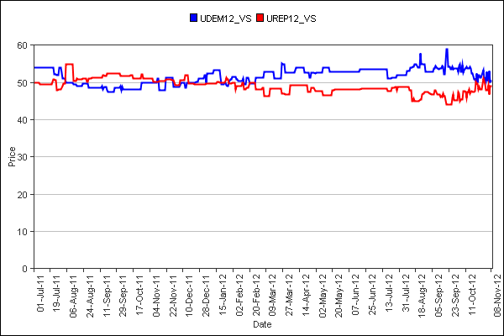
RESULTS FOR THE PRESIDENTIAL ELECTION: JUNE 2011-NOVEMBER 2012

Slide 5
RESULTS FOR THE PRESIDENTIAL ELECTION: JUNE 2011-NOVEMBER 2012
With about nine months to go before Election Day, the Iowa Electronic Markets began consistently picking President Obama to be the eventual winner.
Though the race seemed to tighten by the beginning of the 2012 summer, there was a dramatic parting of opinion toward the end of September 2012 in the wake of candidate Romney’s infamous “47%” remarks being exposed.
The lines below are from the head to head market indicating the reaction to that incident. The number of units, dollar volume, and price disparity were all new highs.
Date | Market | Units | Volume ($) | Last Price
9/20/2012 | Dem_VS | 401 | $218.293 | 0.589
9/20/2012 | Rep_VS | 313 | $143.388 | 0.441

