Slide 1
Election Economics

Slide 2
U.S. Immigrants by Class of Admission, 2013
Source: United States Department of Homeland Security, Yearbook of Immigration Statistics: 2013. Washington, D.C.: U.S. Department of Homeland Security, Office of Immigration Statistics, 2015, p. 18.
Class of Admission | Number of Immigrants
Family-sponsored preferences | 210,303
Immediate relatives of U.S. citizens | 439,460
Employment-sponsored preferences | 161,110
Diversity programs | 45,618
Asylees | 42,235
Refugees | 77,395
Others | 14,432
TOTAL | 990,553

Slide 3
U.S. Annual Caps (Limits) and Total Admissions on Temporary Worker Visas
Actual admissions are larger than the cap (limit) because: * Workers may enter the country more than once in a year * Visas are often issued for multiple years, and may be renewed * Caps for H1-B visas were higher in years before 2004
Source: United States Department of Homeland Security, Yearbook of Immigration Statistics: 2013. Washington, D.C.: U.S. Department of Homeland Security, Office of Immigration Statistics, 2015, p. 65.
Caps information from U.S. Citizenship and Immigration Services website at https://www.uscis.gov/news/uscis-reaches-fy-2015-h-1b-cap & https://www.uscis.gov/news/alerts/uscis-reaches-h-2b-cap-fiscal-year-2015.
Visa Class | Annual Cap 2016 | Total Admissions 2013
H1 – B: Occupations with highly skilled workers | 65,000 | 474,355
H2: Occupations in industries with peak load or seasonal employment demands | 66,000 | 309,570

Slide 4
The Wage Debate: One Estimate of the Effects of Immigration on U.S. Wages in the 1980s and 1990s
Source: George Borjas, “The Labor Demand Curve Is Downward Sloping: Reexamining the Impact of Immigration on the Labor Market,” Quarterly Journal of Economics, November 2003, p.1369.
Education Level | The impact of immigration on wages – percentage change in wages as compared to if there had been no immigration
High School Dropout | -8.9
High School Degree | -2.6
Some College | -0.3
College Degree | -4.9

Slide 5
The Wage Debate: Recent Estimates and Reasons
Immigration may not affect native worker wages as much:
If immigrant workers are not perfect substitutes for native workers, or if immigrant workers are complements to native workers. Estimates that account for this find immigration increased overall wages 0.6% for the period 1990 to 2006.¹
If the increased availability of workers attracts capital investment.
¹Ottaviano, G. I. P. and Peri, G. (2012), RETHINKING THE EFFECT OF IMMIGRATION ON WAGES. Journal of the European Economic Association, 10: 152–197. doi: 10.1111/j.1542-4774.2011.01052.

Slide 6
Brain Drain: Costs and Potential Benefits to Source Countries of Emigration by Skilled Workers
I. Costs
The loss of services of a highly skilled worker. For example, emigration by physicians creates significant losses in some developing nations.
The cost of training replacement workers is very high, especially considering low income levels in developing nations.
II. Potential Benefits
Remittances sent by emigrants provide income for households and may be used to promote enterprises within the country.
Emigrants may provide information, ideas, or other opportunities for businesses in their home countries to do business with firms in their host countries.
Returnees may start businesses in their home country after acquiring skills and business experience abroad.
Opportunities to emigrate provide stronger incentives for people to pursue education and training, including some who then chose not to emigrate.

Slide 7
Brain Drain Data for Selected Countries: Inventors
Country | Patent Filings 2007-2012 | % by Emigrants
Myanmar | 75 | 96
Pakistan | 672 | 93.9
Ghana | 121 | 92.6
Vietnam | 724 | 85.9
Kenya | 161 | 77.6
Greece | 3251 | 60.5
India | 52,167 | 48.7
Ukraine | 2595 | 42.8
Britain | 73,814 | 20.2
South Africa | 3,681 | 18.7
Sweden | 33,902 | 7.3
U.S. | 519,553 | 1.5
Source: The Economist. Whose brains are draining? July 1st, 2015. http://www.economist.com/blogs/graphicdetail/2015/07/daily-chart

Slide 8
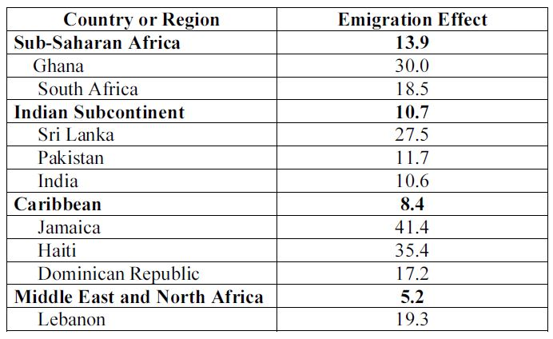
Physicians: Have Visa, Will Travel
The emigration effect is calculated as the number of physicians from the listed country or region who are currently working in one of four nations (the United States, United Kingdom, Australia, or Canada), divided by the total number of physicians from that country (working either in their home country or as immigrants in the four developed nations). It therefore suggests the percentage of a country’s physicians who are working abroad, although some physicians might have emigrated to other countries.
Source: Fitzhugh Mullan, “Metrics of the Physician Brain Drain,” New England Journal of Medicine, October 27, 2005, pp. 1810-1818.

Slide 9
Numbers of Skilled Migrants Working in OECD Countries, 2011*
Country | Number of Skilled Immigrants (in millions)
United States | 6.7
Canada | 2.6
Australia | 1.9
United Kingdom | 1.7
Germany | 1.3
France | 1.1
*Skilled workers are defined here as those with more than a 12th grade education. The member nations of the OECD (Organization for Economic Cooperation and Development) are Australia, Austria, Belgium, Canada, Czech Republic, Denmark, Finland, France, Germany, Greece, Hungary, Iceland, Ireland, Italy, Japan, Korea, Luxembourg, Mexico, Netherlands, New Zealand, Norway, Poland, Portugal, Slovak Republic, Spain, Sweden, Switzerland, Turkey, United Kingdom, and the United States.
Source: Arslan, C. et al., “A New Profile of Migrants in the Aftermath of the Recent Economic Crisis”, OECD Social, Employment and Migration Working Papers, No. 160, OECD Publishing, 2014, pp. 17.

