Slide 1
Election Economics

Slide 2
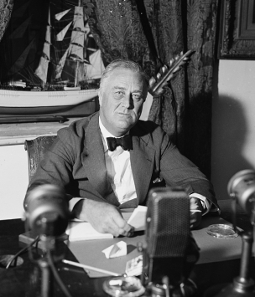
CREATED AT THE END OF THE DEPRESSION
Introduced in 1938 through the Fair Labor Standards Act.
The oversupply of labor and continued use of children in factories led to passage to end the exploitation.
Set a national minimum wage of $0.25 an hour, a 44-hour work week, and the prohibition of "oppressive" child labor.
FDR indicated it was his 2nd most important domestic accomplishment after Social Security. (Jonathan Grossman, "Fair Labor Standards Act of 1938: Maximum Struggle for a Minimum Wage," Monthly Labor Review, June 1978)

Slide 3
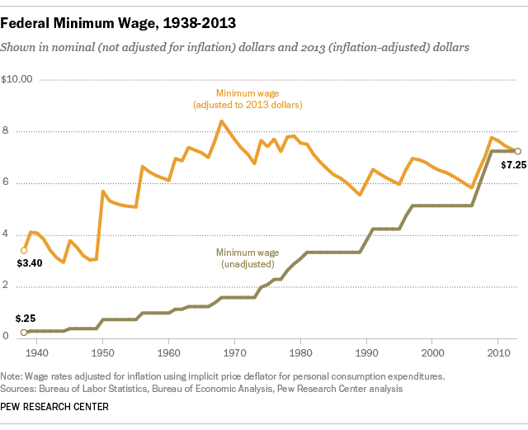
22 INCREASES UNDER 12 PRESIDENTS
Though it has been adjusted 22 times, the real value of the wage has been declining since 1968.
The current $7.25 federal minimum is on par with its real value in the late 1950s.
40 hours a week, 52 weeks a year equals an annual income of $15,080. Only 65% of the poverty threshold if there are two children in the house.
Animated History of the Minimum Wage

Slide 4
WHO MAKES MINIMUM WAGE?
According to the BLS, in 2015 there were 2.6 million wage earners at or below the minimum (some jobs are exempt).
50% are in the food preparation or food serving sector.
63% are women and 55% are over the age of 25, according to the U.S. Department of Labor.
More likely to live in the South than anywhere else, with Florida the only state to adjust higher ($8.05/hour).
http://www.bls.gov/opub/reports/minimum-wage/2015/home.htm

Slide 5
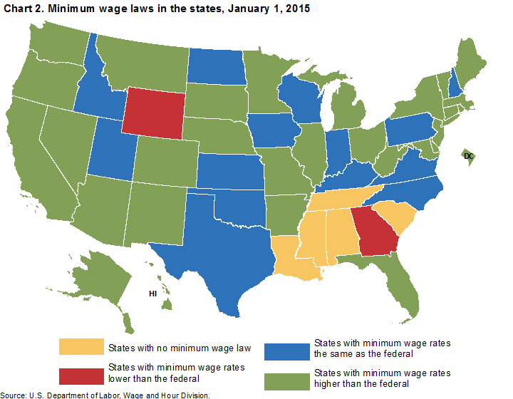
RAISE THE FEDERAL MINIMUM?
States and municipalities are free to set there own minimum hourly wage rate, the higher one prevails.
29 states plus D.C. have established rates higher than the federal $7.25/hour.
At least 30 cities and counties have adopted their own minimum rates.
For example, Washington D.C. has a minimum wage of $10.50/hour and Emeryville, CA of $14.44/hour
*http://laborcenter.berkeley.edu/minimum-wage-living-wage-resources/inventory-of-us-city-and-county-minimum-wage-ordinances/ provides a complete list.

Slide 6
RAISING THE FEDERAL MINIMUM WAGE RATE?
STUDENTS
ON THE FOLLOWING SLIDES YOU WILL SEE A SET OF ARGUMENTS FOR AND OPPOSED TO RAIING THE FEDERAL MINIMUM WAGE RATE FROM ITS CURRENT $7.25 TO A PROPOSED LEVEL OF $10.10 AN HOUR. LEGISLATION HAD BEEN INTRODUCED THREE TIMES BETWEEN 2012-14 TO IMPLEMENT THIS INCREASE WITHOUT SUCCESS.
BEFORE THE RESPONSE TO THE POSITION IS REVEALED, SPEND A LITTLE TIME IN GENERATING YOUR OWN THOUGHTS ON WHY THE POSITION MIGHT BE VALID. ONCE YOU HAVE SUGGESTED YOUR EVIDENCE, THE SLIDE WILL PRESENT ADDITIONAL SUPPORT.

Slide 7
Will a Higher Minimum Wage Spur Income and Job Growth?
Raising the minimum wage would increase economic activity and spur job growth.
Increasing the minimum wage would force businesses to lay off employees and raise unemployment levels.
Any increase in income for low-wage workers would be completely dedicated to consumption as they try to catch up to the cost of living.
Once the increases and decreases in income for all workers are taken into account, overall real income would rise by $2 billion.*
*https://www.cbo.gov/publication/44995
The Congressional Budget Office has predicted that this proposed wage increase could cost the economy 500,000 jobs.*
A 2014 survey of 1213 business owners finds that 39 percent of respondents would reduce future hiring. Among those employers who currently pay the minimum wage, 54 percent would reduce future hiring.**
*https://www.cbo.gov/publication/45138
**http://www.prweb.com/releases/2014/05/prweb11811070.htm

Slide 8
Will Raising the Minimum Wage Solve the Poverty Problem in the U.S.?
Increasing the minimum wage would reduce poverty.
Raising the minimum wage WON’T HAVE MUCH IMPACT ON poverty.
Based on 2015 poverty thresholds, an increase to $10.10 an hour would elevate a single parent with two children out of poverty.*
According to a 2014 CBO report, this would lift 900,000 people out of poverty.
*https://aspe.hhs.gov/2015-poverty-guidelines#threshholds
57% of poor families with heads of household ages 18–64 have no workers
Some workers are poor not because of low wages but because of low hours
Many low-wage workers, such as teens, are not in poor families
If wages were simply raised to $10.10 with no changes to the number of jobs or hours, only 18% of the total increase in incomes would go to poor families
*http://www.frbsf.org/economic-research/publications/economic-letter/2015/december/reducing-poverty-via-minimum-wages-tax-credit/

Slide 9
Should the Minimum Wage Only Apply to Adults Over the Age of 18?
Yes, it Should
No, It should Not
Teens make up a disproportionate percentage of food service and retail workers where minimum wage is most common.
Employers might attract more adults with a universally higher minimum wage, and a two-tiered minimum might be a compromise to get an increased wage for adults.
More (unskilled) teens might be hired at a lower wage, allowing them to gain experience and skills (human capital).
Could hurt teens that support families or lead to adults being passed over for teens in certain part-time occupations.
U.S. federal law already lets employers pay workers just $4.25 an hour during their first 90 days on the job if they're under the age of 20.

Slide 10
COULD YOU LIVE ON MINIMUM WAGE?
STUDENTS
IN ACTIVITY ONE, READ ABOUT THE TYPICAL LIFE OF AN ADULT WORKING FOR THE FEDERAL MINIMUM WAGE. THE INCOME AND EXPENSES ARE HIGHLIGHTED THROUGHOUT THE DESCRIPTION. ON ACTIVITY TWO, CREATE A BUDGET FOR THIS INDIVIDUAL TRACKING THE INCOME FROM WORK AND FOOD STAMPS (SNAP) AND THE EXPENSES REVISITED EVERY MONTH. CALCULATE THE TOTALS AND THE AMOUNT LEFT FOR ALL THAT HAS BEEN LEFT OUT OF THE STORY. A POSSIBLE ANSWER WILL APPEAR ON THE NEXT SLIDE.

Slide 11
COULD YOU LIVE ON MINIMUM WAGE?
NET INCOME/MONTHLY | MONTHLY EXPENSES
WAGES: $987.12 | $547.50/RENT
SNAP BENEFITS : $378.00 | $100/CHILDCARE
 | $378/GROCERIES
 | $125/ELECTRIC
 | $50/CABLE
 | $55/PUBLIC TRANSPORTATION
 | $65/OUT OF POCKET FOOD EXPENSES
 | $40/LAUNDRY
TOTAL: $1365.12 | TOTAL: $1360.50
 | $1.00 A WEEK LEFT FOR THE UNEXPECTED

Slide 12
WHAT IF THE FEDERAL MINIMUM WAS $10.10?
STUDENTS
IN ACTIVITY THREE, CREATE A BUDGET FOR THE SAME INDIVIDUAL IF THE FEDERAL MINIMUM WAGE WERE $10.10 AN HOUR. KEEP EVERYTHING THE SAME WITH THE EXCEPTION OF THE AREA OF FOOD. THE SNAP BENEFIT IS REDUCED FROM $378 TO $333 BECAUSE OF THE INCREASE IN INCOME.* WHILE THE GROCERY EXPENSES WILL REMAIN THE SAME, THE OUT OF POCKET EXPENSES WILL HAVE TO ADJUST TO MAKE UP FOR THE SHORTFALL. THE GROSS INCOME FROM 38 HOURS AT $10.10 AN HOUR IS $383.80 A WEEK AND THE NET INCOME IS $343.77. THE MONTHLY NET IS $1375.08. A POSSIBLE ANSWER WILL APPEAR ON THE NEXT SLIDE.
*http://www.cbpp.org/research/a-quick-guide-to-snap-eligibility-and-benefits

Slide 13
COULD YOU LIVE ON MINIMUM WAGE?
NET INCOME/MONTHLY | MONTHLY EXPENSES
WAGES: $1375.08 | $547.50/RENT
SNAP BENEFITS: $333.00 | $100/CHILDCARE
 | $378/GROCERIES
 | $125/ELECTRIC
 | $50/CABLE
 | $55/PUBLIC TRANSPORTATION
 | $110/OUT OF POCKET FOOD EXPENSES
 | $40/LAUNDRY
TOTAL: $1708.08 | TOTAL: $1405.50
 | $75.00 A WEEK LEFT FOR THE UNEXPECTED

Slide 14
COULD YOU LIVE ON MINIMUM WAGE?
STUDENTS
IN ACTIVITY 4, YOU WILL RESPOND TO THE UNEXPECTED TRIALS OF LIFE UNDER THE CURRENT FEDERAL MINIMUM WAGE OF $7.25 AND THE PROPOSED FEDERAL MINIMUM OF $10.10. ON THE NEXT SLIDES YOU WILL BE PRESENTED WITH A SERIES OF SCENARIOS AND YOUR TASK IS TO FIT THEM INTO YOUR BUDGETS. TREAT EACH DILEMMA AS AN ISOLATED EVENT AND GO BACK TO THE ORIGINAL BUDGET BEFORE ADDRESSING THE NEXT ONE. WRITE YOUR RESPONSES ON THE HANDOUT PROVIDED SUGGESTING THE TRADE-OFF YOU WOULD MAKE WHILE MANAGING AS A SINGLE PARENT WITH TWO CHILDREN.

Slide 15
PLAY THE ROLE, RESPOND TO THESE SCENARIOS WHAT WOULD YOU DO?
Your 11-year old comes home crying because he is embarrassed about purchasing meals through the free and reduced lunch program. It’s $3 a day for lunch.
Your 8-year old tears open her only pair of sneakers. $10 for a new pair or $2 for a roll of duct tape.
You’ve discovered a small leak from the bathroom sink and the landlord is away for a week. $150 for a plumber or $40 in parts and tools to fix it yourself.
Your sister has fallen ill and can’t watch your children after school. You can miss work or pay $125 a week for an after care program.
Your tooth has been hurting for weeks, and it’s starting to get unbearable. You need a root canal, but you don’t have dental insurance. The clinic will do it for $400.

Slide 16
PLAY THE ROLE, RESPOND TO THESE SCENARIOS WHAT WOULD YOU DO?
You are unbanked and can either open a checking account or go to the check cashing store. The bank charges a $8.00 monthly service charge but fees increase dramatically if the balance falls below $50. The check cashing store charges a flat fee of $7.50.
The flu is going around and your child has the chills and a fever. Do you skip work or send him to school sick?
You weren’t paying attention running into the building and accidentally knocked the side view mirror off of your neighbors car. $125 to replace it.
Your landlord raises the rent by $150 dollars a month without warning. You and your roommate protest but it falls on deaf ears. Moving to a new place would require one month’s rent and a security deposit.
One of your co-workers has gotten seriously ill. Because your company doesn’t offer sick days, everyone is contributing $20 to help her out.

