Slide 1
Behavioral Economics

Slide 2
Activity
Sellers are represented by a letter and buyers by a number.
Write your number or letter on your badge. This is how you will be identified in the market.
Affix your badge onto your clothing (with a pin, tape, or clip) so that buyers and sellers can be identified.
Quietly read the information sheet that explains your role as a seller or buyer. Keep the information on this sheet to yourself.
Buyers, pay close attention and be sure to follow the instructions as there is some information you need to fill out.
Slide 2.1

Slide 3
Activity cont.….
The good that is being sold/purchased in this market is a textbook. All sellers have the same textbook and all buyers need to purchase the same textbook.
Once a buyer and seller communicate, you can only make a deal with that specific other person. No shopping around is permitted!
Use the transaction sheet provided to record the final price paid.
Modified from Designing Choice: The Default and Anchoring, Written by Craig Zdanowicz
Slide 2.2

Slide 4
Definitions
What is a cognitive bias?
“Cognitive bias can be characterized as the tendency to make decisions and take action based on limited acquisition and/or processing of information or on self-interest, overconfidence, or attachment to past experience.”
Anchoring Effect: Anchoring is a type of cognitive bias that people exhibit in which there is a tendency to rely significantly on the first piece of information that is given or available when making a decision.
Slide 2.3 Anchoring Effect: Modified from Designing Choice: The Default and Anchoring: Written by Craig Zdanowicz http://ux.saggezza.com/articles/designing-choice-the-default-and-anchoring/
Cognitive Bias: Cognitive Biases Are Bad for Business Do you see irrationality in your company? Jim Taylor Ph.D.: https://www.psychologytoday.com/blog/the-power-prime/201305/cognitive-biases-are-bad-business

Slide 5
Example
Initially we do not know what value the textbook has in terms of price.
Once the buyers were anchored to consider a specific value (which in this case was considering their buyer number as a price), they were able to more easily offer a price for the textbook.
Without having been asked to consider a price for the book, the buyers may not have known what they should pay for the book.
Slide 2.4

Slide 6
Example cont.…
As long as they have a price that they can anchor their expectations to, whether it be their buyer number or a price for that textbook from a different student, bookstore, or online retailer, buyers have a coherent rationale for why they would pay that price or somewhere in the range of the original price that was initially seen.
The price becomes a point of reference for all other future decisions on what price to pay.
Slide 2.5
Modified from Designing Choice: The Default and Anchoring, Written by Craig Zdanowicz

Slide 7
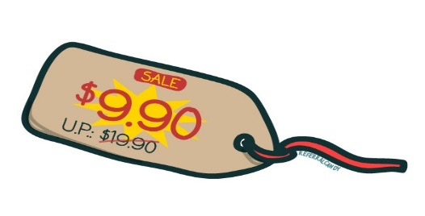
Relativity trap
Consumers think about prices relative to a benchmark and retailers are aware of this.
Retailers set a manufacturer’s suggested retail price (MSRP) as a benchmark, and then discount the actual price. Consumers then evaluate the posted price relative to the MSRP.
Modified from: Why We Buy: How to Avoid 10 Costly Cognitive Biases. See more at: http://www.spring.org.uk/2011/03/why-we-buy-how-to-avoid-10-costly-cognitive-biases.php#sthash.f5DD4lKp.dpuf
Author: Dr. Jeremy Dean
Slide 2.6

Slide 8
Relativity trap
The relativity trap is an example of the anchoring effect.
The MSRP price acts like an anchor in how we think about whether or not we are getting a good deal.
Manufacturer's have an intended outcome for the sales price they receive for their goods; they “anchor” us to a higher price to make any amount lower seem like a good deal, or as we call it, a discount.
Slide 2.7
Modified from: Why We Buy: How to Avoid 10 Costly Cognitive Biases. See more at: http://www.spring.org.uk/2011/03/why-we-buy-how-to-avoid-10-costly-cognitive-biases.php#sthash.f5DD4lKp.dpuf
Author: Dr. Jeremy Dean

Slide 9
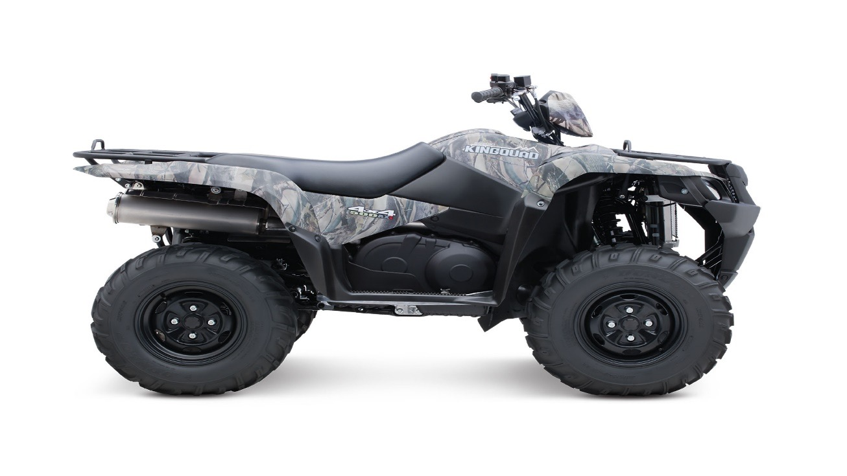
Is this ATV Expensive?
$6,500
from www.atvtraderonline.com
Suzuki Kingquad 500axi ATVs for sale
Slide 2.8

Slide 10
How about now?
$6,500
MSRP$8,299
from www.atvtraderonline.com
Suzuki Kingquad 500axi ATVs for sale
Slide 2.9

Slide 11
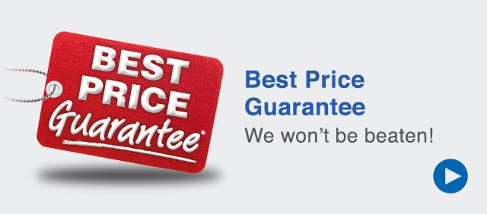
And now?
$6,500
MSRP$8,299
from www.atvtraderonline.com
Suzuki Kingquad 500axi ATVs for sale
Slide 2.10

Slide 12
Comparing Econs and Humans
Lesson | Econs | Humans
1 | Use system 2 for all their decisions. | Use system 1 to make many routine decisions.
 | Carefully weigh costs and benefits to make decisions. | Make decisions on past experience or quick judgments.
2 | Are not subject to cognitive biases when making decisions. | Are subject to cognitive biases when making decisions and so may use anchors and fall into relativity traps.
3 | Make decisions by weighing costs and benefits equally. | Tend to weigh losses greater than gains.
 | Are not influenced by their current situation when making decisions. | Tend to bias to the default or to things they already have.
4 | May discount costs and benefits that occur in the future. | May have self-control problems and discount the future too much or be subject to present bias, causing inconsistent decisions.
5 | Only use costs and benefits to make decisions. | May make decisions based on fairness or for other emotional factors such as whether work is meaningful.

Slide 13
Can we avoid being anchored?
When you go shopping, know the value (benefit) to you of any good you would consider purchasing. Research and know the approximate price of the good in the market so that you can recognize when a discount is really a discount and not just a marketing ploy.
Be aware that you can be influenced by anchors provided by retailers. You can reset the anchor by walking away from negotiations. You can set the anchors by making first offers.
Slide 2.12

Slide 14
Can we avoid being anchored?
If you see that a retailer is trying to anchor you on a high initial price, ask yourself, “do I actually value this at more than the sales price, or is the seller just trying to make this seem like a good deal in comparison to the original price?”
If consumers are less impulsive and more cautious and conscious about the price they pay, they can be less influenced by sellers’ attempts to anchor them on high prices in the guise of making something appear to be a good deal.
Slide 2.13
Modified from Designing Choice: The Default and Anchoring: Written by Craig Zdanowicz

Slide 15
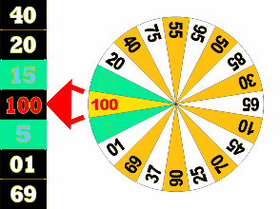
Are random anchors that powerful?
Study conducted by Tversky and Kahneman (1974)
A random number was generated by spinning a wheel in view of the participants.
Participants were asked to tell whether this random number was higher or lower than the percentage of African nations in the United Nations.
Judgment under Uncertainty: Heuristics and Biases, Amos Tversky; Daniel Kahneman, Science, New Series, Vol. 185, No. 4157. (Sep. 27, 1974), pp. 1124-1131.

Slide 16
Are random anchors that powerful?
Participants were asked to estimate the percentage of African nations in the United Nations.
Suppose group A saw a random number of 10 and group B saw a random number of 65. Was group A’s average estimate higher or lower than group B’s? How large a difference would you predict?
Slide 2.15
Modified from Designing Choice: The Default and Anchoring, Written by Craig Zdanowicz

Slide 17
Are random anchors that powerful?
Study conducted by Tversky and Kahneman (1974)
Median estimate by Group A: 25
Median estimate by Group B: 45
Slide 2.16
Judgment under Uncertainty: Heuristics and Biases, Amos Tversky; Daniel Kahneman, Science, New Series, Vol. 185, No. 4157. (Sep. 27, 1974), pp. 1124-1131.

