Slide 1
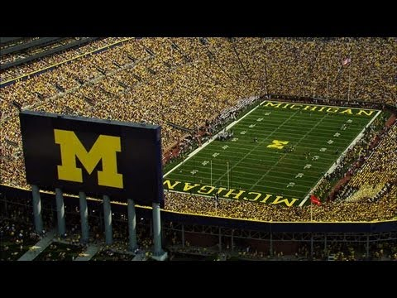
“Care to pay $1,000 for a No. 2 lead pencil? How about $550 for a key chain, or $51 for an unused coaster? Did we mention we’ll throw in free tickets to Saturday’s Big Ten football showdown between Ohio State and Michigan?”
–USA Today
“Michigan-Ohio State: Sellers duck anti-scalping law for clash” 11/18/2003
Notes:
Some may identify that these college students are trying to get around an anti-scalping law.
Most will believe this term has something to do with selling tickets at high prices. Explain that the terms is defined as selling tickets for a sporting event or concert above the tickets face value.
Most will assume the laws are designed to stop consumers from getting ripped off by ticket re-sellers.

Slide 2
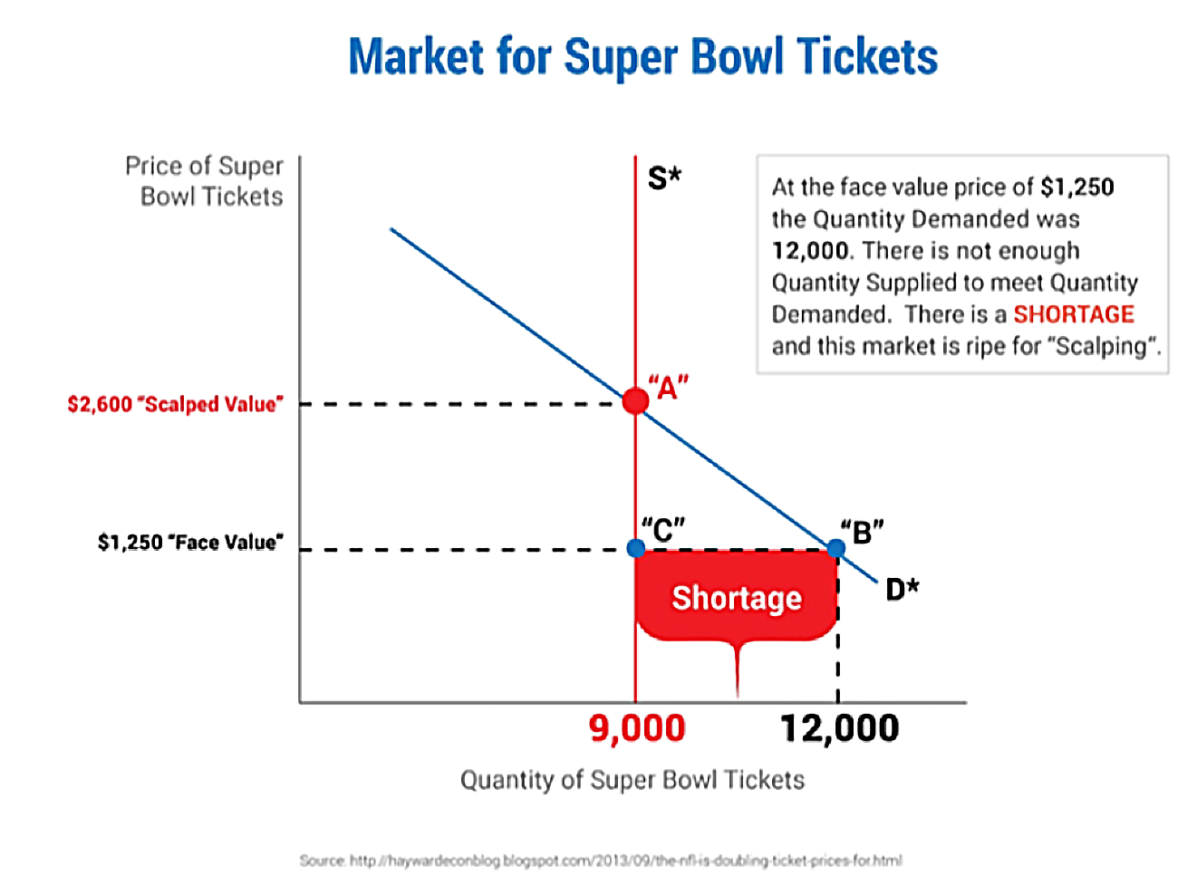
Visual 1
Notes:
[Students will mention that fans may really want to go to a game that many others want to see as well.]
Use this opportunity to explain that in economic terms, the issue is that there is very high demand and a limited supply. Show Visual 1, a supply and demand graph for Super Bowl tickets, to explain why this would lead to a high price.
[For most games this is of course not the case. Explain that for “big” games—like the Super Bowl or a World Series game—the market price may be many times higher than the face value. However, for games with little demand—like when both teams are bad—the market price may fall below the face value on the ticket.]

Slide 3
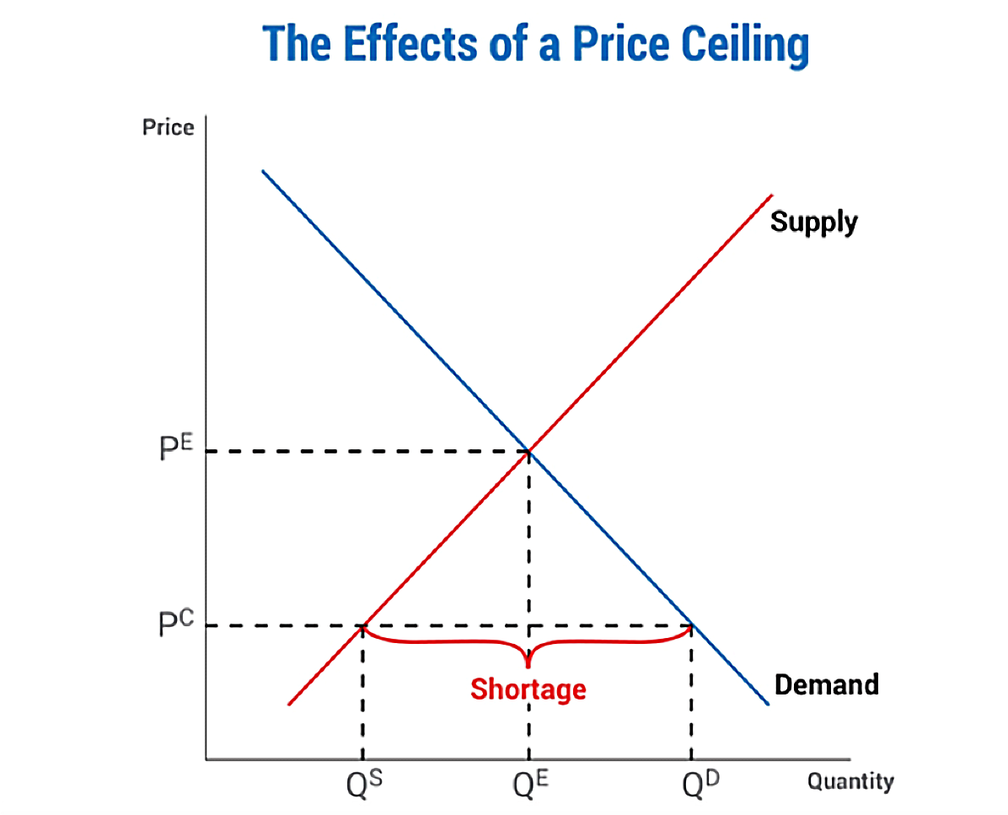
Visual 2
Notes:
Explain that a price ceiling is a maximum price that can be charged for a good or service, as set by law. Well known examples of price ceilings include rent control laws in many large American cities. These laws are designed to protect renters from high rental charges and to help the less well-off find affordable housing. Show the students how such a law may be depicted on a supply and demand graph.

Slide 4
Group Activity
Predict the effects of an anti-scalping law on the buyers and sellers of tickets. Use economic thinking and the supply and demand graph on the prior slide as you answer.
If tickets sell for above face value on the secondary market (like through scalping or on StubHub) this suggests that professional sports leagues underprice their tickets. Why might they do this?
One theory deals with the image of the sports team or music artist. Most teams and artists feel that it is crucial to their image that their venue be sold out. After all, a sold-out venue lends value to attending and may even help a team win. Secondly, a sell-out crowd maximizes complementary revenues from parking and concessions. Another reason to desire a sell-out crowd occurs in the National Football League. The NFL’s blackout rule prevents local television broadcast of a game that is not sold out. Failing to sell out a game, therefore, has negative effects on television revenue and teams’ ability to widen the fan base.
Notes:
[Some students will expect this law to keep prices lower and protect consumers. Others will understand that this law really creates a price ceiling—that is, prices can’t rise above the ceiling. Price ceilings always cause demand to exceed supply and shortages to occur. Show students Visual 2, a supply and demand graph illustrating the effects of a price ceiling. In this case, there are a couple of possible outcomes. Those that value the game the most may not attend the event—in other words, those that have the tickets will go and not participate in a mutually beneficial transaction by selling the tickets at the market price to those willing to pay. Sometimes, however, people will choose to break the law or a black market will occur for tickets. This explains the opening quote about the University of Michigan student’s behavior.]

