Slide 1
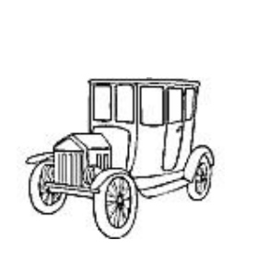
Production Simulation (part 1)
Using your card, pen, string and scissors, make a bookmark like this:
Productivity

Slide 2
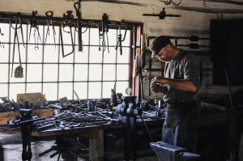
An individual craftsman
Notes:
Explain to students that until the late 1700s, nearly every manufactured item in the world was made by a skilled craftsman, with unique parts.
Ask students: What do you think you would be able to manufacture on your own (like you did with the bookmarks) or in a small group?
Answer: With training, individuals could make items like pottery, rugs, clothing, glass containers, boats, bicycles, and so on, though it might take a lot of time. Explain that it would be nearly impossible to manufacture many of the complex items we have today, like smartphones, jets and computers, using this type of process. Explain to students that in the late 1700s, gun manufacturers first developed the idea of creating interchangeable parts – in other words, intermediate goods (like pictures of the antique car) that could be mass produced and inserted into final products.

Slide 3
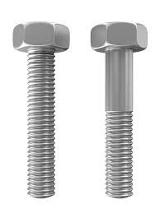
Interchangeable part
Bolts can be used in buildings, bridges, trucks, skateboards and all kinds of industrial processes.
They are produced in standardized sizes and shapes, so that all kinds of manufacturers can use the same part, and they can be easily replaced.
Notes:
Shows bolts that can be used in the production of countless products.

Slide 4
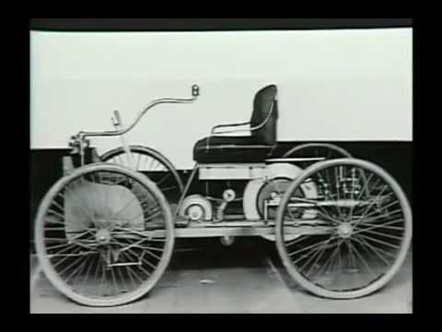
Henry Ford’s innovation
Notes:
Explain that despite the innovation of interchangeable parts, many items were produced on a small scale or by specialized craftsmen for another century.
Explain that in the early 1900s, various entrepreneurs including Henry Ford were developing horse-less carriages – or early automobiles. These cars were not made by individual craftsmen, but by groups of skilled workers at stationary workbenches. It was more efficient than an individual worker but still very time consuming. As a result, cars were an expensive luxury good only available to a few.
Explain that students are going to watch a brief video about Henry Ford’s auto company. Show the Ford video embedded, start at 8:45. Stop the video at 13:06. You will show an additional clip later in the lesson.

Slide 5
Let's Discuss
What did you notice about the workers in the first part of the video? (They were working alone on individual pieces; later they are working in groups. Explain that initially mechanics used everyday tools to assemble these parts.)
What were Henry Ford’s goals? (Produce a car for the masses, a car that could drive on rutted tracks, a car that farmers could use)
What was different about the Model T? (simple, reliable, rugged, higher frame, cheap)

Slide 6
Let's Discuss
What was wrong with Henry Ford’s original process for manufacturing the Model T? (The company couldn’t keep up with orders, they could only produce 25/day)
What was Ford’s revolutionary idea? (The moving assembly line)
How did it change production of the Model T? (Went from 12.5 man-hours to produce a car to 93 minutes to produce a car)
What happened to prices of cars? (Cut by hundreds of dollars.) Explain that the price fell from $850 in 1908 (about $22,000 in 2016 dollars) to less than $300 by 1925 (about $4,100 in 2016 dollars.)

Slide 7
Henry Ford's Auto Company
You will learn more about:
how this process improved productivity
how Ford addressed some of the downsides of assembly-line production
how this innovation affected supply and demand in the auto industry
Notes:
Explain to students that Ford got the idea for the moving assembly line during a visit to a meatpacking plant, where he watched meatpackers remove cuts of beef from a carcass as it was passed along by a trolley until nothing was
left. He reverse-engineered the process – starting with one part and moving it along, adding pieces to build the entire car. Ford implemented specialization, meaning that each worker had one distinct task and did it over and over.

Slide 8
Production Simulation (part 2)
Using your materials to make a bookmark like this:
6”
1/2”
Productivity
2”
Use 12” string

Slide 9
Production Report
Count: How many finished bookmarks did you make?
Calculate: # bookmarks/# workers to get worker productivity
Calculate: 10 minutes/worker productivity to get worker-minutes/bookmark
Productivity
Notes:
Ask each group to calculate its worker productivity (bookmarks/worker) and the average number of worker-minutes it took to produce each bookmark. For example, if a team of 6 produced 12 bookmarks, their worker productivity is 12/6 = 2. Because worker productivity is 2 bookmarks in a period of 10 minutes, it took 10/2 = 5 minutes to produce each bookmark.

Slide 10
Production Line Debrief
How did the number of bookmarks produced on the assembly line compare to the number you made as individuals?
Which assembly line tested by the class was most productive? In other words, which one produced the most bookmarks per worker?
Why did this assembly line produce more than the others?
Which group made the best quality bookmarks?
What were the advantages of producing bookmarks using an assembly line?
Notes:
Possible Answers:
Answers will vary. Students should be able to increase their output per worker compared to the initial simulation, due to specialization.
Be sure the group that produced the most produced more per worker, not just more over all.
They may have been more motivated or more organized. They may have been more skilled at one part of the process.
Quality should be consistent, but some workers might become sloppy when they try to speed up.
More bookmarks could be produced, workers could specialize in the task they did best, the bookmarks were more uniform, they made more efficient use of capital.

Slide 11
Production Line Debrief
What were disadvantages of producing bookmarks using an assembly line?
Are there any additional tools or capital goods that would have helped you speed up the process even more?
Notes:
Possible Answers:
They all looked the same (no artistry), the work was boring, the workers were dependent on other workers and slowed down if someone made a mistake, it took time to plan the assembly line.
A paper cutter, a glue gun, a hole-puncher that could do multiple holes simultaneously.

Slide 12
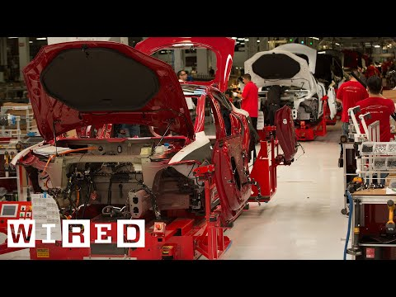
More productivity advances: Tesla Factory
Notes:
Ask students what differences they see between Ford’s production line and the Tesla production line. Answer: Almost no people, bright colors, extremely clean, everything is on a massive scale. Explain to students that assembly lines, more capital goods and even robots have vastly improved the productivity of auto manufacturing in the past century and lowered the costs of producing cars (and many other goods). These innovations have had a huge impact on U.S. productivity and GDP. However, this kind of manufacturing has negative side effects as well. Ask students: What do you think are negative effects of assembly lines? Answers: Goods are generic/less unique, workers’ jobs are boring.

Slide 13
Costs of the assembly line
Notes:
Show Slide 11 and fast forward to where you left off in the Ford video (13:06). Play the video 13:06 to 14:30. Ask students: What were the drawbacks? Answer: Workers hated their repetitive jobs. Ask students: How do you think Ford addressed these drawbacks? Answers will vary.

