Slide 1
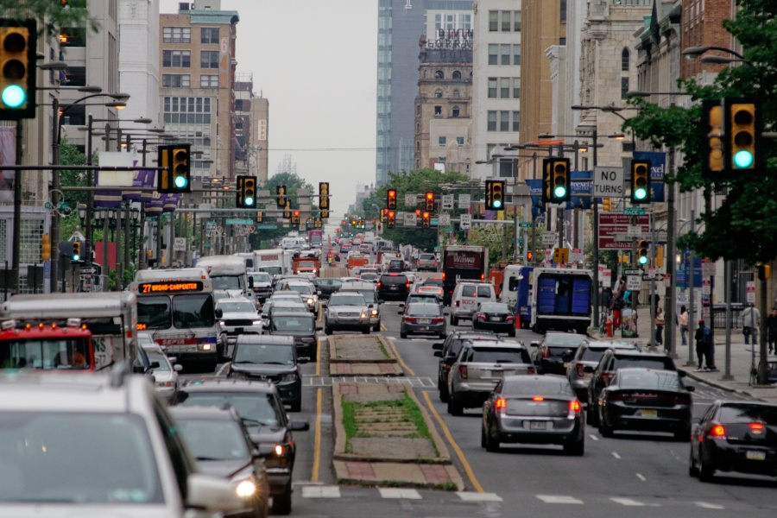
Cities before and after the automobile
Notes:
Tell students that the impact of the expanding auto industry in the early 20th century had consequences that went well beyond the individual sellers and buyers of cars. This slide shows Philadelphia before cars – and Philadelphia in recent years. Ask students to note any differences they see in the two images.

Slide 2
Review Demand and Demand Shifters
Market (change in # of consumers)
Tastes and preferences
Income
Related goods - substitutes
Related goods - complements
Expectations*
P
D₂
D₀
D₁
Q
Notes:
This list of shifters is taken from https://www.econedlink.org/resources/demand-shifters/, but this lesson does not include expectations as a shifter.
Market (change in # of consumers) If there are more potential buyers in a market, for example, more drivers wanting cars, demand will increase and shift right. If there are fewer potential buyers, demand will decrease and shift left.
Tastes and preferences. If a product becomes more popular, like SUVs in recent years, demand will shift right. If a product becomes less popular, like sedans in recent years, demand will shift left.
Income. If incomes increase, demand for normal goods will shift right, but demand for inferior goods (like generic substitutes) will shift left. If incomes decrease, demand for normal goods will shift left, but demand for inferior goods will shift right.
Related goods – substitutes. If the price of a good (like Coke) increases, demand for substitutes (like Pepsi) will shift right. If the price of a good (like Coke) decreases, demand for substitutes (like Pepsi) will shift left.
Related goods – complements. If the price of a good (like peanut butter) increases, demand for complements (like jelly) shifts left. If the price of a good (like peanut butter) decreases, demand for complements (like jelly) shifts right.
Expectations. If consumers expect a good to become more expensive in the future, like gasoline, demand for that good will shift right. If consumers expect a good to become cheaper in the future, demand for that good will shift left.

Slide 3
Review Supply and Supply Shifters
Technology
Taxes
Input prices
Competition
Expectations
P
S₂
S₀
S₁
Q
Notes:
This list of shifters is taken from https://www.econedlink.org/resources/demand-shifters/, but this lesson does not include expectations as a shifter
Technology. New technology in the production of a good (like Ford’s innovations) will lower costs and increase supply, shifting the supply curve to the right. Remind students that although a leftward shift in a supply curve may look like a shift “up” – it is actually a decrease in supply.
Taxes. An increase in taxes on a good, like gasoline, will increase costs and decrease supply, shifting the supply curve to the left. A decrease in taxes or a subsidy will lower costs and increase supply curve to the right.
Input prices. If resources used to produce a good become more expensive – for example, if the steel used to make autos becomes more expensive – costs will rise and supply will shift left. If resources become cheaper, costs decrease and supply will shift right.
Competition. If more producers (like Tesla) enter the market, supply will increase and shift right. If producers leave the market, supply will decrease and shift left.
Expectations. If producers expect a good to become more expensive in the future, they will hold onto inventory and current supply will decrease and shift left. If producers expect a good to become cheaper in the future, they will sell now, and current supply will increase and shift right.

Slide 4
Review Market Equilibrium
What happens to equilibrium price and quantity when:
Demand increases?
Demand decreases?
Supply increases?
Supply decreases?
P
P_{eq}
S₀
D₀
Q_{eq}
Q
Notes:
This list of shifters is taken from https://www.econedlink.org/resources/demand-shifters/, but this lesson does not include expectations as a shifter.
When demand increases (price and quantity both increase)
When demand decreases (price and quantity both decrease)
When supply increases (price decreases; quantity increases)
When supply decreases (price increases; quantity decreases)

Slide 5
Sample Demand Shifter
Market/# of consumers
If more Americans decide to live in cities and use public transportation, what will happen in the auto market?
P
P_{eq}
S₀
D₀
Q_{eq}
Q
Notes:
This list of shifters is taken from https://www.econedlink.org/resources/demand-shifters/, but this lesson does not include expectations as a shifter.

