Slide 1
The Econ Millionaire Game
Each question is a clue to themes or takeaways that will help you as you study Economics.
Think about those themes as you play the game.
16

Slide 2
Some Friendly Team Competition
Step 1: Get into teams of 2 or 3
Pick someone to keep score.
15
Notes:
[RR]

Slide 3
Rules of the Millionaire Game
There's a total of 15 TRUE or FALSE questions
Each team will keep track of their score.
Each correct answer is worth 5 points, while each incorrect answer costs you 5 points.
Hold up “Double Down” and you will double the point values:
+ 10 points if correct and – 10 points if incorrect.
At the end, tally up your team score
Questions?
LET’S PRACTICE!
17

Slide 4
Statement #1
“True” or “False”
Economics majors make more over their lifetime than other Business majors—beating finance, accounting, marketing, and management.
TRUE
18
Notes:
Lifetime = 25 years
https://www.hamiltonproject.org/data/career-earnings-by-college-major

Slide 5
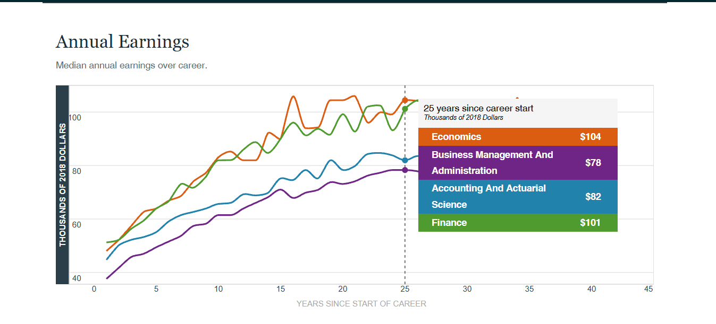

Notes:
https://www.hamiltonproject.org/data/career-earnings-by-college-major/

Slide 6
Statement #2
The opportunity cost of attending college is the tuition.
FALSE
Notes:
It’s also the unearned wages if you were working instead of going to school, Your time: what would you be doing if you weren’t in college?

Slide 7

Statement #3
If you paid $15 for a terrible movie, the $15 is the opportunity cost of leaving halfway through it.
FALSE
Notes:
The ticket price is a sunk cost. It cannot be recovered whether you stay or leave. So leave the terrible movie.

Slide 8
Statement #4
DOUBLE DOWN
When stores have more Stanley cups than shoppers want to buy, there is a surplus.
TRUE

Slide 9
Statement #5
The federal budget deficit and the national debt are NOT the same thing.
TRUE
Notes:
Deficit is that year, national debt is all the years

Slide 10
Statement #6
A company becomes a monopoly whenever it is larger than all its competitors.
FALSE
Notes:
A monopoly generally exists when one seller controls the market and consumers have no close substitutes. Being the largest competitor does not automatically make a company a monopoly.

Slide 11
Statement #7
Even a billionaire experiences scarcity.
TRUE
Notes:
Still only 24 hours in a day.

Slide 12
Statement #8
If a store has plenty of sneakers in stock, sneakers are no longer scarce.
FALSE
Notes:
Be careful of mixing up scarcity and shortage. Scarcity means resources are limited compared with people’s wants. It does not mean a product is currently unavailable.

Slide 13
Statement #9
When the price of Taylor Swift tickets rises, the demand for the tickets falls.
FALSE
Notes:
The QUANTITY Demanded falls!

Slide 14
Statement #10
A company with no direct competitors
can charge any price it wants
and still make a profit.
FALSE
Notes:
Even a monopoly faces a downward-sloping demand curve. If it charges too much, consumers will buy less, choose substitutes, or go without the product.

Slide 15
Statement #11
A tax on luxury yachts can affect people who have no plans to
buy a yacht.
TRUE
Notes:
Taxes may affect workers, suppliers, dealers, and communities connected to the yacht industry.

Slide 16
Statement #12
Unemployment-benefit payments can rise during a recession without Congress voting on a
new stimulus package.
TRUE
Notes:
Unemployment insurance is an automatic stabilizer.

Slide 17
Statement #13
A tariff that raises the price of imported steel shifts the demand curve for American-made cars to the left.
FALSE
Notes:
It shifts the SUPPLY curve to the left.

Slide 18
Statement #14
The Federal Reserve usually lowers interest rates when it wants households and businesses to borrow more and spend less.
FALSE
Notes:
Lowering interest rates results in borrowing more and spending more.

Slide 19
Statement #15
Both Economists and Teachers
consider sleep to be a scarce resource.
TRUE
Notes:
You can never get enough sleep.

Slide 20
How did you do?
A total of 100 points is a perfect score – you might be an “Economist”!
To earn this score, you must have answered all the questions correctly and used the “Double Down” correctly on five of those questions.

Slide 21
What advice about studying economics should you take away from this quiz?
Discuss with your team.
Notes:
Stop here and brainstorm.

Slide 22
Economic Takeaways
Words matter in economics.
“Demand” is different from “quantity demanded,” a shortage is different from scarcity, and the deficit is different from the national debt.
Every choice has a cost.
Money, time, and resources are limited, so choosing one option means giving up another—even when something appears to be free.
Look beyond the price change.
A rising or falling price does not reveal the whole story. Changes in supply, demand, production costs, expectations, or government policy may be responsible.
Markets respond to incentives.
Consumers, businesses, workers, and investors change their behavior when prices, costs, benefits, interest rates, or expectations change.
24

