Slide 1


Watts Up with Electricity Prices?

Slide 2


Raise your hand if you like pizza.

Slide 3


Create a Recipe for Pizza
With your elbow buddy, create a recipe for pizza.
Make sure you include the following:
        List of ingredients
  Procedures, or steps, needed to make the pizza.

Slide 4



What is the of your pizza?
A price is what people pay when they buy a good or service, and what they receive when they sell a good or service.

Slide 5


Name a few pizza delivery places.

Slide 6



Slide 7












Slide 8

Natural Resources Used to Make Electricity
Petroleum: (Oil): a thick, black liquid found beneath the Earth's surface. It is a type of fossil fuel.
Used in Electricity Generation: Petroleum is burned to heat water, producing steam, which then drives turbines connected to generators.

Slide 9
Natural Resources Used to Make Electricity
Natural Gas: A flammable gas, mainly methane, found beneath the Earth's surface. It is a type of fossil fuel.
Used in Electricity Generation: Natural gas is burned in turbines to produce steam, which then drives generators to produce electricity.

Slide 10
Natural Resources Used to Make Electricity
Coal: A black or brown rock, primarily composed of carbon, found beneath the Earth. It is a type of fossil fuel.
Used in Electricity Generation: Coal is burned to heat water, producing steam, which then drives turbines connected to generators.

Slide 11
Natural Resources Used to Make Electricity
Renewable Energy: Energy that comes from sources that can be naturally replenished, like the sun, wind, or water.
Used in Electricity Generation: There are various methods, such as using sunlight in solar panels or wind in wind turbines.

Slide 12
Natural Resources Used to Make Electricity
Nuclear Power: Energy released from reactions in the nucleus of an atom, usually through the process of nuclear fission.
Used in Electricity Generation: In nuclear power plants, reactions heat water to produce steam, which then drives turbines.

Slide 13







How is making pizza and electricity similar?
1. Both use ingredients.
wires, a source of power (e.g. a generator), and a primary source energy (e.g. coal, wind, or sunlight).
dough, sauce, cheese, and toppings.

Slide 14

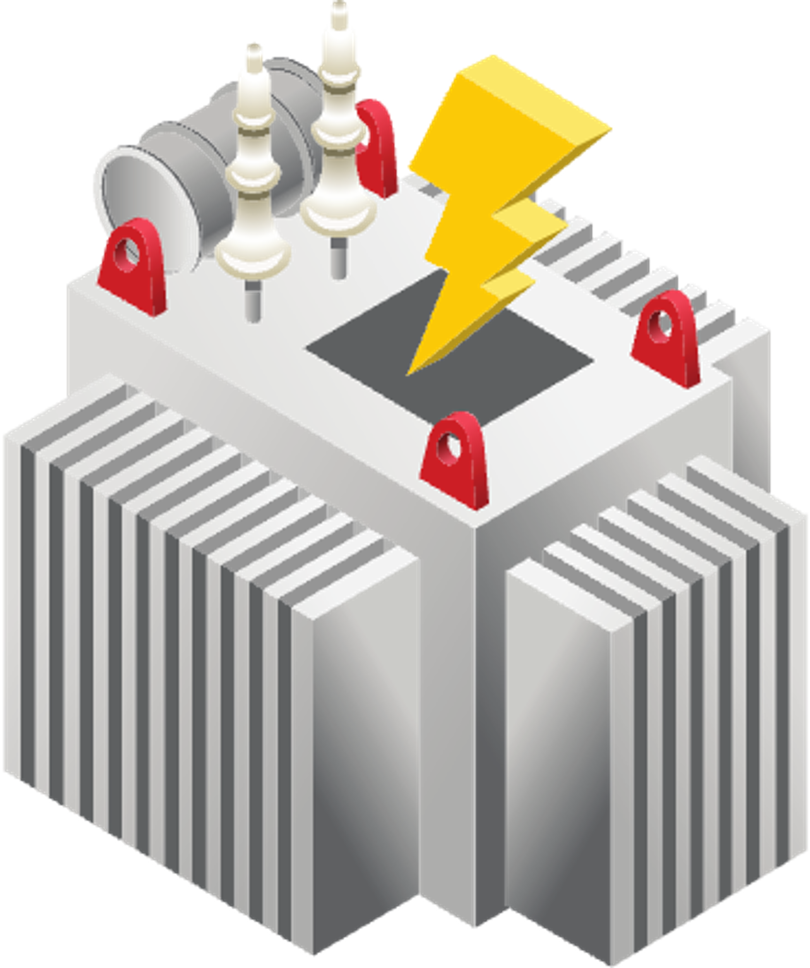


How is making pizza and electricity similar?
2. We mix and combine to create something new!
Mix the dough, spread the sauce, add cheese and toppings, and bake it in the oven.
Use different methods to combine elements like coal, wind, or sunlight with wires and power source to create electrical energy.

Slide 15


How is making pizza and electricity similar?
3. A transformation happens!
The ingredients transform into a delicious pizza when they bake.
The different elements transform into electrical energy that can power our homes, lights, and devices.

Slide 16
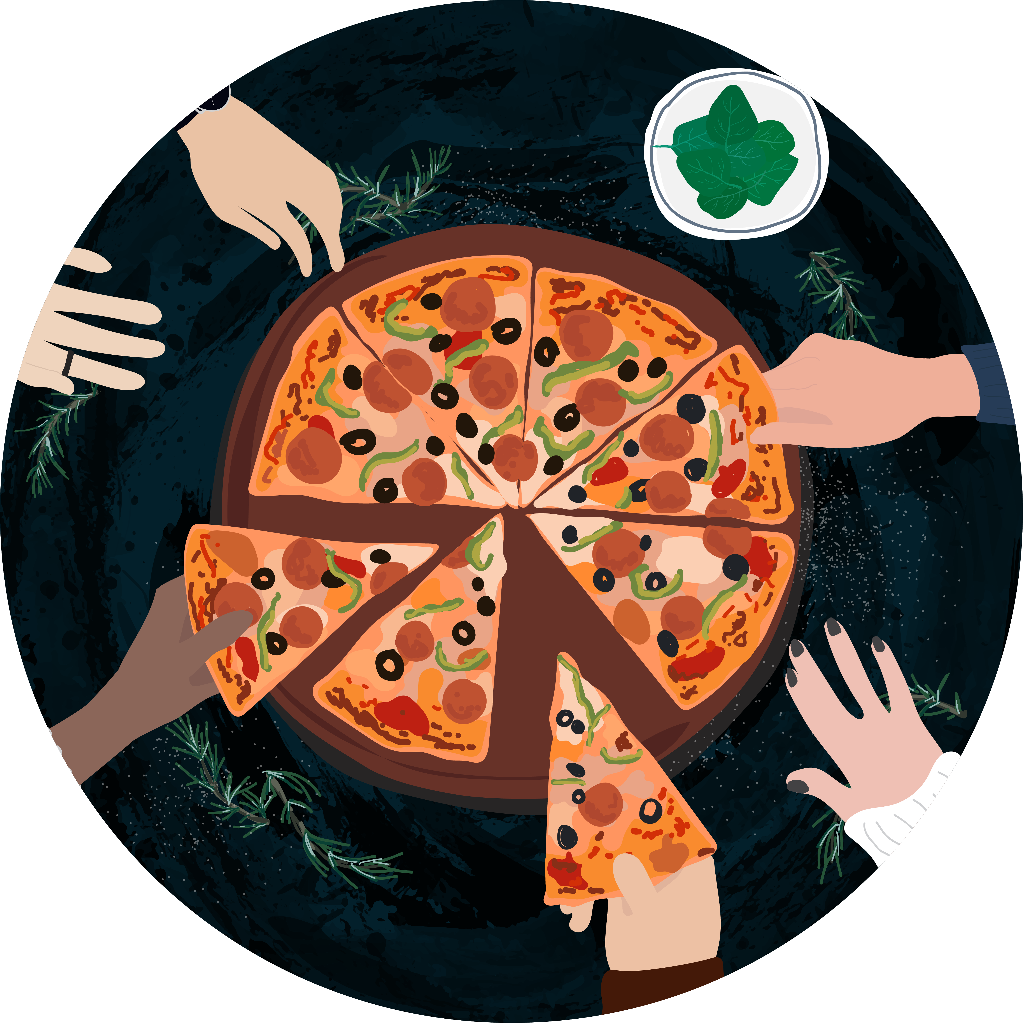

How is making pizza and electricity similar?
4. Enjoying the result!
Enjoy eating our pizza!
Enjoy the electricity to run our gadgets and light up our rooms!

Slide 17

Why are pizza prices different?

Slide 18


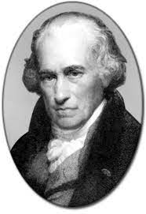
Unit "kilowatt" (kW) was named after James Watt.
Unit of time (h)
"kilowatt-hour" (kWh) is a unit of energy commonly used to measure electricity usage.
It is a unit of power, which represents the rate at which energy is consumed or produced. One kilowatt is equal to 1,000 watts.
Provides a convenient way to measure and understand energy usage over time.

Slide 19

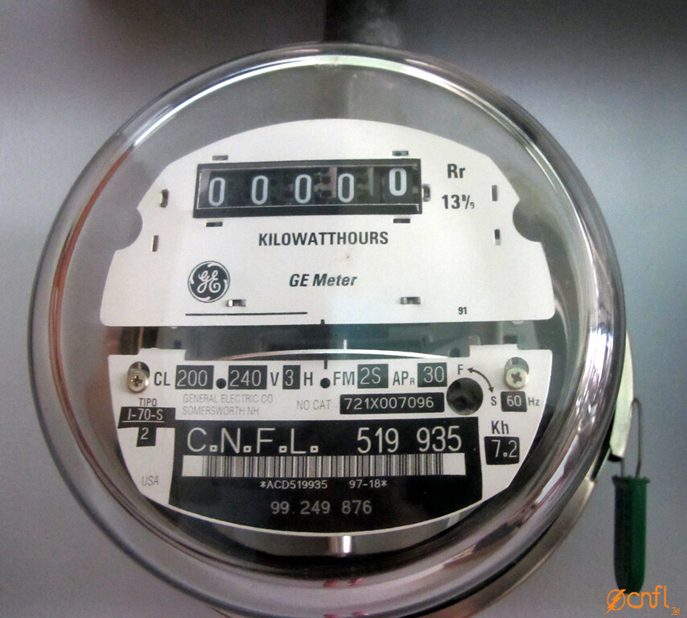
Kilowatt-hour (kWh) is a unit of measurement
It helps us express the price of electricity!
Unit of measurement to express price: slice or whole pie.
It would be silly to see the price of pizza by the inch or foot!
Unit of measurement to express price: kilowatt hour (kWh)

Slide 20

We will now research kWh prices to see how much electricity costs in our state compared to other states!

Slide 21
Research Method
  Go to the website www.eia.gov
  At the top of the page, there are three choices in the middle menu. Select “Geography” and then “US States”
  Choose the appropriate state, using the map or the list view.
  Under the state’s name, under “end-use consumption by source” click on the electricity icon.
  Find the “Average retail price by end-use sector” chart and find the line that says “(Name of state) all sectors” and record the number (cents per kilowatthour)
  Back on the state home page, record the electric power sector consumption by source.
  Repeat for each state, recording the values for the three assigned states on your chart.
  Record the year for the data.

Slide 22
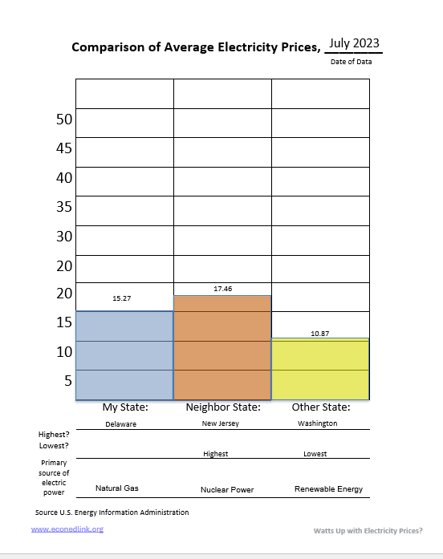
Date of data. Not today’s date.
Data labels: the price per kWh.
Names of the three states.
Label the highest and lowest of your three states.
Add the primary source of electric power for that state.

Slide 23

Why do you think electricity prices are different?

Slide 24
In which case will the price of electricity be higher?
In the Summer or Fall?
  Answer: Summer. Prices are usually highest in the summer when lots of people want electricity to cool their homes, businesses, and schools.

Slide 25

In which case will the price of electricity be higher?
Hot climates or moderate climates?
  Answer: Hot climates. Just like the summer, in hot climates more people want electricity to cool their homes, businesses, and schools.

Slide 26
In which case will the price of electricity be higher?
States that have a lot of natural resources used to make electricity or states that have few natural resources?
  Answer: A lot of natural resources.

Slide 27
In which case will the price of electricity be higher?
A state that burns coal or a state that uses hydro (water) to make electricity?
  Answer: Fossil fuels, such as coal, cause the price of electricity to be higher because the price of the fuel is more. In fact, the prices by major source, in 2021 were as follows:
    Fossil Steam 35.66₵
    Gas Turbine 30.18₵
    Nuclear 22.74₵
    Hydro-electric 12.30₵

Slide 28


In which case will the price of electricity be higher?
For houses or factories?
  Answer: Houses. In fact, in 2022, the price per kWh is 15.12₵ for households and 12.55₵ for commercial properties like factories.

Slide 29

In which case will the price of electricity be higher?
In Hawaii or Wyoming?
  Answer: Hawaii. Looking across all fifty states, in 2022, electricity was the most expensive in Hawaii [39.85₵ per kWh] and least expensive in Wyoming [8.24₵ per kWh]. In general, things tend to be more expensive on islands, like Hawaii, due to the transportation costs of getting things there.

Slide 30
Why Electricity Prices Differ
  Types of Fuel: Sometimes, the primary energy sources, or natural resources, we use to make electricity (e.g., natural gas or petroleum) can become more expensive. This can happen when lots of people need electricity, or if there are problems getting the fuel because of bad weather or accidents. When fuel costs more, making electricity becomes pricier too.

Slide 31

Why Electricity Prices Differ
  Power Plant Costs: Every power plant where electricity is made has its own costs. It costs money to build, run, and take care of these power plants.

Slide 32
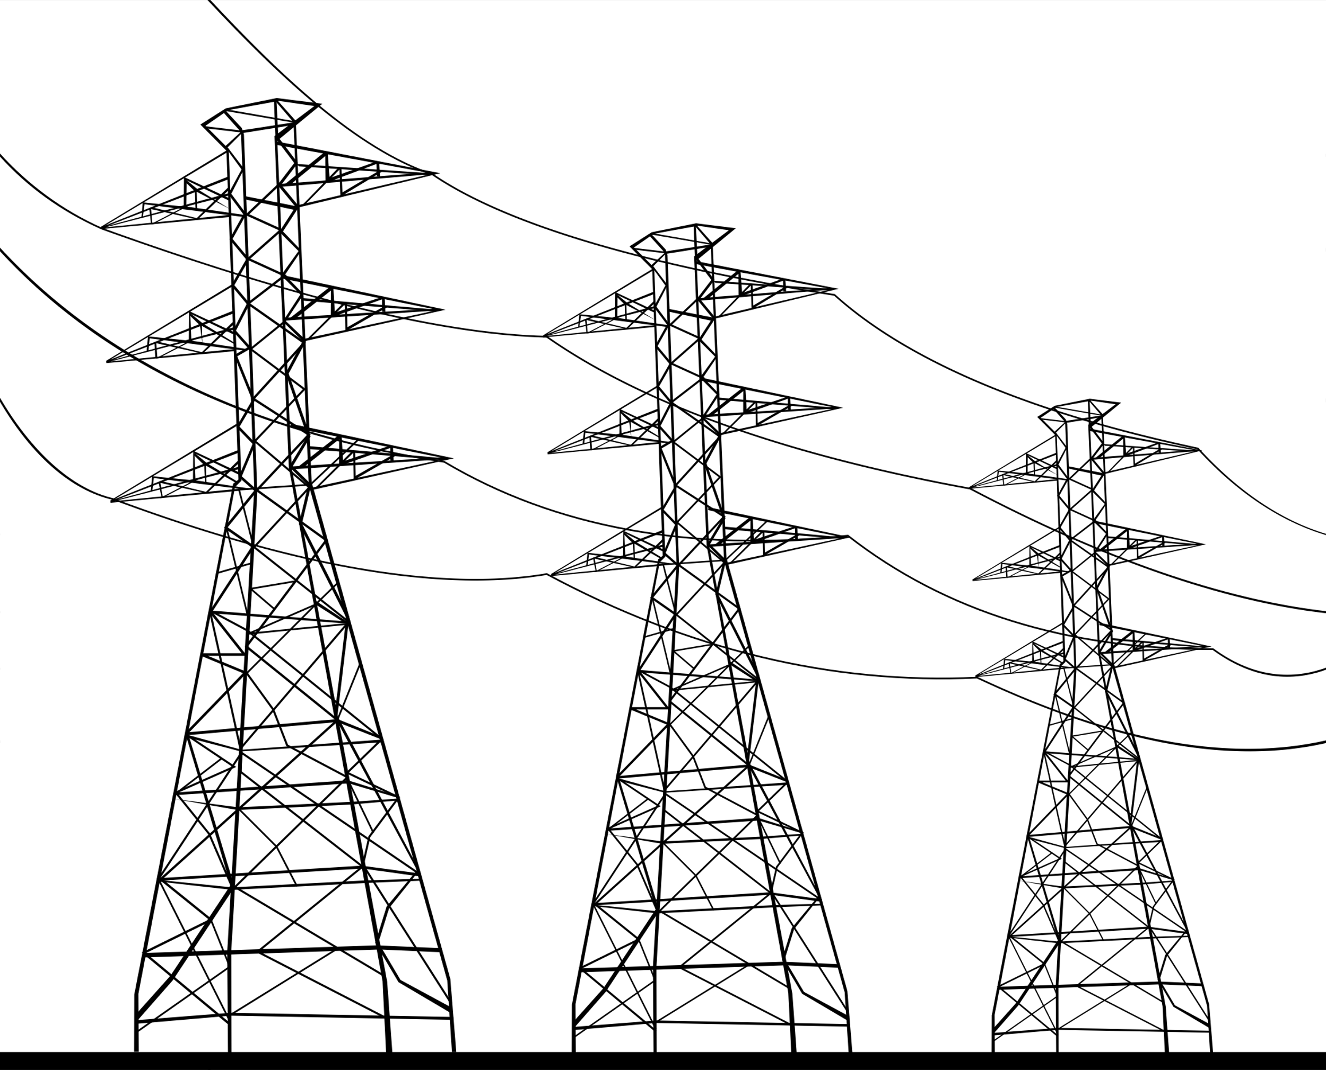
Why Electricity Prices Differ
  Transportation Networks: There are big systems of wires and machines that carry electricity from power plants to our homes. It costs money to build, run, and fix these systems. Sometimes, bad weather or other issues can damage them, and that costs more money to fix.

Slide 33

Why Electricity Prices Differ
  Weather & Climate: If it's very hot or very cold, we use more electricity to heat or cool our homes. This can make electricity more expensive. But when there's lots of rain or wind, making electricity can be cheaper because we use things like water and wind to help.

Slide 34

Why Electricity Prices Differ
  Rules & Laws: Some places have strict rules about how much electricity can cost. In other places, it's more open, and companies that make electricity can set their prices. These rules can affect how much we pay for electricity.

Slide 35

We might care about:
  Paying a lower price for electricity,
  Using less of it in general, or
  Advocating for sources of electricity generation that are better for the environment.
Knowing the factors that influence the price of electricity can help us be more informed consumers – people who use electricity every day—of electricity!

Slide 36

How is the process of making pizza like the process of generating electricity?
What is the name of the pricing unit of electricity?
What is price?
What are the five main reasons that the price of electricity differs?
Why do you think it is important for us to recognize the factors affecting electricity prices?
Why do you think grownups always say, “turn off the lights when you leave the room!”?

Slide 37
Part A. Look at the list below.
If this is one of the key factors that influence the price of electricity place a “√” in the blank.
___Color of electrical wires ___ Type of fuel used ___ Weather and climate
___ How old your home is ___ Noise level of power plants ___ Rules and laws
___ Transportation costs ___ Type of pizza you like ___ Local wildlife
___ Power plant operation ___ Name of the power company ___ Amount of electricity used
√
√
√
√
√
√
Part B.
Circle the unit of energy commonly used to measure electricity usage and price.
Volt Slice Mega Watt Watt Kilowatt Kilowatt-Hour

