Slide 1
Social Security, Governance, and the National Debt
ESSENTIAL DILEMMA
What responsibility does the federal government have to ensure the elderly a secure and stable standard of living?

Slide 2
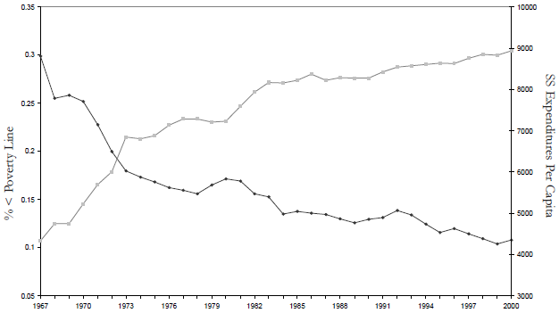
Resource 1 Elderly Poverty and Social Security Expenditures Over Time
Social Security Expenditures
% of Elderly Below Poverty Line

Slide 3
Resource 2 Different Things to Different People
What responsibility does the federal government have to ensure the elderly a secure and stable standard of living?
A bedrock of the social contract as envisioned in the New Deal!
A redistributionist Ponzi scheme that perpetuates fraud on the American public and silently ushers in a collectivist, socialist mentality!
A looming budgetary disaster that nobody wants to talk about—the third rail of politics!
The basis of the modern social welfare state that is fundamentally sustainable and must be preserved!

Slide 4
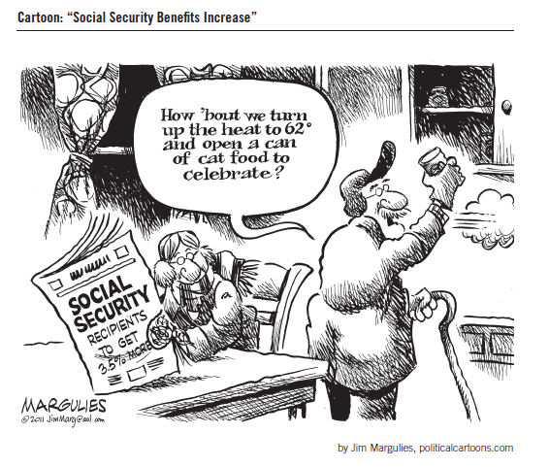
Resource 5 Social Security Benefits Increase

