Slide 1
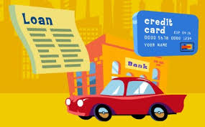

Career and Financial Management Framework Webinar: Credit and Loans (FM.3)
Date: August 20, 2019
Presenter: Kenneth Mengani

Slide 2



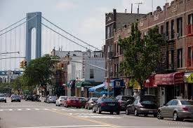

Who am I?
Social Studies Teacher at World Journalism Preparatory School in Queens, New York (a 6-12 school)
Teaching since Fall of 2003
Currently teach AP Macroeconomics, 12 Grade Participation in Government and Economics and 8th Grade US History
Career Highlights: 2009 CEE McGraw Hill “Teaching Champion”; graduate of University of Delaware’s MAEE Program (highly recommended!); workshop facilitator for CEE; textbook and curriculum consultant
Born and raised in Brooklyn NY (so please excuse any peculiar inflection)

Slide 3


Our Agenda:
Review of NYS Career and Financial Management Curriculum Standards (Credit and Loans)
Lesson 12: Making Credit Choices (FFL)
  Activity 12.1: Sharp Financial Advisors
Lesson 13: Credit Reports and Scores (FFL)
  Activity 13.1: Reading a Credit Report Prediction Guide / 13.3: Reading a Credit Report
  Activity 13.3: Earning Credit Online Activity / Your Credit Score and the Price of a Car
  Activity 13.4: Evaluating Three Loan Applications
Review and Closing
www.councilforeconed.org

Slide 4
Our Learning Objectives:
Review NYS CFM Standards (What should I be teaching?!)
Introduce and demonstrate several CEE teaching resources pertaining to key topics (How can I teach it?!)
Share pedagogical approaches that will make teaching more fun, engaging and improve student learning outcomes (How can I teach it better?!)
www.councilforeconed.org

Slide 5
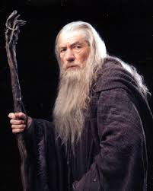
Challenge Slide 1!
Please use the polling feature to answer the following question:
What is the most important reason you are viewing this webinar?
  Learn more about NYS CFM Standards
  Explore new/different ways to teach the topic
  Expand my own knowledge of the topic
  I need credit to maintain my professional license/certification
www.councilforeconed.org

Slide 6
FM3: Credit and Loans
Essential Question: How can students establish a credit history and protect themselves from identity theft?
Sources of Credit: Identify and describe differences in the structure, options, and possible consequences of borrowing from various sources
Different Loan Types: Identify and describe the various types of credit as well as differences between secured and unsecured credit
Getting Credit: Review application process and FICO Score; explain 3Cs of Credit; explore FAFSA
Risks Associated with Credit: Identity and explain concepts such as: default, foreclosure, repossession, overspending, bankruptcy, impact of poor credit decisions on cost and availability of credit
www.councilforeconed.org

Slide 7
FM3: Credit and Loans
Understanding Credit Cards: Identify and explain the difference between types of cards as well as the true cost of minimum payment
Credit Card Options and Protections: Identify key credit card terms (i.e. cash advance); practice reading a credit card statement; recognize consumer protection law
Identity Theft and Security: identify different kinds of consumer fraud and how to avoid them; determine what to do if you are a victim
www.councilforeconed.org

Slide 8
Lesson 12: Making Credit Choices
When do the advantages of credit outweigh the costs of using credit?
Type and Timing: (Simulation; 90 minutes)
Standards (NSFL G12 4.8; CCLS: CCRA.R10; W9-10.9; W11-12.9; L.11-12.6; RH.9-10.4)
SWBAT:
  identify the advantages and disadvantages of using credit
  make decisions about the wise use of credit
Sequence:
  Students will examine and assess five hypothetical cases, acting as financial advisors to clients considering the use of credit
www.councilforeconed.org

Slide 9
Lesson 12: Making Credit Choices
Opening Discussion Question: How do you know when to use credit?
  Chart/record student responses; possible review of previous lesson
  Responses might trend toward purchasing a prohibitively expensive but valuable asset (house, loan, car); large purchase security; emergency situations
Introduce Exercise 12.1
  Explain to students they are going to play the role of financial advisors.
  Read and review instructions and general credit principles.
www.councilforeconed.org

Slide 10
www.councilforeconed.org

Slide 11

www.councilforeconed.org

Slide 12

Challenge Slide 2!
Please use the polling feature to answer the following question:
Do you recommend Client 3 apply for credit?
  Definitely, yes!
  Not sure.
  Absolutely not!
www.councilforeconed.org

Slide 13

Client 3 Debrief:
Absolutely not!
Credit not using credit to purchase a valuable asset (vacation).
Client may be able to pay back the loan, but over a long period of time→ increasing cost of credit!
Better able to afford in the future!
www.councilforeconed.org

Slide 14

www.councilforeconed.org

Slide 15

Challenge Slide 3!
Please use the polling feature to answer the following question:
Do you recommend Client 4 apply for credit?
  Definitely, yes!
  Not sure.
  Absolutely not!
www.councilforeconed.org

Slide 16

Client 4 Debrief:
Absolutely yes!
Credit is being used to purchase a valuable asset (safe/prompt arrival at work).
Client has high likelihood of repaying the loan.
Reliable, inexpensive car is recommended!
www.councilforeconed.org

Slide 17
Lesson 12: Making Credit Choices
Closing/Assessment:
  Debrief each client decision
  Class discussion and/or exit ticket: What is the best advantage to using credit; what is the worst disadvantage to using credit?
  Extended writing assignment: show students Slide 12.2 (Eager Young Professionals) and have them draft a letter recommending for or against car purchase
Ideas for extending and/or scaffolding:
  View Econedlink video “Credit Decisions”
  For advanced students, withhold question rubric and have them develop their own
  For struggling students: model one or more clients for class; reduce number clients to be assessed; revise rubric to be more guided/close ended
www.councilforeconed.org

Slide 18
Lesson 13: Credit Reports and Credit Scores
How does having good credit impact the cost of credit?
Type and Timing: (readings and online research; 90 minutes+)
Standards (NSFL G12 4.5, 4.6 and 4.13; CCLS: CCRA.R10; W9-10.9; W.11-12.9; L.11-12.6)
SWBAT:
  describe what a credit report is and how it is used
  summarize the information used to calculate a credit score
  explain how credit scores affect creditworthiness and the cost of credit
  explain the factors that improve a credit score; determine the cost of financing based on credit scores
www.councilforeconed.org

Slide 19
Lesson 13: Credit Reports and Credit Scores
Sequence:
  Students will complete a survey to predict what factors impact a person’s credit score and then revise those predictions after reading an article (Exercises 13.1 and 13.2)
  They will then log on to a survey that will give them simulated credit scores and examine the impact of creditworthiness on their interest rates.
  Using their simulated credit score, they will complete an online activity demonstrating the impact of creditworthiness on borrowing (Exercise 13.3). They will next compare and contrast their credit terms with classmates and fill out a “post survey” questionnaire
  Students will finish by playing the role of loan officer and evaluating three loan applications (Exercise 13.4)
www.councilforeconed.org

Slide 20

Challenge Slide 4!
Please use the polling feature to answer the following question:
The amount of money you owe is the most important part of your credit score.
  TRUE
  FALSE
www.councilforeconed.org

Slide 21
Opening T/F Survey (13.1)
The amount of money you owe is the most important part of your credit score. (F: Payment History is 35%)
Your FICO score and your credit report are the same thing. (T)
A credit report indicated how well a person has managed credit in the past. (T)
Credit reports are issued monthly, so you know how much money to pay toward your credit card bill. (F: statements are monthly, you can request your CR at any time )
A credit score of 35o is generally considered to be good. (F: VERY LOW!)
People with higher credit scores typically pay higher interest rates for credit. (F: They pay lower)
The Fair Credit Reporting Act allows to receive a copy of your credit score for free. (T)
Potential employers and landlords may check your credit report.
Your income is not considered when calculating your credit score. (T)
One of the best ways to improve your credit score is to apply for additional credit cards. (F: best way is to pay on time and reduce amount owed)
www.councilforeconed.org

Slide 22
“Earning Credit” Online Activity and Your Credit Score and the Price of a Car (Exercise 13.3)
www.councilforeconed.org/earningcredit
www.councilforeconed.org

Slide 23
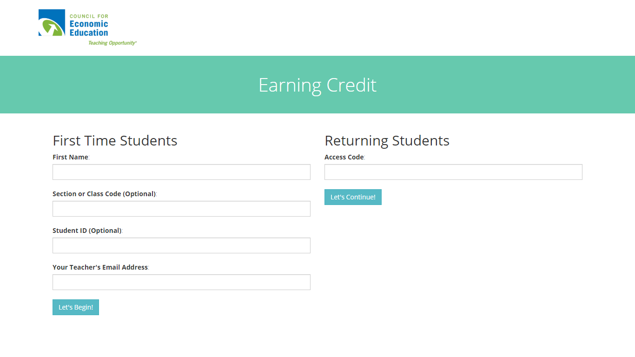

Slide 24
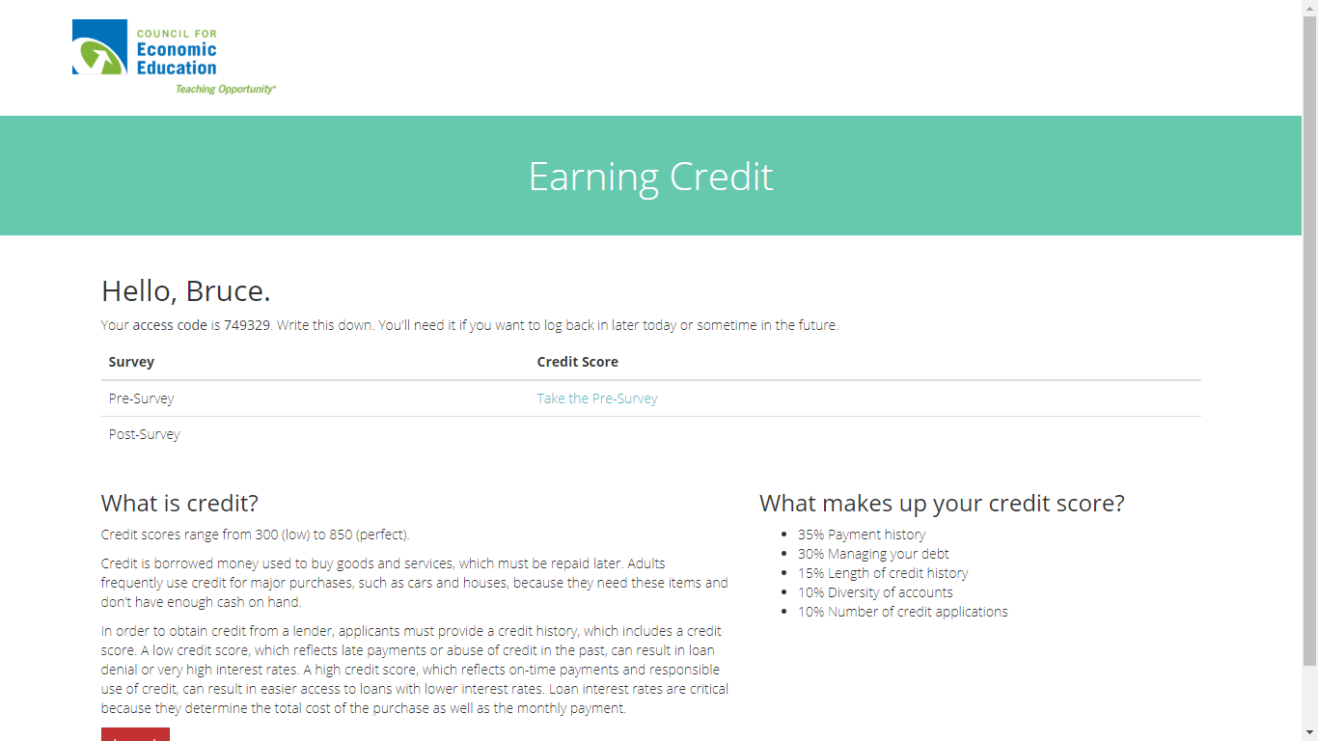

Slide 25
“Earning Credit” Online Activity
Pre-Survey Questions:
What was your score on the most recent test in this class?
In this class, how many assignments have you missed OR turned in late?
At what age did you first save some of your OWN money? (Savings can be kept in many places, from piggy bank to bank savings account.)
In how many clubs/organizations are you involved this year? These may include school sports teams and clubs, community organizations, jobs, religious and political groups.
When was the last time you asked your parents for money (not for a required school activity)?
www.councilforeconed.org

Slide 26
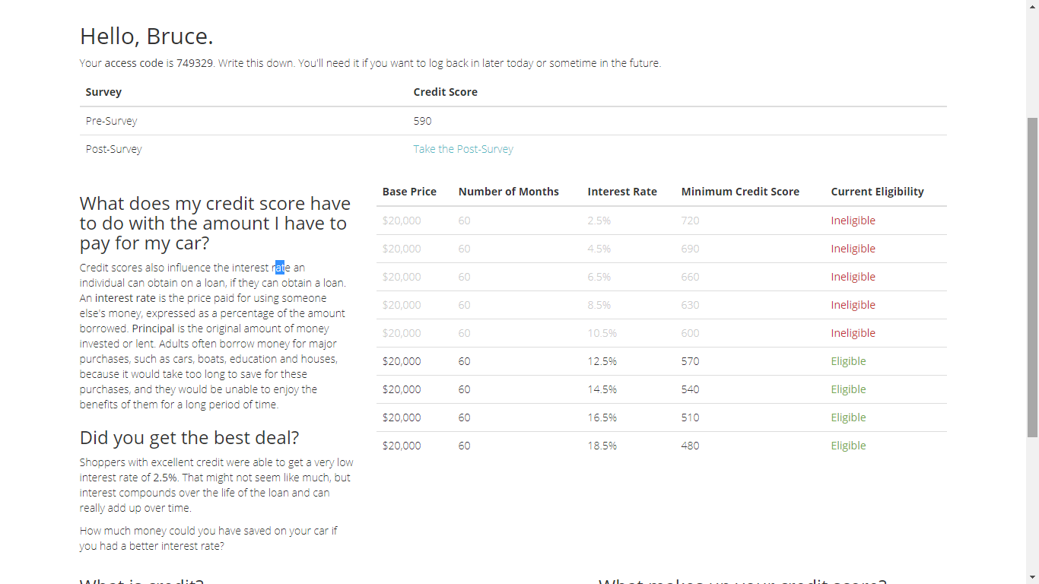

Slide 27
Your Credit Score and the Price of a Car (13.3)
Ask students to share their simulated credit scores; explain that the questions were simulated and then review with them the real components of a credit score.
Have students write down their credit score and the lowest interest rate they qualify for (570 / 12.5%).
Direct them to https://www.bankrate.com/calculators/auto/auto-loan-calculator.aspx and have them fill out the first part of Exercise 13.3 with their information.
www.councilforeconed.org

Slide 28
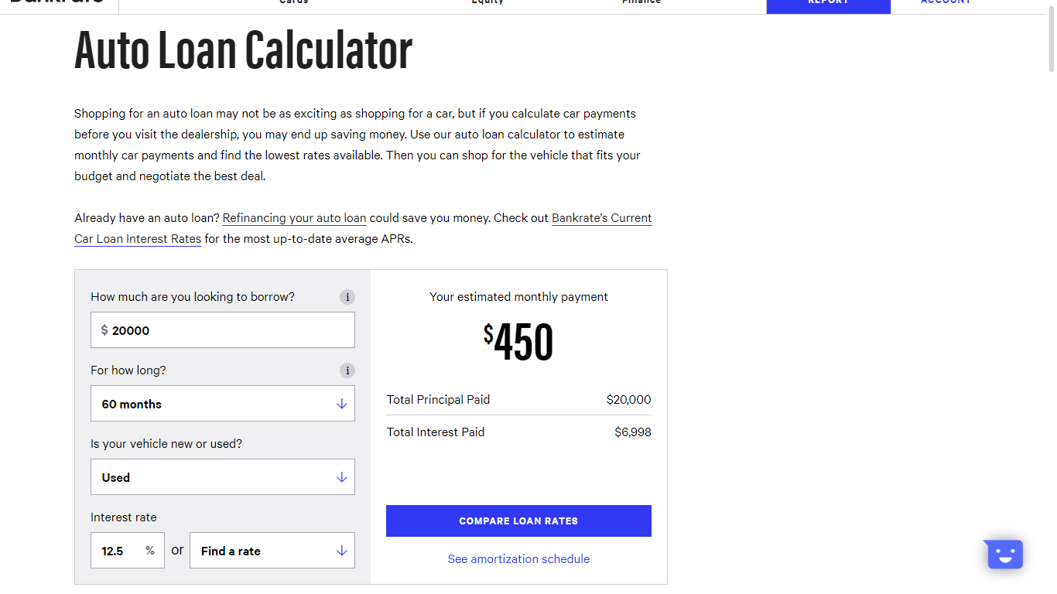

Slide 29
Your Credit Score and the Price of a Car (13.3)
570
12.5%
$450
$6998
$20,000
$26,998
www.councilforeconed.org

Slide 30
Your Credit Score and the Price of a Car (13.3)
Have students form groups of 4-5 so that they have a variety of credit scores and interest rates; instruct them to complete table 3 using the group’s data and answer the questions that follow.
Student | Credit Score | Interest Rate | Estimated Monthly Payment | Total Principal Paid | Total Interest Paid | Total Cost (Principal +Interest)
A | 720 | 2.5% | $355 | $20,000 | $1,297 | $21,297
B | 690 | 4.5% | $373 | $20,000 | $2,372 | $22,372
C | 630 | 8.5% | $410 | $20,00 | $4,620 | $24,620
D | 570 | 12.5% | $450 | $20,000 | $6,998 | $26,998
E | 510 | 16.5% | $492 | $20,000 | $9,501 | $29,501
www.councilforeconed.org

Slide 31
“Earning Credit” Online Activity
Instruct students to return the Earning Credit Activity and complete the post survey questionnaire for a new opportunity to earn a better credit score (make sure they have their access code):
Post-Survey Questions:
Imagine you are 30 years old. You will face many bills – including rent or mortgage, possibly diapers and daycare, college loans, utilities, and transportation costs. How many times in one year do you anticipate you would be late on a payment?
Imagine you are 30 years old. Not including a mortgage (to buy a home), how much consumer debt do you expect to have? Include student loans, car loans, credit card and any other debts.
Imagine you are 30 years old. At what age did you first apply for a credit card or loan?
Imagine you are 30 years old. How many of the following accounts do you currently have: credit cards, mortgages, retail finance, auto loans, student loans, other loans?
Imagine you are 30. How many times have you applied for a loan or new credit card in the past 6 months?
www.councilforeconed.org

Slide 32
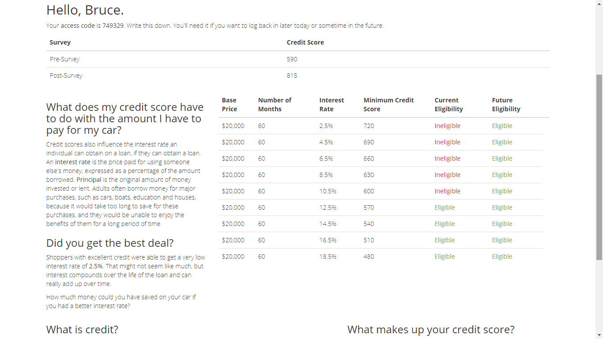

Slide 33
Evaluating Three Loan Applications (Exercise 13.4)
Inform students they are now going to apply their new knowledge by playing the role of loan officer and evaluate three applicants for a potential loan.
In each case, they will decide whether to give the loan and then explain the reasoning for their decision.
www.councilforeconed.org

Slide 34
Evaluating Three Loan Applications (Exercise 13.4)
Should we make the loan?
Absolutely! Tito has an excellent credit score, no past due accounts, below total high credit amount
www.councilforeconed.org

Slide 35
Evaluating Three Loan Applications (Exercise 13.4)
www.councilforeconed.org

Slide 36

Challenge Slide 5!
Please use the polling feature to answer the following question:
Should we make the loan to Janice Brown?
  Absolutely, yes!
  Not sure.
  Definitely not!
www.councilforeconed.org

Slide 37
Evaluating Three Loan Applications (Exercise 13.4)
Absolutely not! Janice’s credit score is low, codes indicate multiple past-due accounts, close to high credit amount
www.councilforeconed.org

Slide 38
Lesson 13: Credit Reports and Scores
Closing/Assessment:
  Activity 13.4 can be used as a closing
  Class discussion and/or exit ticket: What is a credit report and how is it used? What information is used to calculate a credit score? How do credit scores affect a person’s cost of borrowing? What can a person do to improve their credit score?
  Lesson includes five M/C assessment questions
Ideas for extending and/or scaffolding:
  For advanced students: research assignment/project to develop a profile of average American citizens’ creditworthiness / debt level
  For struggling students: survey and article can be done as a whole class; online activities can be more guided/close ended
www.councilforeconed.org

Slide 39
What did we learn today?
Reviewed NYS CFM Curriculum Standards (Credit and Loans)
Explored 4 Activities:
  12.1: Sharp Financial Advisors
  13.1: Reading a Credit Report Prediction Guide / 13.2: Reading a Credit Report
  13.3: Earning Credit Online Activity / Your Credit Score and the Price of a Car
  13.4: Evaluating Three Loan Applications
www.councilforeconed.org

Slide 40
What did we learn today?
In using these activities with our students they will:
  identify the advantages and disadvantages of using credit
  make decisions about the wise use of credit
  describe what a credit report is and how it is used
  summarize the information used to calculate a credit score
  explain how credit scores affect creditworthiness and the cost of credit
  explain the factors that improve a credit score
  determine the cost of financing based on credit scores
www.councilforeconed.org

Slide 41
Resources Used
CEE’s Financial Fitness for Life (3rd Edition) https://www.econedlink.org/resources/collection/fffl-9-12/
Lesson 12 Making Credit Choices: https://www.econedlink.org/resources/making-credit-choices/
Lesson 13: Credit Reports and Credit Scores
  https://www.econedlink.org/resources/credit-reports-and-credit-scores/
  Earning Credit Activity: www.councilforeconed.org/earningcredit
  Auto Loan Calculator: https://www.bankrate.com/calculators/auto/auto-loan-calculator.aspx
www.councilforeconed.org

Slide 42

And now . . . the end!
This concludes the webinar!
Please feel free to e-mail me any questions you may have!
Thank you for your attention! ☺
My contact info
  Kenneth Mengani; kenneth.mengani@wjps.org
  World Journalism Preparatory School
  34-65 192nd Street, Flushing, NY 11358
  Phone: (718) 461-2219 | Fax: (718) 461-2633

