Slide 1

Should Private
Companies Operate
Prisons?

Slide 2
60 second brainstorm
Why do prisons exist?

Slide 3
Relevant Vocabulary
incarceration: confinement in a jail, prison, or correctional facility, generally as a result of a sentence for a crime committed
jail: state or local facility for holding people awaiting trial, hearings, or who have committed minor crimes
prison: higher security level facility for holding people for longer periods of time (generally a year or more) and can be federal, state, or privately owned
penitentiary: historically a prison or place of confinement. Today it refers to a prison designed for long-term incarceration.
correctional facility: can merely be a jail or prison, but may be a combination of jail, prison, mental institution and rehabilitation center

Slide 4
Ownership/Operation of Prisons
Public
provided as a service of the Department of Justice (Bureau of Prisons at federal level)
facilities, labor, technology, etc. paid for with tax dollars
most employees are government employees
subject to government audits and oversight
Private
owned by a corporation (like CoreCivic or GEO Group) that receives tax dollars directly in exchange for providing services at a cheaper rate than the government
most employees are private citizens
subject to fewer audits and oversight (if not publicly traded)

Slide 5
Important Vocabulary
Revenue - money received, income
Profit - the amount of revenue that remains after a business pays the costs of producing a good or service
Costs - in this lesson, the amount of money spent to run a prison, may also refer to missed opportunities no longer available (opportunity cost)

Slide 6
Private Prison Business Model
Contract
The private corporation gets an exclusive contract from a state or federal government to provide correctional services
Delivery
Corporation builds/updates a facility or agrees to operate an existing facility by assuming some or all of the costs
Payment
The corporation is paid by the government based on size of the institution, the amount of time or - most commonly - per inmate served
What are the incentives for the corporation?
Notes:
On the surface, the business model is pretty straight forward. If the government is paying $200 a day to keep an inmate, and a private company says they can do the same thing for $175, it makes sense for the government to pay the company to do that. However, the incentives for the company are potentially darker. As a profit-seeking corporation, cutting costs and increasing revenue are desirable. With prisons, cutting costs often means decreasing services or reducing personnel. Increasing revenue means coming up with ways to keep people in the institution or getting more people inside.

Slide 7
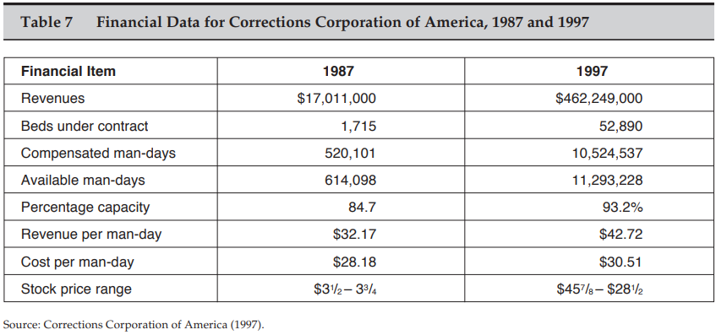
Private Prison Business Model
Notes:
This is a table showing changes in financial information for a private prison company (now called CoreCivic) in regards to their federal contract. The primary point to make is that the revenue per “man-day” (sort of a per inmate measure) grew 33% over this 10 year period, but the cost only grew about 8%. Furthermore, the number of man-days ballooned from a little over 520,000 to more than 10 million. As an option, you can use a clip from Youtube Video 1:Who Makes Money from Private Prisons (3:30 - 4:10) to explain this as well.

Slide 8
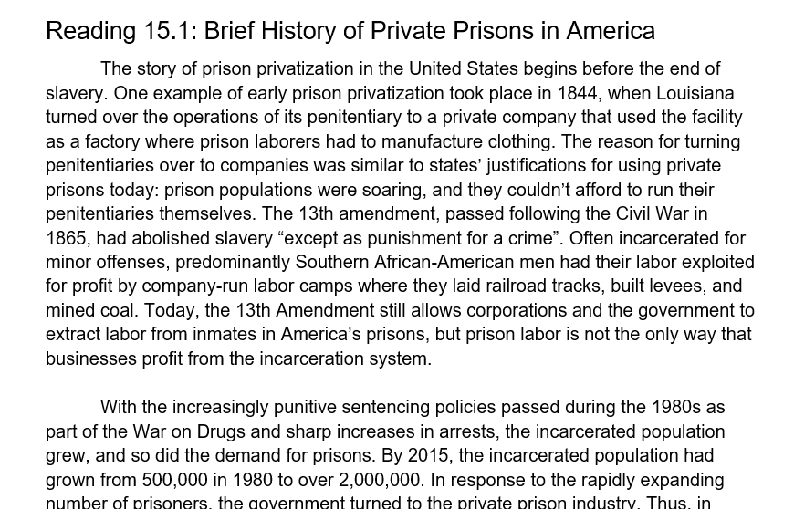
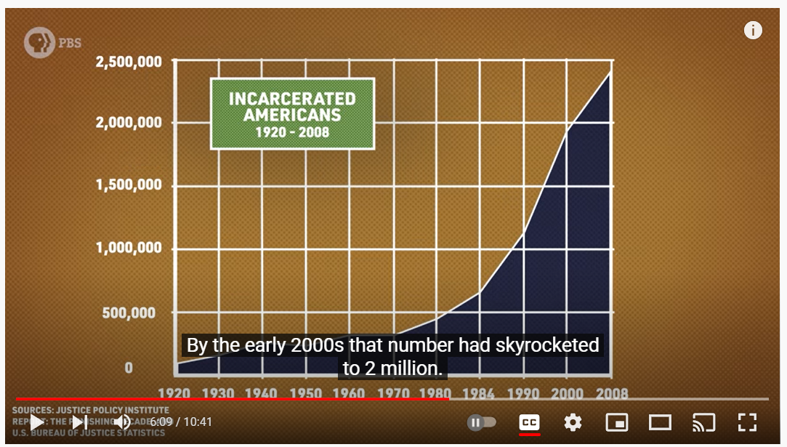
Why do private prisons even exist?
According to this reading, how far back does privatization of incarceration go in the US?
What role did the 13th amendment play in allowing companies to profit from prisons?
How did the “War on Drugs” and the increase in crime in the 1980’s contribute to prison privatization?
How do private companies believe they can save the government money on prisons?
https://www.youtube.com/watch?v=OwVEL7d3NsM
(Play from 5:50)

Slide 9
Goals of Prisons
Incapacitation | Deterrence
Retribution | Rehabilitation
Notes:
Display this slide as students are reading the first page of Activity 15.1. You may also wish to leave it displayed as students complete the “four corners” activity to help students know where to go.

Slide 10
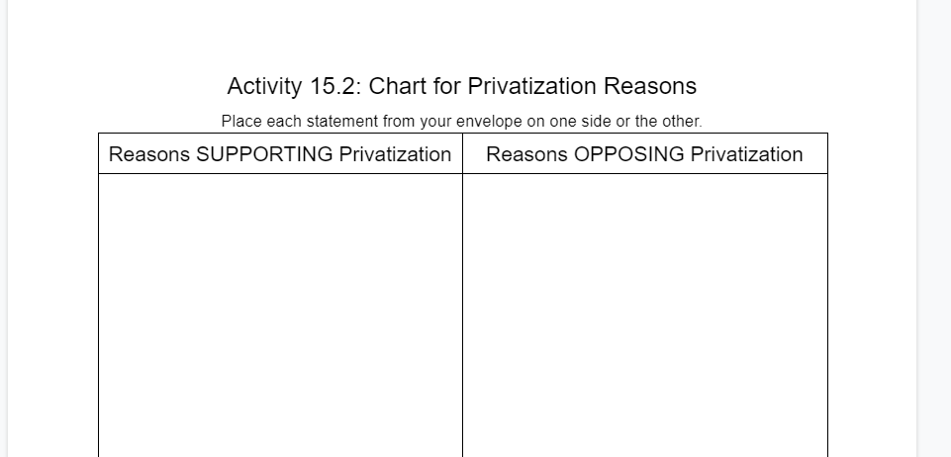
Support or Oppose?
With your group, discuss the 16 statements in your envelope and place them on either side of the chart
Each statement can only go on one side - none in the middle
If the group is split, discuss and come to consensus

Slide 11
Assessment
You are a state representative who is about to go vote on whether or not your state should renew a contract with CoreCivic to operate private prisons in your state. The vote is VERY close and it may come down to you!
Before you go vote, craft a short, two paragraph press release explaining how you plan to vote. Include at least three solid reasons why you are voting the way you are using statistics when possible.
You may use examples from this lesson or research your own.

