Slide 1


What is the Most
Ethical Way to Fund
Public Schools?

Slide 2
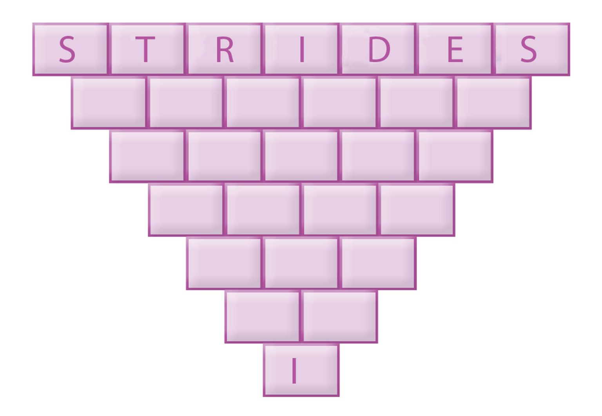
Step Down Puzzle
Remove a letter from each line and then rearrange the letters to create a word.
Note that the last line is the letter “I” so we know that each word will include the letter “I”.
You have 3 minutes to complete the puzzle.

Slide 3
Here are the answers!
Why did students with Activity 11.2 finish the puzzle faster than the students with Activity 11.1?

Slide 4
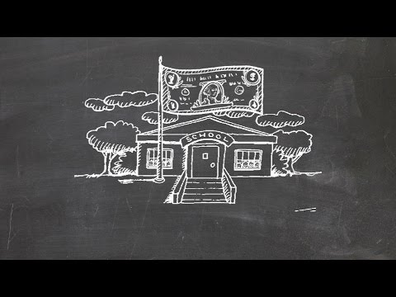
School Funding Explained

Slide 5
Equity vs. Equality
Equality: means providing the same to all
Equity: refers to fairness and justness and is distinguished from equality
  Equity means recognizing that we do not all start from the same place and must acknowledge and make adjustments to imbalances³.
³National Association of Colleges and Employers: https://www.naceweb.org/about-us/equity-definition/

Slide 6
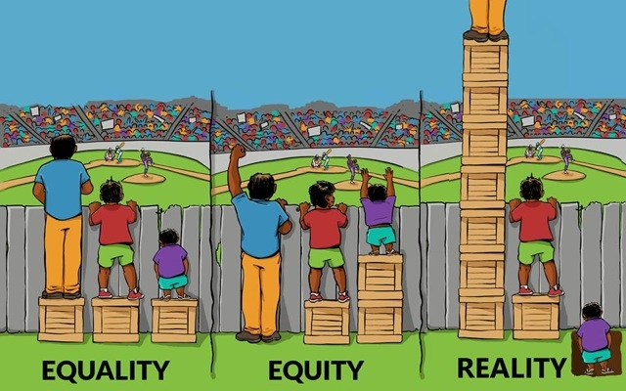
Equity vs. Equality
Should public education funding promote equality or equity?

Slide 7
DBQ Time
You are going to be looking at 4 documents.
You have 6 minutes per station to look over the information and answer the guiding questions to go with it.
Make sure you are answering individually on your document but feel free to talk and discuss with the people at your station.

Slide 8
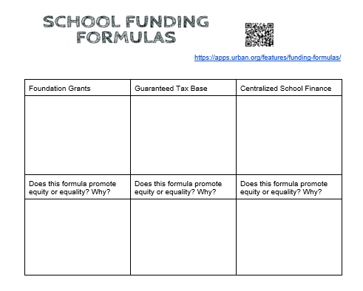
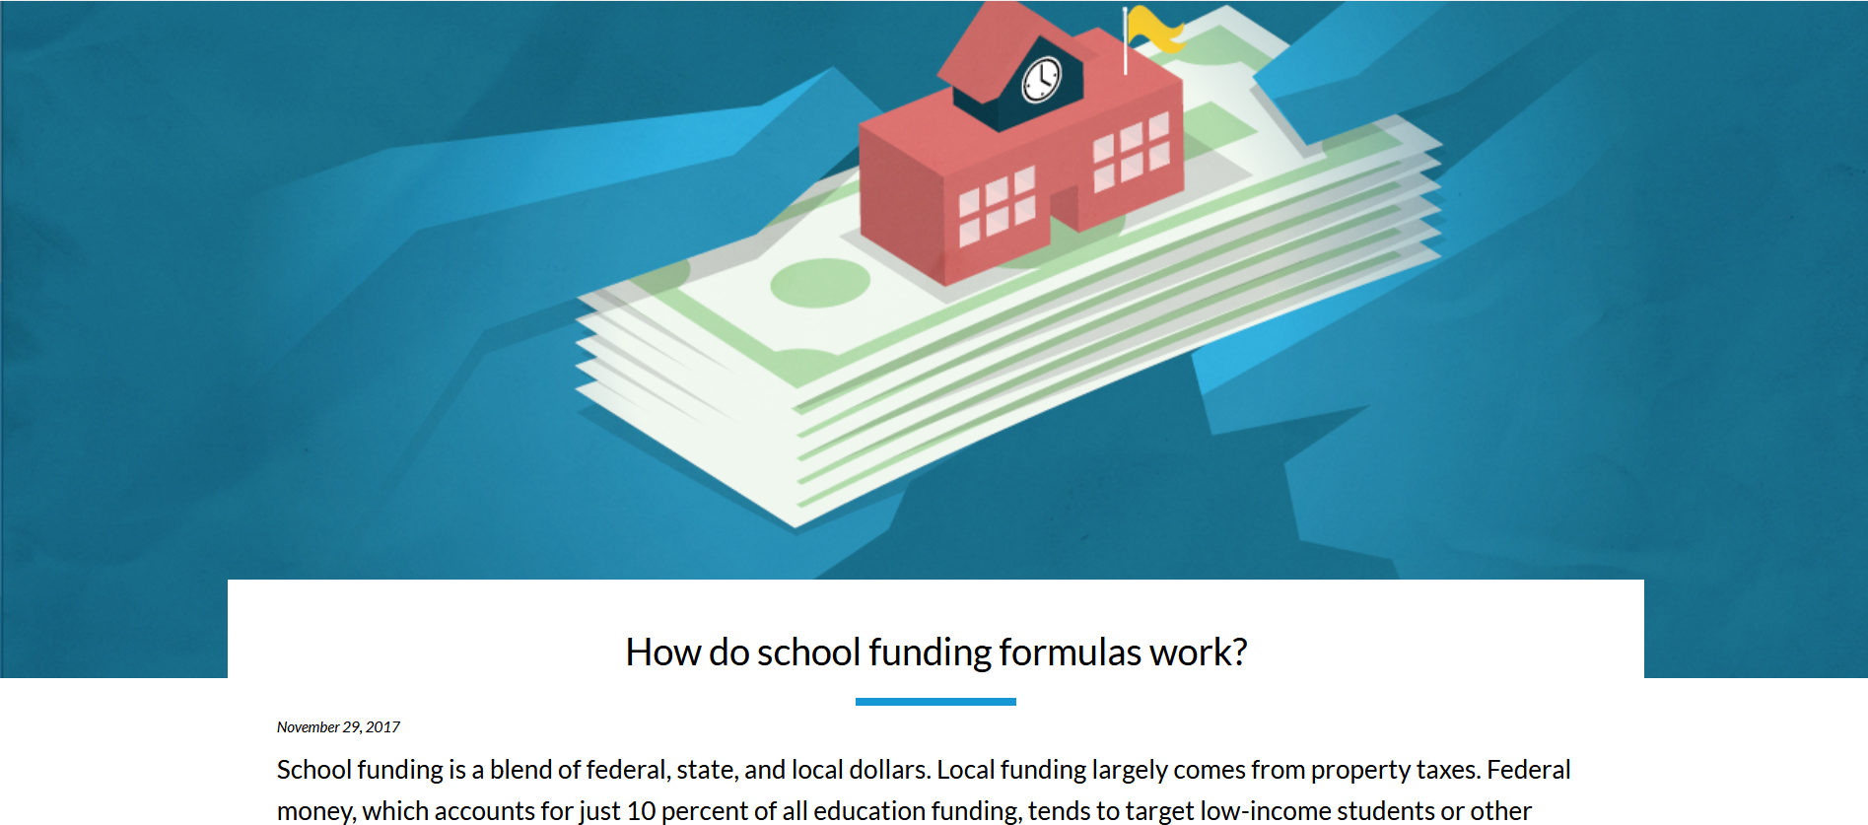
School Funding Graphic Organizer
https://apps.urban.org/features/funding-formulas/

Slide 9
School Funding Graphic Organizer

Slide 10
Closure
Now that you have learned about Public School Funding, what do you think? Should public school funding support equality or equity? What are the trade-offs?

