Slide 1

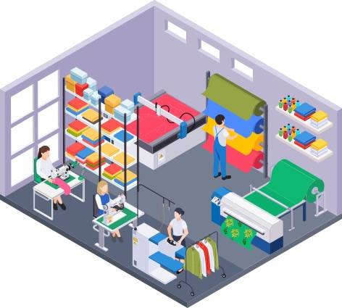
Can You Be
Fashionable
and Ethical?

Slide 2
Think about the jeans you have at home…
How many pairs of jeans do you have?
What brands of jeans do you know of?
What is your favorite brand of jeans?

Slide 3
You are going to produce jeans
Get into groups of 3-4 around a table or desk.
Each group will get Activity 14.1: Costs of Production and one person will need to help keep track of production for your group.
Your goal is to make as much profit as possible!!!

Slide 4
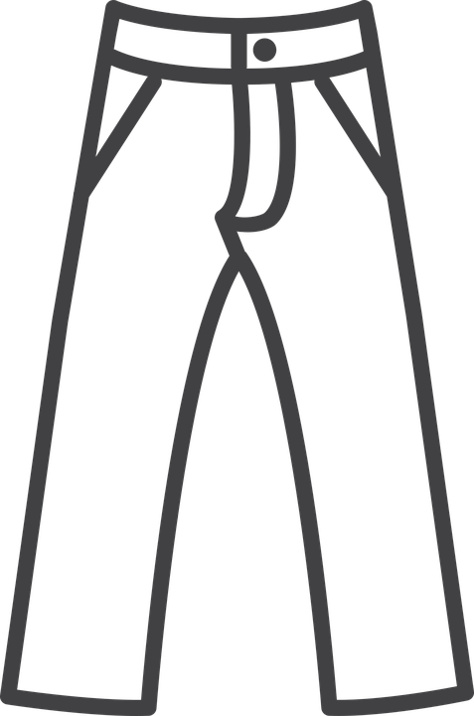
Producing the Blue Jeans
3 minutes!
It takes about 1.5 - 2 yards of denim to make a pair of jeans.
This 5-yard Bolt of Denim costs $80 and you will cut each pair of jeans out carefully.
Each pair of jeans can be sold for $100 in a store!

Slide 5
Costs of Production, Revenue, Profit
Costs of production is the amount producers pay for the resources used to produce a product.
  In this case each bolt of fabric costs the company $80 each.
  Total cost = # of bolts of fabric (sheets of jeans) x $80
Revenue is the money received or income of the company.
  In this case each pair of jeans can be sold for $100
  Total revenue = # of jeans cut out carefully x $100
Profit is the amount of revenue that remains after a business pays the costs of producing a good or service.
  Profit = Revenue - Costs

Slide 6
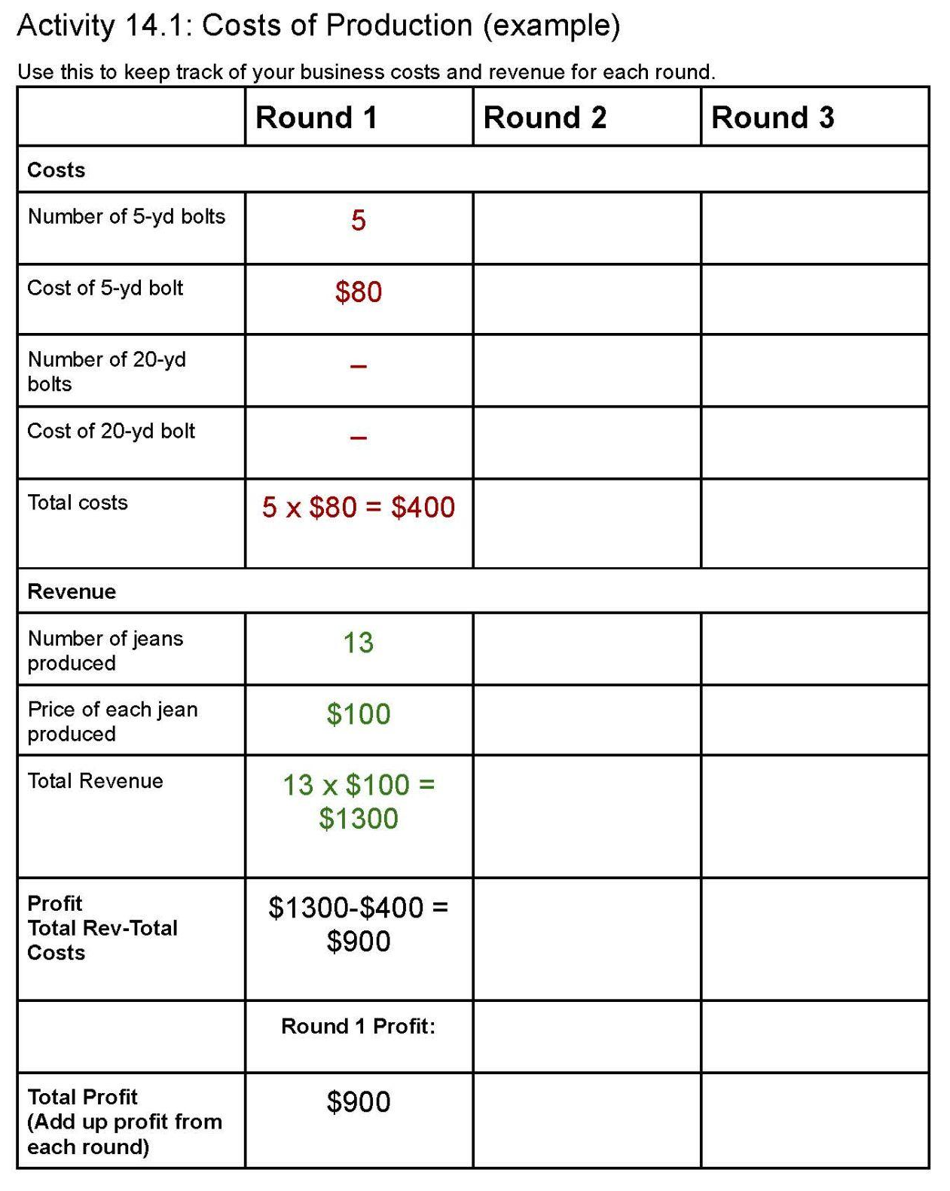
How much profit did you make?

Slide 7
There’s a new denim you can use!
3 minutes!
This 20-yard bolt of average quality denim costs $100.
You can make 12 pairs of jeans and they each sell for $60 each.
Which type of fabric/denim is your group going to use for this round?

Slide 8
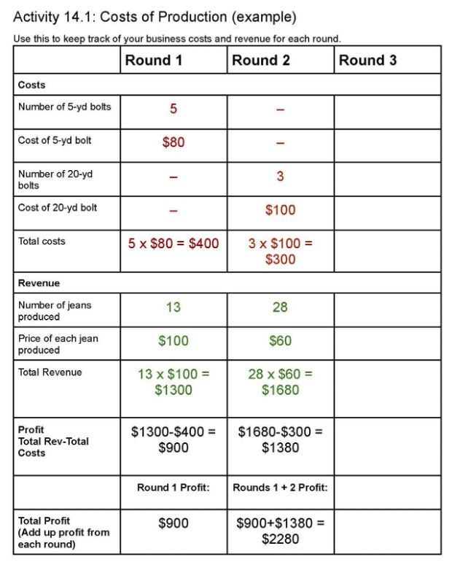
How much profit did you make in Round 2?
What is your total profit?

Slide 9
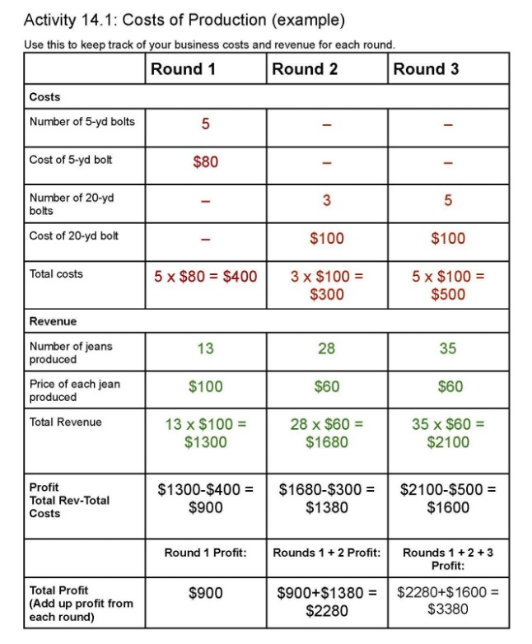
How much profit did you make in Round 3?
What is your total profit?

Slide 10
Some facts about producing jeans
It takes about 700 gallons of water to produce a shirt and about 2,000 gallons to produce a pair of jeans!
The world consumes around 80 billion new pieces of clothing every year, 400% more than the consumption twenty years ago.
Every year a half a million tons of plastic microfibers are dumped into the ocean, the equivalent of 50 billion plastic bottles [from clothing and textiles].
Around 20% of wastewater worldwide comes from fabric dyeing and treatment.
Less than 1% of used clothing is recycled into new garments. The Ellen MacArthur Foundation estimates that every year some USD 500 billion in value is lost due to clothing that is barely worn, not donated, recycled, or ends up in a landfill.

Slide 11

People are bathing in the heavily polluted
Yamuna River in India
Business Insider:
https://www.insider.com/polluted-yamuna-river-in-india-2021-11

Slide 12
Costs to Someone Else
What is the economic term where there is a cost/burden on a third party or a person who is not directly the buyer or seller of jeans?
Negative externality
  exists when the production or consumption of a product results in a cost to a third party.

Slide 13
We have got to clean this mess up!
It’s time to clean up all the environmental damage, trash, and pollution you have created.
The trash from the high-quality denim needs to be cleaned up as it’s causing environmental issues.
  To clean up this mess it’ll cost you $100 per bolt of denim you used
The trash from the average-quality denim is more difficult to clean up. It is more costly to clean up polluted water, or to fix the land around their firms.
  To clean up this mess it’ll cost you $300 per bolt of denim you used.
Your company must pay to clean things up or your company will be shut down!
Calculate your total cost of cleaning up the environment and subtract that from your total profit in round 3.

Slide 14
Debrief
Why did you switch denims?
If we were to play another round what type of denim would you likely choose?
At the end of the activity, all groups or companies had to pay a large amount of money to clean up the environment.
  In economics we call this internalizing the cost of the negative externality.
  Paying a tax or money is one way for a company to internalize the cost.
  Can you think of other ways the company could internalize the cost of producing the jeans?

Slide 15
MB vs. MC
In economics, decisions are made marginally, comparing marginal benefits against marginal costs
Marginal benefits are the benefits of consuming the next item - in this case the benefit someone would have from buying the next pair of jeans.
Marginal costs are the costs of production costs of producing the next item which is producing one more pair of jeans.

Slide 16
Debrief
For the last several decades companies have been responding to the market and consumers wanting more clothing and cheaper clothing. This has given rise to “fast fashion”.
Fast fashion is defined as, ‘cheaply produced and priced garments that copy the latest catwalk styles and get pumped quickly through stores in order to maximize on current trends’.
Besides responding to the market, what ethical considerations should the fashion industry take into account when making decisions about their production?

Slide 17
Debrief
One of the consequences of fast fashion is that the clothes can be more disposable. They are often not as high quality and therefore they get thrown away more quickly by consumers.
From an economic standpoint this decision - including both costs and benefits - falls on the consumer.
From an ethical standpoint this could be a cost that a producer must take on.
Should consumers or producers have to take into consideration the waste of the clothing?
How did our simulation “fix” the problem of negative externalities?

Slide 18
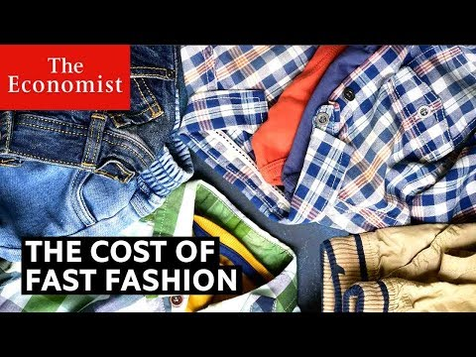
The Cost of Fast Fashion

Slide 19
Assessment 14: Fast Fashion and the Environment
It is unlikely that the world is going to halt all production of jeans, but, using your economic analysis and marginal decision-making (that is comparing marginal costs and marginal benefits) create an infographic that could be printed and put around the school to help raise awareness about this issue with some reasonable solutions that your peers could take to help the environment related to fast fashion.
Keep in mind that almost all donated clothes end up being in a landfill or incinerated so your solution cannot simply be to donate their clothes.

