Slide 1

Income Inequality
in the US:
What Can Be Done?

Slide 2
Income Inequality
What is the first thing that comes to mind when you hear/see this term?

Slide 3
Income Inequality
Defined: the extent to which
income is distributed unequally
in a group of people.

Slide 4

The use of “quintiles”
Income inequality is often discussed using quintiles
Imagine the entire population lined up single file according to how much income they have
Quintiles split the population into 5 even groups based on numbers
Lowest Income
Highest Income
1st quintile
2nd quintile
3rd quintile
4th quintile
5th quintile

Slide 5
The use of “quintiles”
While the number of people are the same, the amount of income they have can be very difference depending on how much income inequality there is
Here is what the US would look like if there was $100 of income and complete equality.
20% of income
($20)
20% of income
($20)
20% of income
($20)
20% of income
($20)
20% of income
($20)
Lowest Income
Highest Income
1st quintile
2nd quintile
3rd quintile
4th quintile
5th quintile
Notes:
Ask students if they feel like this is what the U.S. actually looks like. Answers will vary, but most will assume it’s not. Follow up by asking students what makes them think the quintiles are not equal in the United States.

Slide 6
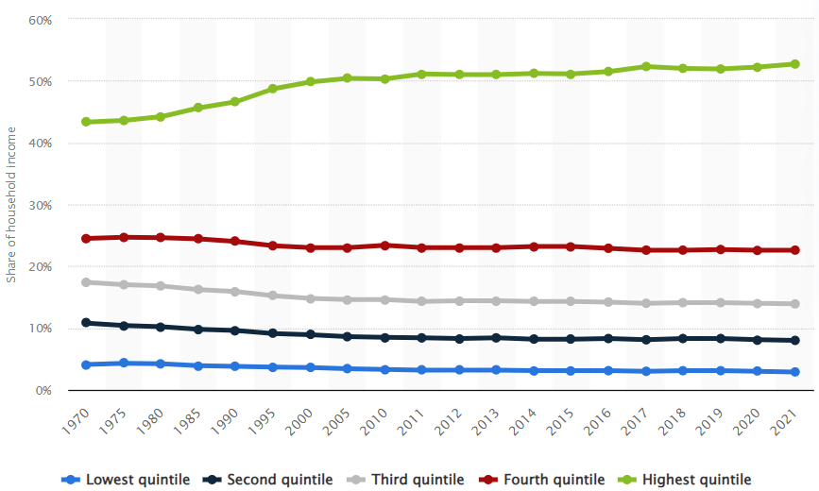
Share of U.S. Household Income Quintiles
Notes:
This chart (available from Statista here: https://www.statista.com/statistics/203247/shares-of-household-income-of-quintiles-in-the-us/) shows the U.S. Quintile distribution dating back to 1970. An obvious trend is the growth of the top quintile and the slight downward slope of the bottom four.

Slide 7
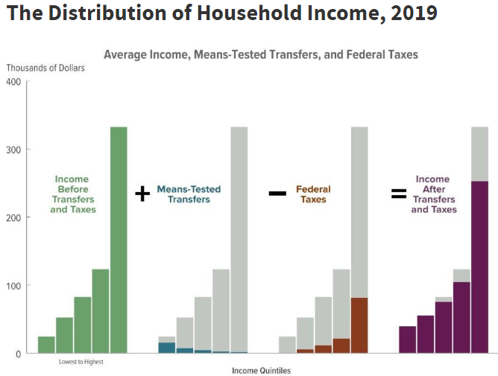
Share of U.S. Household Income Quintiles
Notes:
This chart is from a thorough report on income distribution compiled by the Congressional Budget office in 2019 found here: https://www.cbo.gov/publication/58781#_idTextAnchor051. The primary takeaway is that transfers and federal taxes do a little to help reduce income inequality in the U.S. but not to a significant measure. This report is loaded with other visuals that show the source of income from various quintiles and the degree to which taxes help reduce them.

Slide 8
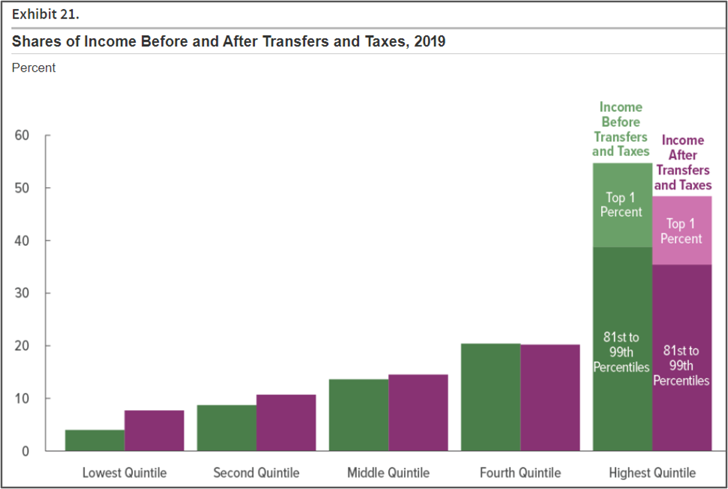
Share of U.S. Household Income Quintiles
Notes:
This image from the same report as the one on slide 7 helps clarify the effects transfers and taxes have on making income more equitable.

Slide 9
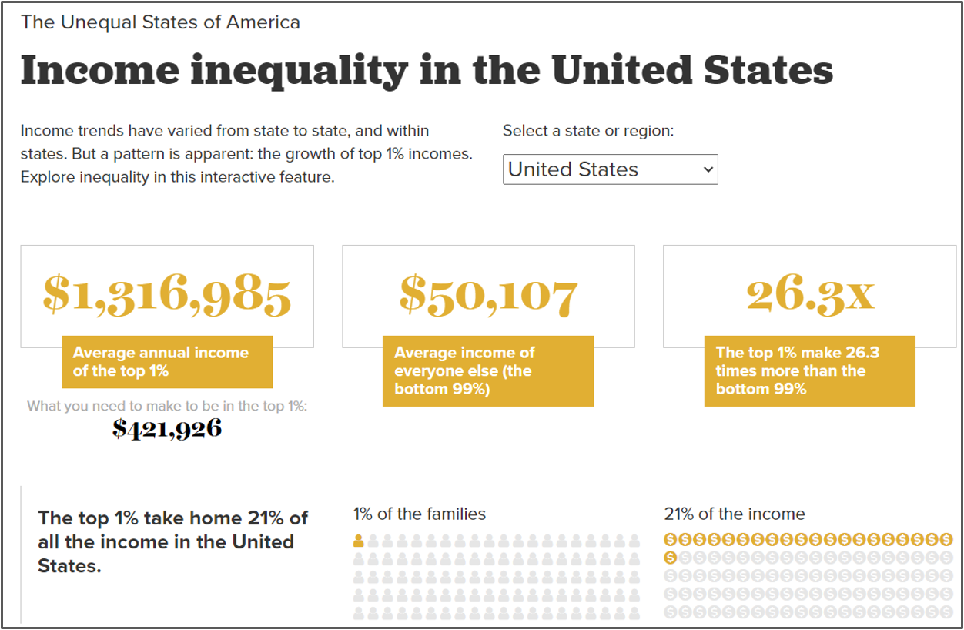
Share of U.S. Household Income Quintiles
Notes:
These statistics come from the Economic Policy Institute (available in interactive form here: https://www.epi.org/multimedia/unequal-states-of-america/#/United%20States). These statistics are often state like this to show the extreme inequality between the top 1% of the population and the bottom 99%. Policy-wise, however, this is perhaps not the most useful information. It is helpful for students to see how vast the inequality can be when taken in its extreme form.

Slide 10
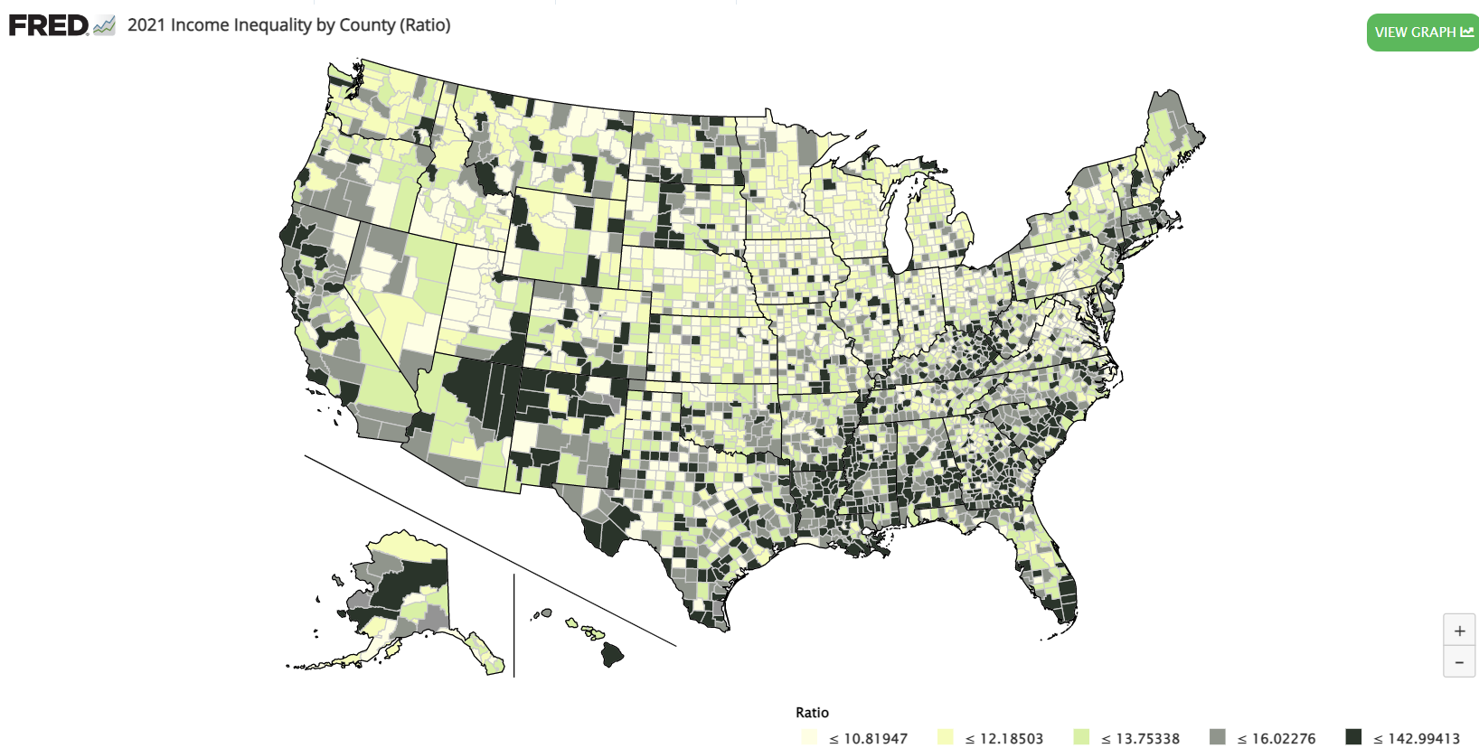
Share of U.S. Household Income Quintiles
Notes:
Income inequality varies significantly across the country. This map ( with an interactive version available here https://fred.stlouisfed.org/series/2020RATIO006037 ) shows income inequality by county using the ratio method. The darker the county, the more unequal the income distribution.

Slide 11
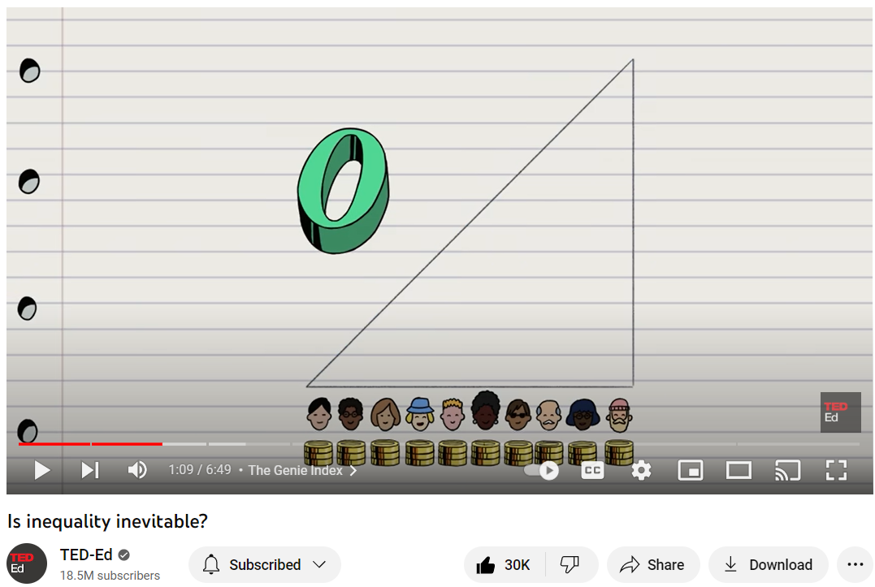
Is this inevitable?
Notes:
Link to video: https://www.youtube.com/watch?v=rEnf_CFoyv0&t=6s

Slide 12
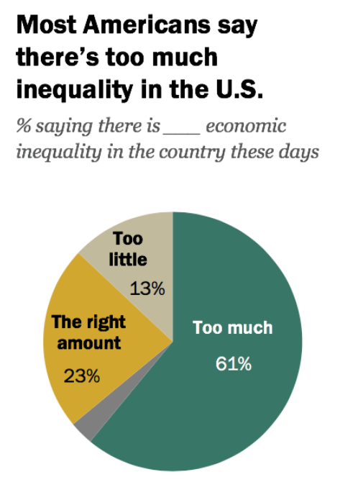
Share of U.S. Household Income Quintiles
Notes:
Pew Research Center Study, 2019.

Slide 13
Ethical concerns
The following ethical frameworks that are key to the decision-making process.
Outcomes-based ethics: a moral philosophy that discerns right or wrong action based on the consequences produced by the action.
Virtue-based ethics: a moral philosophy that discerns right or wrong based on whether one’s actions contribute to the formation of good character.
Duty-based ethics: a moral philosophy that discerns right or wrong based on the analysis of one’s obligations.
*Choose one framework and discuss with a neighbor how that framework might be applied to income inequality.

Slide 14
Ethical Frameworks Applied to Income Inequality
Ethical Model | Ethical reason to address income inequality | Ethical reason to not address income inequality
Outcomes-based (consequences) | Unequal income creates negative consequences like lack of access to basic needs for many | Unequal income creates motivation, entrepreneurship, and innovation
Virtue-Based (character) | Unequal income harms character development by potentially encouraging criminal activity on the lower end and hoarding of resources on the higher end | Unequal income boosts character development by encouraging development of skills and working hard to earn more
Duty-based (obligation) | Unequal income goes against the government’s obligation to promote the general welfare | Unequal income is not related to anyone’s duties as no government or company has an obligation to provide income

Slide 15
Who should do something about income inequality?
Countries that have less inequality usually have higher (and progressive) taxes with large amounts of social support provided by the government
Some people argue that private companies are better suited to deal with income inequality because they can take actions that are more in line with economic efficiency
Still others say no one needs to do anything about income inequality because it’s a natural occurrence found in all countries

Slide 16
Income Inequality “Build an Argument” Game
One person in the group should read your instructions (Activity 16.3) carefully to the rest of the group.
You choose ONLY one action at a time - even if you don’t like the options, choose from what’s available.
You may choose multiple economic and ethical outcomes.
You are not required to cover all the ethical frameworks, but you must choose at least one. Also, remember that an action can be ethical under one framework and unethical under another so you can mix and match.
You earn a point if at least two people in the group believe that your answer to the discussion question is the best (and you can vote for yourself).

Slide 17
Income Inequality “Build an Argument” Game
Play at your own pace, but make sure you get at least two rounds in in the 20 minutes.
You may begin.
After 20 minutes we will have a class discussion.

Slide 18
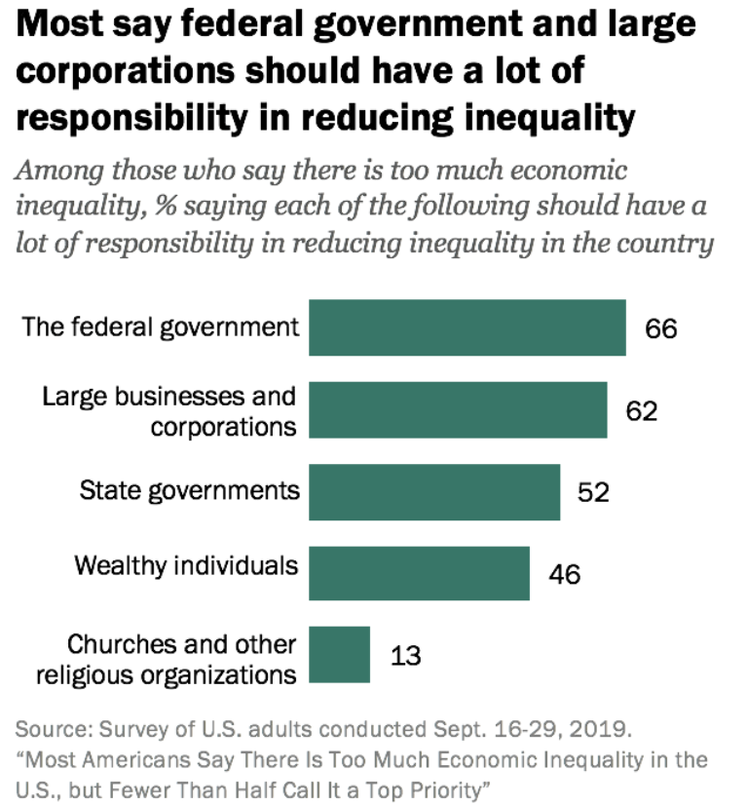
But who bears that responsibility?

Slide 19
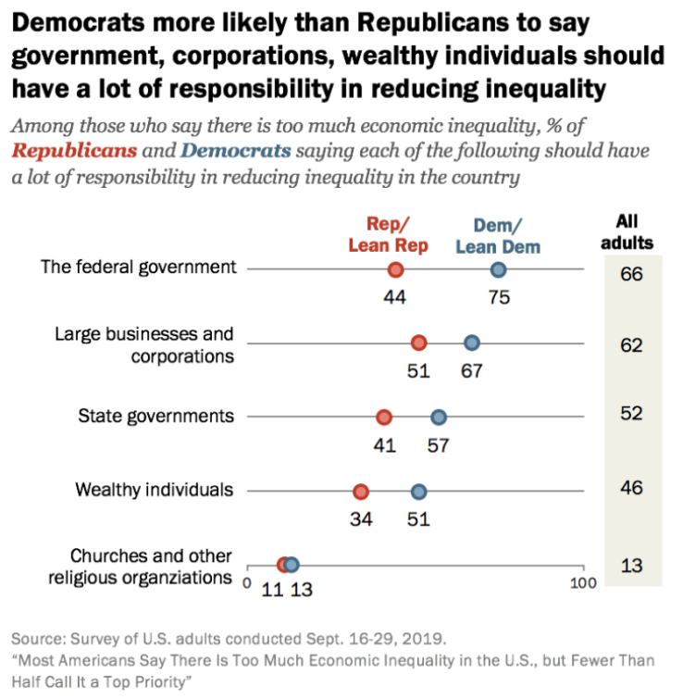
No surprise…politics plays a role

Slide 20
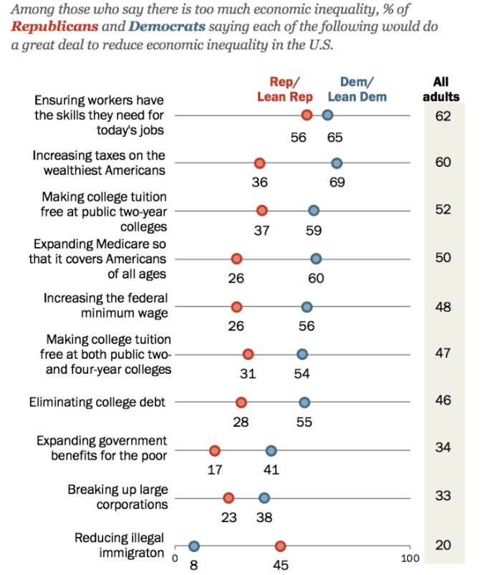
There is disagreement about what should be done

Slide 21
Assessment
Instructions: You are working on the campaign staff of a popular young politician. There is an upcoming debate and one of the central topics is income inequality. The politician has heard about your skills and has asked you to create your preferred argument using Assessment 16.1. You may use information from the game OR research your own policies and reasons.

