Slide 1
Toys for Me By C. D. Crain

Slide 2
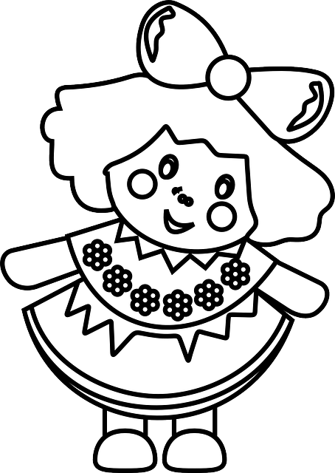
On my birthday I asked
My Mother to buy
This baby doll that burps
AND that wooden bird that chirps.
“NO!” was her reply
With that glint in her eye
“But you may choose this doll that burps Or that wooden bird that chirps.”

Slide 3
“But Mommy!” I did cry
“It’s unfair to make me choose
I really NEED them both
Or I’ll just DIE!”
Mother gave a grin
She pinched my girlish chin
She squeezed my crusty nose
Until I wiped it on my clothes.
She said, “Time and money
Will always make you choose
Remember: this OR that
It’s a rule you mustn’t lose.”

Slide 4
On Christmas Eve
I asked My Mother to buy
This pink and purple bike
AND that shiny kite I like.
Mother shook her head,
“Now Scarcity, you know I said
You may choose between this bike
OR that shiny kite you like.”
“But Mommy,” I did cry
I can’t pick and choose.
I really NEED them both
Or I’ll just DIE!”

Slide 5
Mother softly said “Do you think that toys are free?
That toys grow like leaves on a MAGIC TREE?
This AND that - The world can never be.
It’s this OR that - Can’t you see?”
“ENOUGH!” I yelled, “ENOUGH!
I’m tired of all this STUFF...
This isn’t fair; it isn’t right
I NEED more toys to play and use
So give me every toy I like...
It’s just not right to MAKE ME CHOOSE!”

Slide 6
Well...
I saw Mother wink at the big black clock
That was hanging on the wall singing tick-tick tock And then, I’m not kidding, the clock began to talk It said, “Refuse to choose and you will LOSE!”
Pouting, I was sent to my room for a spell
I guess to be punished for my childish yell
But after an hour I was happy to see…
In my room, growing tall, was a giant magic tree.

Slide 7
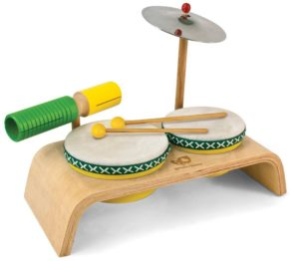
The tree pierced the roof.
My room was filled with sunny light
I grabbed a lowly branch and climbed up to the eaves
What a FEELING! How AMAZING!
What an awesome sight!
Toys began to sprout, just like leaves.
Toys, toys, the tree was filled with toys
Lots of toys, like big bright bikes
And other things that make loud noise.
Toys beyond my WILDEST dreams -
Pretty dolls, lots of balls, and super toy machines.

Slide 8
I squeezed the dolls
I hugged a ball
I stroked the trucks
I loved them all.
Then balanced on my toes with poise
I quickly started plucking toys.
To reach every limb I used a broom
I picked my toys by the sun, then the moon
Not once did I use my time to choose –
I was busy throwing every toy,
on the floor inside my room.

Slide 9
Finally, I reached the tree’s tip-top
And grinning, there on top, was that big black clock
It made not a sound - not one tick-tick tock
For time had stopped
What a tick-tick SHOCK!
The clock smirked and said: “I don’t like to fuss
But Scarcity, dear girl, your time is up
This OR that - this rule you did abuse
Because you would not choose,
it’s time for you to lose.”

Slide 10
I grabbed that clock; it was such a brat
Then I whacked it HARD, with the broom as a bat
I screamed, “NO MORE RULE NO MORE THIS OR THAT!”
Silence, then a sigh - the clock was gone like a snap.
Now that there were no more toys on the tree
I climbed down, quickly, feeling fine and free
For there was no more clock to be
A source of time to punish me.
Besides, I had toys in my room to see.

Slide 11
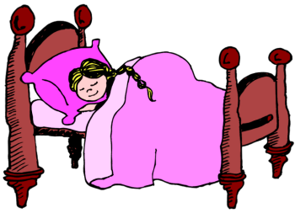
OH! … NO! … I rubbed my blurry eyes
All my toys were smashed and crushed –
Just a heap of junk and some buzzing flies.
My eyes, so tired, slowly closed to sleep
I awoke, the tree was gone - no sounds, not one peep
I sniffed, rubbed my nose, and slept some more
And dreamed of the toys that were mine before

Slide 12
LOVE! REJOICE!
I heard my Mother’s voice
With Christmas cheer, she called my name
I was relieved; she looked the same.
And that black clock?
It looked real swell
And the sound of time made me feel well.
Such a special Christmas
I hugged Mommy – what a saint
I got to CHOOSE the perfect gift …
It was the bike, without complaint.

