Slide 1
Hawaiian Economics: From the Mountains to the Seas

Slide 2
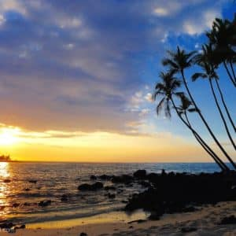
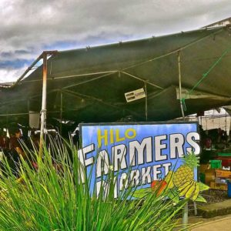
Photos of Hawaii

Slide 3
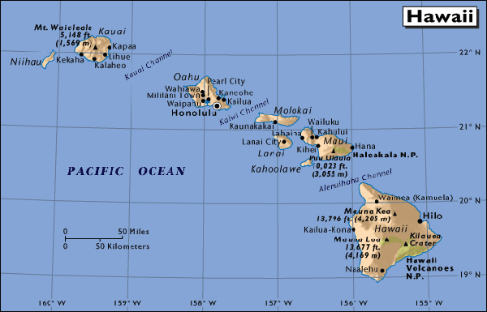
Hawaiian Islands

Slide 4
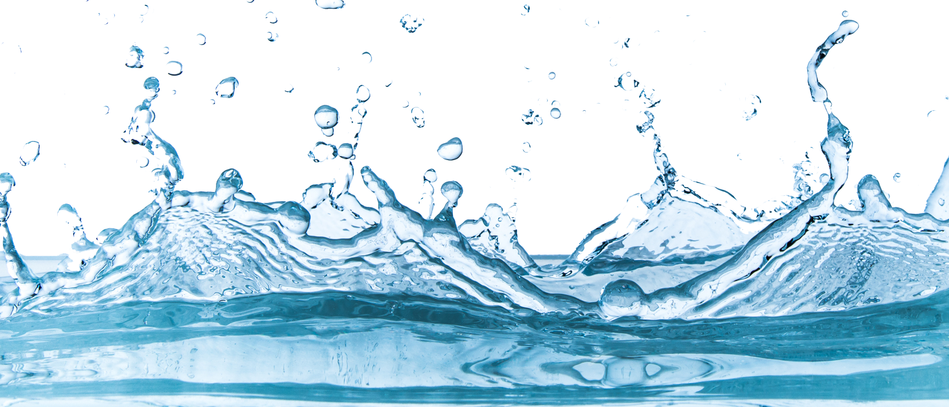
Natural Resources
“Gifts of nature” used to produce goods and services; examples include land, oceans, air, trees, mineral deposits, soil fertility, and climatic conditions.

Slide 5
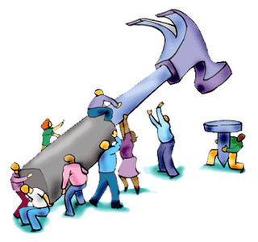
Human Resources
Intangible assets possessed by individuals, including knowledge, talent, skills, health, and values. (Also known as human capital)

Slide 6
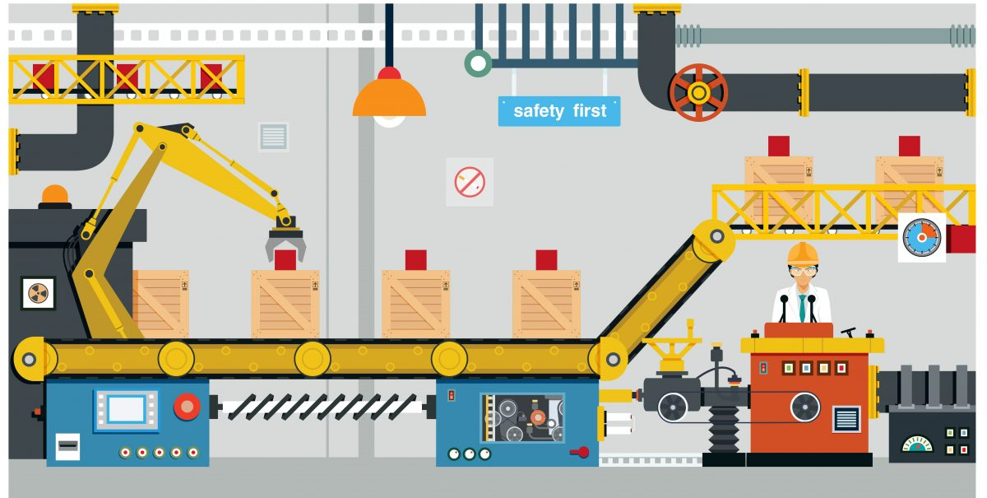
Capital Resources
Resources made and used to produce and distribute goods and services; examples include tools, machinery and buildings.

Slide 7
Photos of Hawaii

Slide 8
Natural Resources from the Mountains
Rainforests
Trees for canoe building
Trees for house posts
Wild banana trees
Wild pigs

Slide 9
Natural Resources from the Valleys
Lush farmland
Fresh water streams for drinking and watering crops
Taro to make poi
Sweet potato
Bananas
Ti leaf for wrapping food, making hula skirts, and more
Other resources

Slide 10
Natural Resources from the Sea
Beaches
Reefs
Fishponds
Salt
Shellfish, lobster, crab
Seaweed

