Slide 1
"Tips and Strategies to Pass the AP Economics Exam: FRQ's and Graphing
THERESA FISCHER
APRIL 2022
Ecofisch@gmail.com

Slide 2
EconEdLink Membership
You can now access CEE’s professional development webinars directly on EconEdLink.org! To receive these new professional development benefits, become an EconEdLink member. As a member, you will now be able to:
Automatically receive a professional development certificate via e-mail within 24 hours after viewing any webinar for a minimum of 45 minutes
Register for upcoming webinars with a simple one-click process
Easily download presentations, lesson plan materials and activities for each webinar
Search and view all webinars at your convenience
Save webinars to your EconEdLink dashboard for easy access to the event
You may access our new Professional Development page here

Slide 3
Professional Development Certificate
To earn your professional development certificate for this webinar, you must:
Watch a minimum of 45-minutes and you will automatically receive a professional development certificate via e-mail within 24 hours.
Accessing resources:
You can now easily download presentations, lesson plan materials, and activities for each webinar from EconEdLink.org/professional-development/

Slide 4
Agenda
Looking at the AP Economics exam and its point value
Using the CED to further understand the structure and point values of the FRQs
Understand the language and its meaning when trying to answer the FRQs
Looking at the graphing and how to practice this graphing
Giving the students confidence right before the exam.

Slide 5
Objectives
Teachers will have a better understanding about the FRQs and how they are graded.
Teachers will see how important the CED is for their teaching and for the preparation for the exam.
Teachers will understand the importance of the Chief Read’s Report and how to use it in their classroom.

Slide 6
Assessment Questions
1 What is the value for students to review past FRQs?
2. Does the Chief Reader share information about the exams? When and Where?
3. How best to teach graphing to a High School student?
4. Explain the key words used in AP Economics FRQs
5. Are the skills of economic concepts and models the same in Macro as in Micro? Explain.

Slide 7
References
The CED from the College Board Macroeconomics
https://apcentral.collegeboard.org/pdf/ap-macroeconomics-course-and-exam-description.pdf
The CED from the College Board Microeconomics
https://apcentral.collegeboard.org/pdf/ap-microeconomics-course-and-exam-description.pdf
FRQs for Macroeconomics
https://apcentral.collegeboard.org/courses/ap-macroeconomics/exam/past-exam-questions
FRQs for Microeconomics
https://apcentral.collegeboard.org/courses/ap-microeconomics/exam/past-exam-questions

Slide 8
Alternate Sources for Review

Slide 9
CEE Affiliates
https://www.councilforeconed.org/resources/local-affiliates/

Slide 10
Thank You to Our Sponsors!

Slide 11
https://bit.ly/CEEConference2021

Slide 12
MATERIALS
CED for AP Microeconomics—
https://apcentral.collegeboard.org/pdf/ap-microeconomics-course-and-exam-description.pdf
CED for AP Macroeconomics –
https://apcentral.collegeboard.org/pdf/ap-macroeconomics-course-and-exam-description.pdf
AP Microeconomics Past Exam Questions
https://apcentral.collegeboard.org/courses/ap-microeconomics/exam/past-exam-questions
AP Macroeconomics Past Exam Questions
https://apcentral.collegeboard.org/courses/ap-macroeconomics/exam/past-exam-questions
MYAPCLASSROOM and AP AUDIT site on Collegeboard.com

Slide 13
https://apcentral.collegeboard.org/pdf/ap-macroeconomics-course-and-exam-description.pdf
https://apcentral.collegeboard.org/pdf/ap-microeconomics-course-and-exam-description.pdf

Slide 14
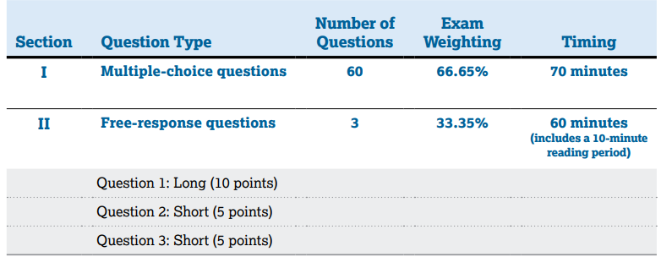

Slide 15
AP Course in Microeconomics and Macroeconomics Assesses Four Ideas
MICROECONOMICS
MACROECONOMICS

Slide 16
FRQs will Test Students on ALL These 4 Skills

Slide 17
KEY WORDS FOR AP Macro/Micro FRQS
IDENTIFY. WHAT? WHICH? WILL? And other interrogatory words.
EXPLAIN
Students must underline these words when they are reading the qt and be ready to answer.
CALCULATE
DRAW A CORRECTLY LABELED.
SHOW. LABEL. PLOT . INDICATE

Slide 18
All four skill categories will be assessed in the THREE free-response questions, through four distinct types of tasks:
1. Make assertions about economic concepts, principles, models, outcomes, and/or effects
Skill #1 - Students will need to describe and compare economic concepts, principles, and models. Additionally, students will need to identify economic concepts, principles, or models illustrated by an example. This task exams student’s knowledge. This task assesses skills in categories 1, 2, and 3 and accounts for 10–20% of total points in the free-response section.
Notes:
This task assesses skills in categories 1, 2, and 3 and accounts for 10–20% of total points in the free-response section.

Slide 19
Microeconomics 2018 Qt 2
Identify the type of market failure indicated on the graph. Explain.
Using the numbers on the graph indicate the market equilibrium price and quantity
Using the labeling on the graph, identify the area representing the deadweight loss at the quantity identified in part (b)

Slide 20
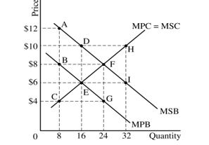
ANSWER 2018 Qt 2
1 pt One point The market failure indicated in this graph is a positive externality BECAUSE marginal social benefit is greater than marginal private benefit MSB>MPB
b. One point The market equilibrium price as $6 and the market equilibrium quantity as 16 units
c. One point The area of the deadweight loss as DEF

Slide 21
Skill #2 - Interpretation
Students will need to explain how a specific economic outcome occurs, given one or more contributing variables, or what action(s) should be taken in order to achieve a specific economic outcome. This task assesses skills in categories 1, 2, and 3 and accounts for 25–35% of total points in the free-response section.

Slide 22
Microeconomics 2017 Qt 3 & Answer
(a) 2 points:
• One point The monopolist’s profit-maximizing quantity, Q3.
• One point The monopolist’s profit-maximizing price isP4.
(b) 1 point: • MSC > MPC or that the MSC curve exceeds, is above, or is greater than the MPC curve.
(c) 1 point: • The socially optimal quantity, Q3

Slide 23
Skill #3 Manipulation
Students will need to use economic concepts, principles, or models to determine the outcome of an economic situation or determine the effects of one or more changes on other economic markets. This task assesses skills in categories 1, 2, and 3 and accounts for 25–35% of total points in the free-response section. Perform numerical analysis:

Slide 24
Microeconomics 2019 Qt 1
(b) Suppose the demand for the prescription drug increases, and Gigantic hires its warehouse workers in a perfectly competitive labor market.
(i) What will happen to Gigantic’s demand for warehouse workers? Explain. (ii) What will happen to the wage rate Gigantic pays its warehouse workers and the number of warehouse workers it hires?
(c) After Gigantic’s patent expires, another firm enters the prescription drug market and produces an identical drug that sells for a lower price.
(i) What will happen to Gigantic’s producer surplus?
(ii) What will happen to the consumer surplus in this prescription drug market? Explain.

Slide 25
Microeconomics 2019 Qt 1- Answer
(b) 2 pt • One point is earned for stating that Gigantic Pharmaceutical Corporation’s demand for warehouse workers will increase and for explaining that the marginal revenue product of labor increases because of the increase in the product price.
• One point is earned for stating that the wage rate Gigantic pays to its warehouse workers will not change and the number of workers hired will increase.
(c) 1pt• One point is earned for stating that Gigantic’s producer surplus will decrease. •
One point is earned for stating that the consumer surplus will increase and for explaining that because of the increased competition the price will decrease and the quantity will increase

Slide 26
Macroeconomics 2019 Question 1c
A very good math student will know how to calculate this in their head. However, the requirement is that you SHOW YOUR WORK. So, having just the answer $8 Billion will not earn that 1 pt credit and $10B will not earn the 1 pt

Slide 27
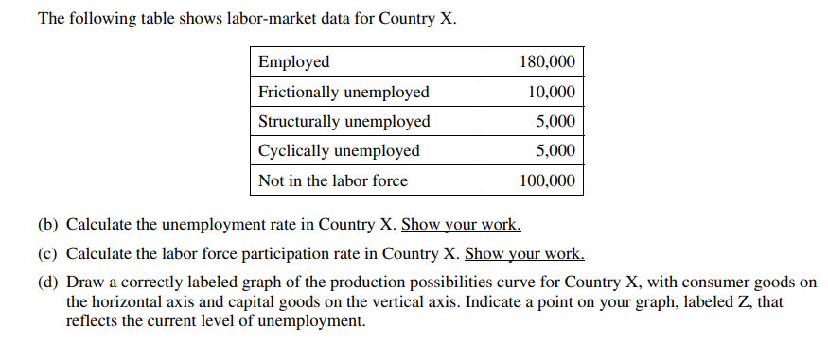
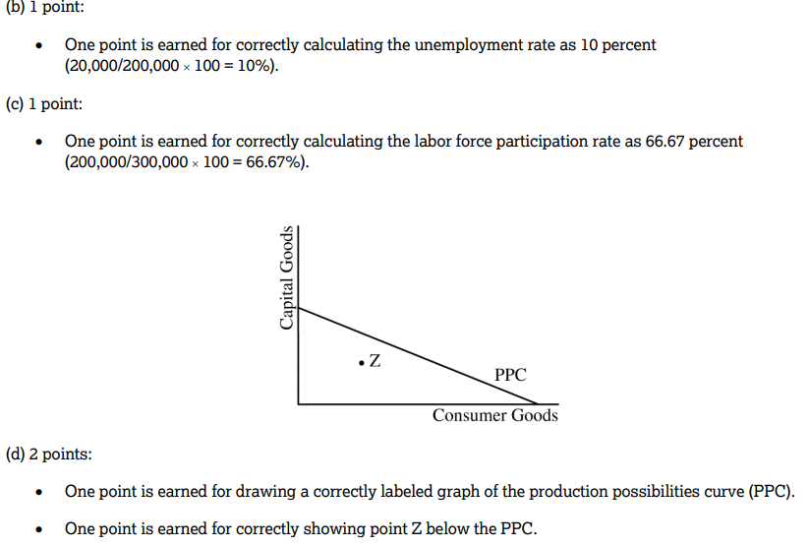
AP Macroeconomics 2018 Qt 3
KEY WORDS
Calculate
Draw

Slide 28
Skill #4 Create Graphs and Visual Representation
Draw an accurately labeled graph or visual to represent an economic model or market (Skill 4.A) § Demonstrate your understanding of a specific economic situation on an accurately labeled graph or visual (Skill 4.B) § Demonstrate the effect of a change in an economic situation on an accurately labeled graph or visual (Skill 4.C)
This task assesses Skill Category 4 (Graphing and Visuals) and accounts for 30–50% of the total points in the free-response section.

Slide 29
Macroeconomics 2019 Qt 1
Student needs to understand that there are several parts to this qt. Not only are the curves drawn and labeled, but PL and Output and Full employment.
HOW MANY PARTS OF THIS GRAPH NEEDS TO BE LABELED?
LRAS
SRAS
AD
Real Output- Y1
PL- PL1
Fe - Yf

Slide 30
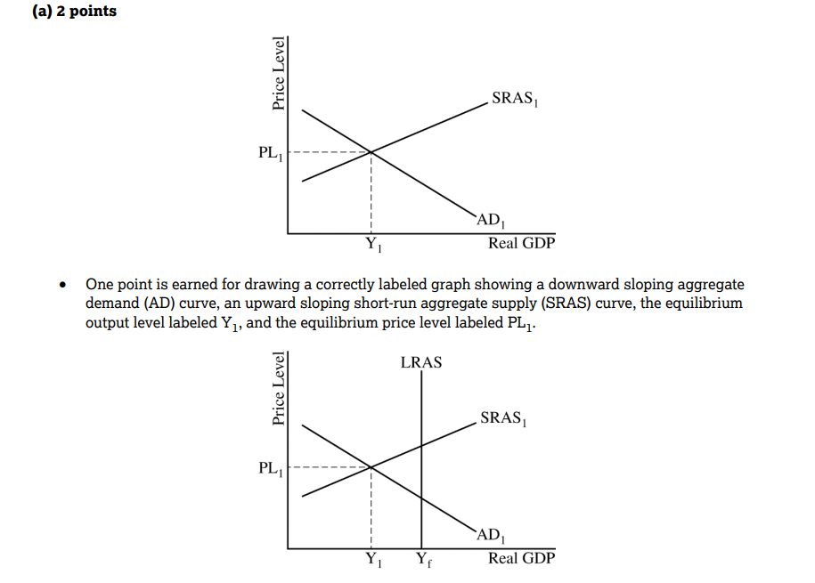
AP Macroeconomics 2019 Qt 1 Scoring for part a

Slide 31
AP Macroeconomics Question 2019 1 b
(b) The central bank and the government do not take any policy action to close the output gap.
(i) Explain how the economy will adjust to full employment in the long run.
(ii) On your graph in part (a) show how the economy adjust to full employment in the long run.
KEY WORDS:EXPLAIN; SHOW
2 points
One point is earned for explaining that nominal wages, input prices, or expected inflation will decrease, causing the SRAS curve to shift to the right until real GDP reaches full employment at Yf .

Slide 32
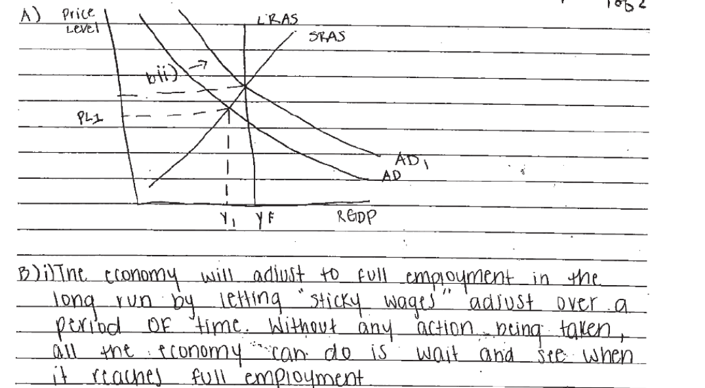
Student SAMPLE

Slide 33
Microeconomics 2016 Qt 3
Key words—Correctly labeled; Demand curve, MR, MC and LRATC Draw; showing; Explain

Slide 34
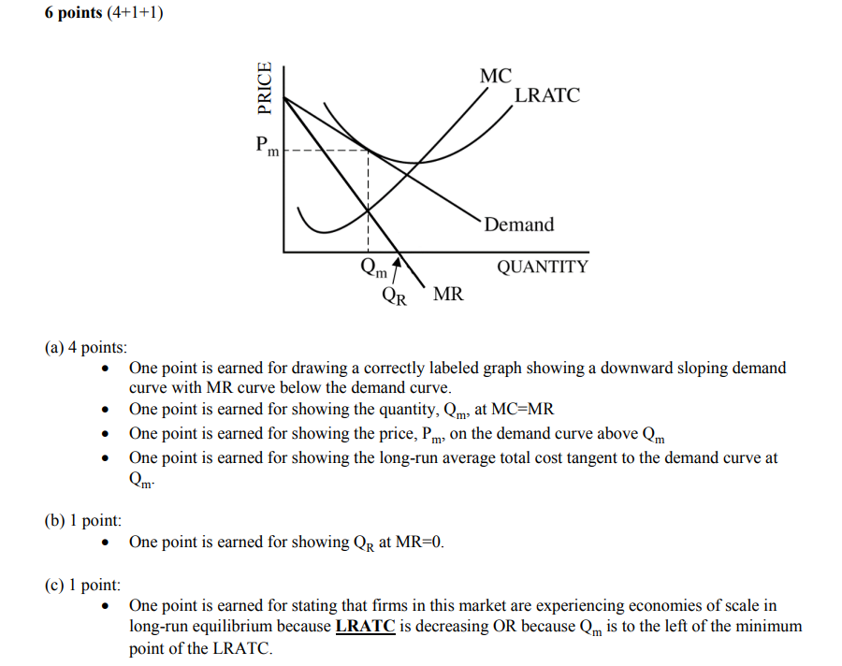
Answers to Microeconomics FRQ 2016 #3 6 points

Slide 35
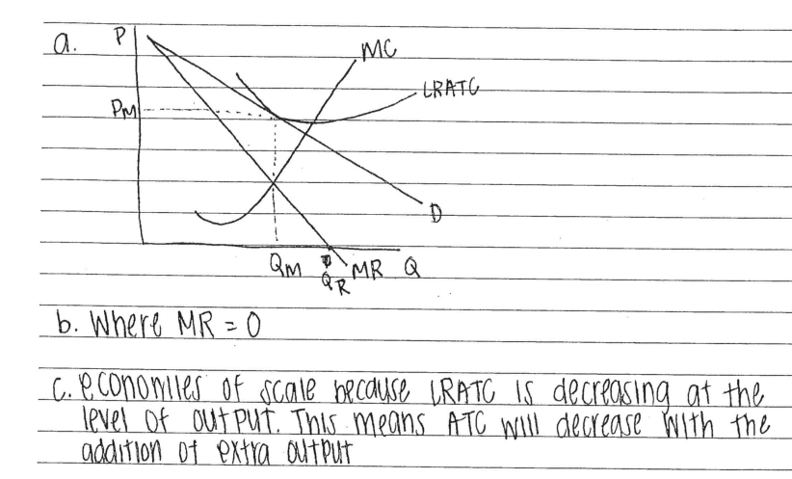
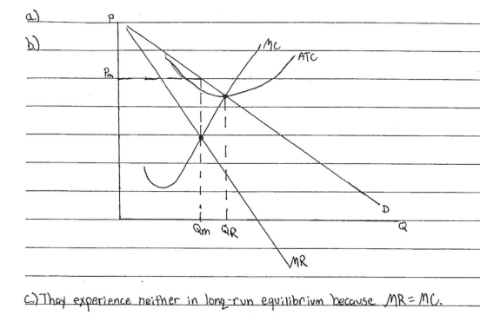
Earned 6 pts.
Earned 3 pts

Slide 36
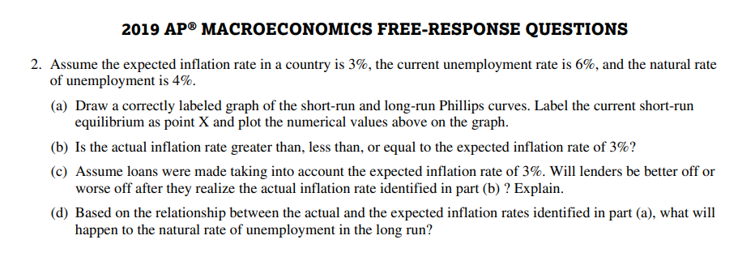
Macro 2019 Qt 2

Slide 37
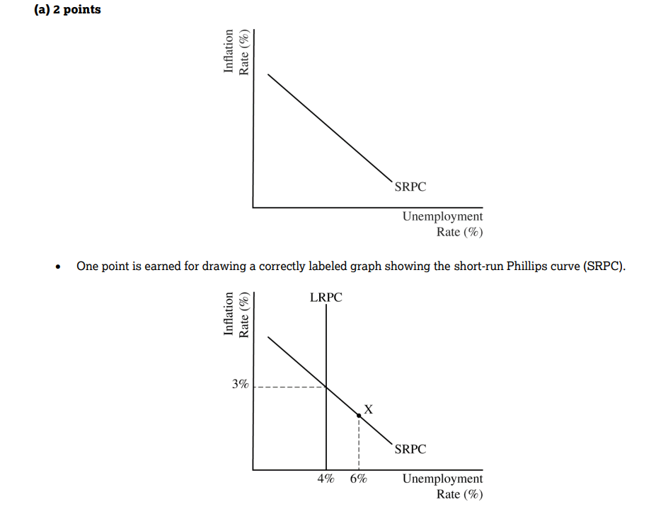
5 pt question
One point is earned for stating that the natural rate of unemployment will not change in the long run
One point is earned for stating that lenders will be better off and for explaining the real value of the loans that will be repaid will be higher than expected OR for explaining the relationship between the nominal and the real interest rates using the Fisher equation.
One point is earned for stating that the actual inflation rate is less than the expected inflation rate.

Slide 38
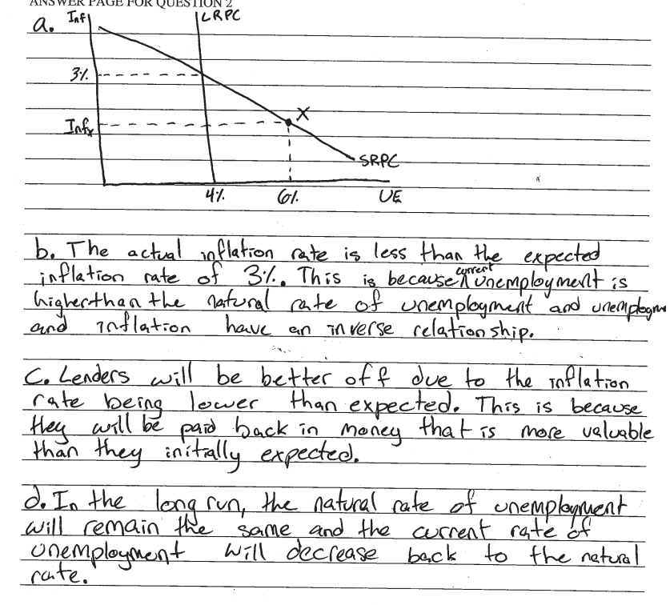
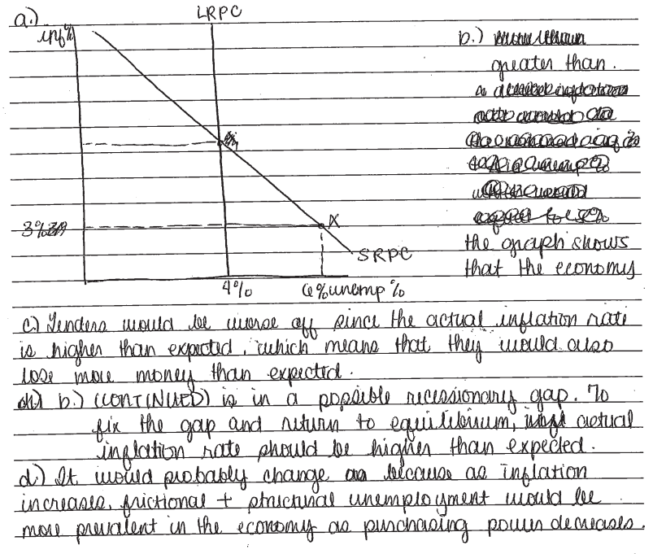
5 pts
1 pt

Slide 39
KNOW WHAT YOUR STUDENTS DO NOT KNOW AND WORK ON THOSE CHALLENGES.
KNOW WHAT THE COMMON ERRORS ARE ON THE PAST EXAMS

Slide 40
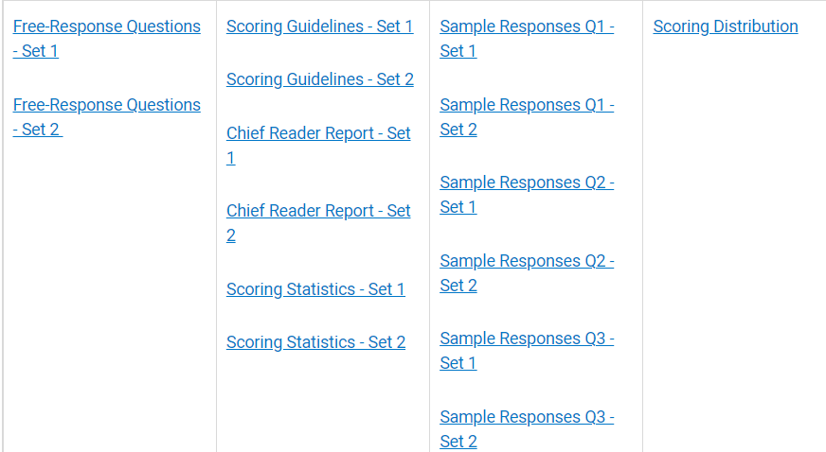
COMMON ERROR ON AN EXAM CAN BE FOUND in the Chief Reader’s Comments?
On the College Board site with the FRQs ( 2019 Set 1 Set 2)

Slide 41
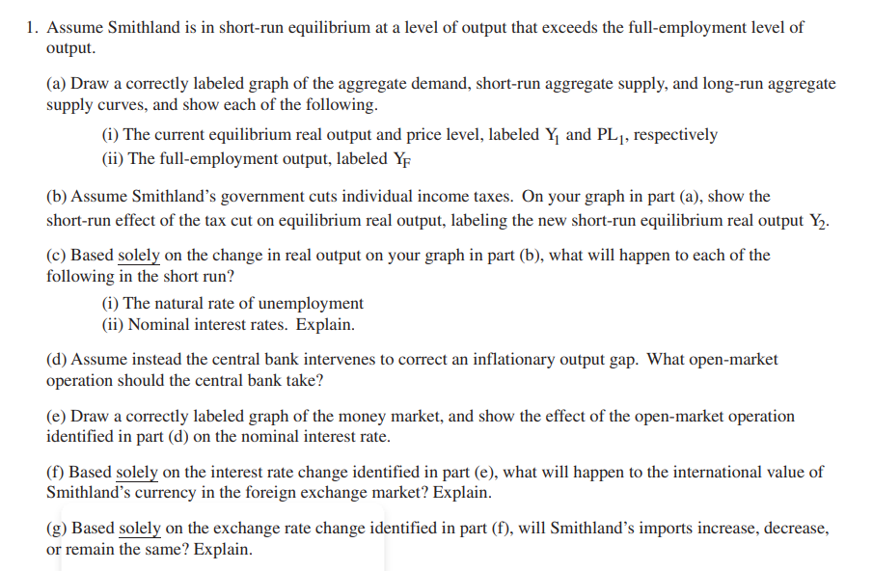
Chief Reader’s Report on Student Responses https://apcentral.collegeboard.org/pdf/ap21-chief-reader-report-macroeconomics.pdf - 2021
Chief Reader, Sam Andoh, Professor of Economics, Southern Connecticut State University

Slide 42
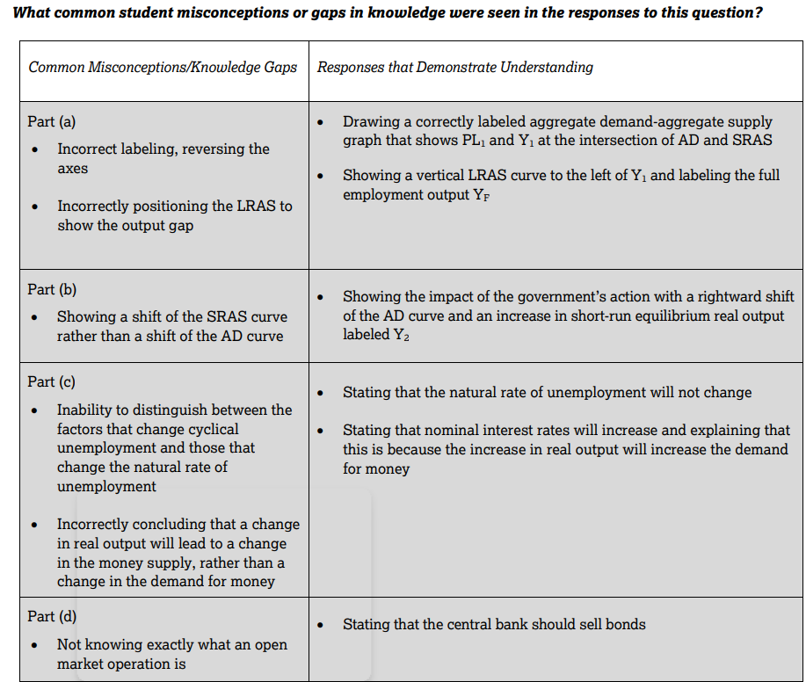

Slide 43
How do I teach my students to Earn the Most Points on their FRQs?
Know and Label Your Graphs –
--the x axis and the y axis
--clearly draw your graphs
--label all the lines (use the clock method)
--show the shifts relating to the question
Know Your Vocabulary and the Connections
--If interest rates decrease → investment in capital stock will increase-> AD will increase-> Output will increase-> UE will decrease.
--If government has deficit spending -> interest rates will increase-> value of the dollar will increase> imports will increase.
-- I f there is a lump sum tax what will happen to price and qty for the firm, Explain.
Learn to time Manage and complete the FRQs
--30 minutes for the Long essay and 15 minutes for the Short essays

Slide 44
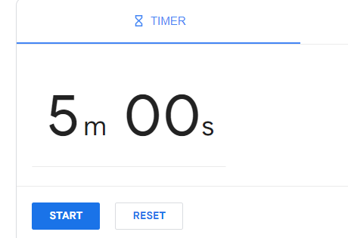
How can I teach my students to Earn the Most Points on their FRQs?
1. Read the stem of the question.
2. Stop and think→ do not panic!
3. Use the first 10 minutes to plan out the answers. Do not rush.
4. Underline the key words what THE QUESTION IS ASKING?
Time your students. Give them a few minutes to organize their thoughts.

Slide 45
Readable Graphs
5. Graphs should show PRIDE of achievement.
They should be at least FIVE lines on the student paper. If there is an error; Cross out the entire graph and begin again.

Slide 46
.
6. . Answer the question in the order that it is given. Skip a line or two between a. b. c. etc.
7. Practice writing in pen or get an erasable pen.
8. When the student feels that they made a mistake. Cross out the entire section and rewrite. Do not try to rewrite on top of a word
9. DONOT flip flop. If they ask- increase, decrease or no change, pick one and explain. If your explanation is over 3-4 sentences you are writing a novel!
10. Be aware of consistency points.

Slide 47
FLIP/FLOPPING
Macroeconomics 2015 Q1 e
Assume the government lowers income tax rates to eliminate the recessionary gap. Will each of the following increase, decrease, or stay the same?
(i) Aggregate demand. Explain. (ii) Long-run aggregate supply. Explain.
A student wrote the following:
(i) AD will increase because the people will have more money to spend and therefore RGDP will increase. However, it could decrease the same because people will not spend their tax money and give it to relatives in need.
(ii) LRAS could increase because more people will spend money however, it could also decrease because people made donations. Or it can remain the same because people are giving the money to their relatives. .

Slide 48
No Flip/Flopping and Stay the Course
The Economy is in a recession,
A. What Open Market Operation policy will be implemented?
B. What will the effect be on Aggregate Demand? Explain
C. Based on your answer in(B) explain the effect on
(i) Unemployment
(ii) RGDP
Student writes
Sell bonds and raise the reserve requirement
This will decrease Aggregate Demand
(i) Raise UE because there will be less spending because the interest rates are higher and cost more money to borrow
(ii)If people spend less then RGDP will decrease.

Slide 49
MICROECONOMICS – 2018 Qt 1
NOTE: 1 c The qt asks for a total revenue to increase, decrease or stay the same with an EXPLAIN.
Here is a student answer. The explanation is correct. However, can you read increase? Decrease?

Slide 50
Macroeconomics 2014 Qt 1
Assume that the United States economy is currently operating below the full-employment level of real gross domestic product with a balanced budget.
(a) Draw a correctly labeled graph of aggregate demand, short-run aggregate supply, and long-run aggregate supply, and show each of the following in the United States.
(i) Current output and price level, labeled as Y1 and PL1, respectively (ii) Full-employment output, labeled as Yf

Slide 51
Challenge and Problem for many Students!!
Students were used to seeing a statement that read the following:
The United States economy is in a recession
The United States economy is in inflation
The United States is at Full employment

Slide 52
Challenges in the FRQs in Graphing.
Shading DWL
Locating qty and price for imperfect competition.
Externality graphs – Positive or Negative externalities.
If a fixed cost changes what happens to Qty and Price?
Include all of the curves for AD/ SRAS/ LRAS/ PL. Y1, Yf
Labeling Currency graphs
If government or the Central Bank does no policy action, in the LR what happens to SRAS? Explain.

Slide 53
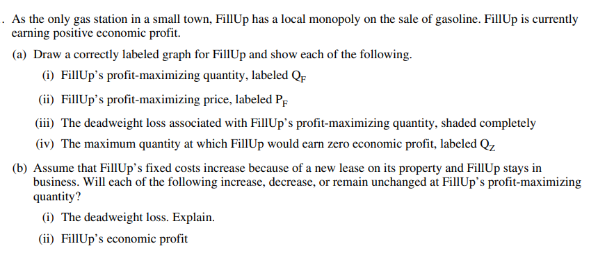
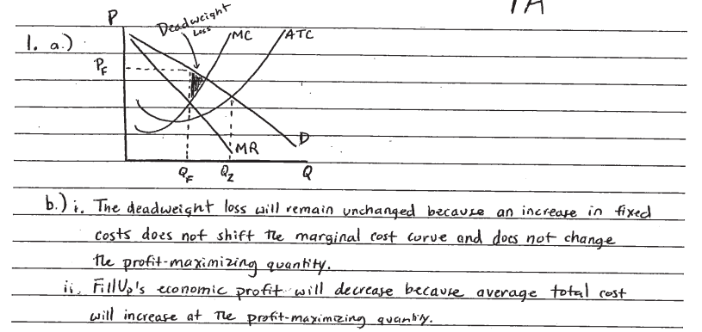
MICROECONOMCIS 2019 Qt

Slide 54
MICROECONOMICS 2019 Q1 Locating P & Q

Slide 55
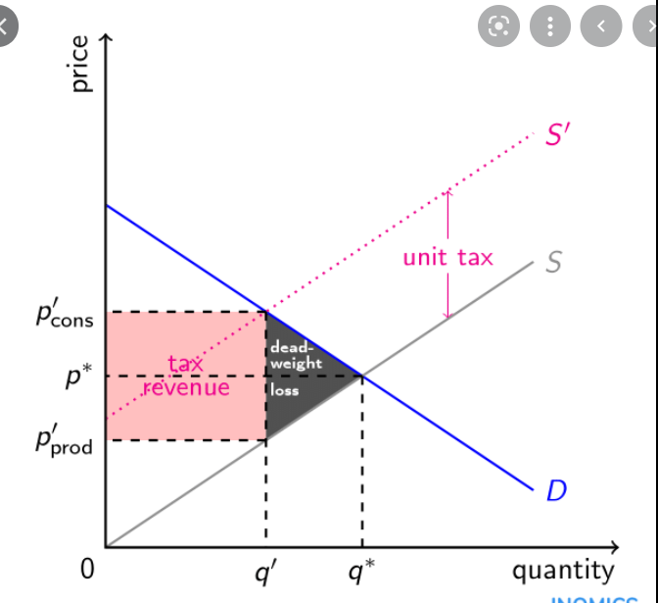
Externality graphs DWL vs Tax graph
This is a negative consumption externality. Note the DWL→ and its direction. Note the tax graph and its DWL position.

Slide 56
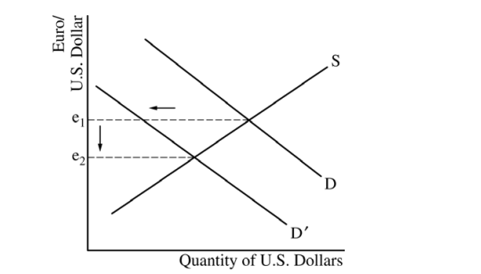
Macroeconomics Question 1 2018
The question is asking about the United States Dollar therefore the x axis has to be the United States dollar. The y axis is Euro/US dollar. Whatever the graph represents, then the y axis denominator will be the same. This is a good clue for the student. Once again. Underline the important parts of the qt.
Student never need to know what the currency name of the countries. But they need to know how to draw this graph and understand that due to the recession, these countries will demand less US goods and therefore less US dollars.

Slide 57
Frequent Macro Qts that Challenge the Students
----When the government conducts Expansionary Fiscal policy what happens to
(i) LRAS Explain
(ii) The Natural Rate of Unemployment
----No action taken what will happen to the SRAS in the LR? Explain

Slide 58
Frequent Micro Qts that Challenge students
If there is a tax or subsidy per unit or lump sum- what happens to Price and Quantity. Explain
Max quantity when there is zero economic profit.
Numerous graphs SR and LR
Explanations regarding Elasticity and Externalities

Slide 59
Last words for Review
Build up the confidence for the students. –Taper the students. Do not give them tons of work
Have the students work in pairs and share their work.
Do lots of board work so that the students see the answers. Let them find the mistakes!
Make the review fun! Use white Board with fun markers to help students practice.
Create camaraderie among the students so that they feel that they are taking this test as a team.
Show them A movie clip to inspire them Braveheart scene before the attack!
The rewards are great at the end of the tunnel for many of them!
Use the videos from MYAPCLASSROOM and create an individual program for the students.
Encourage the students to go to the various online video programs that help review. For those visual learners
ACDC, Reviewecon.com. Reffonomics.com, Khan Academy, Jason Welker (https://www.youtube.com/watch?v=gl9dIJ1n9D8)
Have students help students on the topics that need some extra help.

Slide 60
Parting Words
"You gain strength, courage and confidence by every experience in which you really stop to look fear in the face. You can say to yourself, 'I have lived through this horror. I can take the next thing that comes along.' You must do the thing you think you cannot do." --Eleanor Roosevelt

Slide 61
KAHOOT

Slide 62
Thank you and Good Luck to Your Fine Students

