Slide 1
Preparing Taxes

Slide 2
Personal Income Facts in the U.S.
The U.S. tax code contains more than 3.7 million words and is more than 70,000 pages in length.
Americans spend 7.6 billion hours every year preparing taxes – an average of about 25 hours per person.
In addition, U.S. taxpayers spend over $27 billion every year on tax preparation services – an average of about $89 per person.

Slide 3
Personal Income Facts in the U.S.
The Internal Revenue Service has a budget over $11 million and employs about 80,000 people.
The word “tax” means “I estimate” in Latin.
Albert Einstein once said, “The hardest thing in the world to understand is income tax.”
Question: How might these facts affect people’s understanding of personal income tax and their willingness to pay?

Slide 4
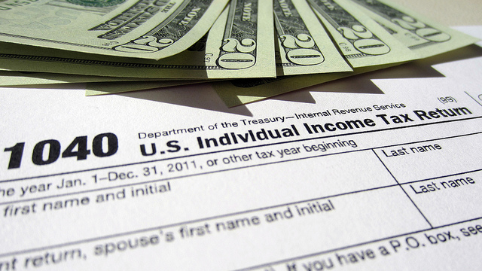
Notes:
Many students today have part-time or summer jobs. Remind them they probably received a W2 from their employer and may have completed a Form 1040 to file their taxes. Explain that this lesson will help them better understand the information provided by their employers and the steps involved in filing their taxes. Explain that employees or others with various types of income are required to submit the Form 1040 to their designated IRS Office on or before April 15 each year unless they meet specific criteria.

Slide 5
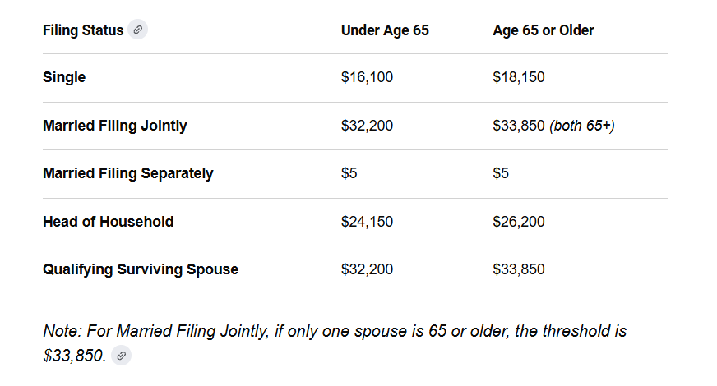
You need to file income taxes if you make over the following (gross income).
Notes:
So, what is the criteria for those who don’t have to file a Form 1040? This table shows the five different categories established by the IRS and the gross income limitations that exempt individuals of various ages from filing a tax return. Anyone who earns more than the gross for their age and filing status are required to file a Form 1040. Exceptions and Special Rules
You are also required to file a tax return if any of the following apply to you:
Self-Employment: You had net earnings from self-employment of at least $400. [1]
Dependents: You are claimed as a dependent on another person’s tax return and your unearned income was more than $1,350 (or earned income was over $16,100). [1, 2]
Specific Credits & Taxes: You owe special taxes (such as the Alternative Minimum Tax or household employment taxes) or received distributions from specific accounts like a Health Savings Account (HSA).
Advanced Payments: You owe taxes because you received advanced payments of the Premium Tax Credit.
If you are unsure whether your specific combination of income, deductions, or age triggers a requirement, you can use the IRS Interactive Tax Assistant to determine your exact filing status.

Slide 6
Personal Income Tax
Employers (in most situations) are required to deduct federal income tax from an employee’s paycheck
  Gross income is the amount of earned income before deductions
  Net income is the amount of “take home” pay in an employee’s paycheck
  Federal income tax is only one example of a deduction
  Other possible types of deductions
    State and local income tax, if required
    Social Security and Medicare payments (called FICA)
    Retirement contributions, health care payments, etc.
Notes:
This slide shows some of the basic information about personal income tax. Ask students if they ever looked at a pay stub. Tell them the pay stub shows how much money is deducted from their gross income (the total amount earned for that pay period) and the net income (the amount they are actually paid after the deductions). Remind them their pay stub will probably show several types of deductions, including federal income tax, state and local income taxes (depending upon their location), social security payments, medicare payments, and various employee benefits. These deductions are important and treated differently by the IRS when it comes to calculating your total tax liability for the year.

Slide 7
Paying Personal Income Tax
Employers are required to provide employees with IRS Form W2 on or before January 31 of each year
W2 forms include income and tax information needed about the past tax year (the preceding calendar year)
Information on the W2 is used to complete IRS Form 1040 to indicate potential refunds (overpayment of taxes) or additional money owed (underpayment of taxes during the tax year)
Form 1040 must be submitted to the appropriate IRS Office on or before April 15 of each year
Notes:
Tell students the rest of this lesson will focus on the forms provided by the IRS to determine their total tax liability. Remind students that two IRS forms are the basis for calculating taxes for most taxpayers: Form W2 and Form 1040. The W2 is a report of their earnings and deductions. Employers are required by law to provide every employee a Form W2 by the end of January following the tax year. The information on that form is needed to complete the Form 1040, which is the form used to calculate personal income tax. 1040 Forms can be completed online and submitted electronically or mailed to the IRS, but must be submitted or postmarked on or before April 15. While it is possible to file an extension for submitting the1040, the IRS requires anyone seeking an extension to estimate the amount of taxes owed and make payment at that time. Payments submitted after April 15 are subject to penalties or additional fees.

Slide 8
W2 Information
https://www.hrblock.com/tax-center/irs/forms/how-to-read-a-w2-form/
Notes:
This link connects to a web site showing additional information about the W2. It includes a series of questions and answers and an infographic explaining the different boxes on the form. (Note: The next slide depicts an “actual” W2 which has data added; this information will be used to complete the group activity.) Ask students if they have any questions about the W2.

Slide 9

Sample W2
 | a Employee’s social security number 123-45-6789 |  | Safe, accurate, Visit the IRS website at OMB No. 1545-0008 FAST! Usewww.irs.gov/efile
b Employer identification number (EIN) 46-0997139 |  |  |  | 1 Wages, tips, other compensation $39,027 |  |  |  |  |  |  |  | 2 Federal income tax withheld $3,125
c Employer’s name, address, and ZIP code Billie J. Does 6101 N. American Avenue Belton, MO 64012 |  |  |  | 3 Social security wages $40,254 |  |  |  |  |  |  |  | 4 Social security tax withheld $2,691
 |  |  |  | 5 Medicare wages and tips $40,254 |  |  |  |  |  |  |  | 6 Medicare tax withheld $584
 |  |  |  | 7 Social security tips |  |  |  |  |  |  |  | 8 Allocated tips
d Control number |  |  |  | 9 Verification code |  |  |  |  |  |  |  | 10 Dependent care benefits
Happy Days Public Schools 100 N. Pleasant Run Blvd. Belton, MO 64012 Employee’s first name and initial Last name Employee’s address and ZIP code |  |  | Suff | 11 Nonqualified plans |  |  |  |  |  |  |  | 12a C DD o d e | See instructions for box 12
 |  |  |  | 13 Statutory Retirement Third-party employee plan sick pay |  |  |  |  |  |  |  | 12b C D o d e
 |  |  |  | 14 Other |  |  |  |  |  |  |  | 12c C o d e
 |  |  |  |  |  |  |  |  |  |  |  | 12d C o d e
15 State Employer’s state ID number MO 2166973 |  | 16 State wages, tips, etc. $39,027 | 17 State income tax $1,597 |  |  | 18 Local wages, tips, etc. |  |  |  |  | 19 Local income tax |  |  | 20 Locality name
Notes:
This Sample W2 shows the income and tax information for Billie Does, who lives in Belton, Missouri and teaches at Happy Days Public Schools. Point out and explain the boxes with Billie’s information: Billie’s Social Security Number – which has become a personal ID number for the IRS and other government agencies; the federal EIN – an Employer’s Identification Number –below the SSN is unique to this employer; states also have ID numbers for each employer, shown at the bottom of the form. The columns on the righthand side show different amounts of income and taxes paid for Billie: wages, federal income tax withheld, social security and medicare wages and the amount of tax withheld for each of them. Ask students why there is a difference between total wages in Box 1 and wages shown in Boxes 3 and 5. Remind them the wages in Box 1 represent taxable wages and Boxes 3 and 5 is total wages. Tell them the next slide will better explain the difference. Tell students the information in Boxes 12 and 13 shows Billie has an eligible retirement plan, and the information in Boxes 15-17 shows the required information for the state in which Billie lives. If Missouri didn’t have a state income tax, those boxes would be empty.
Box 12 (an actual W2 would have numbers in these boxes, but are not in this sample to avoid confusion)
D : Contributions to your 401(k) plan
DD: Cost of employer-sponsored health coverage

Slide 10
Taxable Wages vs Social Security Wages
Taxable wages (Box 1) do not include deductions exempt from federal income tax such as:
  Employer-sponsored retirement contributions
  Health insurance payments
  Flexible spending account contributions
  Other miscellaneous payments/contributions
Social Security and Medicare wages (Boxes 3 and 5) may include some deductions as specified by the IRS such as:
  Flexible spending account contributions
  Health insurance payments
Notes:
Tell students this slide helps explain the differences between taxable wages and social security/medicare wages. The deductions for taxable wages is more extensive than the deductions for social security/medicare wages, which accounts for the lower taxable wages. This difference is beneficial to employees for several reasons. For one, reducing the amount of social security wages reduces the employee’s future social security payments. Second, allowing additional deductions for taxable wages decreases the employee’s annual tax liability while providing an incentive to invest in employer-sponsored retirement programs.

Slide 11
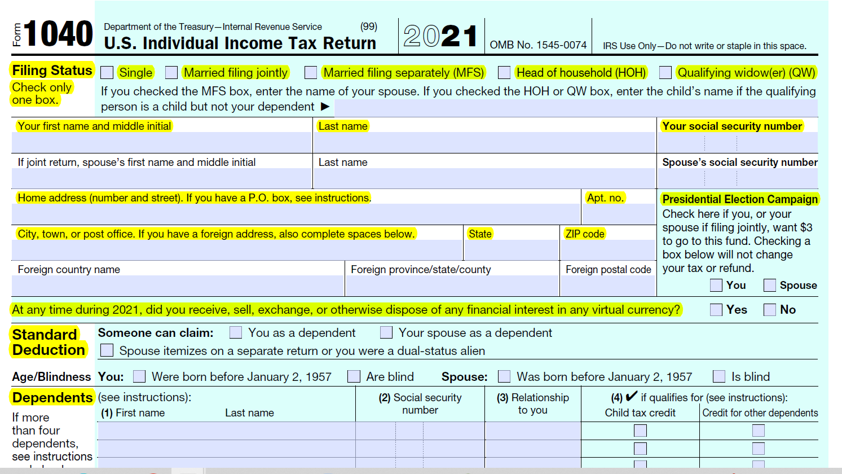
Sample
Notes:
Focus on the highlighted areas to explain the different parts of the form in detail. See file “IRS 1040 Instructions” in lesson plan for more information
Explain that Form 1040 is the official report of your taxes submitted to the IRS. The form is divided into different sections for income and deductions to help them calculate the total amount of taxes they owe. Depending upon the type of income and deductions they have, they may need to complete additional forms (called schedules) as well. Tell students they will be using the information on Billie Does’ W2 to complete a 1040 and calculate the taxes that Billie owes.

Slide 12
Conclusion
Federal income taxes are deducted from most employee’s gross income in each paycheck.
Employers are required to provide employees with a W2 showing information on income, taxes and deductions needed to complete their tax returns (Form 1040).
Taxpayers may choose to use standard deductions or itemized deductions, whichever provides the largest reduction in taxable income.
Notes:
Remind students that paying federal income tax is required of almost all workers in the U.S. Most people have taxes deducted regularly from their paychecks, and the W2 shows the total amount paid during the tax year (which is a calendar year). The IRS provides various forms and regulations to help complete the tax filing process. For example, these regulations provide each taxpayer with the option of taking a standard deduction or an itemized deduction. Also, there are several options and software packages available to help them file their taxes. In addition, they may opt to pay someone to complete the forms for them. It generally costs a minimum of $150 for these services.

Slide 13
Conclusion
The deadline for filing a Form 1040 is April 15.
Tax forms and instructions for completing them are available from various tax software packages and from the Internal Revenue Service web site. Another option is paying someone who specializes in taxes to complete the forms and submit them.
Notes:
Remind students that paying federal income tax is required of almost all workers in the U.S. Most people have taxes deducted regularly from their paychecks, and the W2 shows the total amount paid during the tax year (which is a calendar year). The IRS provides various forms and regulations to help complete the tax filing process. For example, these regulations provide each taxpayer with the option of taking a standard deduction or an itemized deduction. Also, there are several options and software packages available to help them file their taxes. In addition, they may opt to pay someone to complete the forms for them. It generally costs a minimum of $150 for these services.

Slide 14
Group Activity
Work in small groups to prepare a Form 1040 for Billie Does
Billie is a teacher, is single, 28 years old and has no dependents. Billie rents a nice apartment not far from school. Also, Billie’s employer provides a qualified retirement plan as well as pays health insurance for all employees.
Notes:
Put students in groups of two or three. Distribute copies of the completed W2 and the blank 1040. Tell them to use the information from the W2 to complete the 1040 for Billie Does. Additional information about Billie is provided to assist them in completing the form. Tax tables for this activity are found on pages 65-76 of this year’s instructions: https://www.irs.gov/pub/irs-pdf/i1040gi.pdf. If students have internet access, you may want to send them to the instructions to find the correct income and tax liability. Otherwise, you may want to give students a copy of page 68 showing the contents of the tax table needed to complete this lesson. Review their answers after they have completed the activity.

Slide 15
Individual Activity
Tax Time
Directions: Write four things to remember when filing federal income tax.
1._____________________________________
2. _____________________________________
3. _____________________________________
4. _____________________________________
Notes:
Have students write four things to remember when filing federal income tax.

