Slide 1


Let's Talk Turkey: Inflation and the Cost of Thanksgiving Dinner
Information from the American Farm Bureau Federation’s Thanksgiving dinner survey
Notes:
Info is from these websites
2025 https://www.fb.org/market-intel/thanksgiving-dinner-cost-analysis-moderate-decline
2024 https://www.fb.org/market-intel/thanksgiving-dinner-costs-are-down-again

Slide 2
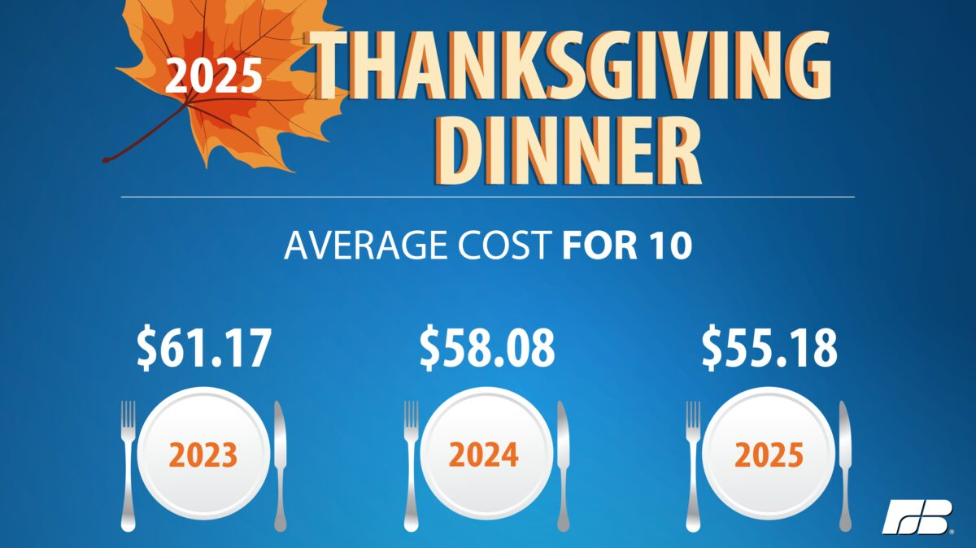


Slide 3
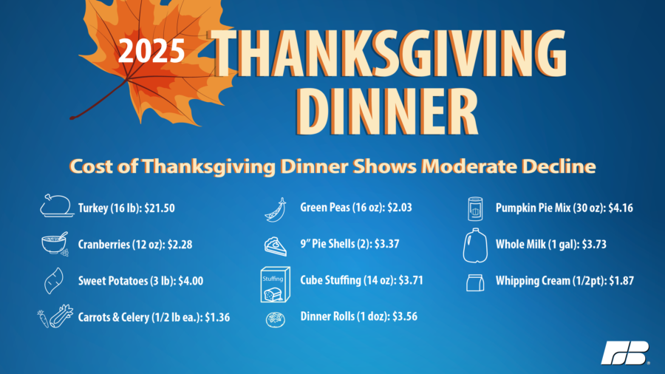

Slide 4
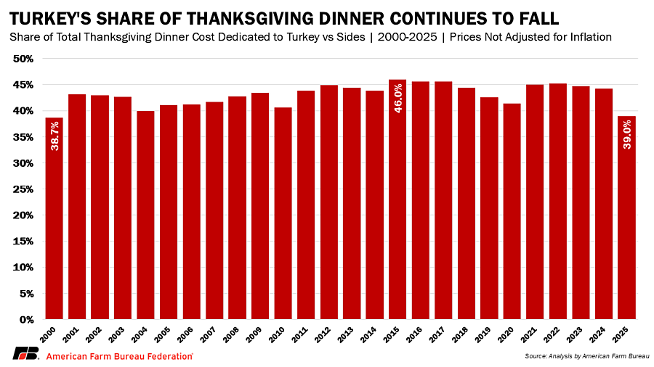

Slide 5
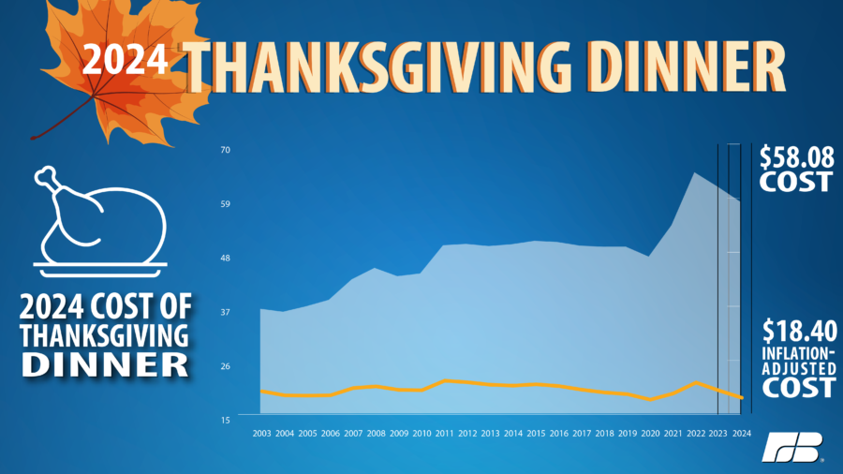
Notes:
This information is from the 2024 report.

Slide 6
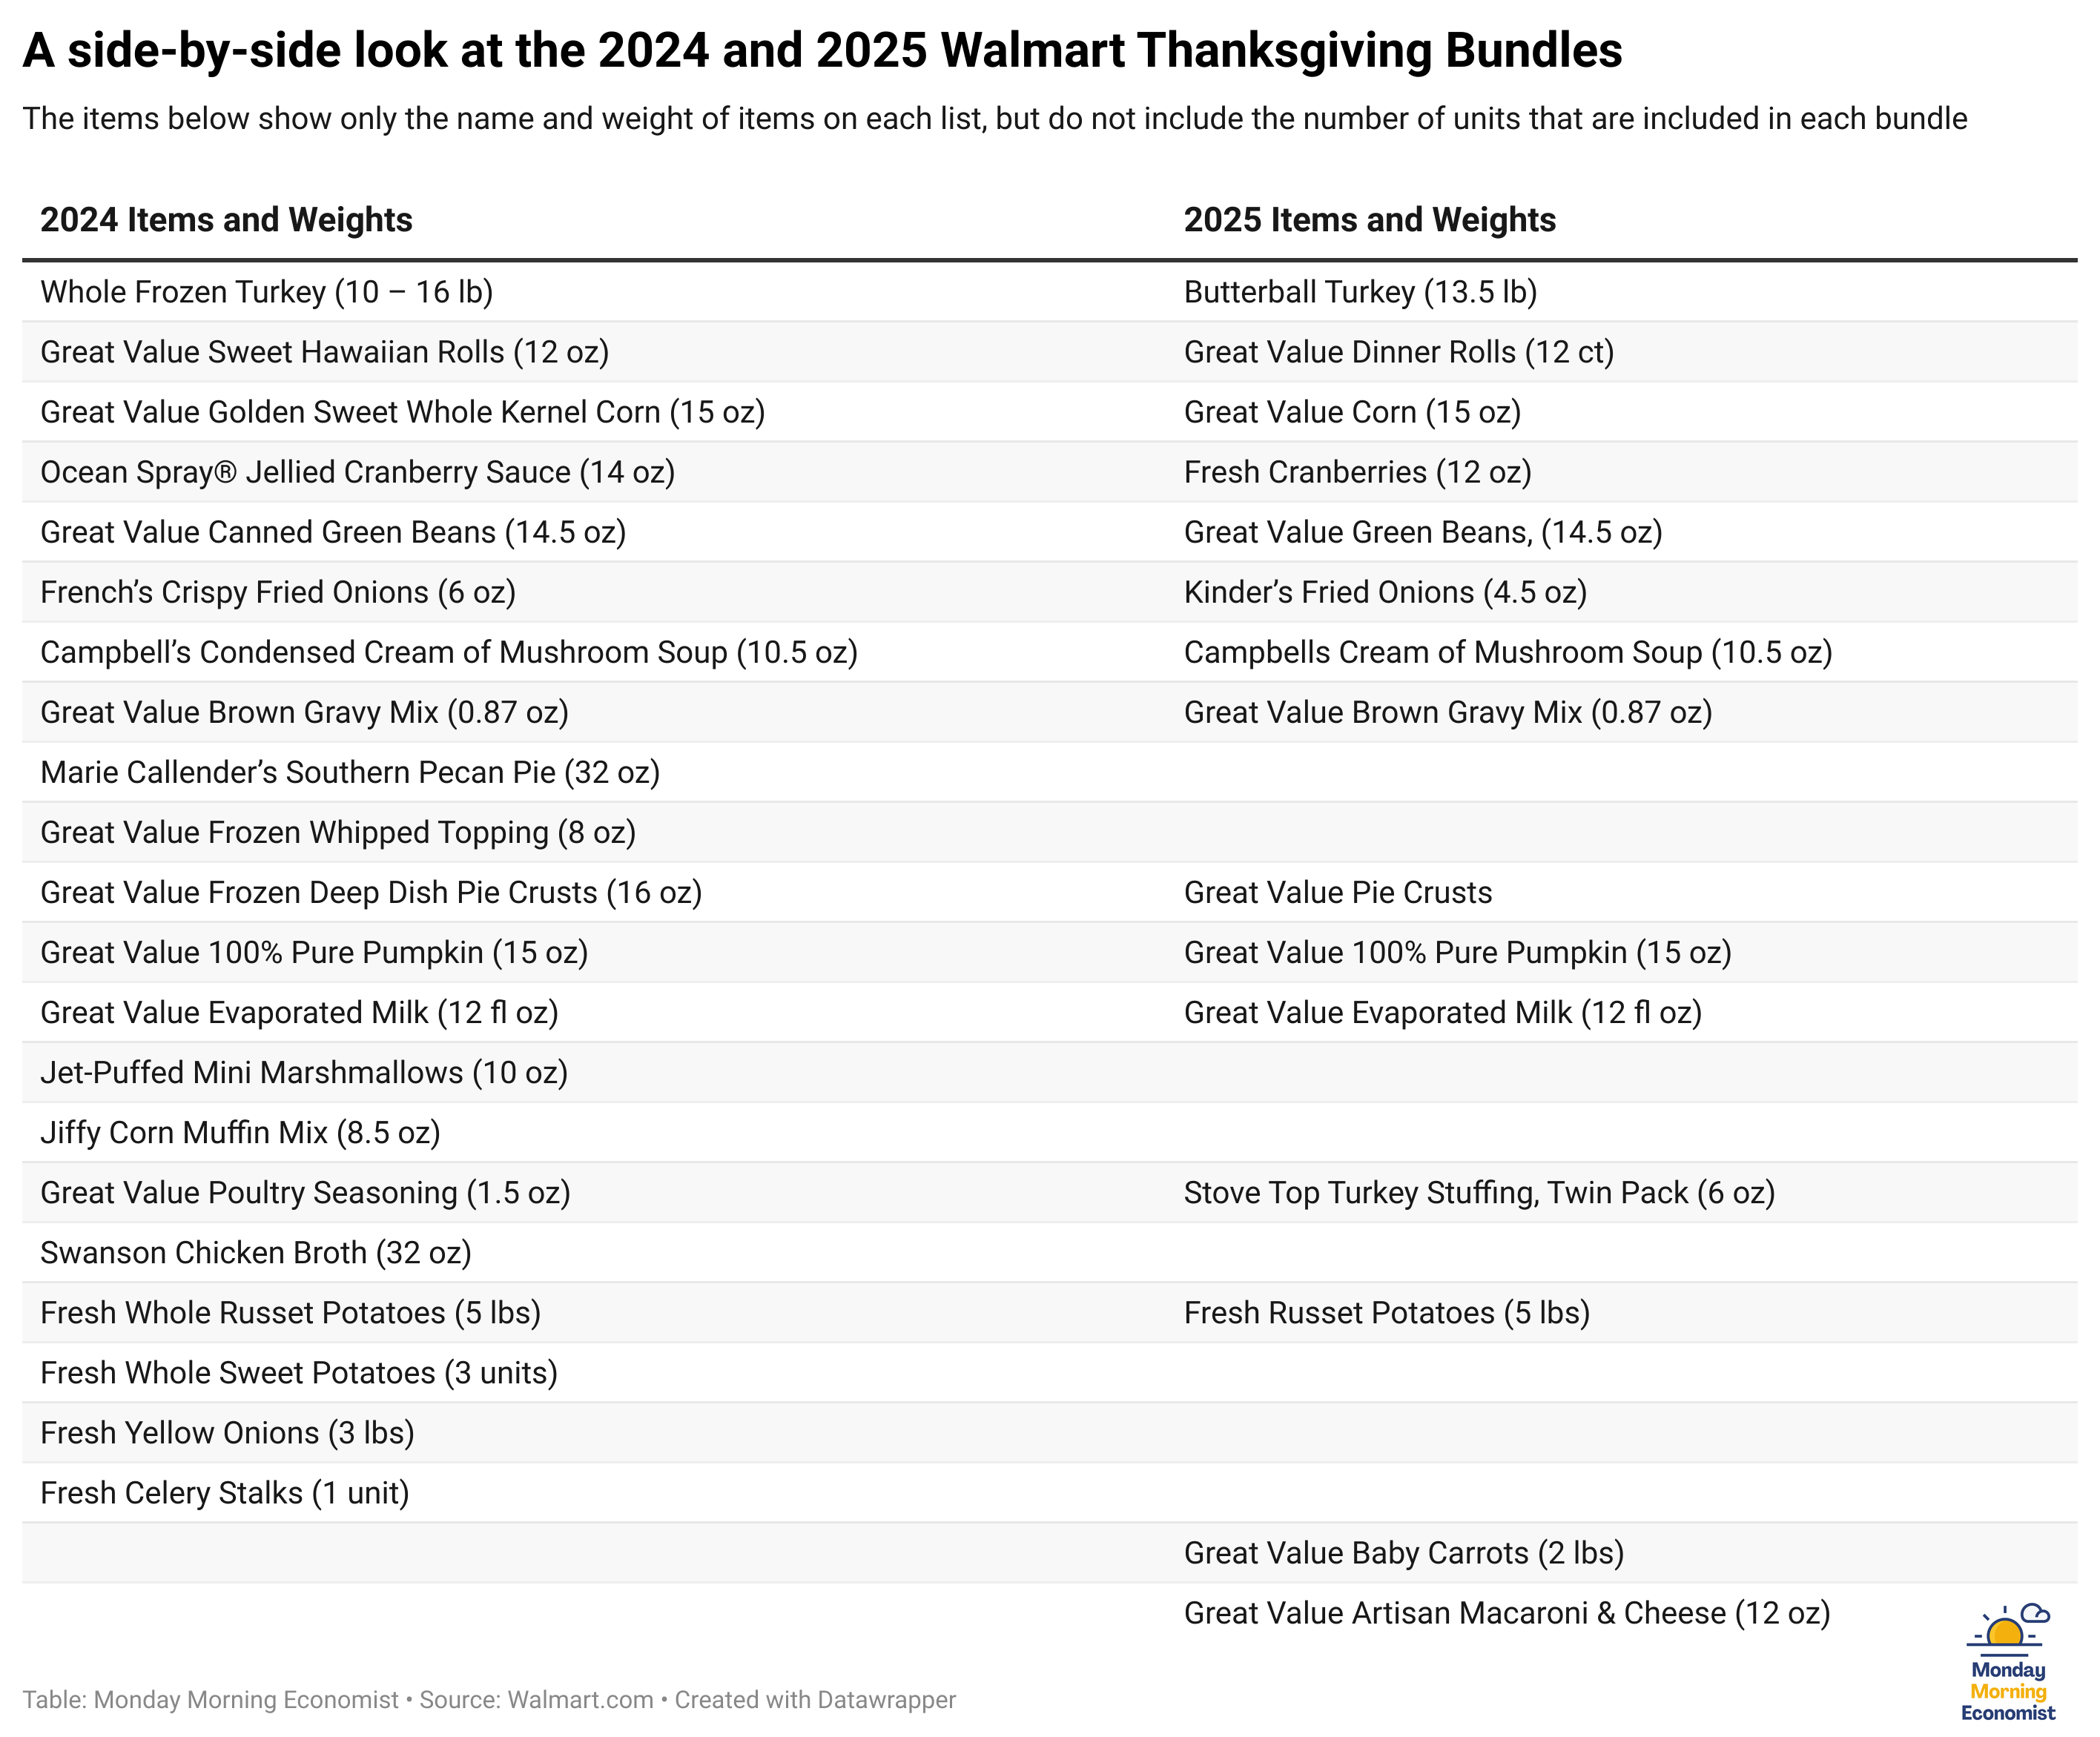
“Monday Morning Economist”

Slide 7
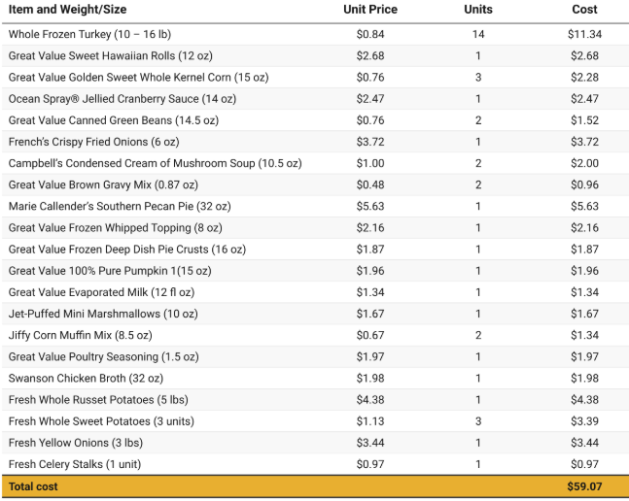
2024 Walmart
Thanksgiving Bundle if purchased in 2025
from “Monday Morning Economist”
Notes:
https://www.mondayeconomist.com/p/walmart-thanksgiving

