Slide 1
Teaching Economics While Cultivating Civil Dialogue
Series
Webinar 1 Lecture-Based
October 4, 2023
6:00-7:00pm ET

Slide 2
Introductions
Mr. Dan Mortensen
President & CEO
Center for Economic Education
Economic Empowerment Project
Dr. Cheryl Ayers, Director

Slide 3
Session Objectives (Lecture-Based)
Identify controversial issues and culturally responsive teaching best-practices that cultivate civility toward opposing economic viewpoints while increasing student engagement.
Understand how to use research-based economic reasoning skills to critically inquire, analyze, discuss, and debate economic topics to develop evidence-based opinions and arguments.

Slide 4
3 Economic Reasoning Skills & Tools
3 Economic Reasoning Skills & Tools #1 Cost-benefit analysis chart #2 PACED decision making model #3 Economic way of thinking 6 principles
Social Studies, English, Science, Math, Personal Finance, Entrepreneurship, Controversial Issues, Life
Real-world Critical Thinking Skills
Economics
Ayers, C. A. (2018). A first step toward a practice-based theory of pedagogical content
knowledge in secondary economics. Journal of Social Studies Research, 42, 61-79.
Ayers, C. A. (2019). Teaching students to ‘think like economists’ as democratic
citizenship preparation. Journal of Social Studies Research, 43(4), 405-419.
Notes:
Research-related backstory on using economics as an objective lens to discuss controversial issue

Slide 5
3 Economic Reasoning Skills (Ayers, 2019)
Simple yet powerful “game-changing” tools!
Student Learning Outcomes
sharpening critical thinking and critical literacy skills
entertaining multiple perspectives
gaining a deeper, nuanced understanding of subject-specific content
making students’ thinking explicit for assessment purposes
achieving a inter/multidisciplinary understanding of current events
using evidence to draw conclusions and make generalizations
articulating and defending positions using content vocabulary
laying the groundwork for authentic discussions and civil debates
casting informed votes
analyzing and synthesizing primary and secondary sources
comparing and contrasting historical, cultural, and political perspectives
explaining cause-and-effect relationships
practicing citizenship skills such as collaborating, compromising, and reaching consensus
thinking like an economist for authentic disciplinary learning (like historical thinking)
making more productive and prosperous workplace and everyday life decisions

Slide 6
Virginia Standards of Learning
CIVICS & ECONOMICS (CE.1) SKILL (8th grade)
The student will demonstrate skills for historical thinking, geographical analysis, economic decision making, and responsible citizenship by
a) analyzing and interpreting evidence from primary and secondary sources, including charts, graphs, and political cartoons;
b) analyzing how political and economic trends influence public policy, using demographic information and other data sources;
c) analyzing information to create diagrams, tables, charts, graphs, and spreadsheets;
d) determining the accuracy and validity of information by separating fact and opinion and recognizing bias;
e) constructing informed, evidence-based arguments from multiple sources;
f) determining multiple cause-and-effect relationships that impact political and economic events;
g) taking informed action to address school, community, local, state, national, and global issues;
h) using a decision-making model to analyze and explain the costs and benefits of a specific choice;
i) applying civic virtue and democratic principles to make collaborative decisions; and
j) defending conclusions orally and in writing to a wide range of audiences, using evidence from sources.
GOVERNMENT (GOVT.1) SKILL (12th grade)
The student will demonstrate skills for historical thinking, geographical analysis, economic decision making, and responsible citizenship by
a) planning inquiries by synthesizing information from diverse primary and secondary sources;
b) analyzing how political and economic trends influence public policy, using demographic information and other data sources;
c) comparing and contrasting historical, cultural, economic, and political perspectives;
d) evaluating critically the quality, accuracy, and validity of information to determine misconceptions, fact and opinion, and bias;
e) constructing informed, analytic arguments, using evidence from multiple sources to introduce and support substantive and significant claims;
f) explaining how cause-and-effect relationships impact political and economic events;
g) taking knowledgeable, constructive action, individually and collaboratively, to address school, community, local, state, national, and global issues;
h) using a decision-making model to analyze the costs and benefits of a specific choice, considering incentives and possible consequences;
i) applying civic virtues and democratic principles to make collaborative decisions; and
j) communicating conclusions orally and in writing to a wide range of audiences, using evidence from multiple sources and citing specific sources.

Slide 7
Teaching
Controversial Issues
& Civil Dialogue
(references in notes section)
Notes:
REFERENCES
Ayers, C. A. (2019). Teaching students to ‘think like economists’ as democratic citizenship preparation. Journal of Social Studies Research, 43(4), 405-419.
Byford, Jeff, et al. ”Teaching Controversial Issues in the Social Studies: A Research Study of High School Teachers, The Clearing House: A Journal of Educational Strategies, Issues and Ideas”, 2009, 82:4, 165-170, DOI: 10.3200/TCHS.82.4.165-170
Journell, W., Ayers, C. A., & Beeson, M. W. (2014). Tweeting in the classroom. Phi Delta Kappan, 95(5), 63-67.
“Managing Controversy.” Diversity in the Classroom | Center for Teaching and Learning, Yale University, 5 Jan. 2018, poorvucenter.yale.edu/teaching/teaching-how/chapter-2-teaching-successful-section/managing-controversy.
Philpott, Sarah, et al. “Controversial Issues: To Teach or Not To Teach? That Is The Question! .” The Georgia Social Studies Journal, The University of Tennessee, Georgia Council for the Social Studies, 2011, coe.uga.edu/assets/downloads/misc/gssj/S-Philpott-et-al-2011.pdf.
“Teaching Controversial Topics.” Center for Teaching and Learning, Yale University, 5 Jan. 2018, poorvucenter.yale.edu/teaching/ideas-teaching/teaching-controversial-topics.
“Difficult Dialogues.” Center for Teaching, Vanderbilt University, https://cft.vanderbilt.edu/guides-sub-pages/difficult-dialogues/#tools.
Kawashima-Ginsberg & Junco (2018). Teaching Controversial Issues in a Time of Polarization. Social Education 82(6), pp. 323-329.
Revolution of One (@revolutionof1) tweeted at 9:06 PM on Fri, Apr 15, 2022: How to develop intellectual integrity.

Slide 8
Controversial Issues & Civil Dialogue
What’s the challenge?
US is Politically Polarized
Americans less likely to hear diverse opinions
(self-selection into like-minded physical and virtual communities)
Media Echo Chambers
Liberals become more liberal and conservatives become more conservative
(scarcity of moderate viewpoints)
Youth Impact
Social media and habits of consuming news
Scarcity of instruction prior to political identities formed then closed off to alternative perspectives
(further polarization toward dominant community narrative)

Slide 9
Controversial Issues Best-Practices
Carefully Align Difficult Topics with Subject Area Learning Goals
Anticipate what “hot button” topics may become controversial to your unique group of students BEFORE the lesson/course begins
Reflect on how such conversations might actually contribute to – rather than detract from – your overall learning objectives
Clearly define course goals in the course syllabus for students and parents; perhaps ask your principal to approve

Slide 10
Controversial Issues Best-Practices
Co-Create and Post Clear Ground Rules
What will and will not be permitted and consequences for violating the rules
Model appropriate thinking and behaviors for students
Explicitly and proactively invite unique and differing experiences and perspectives as valuable parts of social discourse and decision-making in a democracy
EXAMPLES OF GROUND RULES
Argue ideas rather than attacking people
Develop empathy for other viewpoints by actively listening
Paraphrase others’ ideas before responding (don’t assume)
Value insight above being right
Be curious about the gaps in your own arguments
Discover points of connection to reach a compromise

Slide 11
Controversial Issues Best-Practices
Prepare “Intervention” Activities In Advance
Take a break after “hot button” moments and have students write out what they’re feeling or thinking about the conversation before resuming in a more respectful and constructive way
Ask students to write a paper in which they argue for the position with which they most disagree before the debate to help desensitize strong emotions

Slide 12
Scaffolded Economics Instructional Strategy
CONTENT + PEDAGOGY

Slide 13
Scaffolded Economics Instructional Strategy
4 Corners or Poll (Pre-Test)
Background Knowledge
Content Knowledge Research
Tool #1 Cost-Benefit Analysis Chart
Tool #2 PACED Decision Making Model
Tool #3 Economic Way of Thinking 6 Principles
Debate or Essay
4 Corners or Poll (Post-Test)

Slide 14
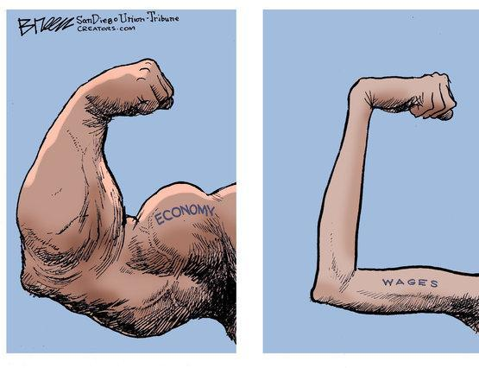
Minimum Wage Topic
Source: US News & World Report - Political Cartoons on the Economy
https://www.usnews.com/cartoons/economy-cartoons?slide=27

Slide 15
4 Corners (Pre-Test)

Slide 16
Background Knowledge
What is a minimum wage?
A minimum wage is the lowest hourly rate that eligible workers can be paid, by law.
Who determines the minimum wage?
Minimum wage laws have been enacted at the federal, state, and local level.
In 1938, the Fair Labor Standards Act established the first federal minimum wage, and it has been updated periodically since then, currently standing at $7.25 per hour.
A number of states, cities, and localities have passed minimum wage laws which establish higher minimum wages than the federal rate.
How is the minimum wage determined?
Economic and political factors influence lawmakers as they determine the minimum wage hourly rate.
Notes:
Federal is $7.25

Slide 17
Background Knowledge
State Minimum Wage Laws | U.S. Department of Labor (dol.gov)
Notes:
Federal is $7.25

Slide 18
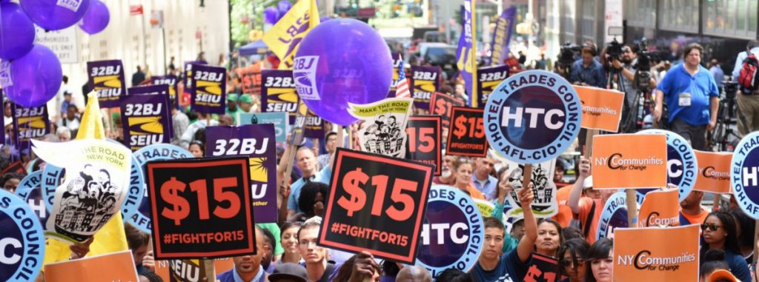
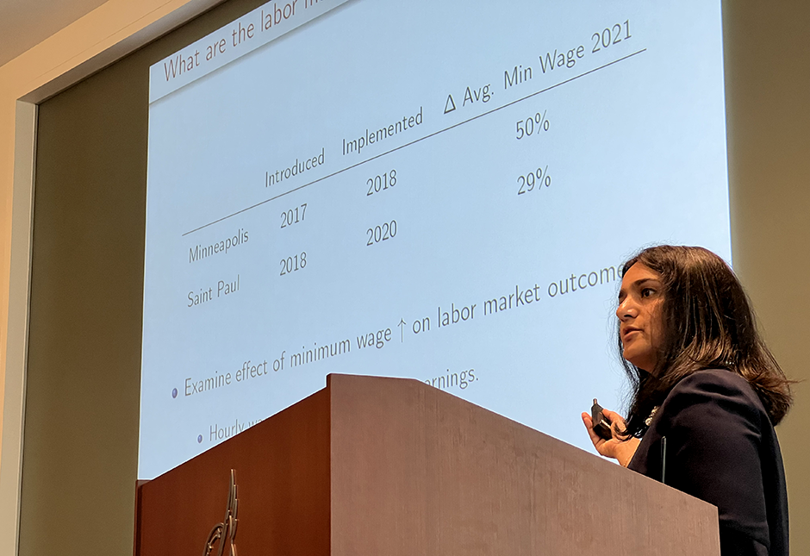
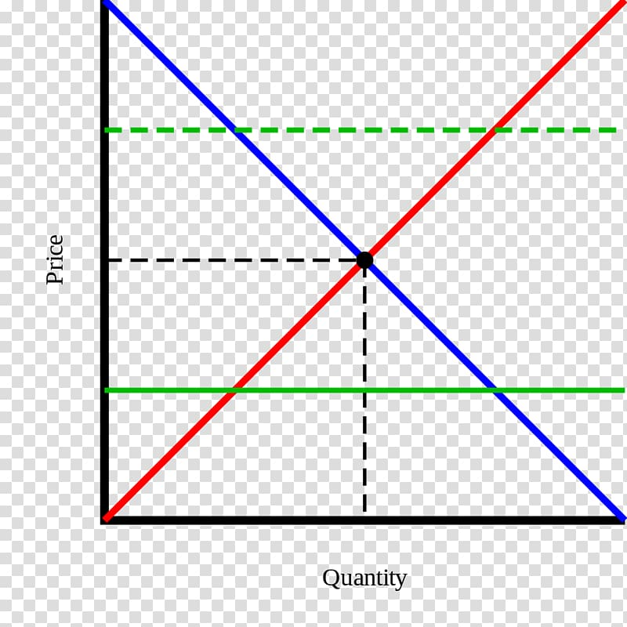
Content Knowledge Research
$15 Minimum Wage COSTS
Many people earning minimum wage are not a family’s primary source of income “Minimum wage in America: how many people are earning $7.25 an hour?” USA Facts March 28, 2023 https://usafacts.org/articles/minimum-wage-america-how-many-people-are-earning-725-hour/
Increases costs for a company with no corresponding increase in productivity “Should the Federal Minimum Wage Be Increased?” ProCon.org, January 12, 2023
https://minimum-wage.procon.org/
History shows that minimum wage increases result in reductions in hours and jobs
Stokes, “Fed researchers: $15 minimum wage in Minneapolis and St. Paul boosted pay – but cost jobs” MinnPost, May 9, 2023
https://www.minnpost.com/metro/2023/05/fed-researchers-15-minimum-wage-in-minneapolis-and-st-paul-boosted-pay-but-cost-jobs/
Increases the price of consumer goods as businesses pass along additional costs “Should the Federal Minimum Wage Be Increased?” ProCon.org, January 12, 2023
https://minimum-wage.procon.org/
Price floors disrupt markets (supply and demand), resulting in inefficiencies
Bourne, “The Case Against a $15 Federal Minimum Wage: Q&A” Cato Institute, February 25, 2021
https://www.cato.org/commentary/case-against-15-federal-minimum-wage-qa?utm_campaign=Regulation%20Roundup%20Newsletter&utm_medium=email&_hsmi=1178...%201/19%20tnemyolpme%20ni%20eb%20lliw%20srekrow%20rewef%20noillim

Slide 19
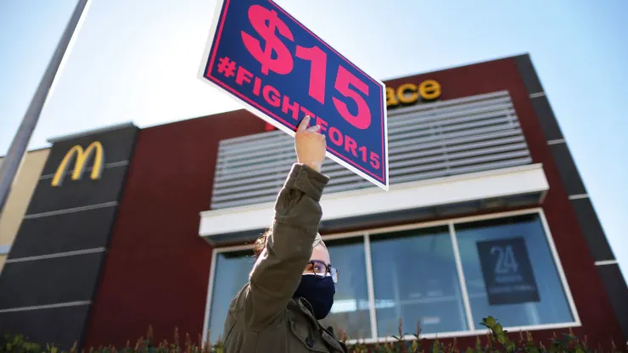
Content Knowledge Research
$15 Minimum Wage BENEFITS
Provides a “living wage” for families and reduces poverty
Leonhardt, “How raising minimum wage to $15 per hour could affect workers and small businesses” CNBC.com, February 24, 2021
https://www.cnbc.com/2021/02/24/minimum-wage-15-dollars-per-hour-brings-benefits-consequences.html
Reduces government welfare spending
Buchwald, “A $15 minimum wage could cut government spending on welfare programs by up to $30 billion, study finds” MarketWatch, February 2, 2021
https://www.marketwatch.com/story/a-15-minimum-wage-could-cut-government-spending-on-welfare-programs-by-up-to-30-billion-study-finds-11612290567
Increases consumer spending and grows the economy “Should the Federal Minimum Wage Be Increased?” ProCon.org, January 12, 2023 https://minimum-wage.procon.org/
Incentivizes more people to enter the workforce “A $15 minimum wage changes more than just take-home pay U.S. Bureau of Labor Statistics” Monthly Labor Report September 2021
https://www.bls.gov/opub/mlr/2021/beyond-bls/a-15-minimum-wage-changes-more-than-just-take-home-pay.htm
Reduces income inequality
Maverick, “What Are the Pros and Cons of Raising the Minimum Wage” Investopedia, August 26, 2023 https://www.investopedia.com/articles/markets-economy/090516/what-are-pros-and-cons-raising-minimum-wage.asp

Slide 20
Tool #1 Cost-Benefit Analysis Chart
Instructional Tips
In-depth analysis of a single alternative/choice
To do or not to do something
Consider short-term and long-term costs and benefits
Incorporate multiple perspectives
Use weights to identify what is more/less important
Apply to past, present, and future choices
COSTS
BENEFITS
Opportunity Cost and Tradeoffs by MRU
Video 4:38

Slide 21
Tool #1 Cost-Benefit Analysis Chart
CHOICE: To Be a Teacher
1=not at all important 3=average importance 5=very important
COSTS (disadvantages/given up) | 1-5 | BENEFITS (advantages/gained) | 1-5
Totals |  | Totals
DECISION:
OPPORTUNITY COST:
Give up free time on weekends
3
Developing young minds for future
4
Dealing with disciplinary problems
2
Summers off
5
Not a high salary
1
6
9
Become a teacher
Give up free time on weekends

Slide 22
Tool #1 Cost-Benefit Analysis Chart
CHOICE: Raise the minimum wage to $15
1=not at all important 3=average importance 5=very important
COSTS (disadvantages/given up) | 1-5 | BENEFITS (advantages/gained) | 1-5
Totals |  | Totals
DECISION:
OPPORTUNITY COST:
1. Complete individually (add your own costs and benefits)
2. Compare scores and discuss decision
3. Add classmates’ new costs and benefits
4. Rescore
5. If applicable, discuss new decision (If it changed, why?)

Slide 23
Tool #2 PACED Decision-Making Model
Instructional Tips
Choosing among multiple alternatives/choices
Important criteria to consider
Past, present, and future choices
State the Problem.
List the Alternatives.
Determine the Criteria.
Evaluate the alternatives.
Make a Decision.
Marginal Thinking and the Sunk Cost Fallacy by MRU
Video 6:19

Slide 24
Tool #2: PACED Decision Making Model
1. Question/Problem: Which profession should I choose?
3. Criteria 2. Alternatives | Help People | Make over $100K | Requires BS only | Enjoy | Totals
Nurse
Dentist
Police
3
1
2
1
7
4. Evaluate the Alternatives
3 = alternative meets criteria
very well
2 = alternative meets criteria
satisfactorily
1 = alternative does not meet
criteria satisfactorily
3
3
1
2
9
3
1
3
3
10
5. Decision (highest scoring alternative): _______________________________
Opportunity Cost (second highest scoring alternative): _______________________
Police
Dentist
Notes:
Cannot use a “0” to evaluate when using weights b/c automatically negates weight value

Slide 25
Tool #2: PACED Decision Making Model
1. Question/Problem: Which profession should I choose?
3. Criteria 2. Alternatives | Help People | Make over $100K | Requires BS only | Enjoy | Totals
Nurse
Dentist
Police
20
50
20
10
3
1
2
1
10
7
160
4. Evaluate the Alternatives
3 = alternative meets criteria
very well
2 = alternative meets criteria
satisfactorily
1 = alternative does not meet
criteria satisfactorily
60
50
40
3
3
150
1
2
9
60
20
20
250
3
1
3
3
10
60
50
60
30
200
Dentist
5. Decision (highest scoring alternative): ________________________
Opportunity Cost (second highest scoring alternative): _______________________
Police

Slide 26
Tool #2 PACED Decision-Making Model
1. Question/Problem: What should be done with minimum wage (assume currently at $7.25)?
3. Criteria 2. Alternatives | Help Employees | Help Employers | Incentivize Higher Ed | Reduce Unemployment | Totals
Leave at $7.25
Raise to $15.00
Raise to $50.00
85
5
5
5
4. Evaluate the Alternatives
3 = alternative meets criteria
very well
2 = alternative meets criteria
satisfactorily
1 = alternative does not meet
criteria satisfactorily
5. Decision (highest scoring alternative): _______________________________
Complete as a group and reach consensus on evaluation numbers

Slide 27
Tool #1 Cost-Benefit Analysis Chart
Tool #2 PACED Decision-Making Model
Whole Class
Application on Google Docs!
Graphic Organizer for Primary and Secondary Sources!

Slide 28
Tool #3 Economic Way of Thinking 6 Principles
Inquiry-based Learning 101
Qualitative framework for cost-benefit & PACED

Slide 29
Tool #3 Economic Way of Thinking 6 Principles
People choose.
-Scarcity (limited resources meet unlimited wants)
-Benefits outweigh costs (rational decision-making)
People’s choices involve costs.
-Opportunity cost (second favorite alternative forgone)
-Often nonmonetary – using a resource one way prohibits using it
another way
-Always!

Slide 30
Tool #3 Economic Way of Thinking 6 Principles
People respond to incentives in predictable ways.
-Incentives motivate certain behaviors
-Positive (rewards) or negative (punishments)
-Trophies, coupons, profits, and not being re/elected
People create economic systems that influence individual choices and incentives.
-Formal and informal “rules of the game” determine
incentives thus behaviors
-Traditional, command, market, and mixed economies
-Characteristics of a market economy (competition, profit motive, etc.)

Slide 31
Tool #3 Economic Way of Thinking 6 Principles
People gain when they trade voluntarily.
-Voluntarily get something that is more valuable than what is given up
-Comparative advantage – produce what incurs lowest opportunity cost
(specialization) and then trade (interdependence)
-Win-Win
People’s choices have consequences that lie in the future.
-Unintended and intended consequences – future costs and benefits
-Long-run perspective

Slide 32
Tool #3 Economic Way of Thinking 6 Principles
Qualitative framework for cost-benefit & PACED
People choose.
People’s choices involve costs.
People respond to incentives in predictable ways.
People create rules and economic systems that influence individual choices and incentives.
People gain when they trade voluntarily.
People’s choices have consequences that lie in the future.
Teaches students to “think like an economist” using inquiry-based learning and a set of time/culture-tested assumptions about human behaviors
Framework utilizes accessible, basic economic concepts as a starting point from which to make sense of everyday “mysteries” that seem at odds with ordinary experience and judgment
Avoids trivializing less obvious causes and invoking premature ideas that act as thought-stoppers yet is a streamlined approach to sifting through useless information
Develops critical thinking skills in academics, workplace, and life – ECONOMICS IS A LIFE SKILL!

Slide 33
Tool #3 Economic Way of Thinking 6 Principles
Complete as a group

Slide 34
Tool #3 Economic Way of Thinking 6 Principles
Topic = Raise MW to $15
Group 1 = Employees
Group 2 = Employers

Slide 35
Tool #3 Economic Way of Thinking 6 Principles
Assessments:
Self
Peer
Debate

Slide 36
DEBATE – Opening Arguments
State FOR or AGAINST raising minimum wage to $15/hour.
Share one brief argument through the lens of an Economic Reasoning Tool.
People choose.
People’s choices involve costs.
People respond to incentives in predictable ways.
People create rules and economic systems that influence individual choices and incentives.
People gain when they trade voluntarily.
People’s choices have consequences that lie in the future.

Slide 37
4 Corners (Post-Test)

Slide 38
WRAP-UP
“I want my students to learn how to really listen to one another and understand the perspectives of their classmates. I want to encourage my students to come to class with an open mind, willingness to learn from their peers, and respect for differences.”
Tool #3: Cost-Benefit Analysis RUBRIC
Assessments:
Self
Peer
Debate

Slide 39
Dan Mortensen
drmortensen@vcu.edu
Cheryl Ayers
cheryl42@vt.edu
Google Drive Folder - Content & Pedagogy Resources
https://drive.google.com/drive/folders/1kx9iF_BEv_CUMi7rN9dcpceI3BOhR4xL?usp=sharing
(additional resources on subsequent slides)

Slide 40
MORE SLIDES & RESOURCES
Tool #3: Cost-Benefit Analysis RUBRIC
Assessments:
Self
Peer
Debate

Slide 41
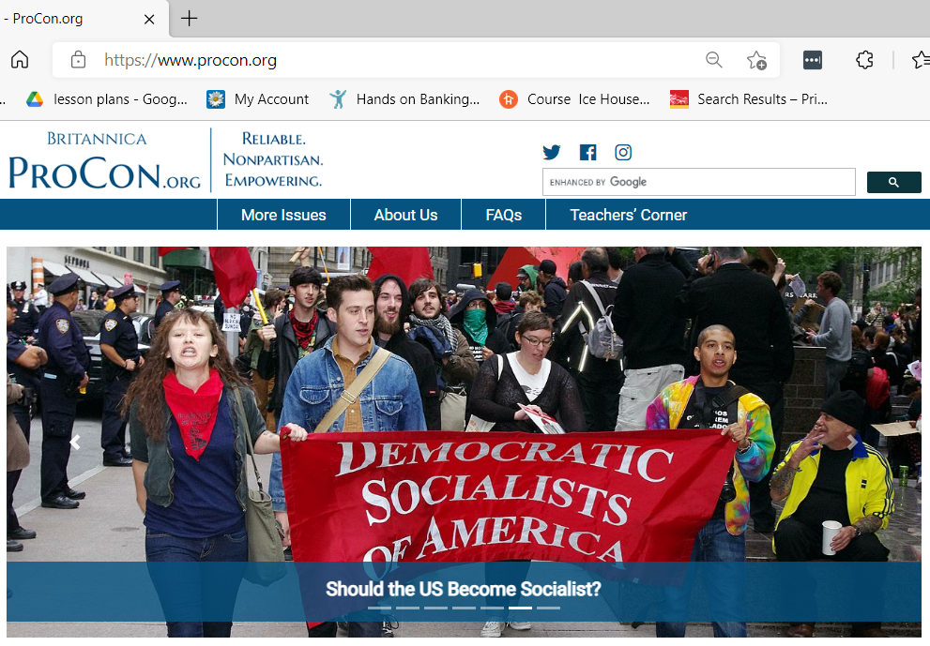
Other Resources

Slide 42
Other Resources
Economics 101
Scarcity and Choice (4:35)
http://www.youtube.com/watch?v=yoVc_S_gd_0
Intro to Economics: Crash Course (12:08)
https://www.youtube.com/watch?v=3ez10ADR_gM&t=5s
Economic Education Podcasts
Think Like an Economist
https://podcasts.apple.com/us/podcast/think-like-an-economist/id1523898793
Planet Money
https://www.npr.org/podcasts/510289/planet-money
Freakanomics
https://freakonomics.com/category/podcasts/
EconEdLink
https://www.econedlink.org/
MRU EconInBox Current Events Subscription
https://www.econinbox.com/

Slide 43
Other Resources
Vanderbilt University, Center for Teaching, Difficult Dialogues
https://cft.vanderbilt.edu/guides-sub-pages/difficult-dialogues/#tools
iCivics
https://www.icivics.org
Teaching for Democracy Alliance
http://www.teachingfordemocracy.org
St. Louis Fed Minimum Wage Debate
https://www.stlouisfed.org/education/structured-minimum-wage-debate?s=03
Education World
http://www.educationworld.com/a_lesson/lesson/lesson304.shtml
Sphere: Teaching Civic Culture Together
https://www.sphere-ed.org
Educational Technology Tools
Nearpod, GoSoapBox, Padlet, Pear Deck, Google Jamboard

Slide 44
Debate Format Example
30 second opening position statement (no specifics) – For
30 second opening position statement (no specifics) – Opposed
3 minute position argument (3 main points) – For
3 minute position argument (3 main points) – Opposed
5 minute work period
2 minute rebuttal (respond to 3 main points) – For
2 minute rebuttal (respond to 3 main points) – Opposed
3 minute work period
2 minute response – For
2 minute response – Opposed
1 minute work period
1 minute position summary and closing statement – Opposed
1 minute position summary and closing statement – For

Slide 45
Debate Rubric Example
Debate Performance Criteria | Score
Uses one or more of the 3 Economic Way of Thinking Tools
Stays on topic
Supports arguments with evidence
Delivers persuasiveness
Demonstrates teamwork
Shows responsiveness to opposing team’s arguments
1=Needs More Practice 5=Join the Debate Club 10=Debate Stage Ready

Slide 46
Controversial Issues & Civil Dialogue
Why is it important to teach students to discuss/deliberate/debate controversial issues?
TEACHER REFLECTIONS
“I want my students to learn how to really listen to one another and understand the perspectives of their classmates. I want to encourage my students to come to class with an open mind, willingness to learn from their peers, and respect for differences.”
“My goals for student learning include introspection, reflection, and critical thinking skills, all of which are fostered in dialogue with peers about topics that make them step outside their comfort zones.”
“The appeal of ‘the hard stuff’ is that it encourages students to think critically about social life, that is, to question what they learn and make meaning from what they learn, to synthesize information from various sources, and to evaluate ideas.”
Notes:
Quotes from teachers

