Slide 1
Teaching Economics While Cultivating Civil Dialogue
Series
Webinar 2 Activity-Based
October 11, 2023
6:00-7:00pm ET

Slide 2
Introductions
Mr. Dan Mortensen
President & CEO
Center for Economic Education
Economic Empowerment Project
Dr. Cheryl Ayers, Director

Slide 3
Session Objectives (Activity-Based)
Apply research-based economic reasoning skills to critically inquire, analyze, discuss, and debate economic topics to develop evidence-based opinions.
Practice controversial issues and culturally responsive teaching best-practices that cultivate civility toward opposing viewpoints while increasing student engagement.

Slide 4
3 Economic Reasoning Skills & Tools
3 Economic Reasoning Skills & Tools #1 Cost-benefit analysis chart #2 PACED decision making model #3 Economic way of thinking 6 principles
Social Studies, English, Science, Math, Personal Finance, Entrepreneurship, Controversial Issues, Life
Real-world Critical Thinking Skills
Economics
Ayers, C. A. (2018). A first step toward a practice-based theory of pedagogical content
knowledge in secondary economics. Journal of Social Studies Research, 42, 61-79.
Ayers, C. A. (2019). Teaching students to ‘think like economists’ as democratic
citizenship preparation. Journal of Social Studies Research, 43(4), 405-419.
Notes:
Research-related backstory on using economics as an objective lens to discuss controversial issue

Slide 5
3 Economic Reasoning Skills (Ayers, 2019)
Simple yet powerful “game-changing” tools!
Student Learning Outcomes
sharpening critical thinking and critical literacy skills
entertaining multiple perspectives
gaining a deeper, nuanced understanding of subject-specific content
making students’ thinking explicit for assessment purposes
achieving a inter/multidisciplinary understanding of current events
using evidence to draw conclusions and make generalizations
articulating and defending positions using content vocabulary
laying the groundwork for authentic discussions and civil debates
casting informed votes
analyzing and synthesizing primary and secondary sources
comparing and contrasting historical, cultural, and political perspectives
explaining cause-and-effect relationships
practicing citizenship skills such as collaborating, compromising, and reaching consensus
thinking like an economist for authentic disciplinary learning (like historical thinking)
making more productive and prosperous workplace and everyday life decisions

Slide 6
Teaching
Controversial Issues
& Civil Dialogue
(references in notes section)
Notes:
REFERENCES
Ayers, C. A. (2019). Teaching students to ‘think like economists’ as democratic citizenship preparation. Journal of Social Studies Research, 43(4), 405-419.
Byford, Jeff, et al. ”Teaching Controversial Issues in the Social Studies: A Research Study of High School Teachers, The Clearing House: A Journal of Educational Strategies, Issues and Ideas”, 2009, 82:4, 165-170, DOI: 10.3200/TCHS.82.4.165-170
Journell, W., Ayers, C. A., & Beeson, M. W. (2014). Tweeting in the classroom. Phi Delta Kappan, 95(5), 63-67.
“Managing Controversy.” Diversity in the Classroom | Center for Teaching and Learning, Yale University, 5 Jan. 2018, poorvucenter.yale.edu/teaching/teaching-how/chapter-2-teaching-successful-section/managing-controversy.
Philpott, Sarah, et al. “Controversial Issues: To Teach or Not To Teach? That Is The Question! .” The Georgia Social Studies Journal, The University of Tennessee, Georgia Council for the Social Studies, 2011, coe.uga.edu/assets/downloads/misc/gssj/S-Philpott-et-al-2011.pdf.
“Teaching Controversial Topics.” Center for Teaching and Learning, Yale University, 5 Jan. 2018, poorvucenter.yale.edu/teaching/ideas-teaching/teaching-controversial-topics.
“Difficult Dialogues.” Center for Teaching, Vanderbilt University, https://cft.vanderbilt.edu/guides-sub-pages/difficult-dialogues/#tools.
Kawashima-Ginsberg & Junco (2018). Teaching Controversial Issues in a Time of Polarization. Social Education 82(6), pp. 323-329.
Revolution of One (@revolutionof1) tweeted at 9:06 PM on Fri, Apr 15, 2022: How to develop intellectual integrity.

Slide 7
Controversial Issues & Civil Dialogue
Challenges
US is Politically Polarized
Media Echo Chambers
Youth Impact
Best Practices
Carefully Align Difficult Topics with Subject Area Learning Goals
Co-Create and Post Clear Ground Rules
Prepare “Intervention” Activities In Advance

Slide 8
Scaffolded Economics Instructional Strategy
CONTENT + PEDAGOGY

Slide 9
Scaffolded Economics Instructional Strategy
4 Corners or Poll (Pre-Test)
Background Knowledge
Content Knowledge Research
Tool #1 Cost-Benefit Analysis Chart
Tool #2 PACED Decision Making Model
Tool #3 Economic Way of Thinking 6 Principles
Debate or Essay
4 Corners or Poll (Post-Test)

Slide 10
4 Corners (Pre-Test)

Slide 11
Background Knowledge
What is a minimum wage?
Who determines the minimum wage?
How is the minimum wage determined?
State Minimum Wage Laws | U.S. Department of Labor (dol.gov)
Notes:
Federal is $7.25

Slide 12
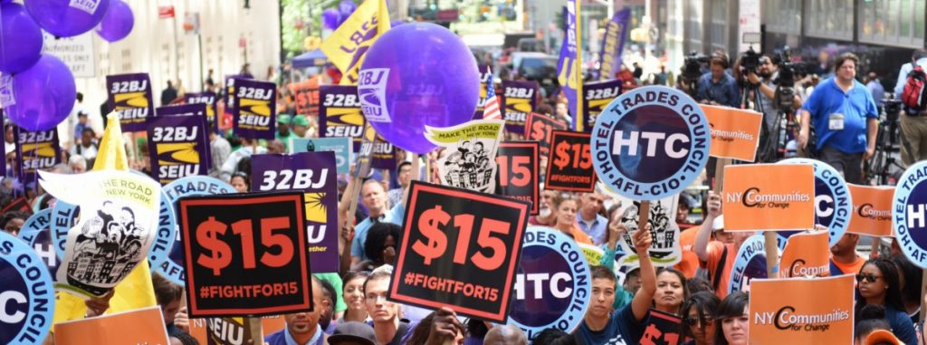
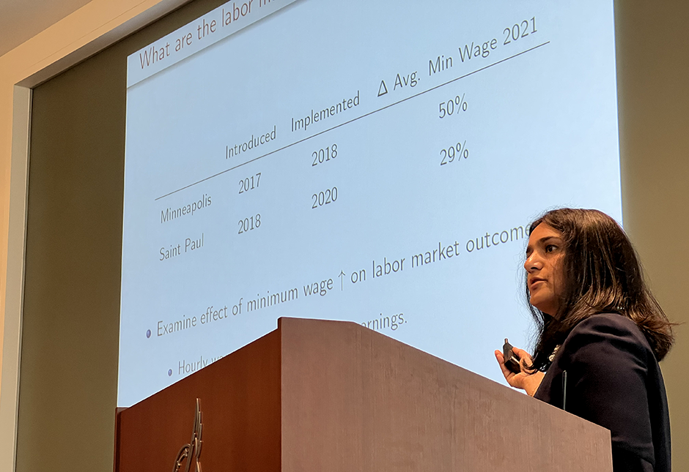
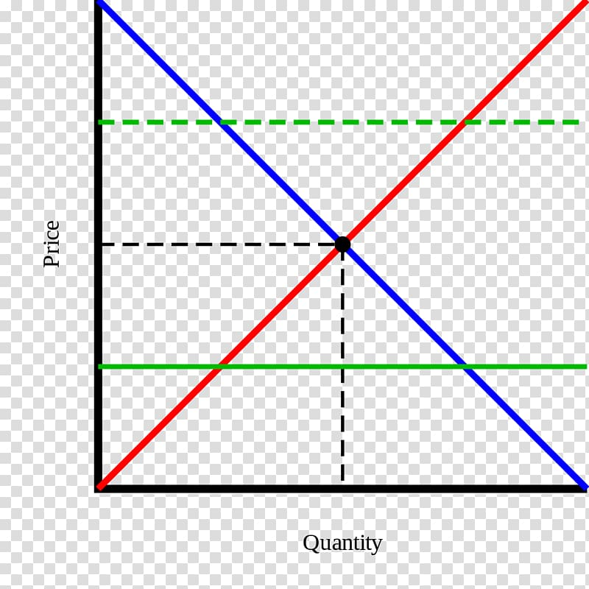
Content Knowledge Research
$15 Minimum Wage COSTS
Many people earning minimum wage are not a family’s primary source of income “Minimum wage in America: how many people are earning $7.25 an hour?” USA Facts March 28, 2023 https://usafacts.org/articles/minimum-wage-america-how-many-people-are-earning-725-hour/
Increases costs for a company with no corresponding increase in productivity “Should the Federal Minimum Wage Be Increased?” ProCon.org, January 12, 2023
https://minimum-wage.procon.org/
History shows that minimum wage increases result in reductions in hours and jobs
Stokes, “Fed researchers: $15 minimum wage in Minneapolis and St. Paul boosted pay – but cost jobs” MinnPost, May 9, 2023
https://www.minnpost.com/metro/2023/05/fed-researchers-15-minimum-wage-in-minneapolis-and-st-paul-boosted-pay-but-cost-jobs/
Increases the price of consumer goods as businesses pass along additional costs “Should the Federal Minimum Wage Be Increased?” ProCon.org, January 12, 2023
https://minimum-wage.procon.org/
Price floors disrupt markets (supply and demand), resulting in inefficiencies
Bourne, “The Case Against a $15 Federal Minimum Wage: Q&A” Cato Institute, February 25, 2021
https://www.cato.org/commentary/case-against-15-federal-minimum-wage-qa?utm_campaign=Regulation%20Roundup%20Newsletter&utm_medium=email&_hsmi=1178...%201/19%20tnemyolpme%20ni%20eb%20lliw%20srekrow%20rewef%20noillim

Slide 13
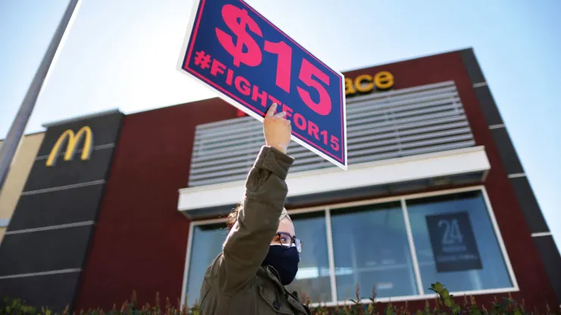
Content Knowledge Research
$15 Minimum Wage BENEFITS
Provides a “living wage” for families and reduces poverty
Leonhardt, “How raising minimum wage to $15 per hour could affect workers and small businesses” CNBC.com, February 24, 2021
https://www.cnbc.com/2021/02/24/minimum-wage-15-dollars-per-hour-brings-benefits-consequences.html
Reduces government welfare spending
Buchwald, “A $15 minimum wage could cut government spending on welfare programs by up to $30 billion, study finds” MarketWatch, February 2, 2021
https://www.marketwatch.com/story/a-15-minimum-wage-could-cut-government-spending-on-welfare-programs-by-up-to-30-billion-study-finds-11612290567
Increases consumer spending and grows the economy “Should the Federal Minimum Wage Be Increased?” ProCon.org, January 12, 2023 https://minimum-wage.procon.org/
Incentivizes more people to enter the workforce “A $15 minimum wage changes more than just take-home pay U.S. Bureau of Labor Statistics” Monthly Labor Report September 2021
https://www.bls.gov/opub/mlr/2021/beyond-bls/a-15-minimum-wage-changes-more-than-just-take-home-pay.htm
Reduces income inequality
Maverick, “What Are the Pros and Cons of Raising the Minimum Wage” Investopedia, August 26, 2023 https://www.investopedia.com/articles/markets-economy/090516/what-are-pros-and-cons-raising-minimum-wage.asp

Slide 14
Tool #1 Cost-Benefit Analysis Chart
CHOICE: Raise the minimum wage to $15
1=not at all important 3=average importance 5=very important
COSTS (disadvantages/given up) | 1-5 | BENEFITS (advantages/gained) | 1-5
Totals |  | Totals
DECISION:
Many people earning minimum wage are not a family’s primary source of income
Provides a “living wage” for families and reduces poverty
Increases costs for a company with no corresponding increase in productivity
Reduces government welfare spending
History shows minimum wage increases result in reductions in hours and jobs
Increases consumer spending and grows the economy
Increases the price of consumer goods as businesses pass along additional costs
Incentivizes more people to enter the workforce
Price floors disrupt markets (supply and demand), resulting in inefficiencies
Reduces income inequality
Other?
Other?

Slide 15
Tool #1 Cost-Benefit Analysis Chart
Individual + Group Work
Individual Work
Add your own costs and benefits then add weights and scores
(File > Download > Microsoft Word > Open file > Enable Editing)
https://docs.google.com/document/d/16jbncTspakz0W_RqcvLPnqrvwEMylc4E/edit?usp=sharing&ouid=106711205687622442230&rtpof=true&sd=true
Group Work
1. Compare scores and discuss decisions
2. Add classmates’ new costs and benefits
3. Rescore and discuss new decisions, if applicable
(i.e., Why did your score change?)
Notes:
https://docs.google.com/document/d/16jbncTspakz0W_RqcvLPnqrvwEMylc4E/edit?usp=sharing&ouid=106711205687622442230&rtpof=true&sd=true

Slide 16
Tool #2: PACED Decision Making Model
1. Question/Problem: What should be done with minimum wage (assume currently at $7.25)?
3. Criteria 2. Alternatives |  |  |  |  | Totals
Leave at $7.25
Raise to $15.00
Raise to $50.00
Help Employees
Help Employers
Incentivize Higher Ed
Reduce Unemploy-
ment
1
3
3
2
9
4. Evaluate the Alternatives
3 = alternative meets criteria
very well
2 = alternative meets criteria
satisfactorily
1 = alternative does not meet
criteria satisfactorily
3
2
2
3
10
3
1
1
1
6
5. Decision (highest scoring alternative): ________________________
Raise to $15.00
Complete as a group and reach consensus on evaluation numbers

Slide 17
Tool #2: PACED Decision Making Model
1. Question/Problem: What should be done with minimum wage (assume currently at $7.25)?
3. Criteria 2. Alternatives |  |  |  |  | Totals
Leave at $7.25
Raise to $15.00
Raise to $50.00
Help Employees
Help Employers
Incentivize Higher Ed
Reduce Unemploy-
ment
20
70
5
5
1
3
3
2
10
9
255
4. Evaluate the Alternatives
3 = alternative meets criteria
very well
2 = alternative meets criteria
satisfactorily
1 = alternative does not meet
criteria satisfactorily
20
210
15
3
2
140
2
3
10
60
10
15
225
3
1
1
1
6
60
70
5
5
140
5. Decision (highest scoring alternative): ________________________
Leave at $7.25
Complete as a group and reach consensus on evaluation numbers

Slide 18
Tool #3 Economic Way of Thinking 6 Principles
People choose.
People’s choices involve costs.
People respond to incentives in predictable ways.
People create rules and economic systems that influence individual choices and incentives.
People gain when they trade voluntarily.
People’s choices have consequences that lie in the future.

Slide 19
Tool #3 Economic Way of Thinking 6 Principles
AGAINST: Because employers have limited resources, they have to make choices between raising wages and lowering prices.
AGAINST: By increasing the wages of employees, it costs employers the opportunity to hire more workers.
FOR: A higher wage is a positive incentive for employees to show up on time and keep a job.

Slide 20
Tool #3 Economic Way of Thinking 6 Principles

Slide 21
Tool #3 Economic Way of Thinking 6 Principles
Individual Work
Write Talking Points + Evidence for 1-2 economic principles
(File > Download > Microsoft Word > Open file > Enable Editing)
https://docs.google.com/document/d/1dIRDAwDx6P_4qrceUqsJWCk55bqueMi7/edit?usp=sharing&ouid=106711205687622442230&rtpof=true&sd=true
Group Work
Share/Discuss Talking Points + Evidence for economic principles

Slide 22
Tool #3 Economic Way of Thinking 6 Principles
Topic = Raise MW to $15
Group 1 = Employees
Group 2 = Employers

Slide 23
DEBATE – Opening Arguments
UNMUTE
State FOR or AGAINST raising minimum wage to $15/hour
Share one brief argument through the lens of an Economic Reasoning Tool
People choose.
People’s choices involve costs.
People respond to incentives in predictable ways.
People create rules and economic systems that influence individual choices and incentives.
People gain when they trade voluntarily.
People’s choices have consequences that lie in the future.

Slide 24
4 Corners (Post-Test)

Slide 25
WRAP-UP
“My goals for student learning include introspection, reflection, and critical thinking skills, all of which are fostered in dialogue with peers about topics that make them step outside their comfort zones.”
Tool #3: Cost-Benefit Analysis RUBRIC
Assessments:
Self
Peer
Debate

Slide 26
Dan Mortensen
drmortensen@vcu.edu
Cheryl Ayers
cheryl42@vt.edu
Google Drive Folder - Content & Pedagogy Resources
https://drive.google.com/drive/folders/1kx9iF_BEv_CUMi7rN9dcpceI3BOhR4xL?usp=sharing
(additional resources on subsequent slides)

Slide 27
MORE SLIDES & RESOURCES
Tool #3: Cost-Benefit Analysis RUBRIC
Assessments:
Self
Peer
Debate

Slide 28
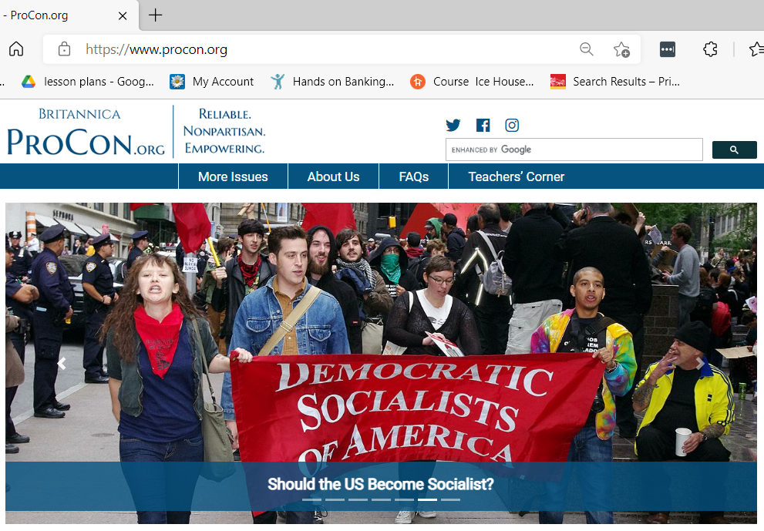
Other Resources

Slide 29
Other Resources
Economics 101
Scarcity and Choice (4:35)
http://www.youtube.com/watch?v=yoVc_S_gd_0
Intro to Economics: Crash Course (12:08)
https://www.youtube.com/watch?v=3ez10ADR_gM&t=5s
Economic Education Podcasts
Think Like an Economist
https://podcasts.apple.com/us/podcast/think-like-an-economist/id1523898793
Planet Money
https://www.npr.org/podcasts/510289/planet-money
Freakanomics
https://freakonomics.com/category/podcasts/
EconEdLink
https://www.econedlink.org/
MRU EconInBox Current Events Subscription
https://www.econinbox.com/

Slide 30
Other Resources
Vanderbilt University, Center for Teaching, Difficult Dialogues
https://cft.vanderbilt.edu/guides-sub-pages/difficult-dialogues/#tools
iCivics
https://www.icivics.org
Teaching for Democracy Alliance
http://www.teachingfordemocracy.org
St. Louis Fed Minimum Wage Debate
https://www.stlouisfed.org/education/structured-minimum-wage-debate?s=03
Education World
http://www.educationworld.com/a_lesson/lesson/lesson304.shtml
Sphere: Teaching Civic Culture Together
https://www.sphere-ed.org
Educational Technology Tools
Nearpod, GoSoapBox, Padlet, Pear Deck, Google Jamboard

Slide 31
Debate Format Example
30 second opening position statement (no specifics) – For
30 second opening position statement (no specifics) – Opposed
3 minute position argument (3 main points) – For
3 minute position argument (3 main points) – Opposed
5 minute work period
2 minute rebuttal (respond to 3 main points) – For
2 minute rebuttal (respond to 3 main points) – Opposed
3 minute work period
2 minute response – For
2 minute response – Opposed
1 minute work period
1 minute position summary and closing statement – Opposed
1 minute position summary and closing statement – For

Slide 32
Debate Rubric Example
Debate Performance Criteria | Score
Uses one or more of the 3 Economic Way of Thinking Tools
Stays on topic
Supports arguments with evidence
Delivers persuasiveness
Demonstrates teamwork
Shows responsiveness to opposing team’s arguments
1=Needs More Practice 5=Join the Debate Club 10=Debate Stage Ready

Slide 33
Controversial Issues & Civil Dialogue
Why is it important to teach students to discuss/deliberate/debate controversial issues?
TEACHER REFLECTIONS
“I want my students to learn how to really listen to one another and understand the perspectives of their classmates. I want to encourage my students to come to class with an open mind, willingness to learn from their peers, and respect for differences.”
“My goals for student learning include introspection, reflection, and critical thinking skills, all of which are fostered in dialogue with peers about topics that make them step outside their comfort zones.”
“The appeal of ‘the hard stuff’ is that it encourages students to think critically about social life, that is, to question what they learn and make meaning from what they learn, to synthesize information from various sources, and to evaluate ideas.”
Notes:
Quotes from teachers

