Slide 1
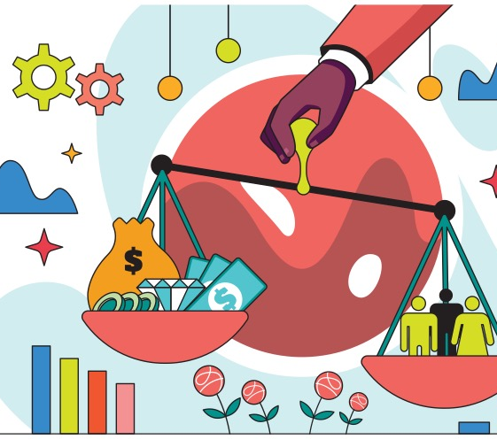
How Can You Apply Ethics and Economics to Any Issue?
A Guide to the Ethics, Economics, and Social Issues Curriculum

Slide 2
Basic Economic Terms
Benefits
Costs
Opportunity Cost
Scarcity
Incentives
Allocation

Slide 3
Benefits
A benefit is what satisfies your wants. Benefits are what is gained when an action is taken or a choice is made.

Slide 4
Costs
A cost is what you give up when you decide to do something. Costs are the effort, loss, or sacrifice necessary to achieve or obtain something.

Slide 5
Opportunity Cost
Whenever you make a choice, you are actually making two choices.
This is because whenever you choose to do one thing, you are also choosing not to do something else.
What you choose not to do is your opportunity cost.

Slide 6
Scarcity
Because of scarcity, the economic condition of not having enough resources to satisfy everyone’s wants, not all wants can be satisfied and people differ greatly in their abilities and opportunities to satisfy their wants.

Slide 7
Incentives
Actions or rewards that encourage people to act. When incentives change, behavior changes in predictable ways.

Slide 8
Allocation
In a world of scarcity, one of the major economic problems we face is who should receive the goods and services that are produced.
First-come-first-serve, price, rationing, and lottery are all examples of allocation methods that are a way used to determine distribution of goods and services.
Because our unlimited wants exceed our limited resources, societies need a system for allocating resources.
Societies have various rules on how they allocate resources, and some societies use these methods to align with common values or to impact their social and economic goals.

Slide 9
Equity and Justice
One definition of justice is the notion that everyone deserves equal economic, political, and social opportunities regardless of race, gender, or religion, for example. To determine if something is just, people often ask two different-and possibly contradictory-questions:

Slide 10
Equity and Justice
Is the outcome equitable?
People who emphasize outcomes tend to see the existing degree of economic inequity as morally wrong.
Is the process equitable?
People who emphasize process are more likely to approve the results of a system, even if those results are highly unequal, provided individuals have equal opportunity to succeed. If they believe the system is designed to be equal for all, they believe the outcomes should be just.

Slide 11
Ethical concerns
The following ethical frameworks are key to the decision-making process.
Outcomes-based ethics
Virtue-based ethics
Duty-based ethics
Let’s look at each one individually.

Slide 12
Ethical concerns
Outcomes-based ethics: a moral philosophy that discerns right or wrong action based on the consequences produced by the action.
We should do the thing that results in the best outcome. Results are the only thing that matters.
Consequences in terms of fairness or unequal access are vague or not considered.

Slide 13
Ethical concerns
Virtue-based ethics: a moral philosophy that discerns right or wrong based on whether one’s actions contribute to the formation of good character.
What are the intentions of the person making the decision?
Is the decider a good person with good morals?

Slide 14
Ethical concerns
Duty-based ethics: a moral philosophy that discerns right or wrong based on the analysis of one’s obligations.
There is a set of ethical principles, rules, or laws to guide our actions.
Rules – formal and informal - help us do the right thing.

Slide 15
Ethical concerns
(1) Economic Agent(s)
(2) Action
(3) Outcome
In all decisions, an economic agent takes an action (or makes a choice) that is expected to produce certain outcomes.

