Slide 1
Presented by: Kathleen Brennan
Email: kmbrennan108@gmail.com
Date: July 17, 2023
1:00 – 2:30 PM ET
2023 Summer Institute
Microeconomics
Session 3

Slide 2

Kathleen Brennan
NJ Council of Economic Education
One Schoolhouse, Washington, D.C.
AP Economics
Intro To Economics
Personal Finance
Business Analytics
Social Entrepreneurship
Euro/Fed Challenge Teams
Investment Club
Quality Of Life Innovations Competition

Slide 3
National Standards
Standard 1: Productive resources are limited. Therefore, people cannot have all the goods and services they want; as a result, they must choose some things and give up others.
Standard 2: Investment in factories, machinery, new technology, and the health education, and training of people can raise future standards of living.

Slide 4
Common Core State Standards
CCSS.Math.Content.HSN.Q.A.1: Use units to understand problems and to guide the solution of multi-step problems; choose and interpret units consistently in formulas; choose and interpret the scale and the origin in graphs and data displays.
CCSS.ELA-Literacy.RH.11-12.2: Determine the central ideas or information of a primary or secondary source; provide an accurate summary that makes clear the relationships among the key details and ideas.

Slide 5
AGENDA
PART 1- ANALYZING MARKETS
PART 2- EXCISE TAXES
PART 3- PROFIT MAXIMIZATION

Slide 6

PART 1: Analyzing Markets

Slide 7
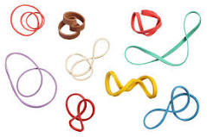
ELASTICITY
A Measure of Responsiveness

Slide 8

Four Types of Elasticity
Price Elasticity of Demand
Price Elasticity of Supply
Cross Price Elasticity
Income Elasticity
This Photo by Unknown Author is licensed under CC BY

Slide 9




1. Price Elasticity of Demand
Sensitivity of Quantity Demanded to a Change in Price

Slide 10

How is Price Elasticity of Demand Used?
To measure the sensitivity of the demand for a good to price changes.
To identify the factors that underly price sensitivity.
To predict the impact of a price change on revenue.

Slide 11
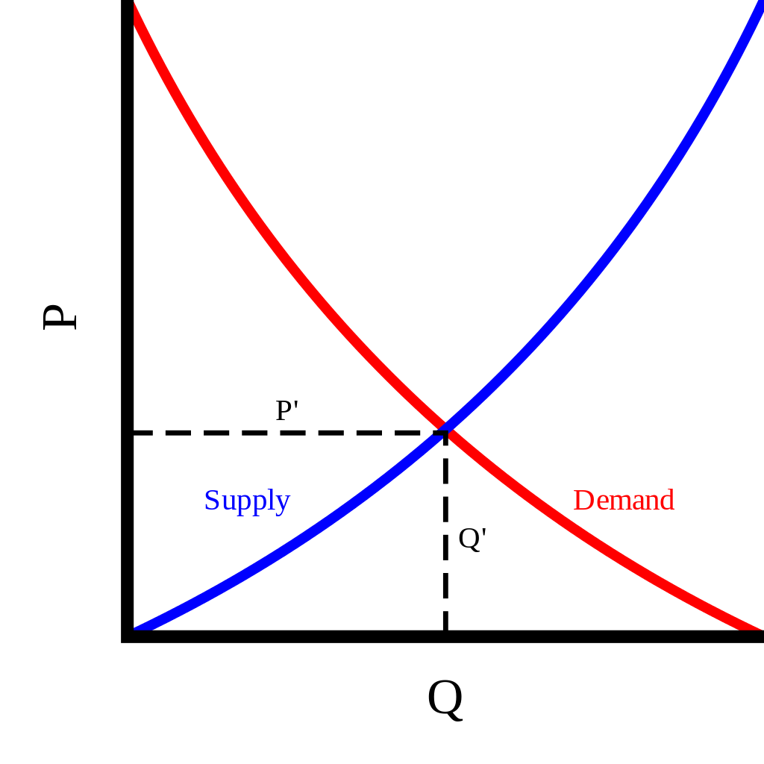
Demand and Supply Review
The demand curve for a good is downward sloping. The total quantity demanded by consumers is higher when the price is lower.
The supply curve for a good is upward sloping. The total quantity supplied by producers increases when the price is higher.
Equilibrium is achieved when the quantity demanded equals the quantity supplied.
This Photo by Unknown Author is licensed under CC BY-SA

Slide 12
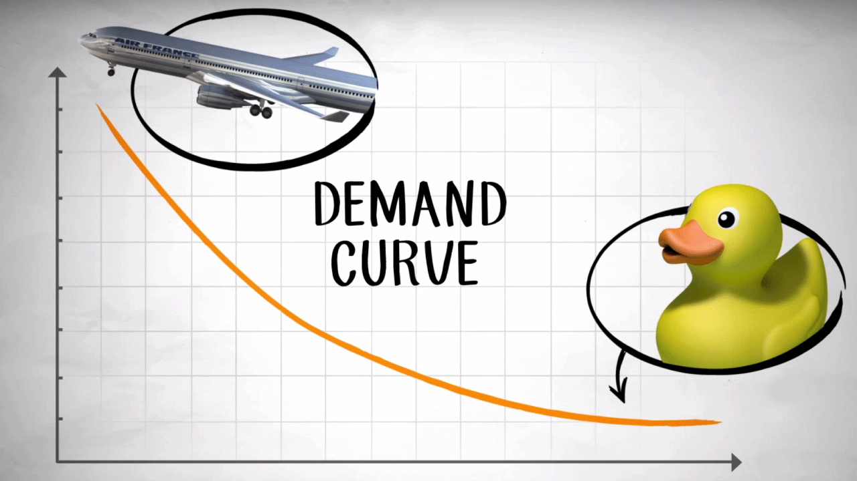
Source: Marginal Revolution University
This Photo by Unknown Author is licensed under CC BY-ND

Slide 13
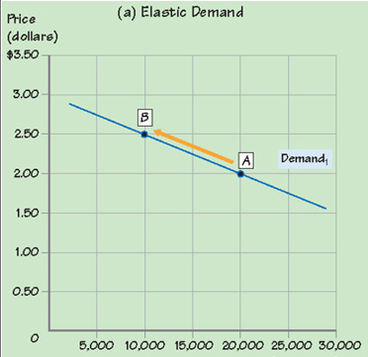
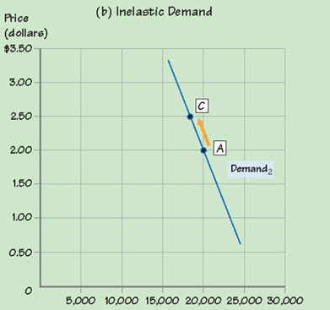
Elastic vs. Inelastic Demand
Price increases from $2.00 to $2.50;
Quantity demanded declines from 20K to 10K
Price increases from $2.00 to $2.50;
Quantity demanded declines from 20K to 18K

Slide 14
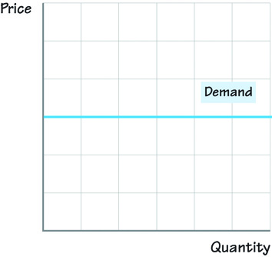
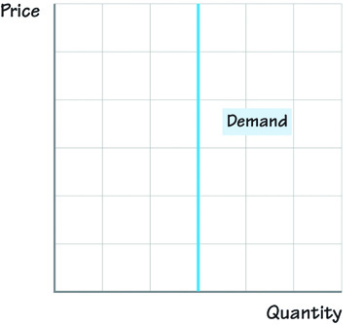
Two “Extreme” Cases of Price Elasticity of Demand
Perfectly Elastic
Perfectly Inelastic

Slide 15
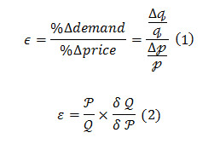
Calculating the Price Elasticity of Demand
Two Methods for Calculating Elasticity:
Point Elasticity Approach*
Mid-Point (Arc) Approach
This Photo by Unknown Author is licensed under CC BY

Slide 16

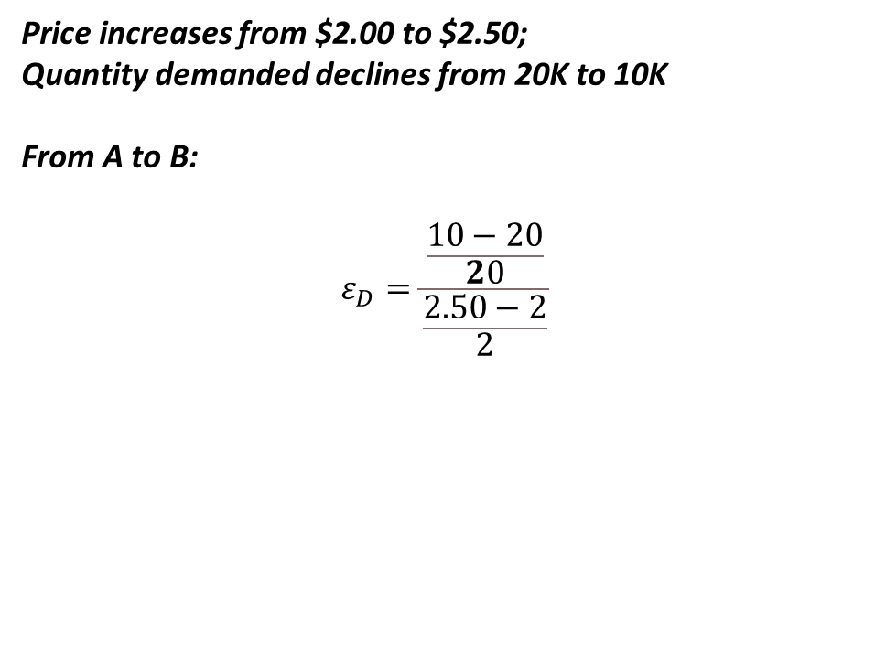
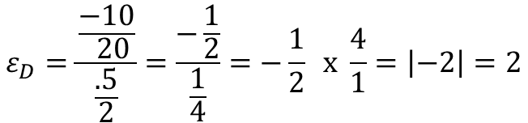
Example 1: Elastic Demand
Price increases from $2.00 to $2.50;
Quantity demanded declines from 20K to 10K
From A to B:
$$ε_{D}=\frac{\frac{10−20}{20}}{\frac{2.50−2}{2}}$$
$$ε_{D}=\frac{\frac{−10}{ 20}}{\frac{.5}{2}}=\frac{−\frac{1}{2}}{\frac{1}{4}}=−\frac{1}{2} x \frac{4}{1}=\left|−2\right|=2$$
Price increases from $2.00 to $2.50;
Quantity demanded declines from 20K to 10K
Source: Krueger Explorations in Economics
This Photo by Unknown Author is licensed under CC BY-SA-NC

Slide 17
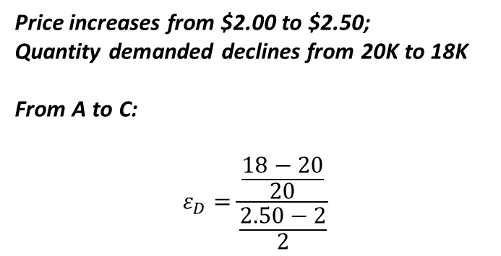
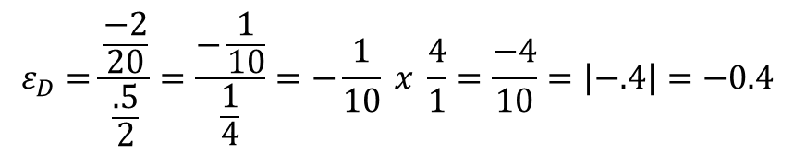
Example 2: Inelastic Demand
Price increases from $2.00 to $2.50;
Quantity demanded declines from 20K to 18K
From A to C:
$$ε_{D}=\frac{\frac{18−20}{20}}{\frac{2.50−2}{2}}$$
$$ε_{D}=\frac{\frac{−2}{20}}{\frac{.5}{2}}=\frac{−\frac{1}{10}}{\frac{1}{4}}=−\frac{1}{10} x \frac{4}{1}=\frac{−4}{10}=\left|−.4\right|=−0.4$$
Source: Krueger Explorations in Economics
This Photo by Unknown Author is licensed under CC BY-SA-NC

Slide 18
Important Things to Remember
Elasticity of Demand is always represented as a positive number.
Either the point or midpoint method can be used to estimate elasticity.
The Point Elasticity estimate is sensitive to your starting point. Evaluating a price increase from A to B will yield a different answer than a price decrease from B to A. BE CAREFUL!
For point elasticity, use the Percentage Change Formula:
% Δ = (New-Old)/Old

Slide 19
ELASTICITY of DEMAND SUMMARY
 | Definition | Implication For Quantity Demanded | Numeric Value of Elasticity (Absolute Value) | Graphical Representation
PERFECTLY INELASTIC DEMAND | % Δ in Q_{D} is zero for any % Δ in P | Unresponsive to price changes | 0 | Vertical Demand Curve
INELASTIC DEMAND | % Δ in Q_{D} is less than the % Δ in P | Relatively unresponsive to price changes | <1 | Relatively Steep Demand Curve
UNIT ELASTIC | % Δ in Q_{D} is equal to the % Δ in P | Moderately responsive to price changes | 1 | Non-linear Demand Curve
ELASTIC DEMAND | % Δ in Q_{D} is more than the % Δ in P | Relatively responsive to price changes | >1 | Relatively Flat Demand Curve
PERFECTLY ELASTIC DEMAND | % Δ in Q_{D} is infinite for any % Δ in P | Infinitely responsive to price changes | ∞ | Horizontal Demand Curve

Slide 20



Factors Underlying Price Elasticity of Demand
The price elasticity of demand is larger (>1) for goods that:
1. Have more substitutes
2. Aren’t necessities
3. Comprise a relatively large percentage of income
4. Whose purchase can be delayed
This Photo by Unknown Author is licensed under CC BY-NC-ND

Slide 21
Some Examples of Price Elasticity of Demand
Product | Elasticity
Rice and Pasta | 0.1
Eggs | 0.2
Water | 0.3
Public Transportation | 0.4
Fruits and Vegetables | 0.8
Citrus Fruits | 1.1
Cakes and Cookies | 1.2
Honey Nut Cheerios | 2.0
Restaurant Meals | 2.0
Source: Stevenson and Wolfers Principles of Microeconomics (2020)

Slide 22


How Businesses Use Demand Elasticity
Elasticity is used by businesses to predict the impact of price changes on their bottom line.
TOTAL REVENUE = PRICE X QUANTITY
TR = P x Q
= $10 x 100
= $1000
$10
100
P

Slide 23
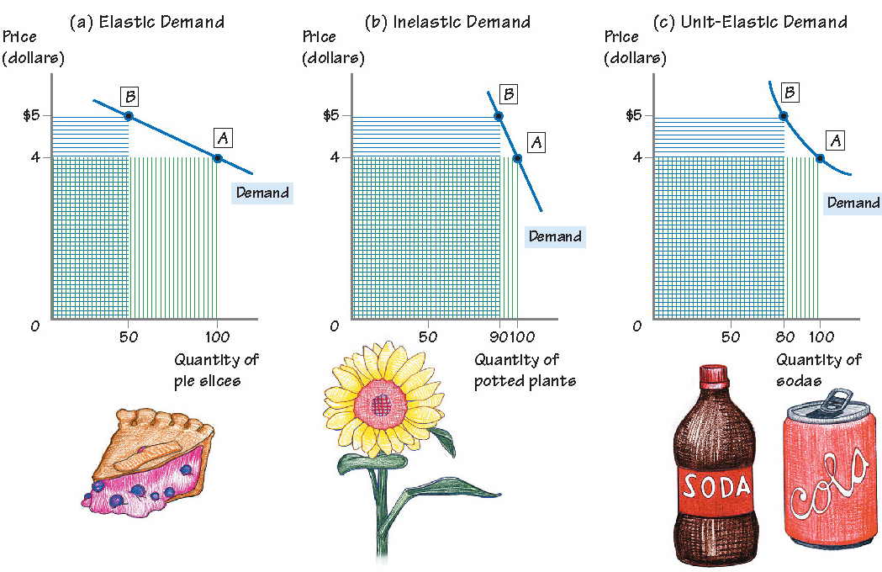
Elasticity, Price Increases, and Total Revenue
Total Revenue Declines
$4 x 100 = $400
$5 x 50 = $250
Total Revenue Increases
$4 x 100 = $400
$5 x 90 = $450
Total Revenue Unchanged
$4 x 100 = $400
$5 x 80 = $400
Source: Krueger Explorations in Economics P. 135

Slide 24
Elasticity and Total Revenue Summary
Type of Demand | Effect of Price Increase on Total Revenue | Effect of Price Decrease on Total Revenue
Elastic | Decrease | Increase
Inelastic | Increase | Decrease
Unit Elastic | No Change | No Change

Slide 25



2. Price Elasticity of Supply
Sensitivity of Quantity Supplied to a Change in Price
This Photo by Unknown Author is licensed under CC BY

Slide 26
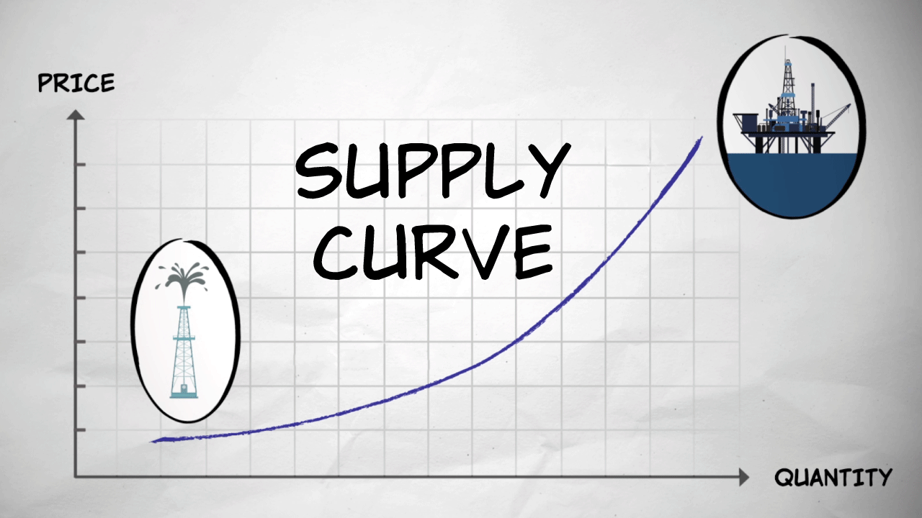
Source: Marginal Revolution University
This Photo by Unknown Author is licensed under CC BY-ND

Slide 27
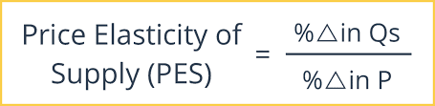

$Ɛ$_{S}
Source: Intelligent Economist

Slide 28
Elasticity of Supply
P
S
P
S
P
P
S
S
Q
Q
Q
Q
Perfectly Inelastic Relatively Inelastic Relatively Elastic Perfectly Elastic
Ɛ_{S} = 0 Ɛ_{S} < 1 Ɛ_{S} > 1 Ɛ_{S} = ∞
*Unit Elastic- Ɛ_{S} = 1

Slide 29
ELASTICITY of SUPPLY SUMMARY
 | Definition | Implication For Quantity Supplied | Elasticity Value | Graphical Representation
PERFECTLY INELASTIC SUPPLY | % Δ in Q_{S} is zero for any % Δ in P | Unresponsive to price changes | 0 | Vertical Supply Curve
INELASTIC SUPPLY | % Δ in Q_{S} is less than the % Δ in P | Relatively unresponsive to price changes | <1 | Relatively Steep Supply Curve
UNIT ELASTIC | % Δ in Q_{S} is equal to the % Δ in P | Moderately responsive to price changes | 1 | Linear Supply Curve from Origin
ELASTIC SUPPLY | % Δ in Q_{S} is more than the % Δ in P | Relatively responsive to price changes | >1 | Relatively Flat Supply Curve
PERFECTLY ELASTIC SUPPLY | % Δ in Q_{S} is infinite for any % Δ in P | Infinitely responsive to price changes | ∞ | Horizontal Supply Curve

Slide 30

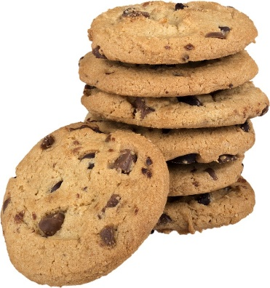
Factors Underlying Price Elasticity of Supply
The price elasticity of supply reflects the flexibility of firms to increase or decrease the quantity supplied. It is larger:
1. for firms that store inventories
2. if inputs are readily available or substitutable
3. for firms that have excess capacity
4. when firms can easily enter the market
5. when there is a longer time horizon

Slide 31
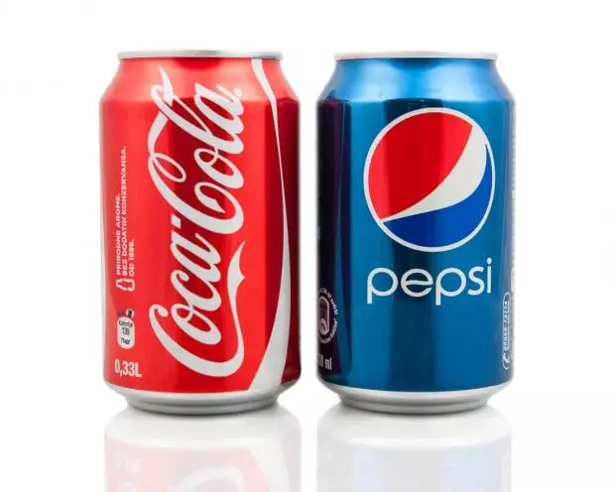
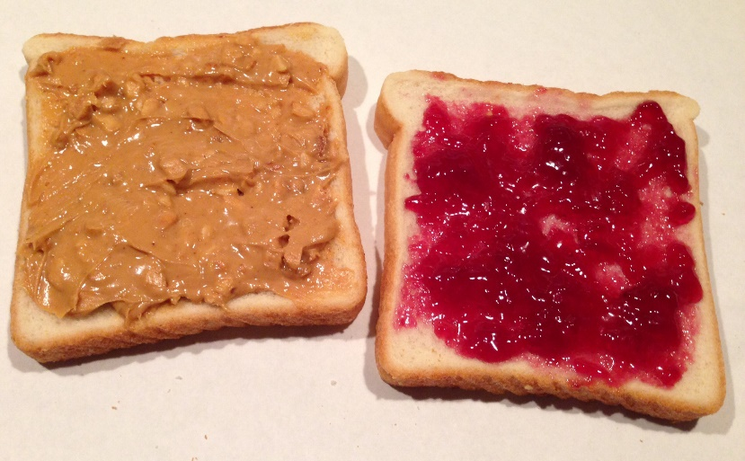
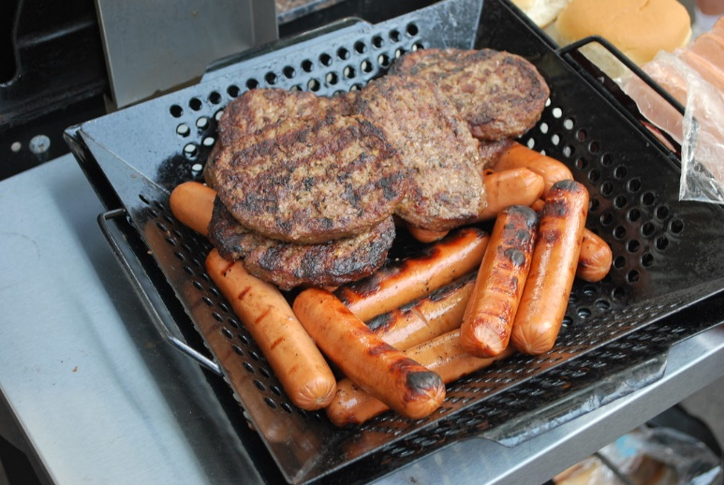


3. Cross Price Elasticity of Demand
Sensitivity of Quantity Demanded of Good X to a Change in Price of Good Y
This Photo by Unknown Author is licensed under CC BY-SA
This Photo by Unknown Author is licensed under CC BY
This Photo by Unknown Author is licensed under CC BY-NC
This Photo by Unknown Author is licensed under CC BY-NC-ND

Slide 32

Cross- Price Elasticity of Demand
Source: Intelligent Economist
If the cross- price elasticity is positive, then good X and Y are substitutes.
If the cross-price elasticity is negative, then good X and Y are complements.
If the cross-price elasticity is zero, good X and Y are unrelated.

Slide 33

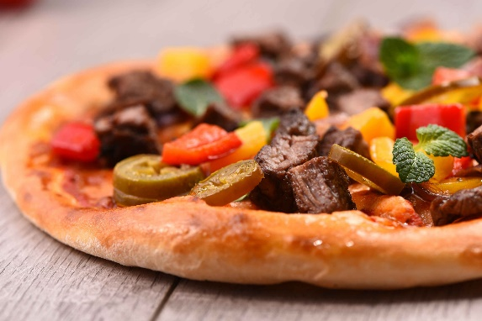




4. Income Elasticity
Sensitivity of Quantity Demanded of a Good to a Change in Income
This Photo by Unknown Author is licensed under CC BY-SA
This Photo by Unknown Author is licensed under CC BY

Slide 34
Income Elasticity of Demand
Income Elasticity of Demand = % Δ in Quantity Demanded
% Δ in Income
If the income elasticity is positive, the good is a “normal” good. As income rises, the quantity demand for the good also rises.
If the income elasticity is negative, the good is an “inferior” good. As income rises, the quantity demanded for the good decreases.

Slide 35
Examples of Income Elasticity of Demand
Product | Income Elasticity of Demand
Processed fruits and vegetables | -0.3
Electricity | 0.0
Organic Fruit | 0.2
Health Expenditures | 0.4
Gasoline | 0.5
New Cars | 1.7
Airplane Tickets | 1.8
Source: Stevenson and Wolfers, Principles of Economics (2020)

Slide 36
Pricing Strategies Worksheet
Elasticity Questions

Slide 37

Elasticity Summary
Every Elasticity is about the same thing– it measures the responsiveness of quantity to a change in various market conditions-- a change in the price of a firm’s good, a change in the price of other goods, or a change in income. It is used by business to determine the impact of pricing strategies on their bottom line as well as to understand how the prices of other goods and changes in income can impact the demand for their product.
Elasticity = Percent Change in Quantity
Percent Change in Some Other Factor
This Photo by Unknown Author is licensed under CC BY-SA

Slide 38

PART 2: Excise Taxes
This Photo by Unknown Author is licensed under CC BY-NC

Slide 39

Excise Tax
Per unit tax imposed on a good or service at the point of sale.
Reduces the quantity demanded and supplied of a good.
“Internalizes” an externality by discouraging the production and consumption of “undesirable” goods.
Raises revenue for the government.

Slide 40


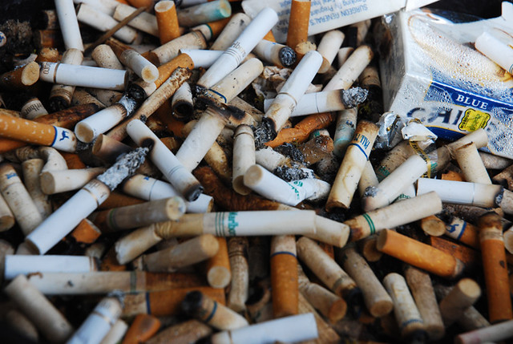



Excise Tax Examples
Cigarette tax
Alcohol tax
Soda tax
Gasoline tax
“Carbon” tax
Hotel tax
This Photo by Unknown Author is licensed under CC BY
This Photo by Unknown Author is licensed under CC BY
This Photo by Unknown Author is licensed under CC BY-ND

Slide 41


Excise Tax Example: $0.30 Soda Tax
Buyers Pay: $1.30 x 10= $13
Sellers Receive: $1.00 x 10 = $10
Government Revenue: $0.30 x 10 = $3

Slide 42

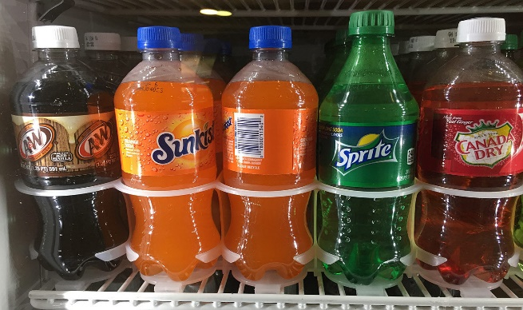
Impact of an Excise Tax on Sellers
Shifts the supply curve up vertically by the amount of the tax.
Leads to a decrease in quantity sold.
Increases the price buyers pay and decreases the price sellers receive.
The government receives revenue from imposing the tax.
Both buyers and sellers bear the economic burden of the tax.
This Photo by Unknown Author is licensed under CC BY-NC-ND

Slide 43


Price Elasticities and Tax Incidence
The incidence of a tax is a measure of who really pays the tax.
Who really bears the burden of the tax does not depend on who officially pays the tax.
The wedge between the demand price and the supply price is the government’s tax revenue.
This Photo by Unknown Author is licensed under CC BY-SA

Slide 44
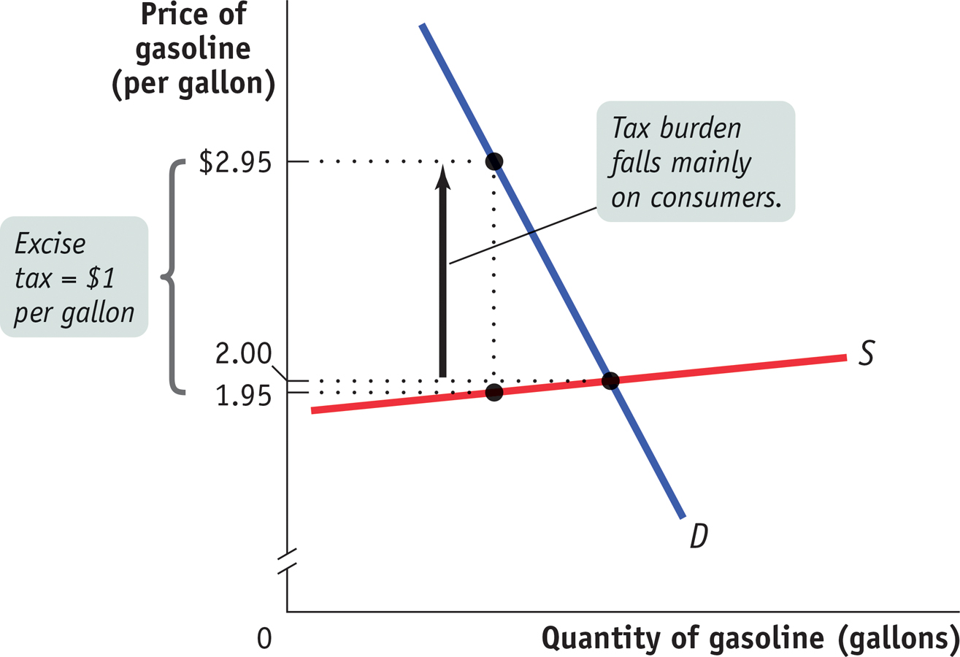
Excise Tax Paid Mainly by Consumers
Demand is relatively more inelastic than Supply.
Source: Krugman AP Economics

Slide 45
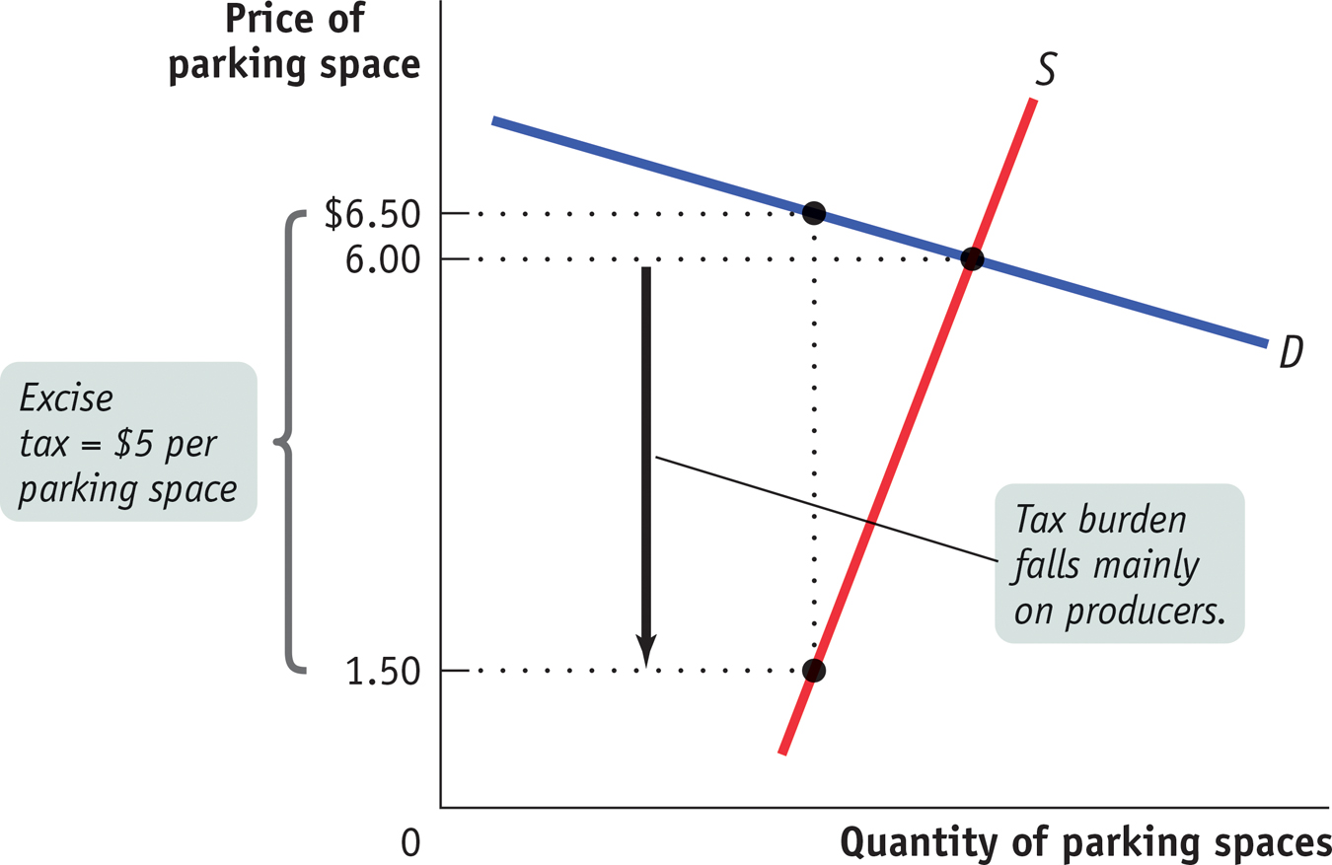
Excise Tax Paid Mainly by Producers
Supply is relatively more inelastic than Demand.

Slide 46
The Economic Burden of Taxes
The incidence of the tax depends on the price elasticity of demand and supply.
Sellers bear a smaller share of the economic burden when supply is relatively elastic.
Buyers bear a smaller share of the economic burden when demand is relatively elastic.
Conclusion: The factor that is more elastic will have a smaller share of the economic burden.

Slide 47

Part 3: Profit Maximization
Businesses strive to make as much profit as possible.
Without profits a business is unlikely to survive in the long run.
Profit maximization occurs at a production quantity where marginal revenue equals marginal cost.

Slide 48
Economic Profit and Economic Loss
Economic versus accounting concepts of profit and loss
  Explicit costs are charges that must be paid for factors of production such as labor and capital.
  Accounting profit is profit computed using only explicit costs.
  Implicit cost is a cost that is included in the economic concept of opportunity cost but that is not an explicit cost.

Slide 49

WHAT IS PROFIT?
REVENUE = Price x Quantity
(TR= P x Q)
COSTS = Fixed Costs + Variable Costs
(TC= FC + VC)
PROFIT= Revenue – Costs
(π = TR – TC)

Slide 50

The Profit-Maximizing Quantity
Marginal Revenue (MR) = the additional revenue from selling an additional unit of output.
Marginal Cost (MC)= the additional cost from producing an additional unit of output.
Profits are maximized at the output level where the additional revenue (MR) is equal to the additional costs (MC).
MR > MC MR = MC MR < MC

Slide 51
Perfect Competition and MR
Price
Firm
The price is set by the market.
The firm is a price taker.
The firm can sell all it wants at the market price.
MR is constant.
MR = Average Revenue= Price
Firm faces a perfectly elastic demand curve for its product.
$10
MR = AR= Price
1 2 3 4 5 6 7 8 9 10
Output

Slide 52

Marginal Costs
Firm
Price
MC
At lower output levels, MC declines due to specialization and increasing returns.
As output levels increase, MC increases as diminishing returns set in.
MC curve resembles a “Nike swoosh”.
MC increases at an increasing rate.
MR = MC
$10
MR = AR= Price
1 2 3 4 5 6 7 8 9 10
Output

Slide 53

Three Short Run Scenarios
Excess Profits: Economic Profits > 0
Normal Profits: Economic Profits = 0
Short-Run Losses: Economic Profits < 0

Slide 54


What is the size of the firm’s profit?
Firm
Average Total Cost- total cost per unit of output
ATC = Total Cost/Q
Average Fixed Cost- fixed cost per unit of output
  AFC = FC/Q
Average Variable Cost- variable cost per unit of output
  AVC = VC/Q
  ATC = AFC + AVC
Price
MC
ATC
MR = MC
$10
MR = AR= Price
1 2 3 4 5 6 7 8 9 10
Output

Slide 55

Economic Profits > 0
Profit = TR – TC
using substitution:
TR= P x Q
TC= ATC x Q
So:
Profit = P x Q – (ATC x Q)
= (P – ATC) x Q
= (10 – 8) x 8
= 2 x 8
= 16
Graphically, the profit is the area of the red rectangle.
Firm
Price
MC
ATC
MR = MC
$10
$8
MR = AR= Price
1 2 3 4 5 6 7 8 9 10
Output
Short- Run Excess Profits

Slide 56
Economic Profits = 0
Firm
Price in the market drops to $7.
Profit = P x Q – (ATC x Q)
= (P – ATC) x Q
= (7-7) x 5
= 0 x 5
= 0
Alternatively, TR = TC
  TR = $7 x 5 TC = $7 x 5
The firm has normal profits (economic profits are zero).
Price
MC
ATC
$10
MR = AR= Price
$7
MR = MC
1 2 3 4 5 6 7 8 9 10
Output
Short- Run Normal Profits

Slide 57
Economic Profits < 0
Firm
Price = $10
At profit maximizing quantity, P < ATC
Profit = P x Q – (ATC x Q)
= (P – ATC) x Q
= (10- 12) x 8
= -2 x 8
= -16
Alternatively, TR –TC < 0
  TR = $10 x 8 TC = $12 x 8
  80 – 96 = -16
Graphically, the losses are equal to the area of the red rectangle.
Price
MC
ATC
$10
MR = MC
MR = AR= Price
1 2 3 4 5 6 7 8 9 10
Output
Short- Run Losses

Slide 58
Should the firm shut down when Economic Profits <0?
Price
$9
8
7
6
5
4
3
2
1
Shut-down Rule
A firm should continue to operate in the short-run as long as the product price is greater than average variable costs.
If P> AVC, the firm should produce at the quantity where MR= MC.
If P < AVC, the firm should shut down and produce nothing.
MC
ATC
AVC
Shut-down if Price falls beneath AVC
1 2 3 4 5 6 7 8 9 10
Output

Slide 59
Tips for Success
PRACTICE, PRACTICE, PRACTICE
CALCULATIONS AND GRAPHING
UNDERSTAND RELATIONSHIPS ACROSS CONCEPTS
MEMORIZATION DOESN’T HELP
AP CLASSROOM PROGRESS CHECKS, MULTIPLE CHOICE, AND FRQS

Slide 60
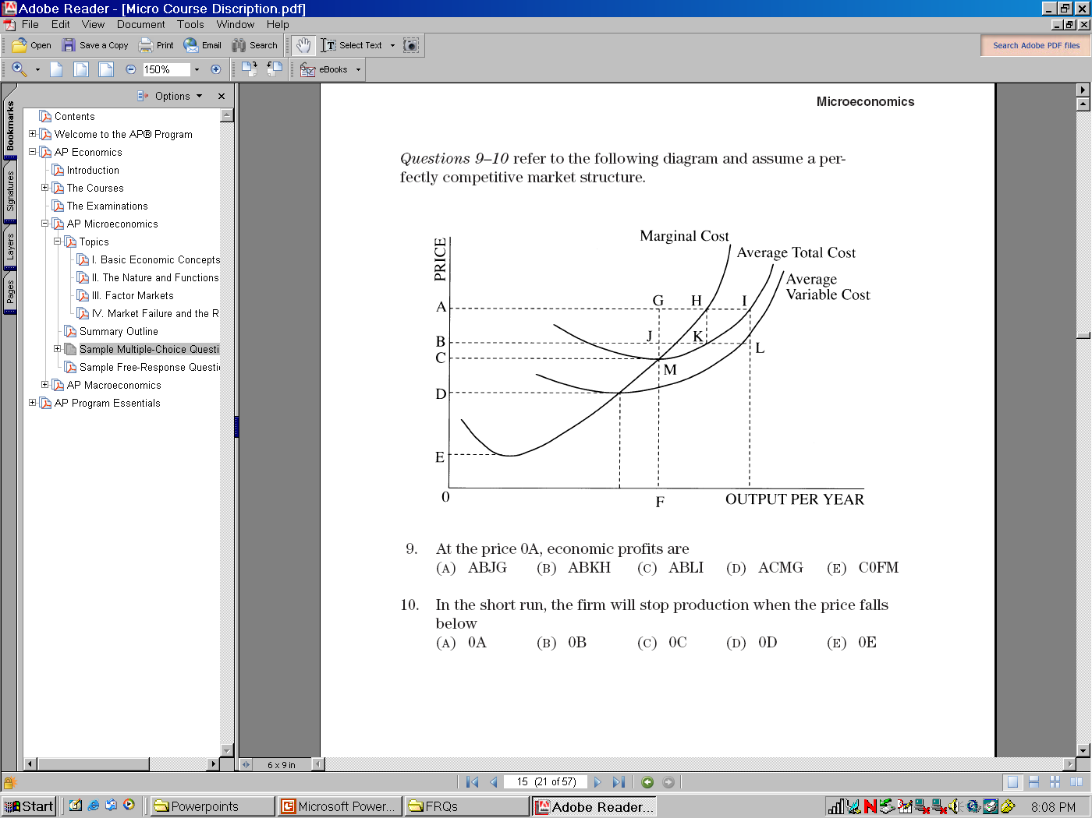


AP TYPE QUESTION

Slide 61
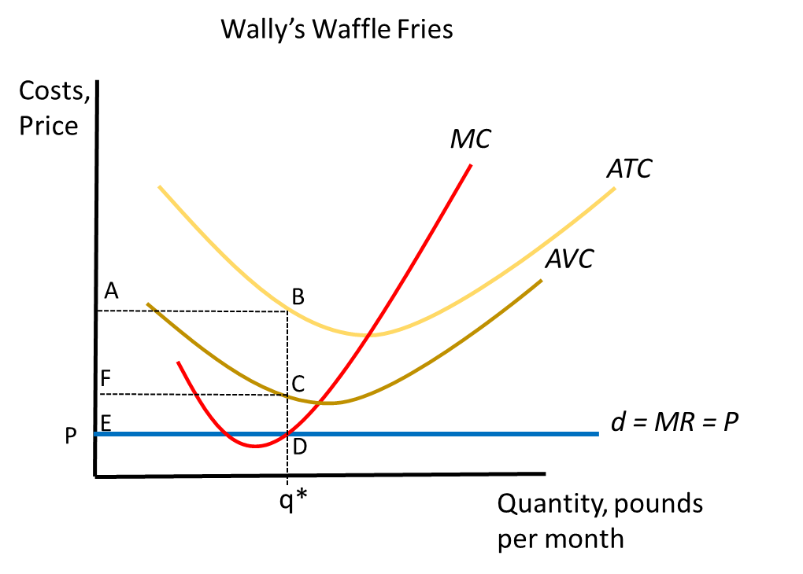
Graph Practice
3. Suppose Wally shuts down. Shade an area that represents his losses.
4. Should Wally produce or shut down? Why?
Wally is losing money. Explain how you know.
Suppose Wally produces. Find the ideal level of output and shade an area that represents his losses.

Slide 62
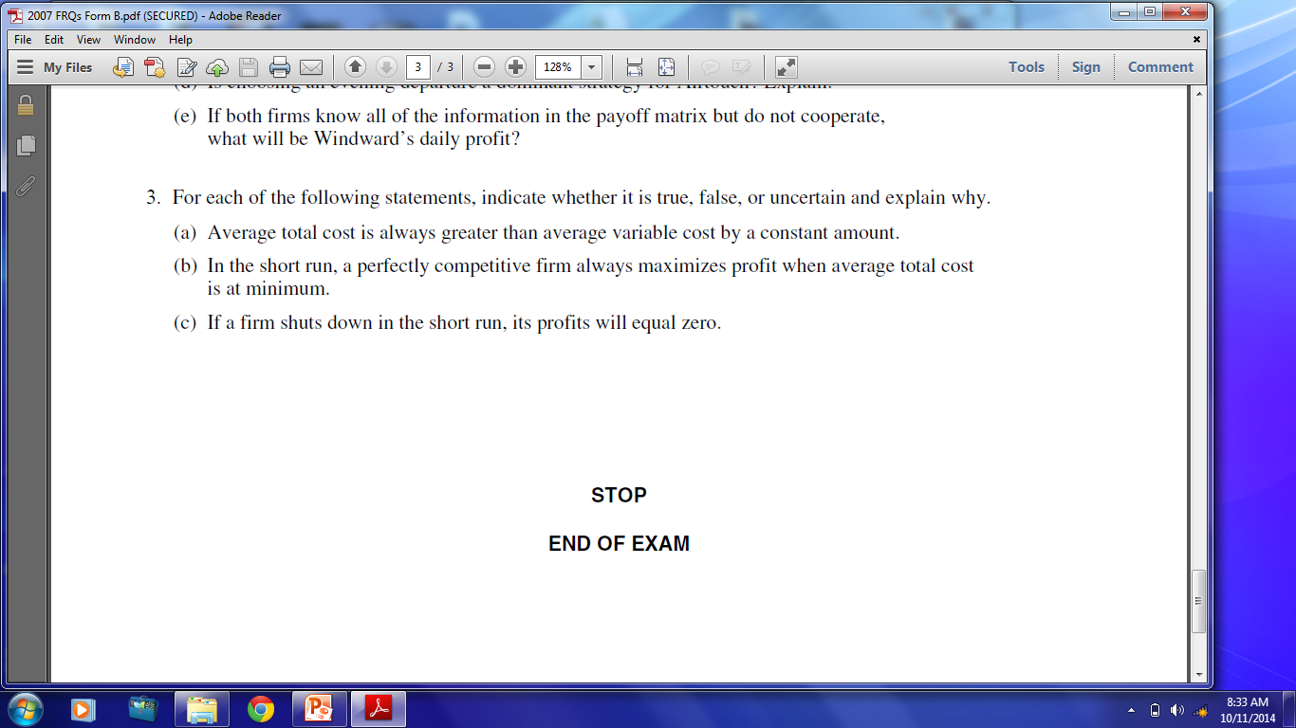
AP Micro 2007 Form B Free Response Question

Slide 63
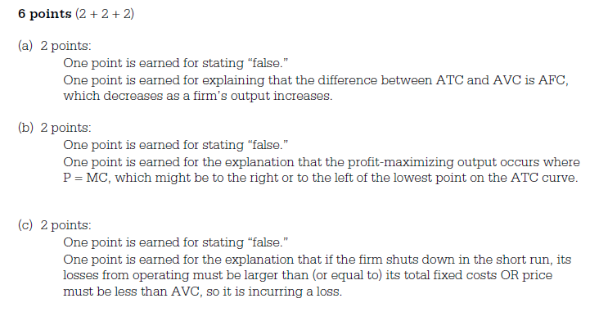
AP Micro 2007 Form B Free Response Question
Grading Rubric

Slide 64
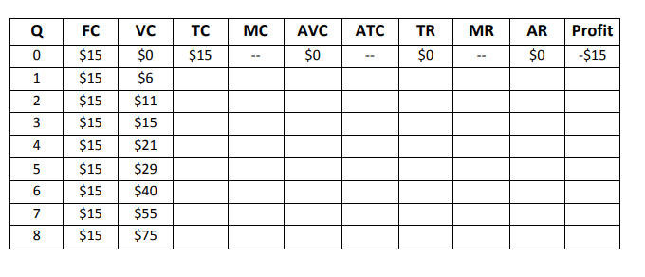

Apply & Analyze: Assume Daphne’s Apparel Company operates in a perfectly competitive industry and sells its product at $15. Complete the table and then graph the MC, AVC, MR, AR and Price for the company. At approximately what quantity is profit maximized?

Slide 65

QUESTIONS??
Inc. Magazine

Slide 66

Suggested Presentation Deck
CEE Affiliates
https://www.councilforeconed.org/resources/local-affiliates/
Include your local affiliate page

Slide 67










Thank You to Our Sponsors!

