Slide 1
Presented by: Kathleen Brennan Email: kmbrennan108@gmail.com Date: July 17, 2023 2:45- 4:00 PM ET
2023 Summer Institute
Microeconomics
Session 4

Slide 2
AGENDA
PART 1- CEE RESOURCES
PART 2- INTRODUCTION TO MRU
PART 3- CURRENT EVENTS
PART 4- ECONOMIC GAMES

Slide 3
High School Economics

Slide 4
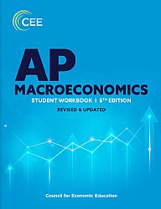
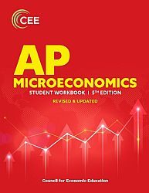
Advanced Placement Economics – 5th edition – Coming Soon!

Slide 5
INTRODUCTION TO MRU

Slide 6
Additional Resources
MJM Foodie
Jacob Reed Review Econ
Jacob Clifford ACDC Economics

Slide 7
CURRENT EVENTS
Econ Inbox
Monday Morning Economist
Planet Money
Planet Money- The Indicator
Marketplace
Think Like an Economist
Conversations with Tyler
Freakonomics Radio
The Economics of Everyday Things
People I (Mostly) Admire
No Stupid Questions
This Photo by Unknown Author is licensed under CC BY-SA-NC

Slide 8
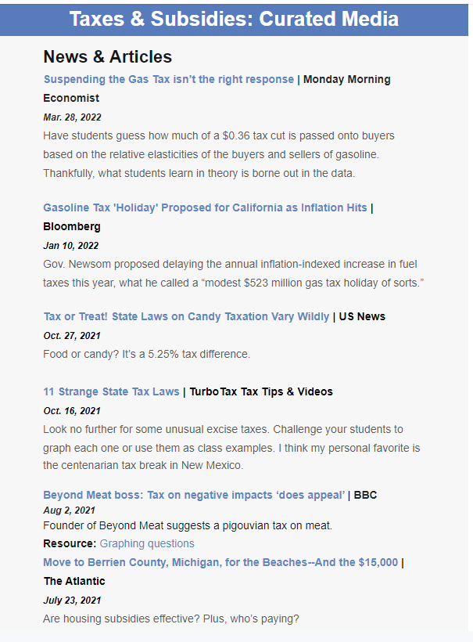
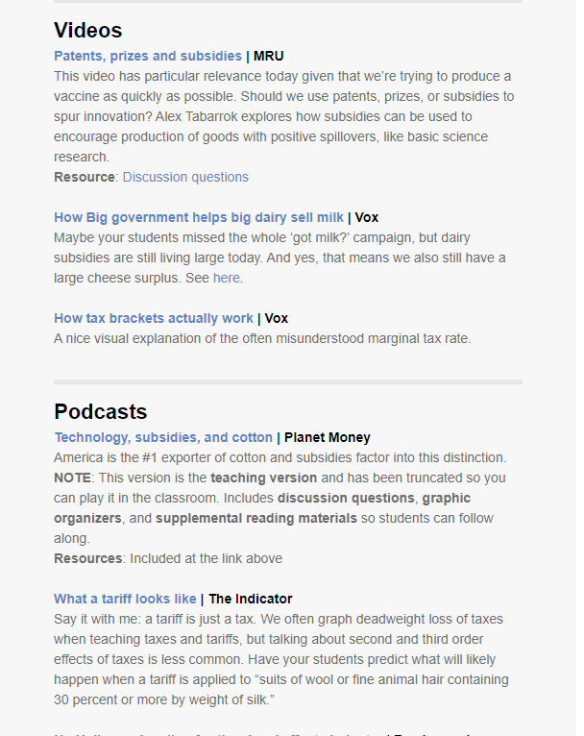
Econ Inbox Example

Slide 9
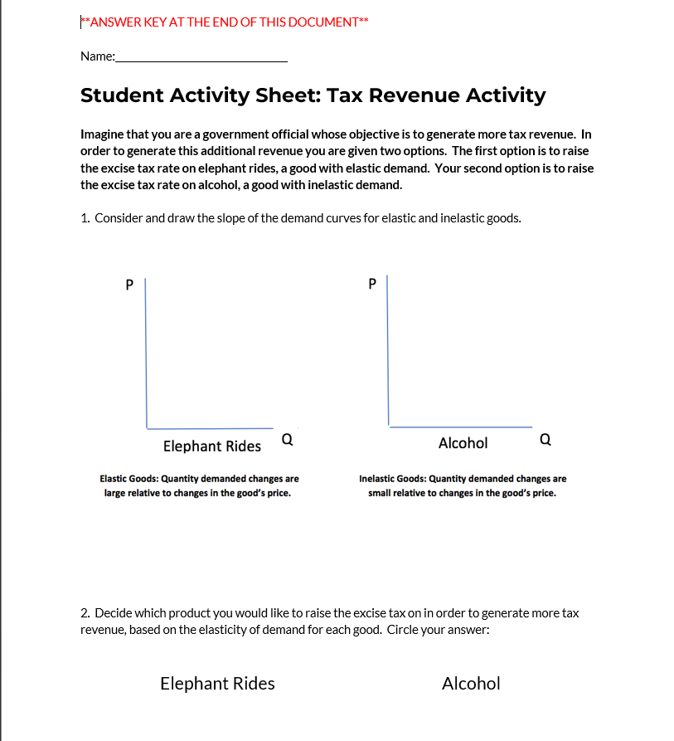
Additional Resources

Slide 10
Extra Practice

Slide 11
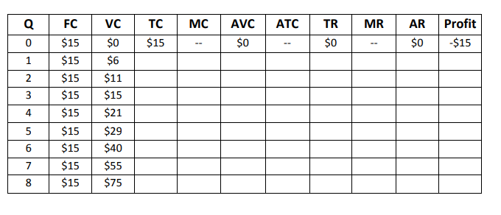
Apply & Analyze: Assume Daphne’s Apparel Company operates in a perfectly competitive industry and sells its product at $15. Complete the table and then graph the MC, AVC, MR, AR and Price for the company. At approximately what quantity is profit maximized?

Slide 12
Economic Games
Top 5 In-Person Economic Games (2022)
Coffee Shop Game
Coffee Shop Game Worksheet- Welker
Classroom Games for Teaching Economics

Slide 13
QUESTIONS??
Inc. Magazine

Slide 14
Suggested Presentation Deck
CEE Affiliates
https://www.councilforeconed.org/resources/local-affiliates/
Include your local affiliate page

Slide 15
Thank You to Our Sponsors!

Slide 16
Contact information
Thank You!
kmbrennan108@gmail.com

