Slide 1

Introducing the
AP Micro and Macro
Teacher Guides
and Student Workbooks

Slide 2

Presenter
Ruth Cookson
Senior Manager, Educational Content
Council for Economic Education
rcookson@councilforeconed.org

Slide 3
Funding
Thank you for your generous support of the AP revision project!
WoodNext Foundation

Slide 4
The Books
AP Microeconomics
AP Macroeconomics

Slide 5
Project Overview
AP Macroeconomics and AP Microeconomics are designed to be used with an AP-level economics textbook
The Teacher Guide is designed to provide a basic framework around which a teacher can design an AP Economics course that best meets the needs of their students. The lessons and activities in AP Macroeconomics and AP Microeconomics provide practice, application of the content, and review for the AP Exam.
AP Macroeconomics and AP Microeconomics consist of:
Teacher Guide
Lesson Plans with unit overviews, objectives, and teacher alerts
Student activities with answers
Visuals
Multiple Choice questions
Student Workbook
Key Ideas section
Student activities

Slide 6
AP Econ: By the Numbers
AP Macroeconomics
6 Units, 41 Total Lessons
AP Microeconomics
6 Units, 41 Total Lessons
4
Brand New Lessons
4
Brand New Lessons
37
Rewritten/Revised Lessons
37
Rewritten/Revised Lessons
65
New/Revised Student Activities
63
New/Revised Student Activities

Slide 7
What’s Changed?
Activities are now with the lesson
Tests are at the end of each unit
More visuals
Separated into shorter, more manageable lessons and activities
Cut a lot of the reading in the activities, put this in the teacher guide as visuals or as procedure
Updated the FRQ to include 2012 – 2023

Slide 8
New and Improved Lessons
All lessons in both Micro and Macro have been revised for the 5th edition, content has been expanded and updated to better correlate to the CED (Course and Exam Description from the College Board), and brand-new lessons have been added that are not in the 4th edition.
New AP Microeconomics Lessons
International Trade and the Effects on Markets
Decisions to Enter, Produce, and Exit a Market
Socially Efficient and Inefficient Market Outcomes
Supply and Demand Graphing Practice
New AP Macroeconomics Lessons
Financial Assets
Nominal vs. Real Interest Rates
Monetary Policy (Ample Reserves vs. Limited Reserves)
Supply and Demand Graphing Practice

Slide 9
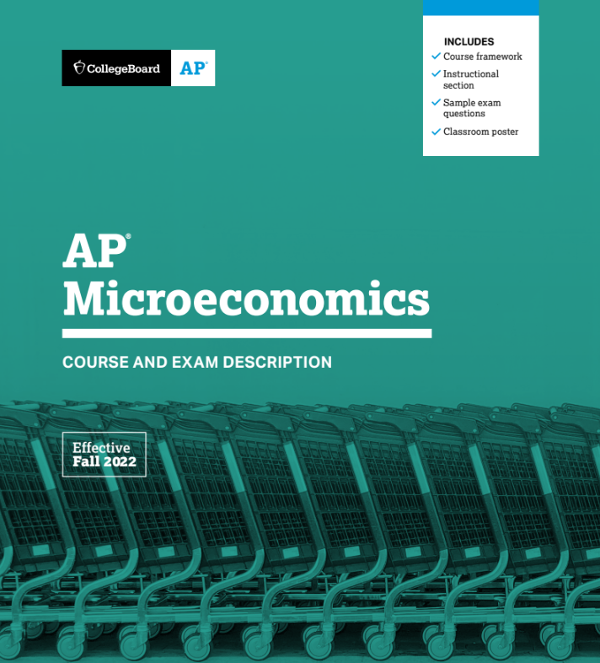
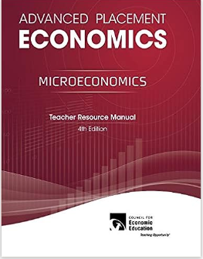
The AP Micro Crosswalk

Slide 10
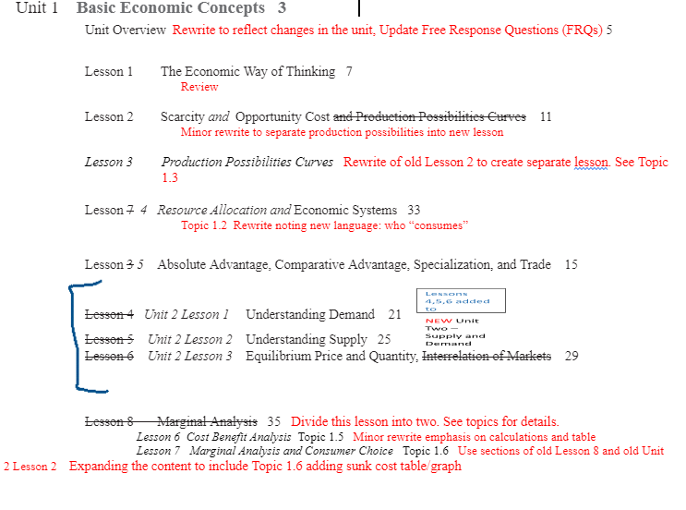
The AP Micro Crosswalk

Slide 11
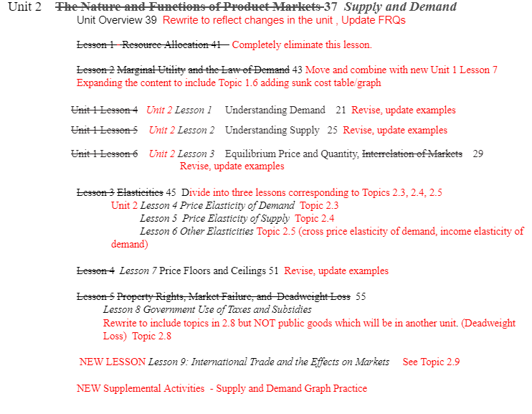
The AP Micro Crosswalk

Slide 12
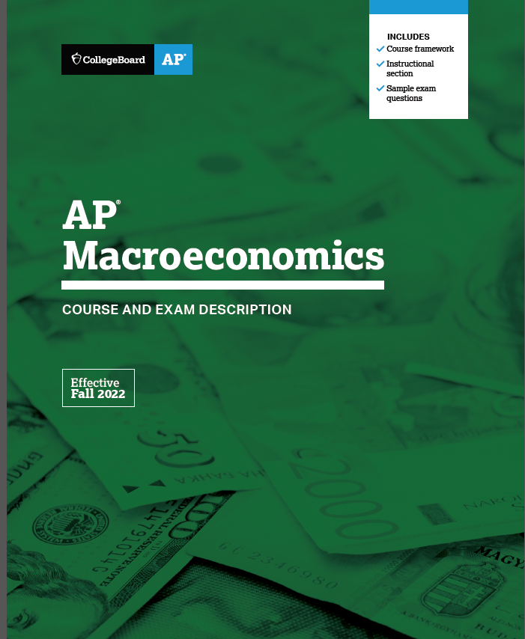
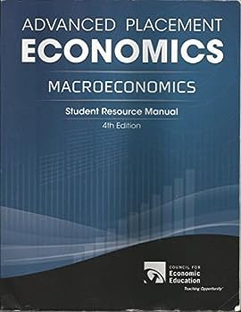
The AP Macro Crosswalk

Slide 13
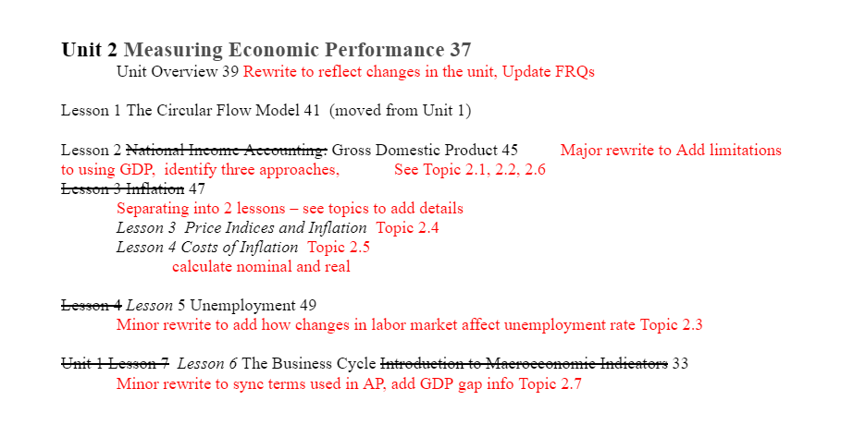
AP Macro Crosswalk

Slide 14
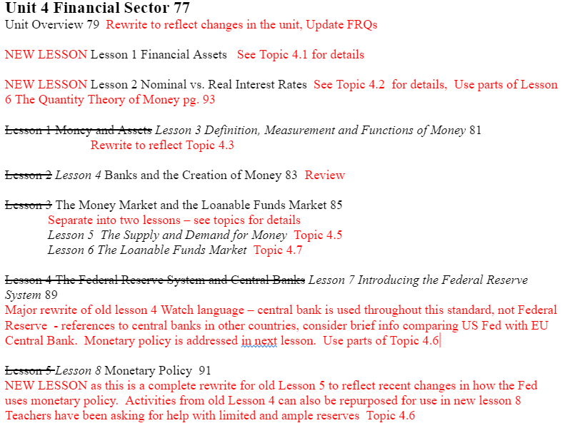
AP Macro Crosswalk

Slide 15
Let’s take a look
at the way the lessons
are structured.
Understanding Demand
Micro Unit 2, Lesson 1
Macro Unit 1, Lesson 5

Slide 16
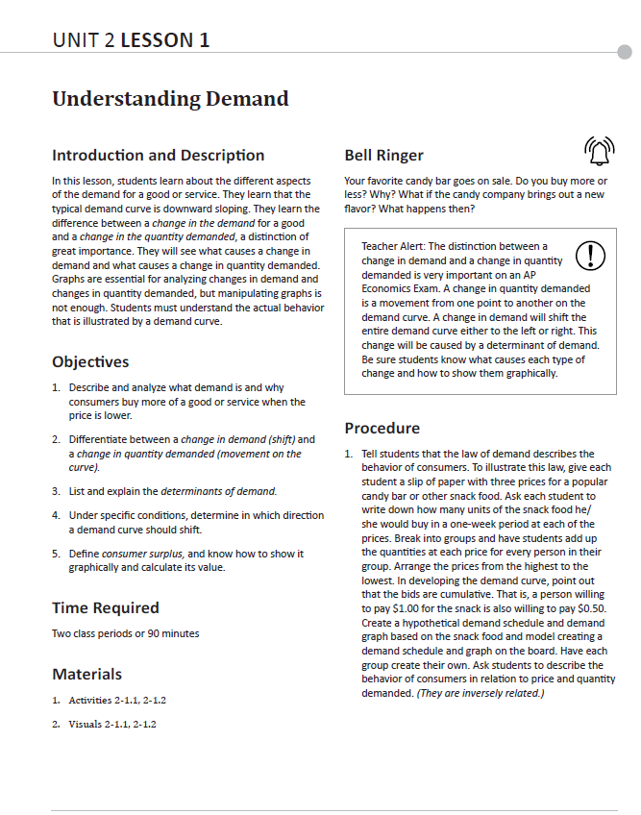
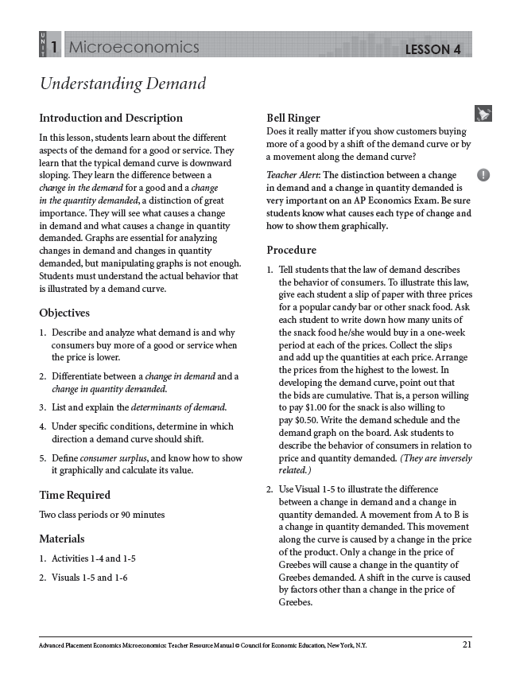
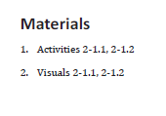
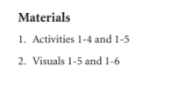
New 5th Edition
4th Edition

Slide 17
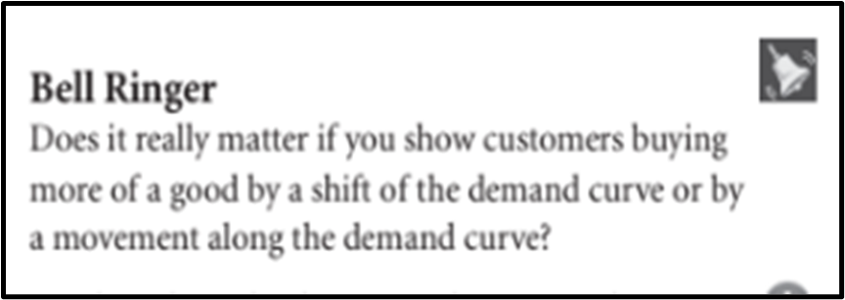
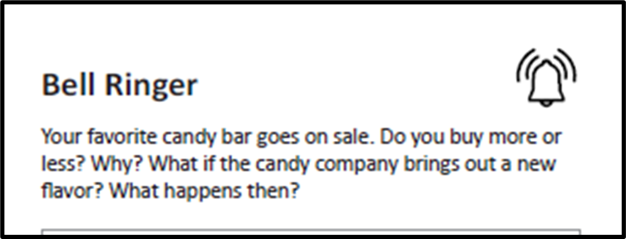
New 5th Edition
4th Edition

Slide 18
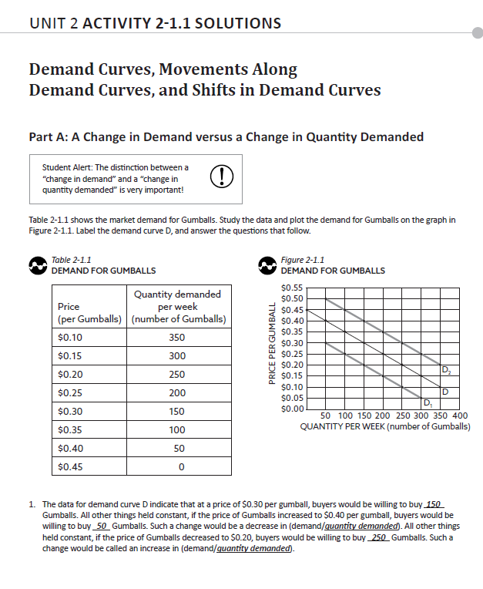

Slide 19
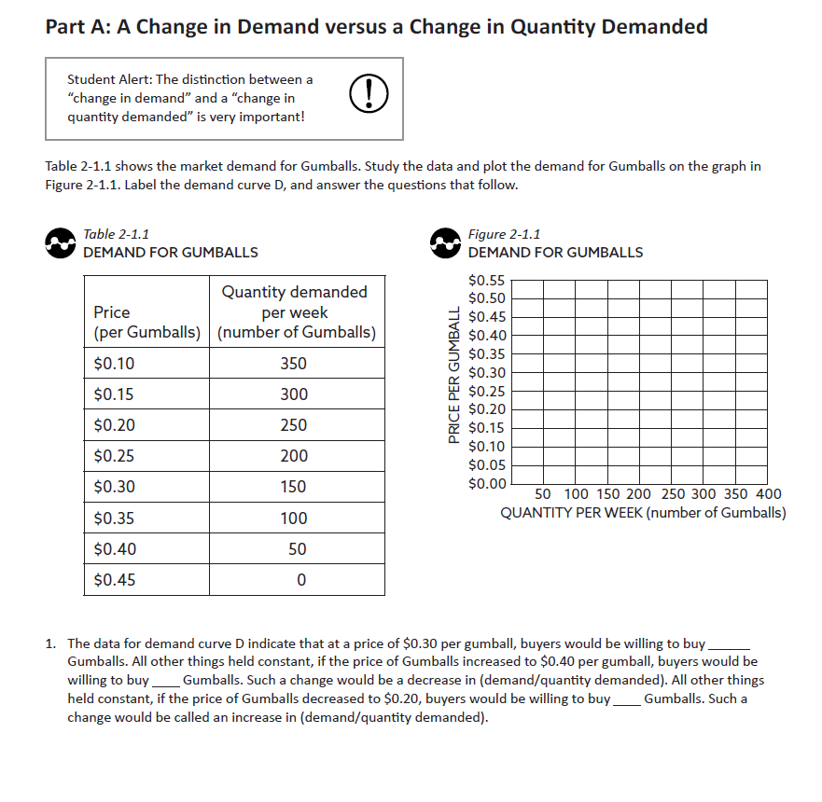

Slide 20
Let’s go right
to the books…

Slide 21
The CEE Store
Downloads of the Table of Contents and Front Pages
for Teacher Guide and Student Workbook
Go to the CEE Store on EconEdLink.org
https://store.councilforeconed.org/shopping_product_list.asp?catID=3839
https://store.councilforeconed.org/shopping_product_list.asp?catID=3839
https://store.councilforeconed.org/shopping_product_detail.asp?pid=52428

Slide 22
Questions?

Slide 23
Thank You!
Ruth Cookson
rcookson@councilforeconed.org

