Slide 1
Presented by: Kevin Morgan Email: LifeFinanceEd@gmail.com Date: 9.12.2023
Consumer Credit in America

Slide 2
EconEdLink Membership
You can now access CEE’s professional development webinars directly on EconEdLink.org! To receive these new professional development benefits, become an EconEdLink member. As a member, you will now be able to:
Automatically receive a professional development certificate via e-mail within 24 hours after viewing any webinar for a minimum of 45 minutes
Register for upcoming webinars with a simple one-click process
Easily download presentations, lesson plan materials and activities for each webinar
Search and view all webinars at your convenience
Save webinars to your EconEdLink dashboard for easy access to the event
Access our new Professional Development page here

Slide 3
Professional Development Opportunities
To earn professional development credit for CEE webinars found on EconEdLink, you must:
Watch a minimum of 45-minutes and you will automatically receive a professional development certificate via e-mail within 24 hours.
Attendees can learn how much credit they will earn per workshop.
Accessing resources:
You can now easily download presentations, lesson plan materials, and activities for each webinar from EconEdLink.org/professional-development/
Local resources:
Insert your local professional development opportunities (if applicable)

Slide 4
Assessment Questions
What are the largest sources of U.S. consumer debt?
What trends currently exist regarding Americans and the personal debt levels?
What role does credit play in the American economy?
What behaviors define responsible use of credit?

Slide 5
About Me
Teacher of Social Studies (Financial Literacy)
Traditional and alternative education
2017: Accepted into the Council for Economic Education Master Teacher program
Facilitate year-round teacher professional development workshops (NJCEE & CEE)
M.Ed. Curriculum & Instruction - The University of Massachusetts
Practicing REALTOR ​®

Slide 6
Objectives
Tonight, we will…..
Explain the history of credit in America
Understand the importance of credit
Analyze statistical trends within U.S. consumer debt
Identify the largest sources of U.S. consumer debt

Slide 7
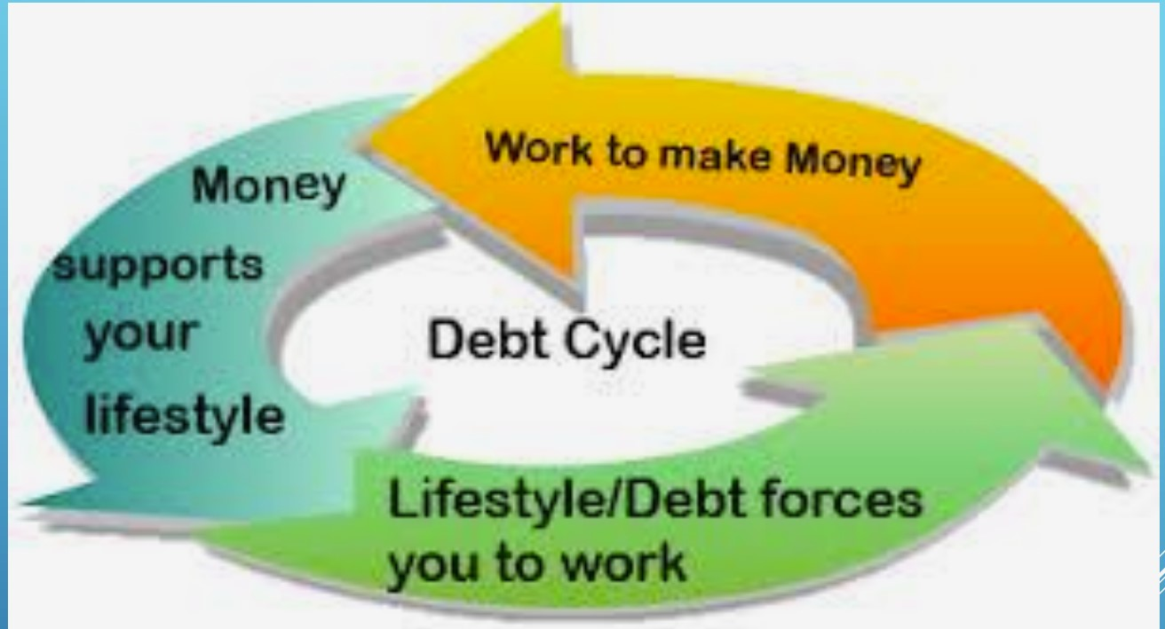
Origins of consumer debt

Slide 8
What’s New(s) in U.S. Consumer Debt

Slide 9
Consumer Debt Headlines
Consumer debt passes $17 trillion for the first time despite slide in mortgage demand (CNBC)
Americans Are Borrowing Again, Which Is Great News for Big Lenders (Wall Street Journal)
State lawmakers find America’s medical debt problem ‘can no longer be ignored’ (Politico)
Generation Z sees biggest increase in credit card debt, Gen X has highest balance: Report (ABC News)

Slide 10
History of Credit in America

Slide 11
Once Upon a Time …
19th Century:
- Rural: Population majority
- Americans’ perception of debt; “no-fun” debt
Credit was exclusive
Borrowing alternatives for the less well-to-do
20th Century:
Essential vs. non-essential
Expansion of luxury goods; “Roaring Twenties”
Innovation, industrialization and advertising, oh my!”
Growth of suburban communities

Slide 12
Current Trends:
Statistical Analysis

Slide 13
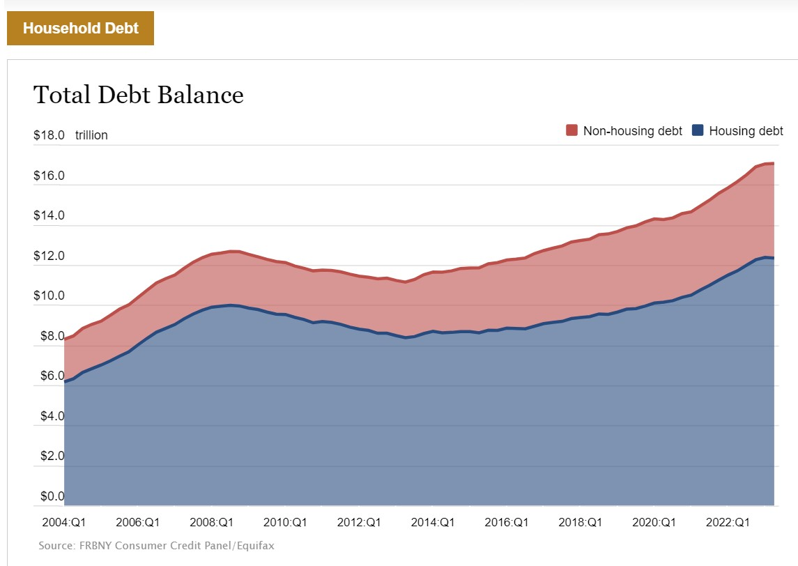
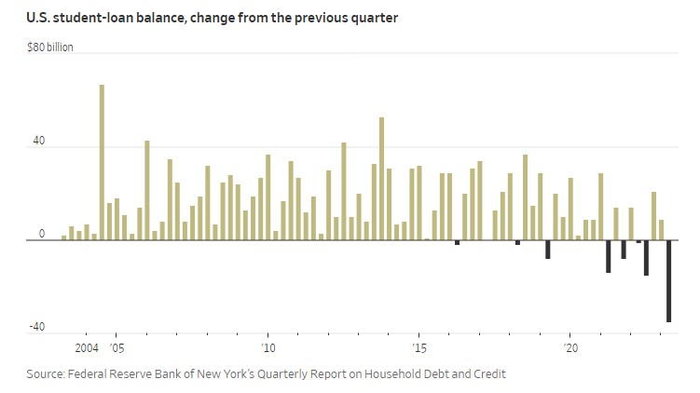
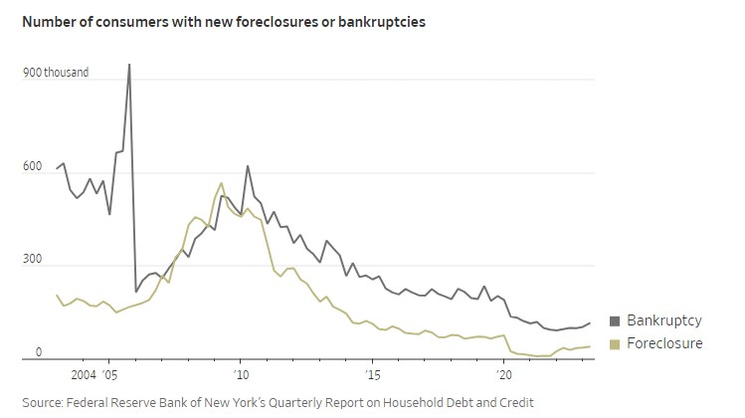
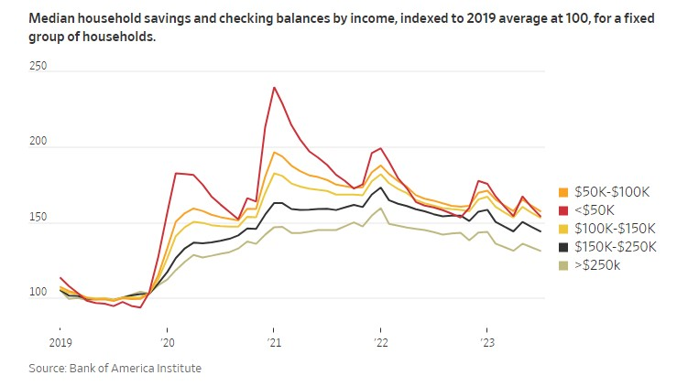
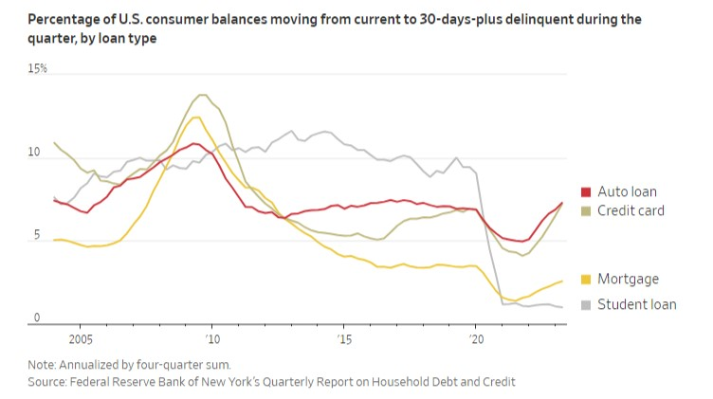
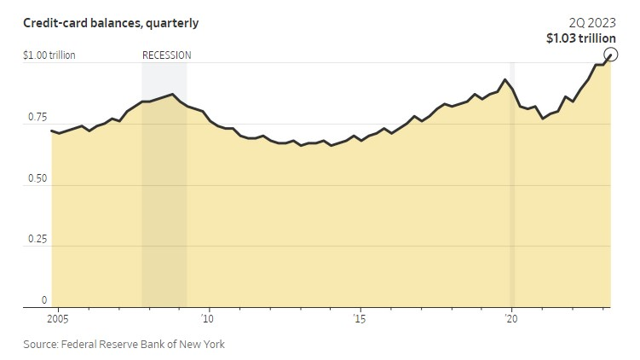
One nation …in debt…

Slide 14
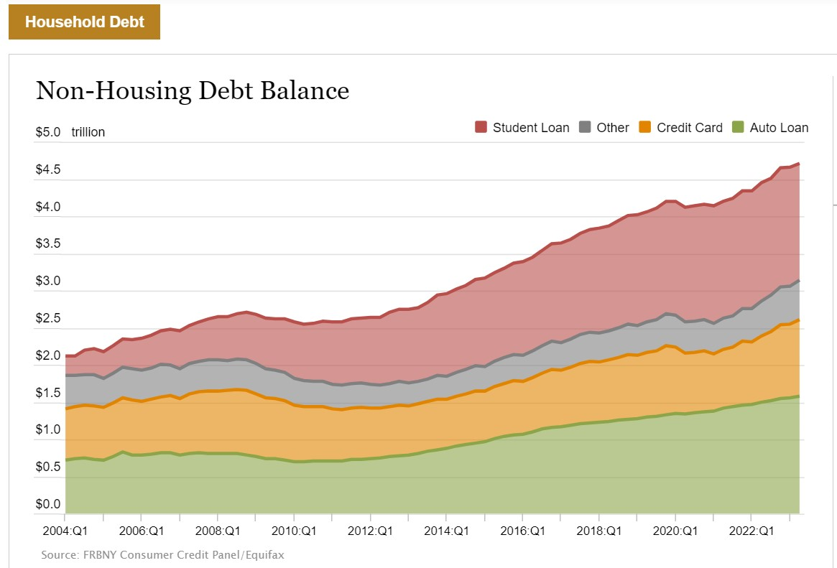
It’s not just mortgages!

Slide 15
Congratulations, grad! You’re in debt!

Slide 16
No one leaves home without it!

Slide 17
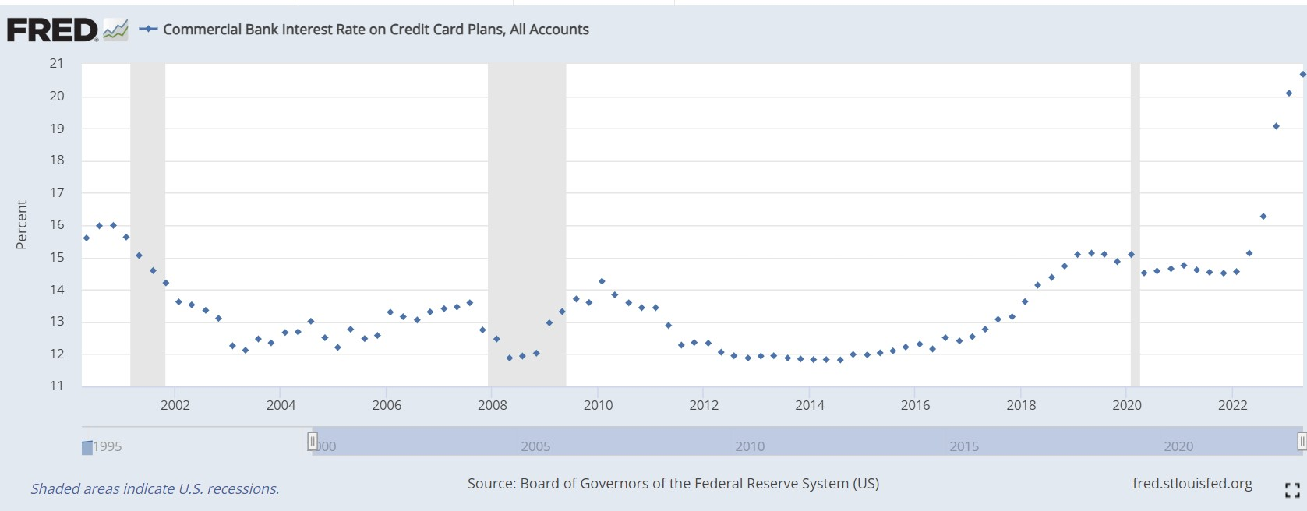
It’s not in your best … interest.

Slide 18
A new take on “buy now, pay later.”

Slide 19
Trending nicely

Slide 20
U.S. Consumer Debt:
A Summary

Slide 21
The Mortgage
Largest source of U.S. consumer debt
Total Debt: Approximately $12 trillion
Median home cost: $416,000
Median monthly payment: $1,600
Major Talking Point: Interest Rates

Slide 22
Student Loans
2nd Largest source of U.S. consumer debt
Total Debt: Approximately $1.7 trillion
Median loan balance: $20-$24K
Monthly payment: $200 - $300
Major Talking Point: Payment Restart

Slide 23
Automobile Loans
3rd largest source of U.S. consumer debt
Total Debt: Approximately $1.5 trillion
Average loan balance: ~20K
Monthly payment: $700 +
Major Talking Point: New vs. Used

Slide 24
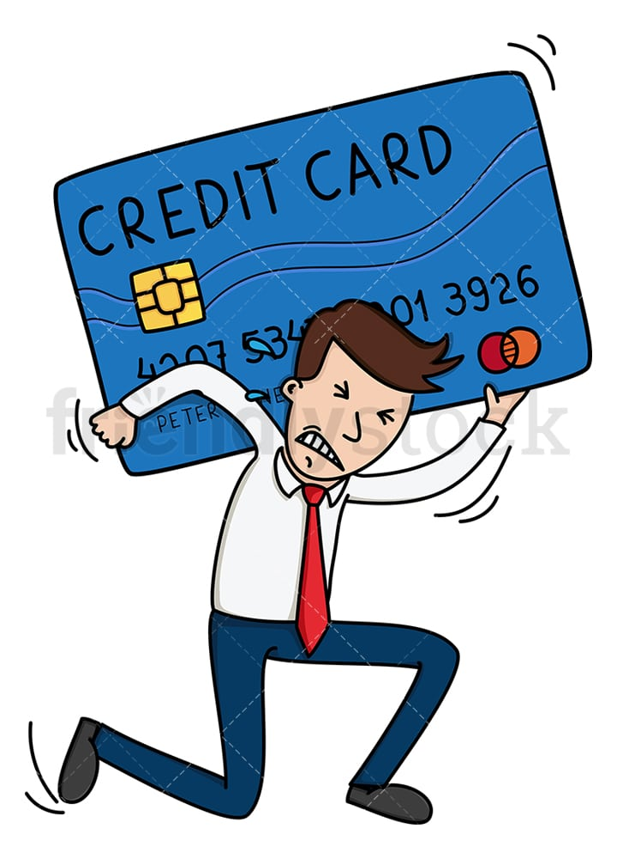
Credit Card Debt
4th largest source of U.S. consumer debt
Total Debt: Approximately $1 trillion
Average balance: ~$6,500
Monthly payment: $400 +
Major Talking Point: Balances & Interest Rates

Slide 25
Medical Debt
A “sleeping giant”
Total Debt: Approximately $200 billion
Average balance: 50% ($2 - $10K)
Major Talking Point: Medical costs & Insurance coverage

Slide 26
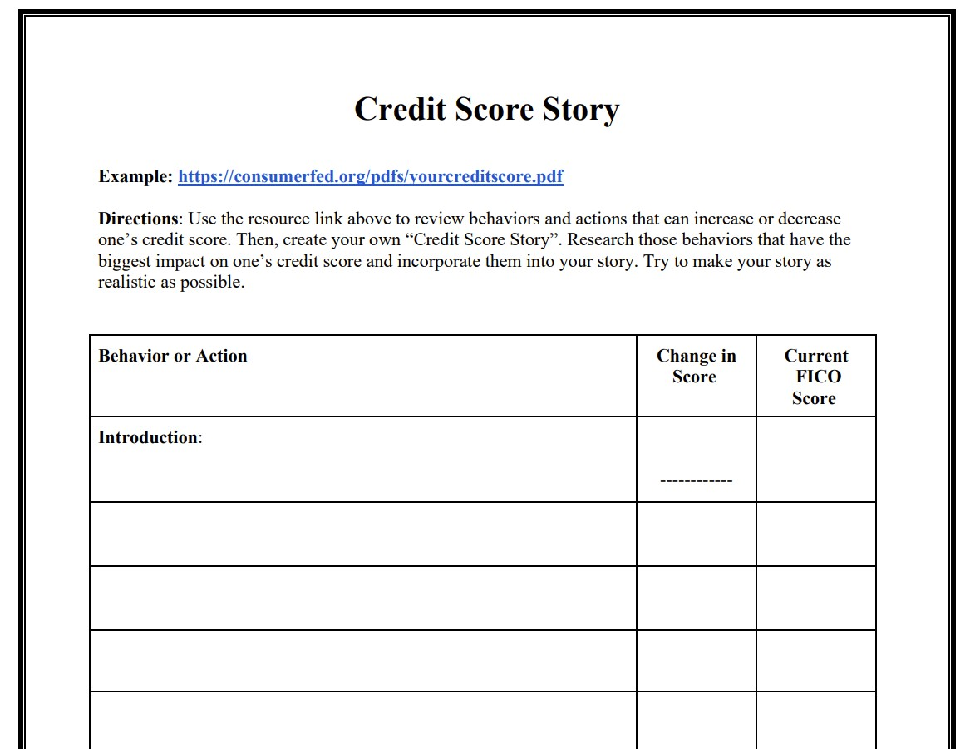
Credit Score Story

Slide 27
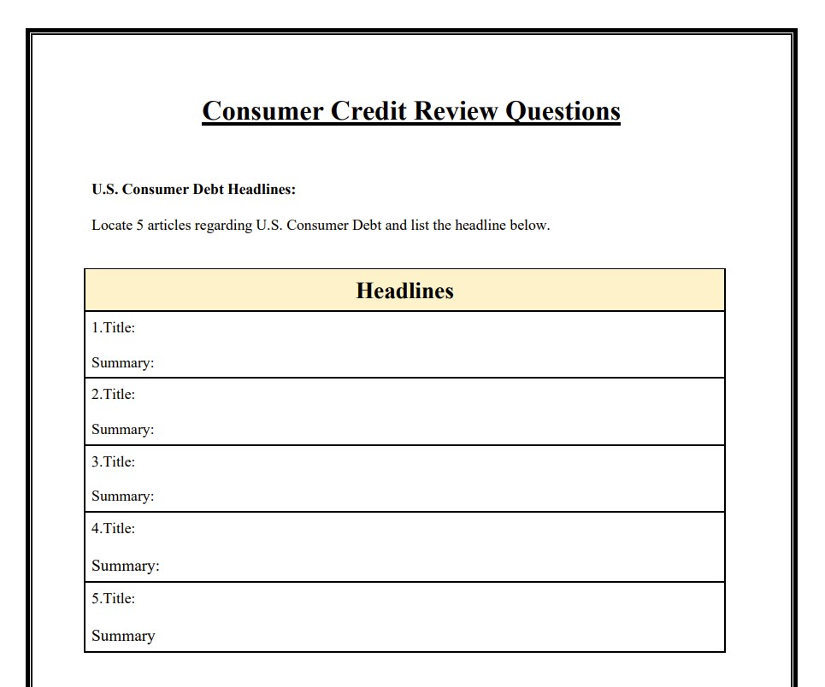
Calculating Simple Interest

Slide 28
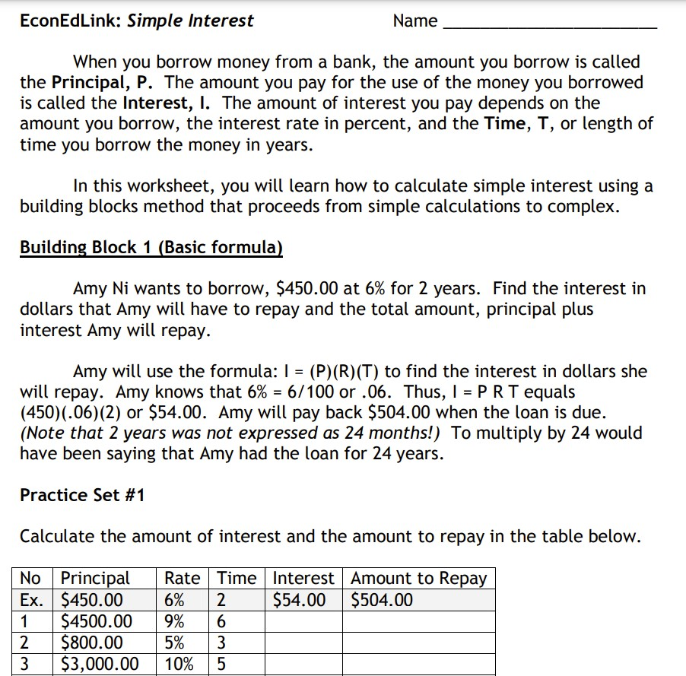
Calculating Simple Interest

Slide 29
National Standards for Personal Finance Education
V. Managing Credit
Credit allows people to purchase and enjoy goods and services today, while agreeing to pay for them in the future, usually with interest.
Lenders evaluate creditworthiness of a borrower based on the type of credit, past credit history, and expected ability to repay the loan in the future. (i.e. credit report, credit score)
Common types of credit include credit cards, auto loans, home mortgage loans, and student loans.

Slide 30
Content Information
https://www.cnbc.com/2023/05/15/consumer-debt-passes-17-trillion-for-the-first-time-despite-slide-in-mortgage-demand.html
https://www.wsj.com/articles/americans-are-borrowing-again-which-is-great-news-for-big-lenders-15be97b3
https://www.politico.com/news/2023/09/07/state-lawmakers-america-medical-debt-00114330
https://abcnews.go.com/US/generation-sees-biggest-increase-credit-card-debt-gen/story?id=102326452
https://www.fool.com/the-ascent/research/average-household-debt/
https://fred.stlouisfed.org/series/SLOAS
https://www.fool.com/the-ascent/credit-cards/articles/heres-how-much-the-average-american-is-spending-on-credit-card-debt-monthly/#:~:text=The%20typical%20consumer%20pays%20%24430,your%20debt%20easier%20to%20manage.

Slide 31
Content Information
https://fred.stlouisfed.org/tags/series?t=debt%3Bmortgage
https://www.cnbc.com/2023/08/11/why-americans-are-struggling-with-car-loans.html
Lessons and Resources
https://econedlink.org/?s=Consumer+Credit+&post_type=post
https://www.stlouisfed.org/search#siteResults_e=0&siteResults_q=Credit
https://www.ngpf.org/curriculum/types-of-credit/
https://www.ngpf.org/curriculum/managing-credit/
https://fred.stlouisfed.org/series/TERMCBCCALLNS

Slide 32
Kevin Morgan LifeFinanceEd@gmail.com
Thank You!

