Slide 1
Presented by: Kathleen Brennan Email: kmbrennan108@gmail.com Date: September 19, 2023
Deciding Who Gets What

Slide 2
Objectives
Understand the concepts of scarcity and choice.
Identify alternative methods for allocating scarce resources.
Explain how a scarce resource like kidneys can be allocated under alternative scenarios.

Slide 3
National Standards
Standard 2
Students will understand that: Effective decision making requires comparing the additional costs of alternatives with the additional benefits. Many choices involve doing a little more or a little less of something: few choices are “all or nothing” decisions.
Students will be able to use this knowledge to make effective decisions as consumers, producers, investors, and citizens.

Slide 4
New York State Standards
Standard 4- Economics
Students define and apply basic economic concepts such as scarcity, supply/demand, opportunity costs, production, resources, money and banking, economic growth, markets, costs, competition, and world economic systems.
The study of economics requires an understanding of major economic concepts and systems, the principles of economic decision making, and the interdependence of economies and economic systems throughout the world.

Slide 5
Scarcity

Slide 6
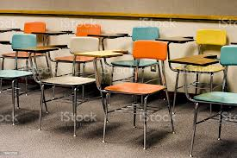
SCARCE CHAIRS’ ACTIVITY
Scarce Chairs Adapted from Jason Welker.docx

Slide 7
How Are Seats Allocated in Our Society?
Movie Theaters
Universities
Private Hospitals
Airlines
Restaurants

Slide 8
ALLOCATION METHODS
Lottery
First-come, first-served
Physical attributes
Merit
Rationing
Payment
Brute force- teacher or “ruler” decides

Slide 9
Economist’s Favorite Solution
Sealed- Bid Auction
Write your full name
Write the maximum amount you would be willing and able to pay each day to have a chair to sit in for the next month.
There is no limit; you can pay me each week. I will donate the money to a charity of my choice.
Once you make a bid to rent a chair, fold your bid, and hand it to me.

Slide 10
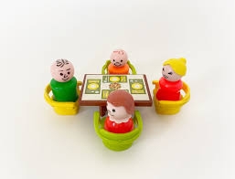
Time to Talk
Did everyone make a bid greater than zero?
Why/why not?
Why did some people bid more than others?
Was our system fair?
Did you feel bad for those who didn’t get a chair?

Slide 11
EQUITY vs. EFFICIENCY
Equity means fairness.
Efficiency means resources go toward their most socially optimal use.
The tradeoff between equity and efficiency is a major theme for societies!

Slide 12
SCARCITY
Everyone wants to sit– there aren’t enough chairs.
The greater the demand relative to the supply, the more scarce an item is.
Choices must therefore be made on how to allocate scarce resources.

Slide 13
Scarce Chairs’ Assignment
List the types of allocation schemes we identified in the scarce chairs’ activity.
Which one do you like and why? What are its advantages? disadvantages?
Is the method you identified the one we use to allocate goods in the United States? If not, what type of allocation mechanism do we use?
Is the allocation method used in the United States fair? In this regard, what does “fair” mean to you?
What is scarcity and why does it exist?
What is a “need”? What is a “want”?
What are some scarce resources in the world outside of school?
How should these scarce resources be allocated between competing wants and needs?
Who should get the stuff that these scarce resources go towards producing?

Slide 14
FUDAMENTAL ECONOMIC QUESTIONS
What is scarcity and why does it exist?
What are some of the scarce resources in the world outside of school?
How should scarce resources be allocated between competing needs and wants?
Who should get the stuff that scarce resources go towards producing?
What is fair? What is efficient?
What kind of system for allocating scarce resources is both efficient and fair?

Slide 15
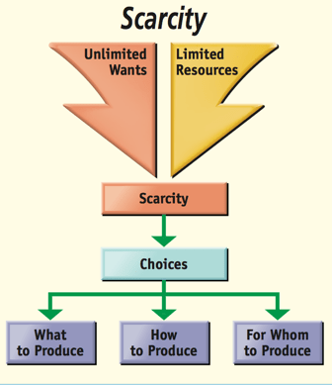

Slide 16
The Price System
Markets Typically Allocate Resources Based on Price and the Ability to Pay

Slide 17
BUT……Should There Be a Price For Everything?

Slide 18
SVU: Black Market Kidneys
(6:18)

Slide 19
Should There Be a Market for Kidneys?
After watching the video clip, answer the following questions:
Would the transplant process be more efficient if people could buy and sell organs?
Is it ethical to trade in organs, and what would be the negative consequences of this market?
3. What are the pros and cons of a market for kidneys?

Slide 20
The Current “Market” for Kidneys- 2023
Over 3,000 new patients are added to the kidney waiting list each month. Thirteen people die each day while waiting for a life-saving kidney transplant
The United States discards about 3,500 donated kidneys a year, many of which could be used to save lives.
For 25 years, the waiting list for donor kidneys, currently 106,000, has remained stubbornly high due to regulations rooted in a federal policy that amounts largely to first come, first served.
Source: National Kidney Foundation

Slide 21
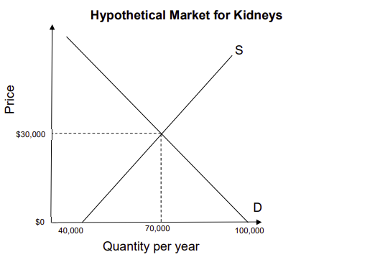
What About Human Organs Like Kidneys?
A Market in Kidneys Worksheet

Slide 22
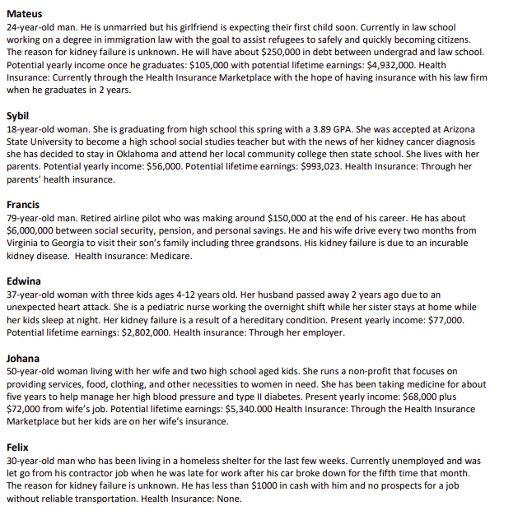
You have only one kidney, but six patients who need a kidney. They all suffer equally and will die within the year if they do not receive a kidney. Who should get the kidney?

Slide 23
Alternative Kidney Transplant Case Study
STUDENT HANDOUT
Kidney Transplant Case Study
Using the criteria listed, you are to select one patient for a kidney transplant. You are to assume that all suffer from equally urgent cases of kidney failure and that those who do not receive a transplant will die within the year.
CRITERIA: 1) the person's merit 2) their contribution to society (past or potential) 3) their ability to pay 4) their need 5) their age
Patient #1: Dr. M.
Forty-five year-old physician with large inner-city practice. Had mild he.art attack three years­ ago but made good recovery and he.art seems sound. No wife or children. Present yearly income: $70,000. Potential lifetime earnings: $994,095. Health insurance? Yes.
Patient #2: Bonnie T.
Twenty-four year- old mother of two children. Active in community work. Red Cross, church. Plans to resume nursing career when children reach school age (4 years). Yearly income now: (Husband's $32,000). Her potential lifetime earnings: $327,003. Health insurance? Yes.
Patient #3: Fred S.
Third year medical student, doing well and considered "of great promise" by his advisors. Plans to specialize in neurology. Father of one child, another on the way. Yearly income now:
$10,000. Potential life earnings: $1,149,812. Health insurance? Yes.
Patient #4: Agnes M.
Twenty-six year-old mother of two children, abandoned by husband. Unable to work because of lack of day-care facilities in area: presently on welfare. Activities: church, Tenant's Organization in her building, welfare rights organization. Present yearly income: (public aid
+ food stamps) $6,996. Potential lifetime earnings: $121,425. Health insurance'] Medicare.
Patient #5: Ellen R.
College junior, 20, suffering from hereditacy condition. Doing excellent work in school, has been accepted already for law school. Family fears her twin sister has the same disease. Yearly income now: (Parent's) $47,000. Potential lifetime earnings: $928,753. Health insurance? Yes.
7.4

Slide 24
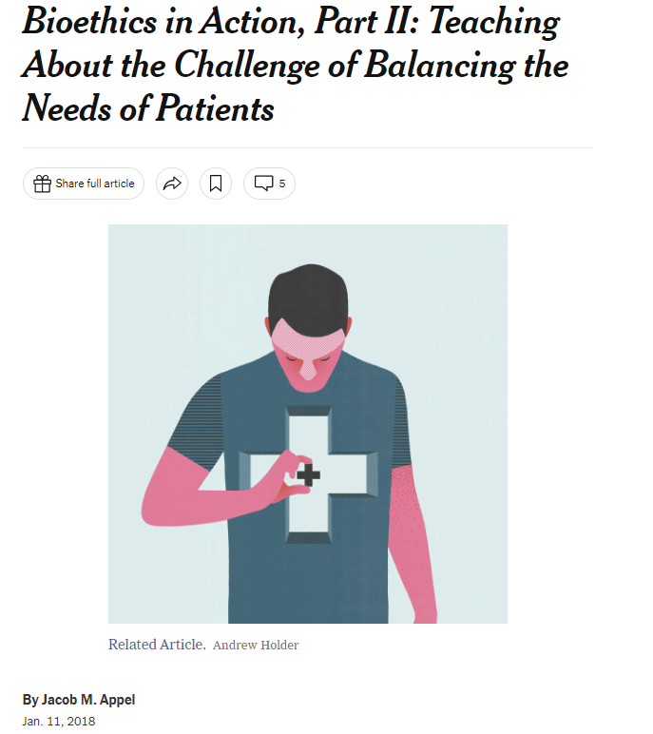
Room for Debate- New York Times
Allocating Scarce Resources- Lesson Plan

Slide 25
An Economist’s Solution (9:58)

Slide 26
Links to Resources
Scarce Chairs’ Adapted from Jason Welker.docx
Scarce Chairs' Assignment
SVU: Black Market Kidneys
A Market in Kidneys Worksheet- CEE
Kidney Transplant Case Study
Resource Scarcity Game
Room for Debate- New York Times
PBS- An Economist's Solution

Slide 27
Questions?? Contact: kmbrennan108@gmail.com
Thank You!

