Slide 1
Charting a Course for the Federal Budget and the National Debt
Notes:
Lesson Revision Author: Joel W. Miller (Jan. 2019)
*Teachers, see lesson notes in the Slides Notes within this presentation.

Slide 2

The Fiscal Ship
Part #1 – Understanding Challenges of the Federal Budget
Notes:
This lesson involves three parts (with optional extension activitiy in part IV):
Understanding Challenges of the Federal Budget (Slides 1-17)
Determining Values and Evaluating Policy Options (Slides 18-27)
Playing the Fiscal Ship Game (Slides 19-
Extension Activity - Complete the Political Typology Quiz by the Pew Research Center.

Slide 3
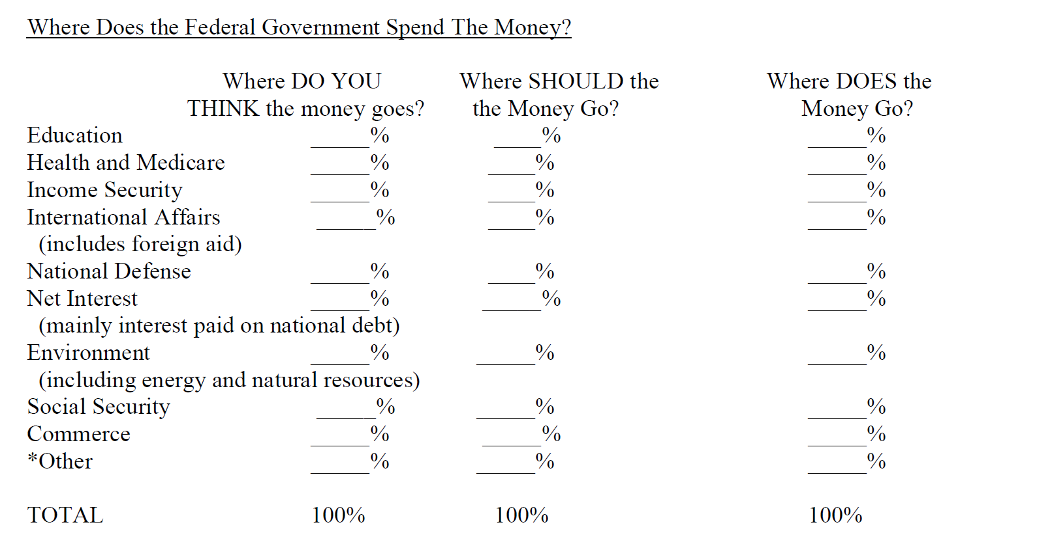
FY 2025
2.1
28.8
7.3
0.7
17.7
12.1
1.9
16.2
1.96
11.24
Notes:
Handout: Where Does the Govt Spend Its Money
Have students complete the first column – “Where do you think the money goes?”
Health and Medicare includes Medicaid and ACA
National Defense includes Veterans Benefits and Services
Commerce includes Community and Regional Development
Other is everything else – Administration of Justice, Agriculture, Generl Government, Science, Space, and Technology, Transportation and Unreported Data
https://www.usaspending.gov/explorer/budget_function

Slide 4
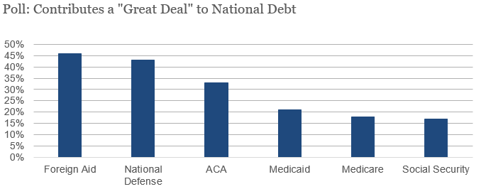
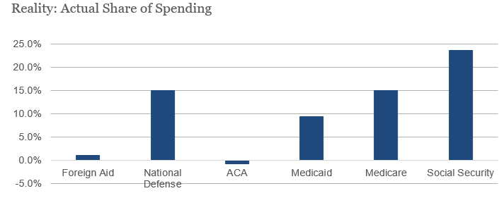
Misconceptions about the budget:
Source: Office of Management and Budget, Congressional Budget Office
Notes:
Sources: Vivien Lee, Brookings Institute
https://www.politico.com/f/?id=0000015a-819f-d2c6-a7db-d9bfcf110001
https://www.cbo.gov/system/files?file=115th-congress-2017-2018/costestimate/52939-hr1628amendment.pdf

Slide 5

Federal Budget
The taxing and spending plan of the national government
A budget deficit occurs in years the government's outlays (spending) are greater than its revenues (tax receipts)
Budget deficits increase the National Debt (the total unpaid borrowed funds, carried by the federal government).
A budget surplus occurs in years the government spending is less than its revenues. This would decrease the size of the National Debt.
Answer
#1-3 Now
Notes:
TEACHER NOTE: Prompt students to answer questions #1-2 from this Slide before advancing to Slide 4.

Slide 6
Mandatory Spending
Spending on certain programs required by existing law. Not dependent on an annual or periodic appropriation bill
  Social Security, Medicare, Medicaid, some veteran’s benefits, food stamps and interest on our national debt.
  “Entitlements” – if you meet eligibility requirements then you are entitled to Federal government benefits or services.
  About 70% of total spending

Slide 7
Discretionary
Spending Congress can adjust on a yearly basis. (Under the discretion of Congress)
  Department of Defense (DoD), Health and Human Services, Veterans Administration, State Department, Homeland Security, etc.
  Roughly half of our Discretionary budget goes to defense, but remember - discretionary spending is only 30 percent of the total budget.

Slide 8
Video: The Federal Budget: Where the Money Comes From and Where it Goes https://www.youtube.com/watch?v=z6ohGMgkYeE
Answer
#4 Now
Notes:
Teacher Note: Video reviews mandatory and discretionary spending, shows were the money goes and where the money comes from (taxes, borrowing) Video: 3:40 minutes (a good review of the previous slides)

Slide 9
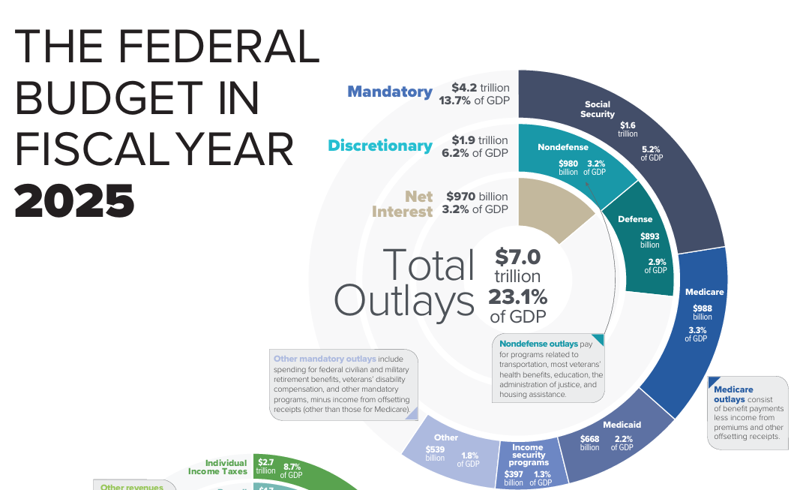
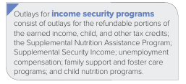
2025 Federal Budget
Source: Congressional Budget Office
Notes:
https://www.cbo.gov/system/files/2026-03/61950-federal-budget.pdf
About half of mandatory spending is spending on programs primarily aimed at the elderly. Social Security pays a monthly old-age benefit to those reaching retirement age (minimum 62), whereas Medicare pays for the health care expenses for those 65 and older. Social Security and Medicare also provide benefits to disabled individuals and families of retired, disabled, and deceased workers.
Next up is Medicaid, the health care program for the poor run jointly by the state and federal governments, and income security programs like unemployment insurance and food stamps. “Other mandatory programs” include an array of much smaller programs that range from federal government and military retirees’ benefits to veterans’ pensions. And last but not least, a portion of mandatory spending goes to interest payments on the federal debt.

Slide 10
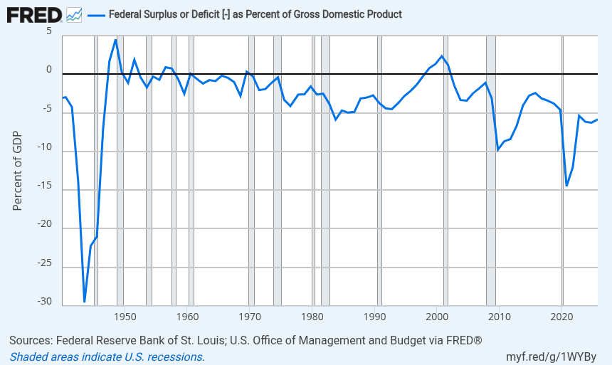
The federal government has run a deficit for much of the last century.
Notes:
Point out that spending increases during times of war (WW2 in the 1940s) and during recessions as a way to stimulate the economy.
Recessions are in the shadowed areas of the graph.
A useful method of comparison is to examine government spending as a percent of GDP over time. This takes into account inflation or growth in population and the real economy and gives a more accurate view of spending over time.
Source:
U.S. Office of Management and Budget
Source:
Federal Reserve Bank of St. Louis
Release:
Debt to Gross Domestic Product Ratios
Units:
Percent of GDP, Not Seasonally Adjusted
Frequency:
Annual, Fiscal Year
U.S. Office of Management and Budget and Federal Reserve Bank of St. Louis,
Federal Surplus or Deficit [-] as Percent of Gross Domestic Product [FYFSDFYGDP],
retrieved from FRED,
Federal Reserve Bank of St. Louis;
https://fred.stlouisfed.org/series/FYFSDFYGDP,
June 24, 2026.

Slide 11
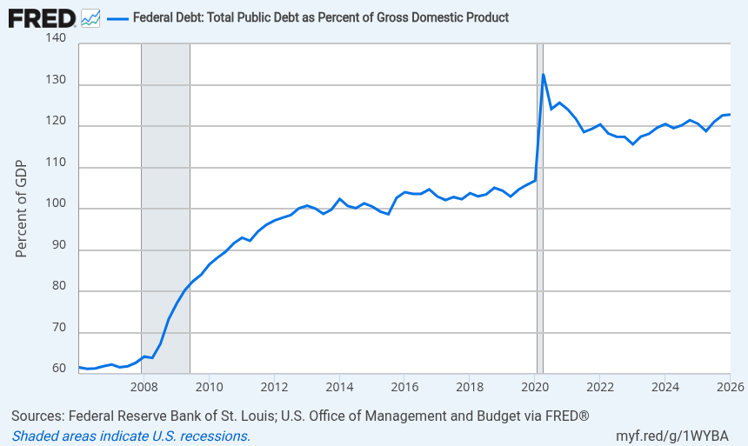
Debt as a % of GDP
Notes:
The ratio of publicly held debt to GDP is a better measure of a country's fiscal situation than just the nominal debt figure because it shows the burden of debt relative to the country's total economic output and therefore its ability to finance or repay it. Debt over 100% of GDP is a cause for worry. High during pandemic Q2 of 2020 134%. Most recent when slides were updated in June 2026 was 123% in Jan of 2026
Source:
U.S. Office of Management and Budget
Source:
Federal Reserve Bank of St. Louis
Release:
Debt to Gross Domestic Product Ratios
Units:
Percent of GDP, Seasonally Adjusted
Frequency:
Quarterly
Federal Debt: Total Public Debt as Percent of Gross Domestic Product (GFDEGDQ188S) was first constructed by the Federal Reserve Bank of St. Louis in October 2012. It is calculated using Federal Government Debt: Total Public Debt (GFDEBTN) and Gross Domestic Product, 1 Decimal (GDP):GFDEGDQ188S = ((GFDEBTN/1000)/GDP)*100GFDEBTN/1000 transforms GFDEBTN from millions of dollars to billions of dollars.
U.S. Office of Management and Budget and Federal Reserve Bank of St. Louis,
Federal Debt: Total Public Debt as Percent of Gross Domestic Product [GFDEGDQ188S],
retrieved from FRED,
Federal Reserve Bank of St. Louis;
https://fred.stlouisfed.org/series/GFDEGDQ188S,
June 24, 2026.

Slide 12
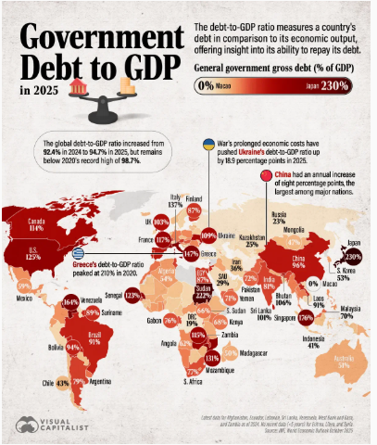
Notes:
https://www.voronoiapp.com/economy/Government-Debt-to-GDP-Around-the-World-in-2025--6978

Slide 13
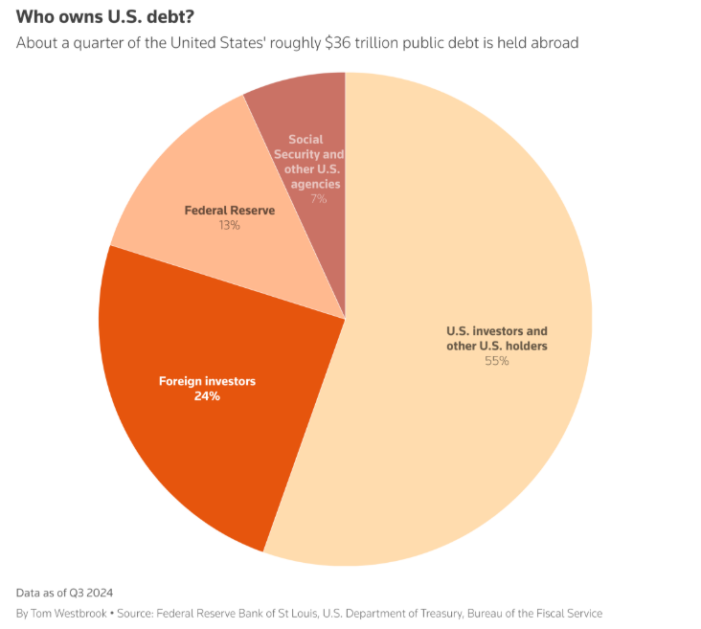
US PUBLIC DEBT –
Who holds the IOUs?
Notes:
. U.S. Federal Reserve system $4.7 trillion
Social Security and other U.S. agencies $2.4 trillion
Foreign investors $8.7 trillion
U.S. investors and other U.S. holders $19.7 trillion

Slide 14
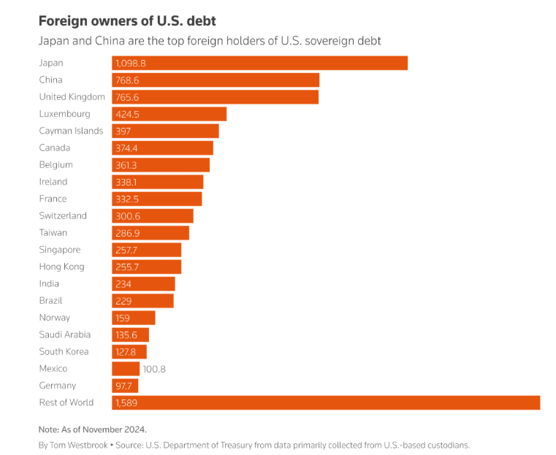
Notes:
https://www.reuters.com/markets/us/who-owns-us-debt-2025-02-10/

Slide 15
Looking at the Federal Budget from Multiple Perspectives

Slide 16
National income will be greater tomorrow than it is today because Government has had the courage to borrow idle capital and put it and idle labor to work. . . . Our national debt after all is an internal debt owed not only by the Nation but to the Nation.
If our children have to pay interest on it they will pay that interest to themselves.
A reasonable internal debt will not impoverish our children or put the Nation into bankruptcy.
—President Franklin D. Roosevelt, May 22, 1939

Slide 17
I have long argued that paying down the national debt is beneficial for the economy: it keeps interest rates lower than they otherwise would be and frees savings to finance increases in the capital stock, thereby boosting productivity and real incomes.
—Federal Reserve Board Chairman Alan Greenspan, April 27, 2001

Slide 18
The U.S. Public Debt
Interest charges on debt
  Main burden of the debt
    US has to pay the interest on the debt in order to remain in good credit standing.
  3.2% of GDP in 2025
  12.1% of budget in 2025
LO4
13-18
Notes:
Interest charges are the main burden imposed by the debt because government always has to at least pay the interest on their debt in order to remain in good credit standing.
Can the federal government go bankrupt? There are reasons why it cannot.
The government can raise taxes to pay back the debt, and it can borrow more (i.e. sell new bonds) to refinance bonds when they mature. Corporations use similar methods—they almost always have outstanding debt. Of course, refinancing could become an issue with a high enough debt-to-GDP ratio. Some countries, such as Greece, have run into this problem. High and rising ratios in the United States might raise fears that the U.S. government might be unable to pay back loans as they come due. But, with the present U.S. debt-to-GDP ratio and the prospects of long-term economic growth, this is a false concern for the United States.
The government has the power to tax, which businesses and individuals do not have when they are in debt.
Does the debt impose a burden on future generations? In 2009 the per capita federal debt in U.S. was $37,437. But the public debt is a public credit—your grandmother may own the bonds on which taxpayers are paying interest. Some day you may inherit those bonds that are assets to those who have them. The true burden is borne by those who pay taxes or loan government money today to finance government spending. If the spending is for productive purposes, it will enhance future earning power and the size of the debt relative to future GDP and population could actually decline. Borrowing allows growth to occur when it is invested in productive capital.

Slide 19
The U.S. Public Debt
False Concerns
  Bankruptcy
  Burdening Future Generations
Real Concerns
  Unequal income distribution
  Foreign Owned debt
  Crowding out Effect
LO4
13-19
Notes:
Interest charges are the main burden imposed by the debt because government always has to at least pay the interest on their debt in order to remain in good credit standing. Can the federal government go bankrupt? There are reasons why it cannot.
The government can raise taxes to pay back the debt, and it can borrow more (i.e. sell new bonds) to refinance bonds when they mature. Corporations use similar methods—they almost always have outstanding debt. Of course, refinancing could become an issue with a high enough debt-to-GDP ratio. Some countries, such as Greece, have run into this problem. High and rising ratios in the United States might raise fears that the U.S. government might be unable to pay back loans as they come due. But, with the present U.S. debt-to-GDP ratio and the prospects of long-term economic growth, this is a false concern for the United States.
The government has the power to tax, which businesses and individuals do not have when they are in debt.
Does the debt impose a burden on future generations? In 2009 the per capita federal debt in U.S. was $37,437. But the public debt is a public credit—your grandmother may own the bonds on which taxpayers are paying interest. Some day you may inherit those bonds that are assets to those who have them. The true burden is borne by those who pay taxes or loan government money today to finance government spending. If the spending is for productive purposes, it will enhance future earning power and the size of the debt relative to future GDP and population could actually decline. Borrowing allows growth to occur when it is invested in productive capital.

Slide 20
The U.S. Public Debt
False Concerns
  Bankruptcy? US is not going bankrupt any time soon.
    Increase taxes
    Borrow (sell new bonds)
      Corporations do this – almost always have outstanding debt
LO4
13-20
Notes:
Interest charges are the main burden imposed by the debt because government always has to at least pay the interest on their debt in order to remain in good credit standing.
Can the federal government go bankrupt? There are reasons why it cannot.
The government can raise taxes to pay back the debt, and it can borrow more (i.e. sell new bonds) to refinance bonds when they mature. Corporations use similar methods—they almost always have outstanding debt. Of course, refinancing could become an issue with a high enough debt-to-GDP ratio. Some countries, such as Greece, have run into this problem. High and rising ratios in the United States might raise fears that the U.S. government might be unable to pay back loans as they come due. But, with the present U.S. debt-to-GDP ratio and the prospects of long-term economic growth, this is a false concern for the United States.
The government has the power to tax, which businesses and individuals do not have when they are in debt.
Does the debt impose a burden on future generations? In 2009 the per capita federal debt in U.S. was $37,437. But the public debt is a public credit—your grandmother may own the bonds on which taxpayers are paying interest. Some day you may inherit those bonds that are assets to those who have them. The true burden is borne by those who pay taxes or loan government money today to finance government spending. If the spending is for productive purposes, it will enhance future earning power and the size of the debt relative to future GDP and population could actually decline. Borrowing allows growth to occur when it is invested in productive capital.

Slide 21
The U.S. Public Debt
False Concerns
  Burdening future generations
    We owe this debt to ourselves.
    Paying it off pays it back to ourselves in a giant transfer payment. Purchasing power won’t change.
    If excess spending is used to increase productivity – allows growth/GDP
LO4
13-21
Notes:
Interest charges are the main burden imposed by the debt because government always has to at least pay the interest on their debt in order to remain in good credit standing.
Can the federal government go bankrupt? There are reasons why it cannot.
The government can raise taxes to pay back the debt, and it can borrow more (i.e. sell new bonds) to refinance bonds when they mature. Corporations use similar methods—they almost always have outstanding debt. Of course, refinancing could become an issue with a high enough debt-to-GDP ratio. Some countries, such as Greece, have run into this problem. High and rising ratios in the United States might raise fears that the U.S. government might be unable to pay back loans as they come due. But, with the present U.S. debt-to-GDP ratio and the prospects of long-term economic growth, this is a false concern for the United States.
The government has the power to tax, which businesses and individuals do not have when they are in debt.
Does the debt impose a burden on future generations? In 2009 the per capita federal debt in U.S. was $37,437. But the public debt is a public credit—your grandmother may own the bonds on which taxpayers are paying interest. Some day you may inherit those bonds that are assets to those who have them. The true burden is borne by those who pay taxes or loan government money today to finance government spending. If the spending is for productive purposes, it will enhance future earning power and the size of the debt relative to future GDP and population could actually decline. Borrowing allows growth to occur when it is invested in productive capital.

Slide 22
Substantive Issues
Real Concerns
Income distribution
Foreign-owned public debt
Crowding-out effect
  Future generations
  Public investment
LO4
13-22
Notes:
Repayment of the debt affects income distribution. If working taxpayers will be paying interest to the mainly wealthier groups who hold the bonds, this probably increases income inequality.
Since interest must be paid out of government revenues, a large debt and high interest can increase the tax burden and may decrease incentives to work, save, and invest for taxpayers.
A higher proportion of the debt is owed to foreigners (about 28 percent) than in the past, and this can increase the burden since payments leave the country. But Americans also own foreign bonds and this offsets the concern.
Some economists believe that public borrowing crowds out private investment, but the extent of this effect is not clear. See the next slide for the graph.
There are some positive aspects of borrowing even with crowding-out. If borrowing is for public investment that causes the economy to grow more in the future, the burden on future generations will be less than if the government had not borrowed for this purpose. Public investment makes private investment more attractive. For example, new federal buildings generate private business; good highways help private shipping, etc.

Slide 23
Substantive Issues
Real Concerns
Income distribution
  Repayment of the debt affects income distribution.
  If working taxpayers will be paying interest to the mainly wealthier groups who hold the bonds, this increases income inequality.
LO4
13-23
Notes:
Repayment of the debt affects income distribution. If working taxpayers will be paying interest to the mainly wealthier groups who hold the bonds, this probably increases income inequality.
Since interest must be paid out of government revenues, a large debt and high interest can increase the tax burden and may decrease incentives to work, save, and invest for taxpayers.
A higher proportion of the debt is owed to foreigners (about 29 percent) than in the past, and this can increase the burden since payments leave the country. But Americans also own foreign bonds and this offsets the concern.
Some economists believe that public borrowing crowds out private investment, but the extent of this effect is not clear. See the next slide for the graph.
There are some positive aspects of borrowing even with crowding-out. If borrowing is for public investment that causes the economy to grow more in the future, the burden on future generations will be less than if the government had not borrowed for this purpose. Public investment makes private investment more attractive. For example, new federal buildings generate private business; good highways help private shipping, etc.

Slide 24
Substantive Issues
Real Concerns
Foreign-owned public debt
  This can increase the burden since payments leave the country.
  But Americans also own foreign bonds and this could offset the concern.
LO4
13-24
Notes:
Repayment of the debt affects income distribution. If working taxpayers will be paying interest to the mainly wealthier groups who hold the bonds, this probably increases income inequality.
Since interest must be paid out of government revenues, a large debt and high interest can increase the tax burden and may decrease incentives to work, save, and invest for taxpayers.
A higher proportion of the debt is owed to foreigners (about 29 percent) than in the past, and this can increase the burden since payments leave the country. But Americans also own foreign bonds and this offsets the concern.
Some economists believe that public borrowing crowds out private investment, but the extent of this effect is not clear. See the next slide for the graph.
There are some positive aspects of borrowing even with crowding-out. If borrowing is for public investment that causes the economy to grow more in the future, the burden on future generations will be less than if the government had not borrowed for this purpose. Public investment makes private investment more attractive. For example, new federal buildings generate private business; good highways help private shipping, etc.

Slide 25
Substantive Issues
Real Concerns
Crowding-out effect
  Future generations
  Public investment
LO4
13-25
Notes:
Repayment of the debt affects income distribution. If working taxpayers will be paying interest to the mainly wealthier groups who hold the bonds, this probably increases income inequality.
Since interest must be paid out of government revenues, a large debt and high interest can increase the tax burden and may decrease incentives to work, save, and invest for taxpayers.
A higher proportion of the debt is owed to foreigners (about 29 percent) than in the past, and this can increase the burden since payments leave the country. But Americans also own foreign bonds and this offsets the concern.
Some economists believe that public borrowing crowds out private investment, but the extent of this effect is not clear. See the next slide for the graph.
There are some positive aspects of borrowing even with crowding-out. If borrowing is for public investment that causes the economy to grow more in the future, the burden on future generations will be less than if the government had not borrowed for this purpose. Public investment makes private investment more attractive. For example, new federal buildings generate private business; good highways help private shipping, etc.

Slide 26
MRU Fiscal policy review
https://mru.org/courses/principles-economics-macroeconomics/fiscal-policy-crowding-out
4 minutes - good review of crowding out

Slide 27
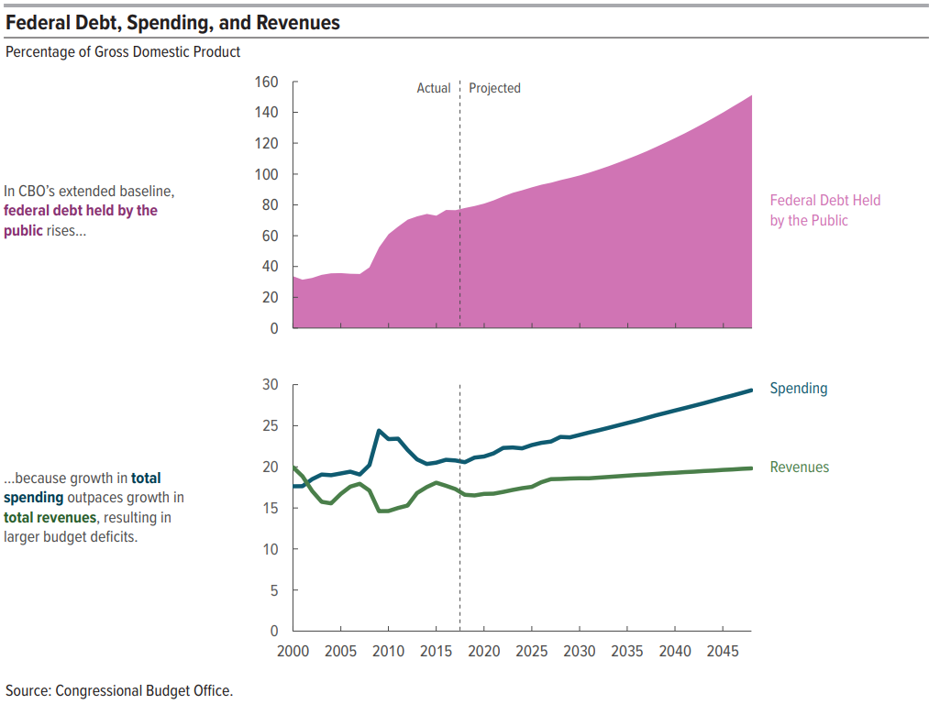
Challenge #1: Growing Budget Deficits
Source: Congressional Budget Office
Notes:
TEACHER NOTE:
That expectation of slower economic growth in the future is attributable to several factors— most notably, slower growth of the labor force. Projected growth in output is also held down by the effects of changes in fiscal policy under current law—above all, by the reduction in private investment that is projected to result from rising federal deficits. (CBO, The 2018 Long-Term Budget Outlook p. 4)

Slide 28
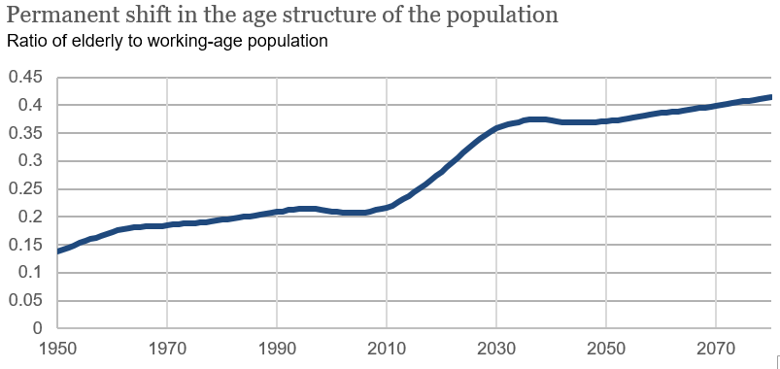
Challenge #2: Population Aging
Source: Social Security Administration
Image credit: Vivien Lee (Senior Research Assistant- Hutchins Center on Fiscal and Monetary Policy, The Brookings Institution)
Notes:
SSA, intermediate assumptions https://www.ssa.gov/oact/TR/2011/lr5a2.html
Image credit: Vivien Lee (Senior Research Assistant- Hutchins Center on Fiscal and Monetary Policy, The Brookings Institution)

Slide 29
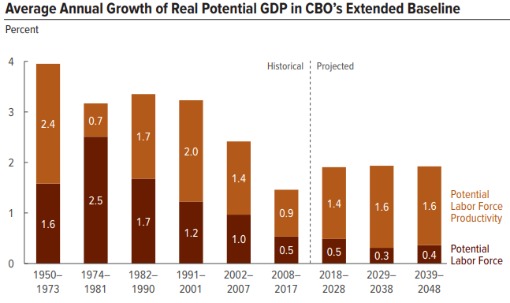
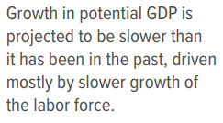
Challenge #2: Population Aging
Source: Congressional Budget Office
Notes:
(CBO, The 2018 Long-Term Budget Outlook)
“Permanent shift in the age structure of the population.” Ration of elderly to working-age population is increasing as fertility rates fall and life expectancies increase.

Slide 30
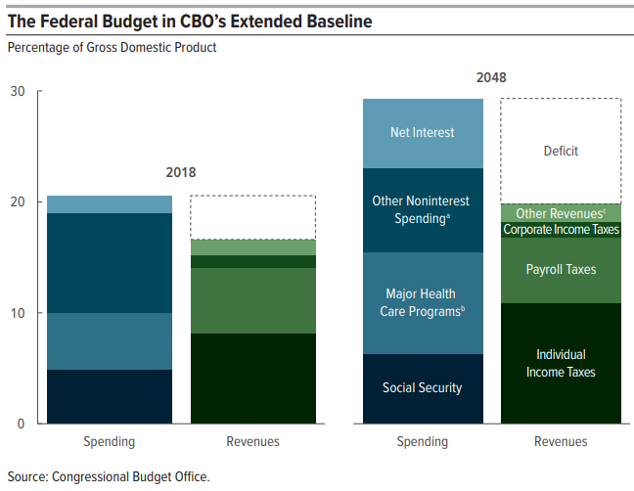
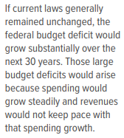
Challenge #3: Increased Costs for Major Health Care Programs
Source: Congressional Budget Office
Notes:
The extended baseline generally reflects current law, following CBO’s 10-year baseline budget projections through 2028 and then extending most of the concepts underlying those baseline projections for the rest of the long-term projection period.
Consists of all federal spending other than that for Social Security, the major health care programs, and net interest.
Consists of spending for Medicare (net of premiums and other offsetting receipts), Medicaid, and the Children’s Health Insurance Program, as well as outlays to subsidize health insurance purchased through the marketplaces established under the Affordable Care Act and related spending.
Consists of excise taxes, remittances to the Treasury from the Federal Reserve System, customs duties, estate and gift taxes, and miscellaneous fees and fines.
*It is important to emphasize that CBO numbers are what would happen under current law, which is not necessarily what is likely to happen (For instance, the law might say that certain tax cuts will expire. But historically, Congress usually doesn’t let tax cuts expire. CBO must estimate what is said under current law—that the tax cuts will expire. This is not the same of what CBO expects will happen).

Slide 31
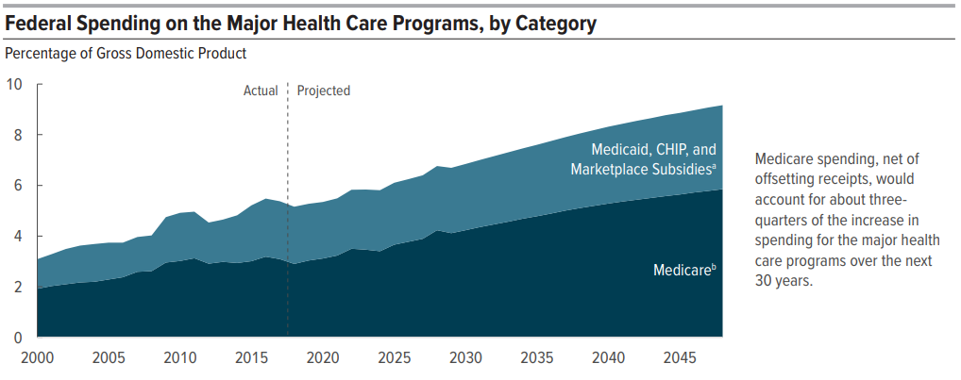
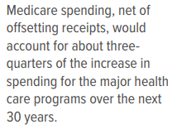
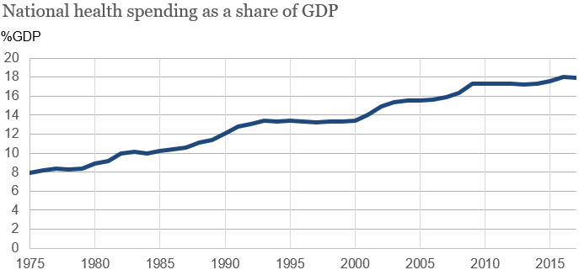
Notes:
Source: (CBO, The 2018 Long-Term Budget Outlook)
The extended baseline generally reflects current law, following CBO’s 10-year baseline budget projections through 2028 and then extending most of the concepts underlying those baseline projections for the rest of the long-term projection period.
CHIP = Children’s Health Insurance Program; GDP = gross domestic product.
“Marketplace Subsidies” refers to spending to subsidize health insurance purchased through the marketplaces established under the Affordable Care Act and insurance provided through the Basic Health Program, as well as spending to stabilize premiums for health insurance purchased by individuals and small employers.
Refers to net spending for Medicare, which accounts for offsetting receipts that are credited to the program. Those offsetting receipts are mostly premiums paid by beneficiaries to the government.
*It is important to emphasize that CBO numbers are what would happen under current law, which is not necessarily what is likely to happen (For instance, the law might say that certain tax cuts will expire. But historically, Congress usually doesn’t let tax cuts expire. CBO must estimate what is said under current law—that the tax cuts will expire. This is not the same of what CBO expects will happen).

Slide 32
What consequences do a large and growing federal debt have?
Significant negative consequences of a large and growing federal debt:
  Reduce national savings and income in long-term
  Increase the government’s interest costs, putting more pressure on the rest of the budget
  Limit lawmaker’s ability to respond to unforeseen events
  Increase the likelihood of a fiscal crisis, a situation in which the interest rate on federal debt rises abruptly, dramatically increasing the cost of government borrowing.
Notes:
(CBO, The 2018 Long-Term Budget Outlook p. 8)
TEACHER NOTE:
Large amount of federal borrowing would draw money away from private investment in productive capital over the long term
↑ federal spending on interest payments → ↑taxes, ↓ spending on benefits/services, or both

Slide 33
The Fiscal Ship
Part #2 – Determining Values and Evaluating Policy Options

Slide 34
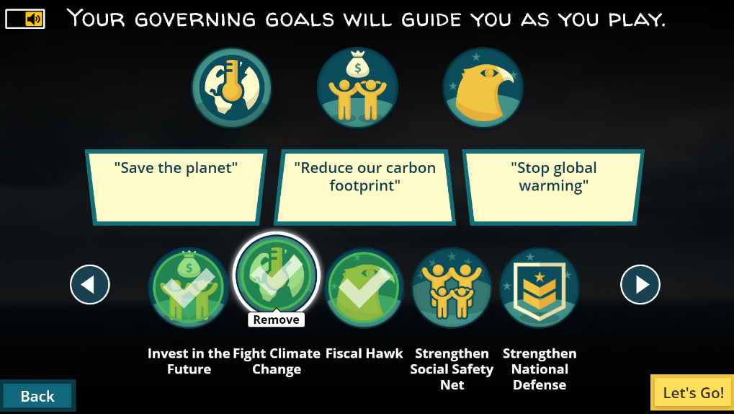
See Handout #2:
Select Your Governing Goals
Before we begin the game, you’ll select your governing goals. The goals are your aspirations and values – the ones that shape the kind of country we live in. Select 3 of the 10 goals.
Notes:
TEACHER NOTES:
See the 10 goals on the next three slides. Read through the goal choices and allow students to select their goals.

Slide 35
Fiscal Ship Governing Goals
Select 3 out of the 10
Reduce Inequality: The disparity between Americans who have the most and the least income is growing, mirrored by disparities in education, health, and family structure. You want to narrow the widening gaps in incomes and well-being at the top and the bottom.
Strengthen National Defense: Projections of current policies show defense spending, measured as a share of the economy, falling over the next decade and then plateauing. You’d bolster the U.S. military by providing it with more personnel and more arms. (To reach fiscal sustainability, you’ll have to pay for these somehow.)
Fight Climate Change: You want to use government policies to promote a cleaner, healthier environment, reduce greenhouse gas emissions and avoid the damage that could be caused by global climate change.
Strengthen Social Safety Net: You believe it’s important for the federal government to give a hand up to those in poverty and protect those at risk of falling down the income ladder when times are tough. You want to expand and protect programs that protect the vulnerable.
More Goals to Select from on the next two slides…

Slide 36
Fiscal Ship Governing Goals
Select 3 out of the 10
Tax Cutter: You believe lower taxes will boost economic growth and want to allow Americans to keep more of what they earn. Your goal is to substantially reduce federal tax revenues as a share of the economy. (To reach fiscal sustainability, you’ll have to cut spending, too.)
Shrink Government: You believe that we’re better off with a leaner federal government, shifting responsibilities to the private, non-profit and state and local sectors. Spending on general government operations and federal programs (other than health and retirement benefits) is projected under current policy to decline over the next decade. You’d reduce it more.
Shield the Elderly: Under current policy, about 60% of the increase in federal spending over the next decade will go to Social Security, Medicare, Medicaid and other major health programs, much of that for the growing number of people who will be over age 65. You want to protect benefits for senior citizens.
More Goals to Select from on the next slide…

Slide 37
Fiscal Ship Governing Goals
Select 3 out of the 10
Invest in the Future: You believe in planting seeds today that will be harvested in years to come. You want policies to increase, above what’s currently projected, government and private investment in children and young adults and in education, infrastructure and research that will pay off in the future. (To reach fiscal sustainability, you’ll have to pay for these somehow.)
Fiscal Hawk: You’re not satisfied with restraining the projected increase in the federal debt so that in 25 years it’s roughly where it is today, measured as a share of the overall economy. To put the government and the economy on a sounder footing, you want to reduce it substantially below today’s levels.
Rein in Entitlements: Spending on retirement, health and other government benefits, much of that for the elderly, account for two-thirds of non-interest spending today and threaten to squeeze out spending on everything else—from equipping soldiers with modern gear to repairing old bridges to pursuing cures for cancer. You want to restrain this spending to make room for other priorities.

Slide 38
Your governing goals – Pair-and-Share
Turn to a neighbor and discuss the following questions…
Partner #1 Explain:
Which goals did you choose?
Why did you choose these goals?
Partner #2 Explain:
Which goals did you choose?
Why did you choose these goals?
Discuss together and record your answers on Handout #3, question #3.
Do your goals work together so achieve a common objective?
Do they balance both revenues and expenditures so that you will be able to put the country on a sustainable fiscal path?
Are there any inherent contradictions in your selected goals that make policy-making difficult during the game?

Slide 39
Evaluate Policy Options in the Game
Policy Options on the Fiscal Ship
  Based on your personal beliefs as stated in your three governing goals, highlight options you agree with in GREEN (good) and those you absolutely disagree with in YELLOW (yucky), or simply place a ‘+’ or ‘—’ by the policies if they do (or do not) align with your three governing goals.
Notes:
Teacher Note:
Some policies could debatably be categorized into more than one view point. Allow the student to decide which policies they favor given their governing goal and values. The importance of this exercise is to practice carefully weighing how policies align with governing goals. Thinking about the three common political views only serves to provide some consistency during policy evaluating. This is a skill they will be applying when they play the Fiscal Ship game.

Slide 40
Completely Evaluate Policies for all Categories
Next Stop…
Game Time!
Notes:
This will likely be the end of day 1. The game can be completed in 20-30 mins, with discussion time post-game requiring 10-15 mins.

Slide 41
The Fiscal Ship
Part #3 – Playing the Game

Slide 42

You need to captain the U.S.S. Federal Budget to avoid the stormy seas of debt.
Your mission is to pick from a menu of tax and spending options to reduce the debt from projected levels over the next 25 years and keep the debt level no higher than it is today.
But budget decisions aren’t only about fiscal sustainability. They also shape the kind of country we live in. To win the game, you need to find a combination of policies that match your values and priorities AND set the budget on a sustainable course.

Slide 43
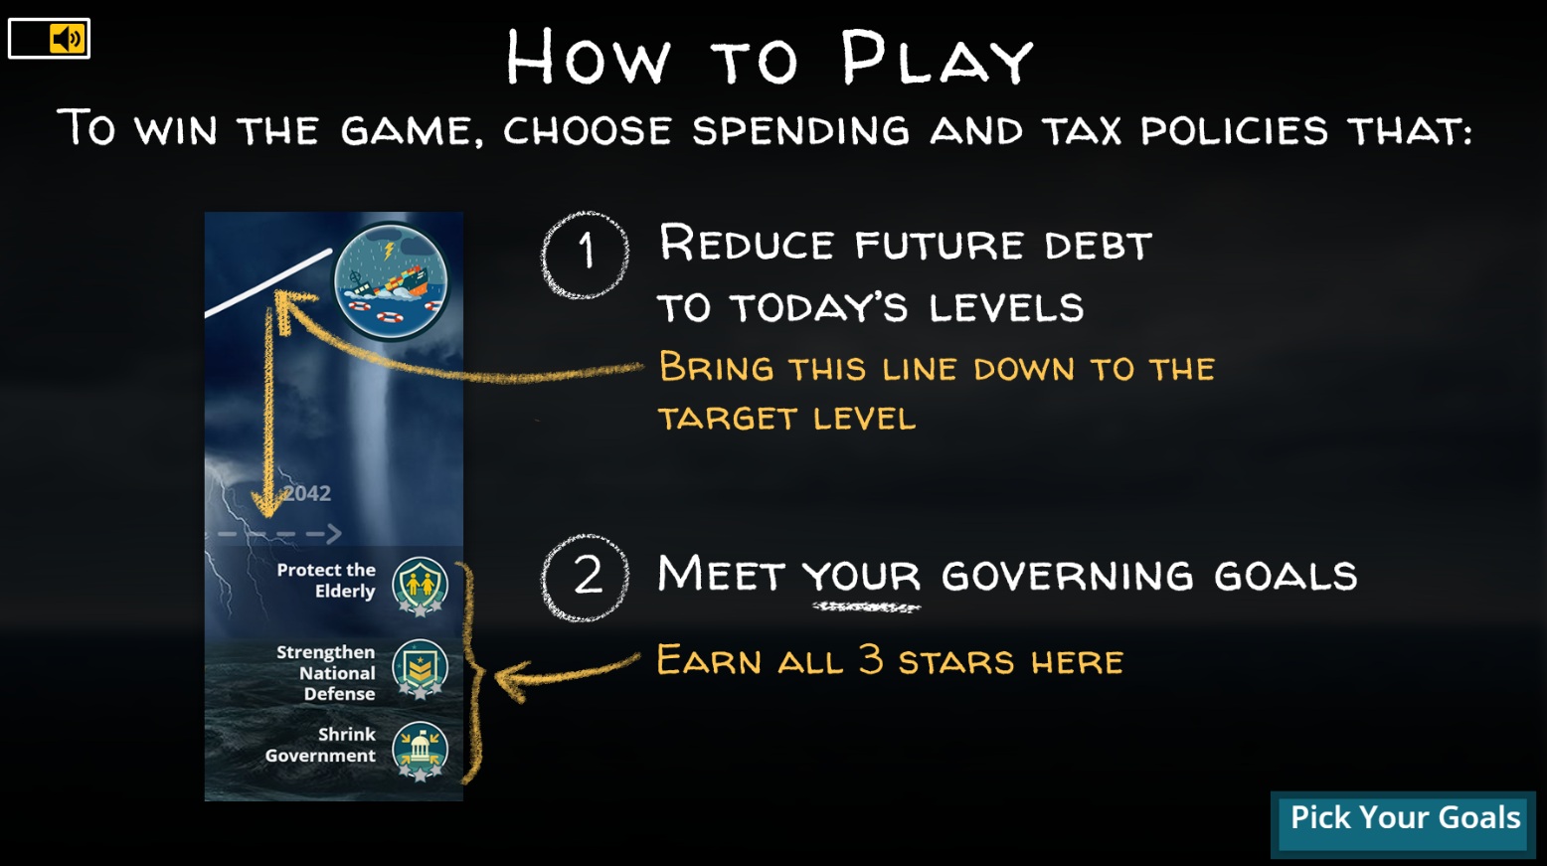

Slide 44

Watch how to play the game
(clip length 1:38)
https://www.youtube.com/watch?v=QSWUcaT4GGA
Notes:
https://www.youtube.com/watch?v=QSWUcaT4GGA

Slide 45
Post-Game Class Discussion
How difficult was it to pursue your goals while also hitting the debt target?
Which of your goals were most difficult to achieve?
Which of your policy choices had the largest impact on your fiscal target? Which barely moved the line?
Were you surprised by the magnitude of any policy choices?
What do you think the political obstacles would be to hitting the debt target?
What do you think would be the impact on the American middle class of the choices you made?
Did the game make you reevaluate your initial governing goals?

Slide 46
Wrap Up
Now that you have played the Fiscal Ship game, how do you propose the federal government set the budget on a sustainable course for the next 25 years?

