Slide 1






November 7, 2023
Lauren Shifflett shiffllh@jmu.edu
Lynne Stover stoverlf@jmu.edu
Hooray for Turkey Day!
Fun Econ Lessons and Activities for the Elementary Classroom

Slide 2
EconEdLink Membership
You can now access CEE’s professional development webinars directly on EconEdLink.org! To receive these new professional development benefits, become an EconEdLink member. As a member, you will now be able to:
Automatically receive a professional development certificate via e-mail within 24 hours after viewing any webinar for a minimum of 45 minutes
Register for upcoming webinars with a simple one-click process
Easily download presentations, lesson plan materials and activities for each webinar
Search and view all webinars at your convenience
Save webinars to your EconEdLink dashboard for easy access to the event
Access our new Professional Development page here

Slide 3
Professional Development Opportunities
To earn professional development credit for CEE webinars found on EconEdLink, you must:
Watch a minimum of 45-minutes and you will automatically receive a professional development certificate via e-mail within 24 hours.
Attendees can learn how much credit they will earn per workshop.
Accessing resources:
You can now easily download presentations, lesson plan materials, and activities for each webinar from EconEdLink.org/professional-development/
Local resources:
Insert your local professional development opportunities (if applicable)

Slide 4
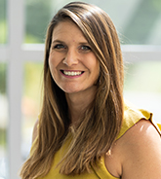
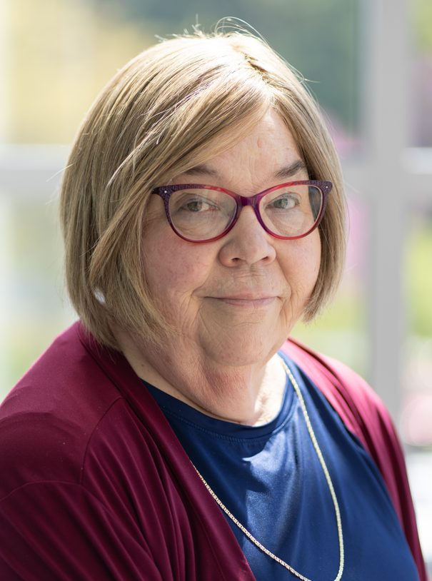
Presenters
Lauren Hensley Shifflett is the new Associate Director at the James Madison University Center for Economic Education. Prior to joining the Center, she spent twelve years in early elementary education where she enjoyed prospering young minds as a classroom teacher. Lauren became nationally known as an elementary economic educator when she received the John Morton Award of the national Council for Economic Education in 2021. Her love for economics guides her lessons to prepare students for life.
shiffllh@jmu.edu
Lynne Farrell Stover is currently a Teacher Consultant at the James Madison University Center for Economic Education. Prior to this, she spent thirty-three years in public education where she enjoyed various teaching assignments including classroom teacher, gifted education specialist, and librarian. She is the author of over fifty educational articles and eight teacher resource books. She is the recipient of the 2022 NAEE Platinum Curriculum Award for her lessons developed for Virginia’s Reading Makes Cents Program.
stoverlf@jmu.edu

Slide 5
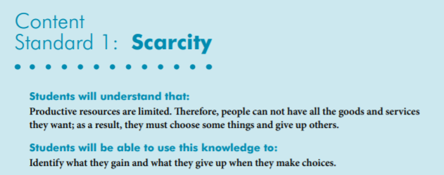
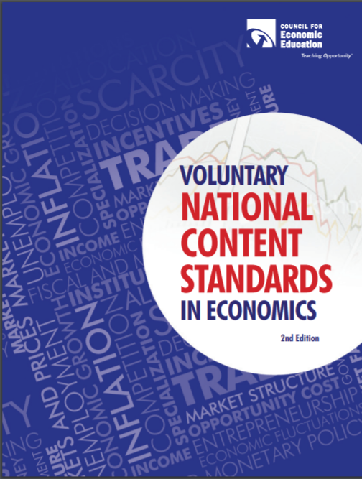
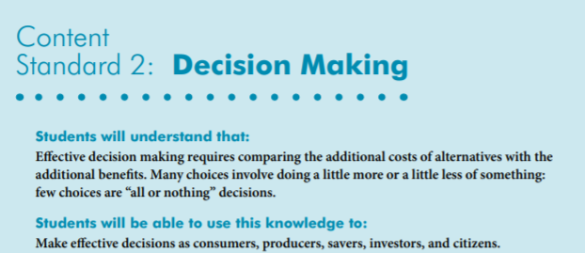
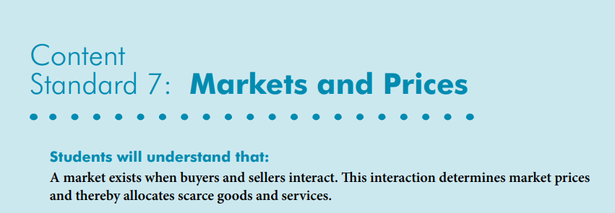
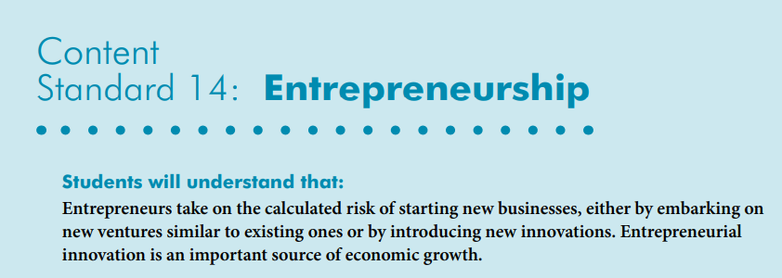
National Content Standards
https://www.councilforeconed.org/wp-content/uploads/2012/03/voluntary-national-content-standards-2010.pdf

Slide 6

Agenda
Introduction [3 mins.]
Review information concerning using children’s literature to teach economics. [2 mins.]
Examine related Thanksgiving themed children’s books and
review lessons and activities based on the six featured titles. [45 mins.]
Conclude with discussion questions, book list review, and webinar survey [10 mins.]

Slide 7

Objectives
In this webinar teachers will:
Explore the concept of the value of using children’s literature to teach in the content areas with an emphasis on economics.
Relate the concepts of choices, opportunity cost, productive resources, unintended consequences, entrepreneurship, and substitute goods as they pertain to the featured titles.
Consider the cross curricular possibilities of the topic as related to the social sciences and creative problem solving.
Discuss the challenge of teaching traditional holidays in the classroom.
Review an annotated bibliography listing topical titles.

Slide 8

Using Children’s Literature to Teach Content
It is to be noted that by using children’s picture books to teach in the content areas, we are providing students with engaging background information that encourages them to relate to concepts, improve vocabulary, and promote reading and writing skills.
Children’s literature offers many interdisciplinary possibilities including those of economics and personal finance.
Notes:
Lynne

Slide 9
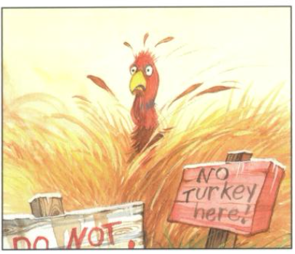
A Turkey for Thanksgiving
By Eve Bunting
Story Synopsis: Mr. and Mrs. Moose invite all their animal friends for Thanksgiving dinner and the only one missing is Turkey. When they set out to find him, Turkey is quaking with fear because he doesn't realize that his hosts want him at their table, not on it.
Publisher: Houghton Mifflin
Copyright Date: 1991
Reading Level: 2.5
Interest Level: PK-2
https://www.youtube.com/watch?v=tEmHlir9uaU
[7 minutes]

Slide 10
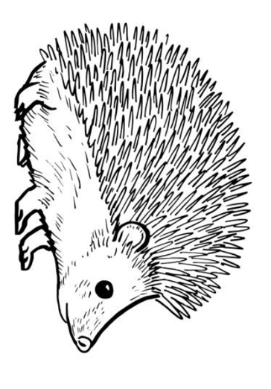
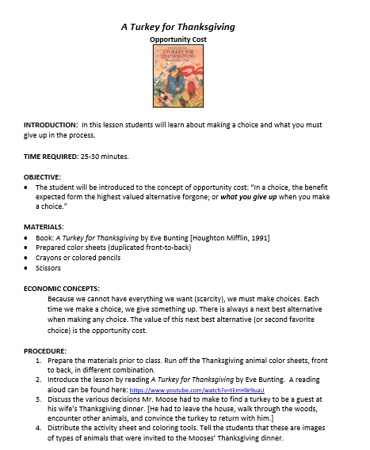

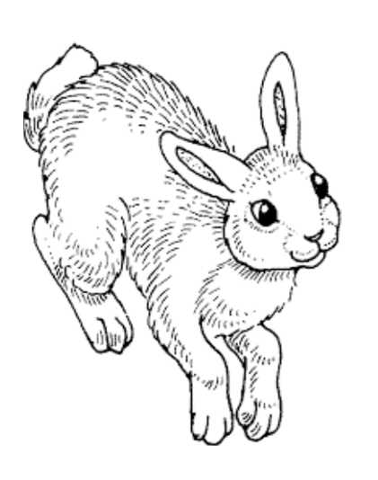
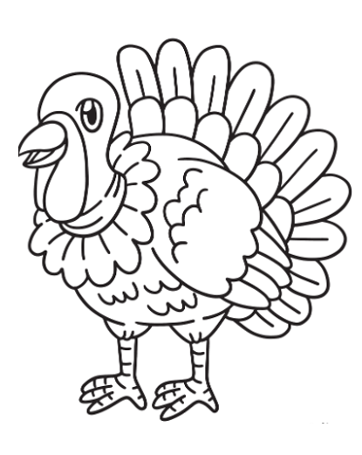
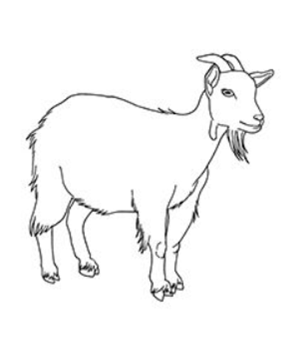
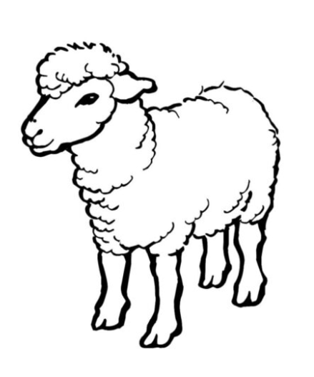

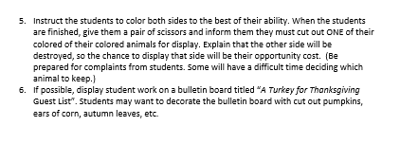
Opportunity Cost

Slide 11
Duck for Turkey Day
by Jacqueline Jules
Story Synopsis: When Tuyet finds out that her Vietnamese family is having duck rather than turkey for Thanksgiving dinner, she is upset until she finds out that other children in her class did not eat turkey either.
Publisher: Albert Whitman & Company
Copyright Date: 2017
Reading Level: 2.6
Interest Level: K-3
https://www.youtube.com/watch?v=sqhB4UG1M1s
[5 minutes]

Slide 12
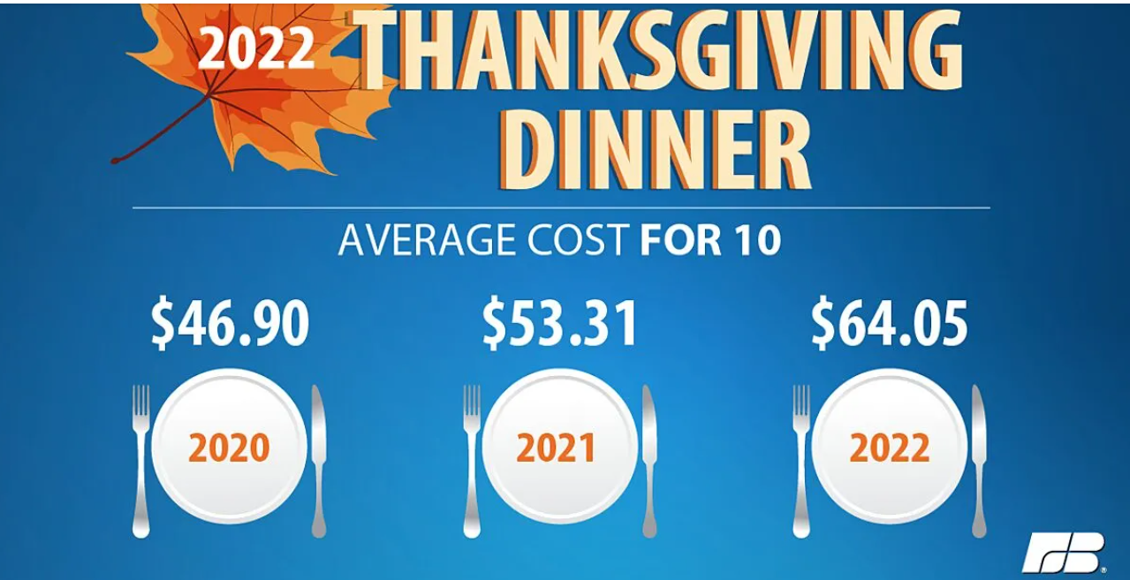
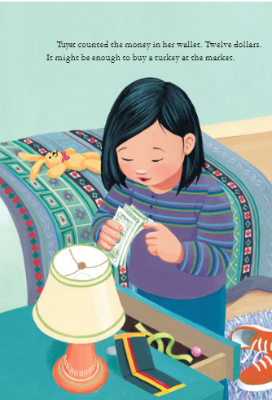
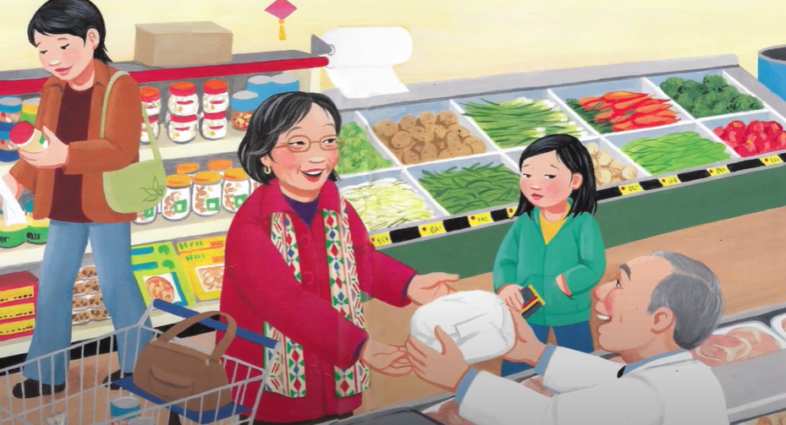
Tuyet wants to buy a turkey at the market.
Will she be able to afford it?
https://www.fb.org/news-release/farm-bureau-survey-shows-thanksgiving-dinner-cost-up-20

Slide 13
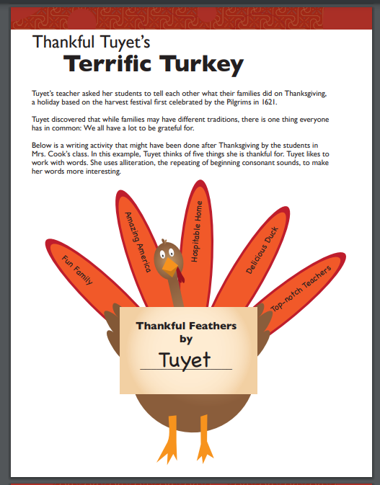
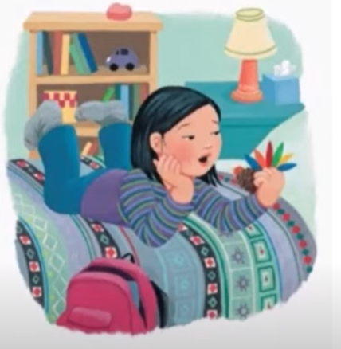
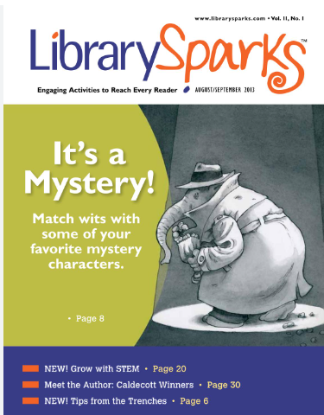
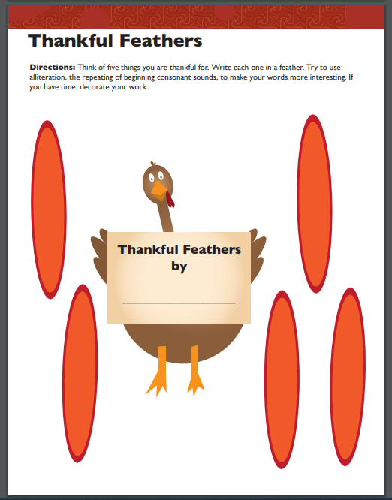
https://www.librarysparks.com/wp-content/uploads/2016/06/lsp_nov13_ll_duckforturkeyday.pdf

Slide 14
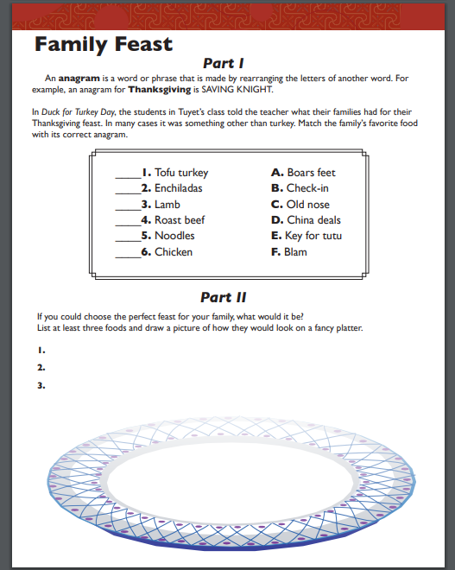
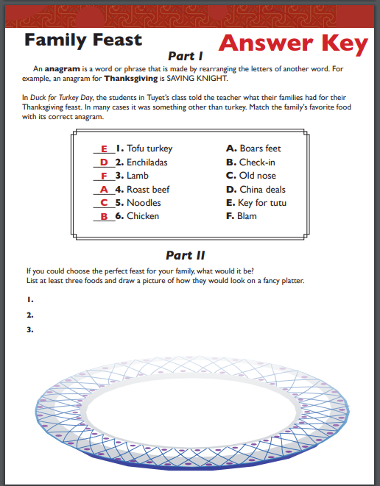
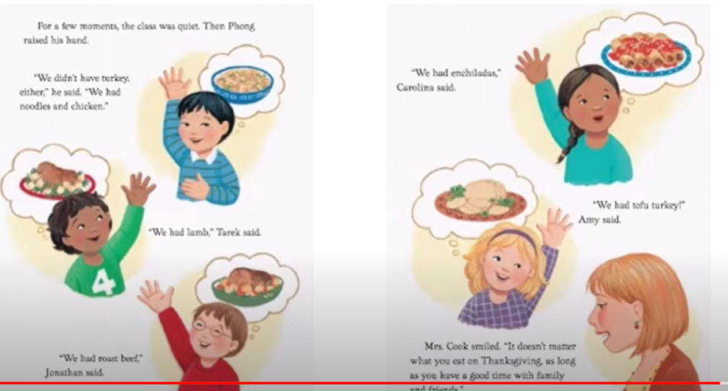
https://www.librarysparks.com/wp-content/uploads/2016/06/lsp_nov13_ll_duckforturkeyday.pdf

Slide 15
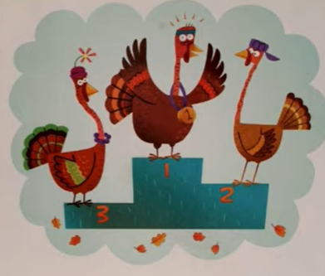
The Great Turkey Race
by Steve Metzger
Story Synopsis: Cassie, Wing, and Ollie all want to be the Thanksgiving Turkey! They decide to have a contest to see which of them Farmer Joe should pick. Is it going to be a happy Thanksgiving for all?
Publisher: Scholastic
Copyright Date: 2006
Reading Level: K-3
Interest Level: 2.8
https://www.youtube.com/watch?v=rRAZAmjMTxA
[7 minutes]

Slide 16
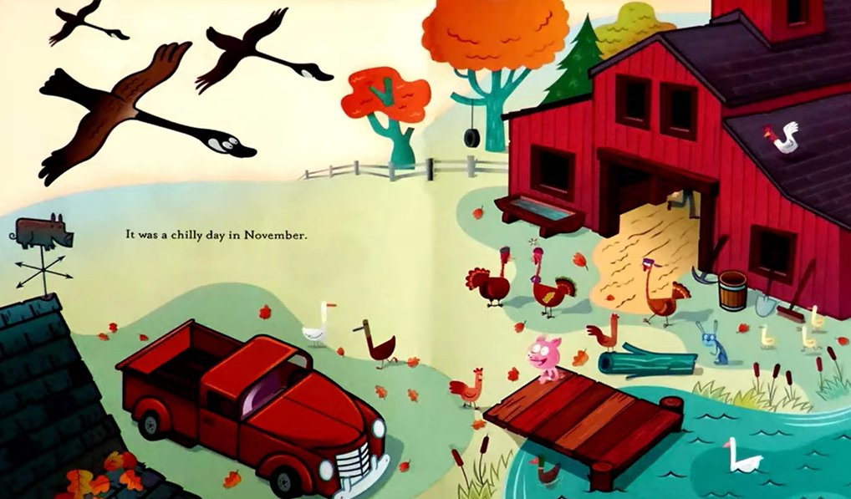
List at least five natural and capital resources in this illustration.
Natural Resources
“Gifts of nature” used to produce goods and services; examples include land, oceans, air, trees, mineral deposits, soil fertility, and climatic conditions.
Capital Resources
Resources made and used to produce and distribute goods and services; examples include tools, machinery and buildings.

Slide 17
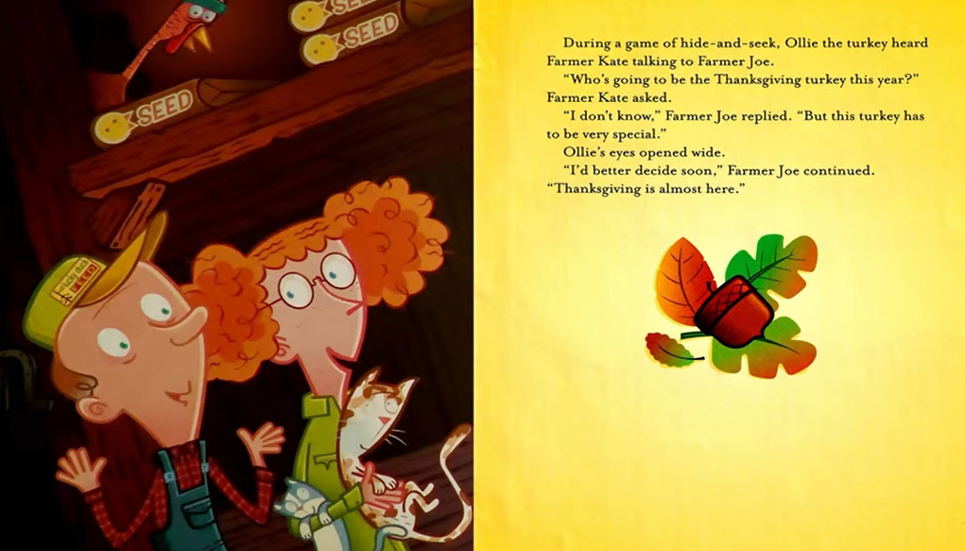
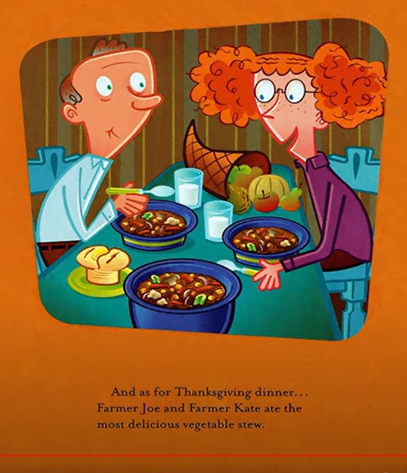
Unintended Consequences
The unexpected and unplanned results of a decision or action.

Slide 18
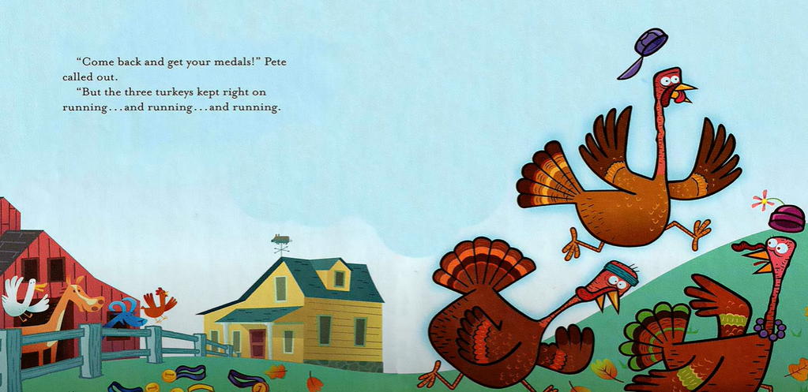
Where do you think to turkeys went?
Will they be safe?
What might be the unintended consequences of their escape?

Slide 19
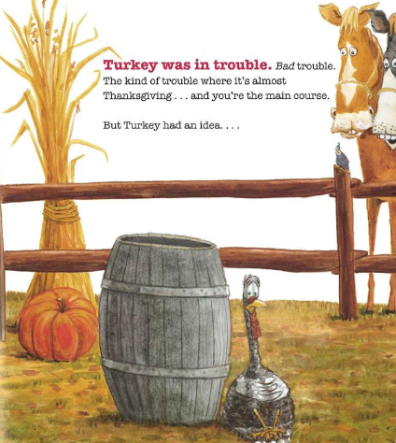
Turkey Trouble
by Wendi Silvano
Story Synopsis: Thanksgiving Day is approaching. Turkey nervously makes a series of costumes, disguising himself as other farm animals in hopes that he can avoid being served as Thanksgiving dinner.
Publisher: Two Lions
Copyright Date: PK-2
Reading Level: 2.3
Interest Level: K-3
https://www.youtube.com/watch?v=Fjz3--KCqkA
[5 minutes]

Slide 20
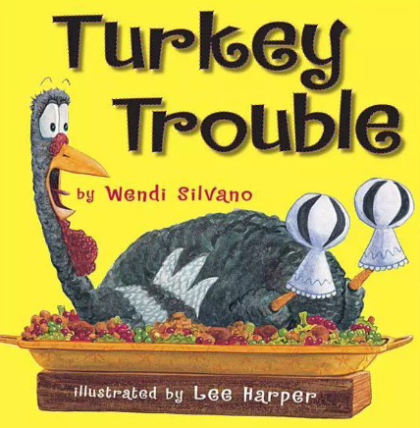
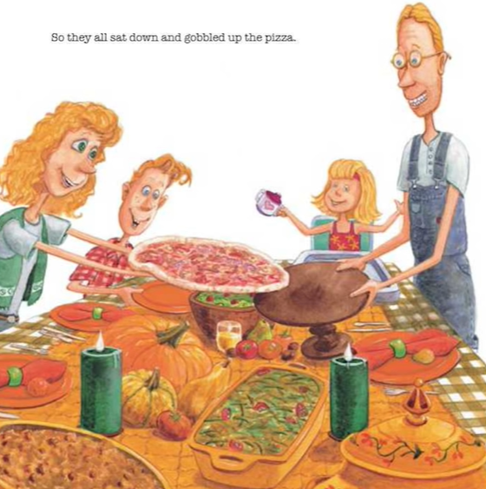
Is PIZZA a substitute good for TURKEY?
Substitute Good
A good that can be consumed or used in the place of another good with minimal differences.

Slide 21
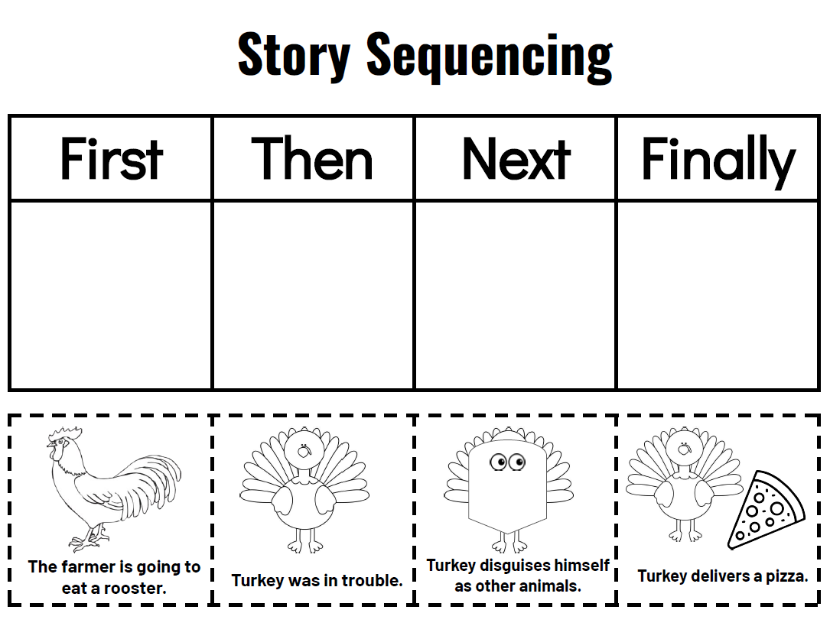
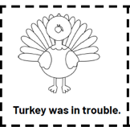
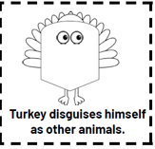
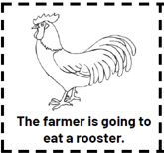
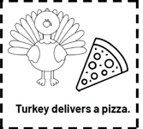

Slide 22
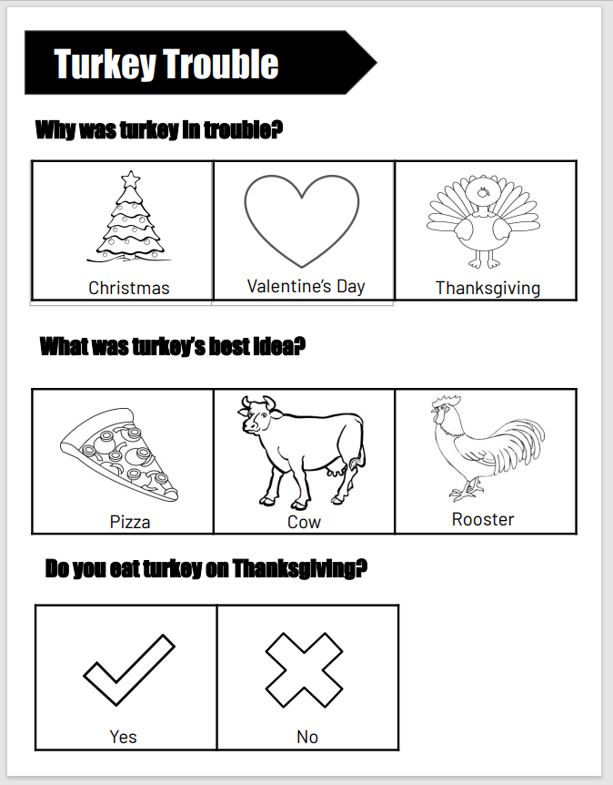

Activity Sheet can be used as:
Assessment
Color sheet
Class discussion questions
Bar graph data

Slide 23
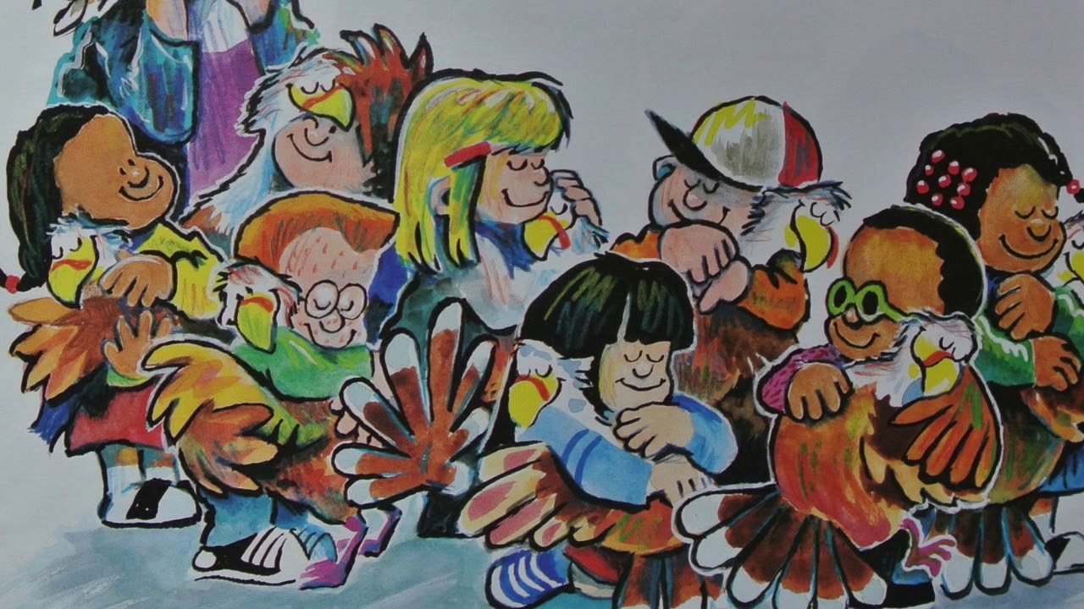
‘Twas The Night Before Thanksgiving
By Dav Pilkey
Story Synopsis: School children on a field trip to Mack Nugget's farm save the lives of eight turkeys in this poem based on "The Night Before Christmas."
Publisher: Scholastic
Copyright Date: 2020
Reading Level: 4.0
Interest Level: PK-2
https://www.youtube.com/watch?v=oxEq-xxGvbo
[5 minutes]

Slide 24
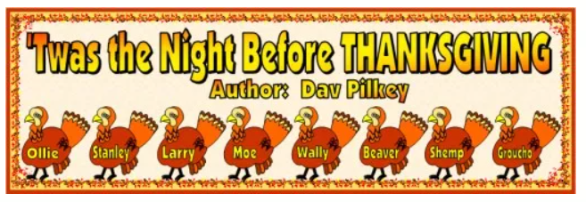
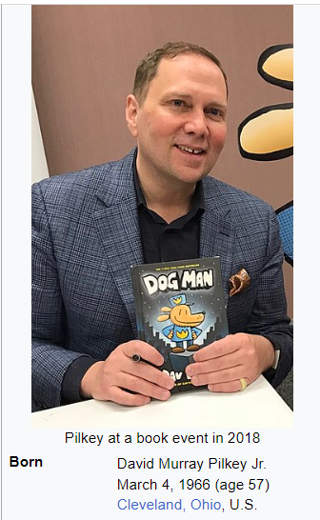

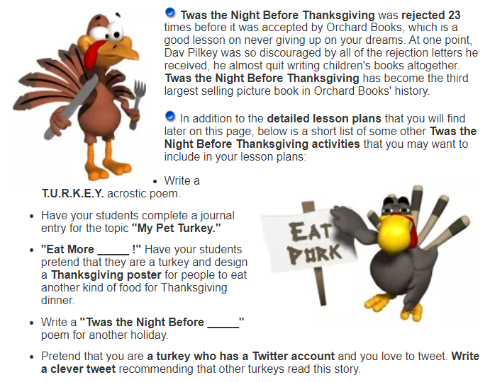

http://www.uniqueteachingresources.com/Twas-The-Night-Before-Thanksgiving-Lesson-Plans.html

Slide 25
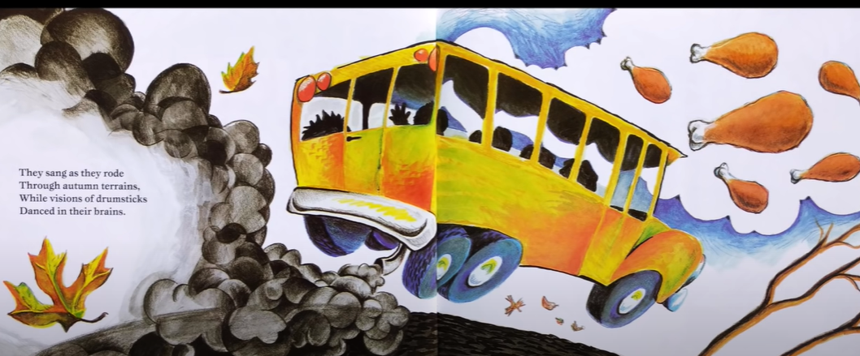
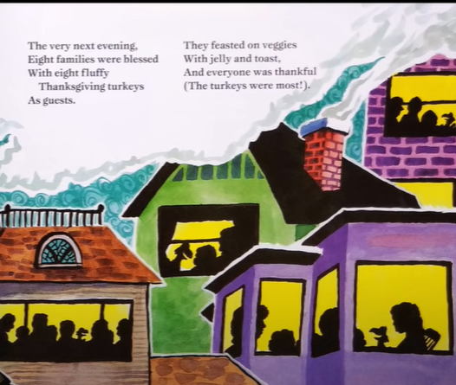
BEFORE meeting the turkeys
AFTER meeting the turkeys
Trade-off
The giving up of one benefit or advantage in order to gain another regarded as more favorable.

Slide 26
Balloons over Broadway:
The True Story of the Puppeteer of Macy's Parade
by Melissa Sweet
Story Synopsis: The story of Tony Sarg, the person who invented the giant balloons for the Macy's Thanksgiving Day Parade. Starting in 1924, the Thanksgiving Day Parade was a success. His grand ideas for bigger balloons became the amazing creatures we know today. For Tony, work was fun!
Publisher: Houghton Mifflin
Copyright Date: 2011
Reading Level: 5.4
Interest Level: K-3
https://www.youtube.com/watch?v=5fRK8VUaTks
[7 minutes]

Slide 27
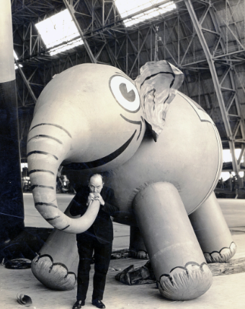
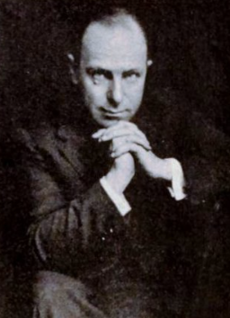
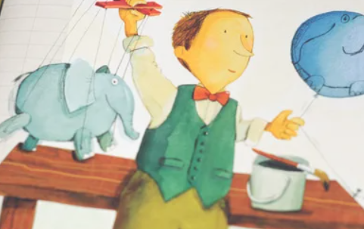
Entrepreneur
One who draws upon his or her skills and initiative to launch a new business venture with the aim of making a profit. Often a risk-taker, inclined to see opportunity when others do not.
Anthony Frederick Sarg (April 21, 1880–March 7, 1942) was a German American puppeteer illustrator.

Slide 28


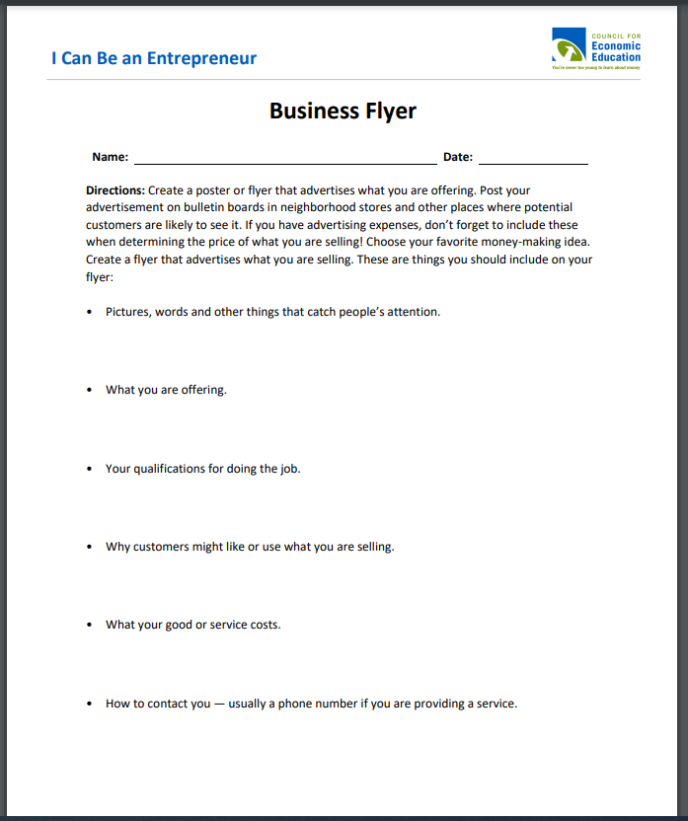
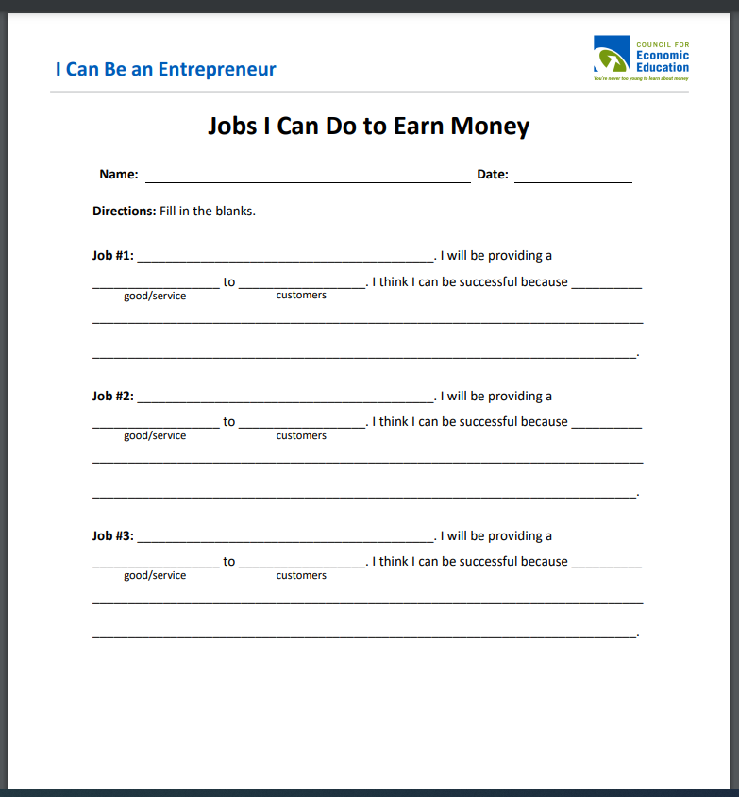


https://www.econedlink.org/resources/i-can-be-an-entrepreneur/

Slide 29




https://noveleffect.com/wp-content/uploads/2022/11/Balloons-Over-Broadway-Activities.pdf

Slide 30


https://noveleffect.com/wp-content/uploads/2022/11/Balloons-Over-Broadway-Activities.pdf

Slide 31




Publisher’s 9-Page Publisher’s Activity Guide
https://drive.google.com/file/d/0B-e2daE0hoOBMXhVbVczMW9DWWc/view?resourcekey=0-6JMJRvTS_0AL1ZS4LoMXIA

Slide 32


For Discussion
Duck for Turkey Day addresses the possible diversity in the classroom.
What are some of the challenges of teaching a traditional holiday in
today’s environment?
There are a “plethora” of holiday books. How do you choose which ones you introduce to your students?
The titles selected for this webinar contained content that could be used to teach economic concepts. Can you think of other content area connections these books could have?

Slide 33





Slide 34

Invest In Girls

Slide 35

NEC

Slide 36

NPFC

Slide 37

Advocacy

Slide 38

Suggested Presentation Deck
CEE Affiliates
https://www.councilforeconed.org/resources/local-affiliates/
Include your local affiliate page

Slide 39











Thank You to Our Sponsors!
39

Slide 40
Contact information
Lynne F Stover stoverlf@jmu.edu
Lauren H Shifflett shiffllh@jmu.edu
Thank You

