Slide 1
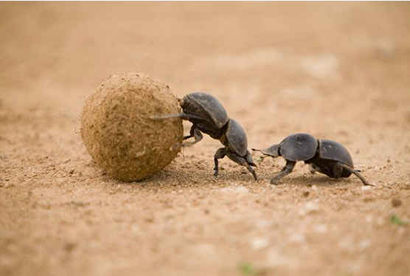
The Economics of Excrement:
Let’s Get this Potty Started!
February 12, 2024
Lauren Shifflett Associate Director
shiffllh@jmu.edu
JMU Center For Economic Education
Lynne Stover Teacher Consultant
stoverlf@jmu.edu
JMU Center For Economic Education

Slide 2
EconEdLink Membership
You can now access CEE’s professional development webinars directly on EconEdLink.org! To receive these new professional development benefits, become an EconEdLink member. As a member, you will now be able to:
Automatically receive a professional development certificate via e-mail within 24 hours after viewing any webinar for a minimum of 45 minutes
Register for upcoming webinars with a simple one-click process
Easily download presentations, lesson plan materials and activities for each webinar
Search and view all webinars at your convenience
Save webinars to your EconEdLink dashboard for easy access to the event
Access our new Professional Development page here

Slide 3
Professional Development Opportunities
To earn professional development credit for CEE webinars found on EconEdLink, you must:
Watch a minimum of 45-minutes and you will automatically receive a professional development certificate via e-mail within 24 hours.
Attendees can learn how much credit they will earn per workshop.
Accessing resources:
You can now easily download presentations, lesson plan materials, and activities for each webinar from EconEdLink.org/professional-development/
Local resources:
Insert your local professional development opportunities (if applicable)

Slide 4

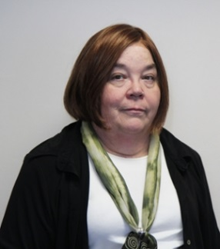
Presenters
Lauren Hensley Shifflett is the new Associate Director at the James Madison University Center for Economic Education. Prior to joining the Center, she spent twelve years in early elementary education where she enjoyed prospering young minds as a classroom teacher. Lauren became nationally known as an elementary economic educator when she received the John Morton Award of the national Council for Economic Education in 2021. Her love for economics guides her lessons to prepare students for life.
shiffllh@jmu.edu
Lynne Farrell Stover is currently a Teacher Consultant at the James Madison University Center for Economic Education. Prior to this, she spent thirty-three years in public education where she enjoyed various teaching assignments including classroom teacher, gifted education specialist, and librarian. She is the author of over fifty educational articles and eight teacher resource books. She is the recipient of the 2022 NAEE Platinum Curriculum Award for her lessons developed for Virginia’s Reading Makes Cents Program.
stoverlf@jmu.edu

Slide 5
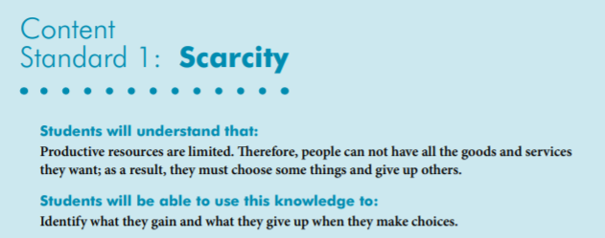

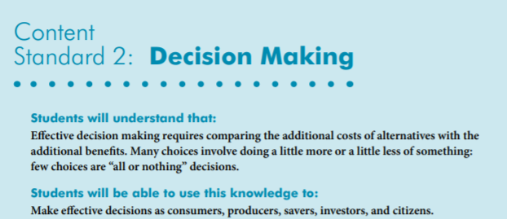
National Content Standards
https://www.councilforeconed.org/wp-content/uploads/2012/03/voluntary-national-content-standards-2010.pdf

Slide 6
Session Agenda
💩 Products from Poo
💩 Poo for Profit
💩 What Do They Do With All That Poo? Activities
💩 Benefits of Poo
💩 For Your Consideration

Slide 7
Objectives
In this webinar teachers will:
💩 List and classify resources into groups of capital, natural,
and human resources.
💩 Explore and understand the benefits of poop, recognizing
its role in nutrient recycling and soil enrichment.
💩 Understand that producers create things, consumers use
them, and both can make eco-friendly choices with waste.

Slide 8
National Standards
https://www.councilforeconed.org/wp-content/uploads/2012/03/voluntary-national-content-standards-2010.pdf

Slide 9

https://www.youtube.com/watch?v=13tnjh3dZw4

Slide 10


HOSTS

Slide 11










Coffee
Paper
Necklace
Tea

Slide 12

What is it?
$50.00
Black Ivory Coffee made by Elephant Dung

Slide 13
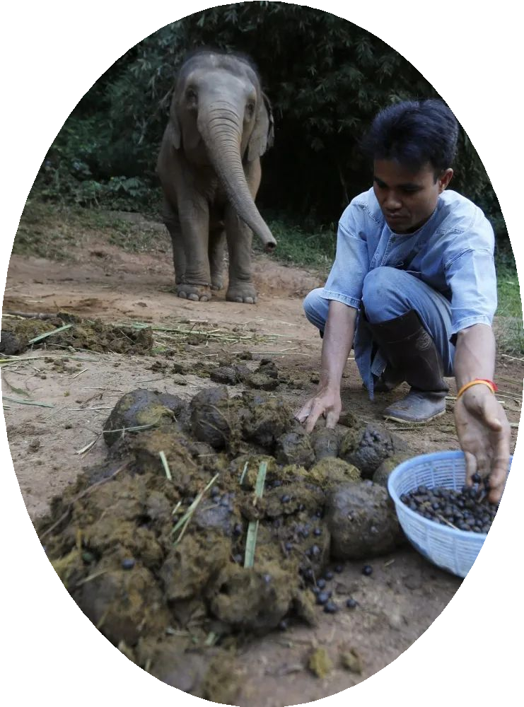
What is it?
Elephant poop coffee, also known as Black Ivory coffee, is primarily produced in Thailand. The process involves feeding Arabica coffee beans to elephants, and the beans undergo fermentation in the digestive system of the elephants. After being excreted, the beans are collected, cleaned, and roasted to produce the unique coffee. Thailand is known for this unconventional coffee production method.
Black Ivory Coffee made by Elephant Dung

Slide 14

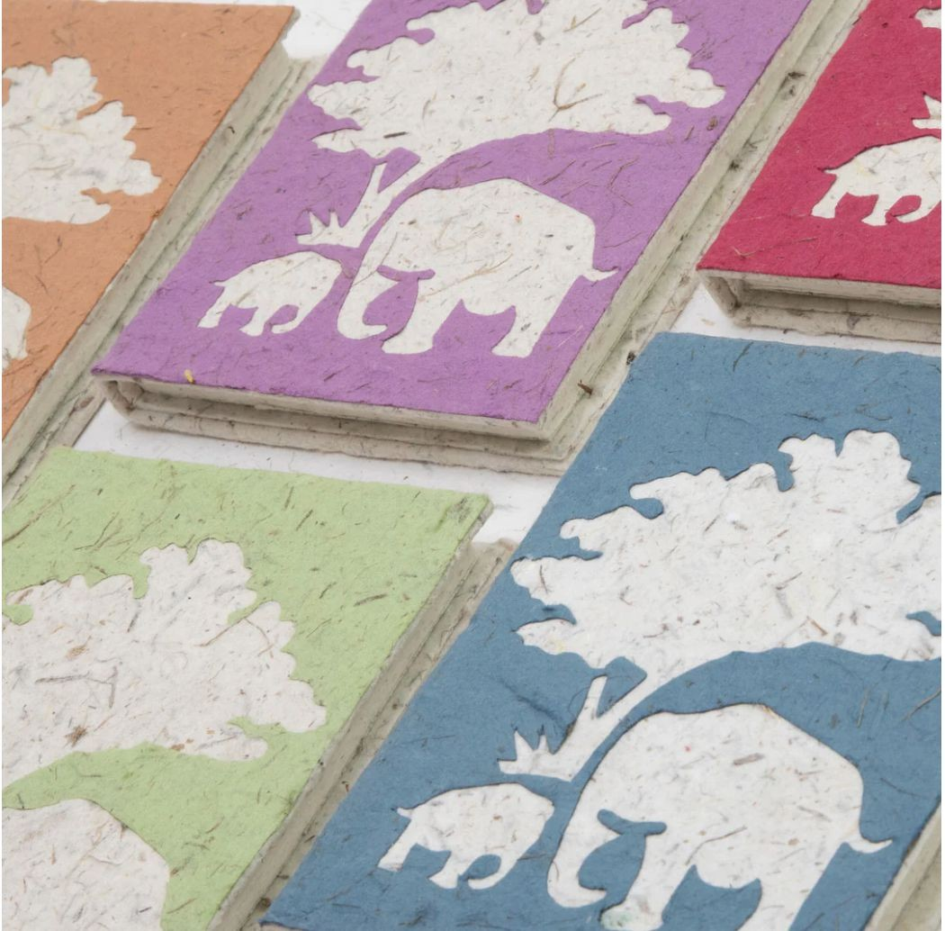
What is it?
This process not only provides a sustainable use for elephant dung but also contributes to conservation efforts and supports local communities engaged in eco-friendly practices. The paper produced is usually considered an ethical and environmentally friendly alternative to conventional paper products.
$13.00
https://poopoopaper.com/

Slide 15

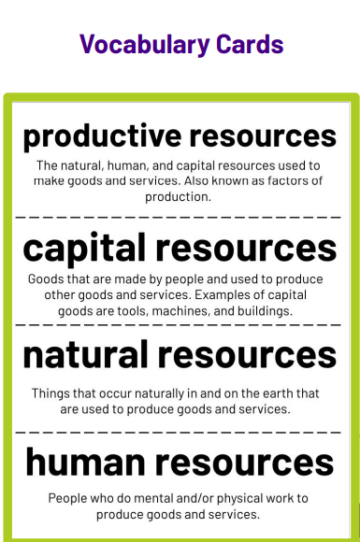
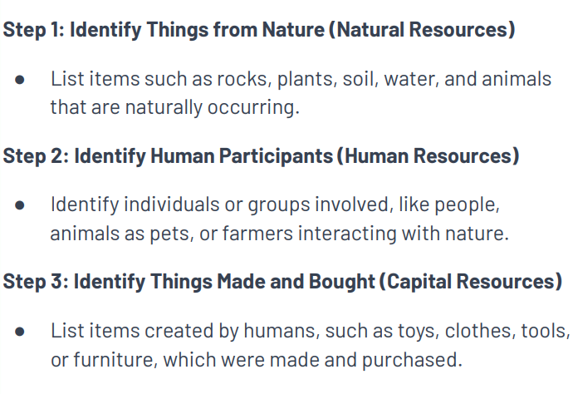

Slide 16

https://www.youtube.com/watch?v=IUWNFEkKXXE

Slide 17
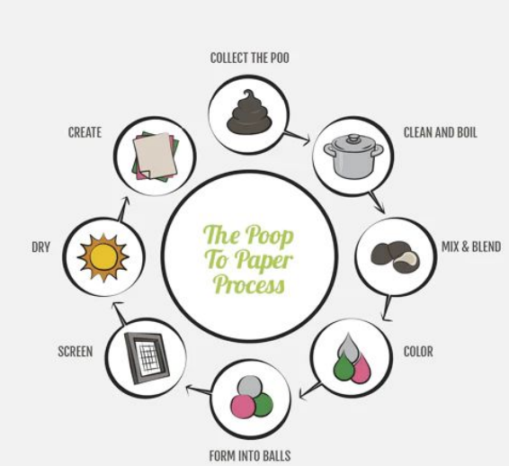
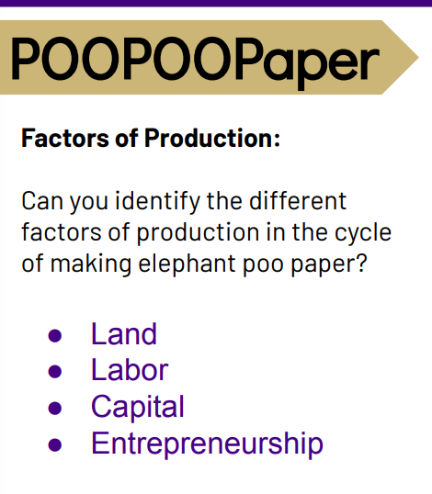
https://poopoopaper.com/

Slide 18

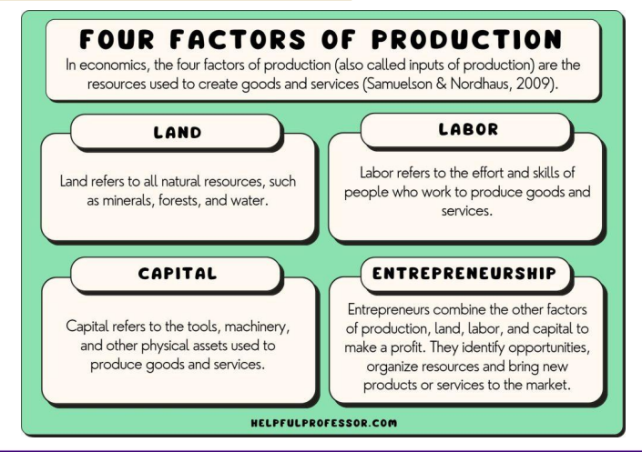

Slide 19

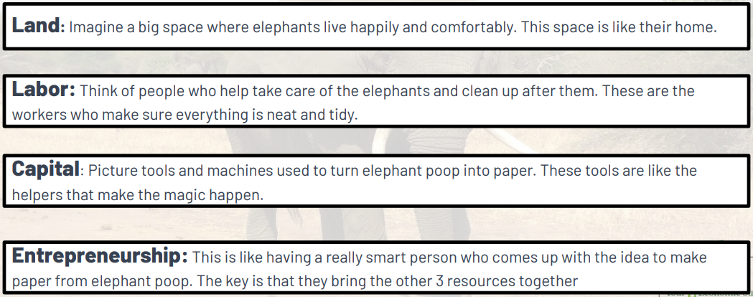

Slide 20
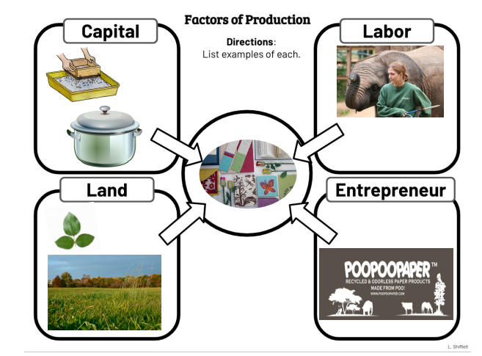
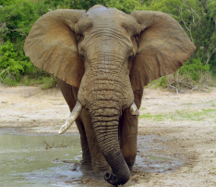

Slide 21

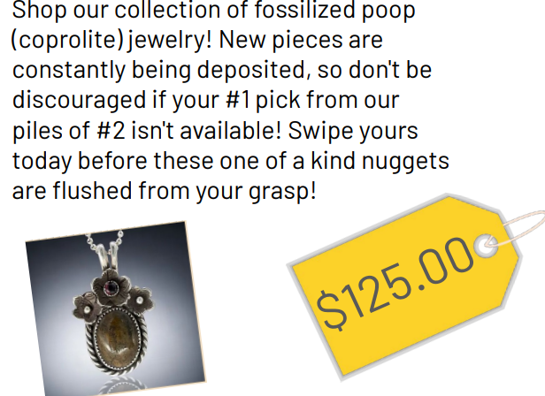

https://www.youtube.com/watch?v=jUuPjy2PLuA
https://www.chsfossiladventures.com/poowelry

Slide 22
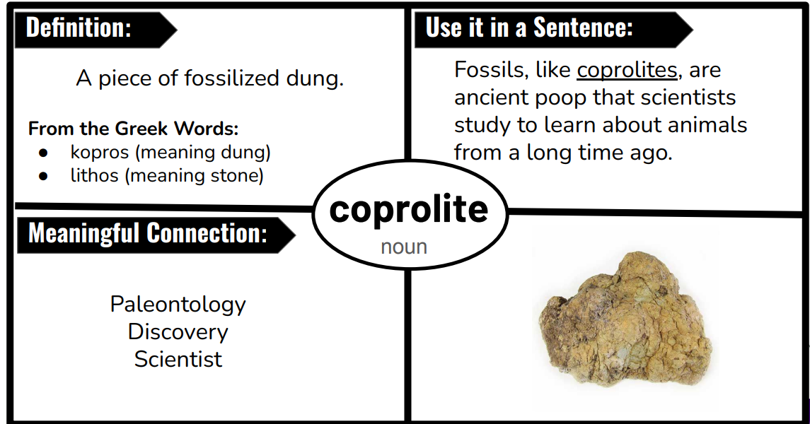

Slide 23


Slide 24


Slide 25



https://www.youtube.com/watch?v=ut_7qdAyEPI

Slide 26
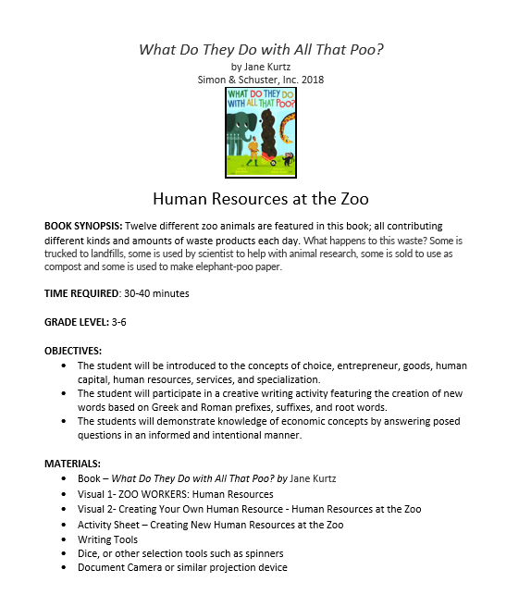
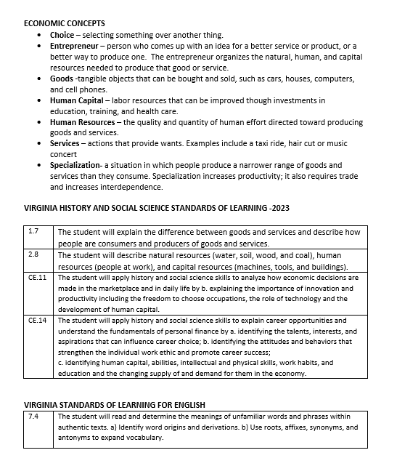
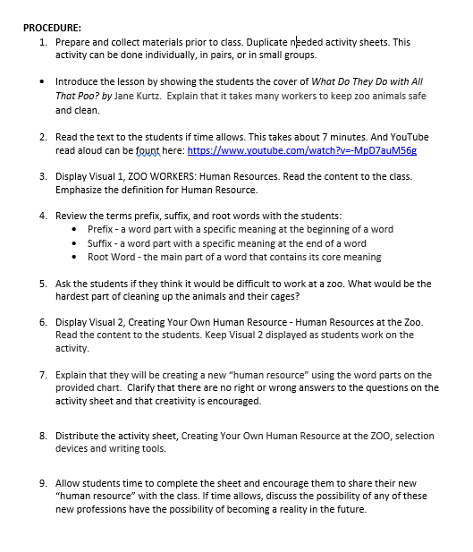

Slide 27
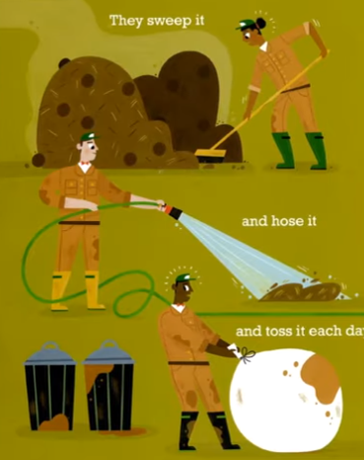
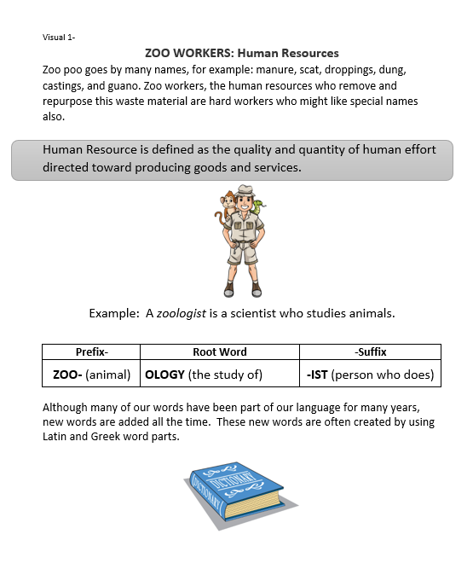
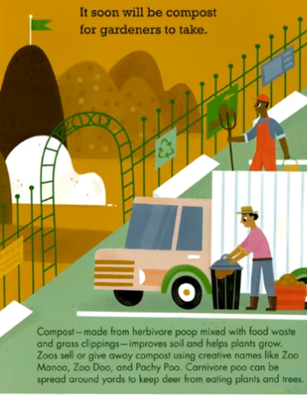


Slide 28
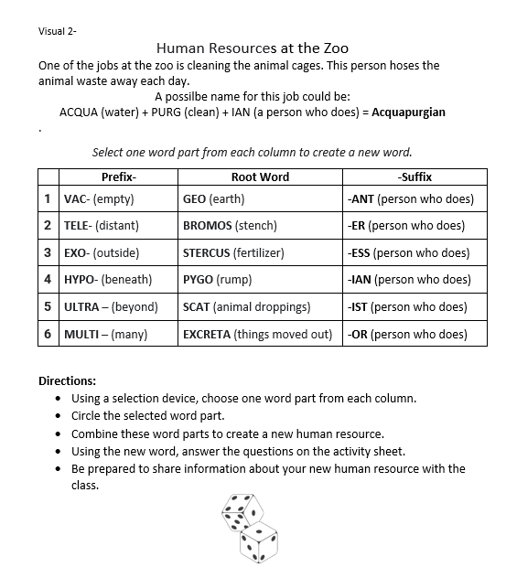
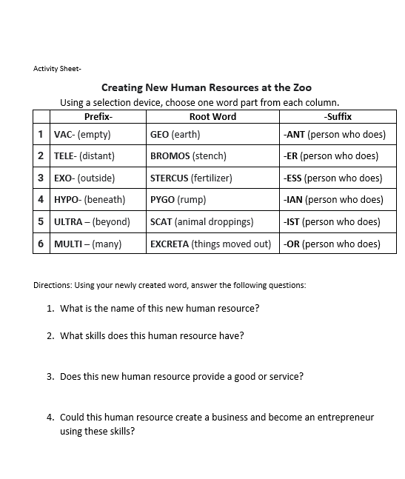

Slide 29
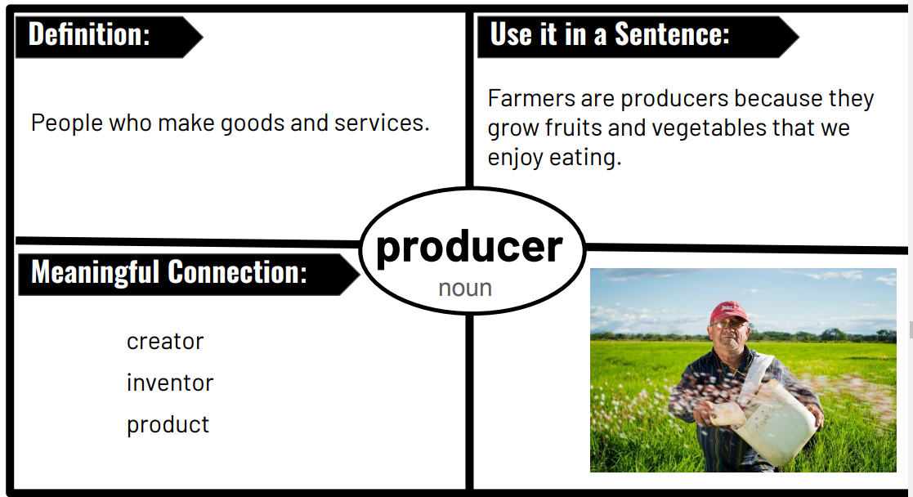

Slide 30


https://www.elephants.com/elephants
https://www.youtube.com/watch?v=TlE73DZ4QM
E

Slide 31

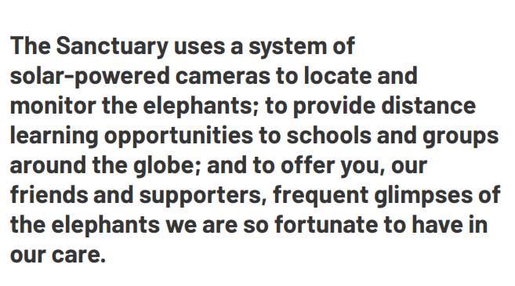

https://www.elephants.com/elecam

Slide 32

Would it be beneficial for elephant sanctuaries/zoos to make elephant poop products?
What type of obstacles and barriers might sanctuary/zoo experience with the creation of these products?
What other ways could elephant sanctuaries be more profitable?

Slide 33

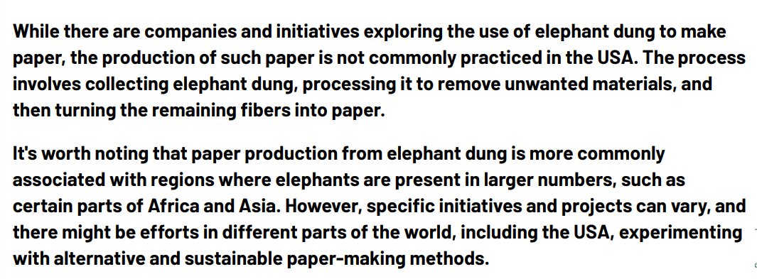

Slide 34
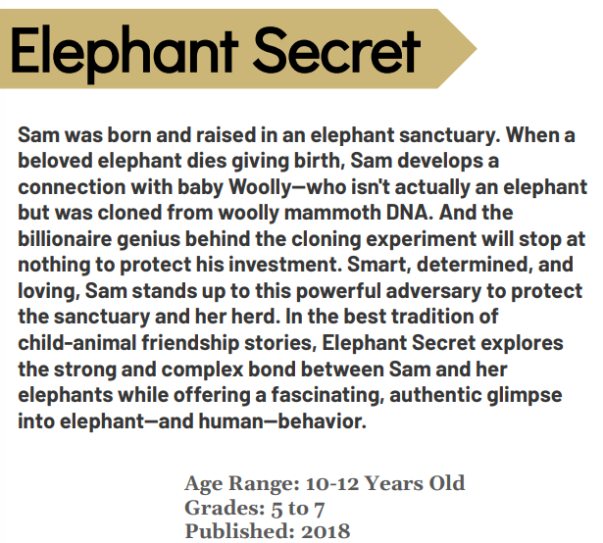


Slide 35
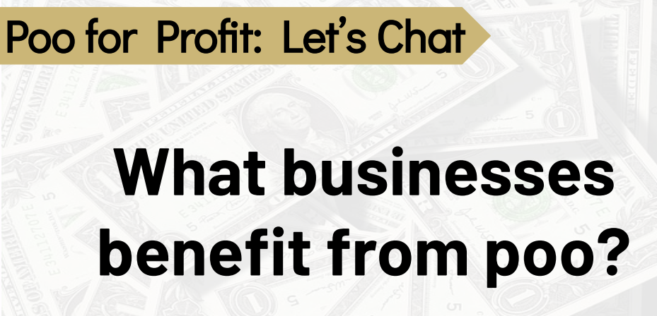

Slide 36


Slide 37
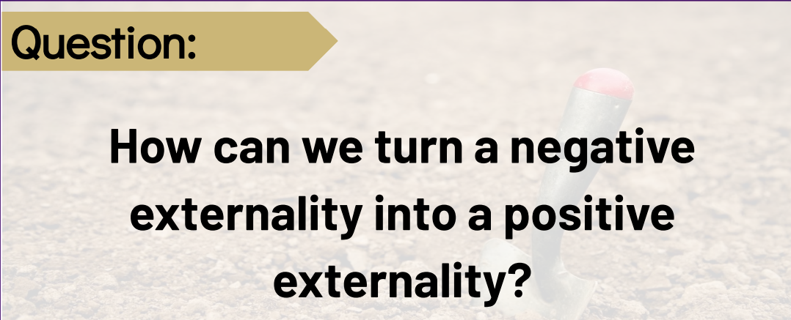

Slide 38



Slide 39
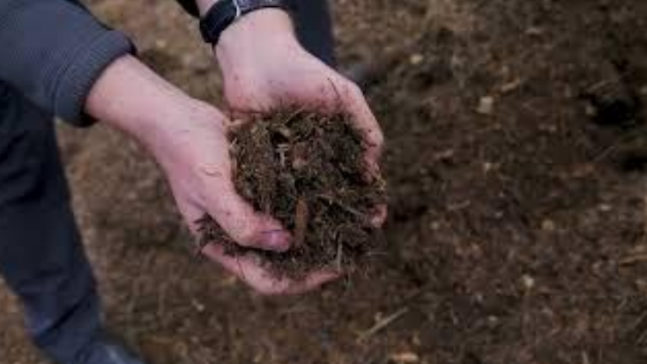
https://www.youtube.com/watch?v=XyxbFWJmTGI

Slide 40

Then researchers take it to a lab, dry it out and dissect it for clues about the animal's diet. Some mammal poop is full of seeds, which shows that the animal eats fruit or berries. Or it might contain bones and fur, which scientists can identify to learn what species that animal is eating.
https://www.farsleyspringbank.co.uk/science-week-poo-experiment/

Slide 41
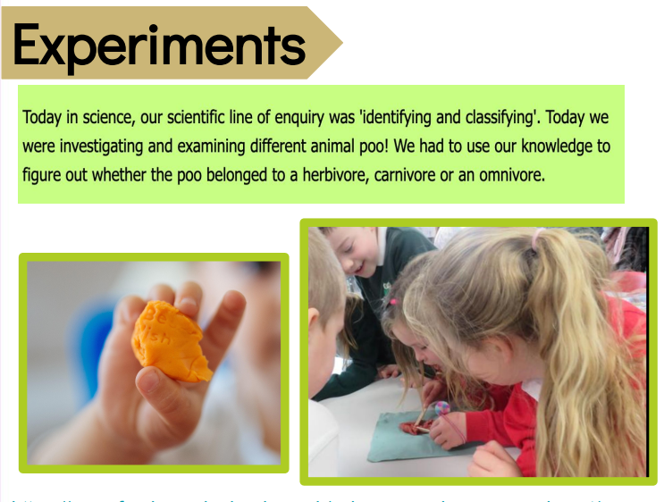
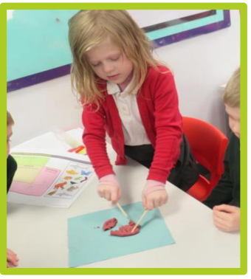

Slide 42


Slide 43
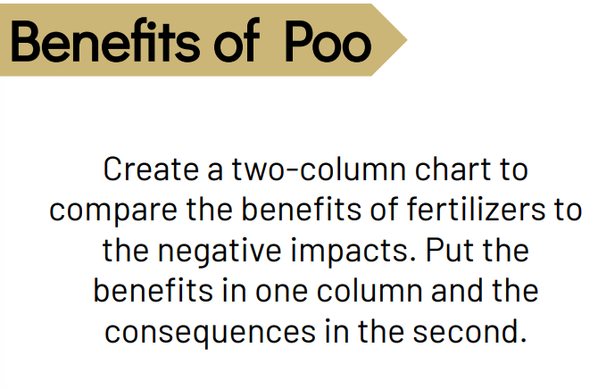
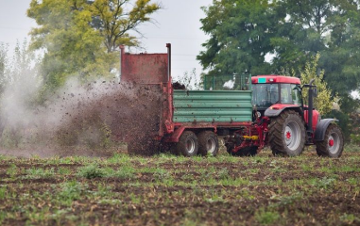
https://www.elephango.com/index.cfm/pg/k12learning/lcid/12449/Soil_Fertilizer

Slide 44
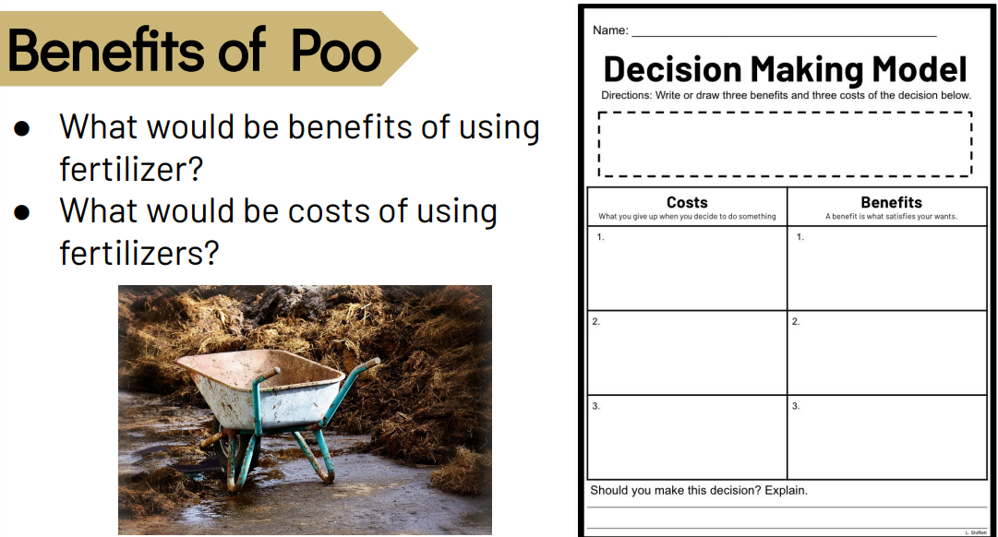

Slide 45
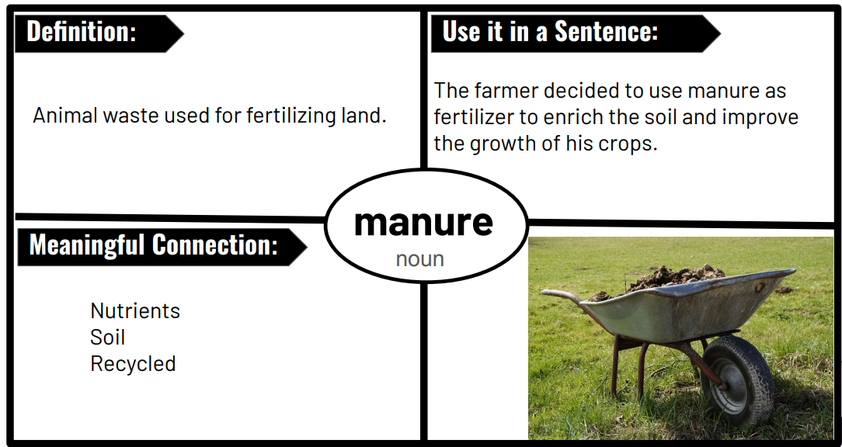

Slide 46
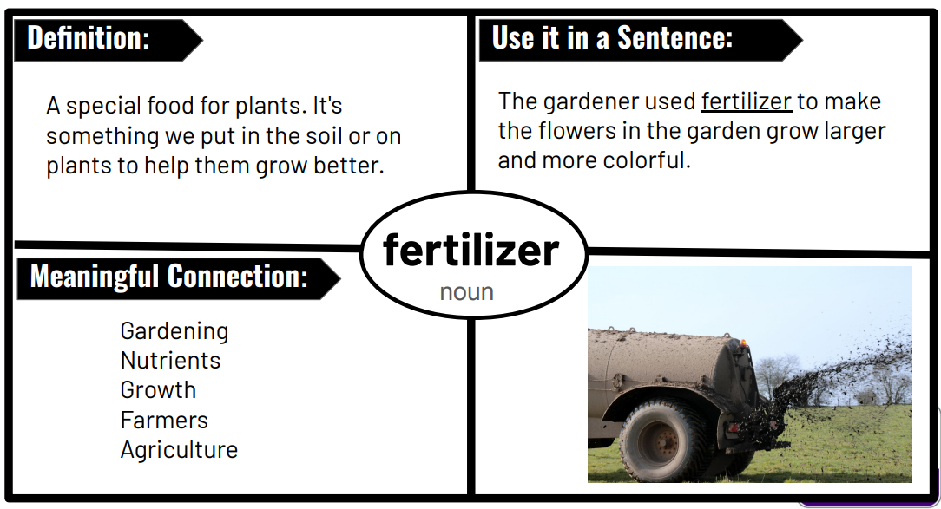

Slide 47


https://www.earthrangers.com/EN/CA/top-10/top-ten-facts-all-about-animal-poop/
https://www.funkidslive.com/learn/top-10-facts/top-10-facts-about-animal-poo/

Slide 48

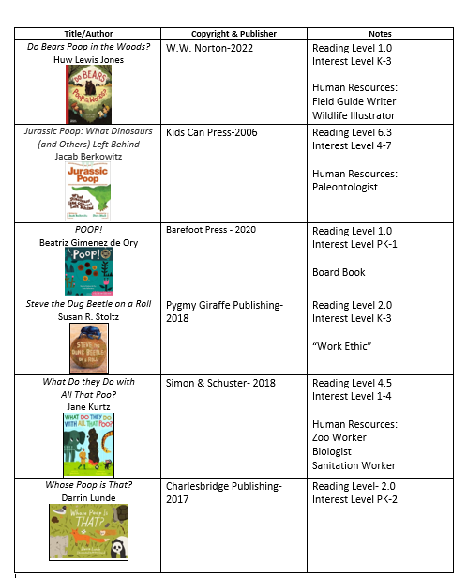



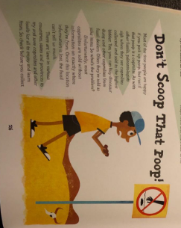

Slide 49


Slide 50

Invest In Girls

Slide 51
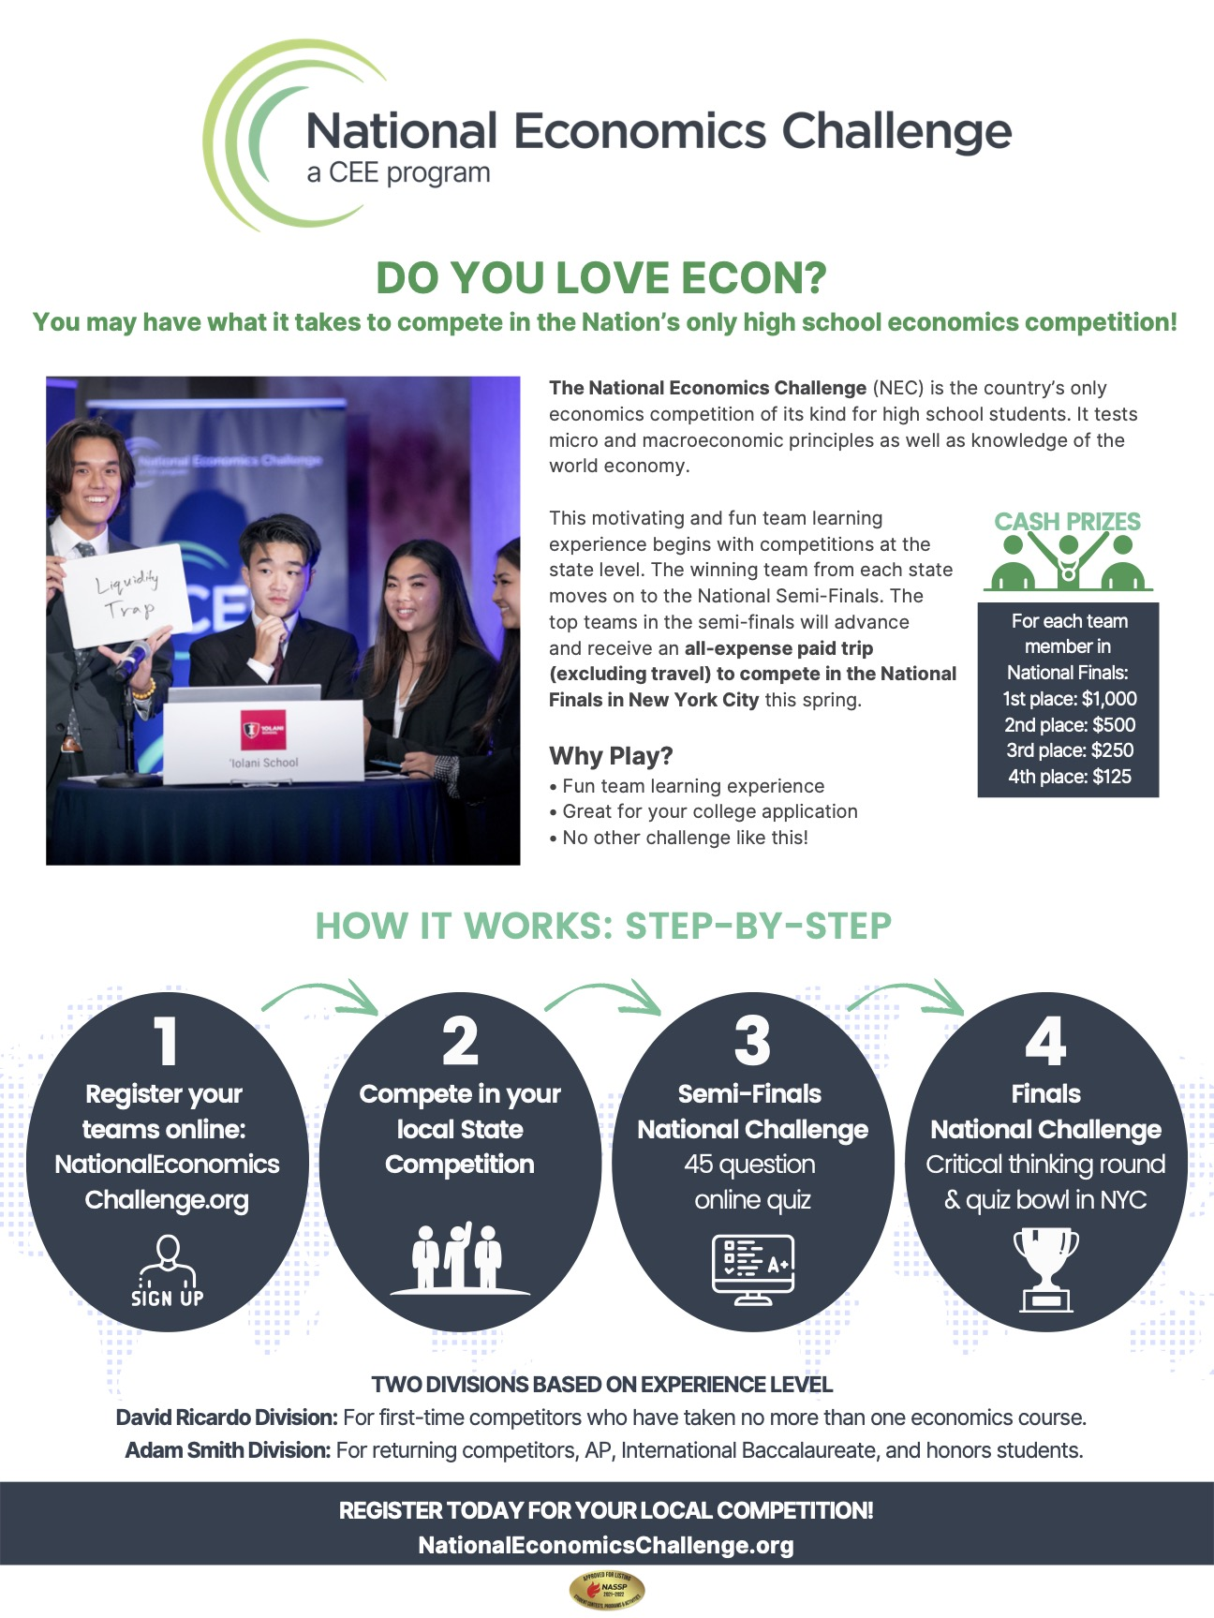
NEC

Slide 52

NPFC

Slide 53

Advocacy

Slide 54

Suggested Presentation Deck
CEE Affiliates
https://www.councilforeconed.org/resources/local-affiliates/
Include your local affiliate page

Slide 55










Thank You to Our Sponsors!

Slide 56
Contact information
Lauren H Shifflett shiffllh@jmu.edu
Lynne F Stover stoverlf@jmu.edu u.edu
Thank You!
Lauren H Shifflett shiffllh@jmu.edu
Lynne F Stover stoverlf@jmu.edu

