Slide 1
The Interdisciplinary Nature of Personal Finances and Economics
Presented by: Rushil Shah
Email: rushil217@gmail.com
Socials available on rushilshah.me

Slide 3
National Standards
Covers Three Main Standards:
Standard Eight (The Role of Prices)
Standard Four (Incentives)
Standard Twenty (Fiscal and Monetary Policy)
https://www.councilforeconed.org/wp-content/uploads/2012/03/voluntary-national-content-standards-2010.pdf

Slide 4
Rushil Shah
Founder, Author, and Researcher.
Rushil Shah is a high school senior at West Shore Jr./Sr. High School in Melbourne, Florida. He is the founder and president of Brevard Finance for Youth Inc., an organization dedicated to promoting financial literacy among students. Rushil has educated over 1500 students on personal finance and aims to expand his organization nationwide.
He's a 2-Time TEDx speaker and was covered on NBC News. Rushil is also an author, with two books, "Finance 101: Explained by a 16-Year-Old" and "The Entrepreneurial Journey to a Millionaire," designed to inspire teenagers to learn about personal finance and entrepreneurship.
As a researcher, Rushil is conducting a multi-disciplinary study on financial decision-making using a unique psychological and mathematical approach. He's presented his research twice at the Regeneron International Science and Engineering Fair and the Harvard Conference of Undergraduate Research. Recently, he was recognized as a Ying Scholar at the State Level for his outstanding contributions to this field.

Slide 5
Objectives & Goals
Understand the relationship between personal finances and other disciplines.
Provide innovative ways to teach essential financial concepts while addressing other subject matters.
Provide unique perspectives of financial education from different students.

Slide 6
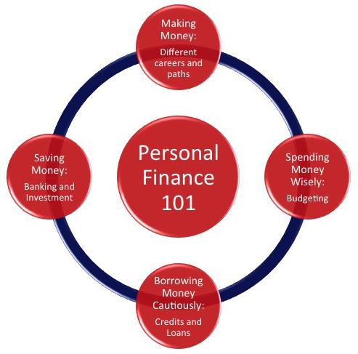
Introduction
The Fundamentals of Personal Finances
Understanding the wide background and interests of students.
Subjects in Relation: Psychology, History, Technology

Slide 7
Psychology & Personal Finances
Understanding of emotions
Financial behaviors of investors
F.O.M.O affecting decisions
My Experiences

Slide 8
Activities
The Psychology of Investing:
Each student independently decides if they want to be IN or OUT OF THE MARKET and marks their spreadsheet IN or OUT. A classmate will verify that they have completed that field:)
If the students decides to be IN the Market then a) Teacher rolls one die which will determine if the market went UP or DOWN. A 1 or 2 on the die means market went DOWN A 3, 4, 5 or 6 means market went UP. b) Indicate on your worksheet UP or DOWN c) Teacher rolls three dice d) Mark your worksheet based on the value of the three dice; number is positive if Market was UP for that round, number is negative if Market went DOWN
If the student chose to be OUT of the Market, they put +1 in If Out...column. (Note: Teacher will need to roll the dice as described in step #2 if students in the class choose to be IN the market)
Students calculate their Ending Balance
Go back to Step 1
Lessons Taught: Loss Aversion, Recency Effect, Overconfidence
Activity guide and student version will be available at the end of presentation

Slide 9
History & Personal Finances
Economic History: The study of economic history examines how economic systems have evolved, including the transition from agrarian economies to industrial economies.
Banking and Financial Institutions: The history of banking and financial institutions (ex. the establishment of the Federal Reserve System)
Currency and Monetary Systems: Historical changes in currency systems, including the gold standard and fiat currencies, have had profound effects on personal finances.
Economic Crises and Their Impact: Historical economic crises, such as the Great Depression or more recent financial crises like the 2008 recession, have had far-reaching consequences for personal finances. Learning from past crises helps individuals and policymakers make informed financial decisions and implement regulations to mitigate future risks.

Slide 10
Technology & Personal Finances
Financial Technology (FinTech): FinTech encompasses a wide range of technologies that aim to improve and streamline financial services.
Data Analytics and Artificial Intelligence: Data analytics and AI play a crucial role in personal finance. These technologies can analyze spending patterns, identify potential fraud, and provide personalized financial advice.
Blockchain and Cryptocurrencies: Blockchain technology, which underlies cryptocurrencies like Bitcoin, has the potential to revolutionize financial transactions and provide more secure and transparent methods of conducting financial transactions. While cryptocurrencies present new opportunities, they also come with their own set of financial risks and considerations.

Slide 11
The Ultimate Activity
The Power
of Research
What can students learn?
My Experiences

Slide 12
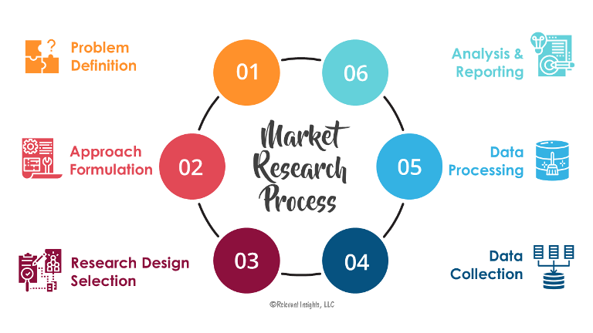
The Research Process
Identify the Research Question or Topic
Conduct a Literature Review
Data Collection and Analysis
Interpretation and Findings
Communicate and Write

Slide 13
Research and Learning
Problem-Solving: In personal finance and economics, individuals frequently encounter financial challenges or questions (e.g., how to save for retirement or assess the impact of inflation). Research equips you with problem-solving skills to tackle these real-life financial issues effectively.
Real-World Application: Many research projects in personal finance and economics can have direct applicability to your own financial situation. For example, researching investment strategies or financial planning can lead to practical insights that you can implement to improve your financial well-being.
Entrepreneurship and Innovation: For those interested in entrepreneurship and innovation, conducting research can lead to the development of innovative financial products or services. You might identify market gaps or opportunities for financial innovation through your research.

Slide 14
Steps to Take
Identify a financial concept you want to investigate
Conduct background research investigating the topic.
Identify a problem/question you have from the research.
Conduct study/literature analysis
Report Findings
Lessons Taught: Problem Solving, Encourages youth to read before making financial decisions, allows them to find the connection between personal finances and subjects they are passionate about.

Slide 15
Supporting Materials
https://www.ngpf.org/blog/investing/activity-idea-psychology-of-investing/
https://www.nhcc.edu/academics/library/doing-library-research/basic-steps-research-process
https://www.youtube.com/watch?v=s5Se53dVamQ

Slide 16
Questions?

Slide 17
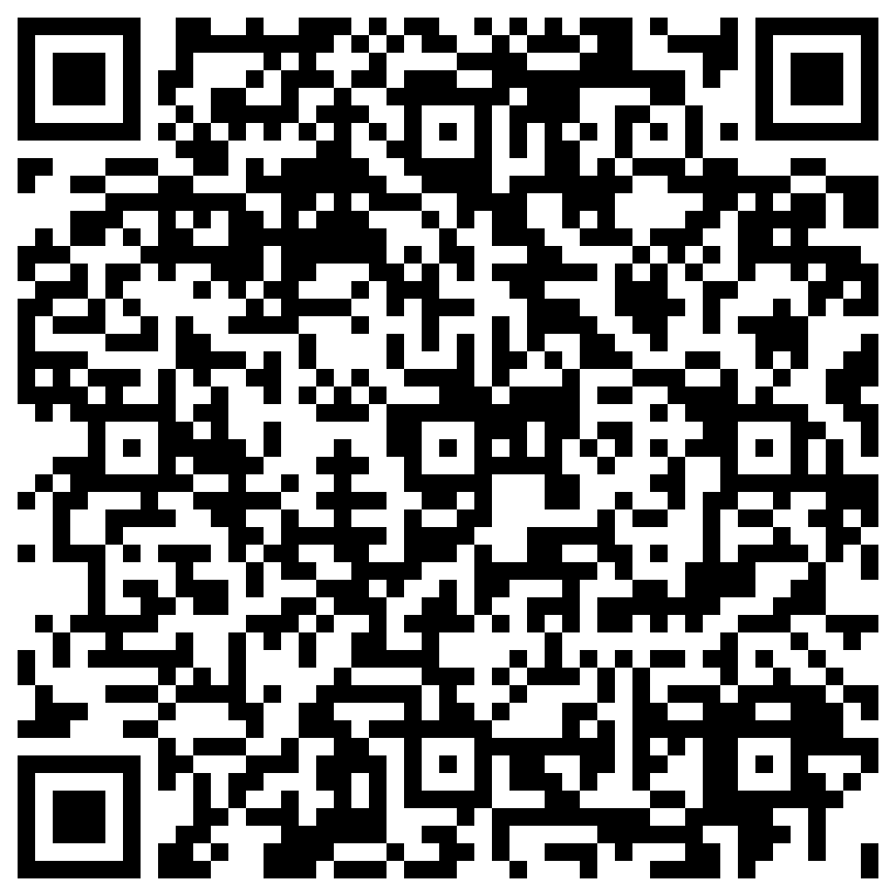
If you have any questions, I would love to stay in touch! You can scan the QR code or send me an email at rushil217@gmail.com

