Slide 1

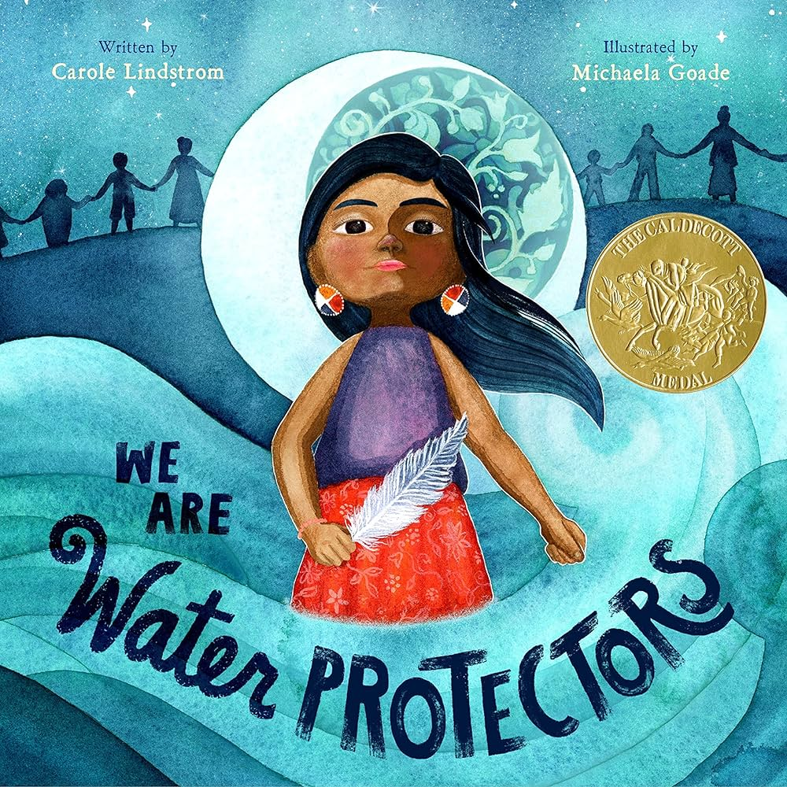
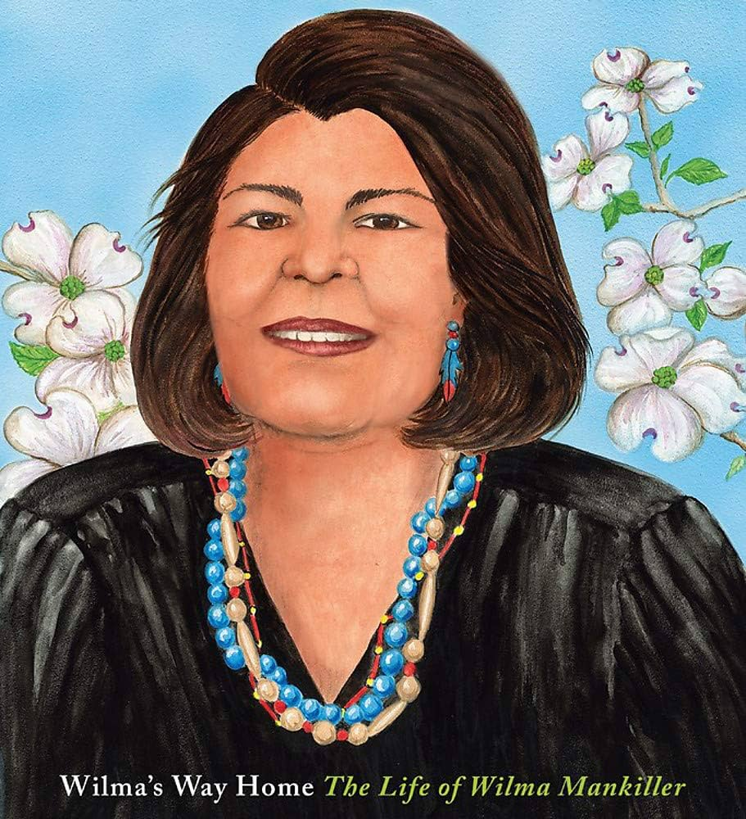
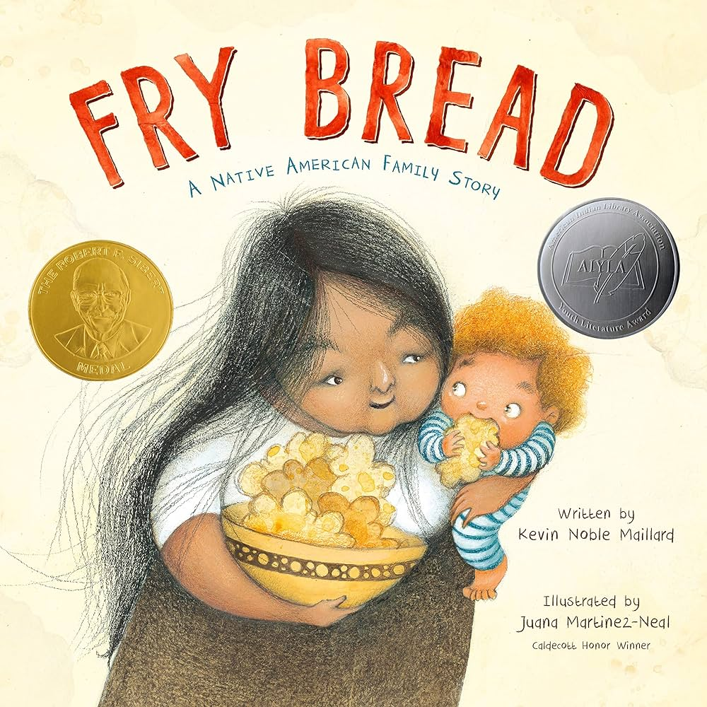
Commemorate Native American Heritage Month:
Using Children’s Literature to Teach Economic Concepts

Slide 2
EconEdLink Membership
You can now access CEE’s professional development webinars directly on EconEdLink.org! To receive these new professional development benefits, become an EconEdLink member. As a member, you will now be able to:
Automatically receive a professional development certificate via e-mail within 24 hours after viewing any webinar for a minimum of 45 minutes
Register for upcoming webinars with a simple one-click process
Easily download presentations, lesson plan materials and activities for each webinar
Search and view all webinars at your convenience
Save webinars to your EconEdLink dashboard for easy access to the event
Access our new Professional Development page here

Slide 3
Professional Development Opportunities
To earn professional development credit for CEE webinars found on EconEdLink, you must:
Watch a minimum of 45-minutes and you will automatically receive a professional development certificate via e-mail within 24 hours.
Attendees can learn how much credit they will earn per workshop.
Accessing resources:
You can now easily download presentations, lesson plan materials, and activities for each webinar from EconEdLink.org/professional-development/
Local resources:
Insert your local professional development opportunities (if applicable)

Slide 4
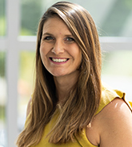
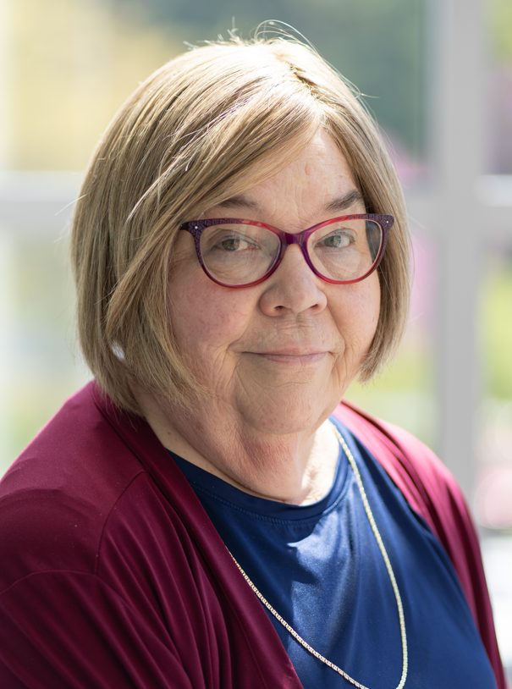
Presenters
Lauren Hensley Shifflett is the new Associate Director at the James Madison University Center for Economic Education. Prior to joining the Center, she spent twelve years in early elementary education where she enjoyed prospering young minds as a classroom teacher. Lauren became nationally known as an elementary economic educator when she received the John Morton Award of the national Council for Economic Education in 2021. Her love for economics guides her lessons to prepare students for life.
shiffllh@jmu.edu
Lynne Farrell Stover is currently a Teacher Consultant at the James Madison University Center for Economic Education. Prior to this, she spent thirty-three years in public education where she enjoyed various teaching assignments including classroom teacher, gifted education specialist, and librarian. She is the author of over fifty educational articles and eight teacher resource books. She is the recipient of the 2022 NAEE Platinum Curriculum Award for her lessons developed for Virginia’s Reading Makes Cents Program.
stoverlf@jmu.edu

Slide 5
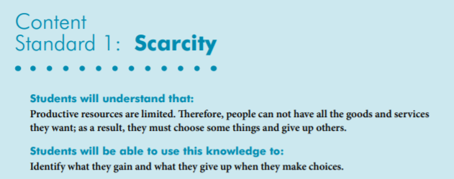
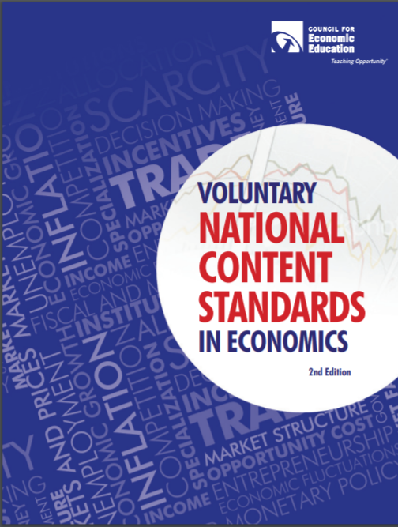
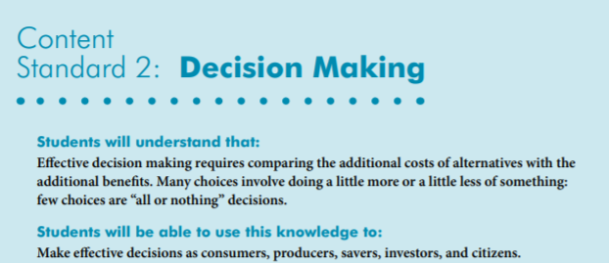
National Content Standards
https://www.councilforeconed.org/wp-content/uploads/2012/03/voluntary-national-content-standards-2010.pdf

Slide 6
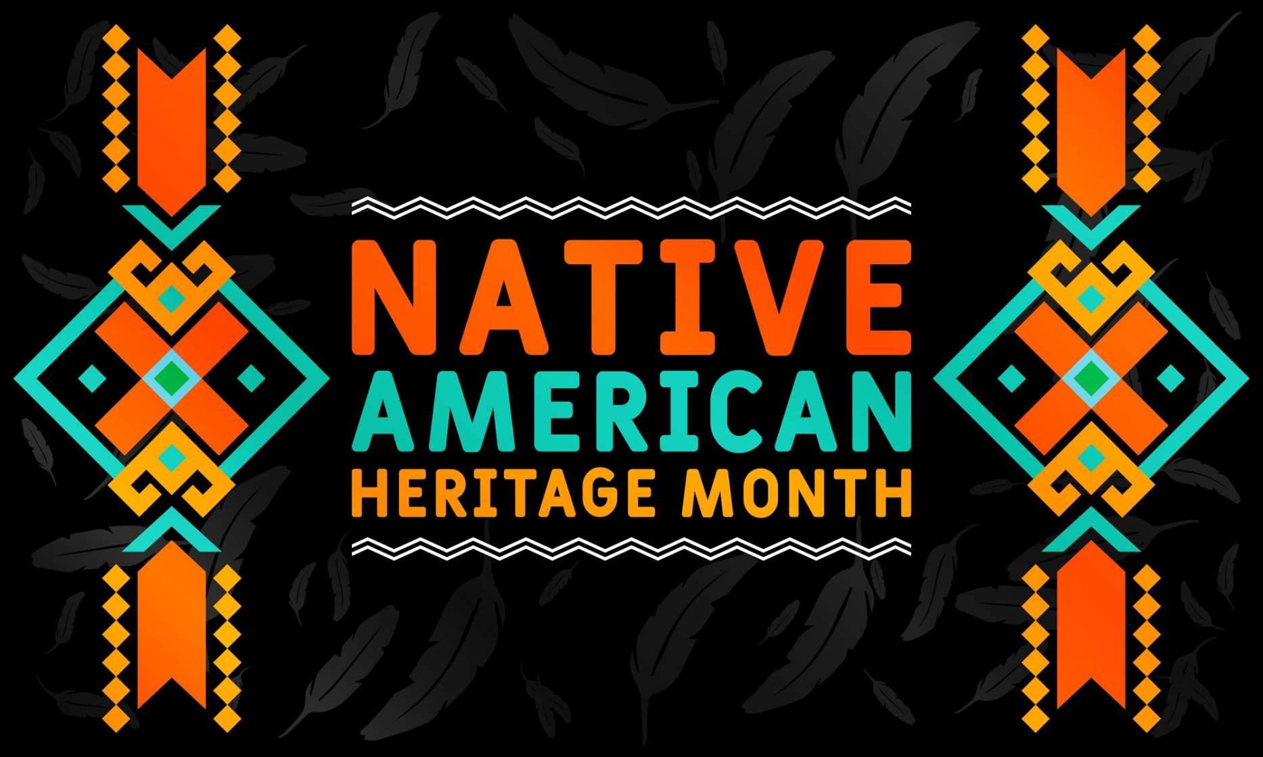
Commemorate Native American Heritage Month:
Using Children’s Literature to Teach Economic Concepts
Agenda
Introduction [5 mins.]
PART I Terminology and Background Information [5 mins.]
PART II Featured Children’s Books: Lessons & Activities [35 mins.]
PART III Extension Activities [5 mins.]
PART IV Resources[5 mins.]
Conclude with discussion questions and webinar survey [5 mins.]

Slide 7
Objectives
In this webinar teachers will:
Determine correct terminology and considerations when teaching about Native Americans.
Discover new book titles featuring Native Americans. [Note: 2.7% of the United States’ population is Native American and 2% of children’s books featured Native Americans in 2020.]
Relate the economic concepts as they pertain to the featured titles.
Review classroom-ready lessons and available resources.

Slide 8
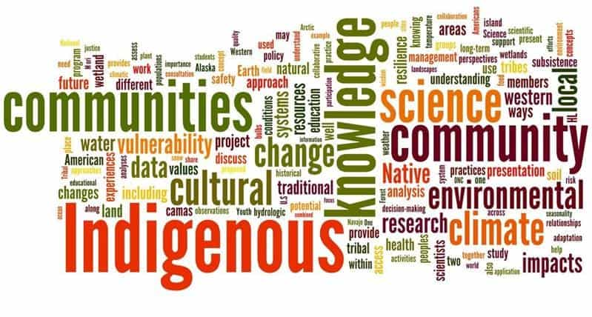
PART I
Terminology & Background information

Slide 9

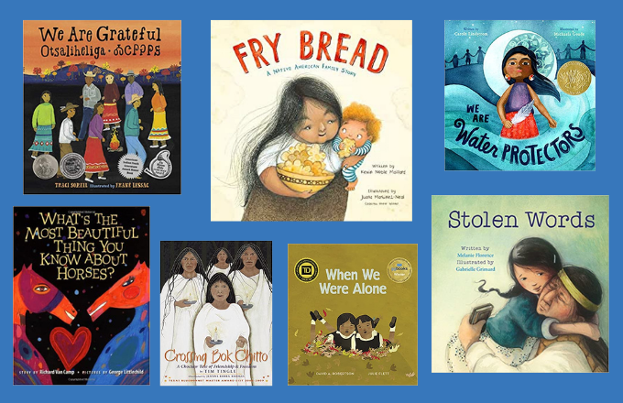
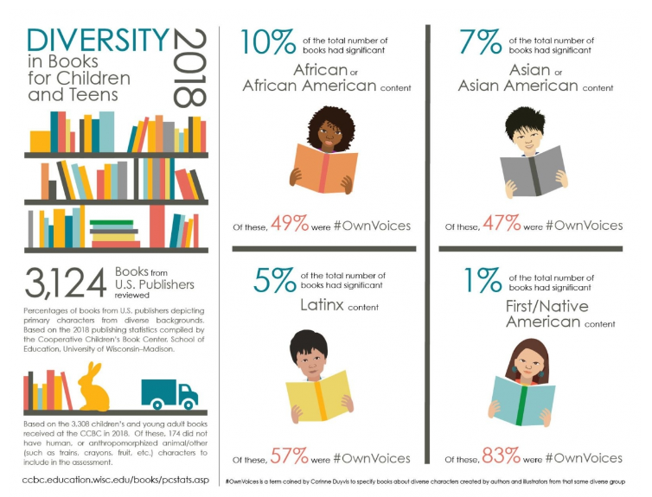

Slide 10
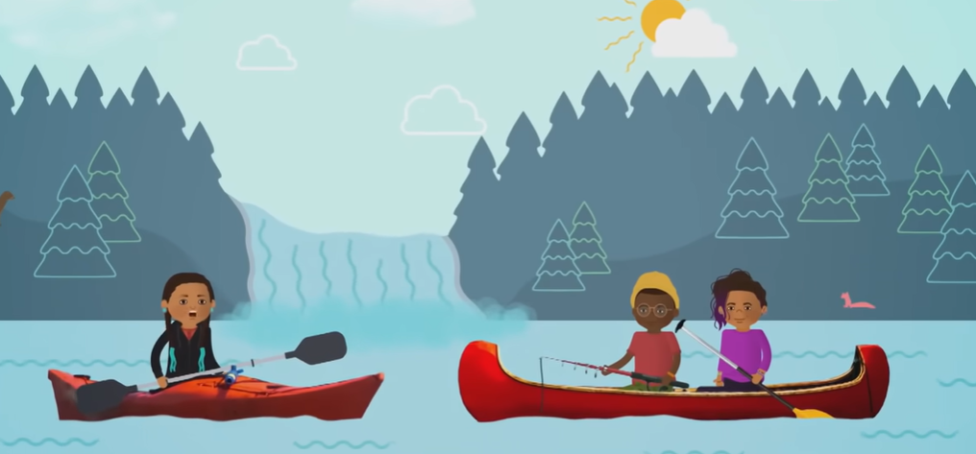
The Word Indigenous Explained
https://www.youtube.com/watch?v=CISeEFTsgDA
2:27 Minutes

Slide 11
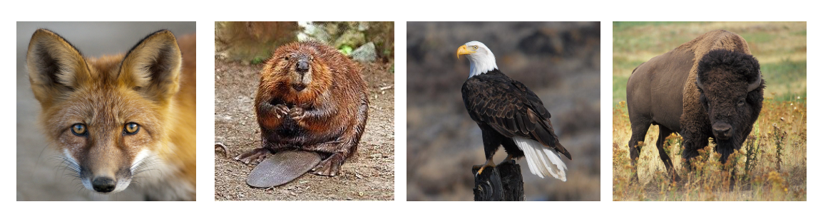
LET’S START THINKING!
How would you rank these animals from the most important to the least important?

Slide 12
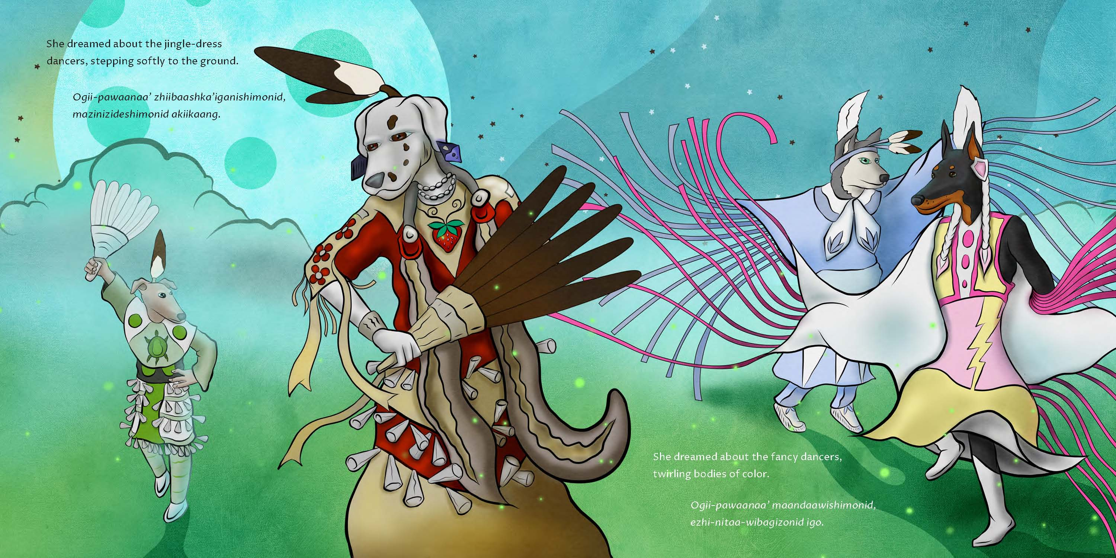

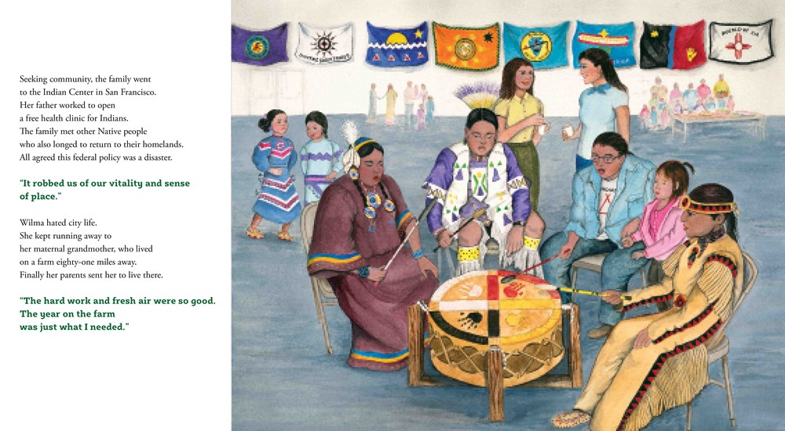
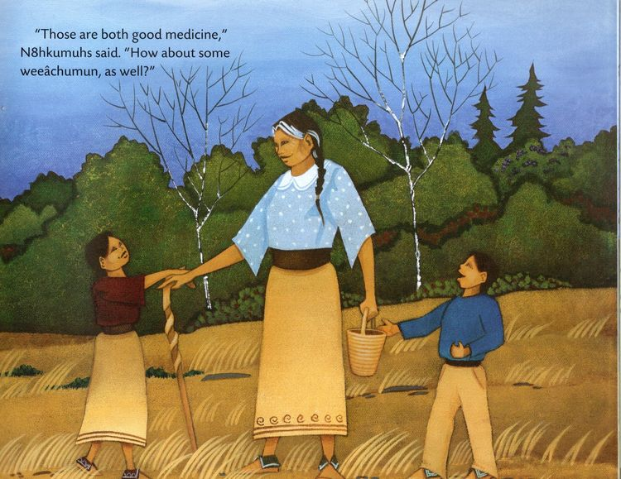

PART II
Featured Childrens’ Books: Lessons & Activities

Slide 13
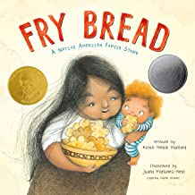
FRY BREAD
by Kevin Noble Maillard
Story Synopsis: This portrayal of a modern Native American family, told in lively and powerful verse, uses fry bread as a metaphor for love, sharing, and honoring the old while embracing the new.
Publisher: Roaring Brook Press
Copyright Date: 2019
Reading Level: 2.0
Interest Level: P-2
https://www.youtube.com/watch?v=MibEeGiFThM

Slide 14
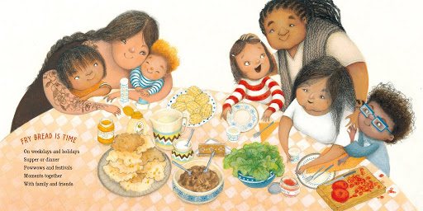
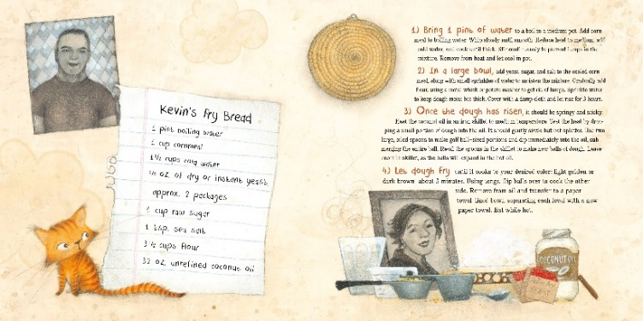
Connections to the making of the bread are made to SOUND, COLOR, FLAVOR, TIME, ART, HISTORY, PLACE, and NATION.

Slide 15
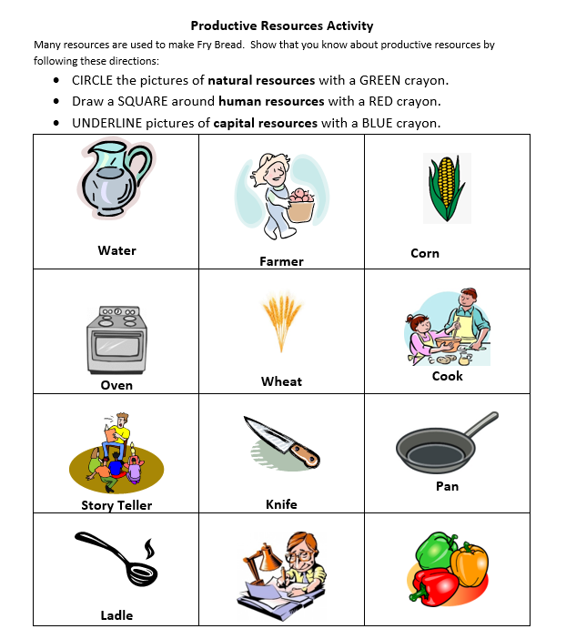
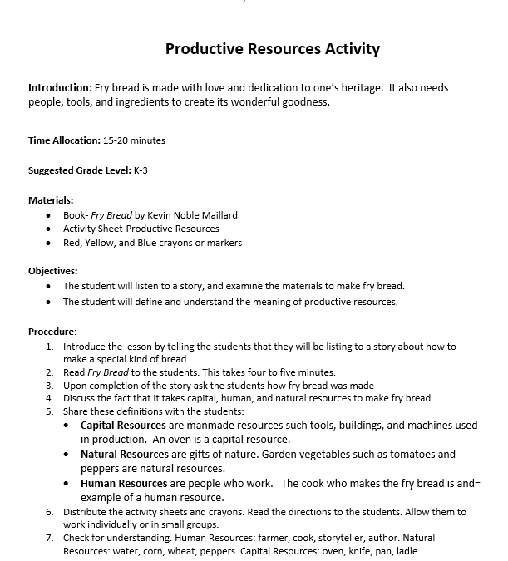
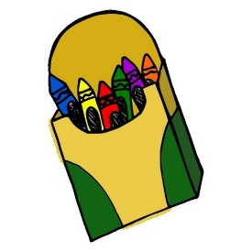
Productive Resources Lesson

Slide 16

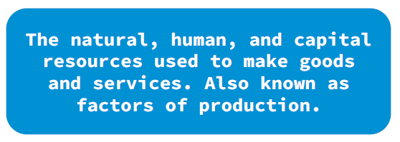

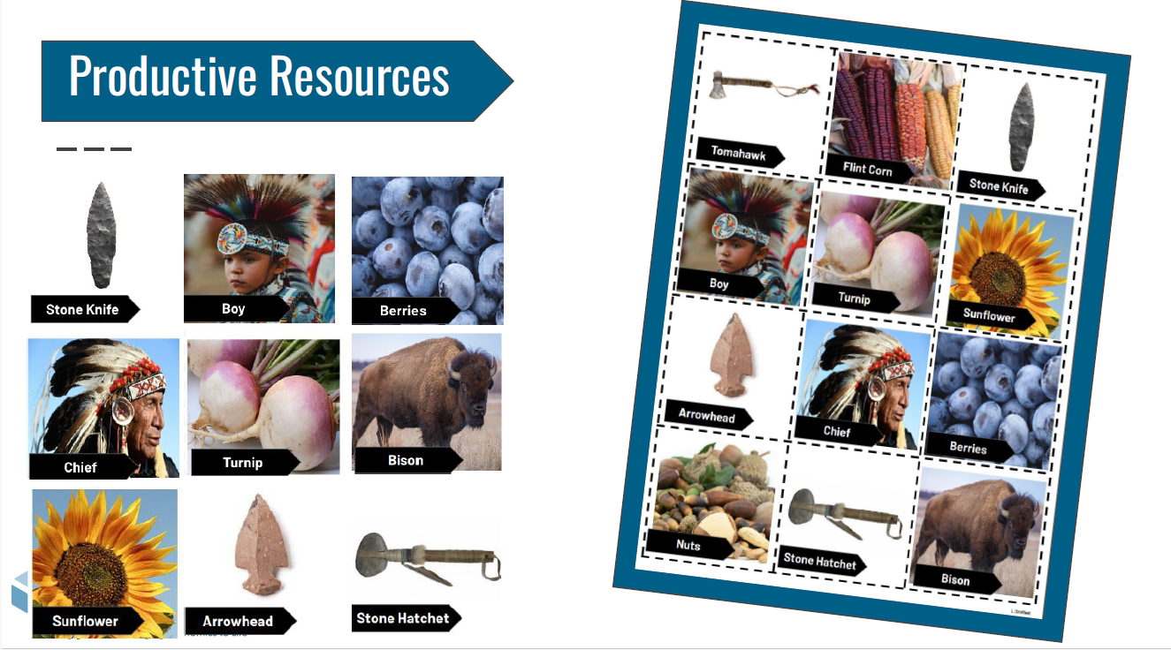
Sort resource picture cards to demonstrate understanding.
Objectives
● List and classify resources into groups of capital, natural, and human resources.
● Describe how natural resources are used to produce goods and services.

Slide 17
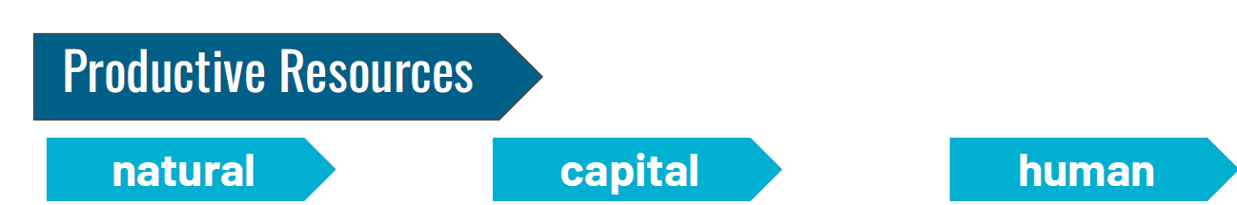

Slide 18
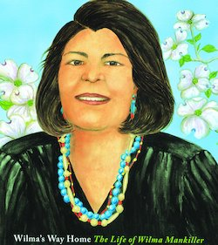
Wilma's Way Home:
The Life of Wilma Mankiller
by Doreen Rappaport
Story Synopsis: A picture-book biography of Wilma Mankiller, the first female chief of the Cherokee Nation.
Publisher: Hyperion
Copyright Date: 2019
Reading Level: 5.1
Interest Level: 2-5
https://www.youtube.com/watch?v=--seTLltE44
15 minutes
November 18, 1945 - April 6, 2010

Slide 19
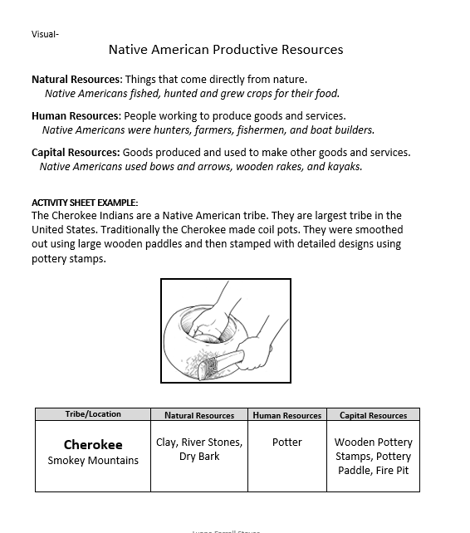
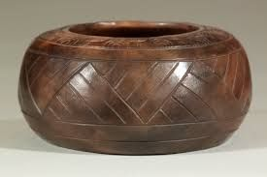
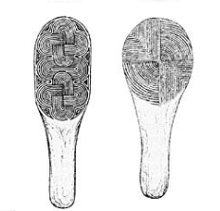
Native American Productive Resources

Slide 20
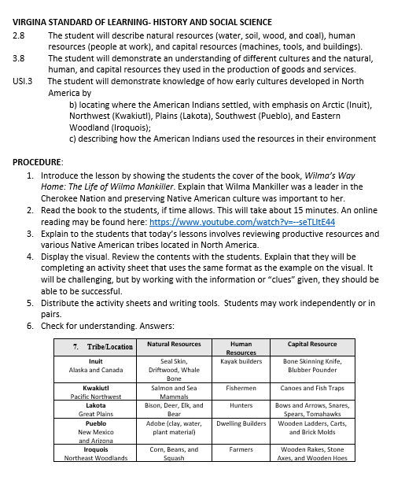
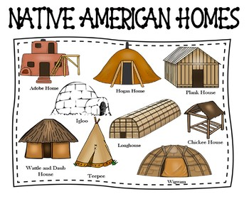
Native American Productive Resources

Slide 21
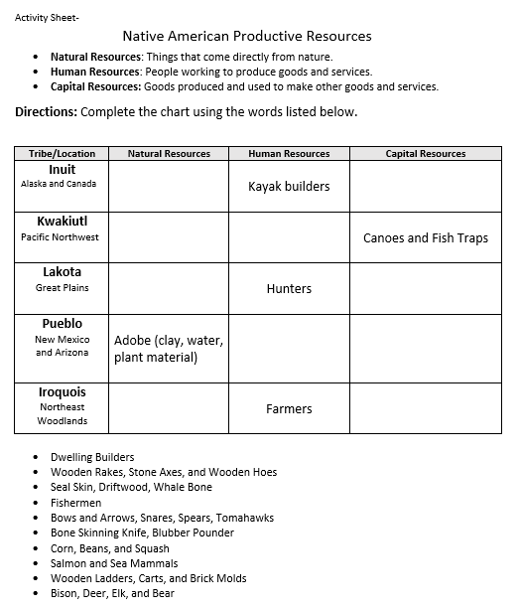


Slide 22
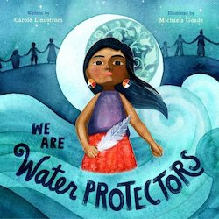
We Are Water Protectors
by Carole Lindstrom
Story Synopsis: Told from the perspective of a Native American child, this bold and lyrical picture book is a powerful call to action to defend Earth's natural resources--inspired by the Dakota Access Pipeline protests and similar movements led by Indigenous tribes all across North America.
Publisher: Roaring Book Press
Copyright Date: 2020
Reading Level: 1.9
Interest Level: P-2
https://www.youtube.com/watch?v=1btJgUXzmw0

Slide 23
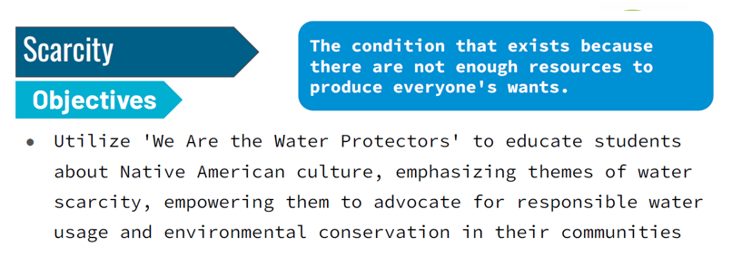
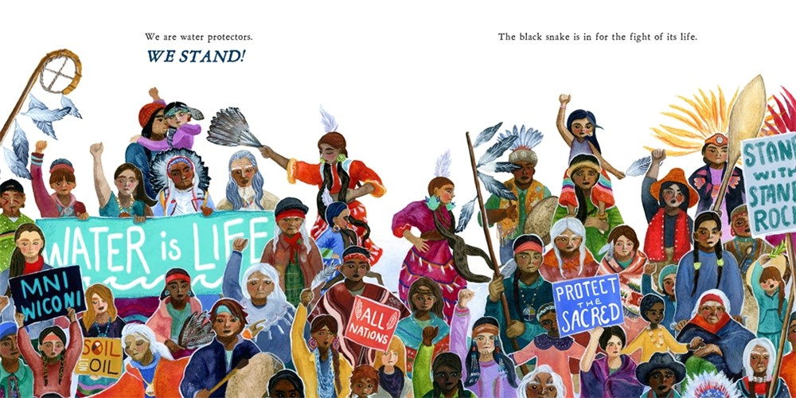

Slide 24

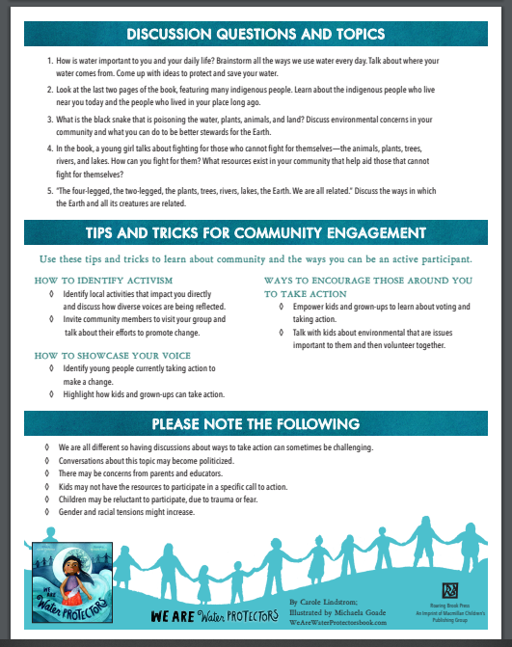
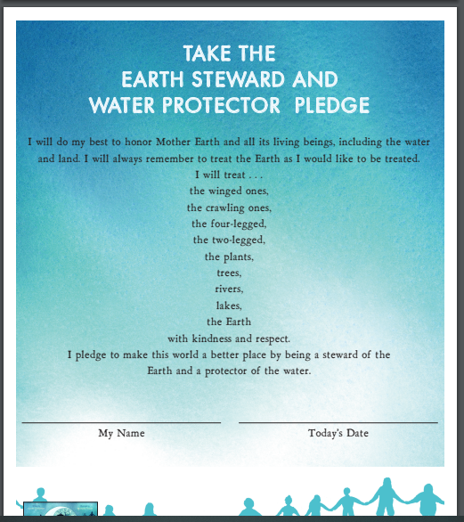
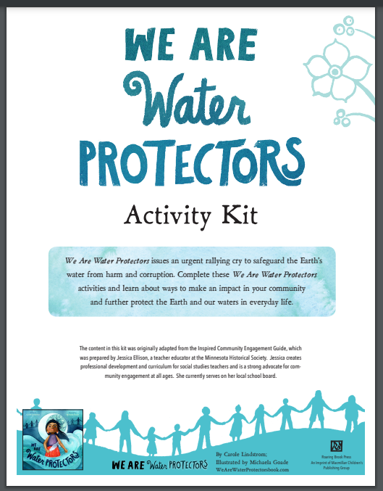
https://static.macmillan.com/static/macmillan/2020-online-resources/downloads/we-are-water-protectors-activity-kit.pdf

Slide 25

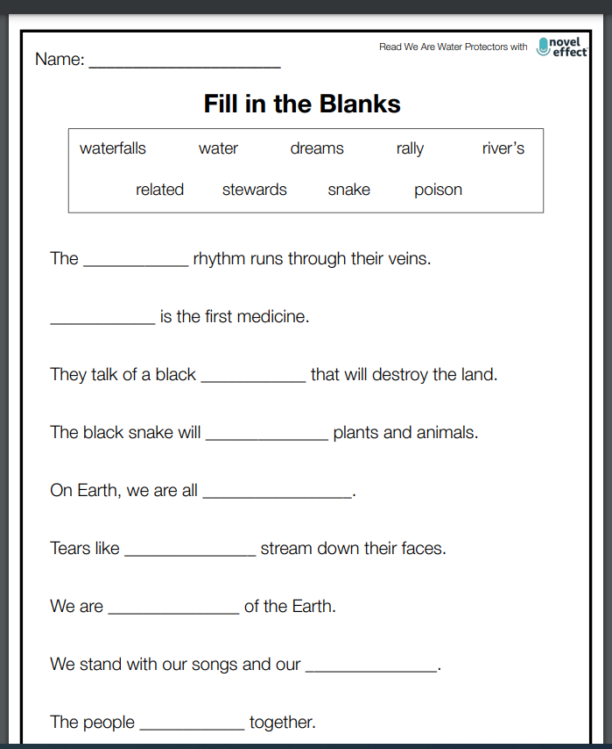



https://noveleffect.com/we-are-water-protectors-k-5-activities/
18-page Activity Guide

