Slide 1
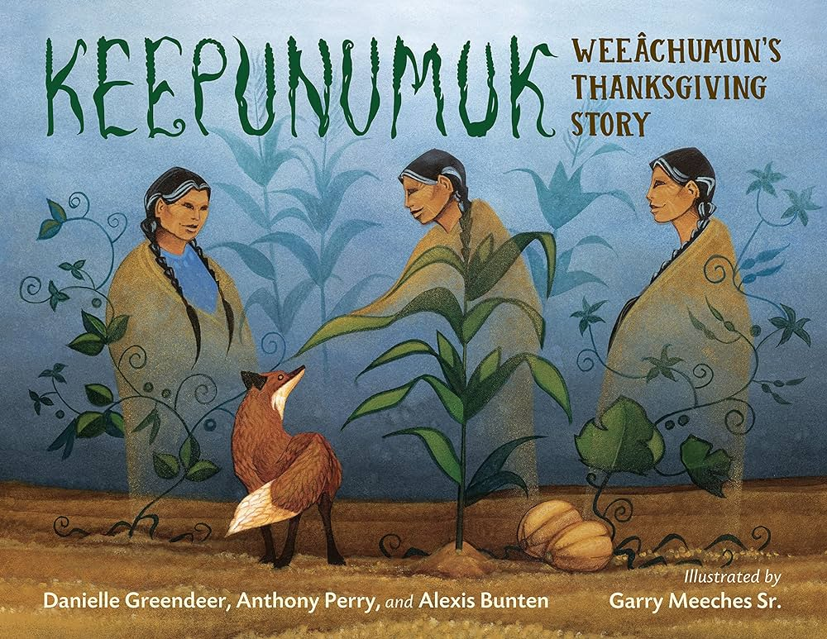
Keepunumuk: Weeâchumun's Thanksgiving Story
Story Synopsis: The Thanksgiving story that most Americans know celebrates the Pilgrims. But without members of the Wampanoag tribe who already lived on the land where the Pilgrims settled, the Pilgrims would never have made it through their first winter. And without Weeâchumun (corn), the Native people wouldn't have helped.
An important picture book honoring both the history and tradition that surrounds the story of the first Thanksgiving.
Publisher: Charlesbridge
Copyright Date: 2022
Reading Level: 2.0
Interest Level: P-2
https://www.youtube.com/watch?v=r4kxFJFj6BQ
9 mins.

Slide 2
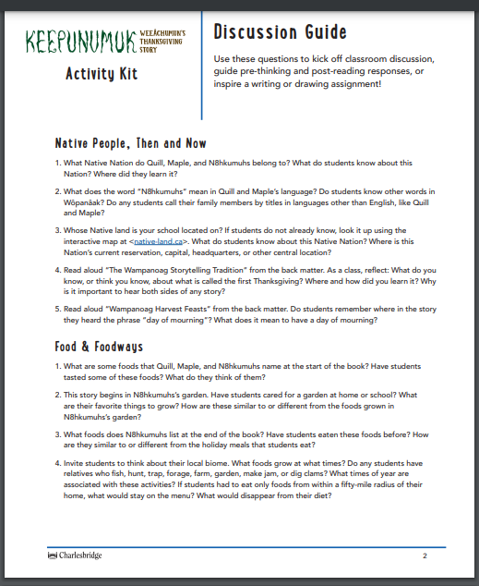
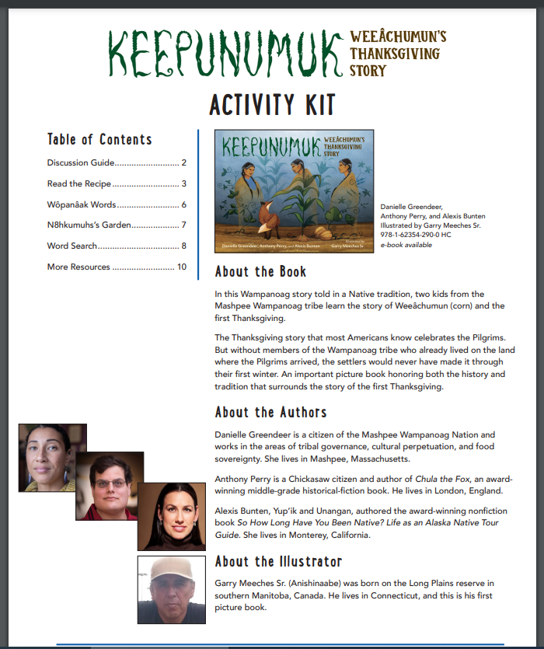
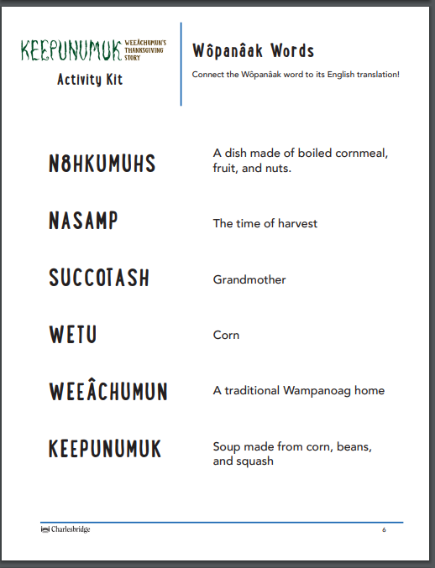
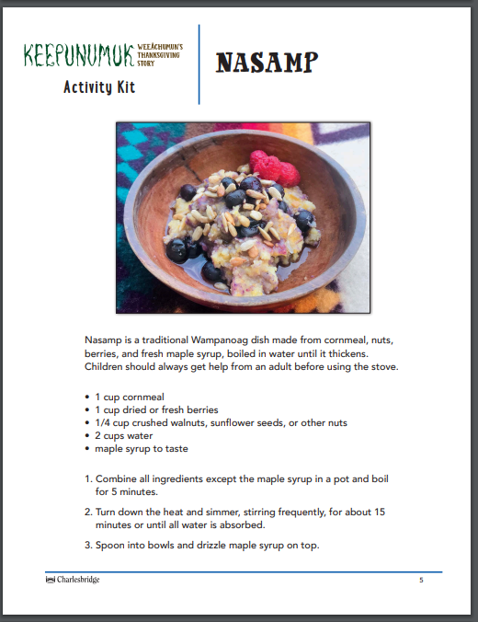
10-page Publisher’s Activity Kit
https://cdn.shopify.com/s/files/1/0750/0101/files/keepunumuk-activity-kit.pdf?v=1656603046

Slide 3
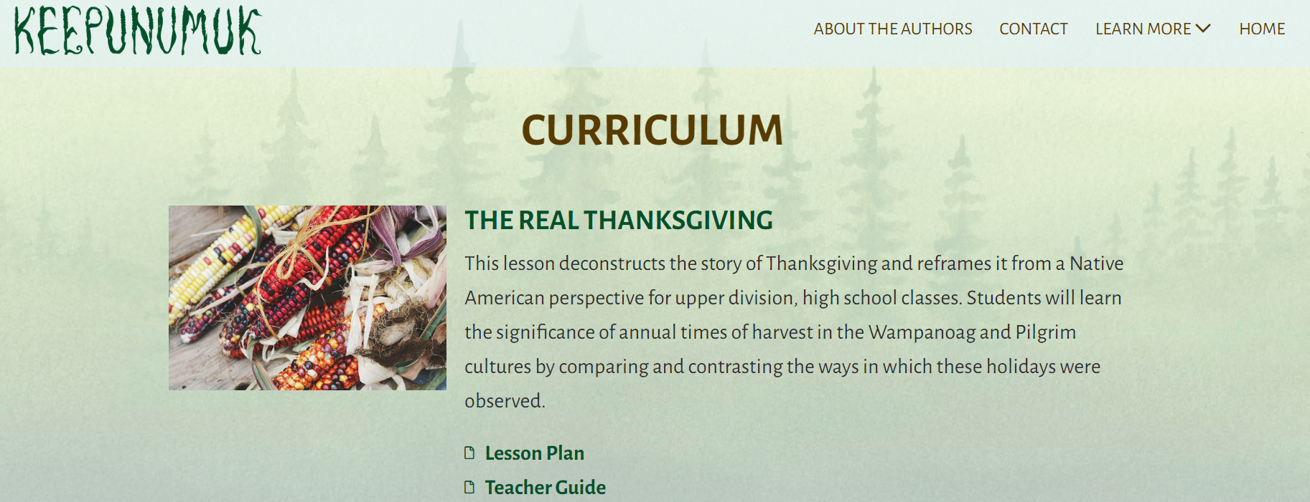
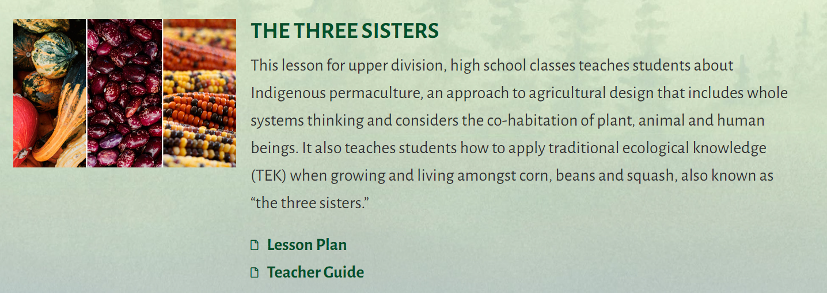
High School Curriculum
https://keepunumuk.com/curriculum/

Slide 4
Bowwow Powwow
Book Synopsis: In 'Bowwow Powwow,' join Windy Girl, Uncle, and Itchy Boy as they immerse themselves in the vibrant world of a Native American powwow. Through Uncle's captivating stories, Windy's imagination takes flight, transforming the human dancers into a lively gathering of dogs in this delightful tale. Experience the joy of community, tradition, and celebration in song and dance, as Windy discovers the magical wonder of the powwow, where cultures blend and hearts unite under the starlit sky.
Publisher: Minnesota Historical Society Press
Copyright Date: 2018
Reading Level: 1.9
Interest Level: K-3
https://www.youtube.com/watch?v=luXF84pESNE -Ojjibwe Version
https://www.youtube.com/watch?v=lpBfWk46JA4 - English Version

Slide 5
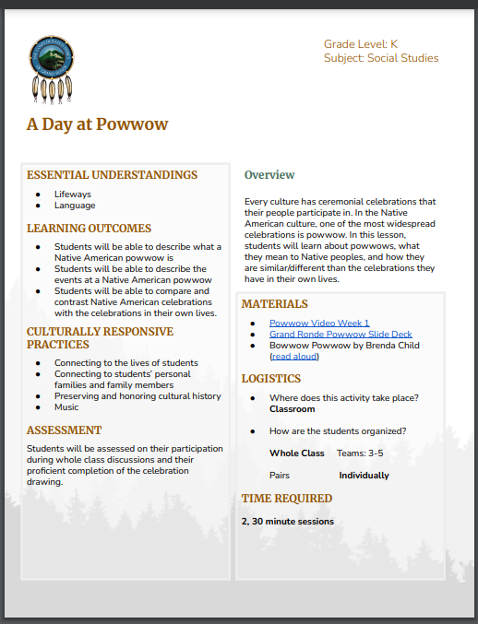
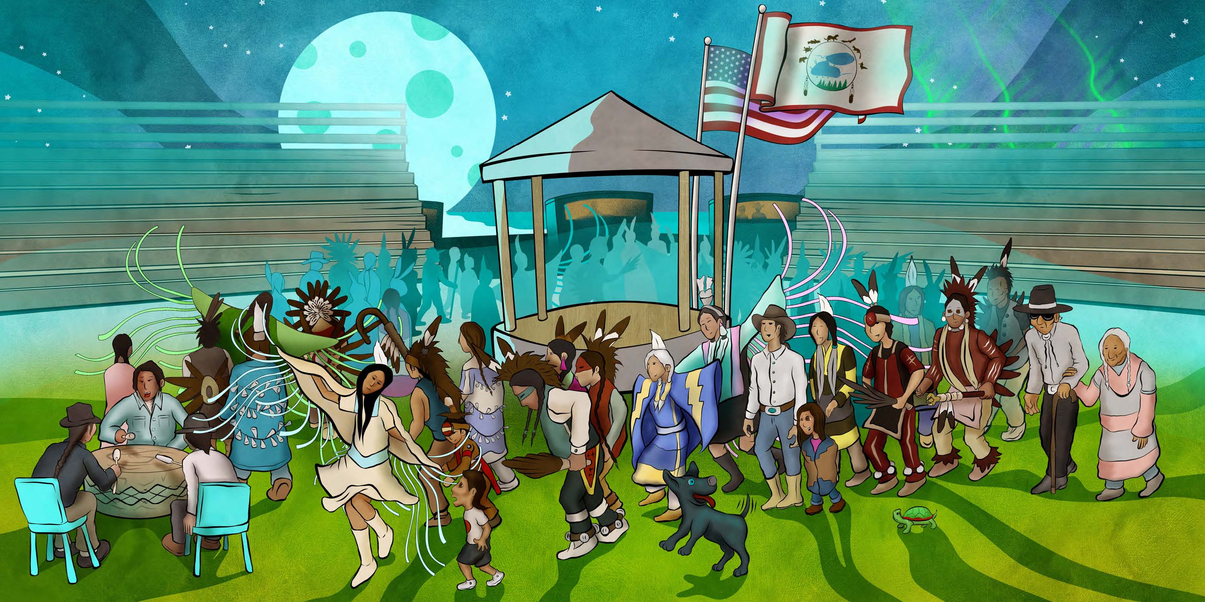
A Native American powwow is a cultural event that features group singing and dancing by men, women and children. They are a time of celebration where cultural traditions are passed down from generation to generation. There are many roles at a powwow event: singers, dancers, drummers, spectators, artisan vendors, and food vendors.
https://www.grandronde.org/media/2844/kss2-a-day-at-powwow-lesson-plan.pdf

Slide 6
Bowwow Powwow
What does this illustration mean to you?
What do you notice?

Slide 7
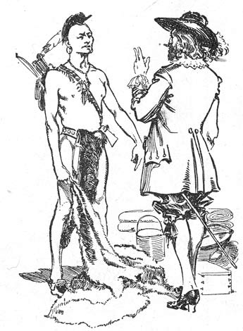
PART IV
Extension Activities

Slide 8
TRADE

Slide 9
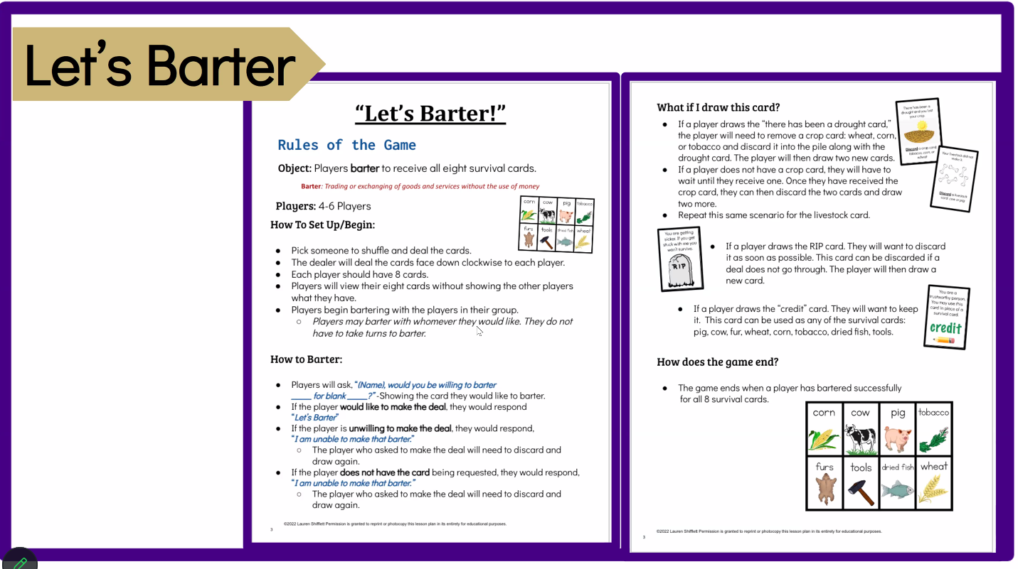
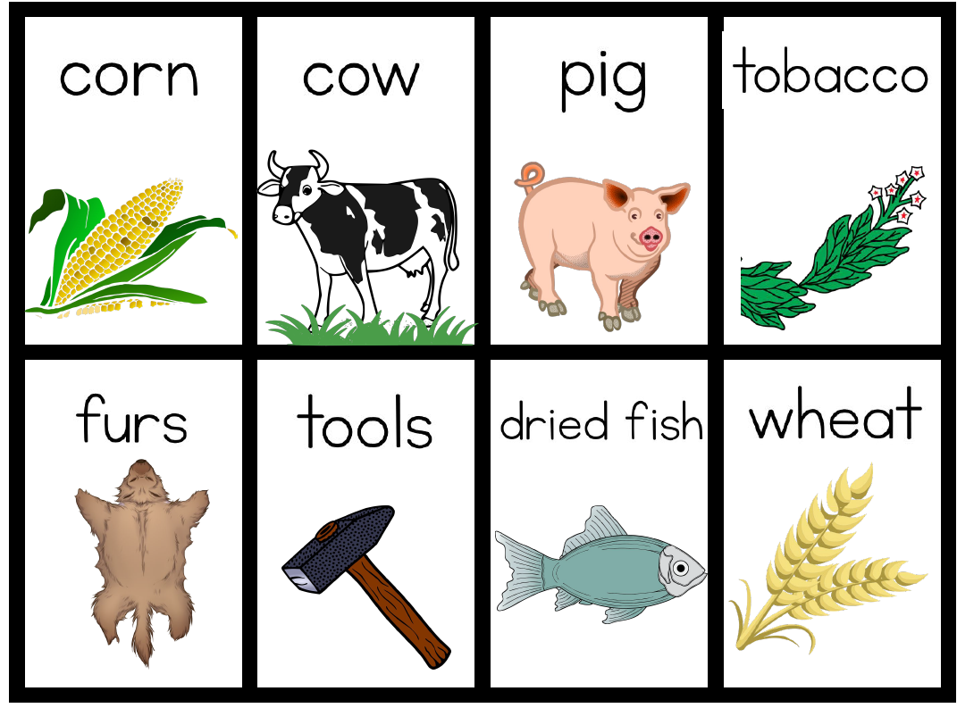

Slide 10




Analyze opportunity cost through 'Would You Rather’ scenarios, making decisions and understanding trade-offs in various situations.

Slide 11
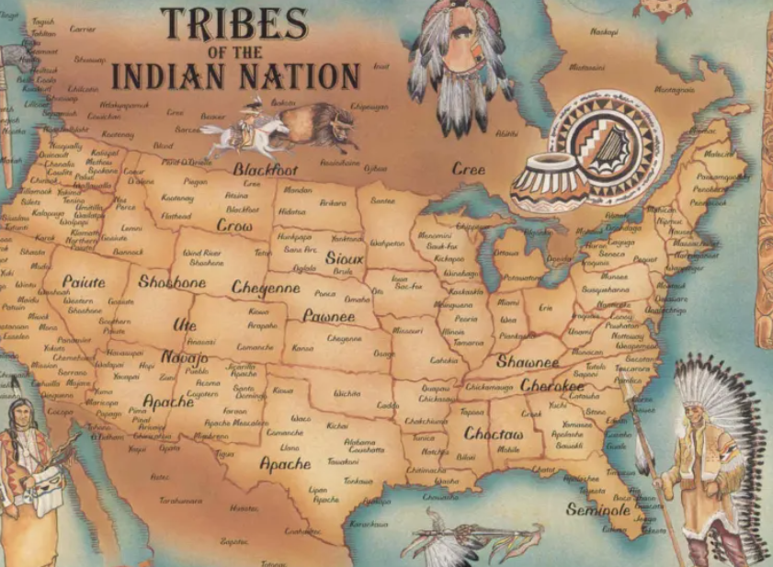
PART III
Resources

Slide 12
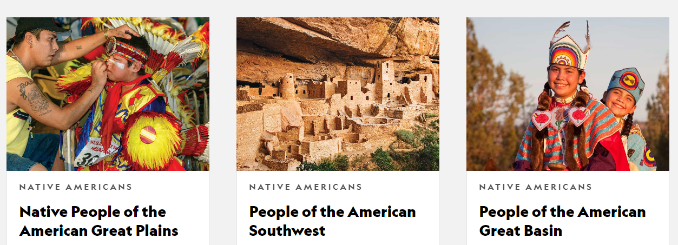

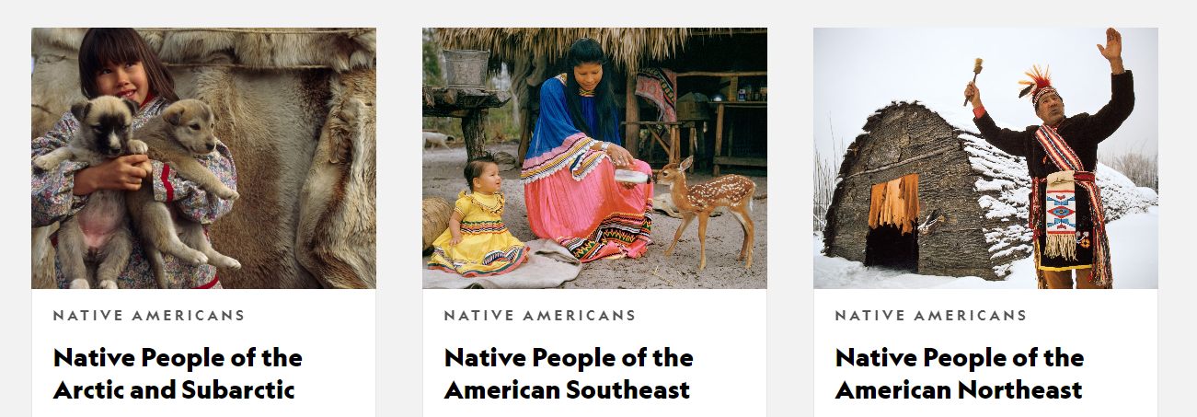
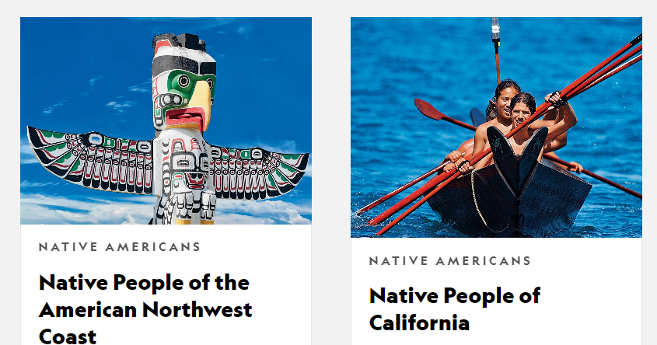
https://kids.nationalgeographic.com/history/topic/native-americans

Slide 13
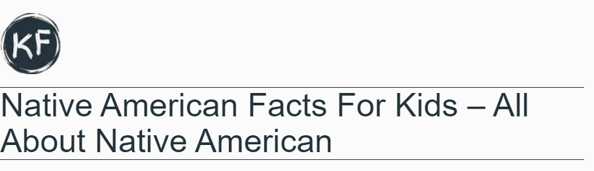
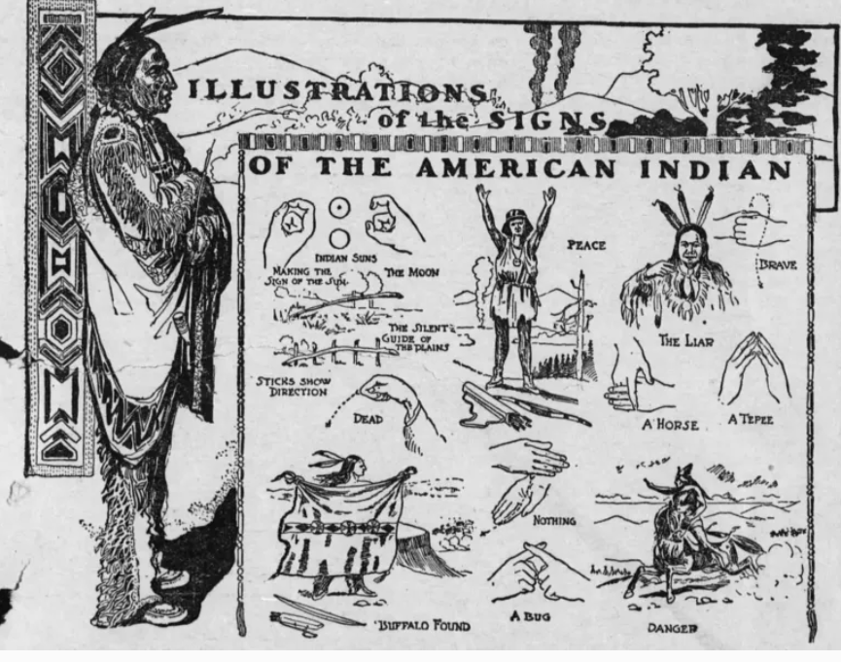
https://kidzfeed.com/native-american-facts-for-kids/

Slide 14

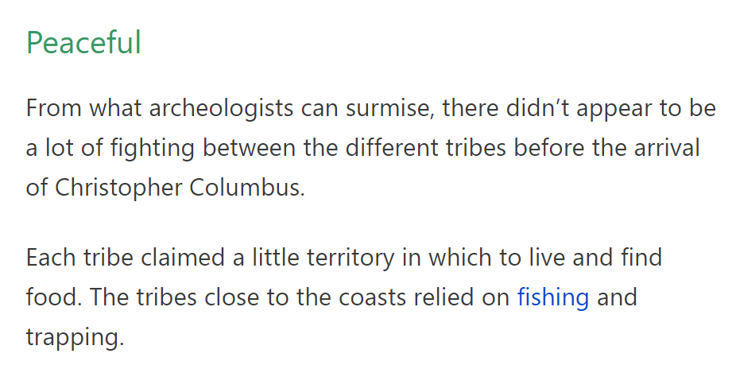
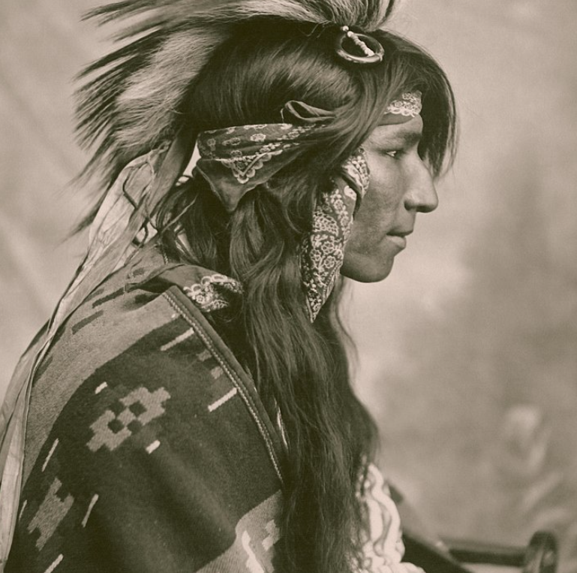
https://www.coolkidfacts.com/native-americans/

Slide 15
FOR DISCUSSION
There are about 2 million Native Americans left in the United States.
[Less than 1% of the population.] How do you think this effects them?
Native Americans were granted American citizenship in 1924. Why do you
think it took so long?
Native Americans spoke more than 300 languages.
It’s likely all but two will exist in 2050. Why do you think this is so?
Native Americans cultivated many of the world's most important crops.
Can you name three of these?
“There are about 2 million Native Americans left in the United States - that's less than 1% of our population.”

Slide 16

QUESTIONS?
COMMENTS?
CONCERNS?

Slide 17

Invest In Girls

Slide 18
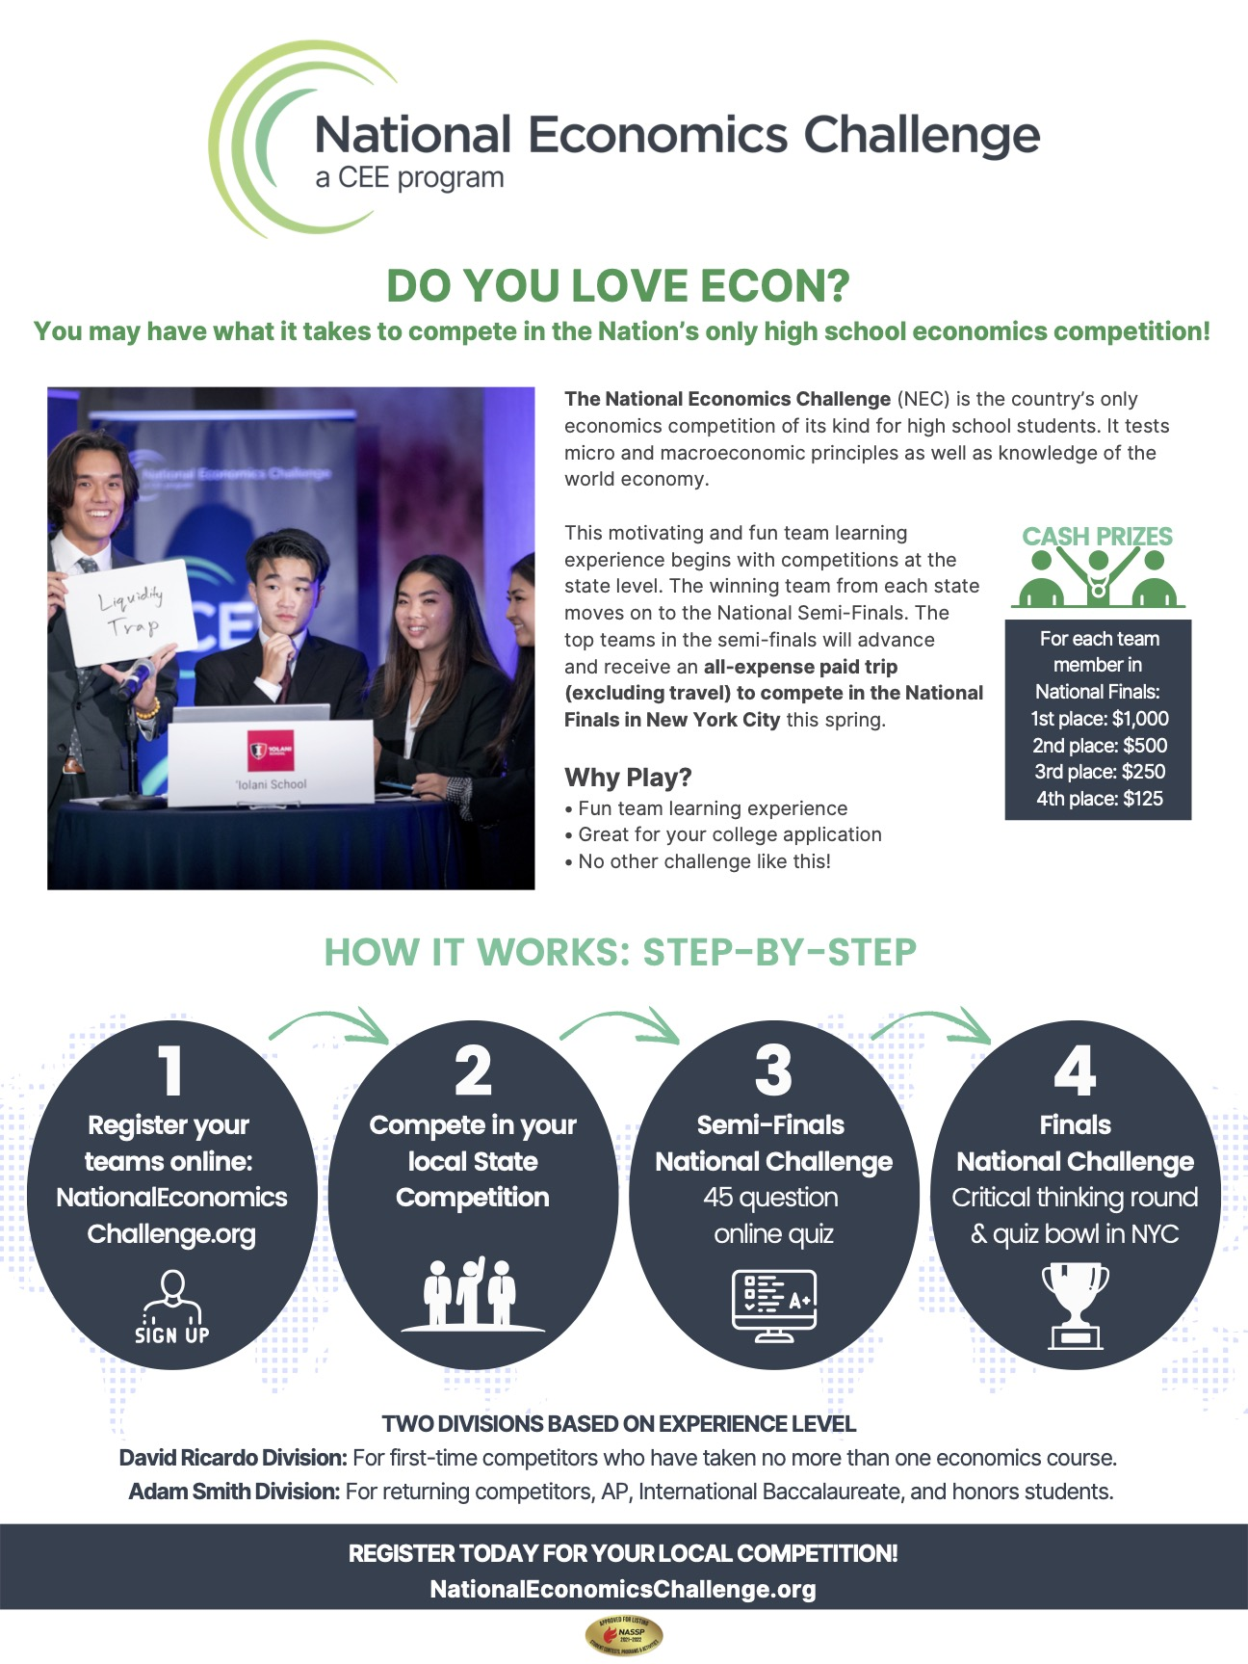
NEC

Slide 19
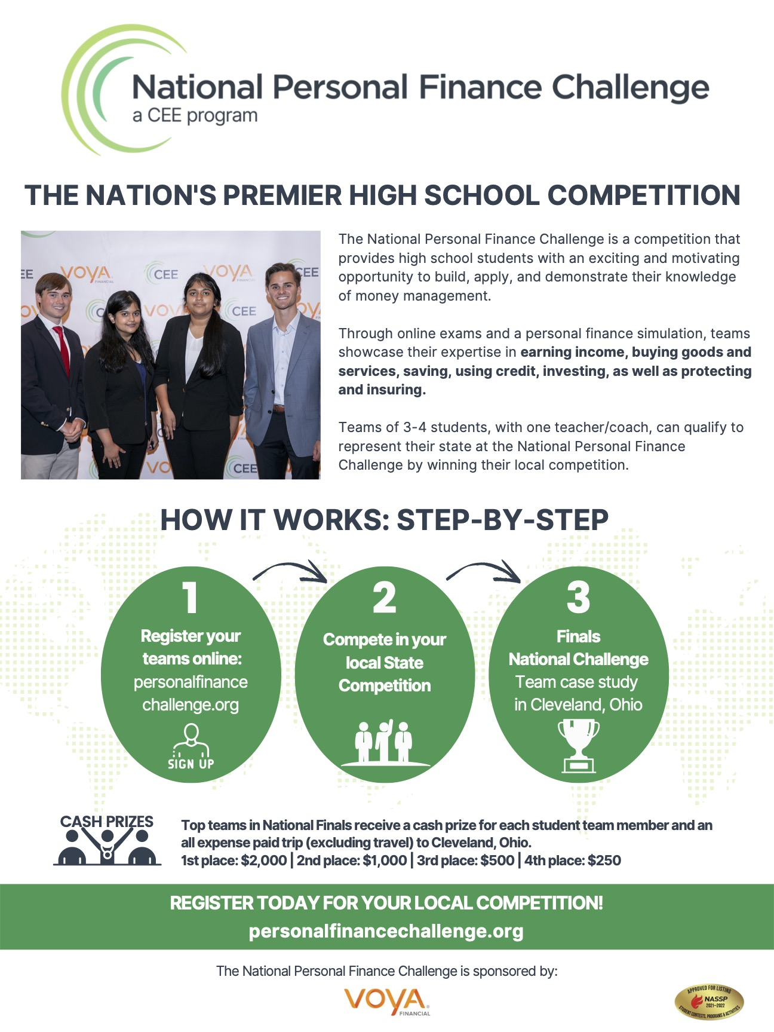
NPFC

Slide 20

Advocacy

Slide 21
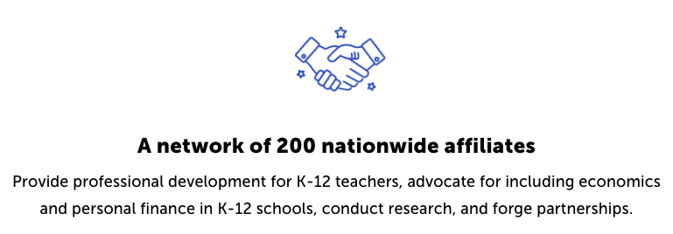
Suggested Presentation Deck
CEE Affiliates
https://www.councilforeconed.org/resources/local-affiliates/
Include your local affiliate page

Slide 22











Thank You to Our Sponsors!
22

Slide 23
Contact information
Lynne F Stover stoverlf@jmu.edu
Lauren H Shifflett shiffllh@jmu.edu
Thank You

