Slide 1
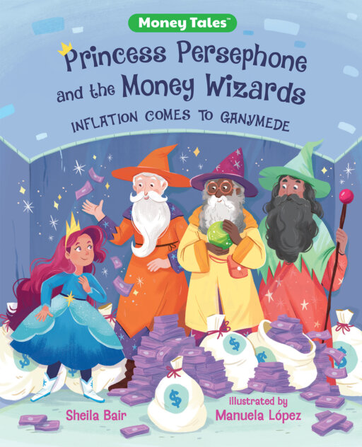
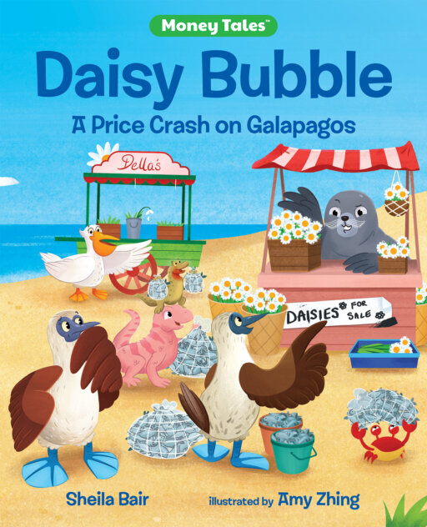
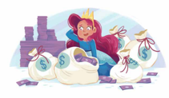
Money Tales Series
Sheila Bair’s New Books
February 8, 2024
Lauren H Shifflett shiffllh@jmu.edu
Lynne F Stover stoverlf@jmu.edu
Notes:
Lauren

Slide 2
EconEdLink Membership
You can now access CEE’s professional development webinars directly on EconEdLink.org! To receive these new professional development benefits, become an EconEdLink member. As a member, you will now be able to:
Automatically receive a professional development certificate via e-mail within 24 hours after viewing any webinar for a minimum of 45 minutes
Register for upcoming webinars with a simple one-click process
Easily download presentations, lesson plan materials and activities for each webinar
Search and view all webinars at your convenience
Save webinars to your EconEdLink dashboard for easy access to the event
Access our new Professional Development page here

Slide 3
Professional Development Opportunities
To earn professional development credit for CEE webinars found on EconEdLink, you must:
Watch a minimum of 45-minutes and you will automatically receive a professional development certificate via e-mail within 24 hours.
Attendees can learn how much credit they will earn per workshop.
Accessing resources:
You can now easily download presentations, lesson plan materials, and activities for each webinar from EconEdLink.org/professional-development/
Local resources:
Insert your local professional development opportunities (if applicable)

Slide 4
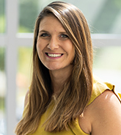
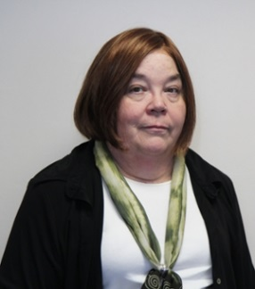
Presenters
Lauren Hensley Shifflett is the new Associate Director at the James Madison University Center for Economic Education. Prior to joining the Center, she spent twelve years in early elementary education where she enjoyed prospering young minds as a classroom teacher. Lauren became nationally known as an elementary economic educator when she received the John Morton Award of the national Council for Economic Education in 2021. Her love for economics guides her lessons to prepare students for life.
shiffllh@jmu.edu
Lynne Farrell Stover is currently a Teacher Consultant at the James Madison University Center for Economic Education. Prior to this, she spent thirty-three years in public education where she enjoyed various teaching assignments including classroom teacher, gifted education specialist, and librarian. She is the author of over fifty educational articles and eight teacher resource books. She is the recipient of the 2022 NAEE Platinum Curriculum Award for her lessons developed for Virginia’s Reading Makes Cents Program.
stoverlf@jmu.edu

Slide 5
Session Agenda
In this session we will:
Introduce the webinar [4 mins.]
Review related standards [1 min.]
Discuss using children’s literature to teach economics and personal finance. [5 mins.]
Explore featured titles and the lessons and activities based on their content. [35 mins.]
Discover online links to websites and resources. [5 mins.]
Share related bibliographies & additional resources. [5 mins.]
Discuss the merits of cautionary tales. [5 mins.]
Notes:
Lauren

Slide 6
Objectives
In this webinar teachers will:
Consider the benefits of using children’s literature to teach in the content areas.
Review the concepts such as auction, central bank, inflation, money, price bubbles, shortage and speculation.
Discover methods for teaching the featured concepts using lessons created for the elementary and middle school classrooms.
Share related bibliography.
Notes:
lynne

Slide 7
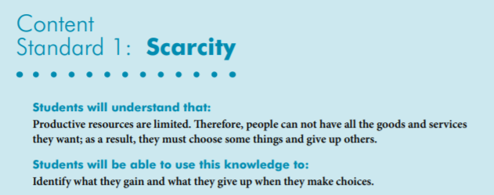
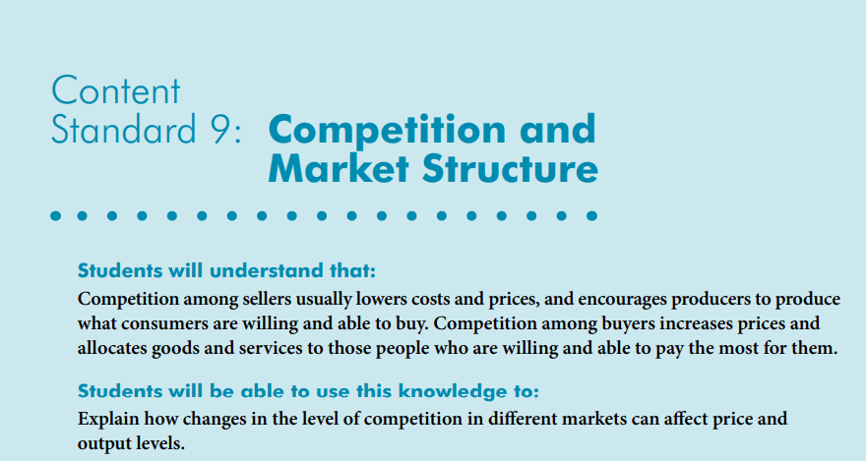
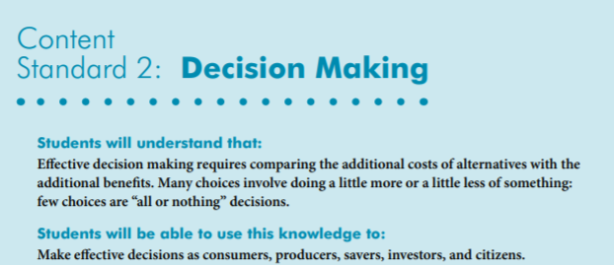
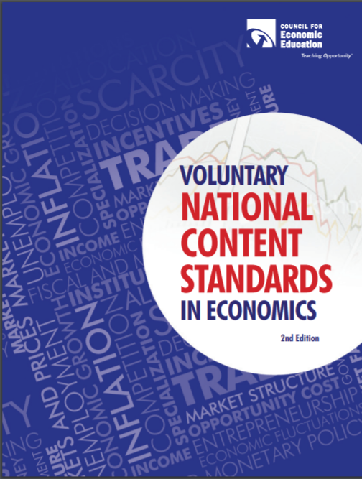
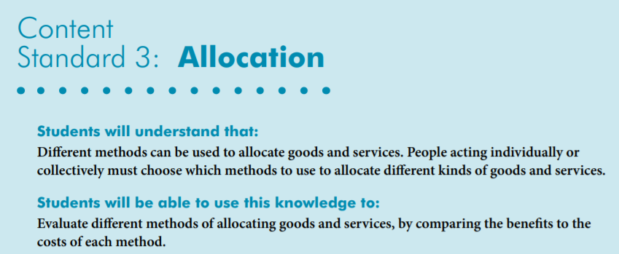
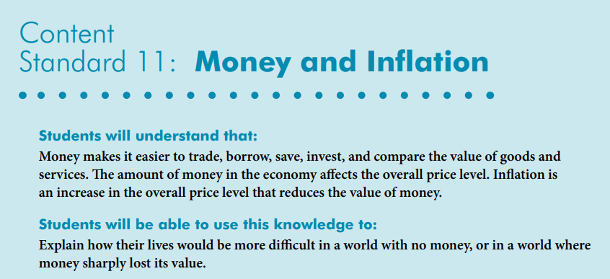
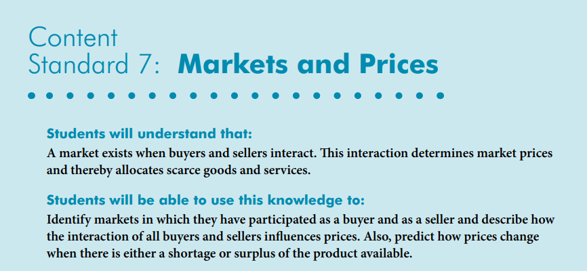
National Standards
https://www.councilforeconed.org/wp-content/uploads/2012/03/voluntary-national-content-standards-2010.pdf

Slide 8
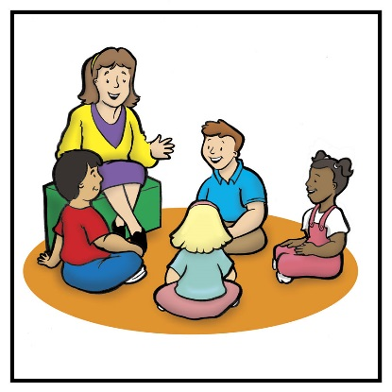
Using Children’s Literature to Teach Content
It is to be noted that by using children’s picture books to teach in the content areas, we are providing students with engaging background information that encourages them to relate to concepts, improve vocabulary, and promote reading and writing skills.
Children’s literature offers many interdisciplinary possibilities including those of economics and personal finance.
Notes:
Lynne

Slide 9
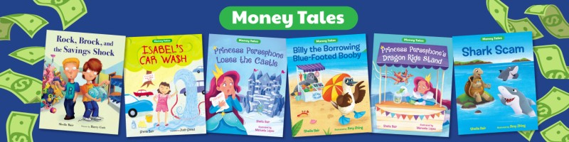
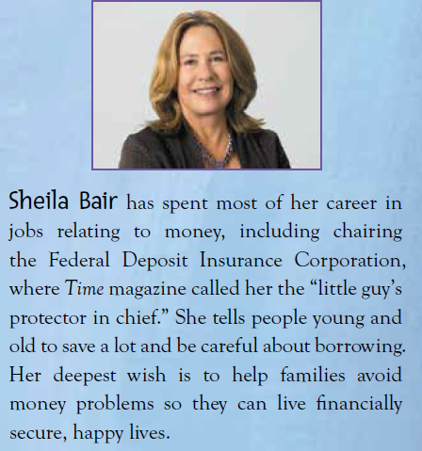

Slide 10
Daisy Bubble: A Price Crash on Galapagos
Story Synopsis: After Arlene the giant tortoise walks down the aisle wearing a crown of daisies, everyone wants some of the beautiful flowers for themselves. Florists sell out quickly, but Seal has a daisy stash that allows him to drive up the price. Soon his customers start buying flowers from each other at even higher markups, hoping to sell them later for a profit. By the time word spreads that more daisies are on the way, this bubble is ready to burst.
Publisher: Albert Whitman
Copyright Date: 2023
Reading Level: 3.0
Interest Level: 2-5

Slide 11

https://www.investopedia.com/articles/stocks/10/5-steps-of-a-bubble.asp
5 Stages of a Bubble
Economist Hyman P. Minsky was one of the first to explain the development of financial instability and the relationship it has with the economy. In his pioneering book Stabilizing an Unstable Economy (1986), he identified five stages in a typical credit cycle, one of several recurrent economic cycles. These stages also outline the basic pattern of a bubble.
1. Displacement
2. Boom
3. Euphoria
4. Profit-Taking
5. Panic

Slide 12

The Five Stages of a Bubble
as featured in
Daisy Bubble: A Price Crash on Galapagos
Displacement- A displacement occurs when investors get enamored by something new.
The animals on Galapagos fell in love with the daisies Arlene wore at her wedding

Slide 13
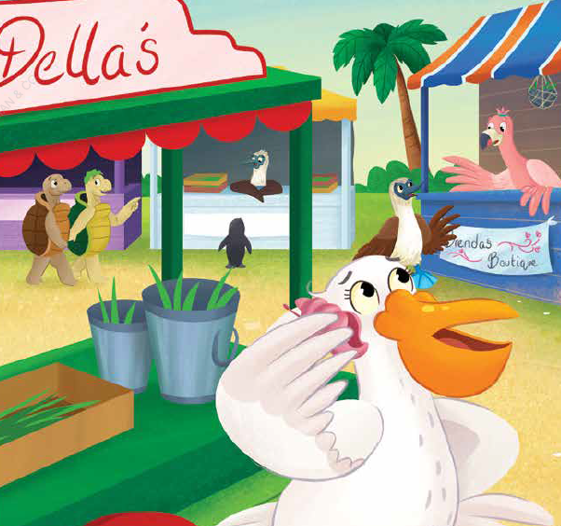
The Five Stages of a Bubble
as featured in
Daisy Bubble: A Price Crash on Galapagos
2. Boom - Prices rise slowly at first, following a displacement, but then gain momentum as more and more participants enter the market.
The week after the wedding, Pelican Della sold all of the daisies at her florist shop.

Slide 14
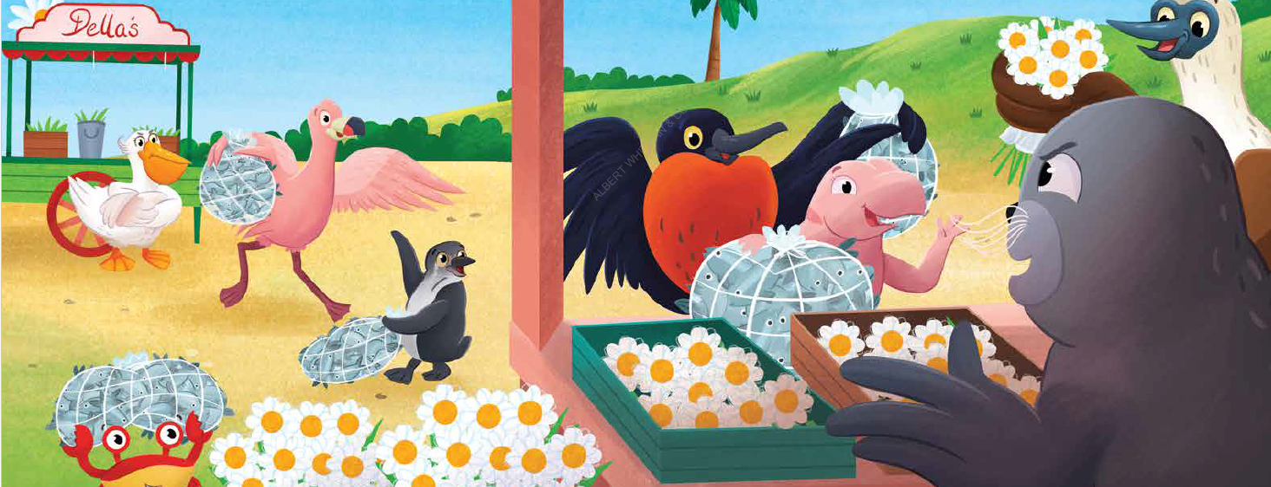
The Five Stages of a Bubble
as featured in
Daisy Bubble: A Price Crash on Galapagos
3. Euphoria - During this phase, caution is thrown to the wind, as the prices for daisies skyrocketed.
Seal was auctioning off his daisies at escalating prices. The first week they sold for ten sardines a flower, the second week twenty sardines, the third week they were up to one hundred sardines a flower.

Slide 15
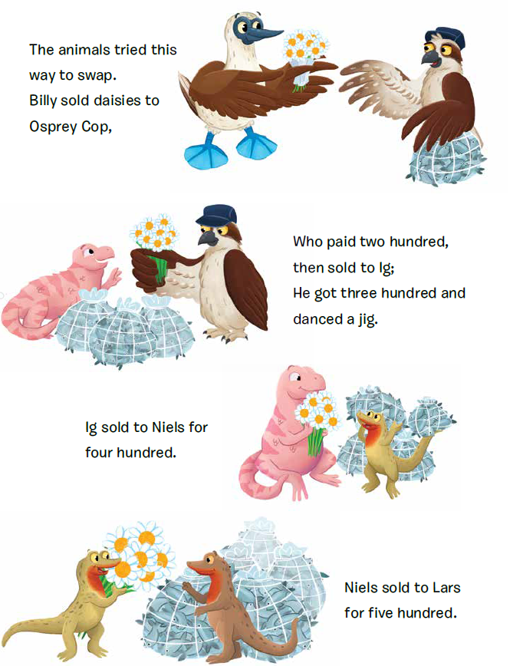
The Five Stages of a Bubble
as featured in
Daisy Bubble: A Price Crash on Galapagos
4. Profit-Taking In this phase, some investors heed warning signs that the bubble is about at its bursting point. They start selling to make a profit.
Bess warned everyone the price would drop, but the animals on the island kept selling the daisies to each other. Prices rose with each transaction, up to ten thousand sardines!

Slide 16
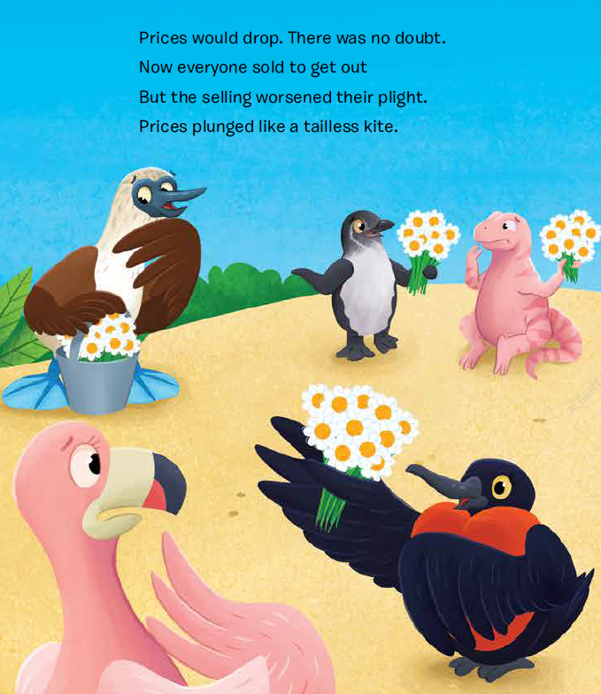
The Five Stages of a Bubble
as featured in
Daisy Bubble: A Price Crash on Galapagos
5. Panic In the panic stage, asset prices reverse course and descend as rapidly as they had ascended.
When it was learned that the farmers on Floreana had grown more daisies and would be sending them to the shops on Galapagos, prices dropped to a fraction of the cost.

Slide 17
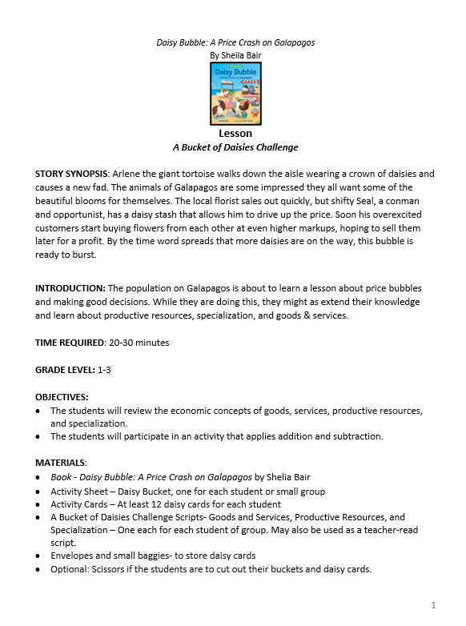
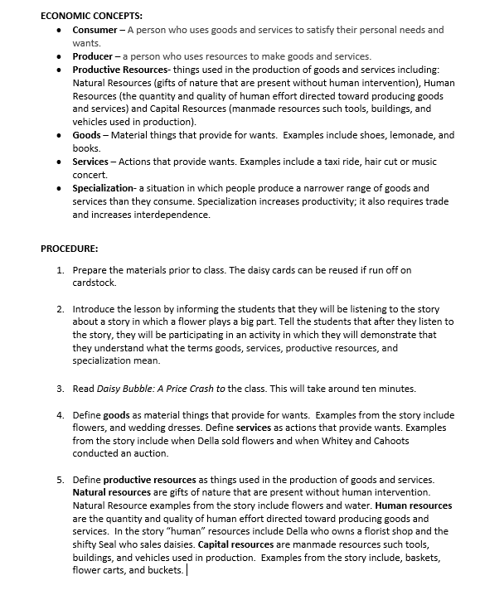

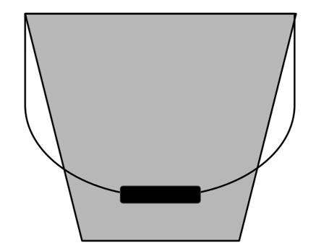
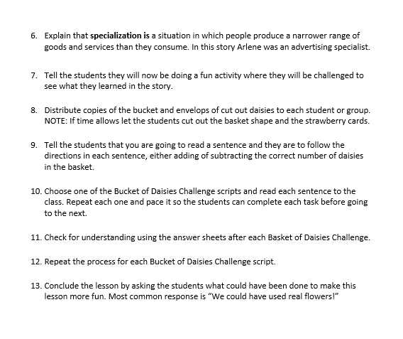
A Bucket of Daisies Challenge

Slide 18
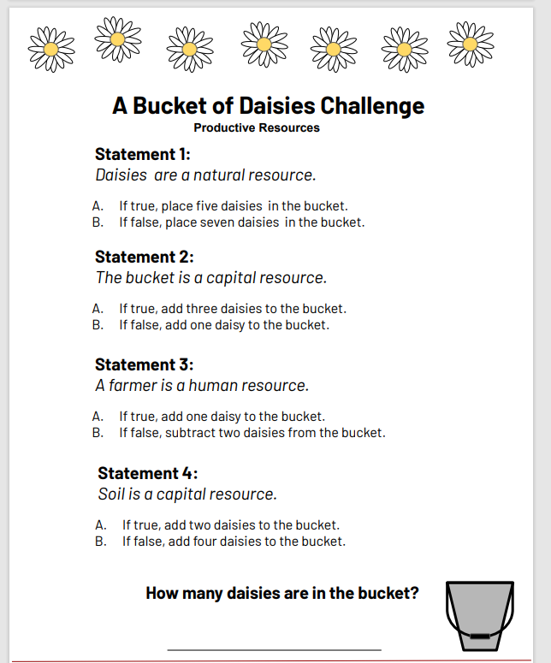
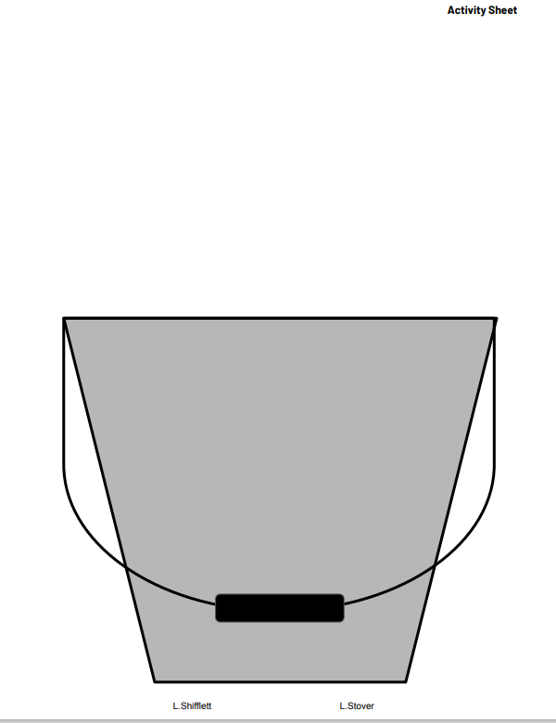
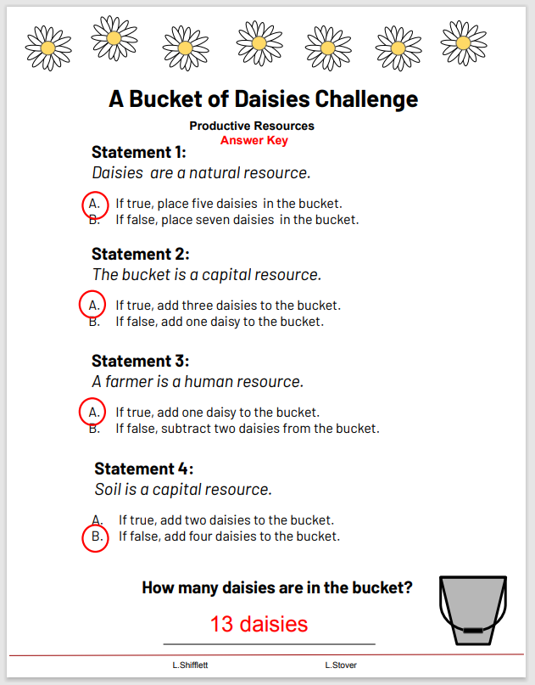
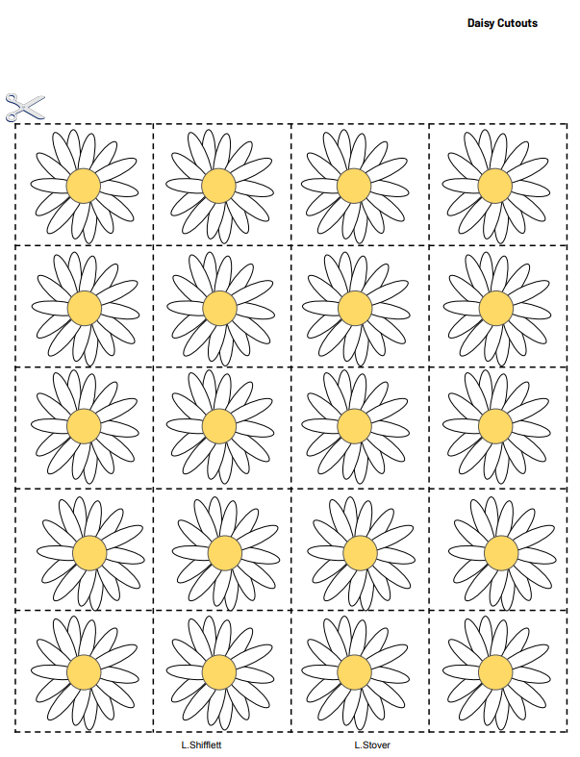
A Bucket of Daisies Challenge

Slide 19
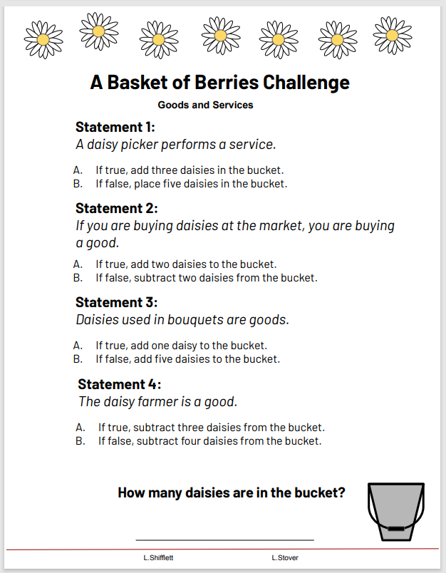
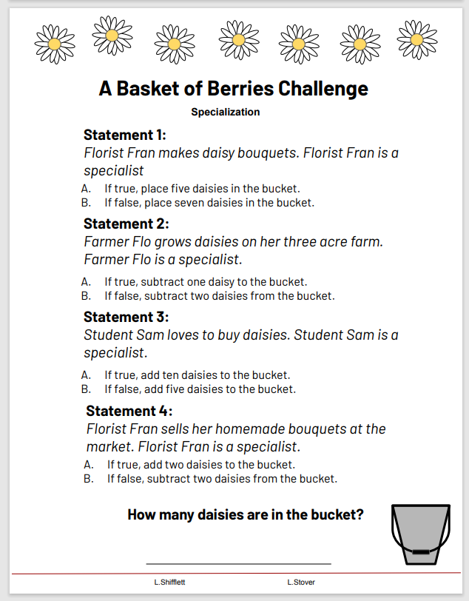
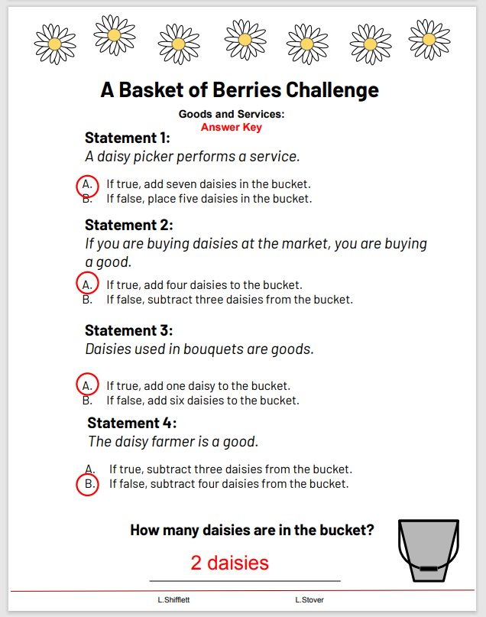
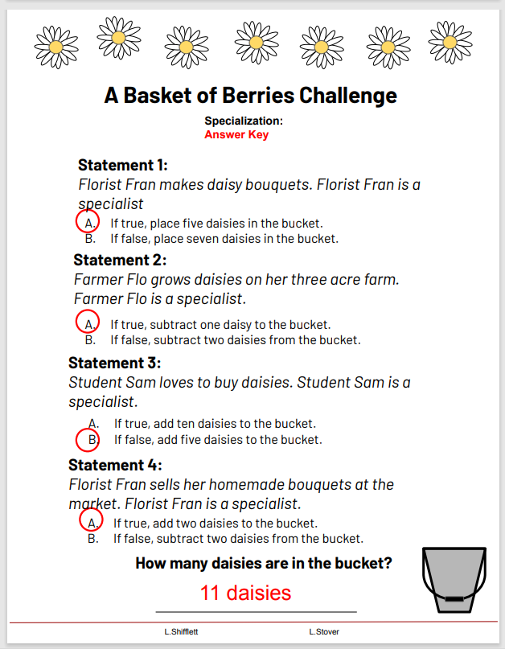
A Bucket of Daisies Challenge

Slide 20
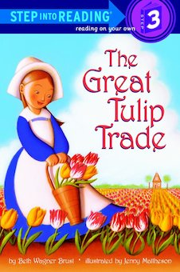
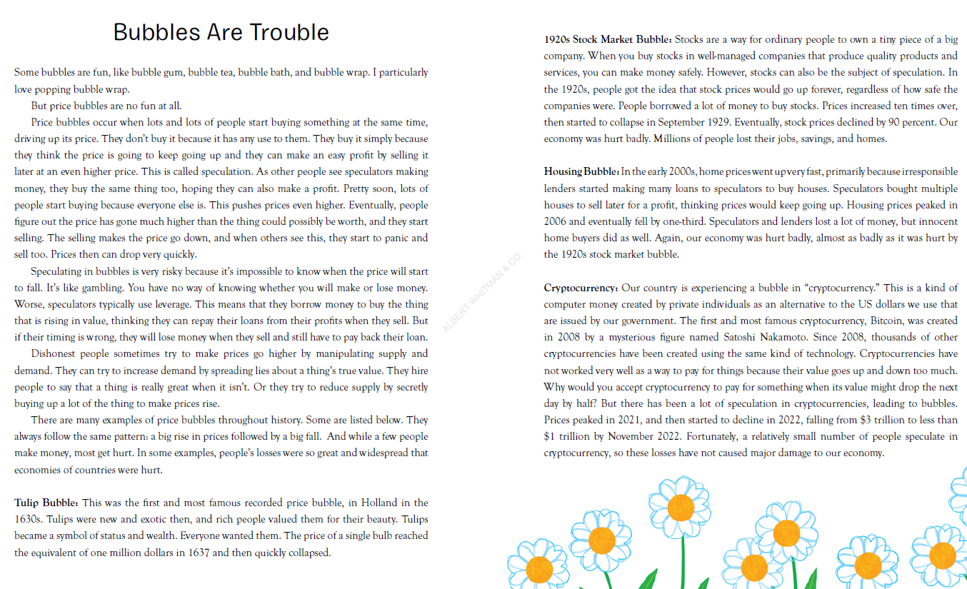
Author’s Notes
Anna’s father gives her the most wonderful present for her birthday—eight beautiful tulips! But tulips in Holland in the 1600s are more precious than gold or jewels, and everyone who walks by the house wants to trade her for one!

Slide 21
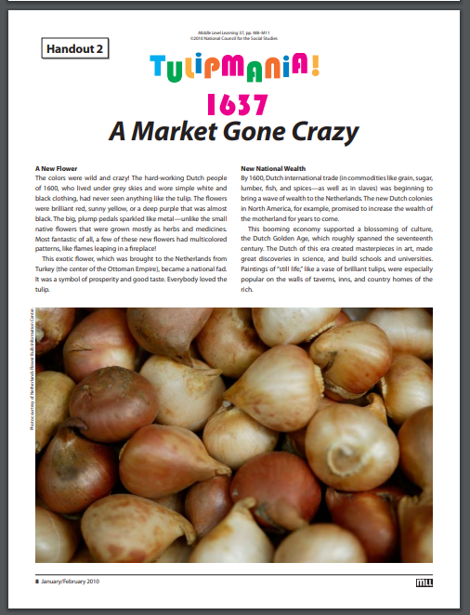

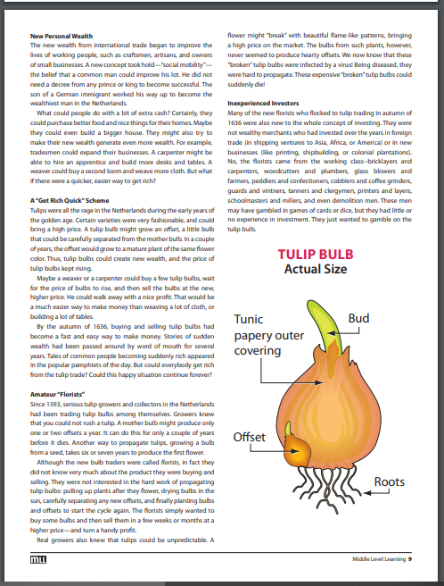
https://www.socialstudies.org/sites/default/files/view-issue/mll37.pdf

Slide 22
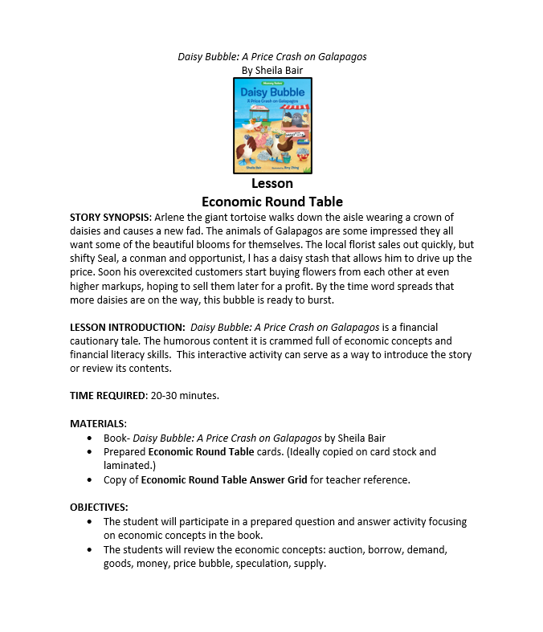
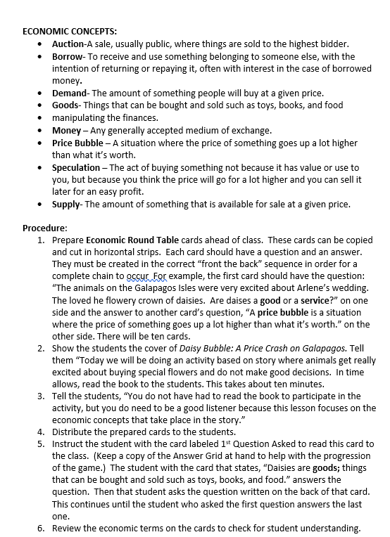
Economic Round Table

Slide 23


Economic Round Table Cards
Front of Card
Back of Card

Slide 24
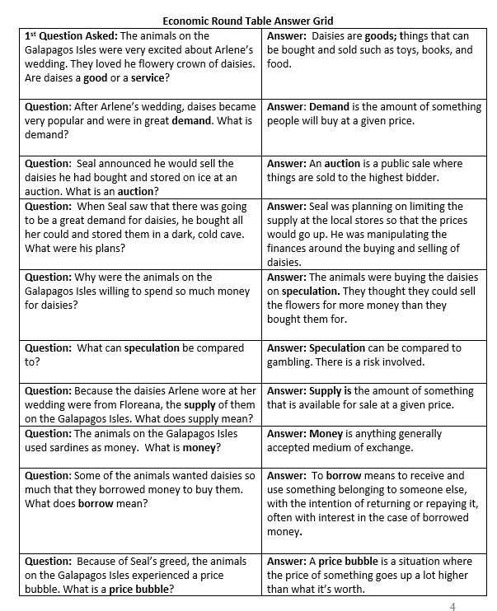
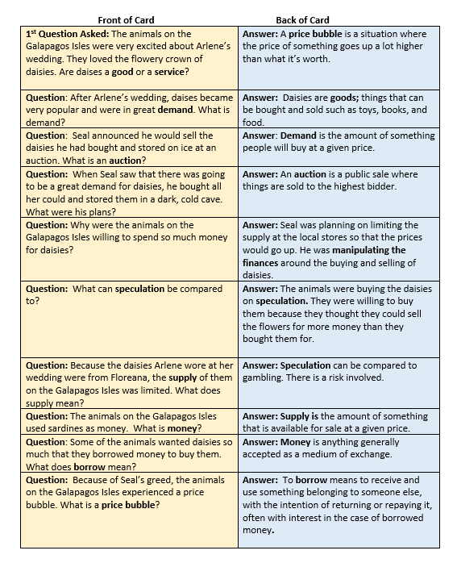
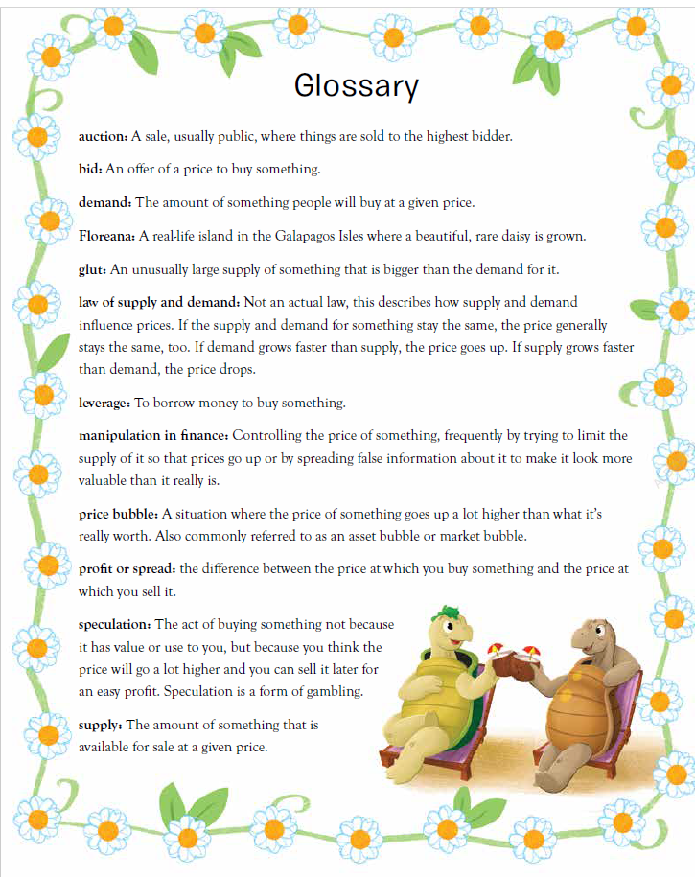

Slide 25
Princess Persephone and the Money Wizards:
Inflation Comes to Ganymede
by Shelia Bair
Story Synopsis: Princess Persephone wants to take a wonderful vacation with her friends. This vacation will cost lots of money so she orders the Money Wizards to print more cash for the people of Ganymede. As her advisors predicted, things do not go well. Soon Ganymede is dealing with shortages of goods and services and rapid inflation. Can King Harris fix this monetary crisis?
Publisher: Albert Whitman
Copyright Date: 2023
Reading Level: 3.0
Interest Level: 2-5

Slide 26
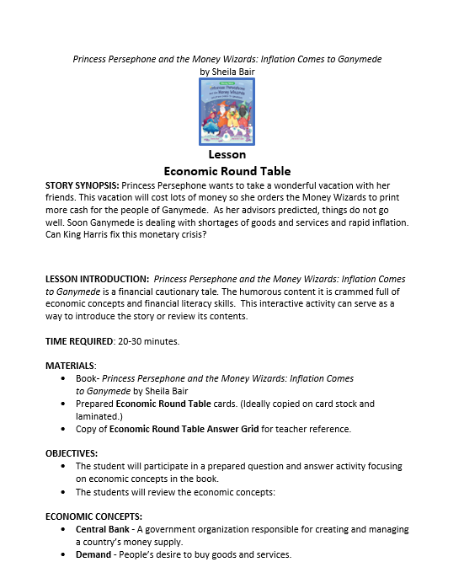
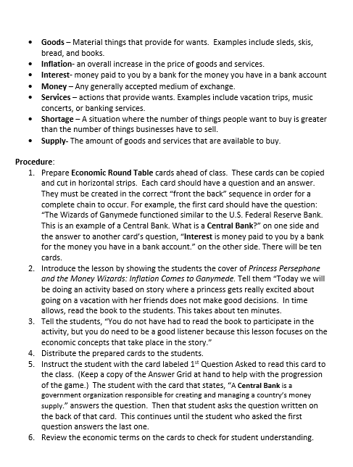
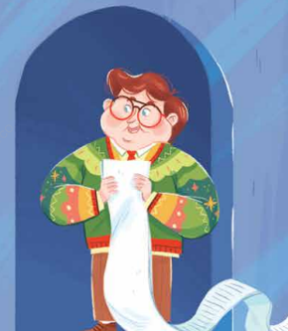
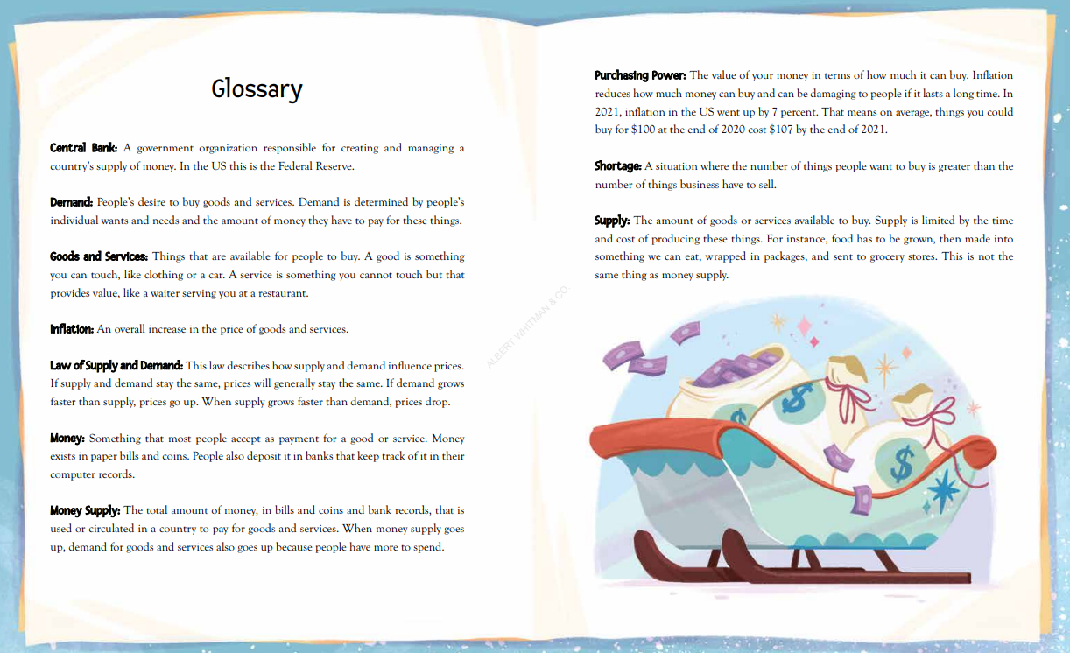
Economic Round Table

Slide 27
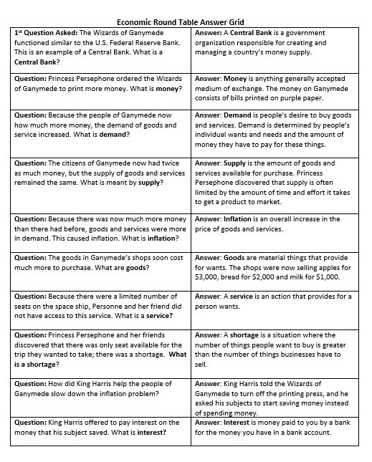
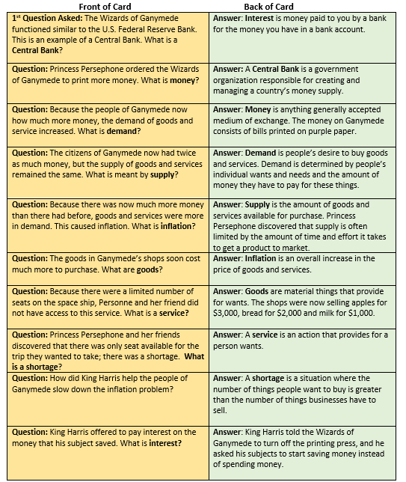
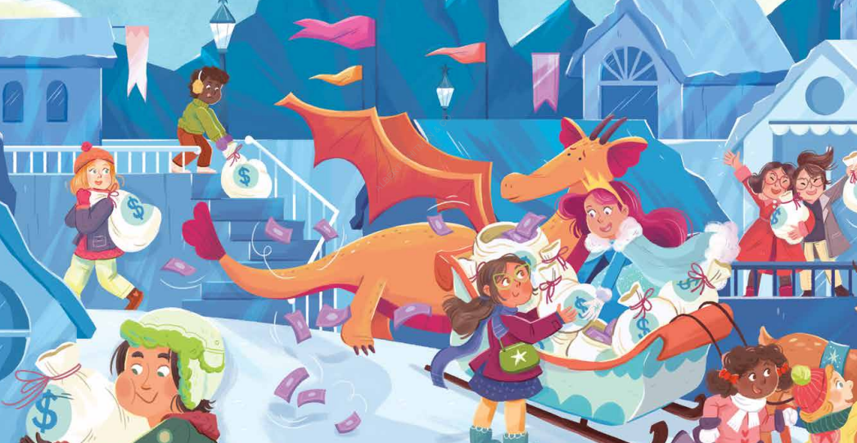
Economic Round Table

Slide 28
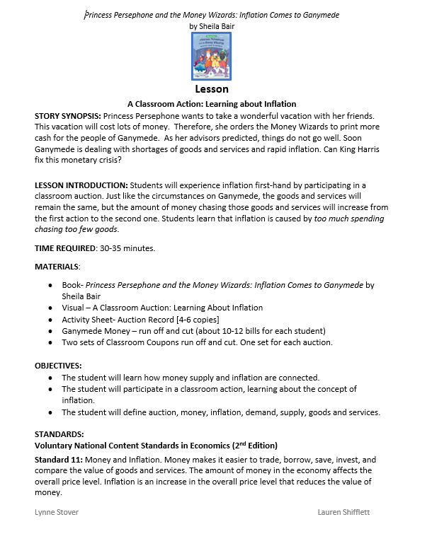
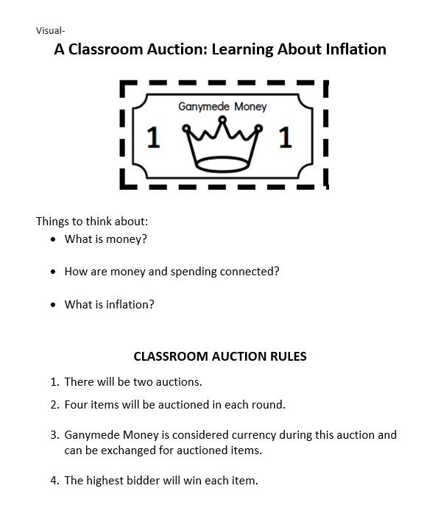
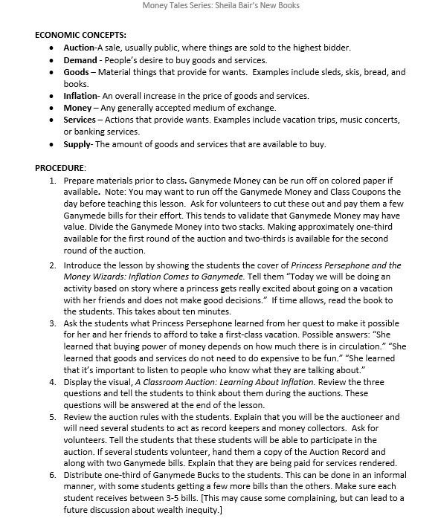

A Classroom Auction: Learning About Inflation

Slide 29



A Classroom Auction: Learning About Inflation

Slide 30

Teaching About Money, Spending, and Inflation | St. Louis Fed (stlouisfed.org)

Slide 31


Your Central Bank
In this 4-minute video, Jay the Eagle shows us what the Federal Reserve System does for the economy.
https://www.youtube.com/watch?v=csPWzRmOKOk

Slide 32

Assessment Questions
Thinking about Money Tales Common Themes
These books all serve as cautionary tales; stories that are told to alert the listeners of a specific danger.
They teach a lesson, often to children.
They follow a specific pattern:
  A situation or individual is said be menacing, or dishonest.
  The main character disregards the warning.
  The character who ignored the warning suffers negative consequences.
  Do you think young children will benefit by interacting with these stories?

Slide 33


Book Series Favorites

Slide 34

Invest In Girls

Slide 35

NEC

Slide 36

NPFC

Slide 37

Advocacy

Slide 38

Suggested Presentation Deck
CEE Affiliates
https://www.councilforeconed.org/resources/local-affiliates/
Include your local affiliate page

Slide 39











Thank You to Our Sponsors!
39

Slide 40
THANK YOU!
Contact information
Lauren H Shifflett shiffllh@jmu.edu
Lynne F Stover stoverlf@jmu.edu u.edu

Slide 41
Contact information
Thank You
Lauren H Shifflett shiffllh@jmu.edu
Lynne F Stover stoverlf@jmu.edu

