Slide 1
Presented by: Kathleen Brennan Email: kmbrennan108@gmail.com Date: January 23, 2024 2:15-3:30 PM ET
2024 Winter Institute
Global Economics and Policy
A Macroeconomic Exploration

Slide 2
Objective
Engage in student-centered activities to solidify concepts introduced in 12:30- 1:15 session.

Slide 3
Agenda: January 2, 2024 2:15- 3:30 PM
Business Cycles
Fiscal Policy
Monetary Policy
Policy Impacts
Globalization
Exchange rates
​

Slide 4
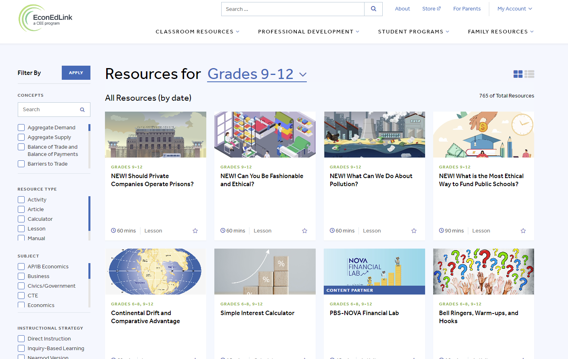
EconEdLink

Slide 5
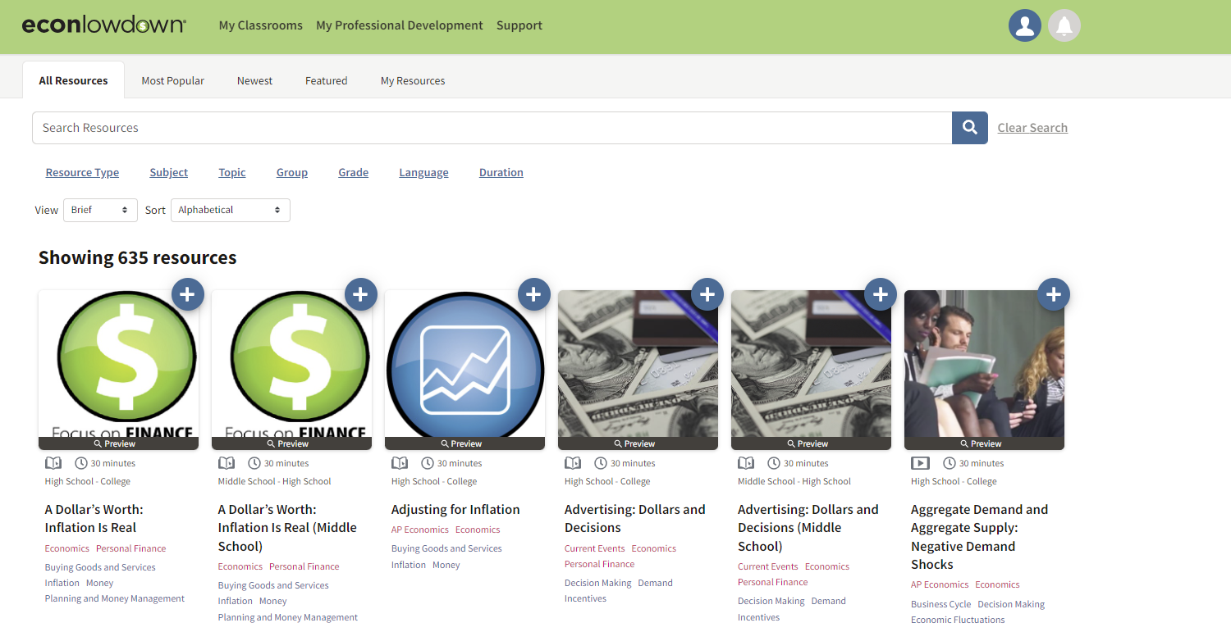
Econlowdown

Slide 6
Marginal Revolution University

Slide 7
I. Business Cycles
Econedlink – Council for Economic Education
Business Cycle Kahoot- 10 minutes
Econlowdown – St. Louis Federal Reserve
Classroom Economist: The Business Cycle – 10 minutes
All About the Business Cycle: Where Do Recessions Come From? -30 minutes
Marginal Revolution University
Business Fluctuations- 30-120 minutes

Slide 8
II. Fiscal Policy
Econ EdLink
To Intervene or Not to Intervene – 90 minutes
Multipliers and Fiscal Policy – 60 Minutes
Automatic Stabilizers – 60 minutes
The Fiscal Ship Game – 120 minutes
Econlowdown
Planet Money: What if We Paid off the National Debt? 10 minutes
MRU
Fiscal Policy – 120 minutes

Slide 9
III. Monetary Policy
Econedlink
Just How Powerful is the Fed Chair? -90 minutes
Econlowdown
Creation of the Federal Reserve System -10 minutes (video)
Making Sense of the Federal Reserve – 20 minutes (video)
How the Federal Reserve Implements Monetary Policy 60-75 minutes
Marginal Revolution University
Banking and Monetary Policy – 5-day lesson plan

Slide 10
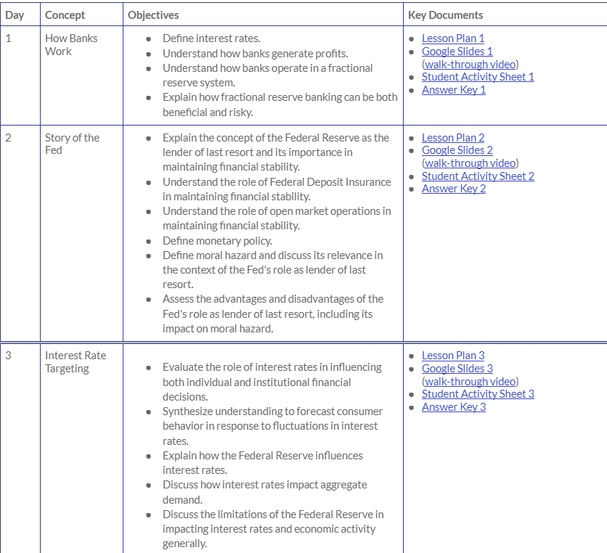
MRU- Banking and Monetary Policy Unit
Days 1-3

Slide 11
MRU- Banking and Monetary Policy Unit
Days 4-5

Slide 12
MRU- VIDEOS AND SAMPLE LESSON PLAN
Marginal Revolution Home Page
Monetary Policy and the Federal Reserve Videos
Day 1 How Banks Work- Lesson Plan

Slide 13
IV. Policy Impacts
Econedlink
Analyzing CPI Data
Interactive Unemployment Survey
High School Economics- Unemployment
St. Louis Fed
Tools for Teaching with FRED
Current Event Resources to Teach AP Economics
The Economic Goal of Price Stability
Dashboard of Key Economic Data by State
Marginal Revolution University
Dangers of Fiscal Policy
Monetary Policy- The Best-Case Scenario

Slide 14
V. Globalization
Econedlink
World101: Globalization- Council of Foreign Relations
Benefits of Trade Video and Quiz
Analyzing U.S. Import Data
Econlowdown
How Do Imports Affect GDP?
Does International Trade Create Winners and Losers?
The Global Economy: It’s a Small World After All
Marginal Revolution University
International Trade Unit

Slide 15
VI. Exchange Rates
Econedlink
Exchange Rates- How Money Affects Trade
Exchange Rates
Macroeconomic 305: Exchange Rates and International Trade
Exchange Rate Calculator
Econlowdown
Is a Strong Dollar Better than a Weak Dollar?
Marginal Revolution University
Exchange Rates

Slide 16
Additional Resources: Posters and Infographics
Fiscal and Monetary Policy- Atlanta Fed
https://www.atlantafed.org/-/media/documents/education/teach/infographic-posters/activity/IB_5_FiscalMonetaryPolicy.pdf
https://www.atlantafed.org/-/media/documents/education/teach/infographic-posters/the-fed-explained.pdf

Slide 17
Thank you!

