Slide 1
Personal Finance Mastery for Teachers
Credit and credit scores, consumer protection and scams
Presented by: Christopher Power
Email: cpower29@gmail.com
Date: 1/24/2024

Slide 2
Christopher Power - economics, virtual enterprise, and technology at Francis Lewis High School.
Passion for finance & economics translates to unique and entertaining lessons and discussion.
Real-world experiences in the classroom.
Pitch decks, analyzing economic data, calculating mortgage payments, managing money, credit cards, credit scores, and other personal financial literacy topics.
“Financial literacy & economic education buy freedom. Evidence suggests 80% of people are financially illiterate. So, contrary to popular belief, money is not the root of all evil, the lack of financial literacy is.”
Where are you all from? Drop your City / State and classes you teach.

Slide 3
CEE Membership & Conferences
Join a Professional Learning Community
Access CEE’s webinars directly on EconEdLink.org
Receive professional development certificates
Register for webinars with one-click process
Download presentations, lesson plan materials and activities for each webinar
Search and view all webinars at your convenience
Save webinars to your dashboard for easy access
Join the Spring CEE Teacher Academy

Slide 4
Agenda Session 1
(recorded)
Part 1 – Credit Pre-Assessment (Quiz)
Part 2 – Credit for Beginners (CEE Sheet)
Part 3 – What is Credit (CEE - FlashCards)
Part 4 – Credit Score Research (Q&A)
Part 5 – Credit Score (CEE - Video)
Part 6 – My Credit Rating (CEE - Read)
Part 7 – A Credit Story (Case Study)
Part 8 – Credit & Finance Tracking @ SOFI
Part 9 – Fraud & Scams
Discussion & Reflection
CEE National Standards
Teacher Objectives
Teacher Live Survey
Teacher Q&A
Student Objectives

Slide 5
Agenda Session 2
(not recorded)
Part 1 – Credit Pre-Assessment (Quiz)
Part 2 – Credit for Beginners (CEE Sheet)
Part 3 – What is Credit (CEE - FlashCards)
Part 4 – Credit Score Research (Q&A)
Part 5 – Credit Score (CEE - Video)
Part 6 – My Credit Rating (CEE - Read)
Part 7 – A Credit Story (Case Study)
Part 8 – Credit & Finance Tracking @ SOFI
Part 9 – Fraud & Scams
Discussion & Reflection
20m Breakout Rooms
1 room / lesson
Collaborate & Complete
Note likes, dislike, & ideas
Join a different 20m breakout
30m attendee led discussion on lessons

Slide 6
Aligned with:
Standard 2 Decision Making
Standard 4 Incentives (of good decisions)
Standard 6 Specialization
Standard 11 Money & Inflation (credit/money)
Standard 12 Interest Rates
CEE National Standards

Slide 7
Teach
Interactively teach students about credit, credit scores, and the impact of financial decisions.
Use
Use a comprehensive set of materials and tools for immediate classroom application.
Design and deliver
Design and deliver lessons that engage students through real-world financial scenarios.
Understand
Understand how to contextualize personal finance topics in a way that is relatable and understandable for high school students.
Teacher Objectives

Slide 8
Teacher Live Survey

Slide 9
Why Teach Credit
The average cost of living is up 23% since 2018. https://www.bls.gov/data/inflation_calculator.htm
As of 2023, 20% of teens work to help with family expenses
Average student graduates 4 year college with $50k of debt
40% of adults ages 18-29 carry credit card debt, averaging $5,272
Only 32% of parents discuss finances / credit with their children

Slide 10
Did You Know
Monitor your credit for free (creditwise, sofi, banks)
Children as authorized users on the Apple Credit Card (start building credit)
Savings account does not impact your credit
Carrying a balance does not help your credit score
Never “cancel” a credit card
Auto-Pay subscriptions do not build credit but can hurt it
Pay-in-4 does not build credit but can hurt it
“There’s a fine line between love & your credit score”

Slide 11
Strategies to Teach Topics like Credit
Use all 3 learning modalities: Auditory. Kinesthetic. Visual.
Student pre-assessments
Live polling. Real-time feedback gives an authentic assessment of an entire class.
Group work.
Videos & Worksheets to differentiate content.
Use real life application such as case studies
Introduce Technology they use (websites / apps)
Posters on classroom walls (have 1 to share on next slide)

Slide 12
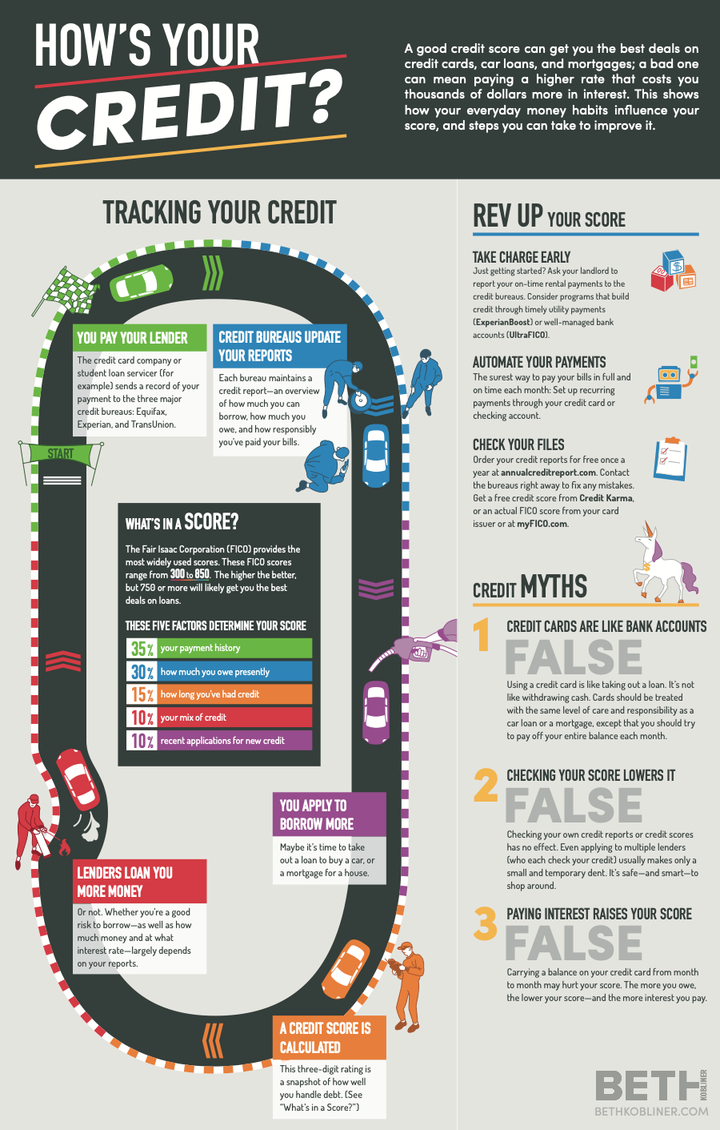
Class Poster PDF
https://drive.google.com/file/d/1bUzgdN6dlVMNXoF5-v6nFZfLYdEcGR0U/view?usp=sharing

Slide 13
Student Objectives
After your teacher lessons, your students will be able to:
Recognize the impact that financial decisions have on their life
Understand and explain the importance of credit scores and credit history.
Identify & define terms associated with credit, the major credit agencies, and circumstances which can impact credit both positively and negatively
Identify potential scams and myths about credit, credit cards and credit scores
Build up their credit score

Slide 14
Part 1 – Credit Pre-Assessment (Quiz)
Purpose: To provide a way to gather key information about what students know about credit related topics, prior to instruction and future lesson planning. This will help to focus content and discussions.
Duration: 20m
https://forms.gle/zWjAFHfMaRTKT1zv7

Slide 15
Part 2 – Credit for Beginners (CEE Sheet)
Purpose: To explain the importance of good credit and define and use basic terms associated with credit.
Duration: 1 Period + Homework (working in teams of 2)
Tools: CEE Website with Web Resources & a Printed worksheet
Lesson Pt1: Complete the worksheet using the resources https://econedlink.org/resources/credit-for-beginners/
Lesson Pt2: Take the quiz with your partner

Slide 16
Part 3 – What is Credit (CEE - FlashCards)
Purpose: To introduce the concept of credit.
Duration: 1 Period in Class
Tools: CEE Website & Quizlet
CEE Lesson: https://econedlink.org/resources/what-is-credit/
Quizlet Link: https://quizlet.com/408864140/what-is-credit-flash-cards/ (use multiple self test strategies)

Slide 17
Part 4 – Credit Score Research (Q&A)
Purpose: For students to take ownership of learning and valuing the content.
Duration: 1-2 Days in class / Homework / Independent
Tools: Google Classroom / Docs
Lesson: https://docs.google.com/document/d/1ufuh9I0GApvSxmkGfS5qcvpDzzelBFObYXVdnDJjxOo/edit?usp=sharing

Slide 18
Part 5 – Credit Score (CEE - Video)
Purpose: In this video a young man wants to get a loan to make surround sound video game chairs, but he has to improve his credit score first.
Duration: ½ Period (2 minute video & class discussion). Followed by the “My Credit Rating” case study
Tools: CEE Website & Vimeo
CEE Lesson: https://econedlink.org/resources/credit-score-video/

Slide 19
Part 6 – My Credit Rating (CEE - Read)
Purpose: If you prove you can handle payment responsibilities well, you will then be able to secure credit for most costly items, such as for automobiles and homes.
Duration: ½ Period (activity then class discussion pending time)
Tools: CEE Website
CEE Lesson: https://econedlink.org/resources/my-credit-rating-why-should-i-care/

Slide 20
Part 7 – A Credit Story (Case Study)
Purpose: In order to apply information learned, complex case studies allow for deeper analysis and understanding. Real world examples are important to make the content relatable.
Duration: 1 Days in class / homework (teams of 2)
Tools: Google Classroom / Google Docs
Lesson: https://docs.google.com/document/d/1S1DZkVhye2Sea4TVjOzmLpH7XhInDvSIAmtKhODB7-I/edit?usp=sharing

Slide 21
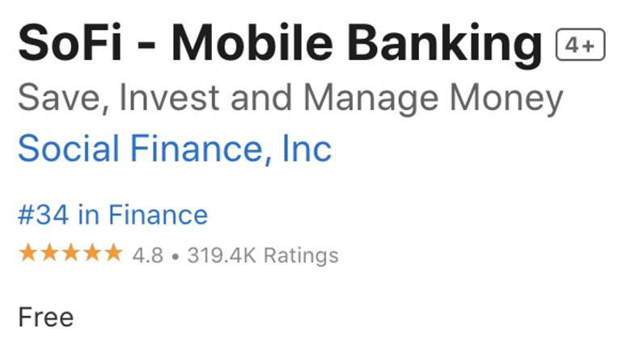
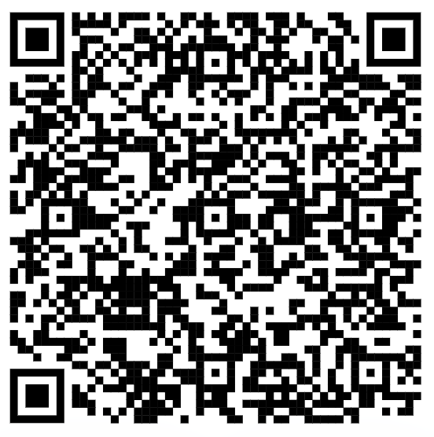
Part 8 – Free Credit Tracking @ SOFI
Purpose: Providing real-time tools on personal finance and credit reports increases engagement in and provides real life tools.
Duration: 1 Period
Tools: SOFI (app or website) & Class Discussion
Lesson 1: Review all the elements that impact your credit score.
Lesson 2: Help students link personal banking accounts or credit cards to SOFI to start tracking their finances in one central location
Another Tool of use - https://www.sofi.com/learn/
Referral Code

Slide 22
Part 9 – Fraud & Scams
Purpose: It is imperative to safeguard yourself against financial exploitation. If you are educated about the latest frauds & scams, you are better equipped to avoid being a victim of them.
Duration: 4 Days (teams of 3)
Tools: Submit a Presentation
Lesson: (2 days) Create a presentation to share with your peers. Must include 3 current types of fraud or scams related to credit/finance. Must describe it, give a real example, why it happens to people, and provide strategies to avoid it.
Lesson 2: (2 days) Students will present findings to the class

Slide 23
Christopher Power cpower29@gmail.com
Thank You

