Slide 1

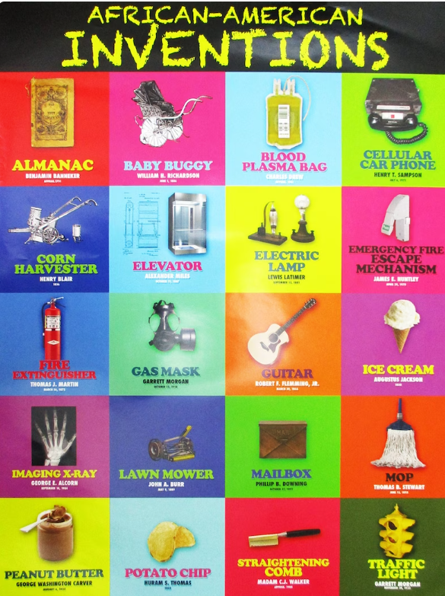
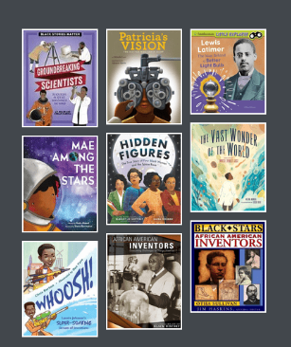
Using Children’s Picture Books to Learn About Little-Known African American Entrepreneurs and Inventors
February 13, 2024
Angie Battle jbattle15@gsu.edu
Marsha Masters marsha@economicsarkansas.org
Lynne F Stover stoverlf@jmu.edu

Slide 2
EconEdLink Membership
You can now access CEE’s professional development webinars directly on EconEdLink.org! To receive these new professional development benefits, become an EconEdLink member. As a member, you will now be able to:
Automatically receive a professional development certificate via e-mail within 24 hours after viewing any webinar for a minimum of 45 minutes
Register for upcoming webinars with a simple one-click process
Easily download presentations, lesson plan materials and activities for each webinar
Search and view all webinars at your convenience
Save webinars to your EconEdLink dashboard for easy access to the event
Access our new Professional Development page here

Slide 3
Professional Development Opportunities
To earn professional development credit for CEE webinars found on EconEdLink, you must:
Watch a minimum of 45-minutes and you will automatically receive a professional development certificate via e-mail within 24 hours.
Attendees can learn how much credit they will earn per workshop.
Accessing resources:
You can now easily download presentations, lesson plan materials, and activities for each webinar from EconEdLink.org/professional-development/
Local resources:
Insert your local professional development opportunities (if applicable)

Slide 4
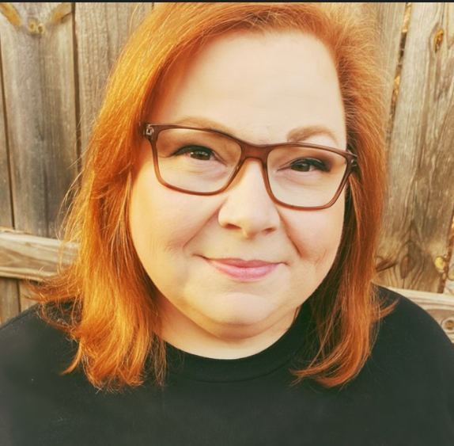
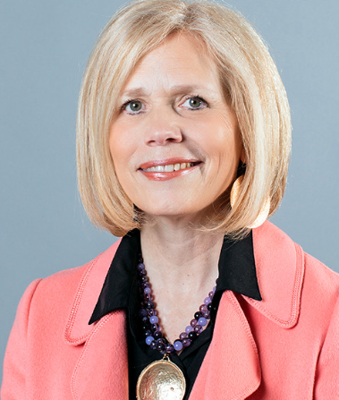
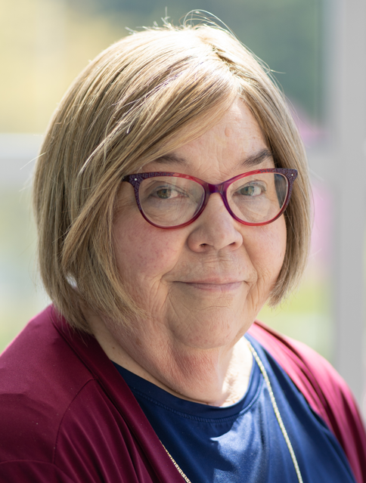
Presenters
Angie Battle Prior to joining the Georgia Council on Economic Education in July 2019, Angie Battle had been a classroom teacher for 26 years, serving students with a broad range of needs and backgrounds in grades 4-8. She is now using her successful experience in the classroom to help other teachers in her role as Program Manager for GCEE.
Marsha Masters joined Economics Arkansas in 2009 and currently serves as Associate Director. She brings more than 20 years of teaching experience to her position. She also has experience with integrating economic education into every subject area in the PreK-12 environment. Marsha's duties include coordinating both student competitions and providing teacher professional development offerings. She has served as a writer for EconEdLink and curriculum for the Council on Economic Education.
Lynne Farrell Stover is currently a Teacher Consultant at the James Madison University Center for Economic Education. Prior to this, she spent thirty-three years in public education where she enjoyed various teaching assignments including classroom teacher, gifted education specialist, and librarian. She is the author of over fifty educational articles and eight teacher resource books. She is the recipient of the 2022 NAEE Platinum Curriculum Award for her lessons developed for Virginia’s Reading Makes Cents Program.

Slide 5

Objectives
In this webinar teachers will:
Consider the benefits of using children’s literature to teach little-known African American inventors and entrepreneurs.
Review economic concepts including: Human Capital, Public Goods & Service, Costs & Benefits.
Discover methods for teaching the featured concepts using lessons developed for elementary students.
Share resource materials and a related bibliography.
Notes:
lynne

Slide 6
Session Agenda
Introduction
Part I - Featured Children’s Book: Lesson Plans
Part II - Fun Stuff!
Part III – Resources & Support Materials
Conclude with discussion questions and webinar survey.

Slide 7
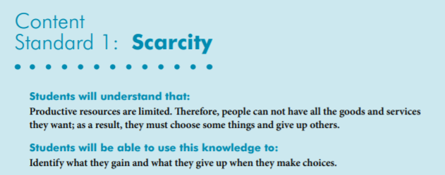
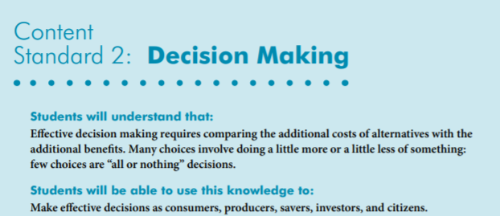

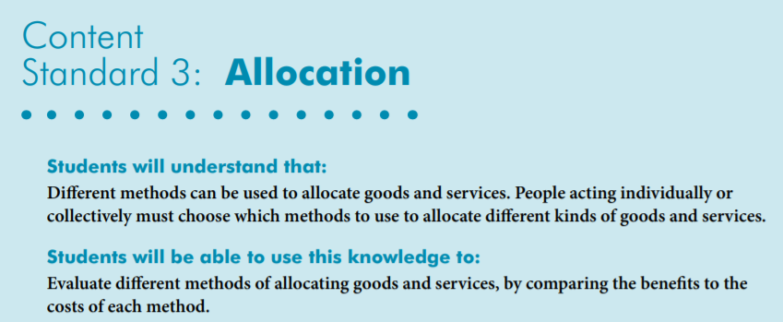
National Standards
https://www.councilforeconed.org/wp-content/uploads/2012/03/voluntary-national-content-standards-2010.pdf

Slide 8
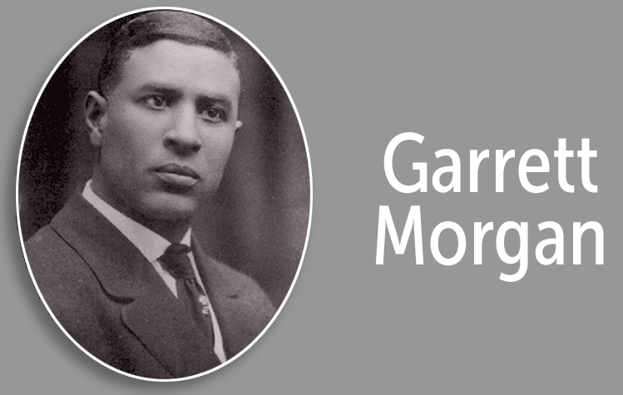
Introduction
What do you know about Garrett?

Slide 9
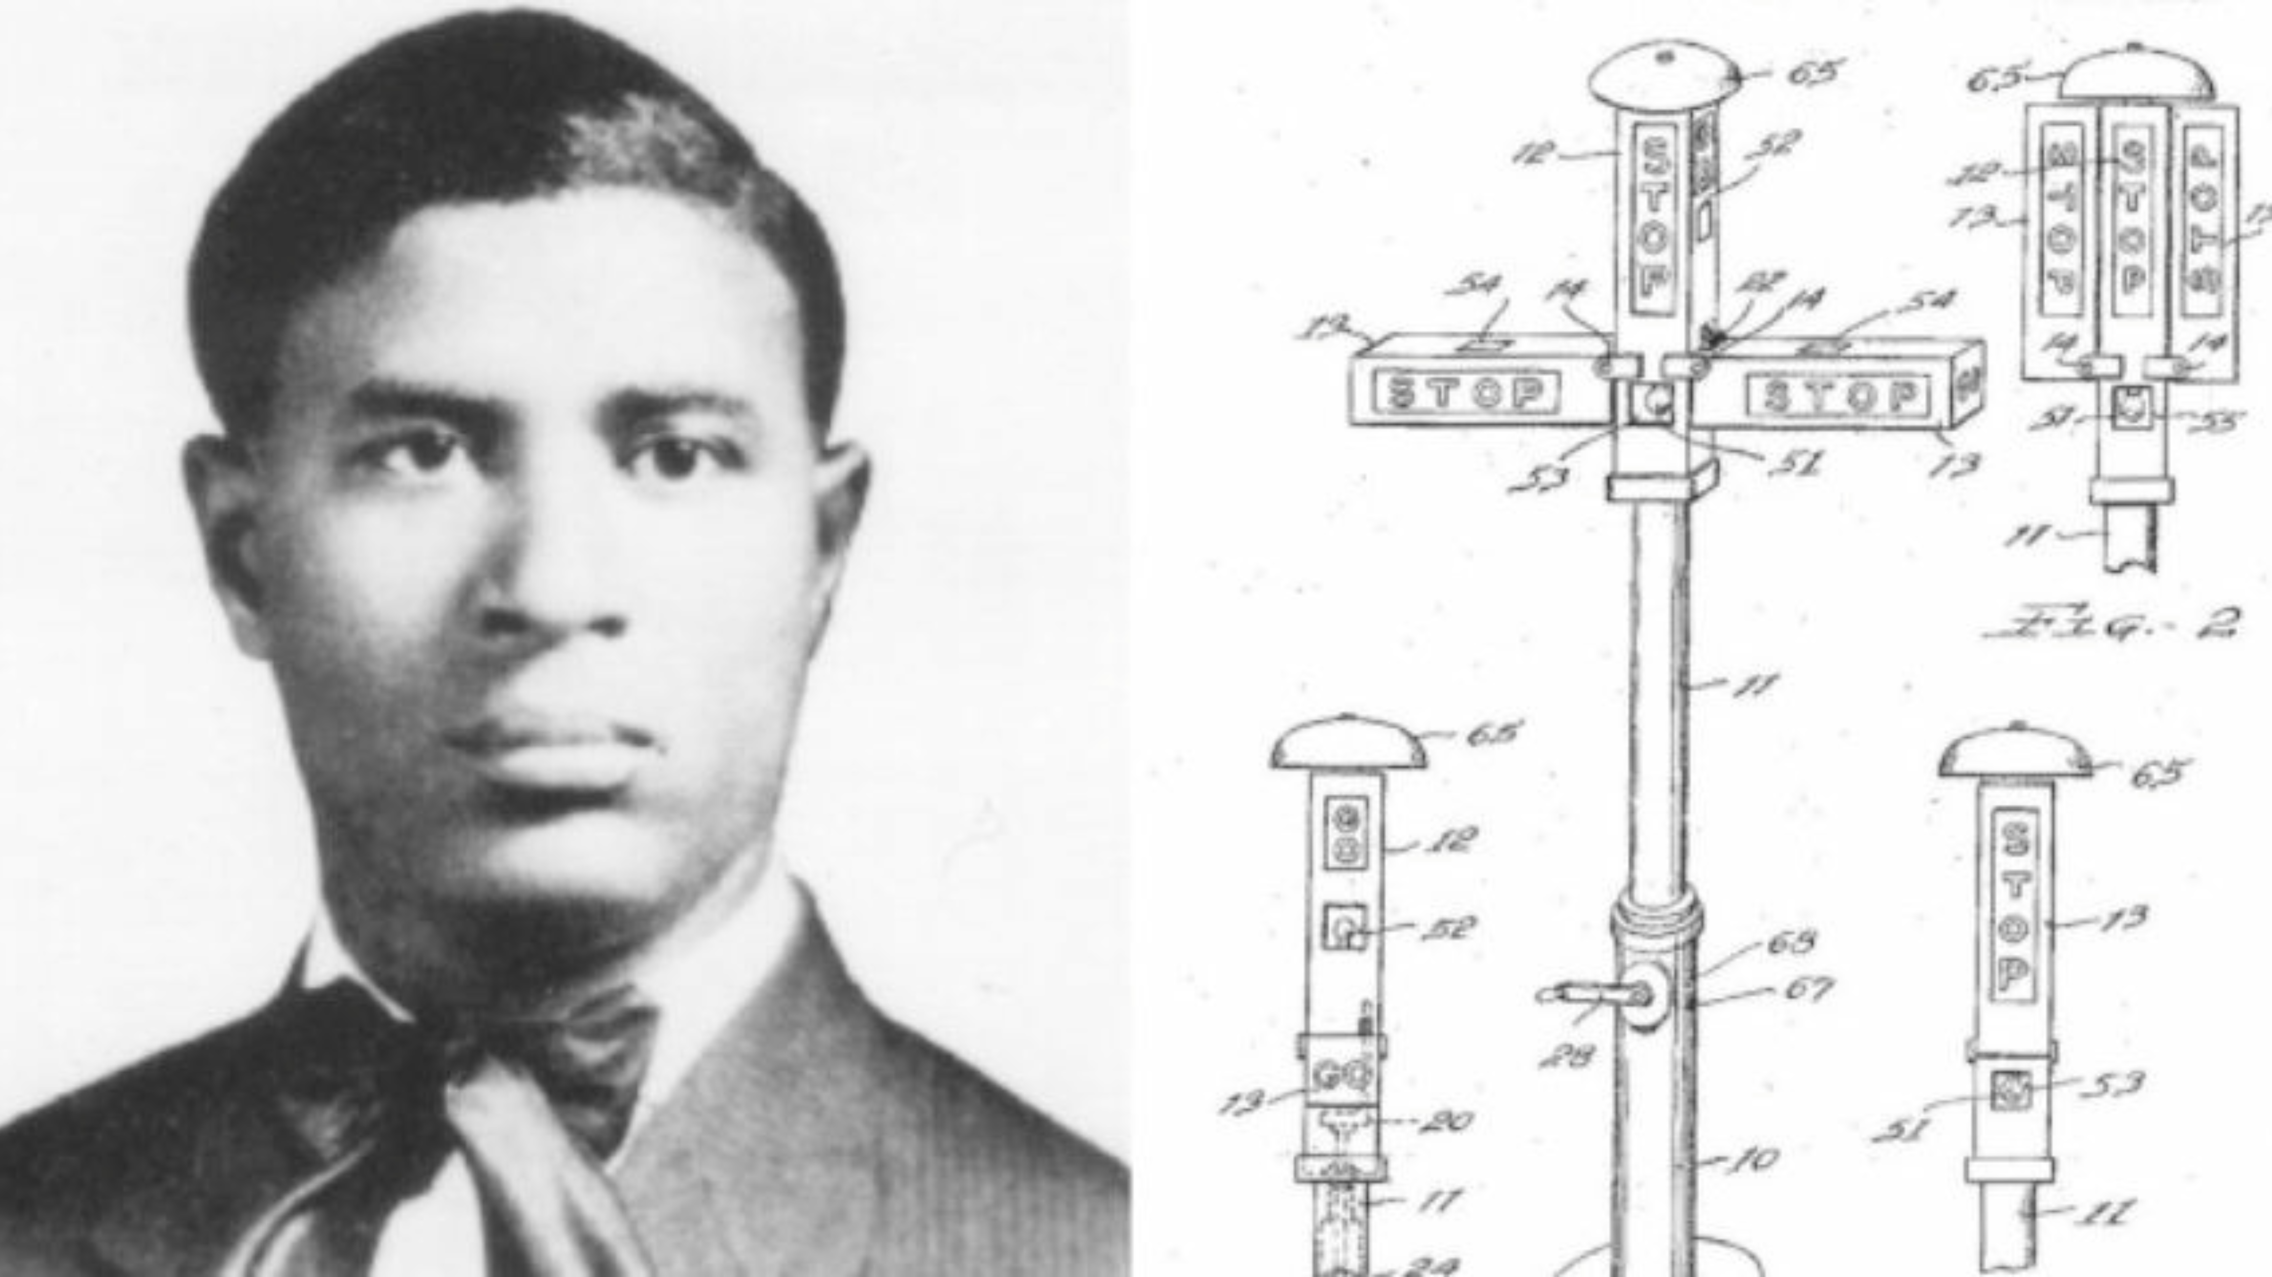
Garrett Augustus Morgan Sr. (March 4, 1877 – July 27, 1963) was an American inventor, businessman, and community leader.
Garrett Morgan blazed a trail for African American inventors with his patents, including those for a hair-straightening product, a breathing device, a revamped sewing machine and an improved traffic signal.

Slide 10
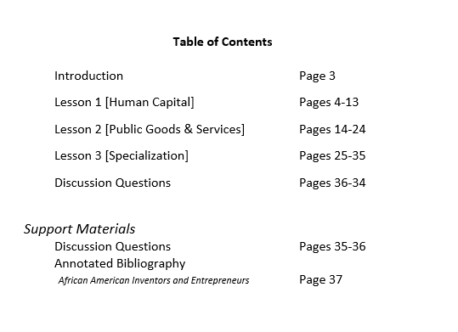

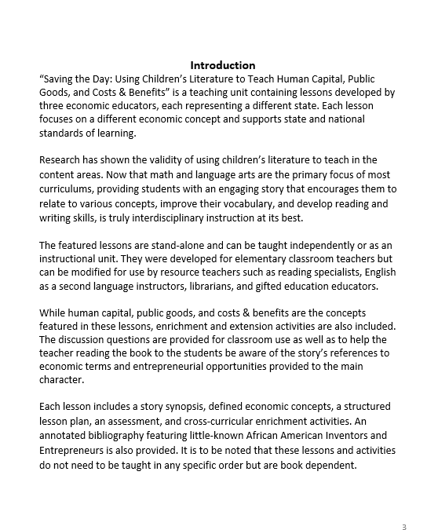

PART I
Lesson Plans

Slide 11
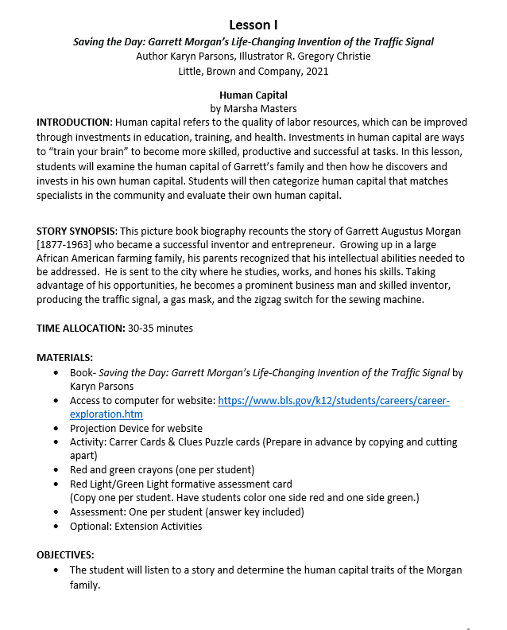
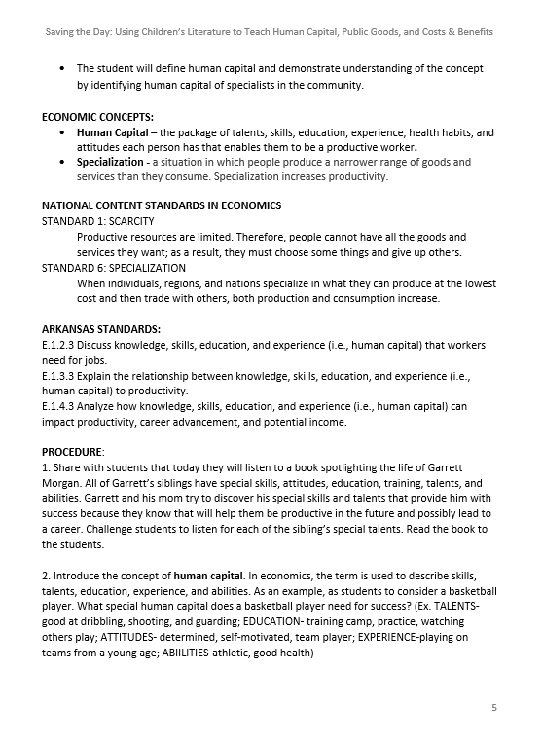
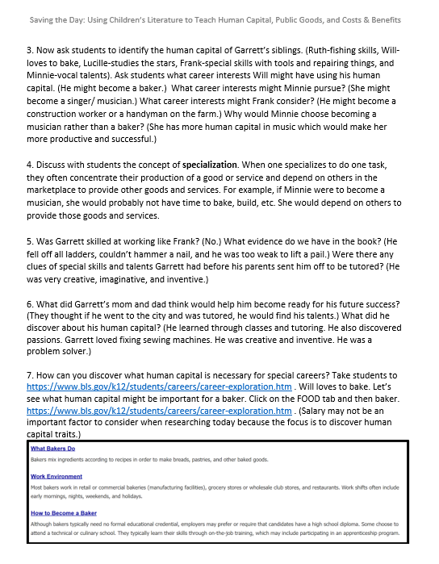
Lesson Human Capital

Slide 12
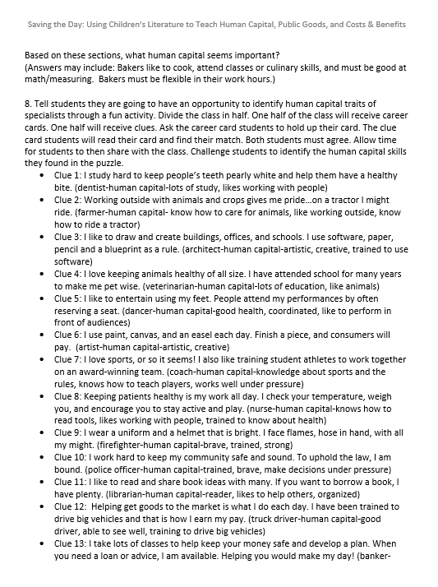
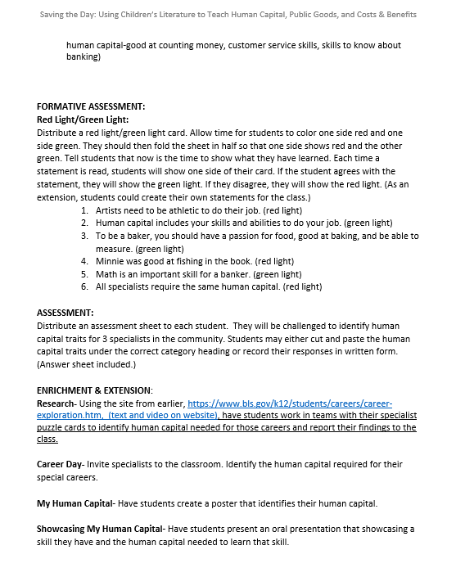
Human Capital

Slide 13
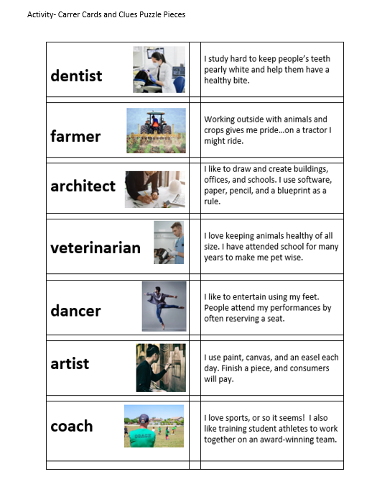
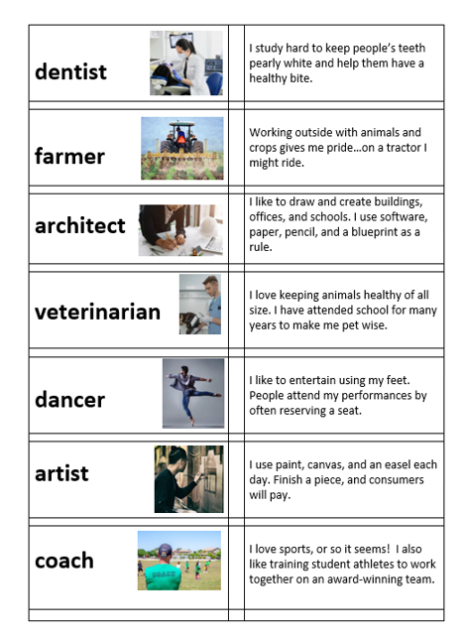
Human Capital

Slide 14

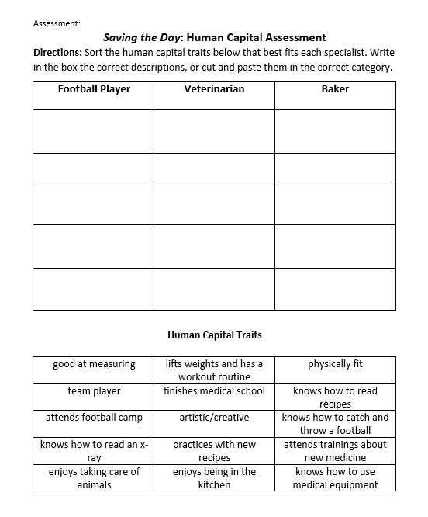
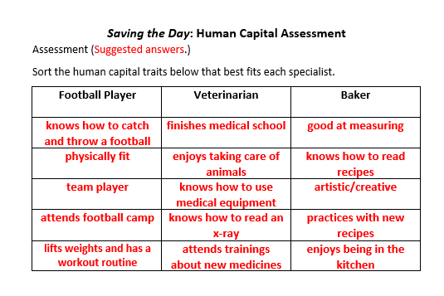
Human Capital

Slide 15
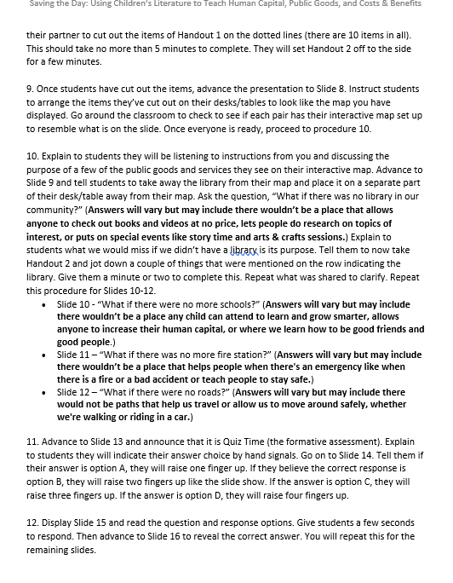
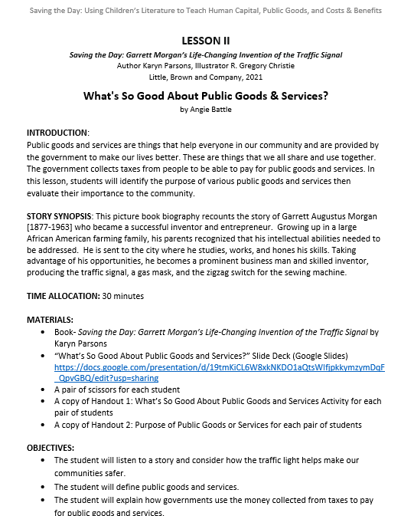
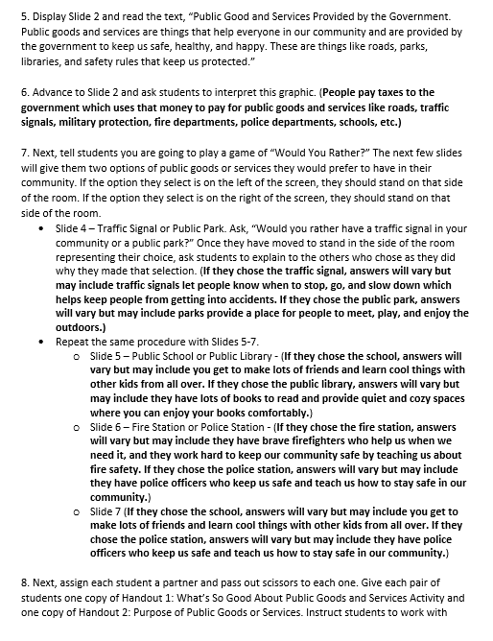
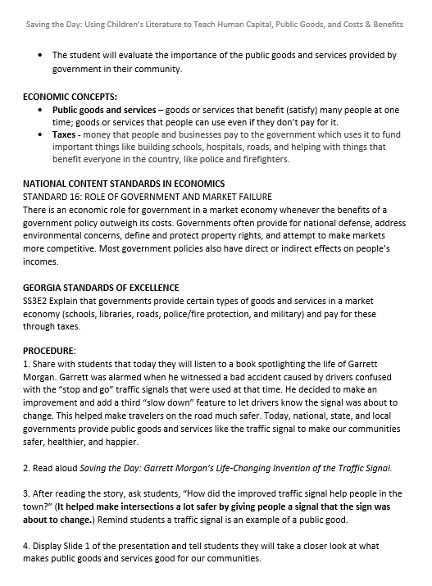
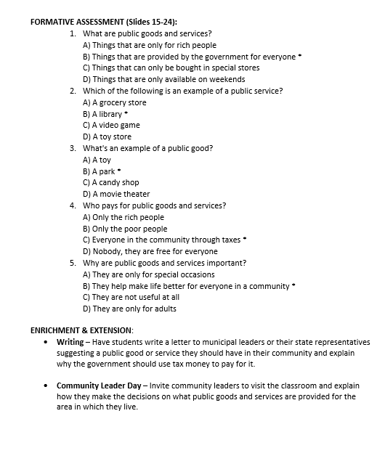
Goods and Services

Slide 16
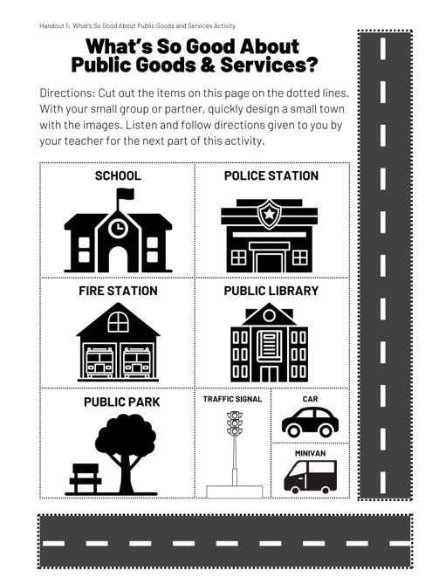
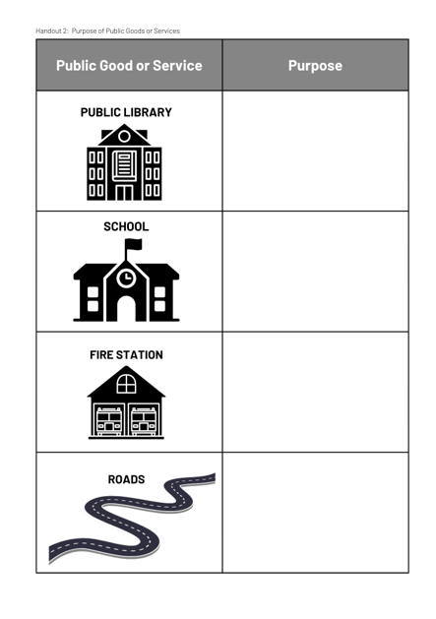
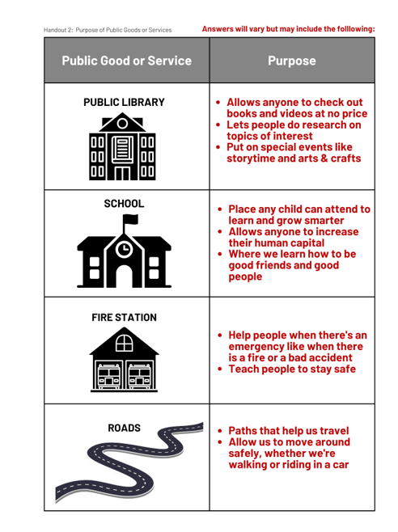
Public Goods and Services

Slide 17


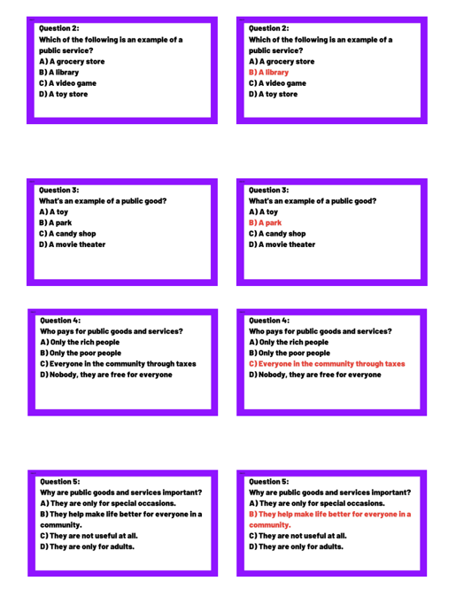
Public Goods and Services

Slide 18
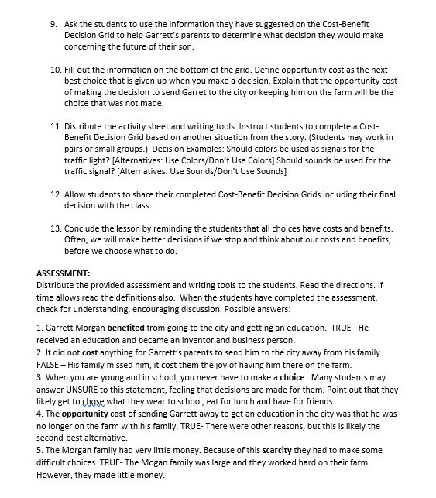
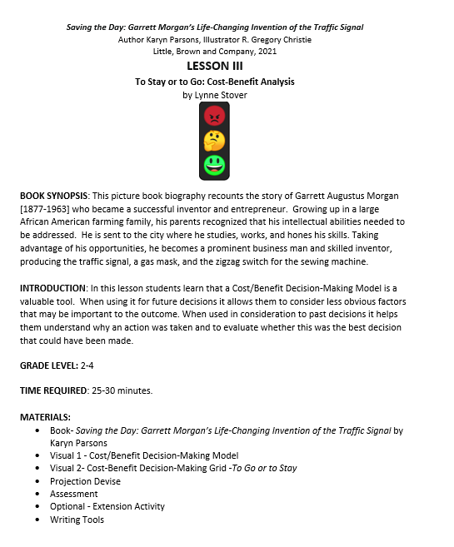
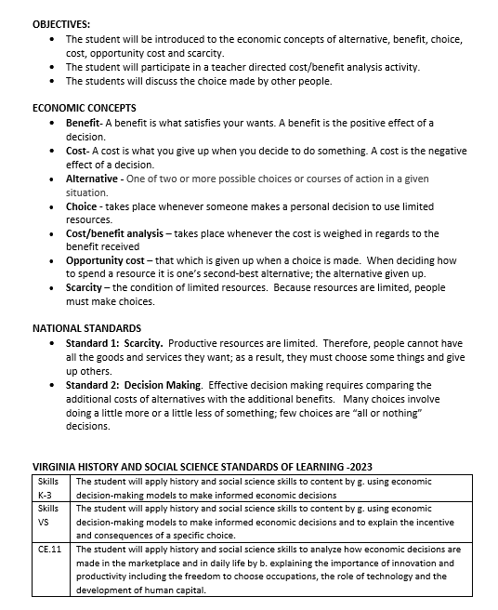
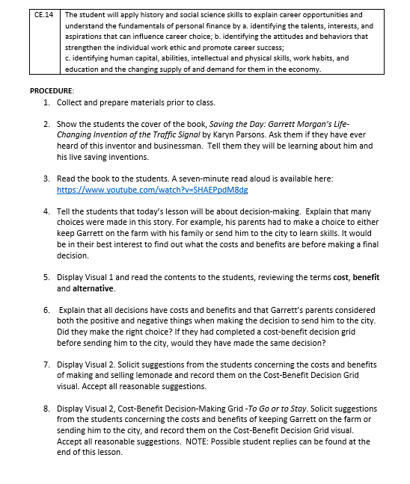
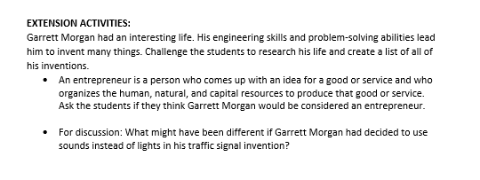
Costs & Benefits Lesson

Slide 19
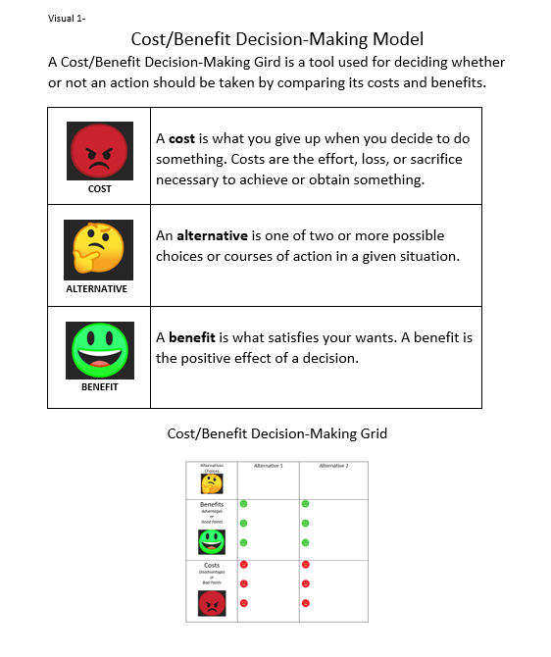
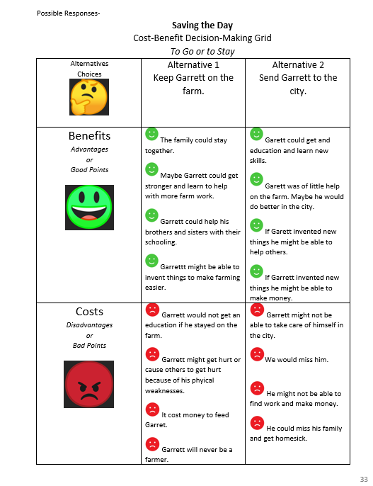
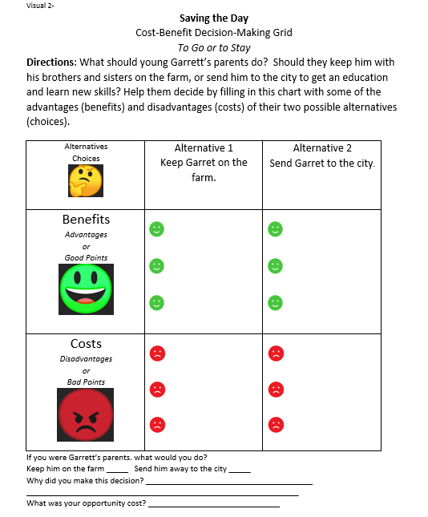
Costs & Benefits

Slide 20
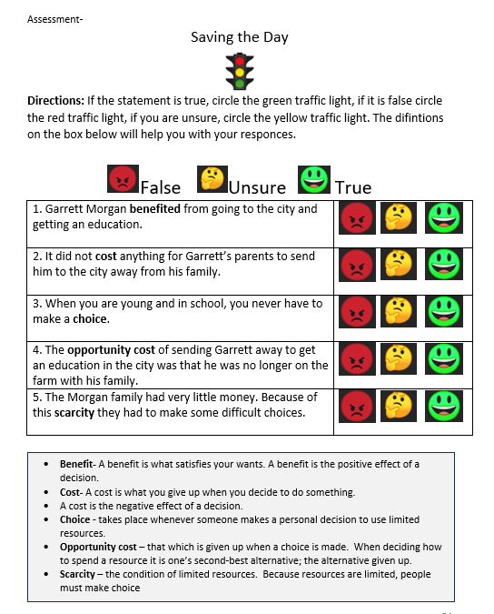
Costs & Benefits

Slide 21
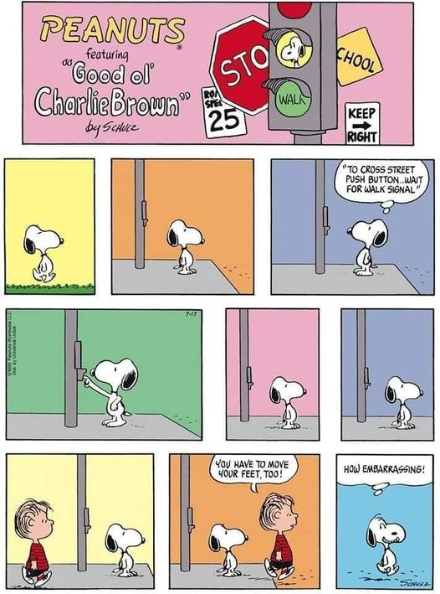
PART II
Fun Stuff!
Activities, Enrichment & Points to Ponder

Slide 22
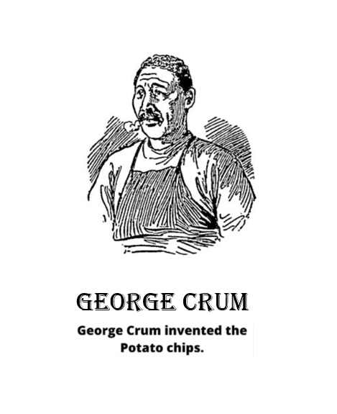
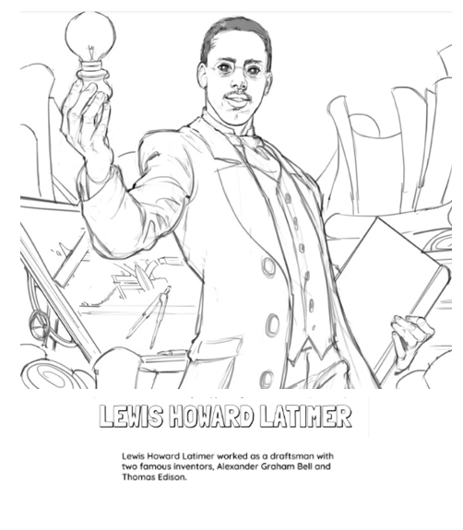
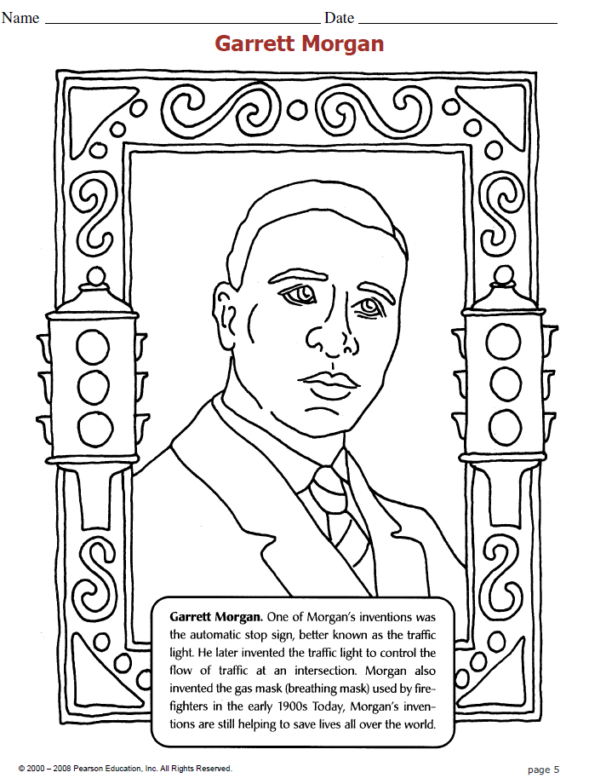

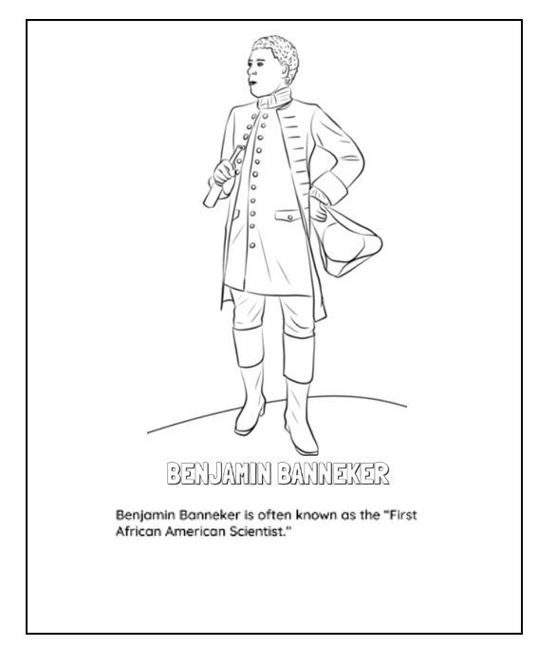
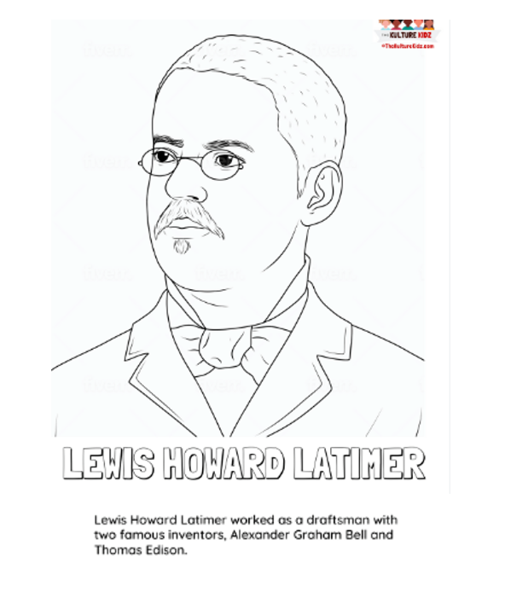
Color Sheets

Slide 23


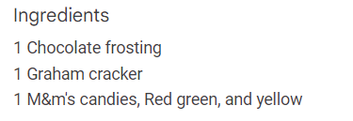
https://www.theseasonedmom.com/traffic-light-graham-cracker-snacks/#wprm-recipe-container-37197

Slide 24
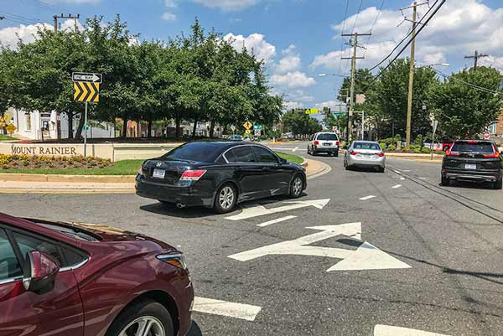
What would Garrett Morgan think about today’s roundabouts?

Slide 25

PART III
On-line Resources
&
Support Materials

Slide 26
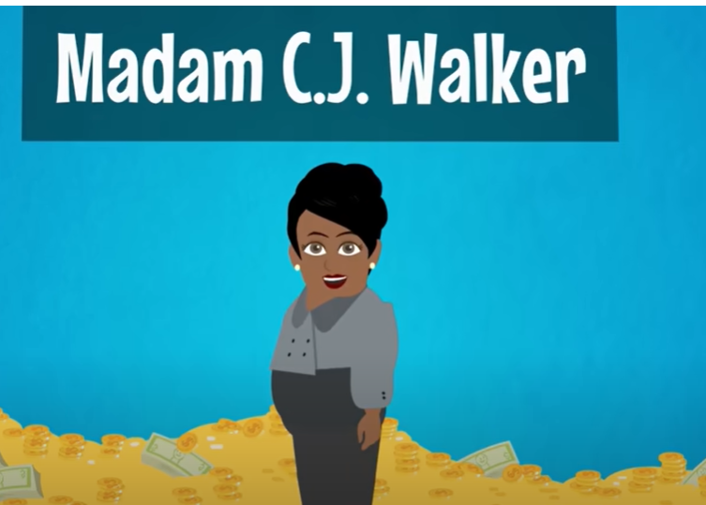
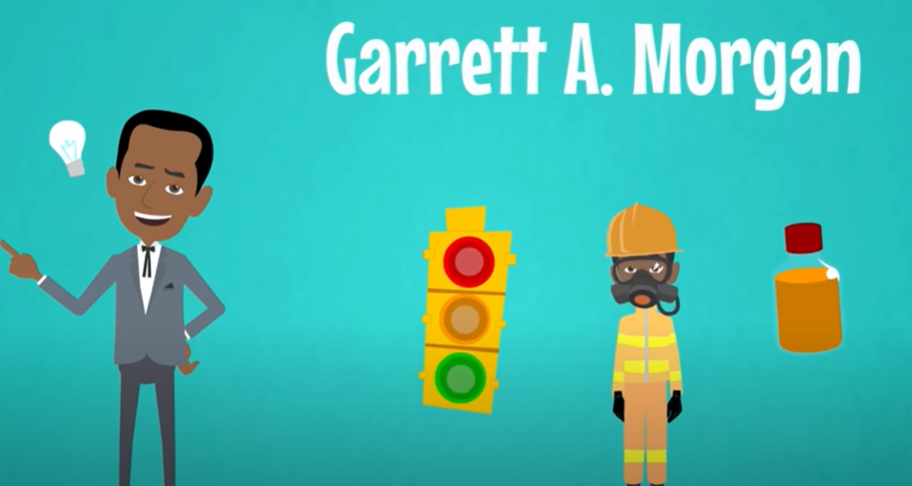
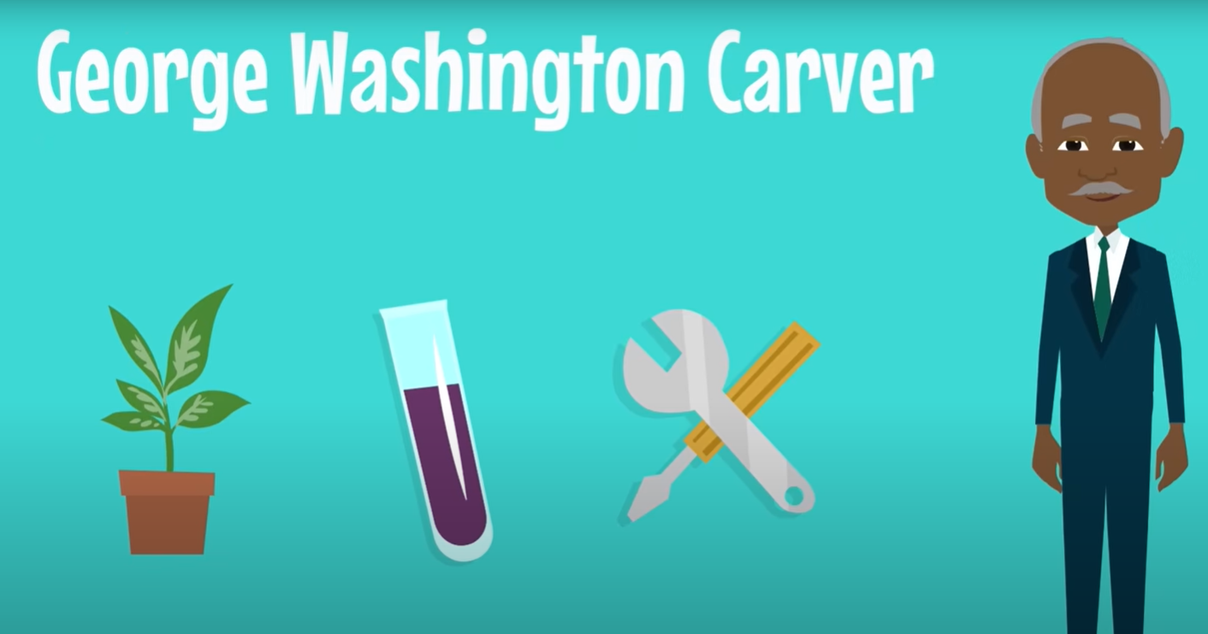



https://www.youtube.com/embed/glZpu0xMSuM

Slide 27




https://www.economicsarkansas.org/for_teachers/grab-go-economics-concept-guides.html

Slide 28


Economics Arkansas Padlet
https://padlet.com/economicsarkansas62/red-light-green-light-apaja2w9kzgn2rmj

Slide 29

The focus of this session was on little-known African American inventors and entrepreneurs. Who are some well-known African American inventors and entrepreneurs?
Can you think of any other little-known African American inventors and entrepreneurs?
Do students benefit from learning about historical figures? If so, how?

Slide 30












Slide 31

Invest In Girls

Slide 32

NEC

Slide 33

NPFC

Slide 34

Advocacy

Slide 35

Suggested Presentation Deck
CEE Affiliates
https://www.councilforeconed.org/resources/local-affiliates/
Include your local affiliate page

Slide 36










Thank You to Our Sponsors!

Slide 37
Contact information
Angie Battle jbattle15@gsu.edu
Marsha Masters marsha@economicsarkansas.org
Lynne Stover stoverlf@jmu.edu u.edu
Thank You!

