Slide 1
Teaching Economics While Cultivating Civil Dialogue
Series
Webinar 2 Activity-Based
February 28, 2024
6:00-7:00pm ET

Slide 2
Introductions
Mr. Dan Mortensen
President & CEO
Center for Economic Education
U.S. Economic Empowerment Project
Dr. Cheryl Ayers, Director

Slide 3
Session Objectives (Activity-Based)
Apply research-based economic reasoning skills to critically inquire, analyze, discuss, and debate economic topics to develop evidence-based opinions.
Practice controversial issues and culturally responsive teaching best-practices that cultivate civility toward opposing viewpoints while increasing student engagement.

Slide 4
3 Economic Reasoning Skills
3 Economic Reasoning Skills/Tools #1 Cost-benefit analysis chart #2 PACED decision making model #3 Economic way of thinking 6 principles
Social Studies, English, Science, Math, LIFE 101, Personal Finance, Controversial Issues
Real-world Critical Thinking Skills
Economics
Ayers, C. A. (2018). A first step toward a practice-based theory of pedagogical content
knowledge in secondary economics. Journal of Social Studies Research, 42, 61-79.
Ayers, C. A. (2019). Teaching students to ‘think like economists’ as democratic
citizenship preparation. Journal of Social Studies Research, 43(4), 405-419.

Slide 5
3 Economic Reasoning Skills (Ayers, 2019)
Simple yet powerful “game-changing” tools!
Student Learning Outcomes
sharpening critical thinking and critical literacy skills
entertaining multiple perspectives
gaining a deeper, nuanced understanding of subject-specific content
making students’ thinking explicit for assessment purposes
achieving a inter/multidisciplinary understanding of current events
using evidence to draw conclusions and make generalizations
articulating and defending positions using content vocabulary
laying the groundwork for authentic discussions and civil debates
casting informed votes
analyzing and synthesizing primary and secondary sources
comparing and contrasting historical, cultural, and political perspectives
explaining cause-and-effect relationships
practicing citizenship skills such as collaborating, compromising, and reaching consensus
thinking like an economist for authentic disciplinary learning (like historical thinking)
making more productive and prosperous workplace and everyday life decisions

Slide 6
Teaching
Controversial Issues
& Civil Dialogue
(references in PPT notes section)
Notes:
REFERENCES
Ayers, C. A. (2019). Teaching students to ‘think like economists’ as democratic citizenship preparation. Journal of Social Studies Research, 43(4), 405-419.
Byford, Jeff, et al. ”Teaching Controversial Issues in the Social Studies: A Research Study of High School Teachers, The Clearing House: A Journal of Educational Strategies, Issues and Ideas”, 2009, 82:4, 165-170, DOI: 10.3200/TCHS.82.4.165-170
Journell, W., Ayers, C. A., & Beeson, M. W. (2014). Tweeting in the classroom. Phi Delta Kappan, 95(5), 63-67.
“Managing Controversy.” Diversity in the Classroom | Center for Teaching and Learning, Yale University, 5 Jan. 2018, poorvucenter.yale.edu/teaching/teaching-how/chapter-2-teaching-successful-section/managing-controversy.
Philpott, Sarah, et al. “Controversial Issues: To Teach or Not To Teach? That Is The Question! .” The Georgia Social Studies Journal, The University of Tennessee, Georgia Council for the Social Studies, 2011, coe.uga.edu/assets/downloads/misc/gssj/S-Philpott-et-al-2011.pdf.
“Teaching Controversial Topics.” Center for Teaching and Learning, Yale University, 5 Jan. 2018, poorvucenter.yale.edu/teaching/ideas-teaching/teaching-controversial-topics.
“Difficult Dialogues.” Center for Teaching, Vanderbilt University, https://cft.vanderbilt.edu/guides-sub-pages/difficult-dialogues/#tools.
Kawashima-Ginsberg & Junco (2018). Teaching Controversial Issues in a Time of Polarization. Social Education 82(6), pp. 323-329.
Revolution of One (@revolutionof1) tweeted at 9:06 PM on Fri, Apr 15, 2022: How to develop intellectual integrity.

Slide 7
Controversial Issues & Civil Dialogue
What’s the problem?
US is Politically Polarized
Americans less likely to hear diverse opinions
(self-selection into like-minded physical and virtual communities)
Media Echo Chambers
Liberals become more liberal and conservatives become more conservative
(scarcity of moderate viewpoints)
Youth Impact
Social media and habits of consuming news
Scarcity of instruction prior to political identities formed then closed off to alternative perspectives
(further polarization toward dominant community narrative)

Slide 8
Controversial Issues Best Practices
Carefully Align Difficult Topics with Subject Area Learning Goals
Anticipate what “hot button” topics may become controversial to your unique group of students BEFORE the lesson/course begins
Reflect on how such conversations might actually contribute to – rather than detract from – your overall learning objectives
Clearly define course goals in the course syllabus for students and parents; perhaps ask your principal to approve

Slide 9
Controversial Issues Best Practices
Co-Create and Post Clear Ground Rules
What will and will not be permitted and consequences for violating the rules
Model appropriate thinking and behaviors for students
Explicitly and proactively invite unique and differing experiences and perspectives as valuable parts of social discourse and decision-making in a democracy
EXAMPLES OF GROUND RULES
Argue ideas rather than attacking people
Develop empathy for other viewpoints by actively listening
Paraphrase others’ ideas before responding (don’t assume)
Value insight above being right
Be curious about the gaps in your own arguments
Discover points of connection to reach a compromise

Slide 10
Controversial Issues Best Practices
Prepare “Intervention” Activities In Advance
Take a break after “hot button” moments and have students write out what they’re feeling or thinking about the conversation before resuming in a more respectful and constructive way
Ask students to write a paper in which they argue for the position with which they most disagree before the debate to help desensitize strong emotions

Slide 11
Scaffolded Economics Instructional Strategy
CONTENT + PEDAGOGY

Slide 12
Scaffolded Economics Instructional Strategy
4 Corners or Poll (Pre-Test)
Background Knowledge
Content Knowledge Research
Tool #1 Cost-Benefit Analysis Chart
Tool #2 PACED Decision Making Model
Tool #3 Economic Way of Thinking 6 Principles
Debate or Essay
4 Corners or Poll (Post-Test)

Slide 13
4 Corners (Pre-Test or Poll)
Strongly Agree
Strongly Disagree
Capitalism is the best economic system for the United States.
Agree
Disagree

Slide 14
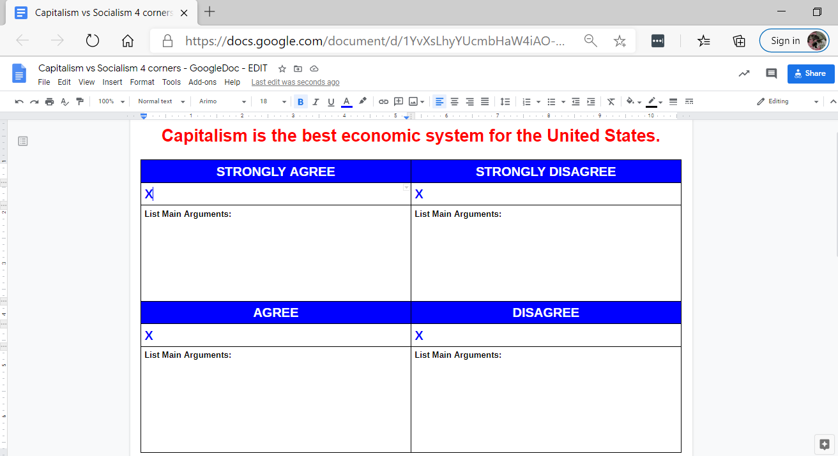
4 Corners – Google Doc (Pre-Test)
Place an “X” in your corner.
Add a reason/argument for your choice.

Slide 15
Tool #1 Cost-Benefit Analysis Chart
Instructional Tips
In-depth analysis of a single alternative/choice
To do or not to do something
Consider short-term and long-term costs and benefits
Incorporate multiple perspectives
Use weights to identify what is more/less important
Apply to past, present, and future choices
COSTS
BENEFITS
Opportunity Cost and Tradeoffs by MRU
Video 4:38

Slide 16
Tool #1 Cost-Benefit Analysis Chart
CHOICE: To Be a Teacher
1=not at all important 3=average importance 5=very important
COSTS (disadvantages/given up) | 1-5 | BENEFITS (advantages/gained) | 1-5
Totals |  | Totals
DECISION:
OPPORTUNITY COST:
Give up free time on weekends
3
Developing young minds for future
4
Dealing with disciplinary problems
2
Summers off
5
Not a high salary
1
6
9
Become a teacher
Give up free time on weekends

Slide 17
Background Knowledge

Slide 18
Background Knowledge
Capitalism Key Tenants
Market economy or free enterprise
Private ownership (means of production)
Property rights
Rule of law
The questions of what to produce, how to produce, what quantity to produce, at what price, and for whom are all answered by individuals in the marketplace
Individuals benefit from their own initiative
Notes:
Mention that Virginia teaches 4 types of economies: market, command, traditional, and mixed.

Slide 19
Tool #1 Cost-Benefit Analysis Chart
CHOICE: Capitalism as the U.S. economic system
1=not at all important 3=average importance 5=very important
COSTS (disadvantages/given up) | 1-5 | BENEFITS (advantages/gained) | 1-5
Totals |  | Totals
DECISION:
OPPORTUNITY COST:

Slide 20
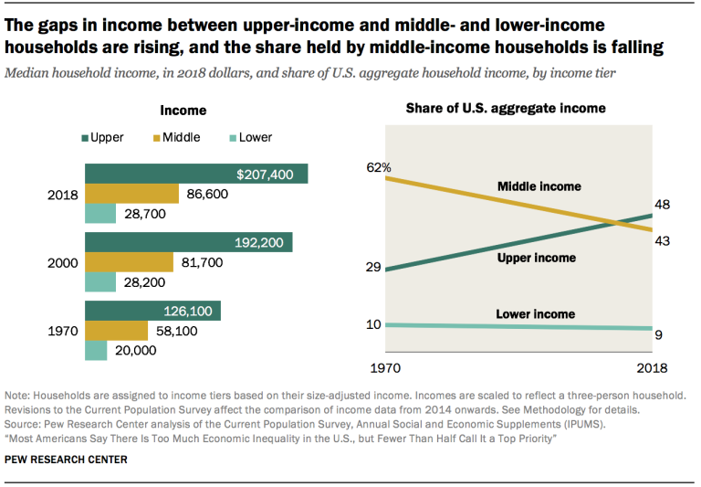
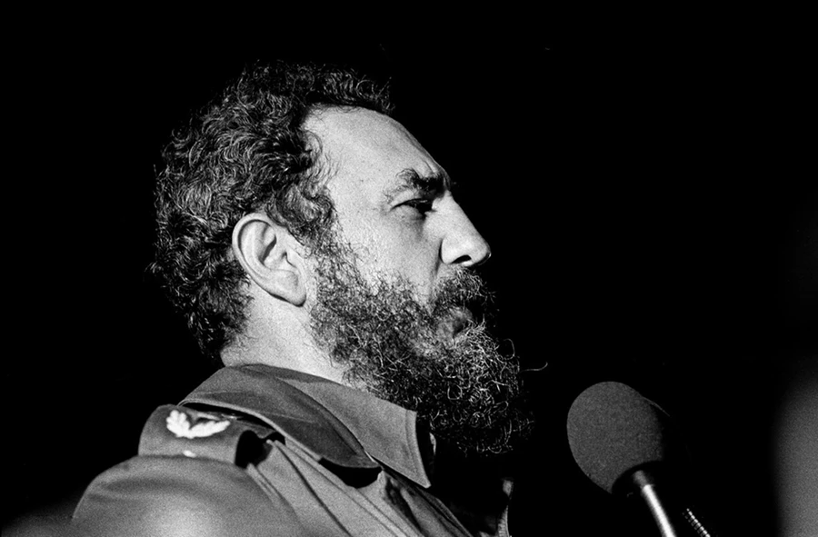
Capitalism RESEARCH
COSTS
BENEFITS
Produces income inequality
Horowitz, Igielnik, & Kochhar “Trends in Income and Wealth Inequality” Pew Research Center January 9, 2020
https://www.pewresearch.org/social-trends/2020/01/09/trends-in-income-and-wealth-inequality/
Places profits ahead of people and the environment
Reid “Capitalism’s Focus on Profit Harms People and the Planet” Forbes December 28, 2021
https://www.forbes.com/sites/carltonreid/2021/12/28/capitalisms-focus-on-profit-harms-people-and-the-planet-says-tech-company-boss/?sh=15431ad67c31
Requires regulations to prevent monopolies and protect consumers
Mauldin “America Has a Monopoly Problem” Forbes April 11, 2019
https://www.forbes.com/sites/johnmauldin/2019/04/11/america-has-a-monopoly-problem/#47aaa6f2972f
Requires safety-net programs for the poor
Amadeo “What is Capitalism?” the balance, July 21, 2022 https://www.thebalance.com/capitalism-characteristics-examples-pros-cons-3305588
Produces higher standard of living for all citizens and reduces poverty
Zitelmann “Anyone Who Doesn’t Know the Following Facts About Capitalism Should Learn Them” Forbes July 27, 2020
https://www.forbes.com/sites/rainerzitelmann/2020/07/27/anyone-who-doesnt-know-the-following-facts-about-capitalism-should-learn-them/?sh=198f1a3e3dc1
Provides economic and personal freedoms Alexe, “I Grew Up in a Communist System. Here’s What Americans Don’t Understand About Freedom” Foundation for Economic Education March 9, 2018 https://fee.org/articles/i-grew-up-in-a-communist-system-here-s-what-americans-don-t-understand-about-freedom/
Encourages innovation and investment
Nash, McLain, Savidge & Wright “How Profits Created the Prosperity We Enjoy Today” Foundation For Economic Education July 27, 2021
https://fee.org/articles/how-profits-created-the-prosperity-we-enjoy-today/
History indicates that outcomes are better for countries under capitalism
Rincon “Taiwan’s Wealth Shows Cuba’s Poverty is the Result of Socialism, Not a Blockade” Foundation For Economic Education September 29, 2021
https://fee.org/articles/taiwan-s-wealth-shows-cuba-s-poverty-is-the-result-of-socialism-not-a-blockade/

Slide 21
TOOL #1 Cost-Benefit Analysis Chart
1=not important 3=average importance 5=very important
COSTS | 1-5 | BENEFITS | 1-5
C1 - Produces income inequality |  | B1 - Produces higher standard of living for citizens and reduces poverty
C2 - Places profits ahead of people and the environment |  | B2 - Provides economic and personal freedom
C3 - Requires regulations to prevent monopolies and protect consumers |  | B3 - Encourages innovation and investment
C4 - Requires safety net programs for the poor |  | B4 - History indicates that outcomes are better for countries under capitalism
TOTAL |  | TOTAL

Slide 22
Background Knowledge
Notes:
Mention that Virginia teaches 4 types of economies: market, command, traditional, and mixed.

Slide 23
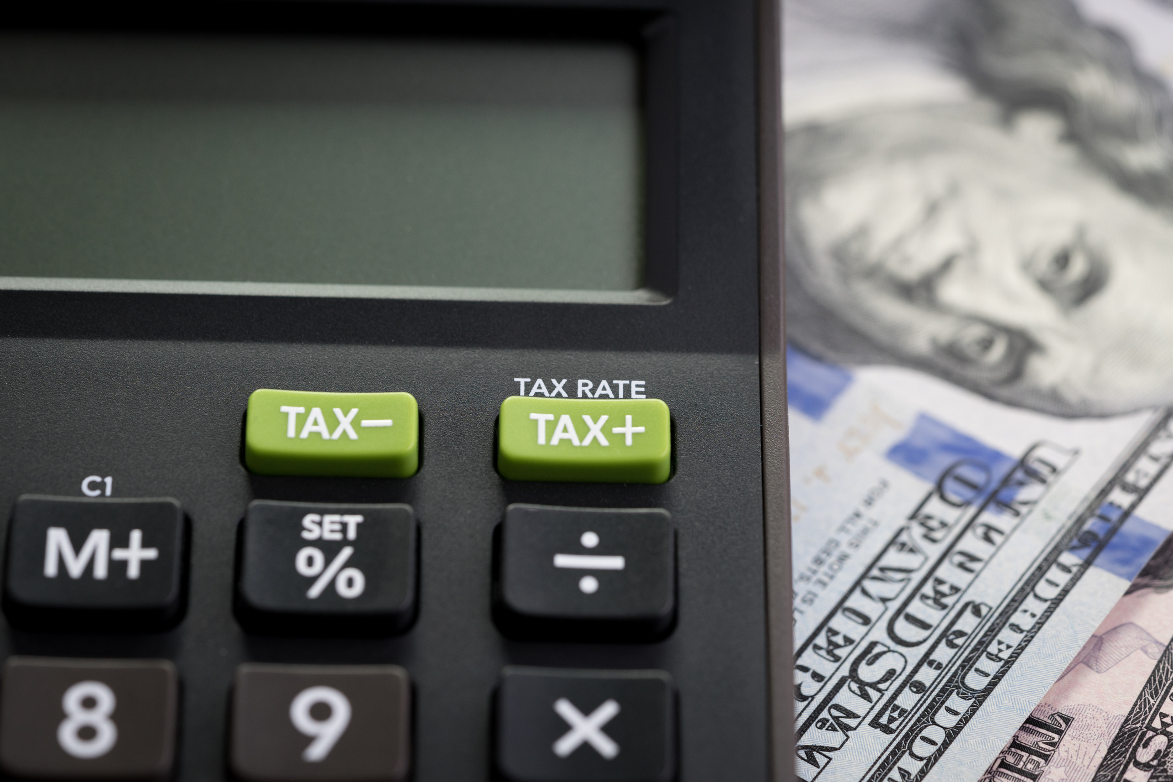
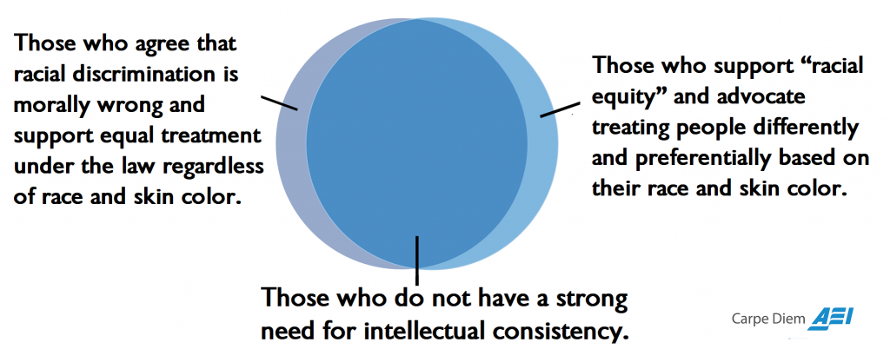
Socialism RESEARCH
COSTS
BENEFITS
Requires higher taxation which reduces incentive to work and earn
Heil “Tax Rate Hikes and the Economy” Hoover Institution February 18, 2021
https://www.hoover.org/research/tax-rate-hikes-and-economy
Equal outcomes require unequal treatment
Perry “Don’t Be Fooled by ‘Equity’ – It’s A Mandate to Discriminate to Achieve Equal Outcomes with Unequal Treatment” American Enterprise Institute March 24, 2021
https://www.aei.org/carpe-diem/dont-be-fooled-by-equity-its-is-a-mandate-to-discriminate-to-achieve-equal-outcomes-with-unequal-treatment/
Central planning and price controls result in shortages
Henderson “Price Controls: Still A Bad Idea” Hoover Institution January 20, 2022
https://www.hoover.org/research/price-controls-still-bad-idea
History of failure and totalitarianism
Walker-Werth “How Socialism Discourages Work and Creates Poverty” Foundation For Economic Education March 30, 2022
https://fee.org/articles/how-socialism-discourages-work-and-creates-poverty/
Reduces income inequality
Lazear “Socialism, Capitalism, and Income” Hoover Institute May 28, 2020
https://www.hoover.org/research/socialism-capitalism-and-income-0
Centralized control simplifies decision-making
“The Benefits of Socialism ”International Business courses.lumenlearing.com
https://courses.lumenlearning.com/suny-internationalbusiness/chapter/reading-the-benefits-of-socialism/
Provides for “free” health care and education
Bassil “A Close Look at Cuba’s Health Care System” University of Miami News / Special Report 2023
https://cuba.miami.edu/business-economy/a-close-look-at-cubas-health-care-system/index.html
Reduces unemployment
Thangavelu “Can Socialism Work in America?” Investopedia April 6, 2022
https://www.investopedia.com/articles/investing/051415/can-socialism-work-america.asp

Slide 24
Socialism RESEARCH + TOOL #1
1=not important 3=average importance 5=very important
COSTS | 1-5 | BENEFITS | 1-5
C1 - Requires higher taxation which reduces incentive |  | B1 - Reduces income inequality
C2 - Equal outcomes require unequal treatment |  | B2 - Centralized control simplifies decision-making
C3 - Central planning and price controls result in shortages |  | B3 - Provides for “free” health care and education
C4 - History of failure and totalitarianism |  | B4 - Reduces unemployment
TOTAL |  | TOTAL

Slide 25
Tool #2 PACED Decision-Making Model
Instructional Tips
Choosing among multiple alternatives/choices
Important criteria to consider
Past, present, and future choices
State the Problem.
List the Alternatives.
Determine the Criteria.
Evaluate the alternatives.
Make a Decision.
Marginal Thinking and the Sunk Cost Fallacy by MRU
Video 6:19

Slide 26
Tool #2: PACED Decision Making Model
1. Question/Problem: Which profession should I choose?
3. Criteria 2. Alternatives | Help People | Make over $100K | Requires BS only | Enjoy | Totals
Nurse
Dentist
Police
3
1
2
1
7
4. Evaluate the Alternatives
3 = alternative meets criteria
very well
2 = alternative meets criteria
satisfactorily
1 = alternative does not meet
criteria satisfactorily
3
3
1
2
9
3
1
3
3
10
5. Decision (highest scoring alternative): _______________________________
Opportunity Cost (second highest scoring alternative): _______________________
Police
Dentist
Notes:
Cannot use a “0” to evaluate when using weights b/c automatically negates weight value

Slide 27
Tool #2: PACED Decision Making Model
1. Question/Problem: Which profession should I choose?
3. Criteria 2. Alternatives | Help People | Make over $100K | Requires BS only | Enjoy | Totals
Nurse
Dentist
Police
20
50
20
10
3
1
2
1
10
7
160
4. Evaluate the Alternatives
3 = alternative meets criteria
very well
2 = alternative meets criteria
satisfactorily
1 = alternative does not meet
criteria satisfactorily
60
50
40
3
3
150
1
2
9
60
20
20
250
3
1
3
3
10
60
50
60
30
200
Dentist
5. Decision (highest scoring alternative): ________________________
Opportunity Cost (second highest scoring alternative): _______________________
Police

Slide 28
TOOL #2 PACED Decision Making Model
Question/Problem: Which economic system is best for the United States?
Economic Freedom
(producers,
consumer)
Economic Efficiency
(little to no waste)
Economic Growth
(revenue, GDP, trade)
Economic Equity
(not equality but fairness)
3. Criteria 2. Alternatives |  |  |  |  | Totals
Capitalism
Socialism
4. Evaluate the Alternatives
3 = alternative meets criteria
very well
2 = alternative meets criteria
satisfactorily
1 = alternative does not meet
criteria satisfactorily
3
2
3
2
10
1
1
2
3
7

Slide 29
TOOL #2 PACED Decision Making Model
Question/Problem: Which economic system is best for the United States?
3. Criteria 2. Alternatives | Economic Freedom (producers, consumer) | Economic Efficiency (little to no waste) | Economic Growth (revenue, GDP, trade) | Economic Equity (not equality but fairness) | Totals
Capitalism
Socialism
5
5
5
85
3
2
3
2
170
10
4. Evaluate the Alternatives
3 = alternative meets criteria
very well
2 = alternative meets criteria
satisfactorily
1 = alternative does not meet
criteria satisfactorily
15
10
15
210
1
1
2
3
7
5
5
10
255
275

Slide 30
Tool #1 Cost-Benefit Analysis Chart
Tool #2 PACED Decision-Making Model
Whole Class
Application on Google Docs!
Graphic Organizer for Primary and Secondary Sources!

Slide 31
Tool #3 Economic Way of Thinking 6 Principles
Inquiry-based Learning 101

Slide 32
Tool #3 Economic Way of Thinking 6 Principles
Qualitative framework for cost-benefit & PACED
People choose.
People’s choices involve costs.
People respond to incentives in predictable ways.
People create rules and economic systems that influence individual choices and incentives.
People gain when they trade voluntarily.
People’s choices have consequences that lie in the future.

Slide 33
Tool #3 Economic Way of Thinking 6 Principles

Slide 34
Tool #3 Economic Way of Thinking 6 Principles

Slide 35
Tool #3 Economic Way of Thinking 6 Principles
Assessments:
Self
Peer
Debate

Slide 36
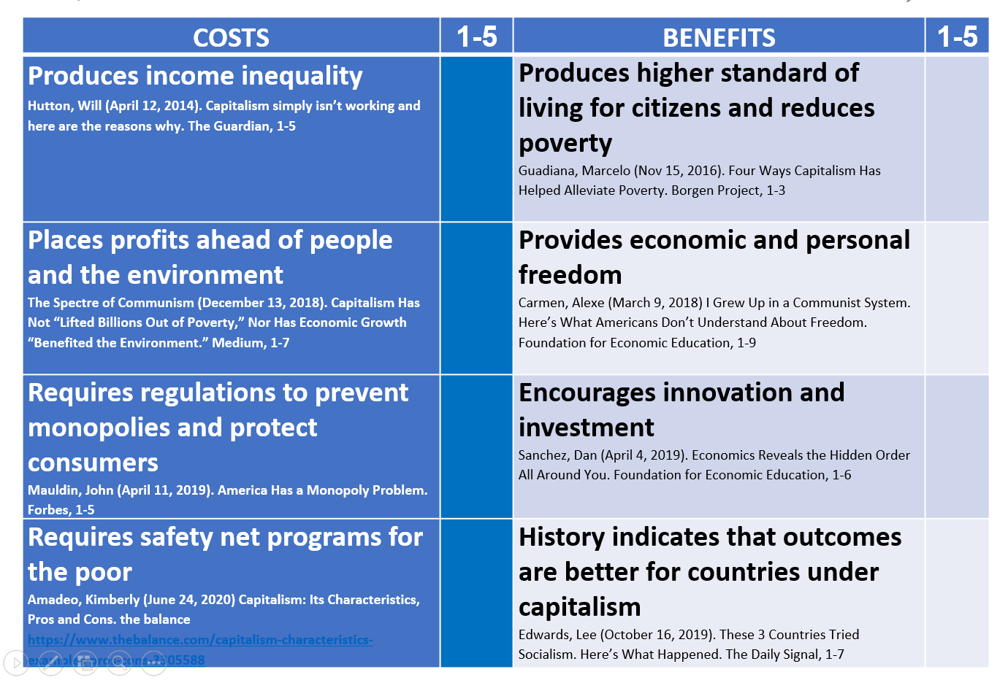
DEBATE – Opening Argument
People choose.
People’s choices involve costs.
People respond to incentives in predictable ways.
People create rules and economic systems that influence individual choices and incentives.
People gain when they trade voluntarily.
People’s choices have consequences that lie in the future.
State FOR or AGAINST Capitalism.
Share one brief argument through the lens of an Economic Reasoning Tool.

Slide 37
4 Corners (Post-test or Poll)
Strongly Agree
Strongly Disagree
Capitalism is the best economic system for the United States
Agree
Disagree

Slide 38
WRAP-UP
Tool #3: Cost-Benefit Analysis RUBRIC
Assessments:
Self
Peer
Debate

Slide 39
Dan Mortensen
drmortensen@vcu.edu
Cheryl Ayers
cheryl42@vt.edu
Google Drive Folder - Content & Pedagogy Resources
https://drive.google.com/drive/folders/1kx9iF_BEv_CUMi7rN9dcpceI3BOhR4xL?usp=sharing

Slide 40
Questions/Comments?

Slide 41
MORE SLIDES & RESOURCES
Tool #3: Cost-Benefit Analysis RUBRIC
Assessments:
Self
Peer
Debate

Slide 42
Controversial Issues & Civil Dialogue
Why is it important to teach students to discuss/deliberate/debate controversial issues?
TEACHER REFLECTIONS
“I want my students to learn how to really listen to one another and take the perspectives of their classmates. I want to encourage my students to come to class with an open mind, willingness to learn from their peers, and respect for differences.”
“My goals for student learning include introspection, reflection, and critical thinking skills, all of which are fostered in dialogue with peers about topics that make them step outside their comfort zones.”
“The appeal of ‘the hard stuff’ is that it encourages students to think critically about social life, that is, to question what they learn and make meaning from what they learn, to synthesize information from various sources, and to evaluate ideas.”
Notes:
Quotes from teachers

Slide 43
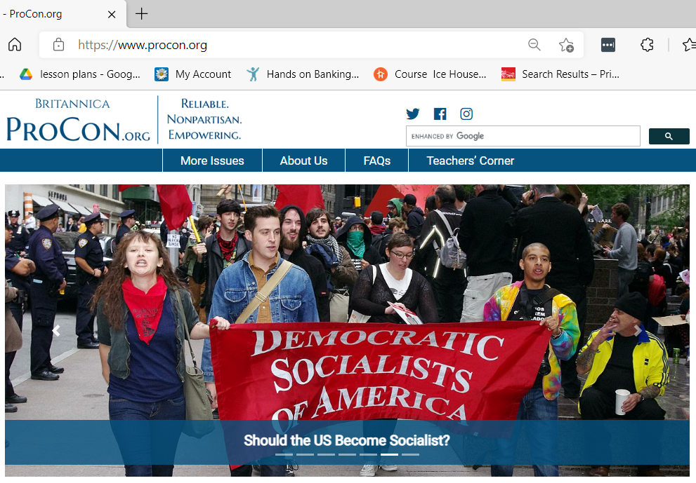
Other Resources

Slide 44
Other Resources
Economics 101
Scarcity and Choice (4:35)
http://www.youtube.com/watch?v=yoVc_S_gd_0
Intro to Economics: Crash Course (12:08)
https://www.youtube.com/watch?v=3ez10ADR_gM&t=5s
Economic Education Podcasts
Think Like an Economist
https://podcasts.apple.com/us/podcast/think-like-an-economist/id1523898793
Planet Money
https://www.npr.org/podcasts/510289/planet-money
Freakanomics
https://freakonomics.com/category/podcasts/
EconEdLink
https://www.econedlink.org/
MRU EconInBox
https://www.econinbox.com/

Slide 45
Other Resources
Vanderbilt University, Center for Teaching, Difficult Dialogues
https://cft.vanderbilt.edu/guides-sub-pages/difficult-dialogues/#tools
iCivics
https://www.icivics.org
Teaching for Democracy Alliance
http://www.teachingfordemocracy.org
St. Louis Fed Minimum Wage Debate
https://www.stlouisfed.org/education/structured-minimum-wage-debate?s=03
Education World
http://www.educationworld.com/a_lesson/lesson/lesson304.shtml
Educational Technology Tools
Nearpod, GoSoapBox, Padlet, Pear Deck, Google Jamboard

Slide 46
Debate Format Example
30 second opening position statement (no specifics) – For
30 second opening position statement (no specifics) – Opposed
3 minute position argument (3 main points) – For
3 minute position argument (3 main points) – Opposed
5 minute work period
2 minute rebuttal (respond to 3 main points) – For
2 minute rebuttal (respond to 3 main points) – Opposed
3 minute work period
2 minute response – For
2 minute response – Opposed
1 minute work period
1 minute position summary and closing statement – Opposed
1 minute position summary and closing statement – For

Slide 47
Debate Rubric Example
Debate Performance Criteria | Score
Uses one or more of the 3 Economic Way of Thinking Tools
Stays on topic
Supports arguments with evidence
Delivers persuasiveness
Demonstrates teamwork
Shows responsiveness to opposing team’s arguments
1=Needs More Practice 5=Join the Debate Club 10=Debate Stage Ready

