Slide 1
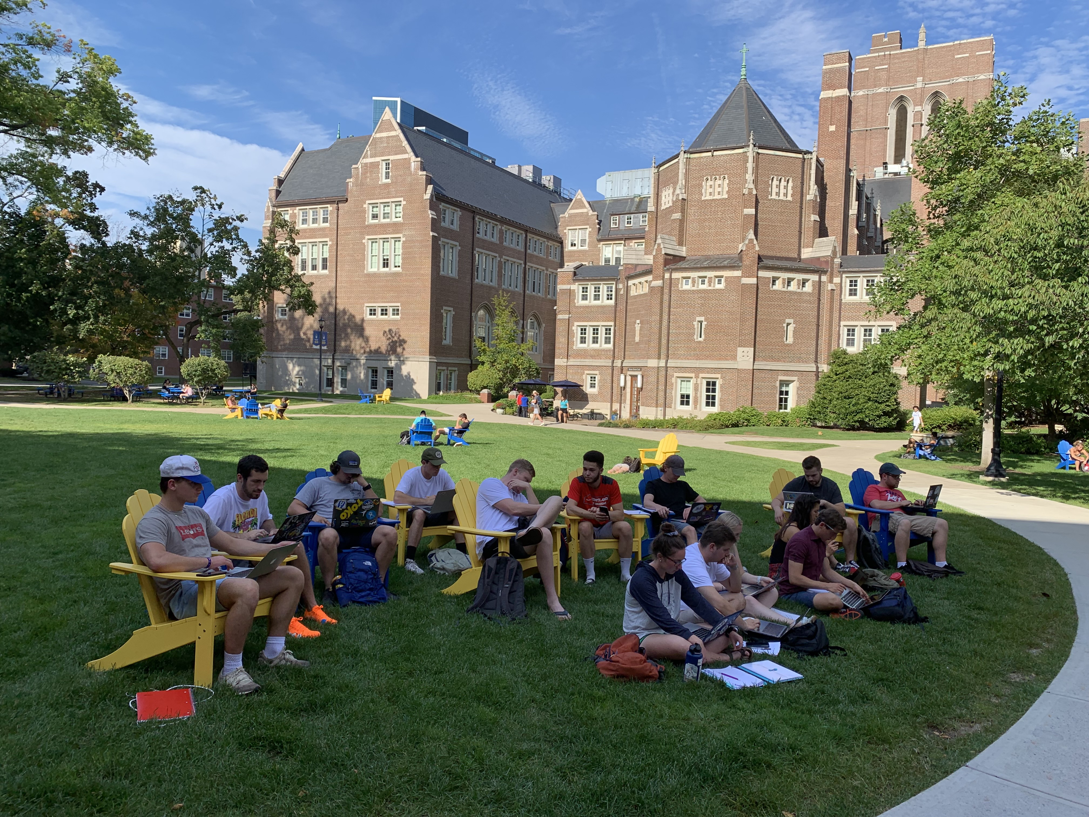
Learn it - Share it
Florencia Gabriele
gabrielef@Emmanuel.edu
Notes:
More than 1 in 3 (or 34 percent) Americans expect their finances to improve in 2023, versus 29 percent who expect their finances to worsen and 36 percent who see their financial situation staying about the same.
The majority of Americans who say their finances won’t improve next year (or 63 percent) say continued high inflation will be to blame.
More than 2 in 5 Americans who expect financial improvement next year (or 41 percent) say making more money at work will help them, followed by 30 percent who credit having less debt and 25 percent who attribute a change in life circumstances.
Paying down debt, budgeting better and saving more money for emergencies are among Americans’ top financial goals for 2023.

Slide 2
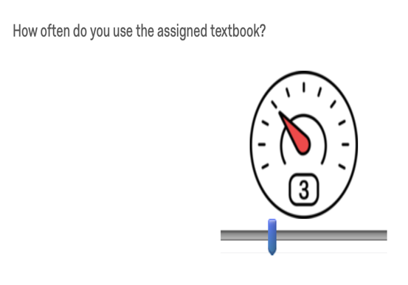
Motivation: Problem of Student Engagement
Notes:
Presents: flor
My students don’t read! So I need to have artifacts that no only uses text, but multimedia
There are OERs for basic economic courses, but not advanced courses
Learner-learner engagement
Group work
Required to complete and manage group work on theor own, encouraging leadership and teamwork
Learner-instructor engagement
Formative assessment
Topic, outline, and first draft encouraged interaction
Learner-content engagement
Creating OER and making it publicly available and openly licensed required students to engage with the material on a deeper level
Removed frustration associated with creation of disposable assignments

Slide 3
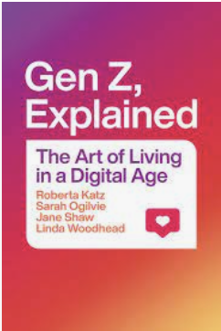
Gen Z’s perspective
Notes:
“Gen Zers, also called postmillennials, Zoomers, or iGen-ers, are the first generation never to know the world without the internet. The oldest Gen Zers, now in their midtwenties, were born around the time the World Wide Web made its public debut in 1995. They are therefore the first generation to have grown up only knowing the world with the possibility of endless information and infinite connectivity of the digital age.”
“The experience of Gen Zers is therefore often paradoxical, even contradictory. They have more “voice” than ever before (e.g., a meme or a YouTube or TikTok video can reach hundreds of thousands, even millions), but they also have a sense of diminished agency “in real life” (e.g., institutions and political and economic systems seem locked, inaccessible to them, and wrongheaded). They are often optimistic about their own generation but deeply pessimistic about the problems they have inherited: climate change, violence, racial and gender injustice, failures of the political system, and little chance of owning a home or improving on their parents’ level of affluence.
“Gen Zers navigate these paradoxes using the new—usually digital—tools that they have at hand. We highlight three main strategies. First, they are very clear about who they are, and they use that clarity of identity to self-define and push back against unwanted pressures and demands (e.g., “no, that’s not appropriate to who I am”). Second, they join (mainly online) communities that fit, support, and help refine their personal and collective identity, purpose, and (for some) activism. Third, they reject hierarchy and embrace wider distributions of voice and power on the basis of equality and collaboration and having a clear set of values.”

Slide 4
Gen Z priorities
High value of collaboration
Modularity and flexibility
Time: “I treat attention as a currency . . .” “and you can spend it on whatever you like” [Ethan]. They are strongly oriented to the present moment, focusing their attention on what is immediately before them
Authenticity on Social media
Cancel/Call out culture
Redefining “fam”/ Parents are seeing as friends
Memes to communicate feelings
“It is not surprising, then, that romantic relationships were variously described as “time consuming,” “energy draining,” “complicated,” and, thanks to online dating apps—on which more shortly—“more a hobby” or “almost like fast food” in that they could begin and end quickly.”
Mental health issues challenges are normal and can be discussed in the open
Notes:
“One of the first things we learned from Gen Zers is the high value they place on collaboration; in their words, they like to “collab.”
“It was only during the COVID-19 pandemic lockdown in 2020 that many who were born long before the internet was launched, who were used to separating online and offline activities, began to experience online/offline life as postmillennials do. Forced to use digital devices for various activities and communications that had been conducted in person before the lockdown, older generations began to understand more clearly how the line between online and offline could blur. In that sense, the pandemic has been a great accelerator of preexisting trends that Gen Zers were already living. While those who grew up in the twentieth century can still recall what life was like before smartphones and the”
“internet, for postmillennials there was no life before these powerful, fast, connecting technologies. They have used software tools since they were very young to read, write, create, compete, understand, organize, interact, process, and interrogate—in other words, to be directly or indirectly in touch with others. They cannot imagine life without digital technology because they have never been without it; indeed, as one interviewee put it, “I wouldn’t want to live without it” [Malia].”
“For the Gen Zers we interviewed, online and offline interaction with family, friends, and others is interchangeable. As one put it, checking her phone is an integral part of her life, and what she sees and reads on it is what her friends discuss when they are physically together, as well as on social media and in texts [Jordan]. Another interviewee noted that he uses social media as a way of interacting with people he knows in real life (IRL), and as a way of keeping up to date on their lives [Andy].
Growing up with the internet—and never knowing a world without it—has profoundly shaped the ways in which Gen Zers “do” life. Digital technology, with the constraints and freedoms it imposes, has affected and shaped not only their online habits of being but also their offline life and practices and the merging of the two. To illustrate, we look at three technology-driven themes that emerged in our interviews:
• the need to learn multiple social codes,
• collaborative modes of working together, and
• new behaviors and attitudes that have developed around the use of time.
“SOCIAL CODES
Behavioral codes have always accompanied media use; for example, the twentieth century saw many rules regarding the “proper” times to place a telephone call. We authors agreed that none of us growing up would have dared phone a friend’s home after 9:00 p.m. Now an abundance of online social codes have arisen that Gen Zers have had to become skilled at recognizing, developing, and putting into practice in their digitally facilitated interactions. At the same time, they still have had to learn how to behave in diverse offline spaces, from formal occasions such as”
“in diverse offline spaces, from formal occasions such as weddings to informal events like visits with grandparents.”
“Finding My Fam
When we asked a linguistics class at Stanford in 2016 to select a “word of the year” that summed up their college life, many of the students chose the word fam. One of them gave a very moving presentation on the word, explaining to the class that he came from a small town in the Midwest, was gay, and had found friends at Stanford who were his new fam. All of his squad—another postmillennial word for community—refer to each other as fam.
Fam refers not to parents or relatives but to a close friend or friends (singular or plural) in whom you confide and trust, and around whom you can be your most authentic self.”
“MODULAR BELONGING
Gen Zers find stability and social anchoring without subsuming their whole identity in one group or tying themselves to it forever. We have come to think of this as “modular belonging,” as analogous to modular furniture or fashion systems: at any one time various modules of identity and belonging fit together, but it is possible to move them around and replace modules one at a time as the need and inclination arises, without destroying the whole array. Postmillennials rarely belong to just one community or invest all their identity in one or two relationships”
“COLLABORATION
The desire for collaborative ways of working and problem solving is widespread among postmillennials. They like to “collab together” to address problems [Sunita].6 This preference became clear to us early in our research project, sparked by the comment of a student on one of our American campuses who said she would choose her college major based on where she could most readily work in collaboration with other students. For her, it was so much more rewarding and enjoyable to learn and problem solve with others, rather than having to work alone.
Digital technologies have been instrumental in the push toward collaborative activity. Postmillennials became comfortable with group assignments—and group grades—in their precollege classrooms, and many had been exposed from an early age to software and websites that promoted joint efforts. They became accustomed to using digital tools like GroupMe, Google Docs, Office, Facebook Messenger, and Skype to create documents jointly, engage in group chats, and share calendars, and they became familiar with “crowdsourcing,” “crowdfunding,” and other communal action through prominent websites like GoFundMe, Kickstarter, Patreon, Change.org, Indiegogo, Wikipedia, Zooniverse, and Amazon Mechanical Turk. Offline, digitally enabled ridesharing, couch surfing, and community organizing have reinforced the[…]”
“preference became clear to us early in our research project, sparked by the comment of a student on one of our American campuses who said she would choose her college major based on where she could most readily work in collaboration with other students. For her, it was so much more rewarding and enjoyable to learn and problem solve with others, rather than having to work alone.”
“Modularity and flexibility are two important aspects of contemporary collaborative work. A recent graduate of one of our three campuses, now employed at a large tech company, told us he simply did not know how work could be accomplished without collaboration.”
TIME “I treat attention as a currency . . .” “and you can spend it on whatever you like” [Ethan]. They are strongly oriented to the present moment, focusing their attention on what is immediately before them. Theorists such as Thomas Davenport have coined the phrase “the attention economy” and have demonstrated that attention is money.14 Being savvy about the economics of digital platforms, many postmillennials understand that when they watch a YouTube video, for example, their attention may translate into actual ad dollars for the video’s producer.
This emphasis on attention, coupled with a sense of “being in the moment,” must be understood in the context of multitasking and constantly moving from one activity to another. Postmillennials may have many different windows open on their screens at the same time, and they flip frequently between their apps and windows. In this regard, they are like other heavy users of digital technologies studied by Byron Reeves and his team, who observed the “screenomes” of 400 computer users in the US, China, and Myanmar with the aim of understanding the sequence of screens these users viewed and interacted with over time. Observing screenshots of the participant’s devices every five seconds, they discovered that users switched screen activity every twenty[…]”
“In other words, we have long worried about the impact of technology on human interaction. The telephone was a game changer because it made communication immediate between two or more people who were not in the same place; before that, the fastest form of communication had been the telegram. Invented in 1876, by 1900 the telephone was being used in business in the US; by the 1920s and 1930s—marketed increasingly to women for social purposes—it had become fairly common for domestic use, especially in the US, but also increasingly in the UK, which meant that it was not only purposeful but also social, its use associated with a whole series of rituals and practices.27”
“The first half of the twentieth century witnessed a gathering intensity of technological mediation of experience. The telephone was joined by the radio and talking pictures, both popular in the interwar years, and, by midcentury, television. Twentieth-century technological advances in communication were such that all the pieces were in place for the hyperconnected society that has been a hallmark of the early twenty-first century. In that sense, the current digital age is the outworking of a capacity for connection and information gathering that began at least a century ago.”
“RACE AND ETHNICITY
Black Lives Matter and similar movements, with their focus on current and historic racial injustices, have highlighted the multiple ways in which race remains a charged category of identity”
“nterviewees who, as children of immigrants, were trying to keep one foot in their parents’ culture and one foot in the American or British culture in which they had grown up were especially vocal about the interplay between race/ethnicity as a personal element of identity and as an element of cultural familiarity and belonging. A Mexican American student put it this way:”
“Class, a significant identity marker in past decades, appears at first glance to be disappearing as a salient category for postmillennials.”
“Postmillennial attitudes to religion are often complex and ambivalent. Some of those we interviewed had retained the religious affiliation of their upbringing, even if they adapted it somewhat to their own personal belief system so that it remained a part of their identity”
“CONCLUSION
In forging their sense of identity, postmillennials focus on gender, sexuality, race, and ethnicity in particular, since these are the inescapable elements that minorities have brought to prominence and that majorities can no longer evade.”
“THE COMMUNICABLE SELF
Because postmillennials’ finely grained identities are so important to them, they care deeply about communicating these identities to others authentically and honestly.”
“FLEXIBILITY AND AUTHENTICITY
I think our generation really highly value flexibility. Flexibility of identity, the flexibility of movement, the flexibility of transaction, the flexibility of time . . . in a lot of ways, most of them are very technologically enabled. So flexibility of identity—I think about gender, for instance. . . . Big picture, there exist many more forms of gender identity and relationship identity. . . . I think it’s a pattern of expanded and more flexible options for sexual identity, family relationships, career paths, and, with Uber, even methods of transportation. [Emma]
” “We were struck by how significant the word free is to this generation in our iGen Corpus.5 The freedom to” “discover who you really are is essential if you are to live life authentically and make the most of your own potential. For Gen Zers, this is bound up with “being real” and communicating honestly who you are. Along with true and honest, the words real and fake occur with unusual frequency in our data bank of Gen Z language when compared with collections of broader language use” “Postmillennials have a deep sense of what counts as an authentic image on social media. They are aware of the plethora of apps such as RetouchMe and Facetune, which enable you to modify everything about your appearance, from your skin color to the size of your physical features. A posed or edited photo posted on a platform where curated pictures are the expected norm is considered acceptable, as is a posed photo that is displayed as natural—a “plan-did” version of a candid—when the editing is not glaring. However, if the poster passes off a doctored photo as natural and lies about it, the action is considered deceptive, inauthentic, and a breach of trust. Researchers at Columbia University have found that the consequences are felt not only by the viewers, but also by the posters themselves. Inauthentic posts on social media (i.e., those that presented the poster in an idealized rather than a real way) negatively affected the well-being of the person who posted. Analyzing data of over 10,000 Facebook users, it was the individuals who were more authentic in their self-expression who also reported greater life satisfaction.7”
“Cancel culture, or callout culture, is a new way for online communities to call out hypocrisy and to hold individuals and groups accountable for their behavior. It allows individuals to exercise personal agency in the online world, where so much power is in the hands of the platform providers. Gen Zers are well aware that depriving a celebrity of their following on social media is equivalent to denying them a livelihood. The expression “you’re canceled!” is now being used against anyone online or offline as a strategy to express disagreement with someone’s opinions or actions.16
Several students described to us the devastation they felt if they were canceled, blocked, or ghosted (when a person cuts off all communication without warning) on social media.”
“Memes have become a primary and highly effective vehicle for postmillennials to communicate how they feel. Memes are relatable or humorous images, videos, or pieces of text that are copied and circulated rapidly by social media users.” “The popularity of the word Zoomer, now sometimes used to describe Gen Zers, itself came out of a meme character called “Zoomer Wojak,” created on the 4chan website in June 2018. Based on a version of the popular internet meme Wojak—also known as “the feels guy,” who generally expresses melancholy and loneliness—this version appeared with glasses and an undercut (a haircut with long hair on top and buzzed back and sides) and was depicted as loving mumble rap (emo rap) and battle royale video games such as Fortnite. The term grew in popularity from there and has taken on new meaning since the COVID-19 pandemic, influenced by the widespread use of Zoom videoconferencing.
Memes are central to the majority of postmillennials’ online lives. In our survey of representative samples of US and UK postmillennials, we asked the following: “How often, if ever, do you currently interact with memes, for example by liking, sharing or tagging?” At least 85 percent in each country said they interacted with memes, over half in each country saying they did so frequently or all the time. Moreover, over a third in Britain and 39 percent in the US reported that they[…]”
“ontrary to a stereotype that views every recent generation as more individualistic than the prior one, postmillennials are finding and forging new modes of community that lessen the contradiction between being a me and a we. Far from “bowling alone”19 or “Generation” “Me”20 gazing narcissistically into their screens, many young people are as concerned about belonging as they are about finding who they really are, and they do not necessarily see the two as distinct.
With modular belonging, postmillennials are involved in a new experiment in sociality. Each person’s unique combination of identities, expressed through belonging to a variety of communities, gives them multiple social supports (without becoming entirely dependent on any one), while also enshrining their uniqueness. As the social theorist Michel Maffesoli puts it, “Participating in a multitude of tribes, which are themselves interrelated, allows each person to live his or her intrinsic plurality.”21 Such belonging is inherently flexible, informal, and conversational. It prioritizes forms of community in which everyone who wants to can have a say, governed by pe“Postmillennials barely remember a world before 9/11, though the 2008 financial downturn was a lived reality for many who were old enough to understand and share in their parents’ sense of insecurity during that time.”
“Our US and UK surveys similarly revealed a strong orientation toward self-reliance. When we asked respondents about whom or what they rely on for guidance in living life and making decisions, in both the US and UK “own reasoning and judgment” and “own feelings and intuition” were very highly valued. “Parents,” “trusted friends,” and “past experience” were also cited as” “ reliable sources of guidance, while strikingly few said they would rely on science, religion, or history and tradition. (Respondents were allowed to select up to three among fourteen possible answers; see figure 14.)”
“PARENTS AS FRIENDS
The institution of the family has changed especially rapidly over the past few decades.6 This means that postmillennials’ experience of family is different than that of boomers. Many postmillennials treat their parents as friends: calling a parent to talk about the day or to share gossip about celebrities is not very different from calling a peer to talk about such topics. This contrasts sharply with previous generations, who tended to see their parents as authority figures ”
“college student talked to her mother every single day during college but it was not until graduation that her parents learned what her major was.7 While the communications may be “check ins” initiated by the parent, the students will call to ask for favors or to chat. As one interviewee described: “I call my parents every day . . . [and] text them but not as much. . . . It’s mostly all texting if I need something, and then I’ll call them if I just want to talk. . . . I normally talk more about my day with my mom, . . . and then I’ll talk to my dad about physics all the time because I’m really bad at it, and he needs to help me. Also, for some reason, he’s really up on the celebrity goings-on, so I’ll talk to him about that” [Malia].
This relates to another feature of the parenting of postmillennials: what we came to think of as “parental project managing.” Modern parents with the means to do so become something akin to project managers when their children are quite young, sorting out playdates, doctor appointments, after-school activities, and summer plans, and that role becomes a habit that is difficult to break”
“There is one area, however, in which the Gen Zers help parents: a role reversal has occurred, with parents looking to their children for help with new technologies and social codes, and this is also an expression of the change in parent–child relationships for postmillennials. Digital technologies have made a significant impact on these changing family dynamics, and vice versa. Postmillennials’ frequently expressed exasperation at what they see as their parents’ digital illiteracy is sometimes real, but it is also a symbol of wide generational tensions.11”
. “The redefining of the relationship between parents and children can be confusing for the parents, too. In the past, parents could at least overhear phone calls or music blaring from bedrooms. Today parents feel increasingly removed as their children work in front of their computers or listen to streamed music and podcasts, earbuds in place. One mother of postmillennials, writing in our Pacific Standard series, described these feelings of exclusion: “Music has always contributed to, and helped to delineate, the generation gaps between parents and children. But in decades past, those gaps mainly involved disagreements over changing musical styles, social mores, and nostalgic attachment. For Gen Z, the vast digital music universe and the ability to live in it secretly and silently is all they’ve ever known. My kids were born into a changed world. I’m still struggling through the transition.”1”
“FRIENDS AS FAM
While family may be more like friends, close friends can be more like family. As we discussed in the previous chapter, many Gen Zers now use familial words like fam and sib to describe their closest circle of friends. These are”
“I’ve come to the conclusion that my friends, my true friends, like me for who I am” [Amir]. The importance of friendship to postmillennials is also very evident in their language: in addition to the popularity of new words like fam, sib, tribe, squad, and crew described in chapter 4, the word friend itself appears with unusual frequency in our iGen Corpus relative to its usage by all age groups.22
Gen Zers are careful to differentiate their close friendships from friendships that are temporal or more limited in scope, including those often developed in online communications. One interviewee explained that “we are so oversaturated by interacting with social media and dealing with people who we only know through Instagram, . . . I think it’s just generated this craving to have those deeper connections with people . . . to actually understand who they are” [Madison]. This is not to say that significant relationships cannot develop from online interactions. One of the students who talked to us about Numtots gave an example: “So it’s, like, a real interesting community that came out of nothing, and I feel . . . weird calling it a community, because I generally hold the belief that online virtual communities are not[…]”
“itself appears with unusual frequency in our iGen Corpus relative to its usage by all age groups.22
Gen Zers are careful to differentiate their close friendships from friendships that are temporal or more limited in scope, including those often developed in online communications. One interviewee explained that “we are so oversaturated by interacting with social media and dealing with people who we only know through Instagram, . . . I think it’s just generated this craving to have those deeper connections with people . . . to actually understand who they are” [Madison].”
“It is not surprising, then, that romantic relationships were variously described as “time consuming,” “energy draining,” “complicated,” and, thanks to online dating apps—on which more shortly—“more a hobby” or “almost like fast food” in that they could begin and end quickly.”
“The internet has transformed how we meet each other, and this has added to the category confusion about what a relationship, friendship, or hookup might be and mean.26 Dating, which in the past was generally a private activity, is now semiprivate, sometimes anonymous, and hugely facilitated by technology and apps such as Tinder (a dating app popular among our interviewees for casual hookups), Bumble (similar to Tinder but where only women can message first), CoffeeMeetsBagel (for both dating and relationships), or Grindr (for hookups between gay men). While sex “is easier to get” because of dating apps, some students described using them for personal affirmation and validation from others, regardless of whether they led to dates or sex. “When first using these apps,” one heterosexual student explained, “it just seemed a little—well, not even a little—very superficial. Like I’m going to base my entire assumption on whether or not I want to meet you off of four pictures and five words. I don’t know how I feel about that. And then, lo and behold, my roommate one day manages to find his girlfriend off of Bumble. And she’s great, a great person, and I’m just, ‘Well[…]”
“women can message first), CoffeeMeetsBagel (for both dating and relationships), or Grindr (for hookups between gay men). While sex “is easier to get” because of dating apps, some students described using them for personal affirmation and validation from others, regardless of whether they led to dates or sex. “When first using these apps,” one heterosexual student explained, “it just seemed a little—well, not even a little—very superficial. ”
“RELIGION AND SPIRITUALITY: SKEPTICISM ABOUT INSTITUTIONS
We know Gen Zers are skeptical about formal institutions, especially hierarchical ones, so religion is an especially tricky area for postmillennials. Our interviewees covered a wide range of religious backgrounds, affiliations, and beliefs: some”
“RELYING ON SELF AND PEERS TO MAKE A BETTER WORLD
Although postmillennials express exasperation at boomers for messing up the world (while claiming to be woke), this has not extinguished their hope; rather, it has shifted it. Gen Zers’ hope largely lies in trust in their peers. As one interviewee put it, the fact that young people are starting to take charge gives her hope and makes her realize that you do not have to have a parent or an older person to make a difference [Sunita]. One said that what gave her hope was her generation’s attitude and her peers using their voices to speak out, [Zoe] while another said, “People give me hope. . . . Although I feel more aware of the shit that goes on in the world, I also am more aware of all the people in all the communities that are fighting so hard to do something about it, and that’s very inspiring” [Eve]. Defending against a popular perception of Gen Zers as “offended” complainers, one interviewee made clear that this generation is neither passive nor ineffective and will address the problems it has inherited:
“CONCLUSION
Gen Zers express a strong sense of inheriting institutional forms that are broken or incapable of solving the enormous problems the world is facing without significant change. They are therefore interested in reinventing the ways and means of effecting change, and living their daily lives.
As the next chapter explores further, rather than hoping for slow, incremental improvement to come from those currently in charge, many look for more fundamental change and either try to bring it about right now in their own lives or join with others who are campaigning to make the world better, putting pressure on institutions to change. As chapter 6 elaborates, in the US and UK some Gen Zers are pragmatic, working with what there is but remaining aloof from institutions and being careful not to be “sucked in.” Others are activists working for change, though they are not necessarily averse to demanding it from existing institutions and their leaders. Yet others are just trying to make the best of what feels to them like a difficult situation, living a worthwhile life, building stable relationships, and helping others as much as they can along the way. Underlying it all are widely shared generational[…]”
“SNOWFLAKES WITH EXISTENTIAL CONCERNS?
Some critics of postmillennials have proposed that Gen Z is less willing than previous generations to take risks or assume adult responsibilities like driving and after-school jobs,3 or that it is a fragile, coddled, or snowflake generation.4 This was not what we found among the Gen Zers in our study, and it is certainly not how they see themselves. Several of our interviewees talked about their parents’ need to stay involved in their lives, more than vice versa. As one put it, “I think my parents are just having difficulty coming to the realization that I’m more of an adult than they give me credit for” [Lauren]. Another interviewee talked about the contrast with his parents’ generation, when a college degree was a guarantee ”
“Another significant factor for mental health issues is the pressure of young adult life today and the anxiety that can come with that; the Gen Zers’ context growing up has been rapid change, violence and conflict, a loss of confidence in economic growth, political uncertainty and flux.”
“FINDING SOLACE
So how do the Gen Zers find solace and respond to their own and their peers’ mental health issues? When our survey respondents in both the US and Britain were asked “What do you do if you feel overwhelmed in life?” and could choose two out of nine options, including “other” and “don’t know,” they gave remarkably similar answers: 45 percent selected “fix it myself,” around 30 percent selected “retreat into myself,” while about 25 percent chose “reach out to friends” and another 25 percent said “reach out to family.” Interestingly, there was some national difference (perhaps confirming the British stereotype of “keep calm and carry on”) in the two surveys: a quarter of Brits said they would “ignore and carry on” compared with one-fifth in the US. Twice the number of Americans said they would “consult a professional” (10 percent) compared with about 5 percent in the UK. The answer that they “never feel overwhelmed” was selected by less than 5 percent of the respondents in each country.21”
“Gen Zers feel a responsibility to “make a difference” and make the world a better place, whether in big ways or small, alone or as a generation. They worry about environmental degradation, inequality, violence, and injustice. Many wish for civil and political institutions that, as one person put it, will “protect the right for [all] individuals to be their authentic, real selves without dictating who they are” [Eve].
Our interviewees revealed that their deepest concerns were related to big, global issues. ”
“1. THEY ARE SELF-DRIVERS WHO CARE ABOUT OTHERS.
Evidence that our interviewees and survey respondents are self-reliant permeates this book. Beginning with their drive to define their own identities, overriding limitations imposed by family or societal ascription, a sense of personal agency is foundational to Gen Zers’ behavior, values, and worldviews. With the ubiquity and richness of online resources, they learned at a very early age how to find their own answers to questions, meet and talk with others from across the globe, and navigate networks and use tools that confounded their elders. They became adept at self-curating their public and private images and self-managing the fragmented pieces of their daily lives. As adults, they turn to others for advice and comfort but, ultimately, trust their own judgment most of all.
Although an orientation to self can suggest narcissism, such is not the case for these young people. They are self-identified and self-reliant but markedly not self-centered, egotistical, or selfish. They may exude confidence, but they are not arrogant. On the contrary, many seem quite burdened by the recognition that they live in troubled times and have uncertain futures. Unlike the “rugged[…]”
“2. THEY ARE INVESTED IN THEIR COMMUNITIES OF IDENTITY.
One of the more interesting findings of our research is that, in the digital age, self and community are tightly interwoven in a chicken-and-egg relationship. Individuals discover their uniquely personal, fine-grained identities largely by becoming familiar with various communities, and, once they accept a particular attribute of identity as their own, they also accept that they have become members of the “tribe” associated with that attribute.
”
“THEY STRIVE FOR DIVERSE COMMUNITY.
As a result of Gen Zers’ experiences IRL and online, the “free to be” ethic of the 1960s has been expanded. Gen Zers’ belief that every person should be free to self-define attributes of identity and have the privilege of equitable treatment in society is perhaps their most widely shared worldview. This belief explains why postmillennials are so adamant about highlighting issues of gender and sexuality, care so much about tackling racism while also acknowledging and addressing white privilege and implicit bias, and feel a need to protect and support minority identities. It also is a factor in their dismay about their elders, many of whom still hold traditional opinions about assigned identity. This orientation to freedom and respect for others serves as a guide, compass, and inspiration; it is at the heart of their wish for a better human future.”
“ AUTHENTICITY IS VERY IMPORTANT.
Gen Zers look for authenticity, by which they mean integrity, in people, products, and relationships. As a synonym for honesty, the term authentic has moral force. Having grown up in a world of pervasive advertising, both online and off, they are practiced at recognizing exaggeration and dissembling, and they will only tolerate misrepresentation in defined contexts. In areas that truly matter to them, they want to be able to trust the truth of who and what they are dealing with.
Examples of contexts in which authenticity is not expected are advertising, certain social media and news sites known for hyperbole or subjectivity, and TV reality shows. But in contexts where someone has a reasonable expectation of truthful representation, lies and distortions constitute breaches of trust. The violation is especially egregious when an assertion of truth is subsequently discovered to be false. A claim of inauthenticity is a serious matter, precisely because it connotes a lack of integrity and a breach of trust. Members of this generation can be quick to denounce inauthenticity or cultural appropriation forcefully.”
“5. THEY ARE HIGHLY COLLABORATIVE AND SOCIAL.
Gen Zers generally prefer to work collaboratively rather than in solitude. Even when they must work alone, they like to be in social settings, such as a coffee shop, a library with communal “nesting” areas, or a common room in a dorm. They have grown up engaging in joint problem solving and group work products in school, and they are familiar with online collaborative efforts, such as Wikipedia and GoFundMe. They do not view group efforts as compromising their individuality; rather, they see collaborations as opportunities to take advantage of diverse skills and ideas, leading to a better result. Moreover, they do not necessarily seek public recognition for their specific contributions to a collaborative endeavor.”
“THEY ARE EXPLORING CONSENSUAL MODELS OF LEADERSHIP.
Many Gen Zers have had positive experiences of working in leaderless groups. They recognize that some groups may require leadership to avoid chaos, but in those situations, their preference is for shared or temporary leadership to the extent possible. Flexible leadership might entail having all members of the group hold the role on a rotating basis, or asking a member to lead when that person’s skills particularly suit the need at hand. In all cases, though, the leader is expected to help the group accomplish its tasks rather than be an authority figure. The orientation is to leadership that reflects consensus, and skillful moderators of social media sites have been cited as exemplars: the best moderators are “guides” who serve rather than “bosses” who oversee. Many Gen Zers continue to disregard or have left organized religions because the associated leadership structures, which they found too hierarchically rigid and directive, are unappealing.
This attitude about consensual authority, combined with their orientation to self-reliance, helps explain why many postmillennials are leery of “experts.” They like communal learning, in which teachers and professors are guides rather than authorities, and they often view parents as[…]”
“7. THEY ARE ORIENTED TO MODULAR AND FLUID STRUCTURES.
Modularity is prevalent throughout postmillennial life. Fragmentation is an essential feature of digital technologies, where information is broken into bits and bytes of 1s and 0s for easier manipulation and transmission. Those bits and bytes are then reconstituted into various modular wholes. With that orientation in mind, it is not surprising to find that Gen Zers see themselves as a composite whole of separate attributes—the fine-grained identities—and that they similarly identify with multiple communities—fine-grained belonging. In the context of social structures, working in collaboration translates into modular work groups that are fluid; they form to address specific needs and then disband when the needs are met.
Gen Zers no longer assume that the household family means a husband, a wife, and their children but instead recognize that a family can take a variety of forms and be subject to change at any time; moreover, close friends now see themselves as “fam.” Similarly, they no longer assume that they will have lifelong professions or employers but rather expect that they will have to move from job to job, or gig to gig, in the coming decades[…]”
“8. THEY ARE DISILLUSIONED BY THE PAST AND HAVE A NO-NONSENSE ATTITUDE ABOUT THE PRESENT.
Gen Zers believe they are inheriting a difficult legacy. They do not expect to do better than their parents, in contrast to the expectations of prior generations, and they worry about climate change, racism, injustice, and gun violence—issues they believe their elders should have addressed. They are for the most part disappointed or, in some cases, angered by the hypocrisy, racism, misogyny, and homophobia of the past. They believe that, thanks to the errors of predecessor generations, they are facing a future of hard work to repair damaged social institutions. And because they do not see the future as resembling the past, they are not generally interested in looking backward for guidance, especially in light of all the social changes they have already experienced in their lives, ”
“9. THEY USE EDGY HUMOR IN MEMES TO LIFT THEIR SPIRITS AND AFFIRM THEIR COMMUNITIES OF BELONGING.
Memes have become a creative and popular way for Gen Zers to express their frustrations and disappointments, softened by humor and group solidarity. The in-joke nature of memes strengthens communal ties by highlighting shared experience and values. In addition to providing communal glue, memes can be an outlet for expressing very personal feelings. In the mental health context, memes provide a self-deprecating way to show fears, stresses, and vulnerabilities to others who might understand and provide comfort. In the relationship context, memes can be a way to express friendship: tagging someone with a meme means not only that you are thinking of them, but that you know what they will find funny or meaningful. Memes provide a useful way of dealing with the many pressures and paradoxes of digital age life.”
“10. THEY ARE FIGHTING FOR OUR HUMANITY.
To prepare for the major changes that they believe will be the backdrop to their futures, Gen Zers embrace new technologies and foster habits and values of flexibility and self-reliance. At the same time, they carry what can appear to be a contradictory yearning for security and stability. They fervently desire lasting and stable jobs, friendships, marriages, and communities.”
“IN CONCLUSION: THE PATH FROM HERE TO THE FUTURE IS YET TO BE BUILT.
During the course of our study, we could see more clearly the turbulence Gen Zers have grown up with, as well as the huge challenges that are ahead for them. We also came to understand how much they, consciously or not, have been fighting to ensure that humans, messy and emotive as we are, can tame and not be tamed by the increasingly “intelligent” machines of the digital age. Their passions for identity, freedom, agency, authenticity, belonging, collaboration, diversity, equity, and inclusion are part of that fight, as are their beliefs in the importance of mental and emotional health and the possibility of a better, fairer society.
Gen Zers’ path for getting from their passions and beliefs to the world they envision, however, is not yet clear, and that lack of clarity is not confined to Gen Zers. Their questions, and the patterns of their daily living and being, nevertheless crystallize the issues. How does effective collaboration on a wide scale occur in an era of identity politics? Can the flexible but often fleeting online communities provide sufficient support and security over time? Is there[…]”
“me to understand how much they, consciously or not, have been fighting to ensure that humans, messy and emotive as we are, can tame and not be tamed by the increasingly “intelligent” machines of the digital age. Their passions for identity, freedom, agency, authenticity, belonging, collaboration, diversity, equity, and inclusion are part of that fight, as are their beliefs in the importance of mental and emotional health and the possibility of a better, fairer society.
Gen Zers’ path for getting from their passions and beliefs to the world they envision, however, is not yet clear, and that lack of clarity is not confined to Gen Zers. Their questions, and the patterns of their daily living and being, nevertheless crystallize the issues. How does effective collaboration on a wide scale occur in an era of identity politics? Can the flexible but often fleeting online communities provide sufficient support and security over time? Is there a viable model for tackling complex problems without the more traditional kinds of institutions and leaders that postmillennials reject as outdated? Can modular, fluid collaborations be an effective substitute? And will organizations that are kinder, gentler, and more participatory than those of the past be sufficiently[…]”
“Gen Zers hold on to a hope that their different vision and values, and their clear-eyed recognition of what is wrong with society, will lead to something radically new and better than before. With added understanding of how and why they experience the world as they do, and with appreciation for the challenges they face, those of us who are in different generations might learn from that hope and join them as they work to build a better digital age future for themselves and the generations that follow. “OK Boomer” need not remain words of disappointment and disillusion. With more understanding, they can also morph into words of intergenerational connection, cooperation, and collaboration.”

Slide 5
Communication
“For Gen Zers, emails, like business letters in the past, are for formal communications that require care over content and grammar, such as exchanges with professors and employers. Some students”
“expressed an intense dislike of emailing, finding the composition of an email message—to a faculty member, for example—burdensome in its formality and too time-consuming” page 26
“I can express myself way better—even tonally—through text” page 27
Notes:
“For Gen Zers, emails, like business letters in the past, are for formal communications that require care over content and grammar, such as exchanges with professors and employers. Some students”
“expressed an intense dislike of emailing, finding the composition of an email message—to a faculty member, for example—burdensome in its formality and too time-consuming”
Excerpt From
Gen Z, Explained: the Art of Living in a Digital Age
Roberta Katz
https://itunes.apple.com/WebObjects/MZStore.woa/wa/viewBook?id=0
This material may be protected by copyright.

Slide 7
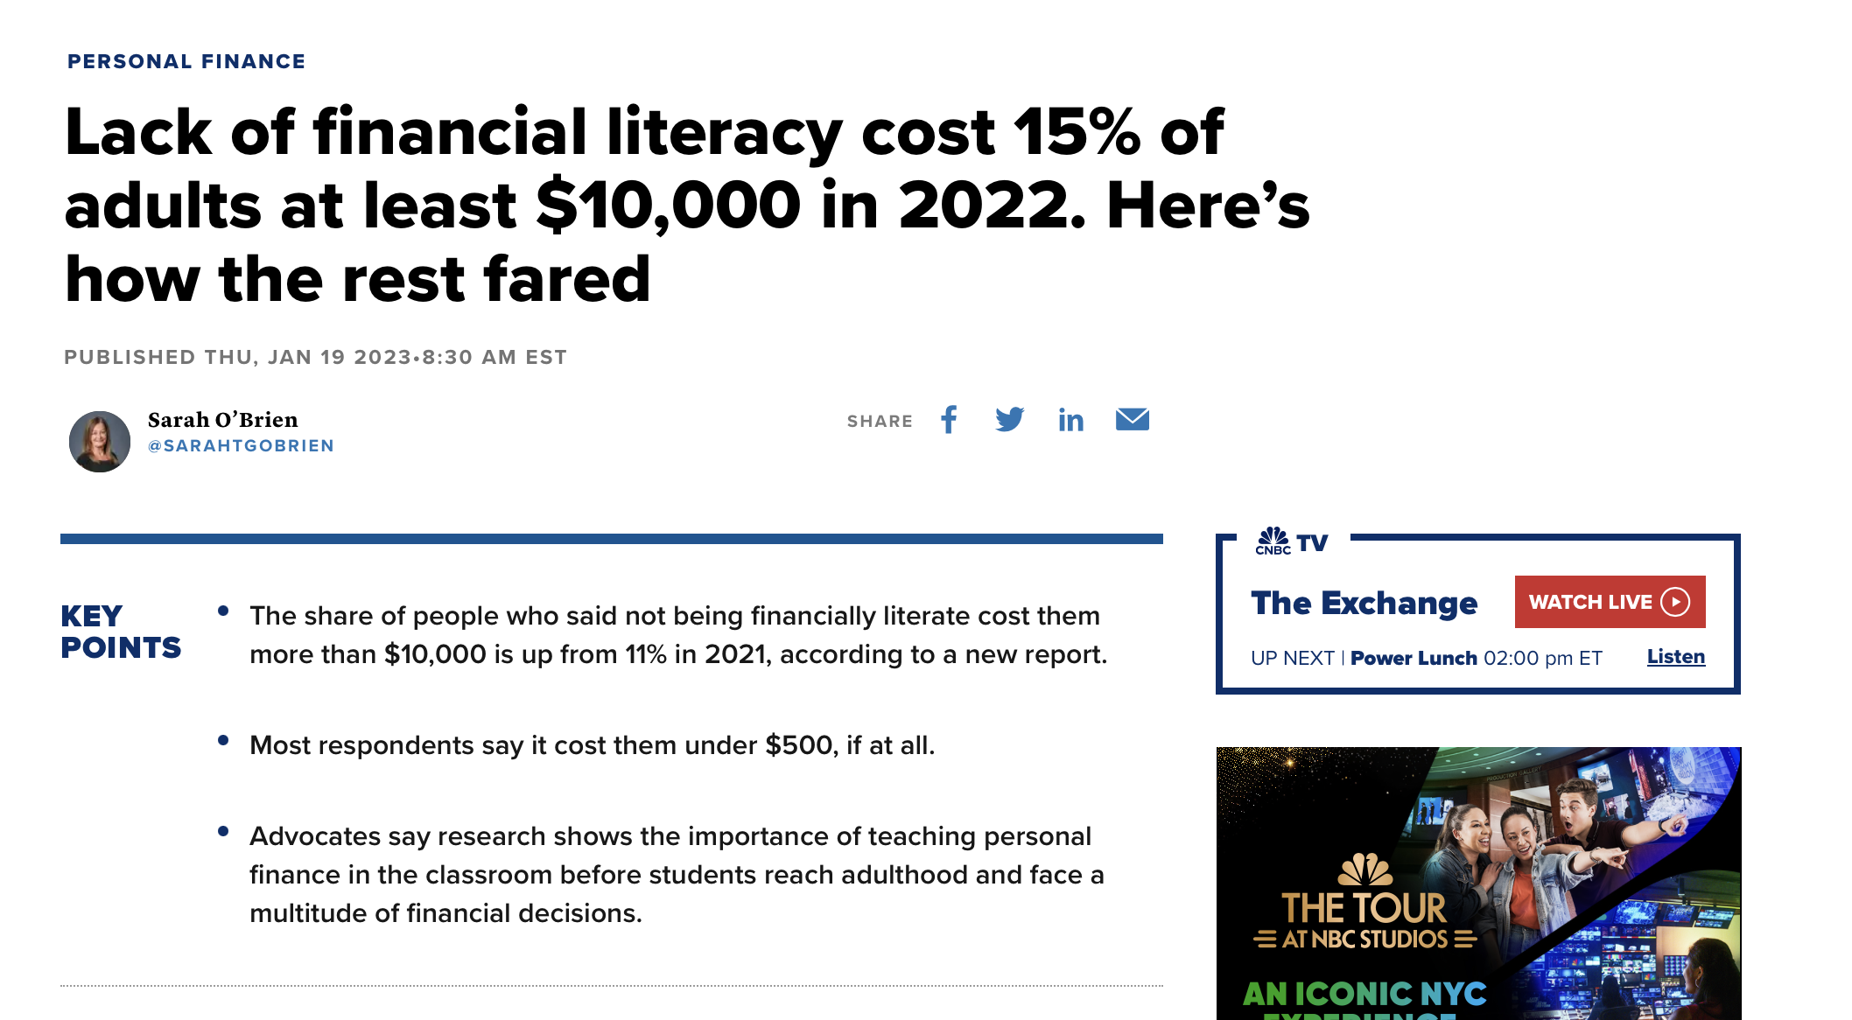
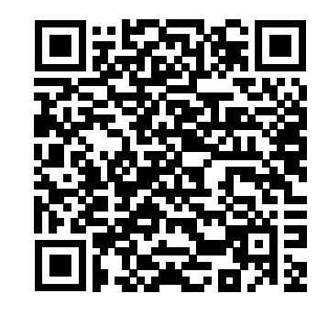
Lack of financial literacy cost 15%% of adults at least $$$10000.
Notes:
“For Gen Zers, emails, like business letters in the past, are for formal communications that require care over content and grammar, such as exchanges with professors and employers. Some students”
“expressed an intense dislike of emailing, finding the composition of an email message—to a faculty member, for example—burdensome in its formality and too time-consuming”
Excerpt From
Gen Z, Explained: the Art of Living in a Digital Age
Roberta Katz
https://itunes.apple.com/WebObjects/MZStore.woa/wa/viewBook?id=0
This material may be protected by copyright.

Slide 8
What does it take to waste $10000 a year?
Just 27.40 a day in miscellaneous spending

Slide 9
FINRA Literacy quiz
Notes:
“For Gen Zers, emails, like business letters in the past, are for formal communications that require care over content and grammar, such as exchanges with professors and employers. Some students”
“expressed an intense dislike of emailing, finding the composition of an email message—to a faculty member, for example—burdensome in its formality and too time-consuming”
Excerpt From
Gen Z, Explained: the Art of Living in a Digital Age
Roberta Katz
https://itunes.apple.com/WebObjects/MZStore.woa/wa/viewBook?id=0
This material may be protected by copyright.

Slide 10
Notes:
Americans had varying degrees of concern about their personal finances heading into 2023. Of the 29 percent expecting their finances to get worse in the new year, 18 percent see their finances getting somewhat worse, while 11 percent are bracing for their finances to worsen significantly.
That was also true for Americans expecting improvement. The 34 percent who foresee a boost to their finances include 10 percent who expect their finances to get significantly better and 24 percent who expect it to get somewhat better.
White Americans are more than twice as likely as Black Americans to expect their finances to get worse next year (at 32 percent and 15 percent, respectively), while 27 percent of Hispanic Americans expect their wallets to worsen. At the same time, 51 percent of Black Americans expect improvement versus 30 percent of White Americans and 37 percent of Hispanic Americans.
Nearly half of individuals earning $100,000 or more a year expect improvement next year (at 46 percent), compared with 35 percent of those making between $80,000 and $99,999, 28 percent of those earning between $50,000 and $79,999 and 35 percent of those earning under $50,000.
Younger generations were also more upbeat about their financial prospects next year, with 48 percent of both Generation Z (those between the ages of 18- 25) and millennials (ages 26-41) expecting their finances to improve in 2023, versus 28 percent of Gen X (ages 42-57) and 22 percent of baby boomers (ages 58-76).
Americans with poor financial outlook point to inflation
The Americans who do not expect their finances to improve next year are overwhelmingly pointing fingers at inflation.
More than 3 in 5 (or 63 percent) say continued high inflation will be the reason their finances do not improve, more than any other category, including:
The work of elected officials (29 percent);
Stagnant wages or reduced income (27 percent); and
Changing interest rates (25 percent).
Meanwhile, 18 percent each say the amount of debt they have or the amount they make from their savings or investments will be what holds them back. Another 16 percent blame a change in life circumstances, along with 12 percent who say they don’t know why they don’t expect their finances to improve and 8 percent who blame something else.
Inflation was the No. 1 reason why these Americans don’t expect to see financial improvement next year across demographics and socioeconomic categories, though some indicated more concern about price pressures than others — particularly older Americans. Two in 3 Gen Xers and boomers (or 66 percent and 73 percent, respectively) blamed inflation for their expected troubles next year versus 38 percent of Gen Z and 55 percent of millennials.
Fed research shows inflation often hits older generations harder, as they’re more likely to be nearing the end of their careers or living off of a fixed income. Younger generations were also more likely than their older counterparts to say their pay has kept pace with inflation in a separate Bankrate poll from September.
Here’s what Americans think could potentially help their wallets next year
Even if inflation falls next year, households aren’t expecting it to help them much. Just 19 percent of those expecting better days for their wallets in 2023 say lower levels of inflation will be what helps them out.
Instead, the most prominent reason for those gains are:
Making more money at work (41 percent);
Having less debt (30 percent);
A change in life circumstances, such as family or health (25 percent); and
Earning more money on their savings and retirement investments (24 percent).
An additional 5 percent say they don’t know why they expect their finances to improve next year, while 9 percent cited something else.
Americans most likely to say paying down debt or budgeting better is their top financial goal for 2023
More often than not, Americans have a specific set of financial goals for 2023, even as high inflation makes it tougher to budget and save.
The top goals include:
Paying down debt (19 percent);
Budgeting spending better (16 percent);
Saving more for emergencies (13 percent);
Saving more for retirement (9 percent);
Many Americans are also prioritizing finding a higher-paying job (8 percent), saving for a non-essential purchase such as a vacation or big-ticket item (7 percent), buying a new home (5 percent) or investing more money (5 percent).
Paying down debt and budgeting better were the top two goals for all Americans, except for the highest-income households, whose top two goals were paying down debt (17 percent) and saving more for retirement (16 percent).
“Americans’ financial goals reflect an expectation of tougher times to come, with households focused on paying down debt, budgeting better and saving more for emergencies in 2023,” McBride says. “High inflation and rising interest rates are squeezing budgets while the additional savings compiled during the pandemic are depleting, highlighting the course corrections Americans are looking to make with their finances.”
Methodology
Bankrate.com commissioned YouGov Plc to conduct the survey. All figures, unless otherwise stated, are from YouGov Plc. Total sample size was 3,656 U.S. adults. Fieldwork was undertaken on November 15-18, 2022. The survey was carried out online and meets rigorous quality standards. It employed a non-probability-based sample using both quotas upfront during collection and then a weighting scheme on the back end designed and proven to provide nationally representative results.

Slide 11
We need to teach Personal Finance

Slide 13
What is the average credit card debt held by Gen Z?

Slide 14
$2,312

Slide 15
Can you share any insights on how prevalent credit card debt is among your students?
Do you think that students generally have a good understanding of responsible credit card use?
Are there any specific courses or resources available at the institution to educate students about managing their finances and avoiding credit card debt?
Have you noticed any patterns or factors that contribute to students accumulating credit card debt?
Are your international students getting any help to understand how credit scores are computed in the US?
What state has the highest financial literacy?

Slide 16
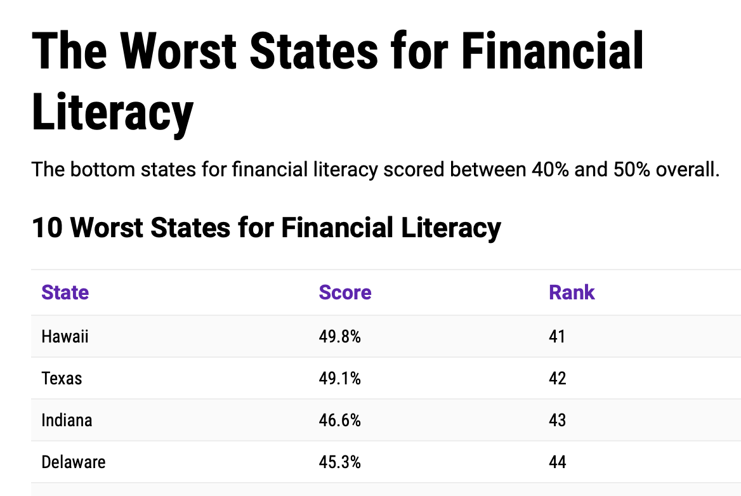
Best and Worst States for Financial Literacy in 2023
Notes:
10 Best States for Financial Literacy
StateScoreRankNew Hampshire79.9%1Virginia79.7%2Nebraska78.6%3North Carolina76.0%4Georgia75.0%5Ohio74.6%6Maryland72.0%7Connecticut71.4%8New Jersey70.4%9Rhode Island70.1%10
The Worst States for Financial Literacy
The bottom states for financial literacy scored between 40% and 50% overall.
10 Worst States for Financial Literacy
StateScoreRankHawaii49.8%41Texas49.1%42Indiana46.6%43Delaware45.3%44Alaska45.0%45Idaho44.0%46Kentucky43.8%47Louisiana43.5%48California42.9%49Nevada40.0%50
How Can You Measure Financial Literacy?
Financial literacy is how much someone understands basic money management concepts that lead to building savings and wealth throughout a lifetime. These include knowing how to balance a checkbook, paying down credit card debt and applying for a mortgage. Plus, it’s important to understand inflation, budgeting, compound interest and investing strategies.
Short of asking every American if they know the difference between a FICO score and VantageScore, we focused on how states support financial literacy at a policy level.
Are they offering courses for students in high school and college, providing easily accessible resources for adults and supporting consumer protections like legislative limits on predatory lending?
Financial literacy isn’t just about understanding key financial topics. It’s also important to be financially resilient, which means being able to withstand financial downturns.
Financial resiliency became important to policymakers during the 2009 Great Recession.
Since then, research on financial literacy has created a push to require financial literacy courses in the classroom.
Recently, the COVID-19 pandemic and economic downturn led to many Americans losing their jobs or taking a pay cut, which impacted their financial resiliency.
Back to top ↑
Ranking Factors for Financial Literacy
The six ranking factors we used to evaluate states on financial literacy comprise 27 total evaluation criteria including credit scores and historic unemployment in each state. From there, states received a score in each individual category, and then the scores were weighted based on the importance of the category.
Our scoring breakdown for each state is:
Personal Consumption (Weight = 25%)
Earning (Weight = 10%)
Knowledge (Weight = 2.5%)
Investing and Savings (Weight = 2.5%)
State Policy (Weight = 50%)
Resilience (Weight = 10%)
The weighted scale allowed the evaluation of each state to be based on criteria related to policy and programs instead of individual financial success.
Consumption (25% of score)
Consumption measures the general financial well-being of a state’s population.
We included data points such as FICO credit score, credit card debt, bankruptcy rates and homeownership rates.
We also included the average APR for payday loans; states with lower APRs received more points.
Earning (10% of score)
Individual earnings are an important part of the score because state policies can influence earnings for marginalized groups. The median household income across all 50 states is $66,644.
We also looked at disparities among white, Black, Native American, Asian-Pacific Islander, Hispanic/Latino and multiracial populations, as well as disparities between male and female earnings.
Pay disparities were calculated based on how many cents to the dollar a marginalized group made compared to the average white man.
Decreasing wage disparities has the potential to increase financial resiliency among a state’s entire population.
Financial Knowledge (2.5%)
We looked at self-reported knowledge of financial literacy reported in a survey by the Financial Industry Regulatory Authority’s educational arm. The focus was on knowledge about four key financial terms.
54% of respondents understood inflation.
70% of Americans understood compound interest.
71% of people surveyed understood mortgage interest.
Only 25% of Americans understand bonds and how interest rates affect bond prices.
Investing and Saving (2.5%)
We focused on data points such as average retirement savings to understand investing and saving rates in each state. The average retirement savings amount across all 50 states is $427,918.
In eight states, mandated retirement plans are available, according to ADP, Inc. This means that states require employers to provide retirement savings opportunities through savings vehicles such as a Roth IRA with payroll deductions.
In total, 13 states have signed state-mandated retirement plans into law. Five of those states have scheduled implementation of retirement plans.
An additional two states have passed the law but have not scheduled implementation of the retirement plan yet.
State Policy Around Resilience and Education (50%)
We weighed state policy the most heavily, as it best indicates what states are doing to support financial literacy.
We looked at Next Gen Personal Finance’s 2023 State of Financial Education report, which measures the number of students in each state required to take a financial literacy course to graduate from high school, as well as the number of students who had access to a stand-alone financial literacy course.
Thirty-three states — or 66% — do not require students to take a standalone financial literacy course to graduate.
Less than half of all American students (43%) have access to financial literacy courses.
We also looked at policies that limit or ban predatory payday loans, as well as states that automatically contribute to or match contributions to college savings funds.
23 states have limited payday loan safeguards while only 18 states have laws to prohibit payday loans or set low-interest rate limits.
To help families save for college, 16 states offer free money through 529 Savings Plans, up to $5,400.
Finally, we looked at the average minimum wage in each state, with states with higher minimum wages receiving more points.
46 states have set a state minimum wage.
The average state minimum wage is $10.41, which is more than $3 above the federal minimum wage.
Financial Resiliency (10%)
Lastly, we examined the overall financial resiliency of each state’s population.
We looked at the affordability index for each state and found that Mississippi was the most affordable state while Hawaii was the least affordable state.
The most expensive regions to live in the U.S. were in the northeast and west coast, plus Hawaii and Alaska.
The least expensive areas were the midwest and southern states.
Examining historical unemployment data from January 2000 – January 2023, we found the historical U.S. average unemployment rate was 5.47%.
North Dakota had the lowest historical unemployment rate at 3.10%.
Nevada registered the highest historical unemployment rate at 7.20%.
Back to top ↑
How States Scored for Financial Literacy
The Top States for Financial Literacy
Each of the 10 best states for financial literacy excels at something different.
New Hampshire (#1), Connecticut (#8) and New Jersey (#9) score the highest for investing and saving while Maryland (#7) and Georgia (#5) have the best earnings in the country. Virginia (#2) scored the highest out of any state for policies supporting resilience and education, with Nebraska (#3) and Ohio (#6) close behind.
Two states in the top 10 — Maryland (#7) and Connecticut (#8) — have state-mandated retirement programs.
Only one state in the top 10 — Nebraska (#3) — received a perfect score for financial resilience.
But even the top-ranking states have room for improvement. Virginia (#2), Nebraska (#3) and North Carolina (#4) all reported low earnings. Nebraska (#3) and Rhode Island (#10) scored low for investing and saving. Georgia (#5) surveyed in the bottom percentile for financial knowledge.
But all of the states in the top 10 reported policies that support education and resilience, receiving a passing grade. And every top-10 state also scored well for overall general financial well-being.
The Bottom States for Financial Literacy
The 10 worst states for financial literacy did not achieve a passing grade.
While we can’t say that financial illiteracy is rampant in these states, we do know that they do not offer well-rounded state programming, policies or education supporting financial resilience and literacy.
Delaware (#44) and Nevada (#50) scored the lowest out of any state for policies supporting resilience and education. Louisiana (#48) also scored the lowest of any state for financial knowledge.
Hawaii (#41) and California (#49) do not have a great track record with financial resilience.
Idaho (#46), Kentucky (#47) and Nevada (#50) are all tied as the worst states for general financial well-being.
On the other hand, Texas (#42), Indiana (#43), Idaho (#46) and Louisiana (#48) all do well with affordability and have low historic unemployment rates. California (#49) is the only state in the bottom 10 that has a state-mandated retirement plan. Alaska (#45) prioritizes investing and saving and Hawaii (#41) has strong financial well-being.
Delaware (#44) is close behind for both financial well-being and investing and saving.
Back to top ↑
What Can States Do to Support Financial Literacy and Resilience?
In our research, we found that states have a lot of power to support financial literacy and resilience. Requiring financial literacy education, limiting payday loans and mandating a livable minimum wage could vastly improve the financial standing of many constituents.
A Wake Forest Middle School student learns about how to manage expenses for things like housing, transportation and food during the Reality of Money Financial Literacy Fair at the school. Photo courtesy of Wake County Public SchoolRequire Financial Literacy Education
Most states in the U.S. (66%) do not require financial literacy education for students. Adding in a required course for high school students increases the likelihood of financial resilience and literacy in adulthood.
However, while most states do not require financial literacy courses, many offer the course as an elective in high school.
We found that 78.7% of students have the option to take a financial literacy course.
However, only 43% are required to take a financial literacy course to graduate.
Limit Payday Loans
Payday loans are generally short-term, high-cost loans for $500 or less that are paid back to the lender when the borrower receives their next paycheck. But many borrowers renew the loans repeatedly, causing their debt to snowball.
Currently, 23 states do not have any protections for payday loans. That means lenders can charge exorbitant fees and interest rates to borrowers who need cash quickly.
In Idaho, a $500 payday loan costs $1,000 with an average APR (annual percentage rate) of 652%.
An easy fix is to follow the 18 states that have “strong laws that prohibit payday loans or set low interest rate limits,” as The Pew Charitable Trusts noted.
Payday lenders do not operate in those 18 states.
Mandate Livable Minimum Wage
The federal minimum wage has been stagnant at $7.25 an hour since 2009. If it were keeping pace with inflation, it would be $10.33 now. While many states have raised their minimum wage since then to an average of $10.41, it’s still not a livable wage in the current U.S. economic climate.
18 states have also scheduled annual minimum wage adjustments based on the cost of living and previous state-wide votes.
An analysis by Amy Glassier, professor of Economic Geography and Regional Planning at MIT, found that a minimum wage of $25.02 would be sustainable for a family of four with two working adults and two children. Yet Oxfam America reports that 31.9% of Americans earn less than $15 an hour.
That’s an increase of 245% from the current federal minimum wage.
A $25.02 minimum wage would equal an income of $104,077.70 per year.
Mandating a livable minimum wage would allow people to work and save money, increasing their financial resiliency in the event of an economic downturn or emergency.
Back to top ↑
Resources for Financial Literacy
If you’re living in a state that’s not supporting financial literacy, you may be wondering how you can actually learn how to be financially literate. Turns out, you don’t need a high school course — although, that sure helps.
The Penny Hoarder has resources that are accessible now and free to use.
Credit score reports can be tricky to understand, but they’re important if you want to get a loan or buy a house. Here’s what’s in a credit report.
What is a good credit score? We’ve got the lowdown.
Saving money for retirement is key to securing a strong financial future. Get started today with our guide.
Paying off debt is one of the first steps toward financial resiliency. But how can you pay off credit card debt? We’ve got some ideas.
Looking for advice on how to budget? We’ve got a five-step guide that can help.
Ready to be an insider? Sign up for The Penny Hoarder newsletter for financial tips each week.
We also found government resources:
Interested in learning more about auto loans, home refinancing and everything in between? Tools and tips from the Consumer Financial Protection Bureau can help.
The National Credit Union Administration has a whole page with financial literacy resources and guidance.
Looking for more resources? The Office of the Comptroller of the Currency has a whole resource directory for financial literacy.
Back to top ↑

Slide 17
Gen Z’ problems
Have inadequate financial knowledge
When tested on financial concepts, only 24% demonstrated basic financial knowledge.
Worry about student loans
When asked about their ability to repay their student loan debt, more than 54% of Millennials expressed concern.
Debt crosses economic and educational lines
Among college-educated Millennials (80%), a staggering 81% have at least one long- term debt.
Are financially fragile
Nearly 30% of Millennials are overdrawing on their checking accounts.
Sacrifice retirement accounts
More than 20% of Millennials with retirement accounts took loans or hardship withdrawals in the past year.
Don’t seek professional financial help Even with inadequate knowledge, only 27% of Millennials are seeking professional financial advice on saving and investment.
Notes:
Gen Z, the generation born between the mid-1990s and early 2010s, faces several unique challenges and issues when it comes to personal finance. Here are some common concerns and problems that Gen Z individuals may encounter:
Student Loan Debt: Many Gen Z individuals pursue higher education, often resulting in substantial student loan debt. Managing this debt while also trying to establish financial stability can be overwhelming.
High Cost of Living: Gen Z faces the rising cost of living, including expenses such as housing, healthcare, and transportation. These costs can put significant pressure on their financial well-being, especially considering entry-level job opportunities and lower starting salaries.
Limited Job Opportunities: The job market can be highly competitive, making it difficult for Gen Z to secure stable employment. The gig economy and the prevalence of contract or freelance work may lead to irregular income and financial uncertainty.
Lack of Financial Education: Gen Z may not receive sufficient financial education in school or from their families. This can result in limited knowledge about budgeting, saving, investing, and managing debt, leaving them ill-prepared to make informed financial decisions.
Impulsive Spending and Peer Pressure: Gen Z grew up in an era of social media and online shopping, which can lead to impulsive spending habits. The pressure to keep up with trends and the desire for instant gratification can contribute to overspending and financial instability.
Saving for the Future: With retirement seeming far off and immediate financial concerns, Gen Z may struggle to prioritize saving for the future. Lack of awareness about retirement planning and the benefits of long-term savings can hinder their ability to build wealth over time.
Economic Uncertainty: Gen Z has witnessed economic downturns, such as the 2008 financial crisis and the COVID-19 pandemic. These events can create a sense of financial insecurity and anxiety about their economic future.
Addressing these issues requires a multi-faceted approach. Some possible solutions include:
Incorporating comprehensive financial literacy education into school curricula to equip Gen Z with essential money management skills.
Encouraging open conversations about personal finance within families, providing guidance and support.
Promoting access to affordable education and resources to help manage student loan debt effectively.
Advocating for policies that support job creation and stable employment opportunities for young adults.
Encouraging saving habits and long-term financial planning, emphasizing the benefits of compound interest and retirement savings.
Providing mentorship and guidance from financial professionals or organizations specializing in supporting Gen Z with personal finance challenges.
By addressing these issues and providing the necessary tools and support, Gen Z can gain the confidence and knowledge needed to navigate personal finance successfully and build a solid foundation for their future financial well-being.

Slide 18
Millennials are unprepared for an emergency
53%carried overall credit card balance in the last 12 months
50%of Millennials don’t believe they could come up with $2,000 if an unexpected need arose within the next month
30%of Millennials are overdrawing on their checking accounts

Slide 19
Millennials have high debt

Slide 20
We need to help our students

Slide 21
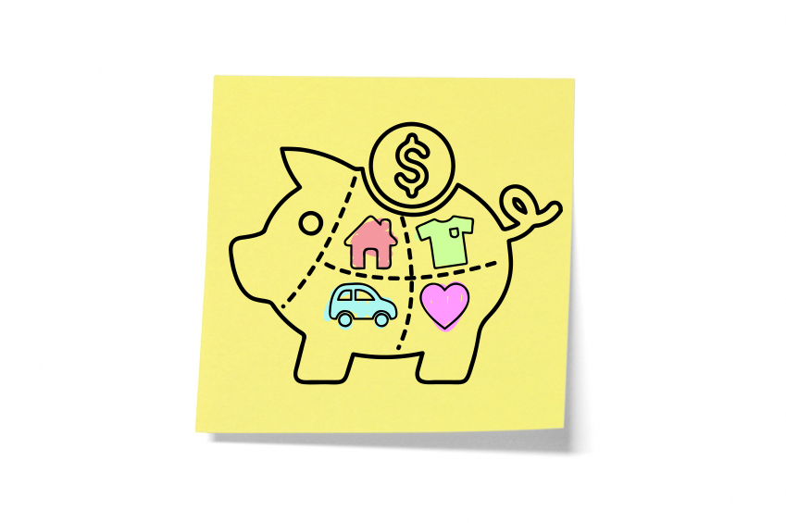
GOAL
Foster group interaction
Learn Personal Finance concepts
Guide student through the planning process
Steps through collecting data
Learn how to incorporate feedback
Peer to peer instruction

Slide 22
Open Pedagogy
”The set of pedagogical practices that include engaging students in content creation and making learning accessible is known as open pedagogy.”
Notes:
Florencia
Open pedagogy is an educational approach that emphasizes openness, collaboration, and learner empowerment. It is closely aligned with the broader concept of open education, which advocates for the free and open sharing of educational resources, knowledge, and practices.
Open pedagogy encourages educators to go beyond traditional models of teaching and learning by involving students in the creation, sharing, and collaborative development of knowledge. It seeks to foster active engagement, critical thinking, and creativity among learners. Some key elements of open pedagogy include:
Open Educational Resources (OER): Open pedagogy often utilizes freely available and openly licensed educational resources, such as textbooks, articles, multimedia materials, and software. OER can be adapted, remixed, and shared, allowing for greater accessibility and customization of learning materials.
Student Participation: Open pedagogy emphasizes involving students as active participants in the learning process. It encourages students to contribute to the creation and sharing of knowledge, engage in collaborative projects, and provide input into course design and assessment methods.
Authentic Assessment: Open pedagogy promotes the use of authentic and meaningful assessments that go beyond traditional exams and quizzes. It encourages students to demonstrate their learning through real-world projects, presentations, portfolios, and other forms of assessment that reflect the complexity of the subject matter.
Collaboration and Networking: Open pedagogy emphasizes collaboration and networking among learners. It encourages students to connect with peers, experts, and communities outside the classroom through online platforms, social media, and open educational practices. This allows for the exchange of ideas, perspectives, and resources beyond the confines of the traditional learning environment.
Reflective Practice: Open pedagogy encourages educators and students to engage in reflective practice, critically examining and evaluating their learning experiences, processes, and outcomes. Reflective practice enables learners to understand their own strengths and areas for improvement, fostering metacognition and self-directed learning.
Ethical Considerations: Open pedagogy promotes ethical considerations related to openness, copyright, and intellectual property. It encourages educators and learners to respect licensing agreements, attribute sources properly, and understand the legal and ethical implications of sharing and using open educational resources.
By embracing open pedagogy, educators can create inclusive, collaborative, and learner-centered environments that promote active engagement and empower students as co-creators of knowledge. It can help foster a culture of openness, critical inquiry, and lifelong learning.

Slide 24
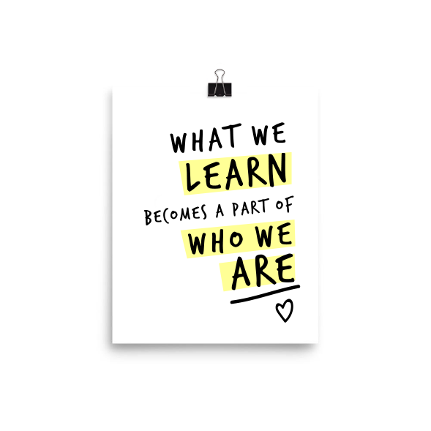
Benefits
Active Learning
Project based Learning

Slide 25
Seven Principles of Good Practice in Education that are still a cornerstone of pedagogy.
1. Encourage contact between students and teachers
2. Develop reciprocity and cooperation among students
3. Encourage active learning
4. Give prompt feedback
5. Emphasize time on task
6. Communicate high expectations
7. Respect diverse talents and ways of learning
15
Notes:
.

Slide 26
Audience
This project is can be used in high schools, community colleges and college programs.
Can be used in traditional settings, flipped classrooms, and online classes.
The idea is to make this project useful for themselves and their friends in the same age group.
15
Notes:
.

Slide 28
Set a goal

Slide 31
Concept Map
Helps students brainstorm and generate new ideas
Encourages students to discover new concepts and the propositions that connect them
Allows students to more clearly communicate ideas, thoughts and information
Helps students integrate new concepts with older concepts
Enables students to gain enhanced knowledge of any topic and evaluate the information

Slide 33
VIDEOS
Notes:
https://www.youtube.com/watch?v=duC6RJQiaNw
CLICK ON THE ICON TO SHOW VIDEO

Slide 34
Pedagogy of Students Creating Videos
Clear learning goals
Encourage exploration
Embedded assessment
Intrinsic and extrinsic motivation
Support autonomy
Productive failure

Slide 35
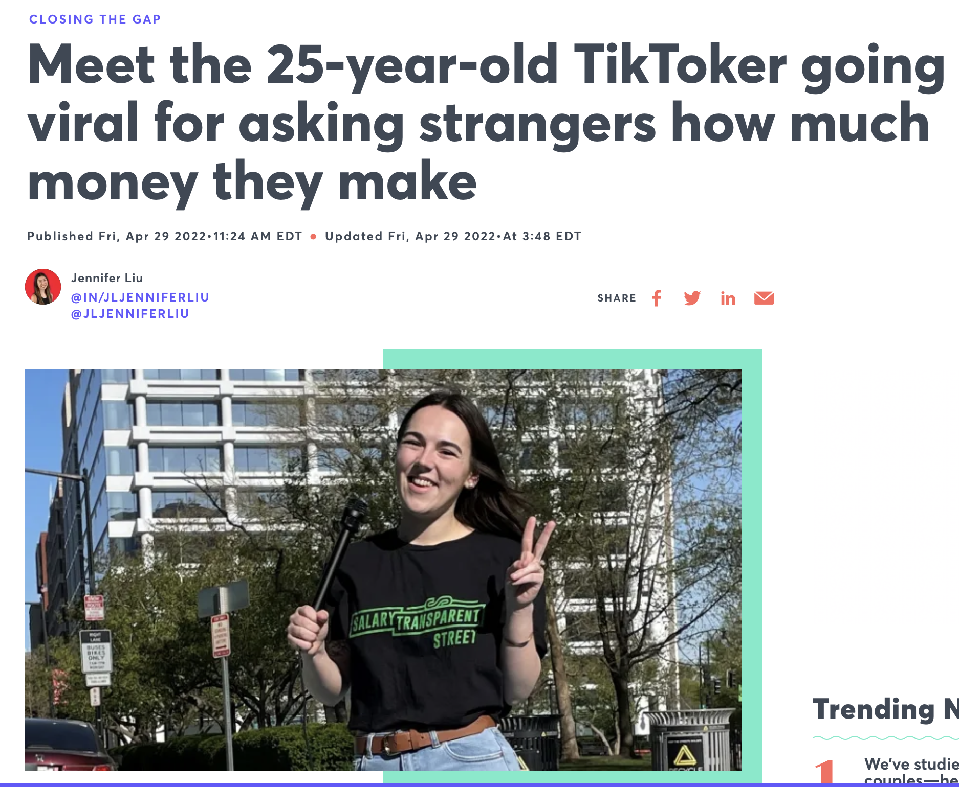
Media coverage of pfin/ Influencer culture
https://www.youtube.com/watch?v=IoLyOqxahGo
Notes:
students as influencers on campus:
We can ideas on this slide as its in a good location within the presentation.
nfluencer culture can work well for college students for several reasons:
Relatability: College students often find influencers who are in the same age group relatable. They share similar experiences, challenges, and interests, which can make the content more engaging and relatable.
Authenticity: Many influencers, especially those who cater to college students, are seen as authentic and genuine. They often share their personal experiences, struggles, and successes, which can resonate with their audience.
Peer Influence: College students are highly influenced by their peers. When their friends or fellow students follow and engage with influencers, it can encourage others to do the same, creating a sense of community and shared interests.
Aspirational Content: Influencers often showcase a lifestyle that college students aspire to have, which can be motivational and inspirational. This can include aspects like fashion, travel, fitness, or entrepreneurship.
Accessibility: Social media platforms make it easy for college students to access and engage with influencer content. It's convenient to follow, like, comment, and share posts, which can create a sense of connection with the influencer.
Escapism: College life can be stressful, and influencer content can serve as a form of escapism. It provides a break from academic pressures and offers entertainment and distraction.
Product Recommendations: Many influencers promote products and services, and college students may rely on influencer recommendations for making purchasing decisions, from fashion to study tools.
Social Validation: Following popular influencers can give college students a sense of belonging and validation. They can feel part of a larger online community, which can be comforting, especially during times of stress or loneliness.
Trends and FOMO (Fear of Missing Out): Influencers often showcase the latest trends, whether in fashion, technology, or experiences. College students may feel a strong desire to stay up-to-date and not miss out on what's trending.
Entertainment and Education: Influencers often combine entertainment with educational content. College students can learn valuable information, tips, and tricks while being entertained, making it a productive use of their time.
Overall, the influencer culture resonates with college students because it taps into their desire for connection, relatability, and inspiration, while also providing a form of entertainment and guidance in various aspects of their lives.

Slide 36
Technology has many advantages
TEACHER
Focus on content and more application of material to new context
Just in Time Teaching
Improved feedback
STUDENT
Prepare for the future workplace
Motivation/more collaboration
Flexibility
Customization
Multiple points to entry to every concept
7
Notes:
Teaching Naked" is a book by José Antonio Bowen that emphasizes the importance of rethinking and redesigning higher education teaching practices to enhance student learning. Here's a summarized overview of the main ideas in the book:
Digital Technology and Face-to-Face Learning: The book argues that technology should be used to enhance in-person, face-to-face teaching rather than replace it. Bowen suggests that instructors should utilize technology outside the classroom to deliver content (e.g., lectures, readings) and create active, engaging, and interactive learning experiences inside the classroom.
Flipped Classroom Model: One of the central concepts is the idea of the "flipped classroom." In this model, traditional lecture-style content delivery is moved outside of class (e.g., through video lectures or online readings), allowing class time to be used for interactive discussions, problem-solving, and active learning activities.
Active Learning Strategies: Bowen promotes various active learning strategies within the classroom, such as group discussions, case studies, problem-solving exercises, and peer teaching. These methods encourage students to engage with the material, apply concepts, and collaborate with their peers.
Technology Integration: The book emphasizes the importance of integrating technology effectively into the teaching process. It suggests that instructors should carefully select and use digital tools to enhance the learning experience, focusing on activities that promote critical thinking, creativity, and deeper understanding.
Assessment and Feedback: Bowen discusses the significance of ongoing assessment and feedback to gauge student progress and adjust teaching methods accordingly. Formative assessment techniques are highlighted as a means of guiding instructional decisions.
Building Relationships: The author emphasizes the importance of building relationships between instructors and students. Engaging with students personally, offering support, and providing timely feedback can lead to improved learning outcomes.
Transparency in Teaching: Transparency in course design and expectations is encouraged. Clearly communicating learning objectives, assessment criteria, and the rationale behind teaching methods helps students better understand and engage with the learning process.
Lifelong Learning: "Teaching Naked" advocates for instructors to continually evolve their teaching methods and adapt to changing student needs and technological advancements. Lifelong learning is key to effective teaching.
Overall, "Teaching Naked" encourages educators to rethink their teaching approaches, incorporating technology strategically and fostering active, engaged, and student-centered learning experiences to improve outcomes in higher education.

Slide 37
Why Videos?
Videos are 4 x times more engaging than static content
Video combines auditory & visual sense
The average viewer remembers 95% of a message when it is watched, whereas only 10% when read
Has the ability to encompass all the other types of content. A video can include text, music, photographs, links, and even podcasts. No other medium has this ability
Notes:
Using videos as a teaching tool offers several benefits for both instructors and students. Here are some of the advantages of incorporating videos into the teaching and learning process:
Enhanced Engagement: Videos can capture students' attention and make complex topics more interesting and accessible. Visual and auditory elements can engage multiple senses, increasing overall engagement in the learning process.
Improved Comprehension: Videos can effectively illustrate abstract concepts, demonstrate procedures, and provide real-world examples, helping students better understand and retain information.
Accessibility: Videos can be accessed on-demand, allowing students to review content at their own pace and convenience, which can be especially beneficial for remote or asynchronous learning environments.
Variety of Content: Videos can showcase a wide range of content types, such as documentaries, animations, interviews, demonstrations, and simulations, providing diverse learning experiences.
Flexibility: Instructors can choose from a variety of video sources, including existing educational content, custom-made videos, or third-party resources, to tailor their teaching materials to suit their objectives.
Self-Paced Learning: Videos allow students to pause, rewind, or fast-forward, enabling self-paced learning and accommodating different learning styles and preferences.
Accessibility Features: Many video platforms offer closed captioning and subtitles, making content more accessible to students with hearing impairments or those who prefer reading along.
Global Perspective: Videos can introduce students to different cultures, viewpoints, and perspectives, fostering a global mindset and promoting diversity and inclusion.
Enhanced Retention: Visual and auditory elements can enhance memory retention, helping students remember key concepts and details for a longer time.
Assessment Opportunities: Videos can be used as a basis for class discussions, group projects, or assignments, allowing for active learning and assessment of comprehension and critical thinking skills.
Real-Life Application: Videos can illustrate real-world scenarios and applications of theoretical knowledge, helping students connect academic concepts to practical situations.
Flipped Classroom: Videos can be used in a flipped classroom model, where students watch video lectures or content before class, allowing in-person class time for discussions, problem-solving, and hands-on activities.
Engagement Analytics: Some video platforms provide analytics on student engagement, allowing instructors to track student participation and identify areas where additional support may be needed.
Cost-Effective: Creating and using videos can be a cost-effective way to deliver lectures and educational content, reducing the need for physical materials and resources.
Scalability: Videos can be shared with a large number of students simultaneously, making them a scalable solution for both in-person and online courses.
While videos offer numerous benefits, it's important for instructors to use them thoughtfully, integrate them into the curriculum effectively, and ensure that they align with the course objectives and the needs of their students.
nfluencer culture can work well for college students for several reasons:
Relatability: College students often find influencers who are in the same age group relatable. They share similar experiences, challenges, and interests, which can make the content more engaging and relatable.
Authenticity: Many influencers, especially those who cater to college students, are seen as authentic and genuine. They often share their personal experiences, struggles, and successes, which can resonate with their audience.
Peer Influence: College students are highly influenced by their peers. When their friends or fellow students follow and engage with influencers, it can encourage others to do the same, creating a sense of community and shared interests.
Aspirational Content: Influencers often showcase a lifestyle that college students aspire to have, which can be motivational and inspirational. This can include aspects like fashion, travel, fitness, or entrepreneurship.
Accessibility: Social media platforms make it easy for college students to access and engage with influencer content. It's convenient to follow, like, comment, and share posts, which can create a sense of connection with the influencer.
Escapism: College life can be stressful, and influencer content can serve as a form of escapism. It provides a break from academic pressures and offers entertainment and distraction.
Product Recommendations: Many influencers promote products and services, and college students may rely on influencer recommendations for making purchasing decisions, from fashion to study tools.
Social Validation: Following popular influencers can give college students a sense of belonging and validation. They can feel part of a larger online community, which can be comforting, especially during times of stress or loneliness.
Trends and FOMO (Fear of Missing Out): Influencers often showcase the latest trends, whether in fashion, technology, or experiences. College students may feel a strong desire to stay up-to-date and not miss out on what's trending.
Entertainment and Education: Influencers often combine entertainment with educational content. College students can learn valuable information, tips, and tricks while being entertained, making it a productive use of their time.
Overall, the influencer culture resonates with college students because it taps into their desire for connection, relatability, and inspiration, while also providing a form of entertainment and guidance in various aspects of their lives.

Slide 38
What is your major?
What is your major?
Film/Video
Writing/Editing and Publishing
English Literature and Writing with a minor in management
Communications
Psychology
English
Communication and Media studies
Communication and Media Studies
History/Pre-Law
Communications
International Studies

Slide 39
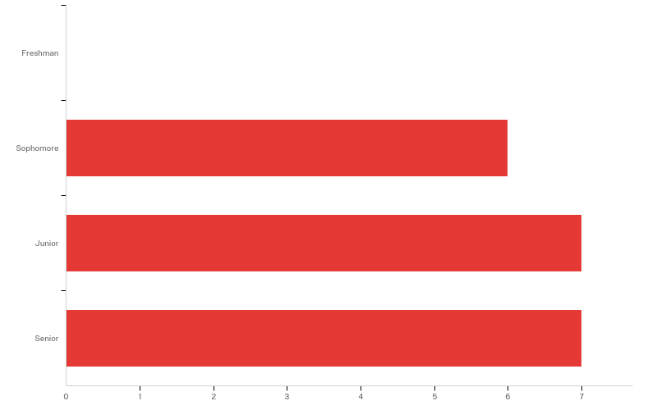
What year are you in?

Slide 40
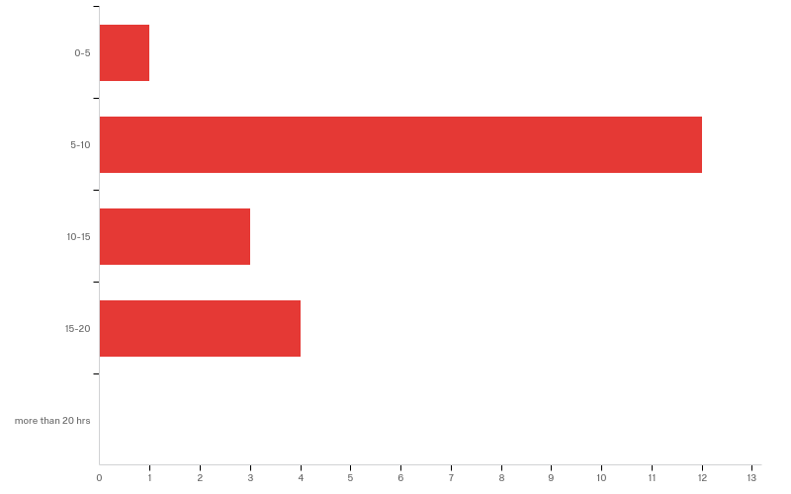
On average, how many hours have you spent preparing This Project?

Slide 41
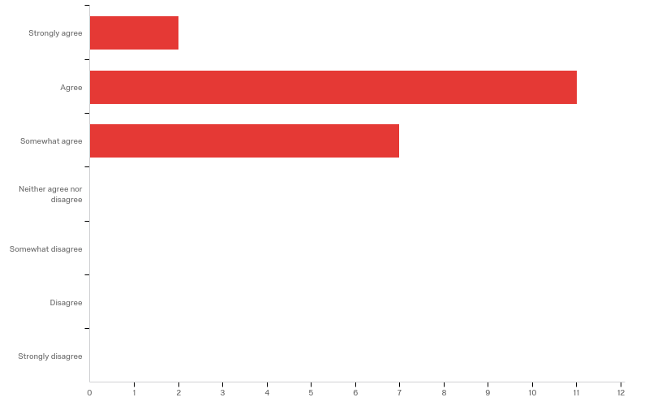
The Project help me identify the most important concepts taught in Personal Finance

Slide 42
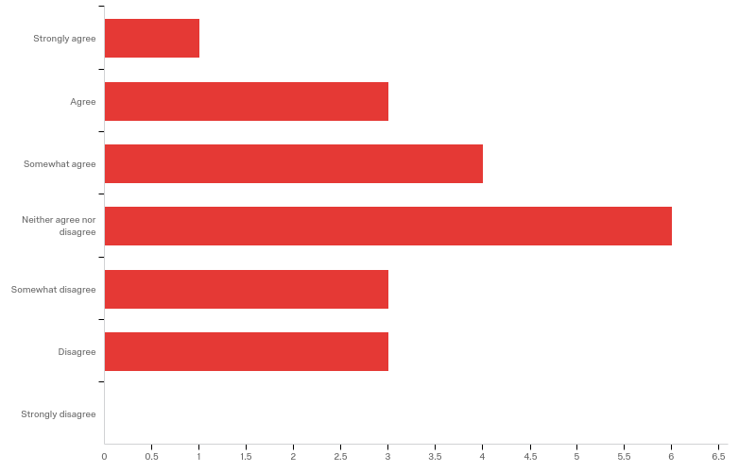
Doing the Project taught me a new way to study

Slide 43
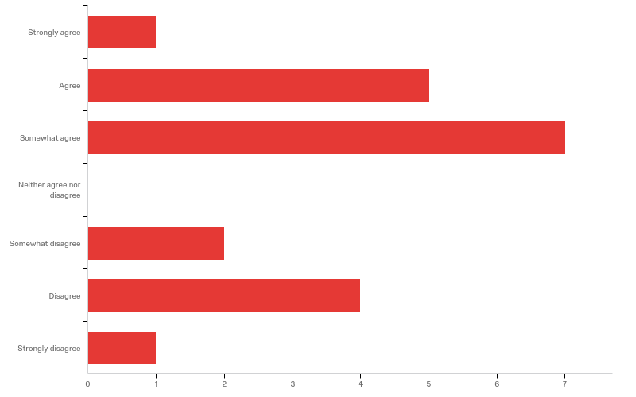
The LISI Project helped me identify concepts I should study for the exams

Slide 44
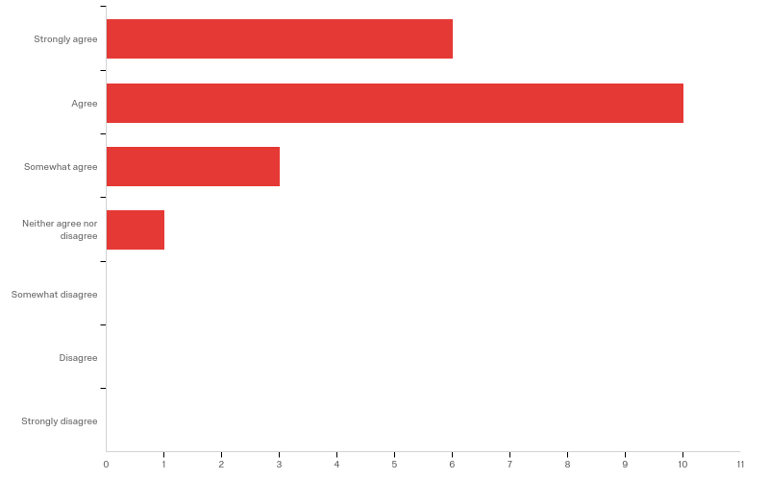
The Project helped me learn information that I will use in my life

Slide 45
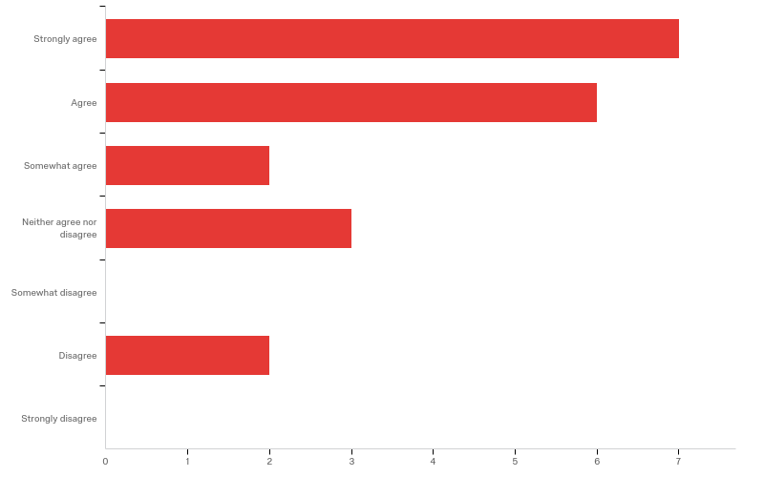
The Project made me aware of the patterns and behaviors that I have in when it comes to managing my finances.

Slide 46
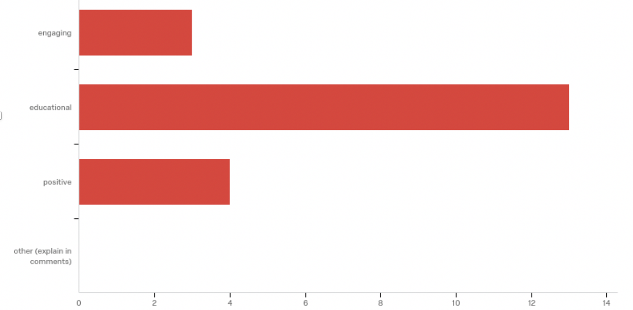
The Project was

Slide 47
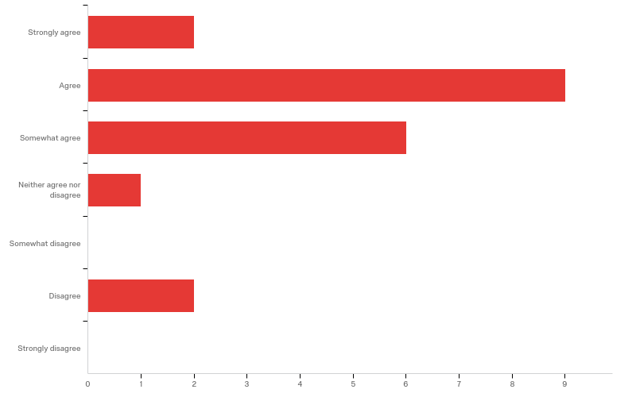
Creating and presenting a poster helped me learn about personal finance

Slide 48
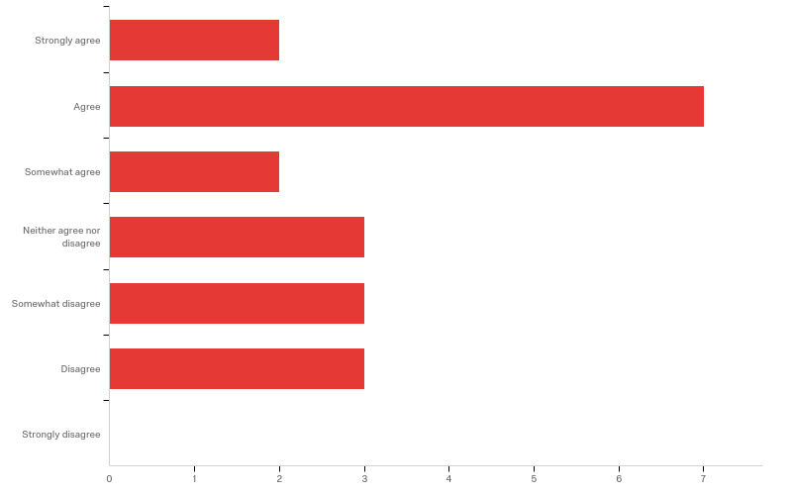
Creating a video helped me learn about personal finance

Slide 49
Best Practices
Key: 2 minutes!
The best engagement on videos that are roughly 2 minutes in length.
The longer a video, the lower its retention,.
Videos under 1 minute enjoy 80% viewer retention up to the 30-second mark, while videos 2-3 minutes in length still enjoy 60% retention. 5-10 minute videos still see over 50% viewer retention halfway through

Slide 50
Best Practices
Give feedback at each stage
Help students to do the project in small bits so it it not overwhelming
Emphasize the creation of short videos
Engage the community (invite your other classes, your peers, administrators)

Slide 51
Why this works: Increases retention
The project uses teaching techniques that the literature recommends to increase information retention such as
Concept Maps
Posters
Connect
Practice
Group work

Slide 52
Survey Says…
“The project was a great opportunity to show the groups creative and knowledgeable side.”
“I feel like I'm learning practical knowledge that I've been wanting to know for a while.”
“The course with the most real world applications I've taken”
“Helped me prepare for the future”
“I think this project offers crucial information in terms of having a healthy financial future.”
“We learned some practical tips about personal finance.”

Slide 53
Google Doc:

Slide 54
Acknowledgments:
Big Thank You to :
Martin Montt
Misty Wood
Steve DeMasco
Lenore Martin
Marina Gabriele
Rebecca Moryl
Kim Holder
Coqui Andreani
My students in MGMT 2111 – Personal Finance
Management and Economics Department

Slide 55
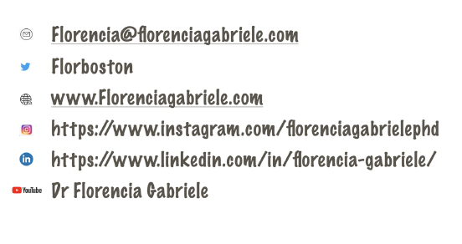
Thank you! Let’s stay in touch!

