Slide 1
Presented by: Dr. Cynthia Fitzthum
April 9th, 2024
Financial Literacy: Mastering Money Matters for High School Educators
Webinar 3: "Standard 3 - Saving: Building for the Future"

Slide 2
EconEdLink Membership
You can now access CEE’s professional development webinars directly on EconEdLink.org! To receive these new professional development benefits, become an EconEdLink member. As a member, you will now be able to:
Automatically receive a professional development certificate via e-mail within 24 hours after viewing any webinar for a minimum of 45 minutes
Register for upcoming webinars with a simple one-click process
Easily download presentations, lesson plan materials and activities for each webinar
Search and view all webinars at your convenience
Save webinars to your EconEdLink dashboard for easy access to the event
Access our new Professional Development page here

Slide 3
Professional Development Opportunities
To earn professional development credit for CEE webinars found on EconEdLink, you must:
Watch a minimum of 45-minutes and you will automatically receive a professional development certificate via e-mail within 24 hours.
Attendees can learn how much credit they will earn per workshop.
Accessing resources:
You can now easily download presentations, lesson plan materials, and activities for each webinar from EconEdLink.org/professional-development/

Slide 4
Agenda
•Journal and Approach
•Overview and Application Ideas
•Assessment
•Resources
•Q and A

Slide 5
Objective
Objective: Introduce saving principles and tools, offering teachers methods to inspire financial foresight and stability among students.
- Topics Covered:
- Importance of Saving and Emergency Funds
- Tools and Accounts for Saving
- Classroom Integration: Savings goal projects and financial tool comparisons

Slide 6
Dr. Cynthia Fitzthum
Director of Economic Education, St. Cloud State University
Professor of Social Studies Education and Economic Education
K-16 Economic Education Projects
Former 5-12 Social Studies Teacher
K-12 Principal, K-12 Superintendent Licenses

Slide 7
Personal Finance:
7 Items To Consider

Slide 8
Create a greater sense of ease
Spend in ways that are true to who you are, not others’ expectations
Buy yourself time
Express your values
Don’t confuse what you buy with joy
Focus on what brings you contentment
Figure out your relationship with money
Full Article Link

Slide 9
Key Terms- EconEdLink Glossary
Decision Making
Reaching a conclusion after considering alternatives and their results.
Choice
An act of selecting or making a decision when faced with two or more alternatives.
Saving
Disposable income (income after taxes) minus consumption spending.
Goal
Something a person or organization plans to achieve in the future; an aim or desired result.

Slide 10
Reflection Journal
Paper or Word Document
•Pause and reflect:
–Answer the questions
–Make connections to your situation
–Application

Slide 11
Name three reasons why you need an emergency savings fund now.
Reflect in journal.

Slide 12
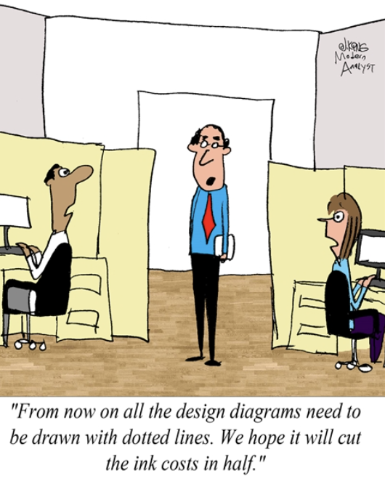

Slide 13
Overview and Application Ideas
(EconEdLink, Personal Examples)

Slide 14
Importance of Saving and Emergency Funds

Slide 16
Why do we need to save?
What’s the Cost of Spending and Saving? Lesson
Emphasize opportunity cost
Objectives
Compound interest activity

Slide 17
Are you prepared for unexpected expenses?
Emergency Savings Article
Discuss with class
Create tangible steps as class or individually

Slide 18
Tools and Accounts for Saving

Slide 19
How do I start saving?
Savings Tools Article
Discuss with class
What are the costs and benefits to each of these?

Slide 20
Classroom Integration:
Savings goal projects &
financial tool comparisons

Slide 21
What other resources can I integrate into my classroom now?
Compound Interest Video and Kahoot Quiz
Savings Goal Calculator
Financial Fitness for Life Lessons 9-12
Review Lessons
Highlight activities

Slide 22
Do not save what is left after spending, but spend what is left after saving.
Warren Buffet
Side Bar:
Discussions

Slide 23
National Standards
The National Standards for Personal Financial Education (2021)
The National Standards for Personal Financial Education is organized around six topics,
with Standards and Learning Outcomes expected by the end of the 4th, 8th, and 12th grades.
The Topics are:
I. Earning Income
II. Spending
III. Saving
IV. Investing
V. Managing Credit
VI. Managing Risk

Slide 24
Assessment Ideas

Slide 25
Quotes:
“He who buys what he does not need, steals from himself.”
– Swedish Proverb
Discuss with students

Slide 26
Discuss the quote:
How does this quote highlight wants versus needs?
How can spending today impact your future finances?
Why is it important to track your income and expenses (within a budget)?
What is your opportunity cost of saving today?

Slide 27
References
Additional MCEE K-12 Resources: z.umn.edu/TeacherResources
Council for Economic Education (National):
EconEdLink

Slide 28
Looking ahead…

Slide 29
4/11: Standards #1-3 Recap and Breakout Rooms (4-5 CT)
4/16 Standard #4 (4-5 CT)
4/23 Standard #5 (4-5 CT)
4/25: Standard #6 (4-5 CT)
4/30: Standards #4-6 Recap and Breakout Rooms (4-5 CT)

Slide 30
Q & A (Or Comments)

Slide 31
Dr. Cynthia Fitzthum
cjfitzthum@stcloudstate.edu
Thank You

Slide 32
Invest In Girls

Slide 33
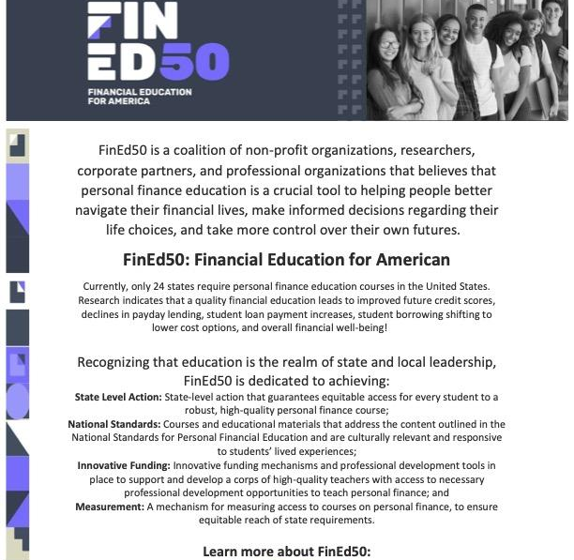
Advocacy

Slide 34
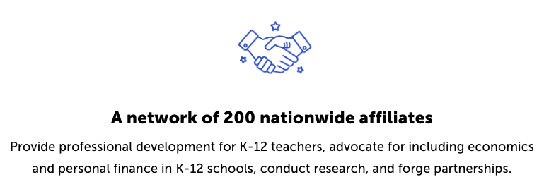
Why do we do that?
CEE Affiliates
https://www.councilforeconed.org/resources/local-affiliates/

Slide 35
Thank You to Our Sponsors!

