Slide 1
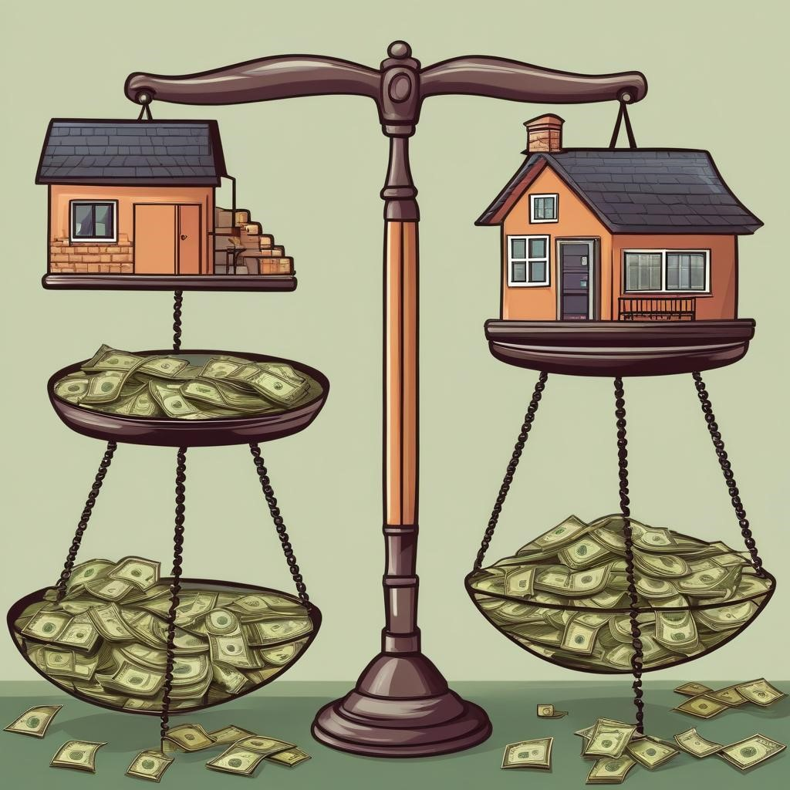
Can We End Housing Insecurity?

Slide 2
Housing Insecurity
Today’s lesson will involve evaluating an issue affecting more than 650,000 Americans¹ according to a press release by the U.S. Department of Housing and Urban Development.
That issue is the lack of housing faced by many Americans.
¹US Department of Housing and Urban Development (HUD) https://www.huduser.gov/portal/sites/default/files/pdf/2023-AHAR-Part-1.pdf

Slide 3
Economic efficiency
Economic efficiency: refers to a state in which the allocation of resources yields the greatest net benefit².
Focusing on efficiency attempts to maximize the benefits from resources.
²Cornell Law School Legal Information Institute: https://www.law.cornell.edu/wex/economic_efficiency

Slide 4
Equity
Equity: refers to fairness and justness and is distinguished from equality:
Equality means providing the same to all.
Equity means recognizing that we do not all start from the same place and must acknowledge and make adjustments to imbalances³.
³National Association of Colleges and Employers: https://www.naceweb.org/about-us/equity-definition/

Slide 5
Efficiency vs Equity
Do you think policymakers should focus more on economic efficiency or on equity when making decisions?

Slide 6
Option #1
Option #1: Expand Open Arms
The current homeless shelter operates from 6:00pm to 9:00am every day.
Occupants are provided dinner and breakfast. They are also provided a cot and bedding (mattress, pillow, sheet, blanket) for sleeping.
The shelter currently has 4 large rooms to house sleeping quarters. The rooms also have small closets to allow for temporary storage of personal items while you sleep. Each room has capacity for 10 individuals.
Total capacity for the existing shelter is 40 total individuals. The shelter maintains a staff of 5 workers and a director.
This proposal would: expand the shelter to allow for 20 additional individuals.
To do this we would: create 2 additional large sleeping quarters. Expand the current dining space and kitchen. Increase the restroom facilities to sustain the expanded capacity.
Final price tag: $2,000,000

Slide 7
Option #2
Option #2: Build a new seven story apartment building to create semi-permanent housing.
Each floor would contain four apartments. This would allow for 28 total apartments.
Each apartment would contain: 2 bedrooms, a full bathroom, a kitchen and small dining area, a small living room.
The apartment would have central air conditioning and heat maintained at a central location. There would be access to an on-site laundry facility.
The city has located land for this apartment adjacent to the downtown business district, providing easy access to workplaces for tenants. This location would also provide easy access to a grocery store and schools.
Final price tag: $10,000,000

Slide 8
Option #3
Option #3: Build a neighborhood of 25 small single-family homes.
Homes would range in size from 1,000ft² to 1,500 ft²
Each home would occupy a lot of land ~⅕ of an acre
Each home would contain: 3 bedrooms, 1.5 bathrooms, a laundry room, a kitchen with a small dining area, and a large living room.
The community would center around a park with: a playground, a walking track, a retention pond, and 3 bus stops for school buses.
The city has located 10 acres of land on the east side of town neighboring existing communities. This location is within walking distance to bus stops for the city bus line.
Final price tag: $50,000,000

Slide 9
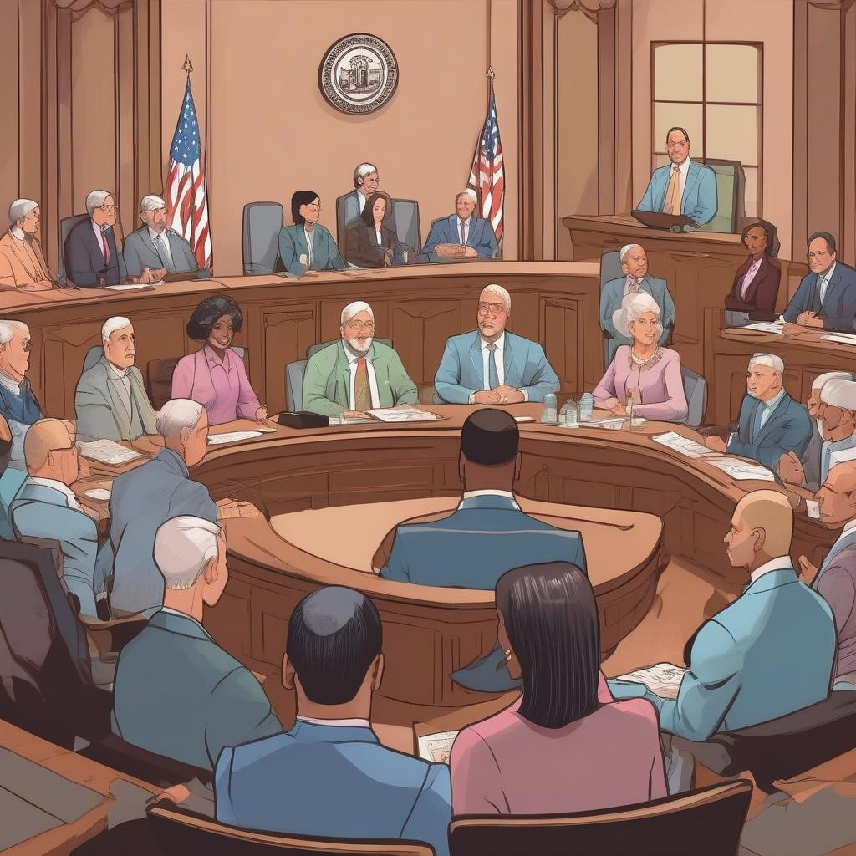
Citizen Role cards
All of you will be given role cards that represent a citizen attending the city council meeting. You will be interviewing each other to better understand the positions of your fellow citizens.
Each card represents a different citizen of Econopolis.
Each role card represents a concern that citizens of Econopolis have regarding the different plans to house the homeless.
After each of you have interviewed 5 people we will discuss if your statement emphasized economic efficiency or equity.

Slide 10
Group discussion
How many of you had an argument on your Citizen Role Card that emphasized economic efficiency?
How many of you had an argument on your Citizen Role Card that emphasized equity?

Slide 11
Closure
Economics involves making decisions while facing scarcity.
Often these decisions can be difficult, especially with policies that may impact someone’s life or livelihood.
Economists often focus on efficiency because it is seen as the most cost-effective way to allocate resources.
There are times when efficiency may need to balance with equity to ensure a more just society.

Slide 12
Wrap-up questions
Which citizen brought up a concern you agreed with?
Which citizen brought up a concern you disagreed with?

