Slide 1
From Pickles to Profits:
Learn about Personal Finance with Sloth & Squirrel

Slide 2
EconEdLink Membership
Enjoy the perks of being an EconEdLink (EEL) member:
Easily download presentations, lessons, and activities
Access new webinar events every month
Save webinars to your EEL dashboard
Download your webinar certificates from your EEL dashboard at any time
Get 20% discount at CEE Store using the code: EEL20

Slide 3
Certificate Requirements
To earn professional development hours for webinars, you must:
Watch a minimum of 45-minutes and you will automatically receive a professional development certificate via e-mail within 24 to 48 hours.

Slide 4
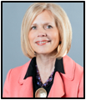
Presenters
Angie Battle
jbattle15@gsu.edu
Marsha Masters
marsha@economicsarkansas.org
Lynne Farrell Stover
stoverlf@jmu.edu

Slide 5
Objectives
You will be able to:
Explore the merits of using children’s picture books to teach economics and financial literacy.
Relate the concepts of earning, spending, saving, human capital, consumers and producers, specialization, jobs, and choices.
Examine the lessons and activities provided to support the presented material.
Consider the cross curricular possibilities related to the Social Sciences, Math, Language Arts.

Slide 6
Session Agenda
Introduction
Lesson Plans and Activities
Resources and Support Materials
Conclusion

Slide 7
National Standards
Content Standard 1: Earning Income
Content Standard 2: Spending
Content Standard 3: Saving
Content Standard 4: Investing
https://www.councilforeconed.org/policy-advocacy/k-12-standards/

Slide 8
National Standards
Content Standard 1 : Scarcity
Content Standard 2: Decision Making
Content Standard 6: Specialization
https://www.councilforeconed.org/policy-advocacy/k-12-standards/

Slide 9
1 - Introduction

Slide 10
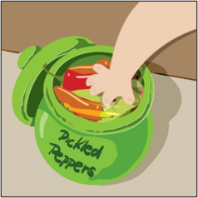
Introduction

Slide 11
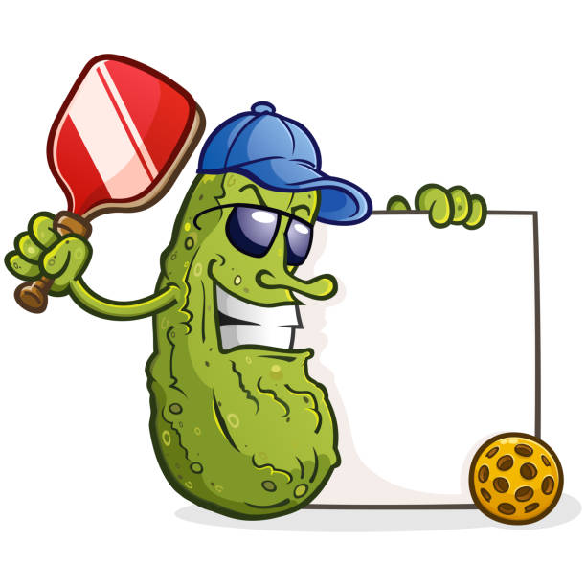
In a Pickle
Do you like pickles?
If so, what is your favorite type of pickle?
?
?
?

Slide 12
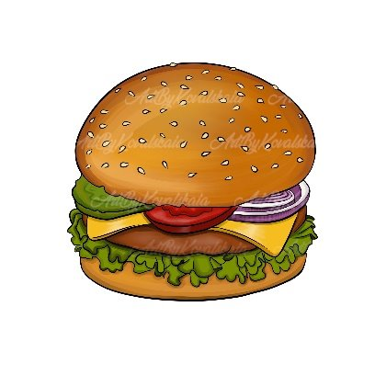
Ready for the Pickles?
How many pounds of pickles does the average American consume each year?
The typical American eats an average of 9 pounds of pickles a year.
(According to the Department of Agriculture)
Dill pickle slices on hamburgers and in restaurants make up the most commercial pickle sales, accounting for 25% of the pickle market.

Slide 13
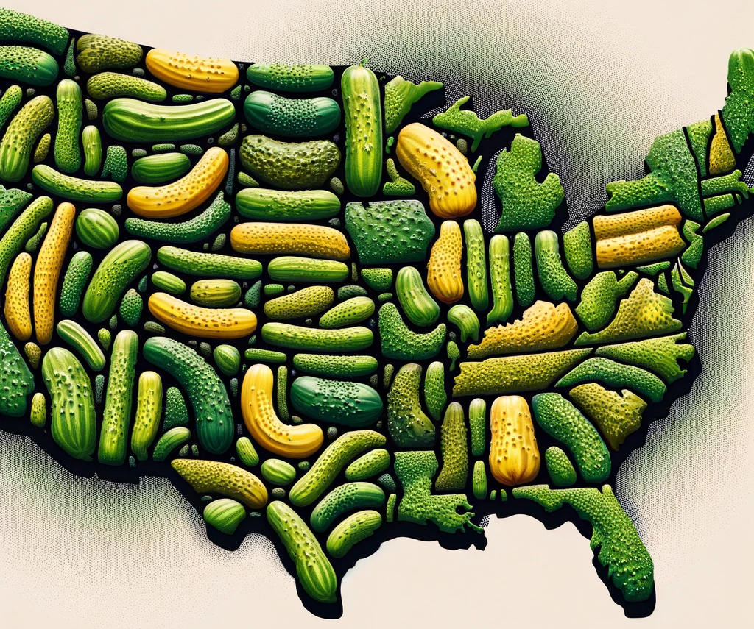
Ready for More Pickles?
States That Love Pickles Research Summary
​
The state that loves pickles the most is
The state that just can't stand pickles is
Americans collectively consume a whopping
As of 2021, the global pickles market is worth
Maine.​
Hawaii.​
20 billion pickles each year.​​
$11.1 billion.​

Slide 14
2 - Lesson Plan and Activities

Slide 15
Sloth & Squirrel in a Pickle
Publisher: Kids Can Press
Copyright Date: 2021
Reading Level: 2.0
Interest Level: PK-2

Slide 16
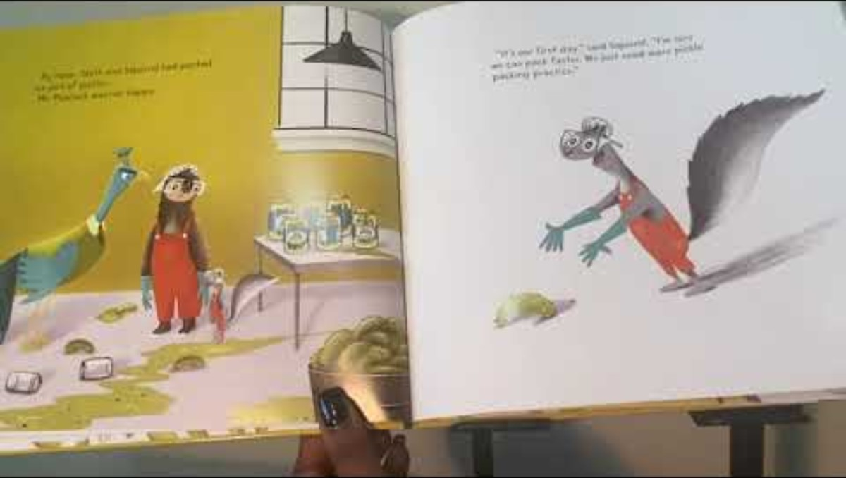
Sloth & Squirrel in a Pickle
https://www.youtube.com/watch?v=lpwVwa8GaxI​

Slide 17
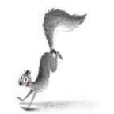
Sloth & Squirrel in a Pickle
Story Synopsis
Sloth and Squirrel have different ways and speeds of doing things. When speedy Squirrel and slow Sloth are hired as pickle packers to earn money for a new bike, things don’t go according to plan. They’re so bad, in fact, that the friends are shown the door, along with the 677 1/2 jars of pickles they packed incorrectly! Now their bicycle dream is shot. Or so they think — until the resourceful pair come up with a resourceful plan!

Slide 18
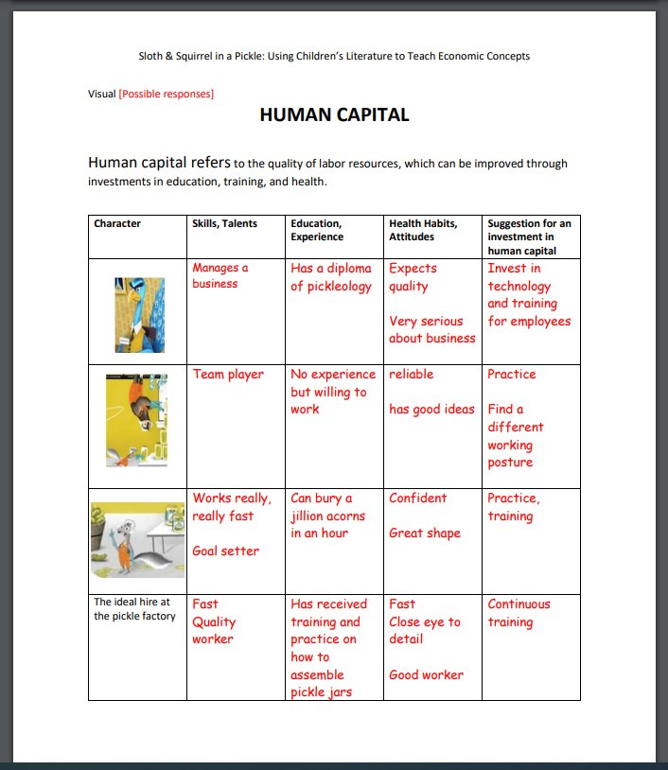
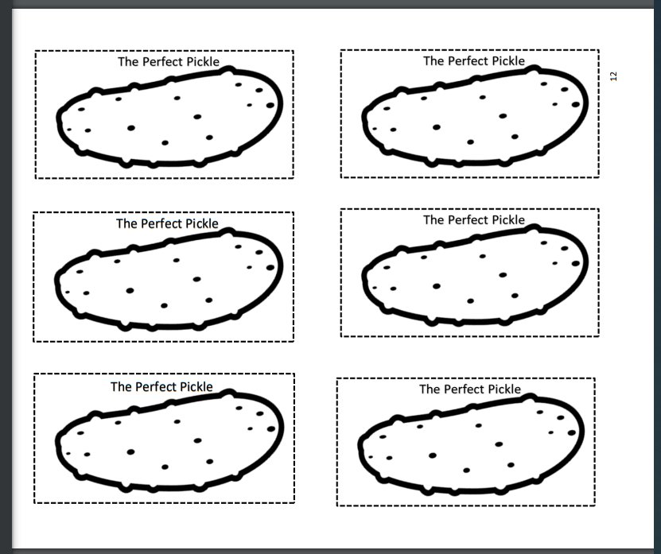
Human Capital
Lesson Plan 1: Human Capital
Human capital refers to the quality of labor resources, which can be improved through investments in education, training, and health. Investments in human capital are ways to “train your brain” to become more skilled, productive, and successful at tasks. In this lesson, students will examine the human capital of Squirrel, Sloth, and Mr. Peacock and apply the concept to identify their human capital.
Let me tell you about this great lesson!

Slide 19
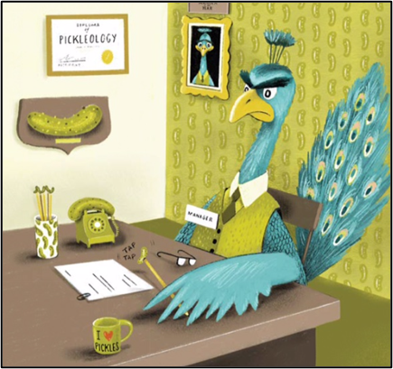
Human Capital
Definition of Human Capital
The quality of labor resources, which can be improved through investments in education, training, and health.

Slide 20
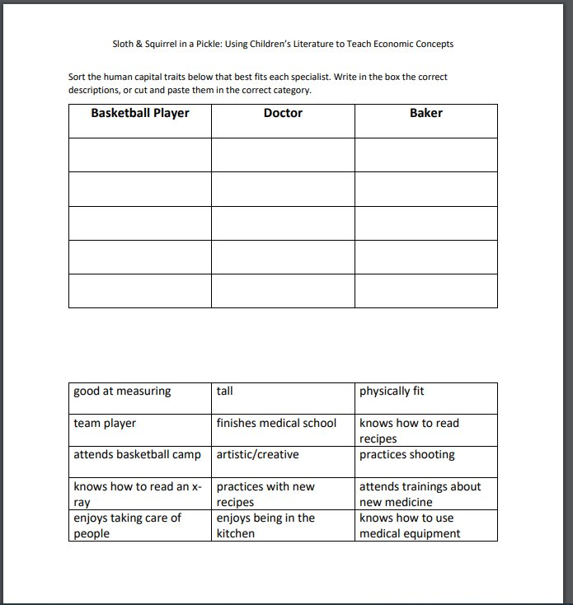
Human Capital
Assessment
Word Sort

Slide 21
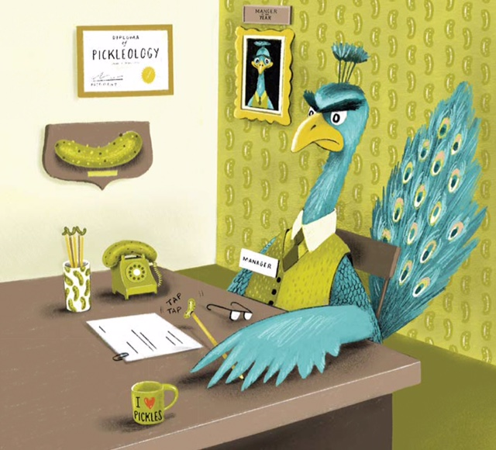
Producers and Consumers
Lesson 2: Producers and Consumers
Producers make and sell the goods and services to satisfy consumers' wants. To do this, producers must also be consumers who buy the goods and services as resources. This lesson takes students through the process of making a good to sell to a fictional business owner, Mr. Peacock, to earn an income. This income, in the form of play money, can be used in an optional activity to purchase small items and classroom coupons.
Here’s another super lesson to teach economics!

Slide 22
Producers and Consumers

Slide 23
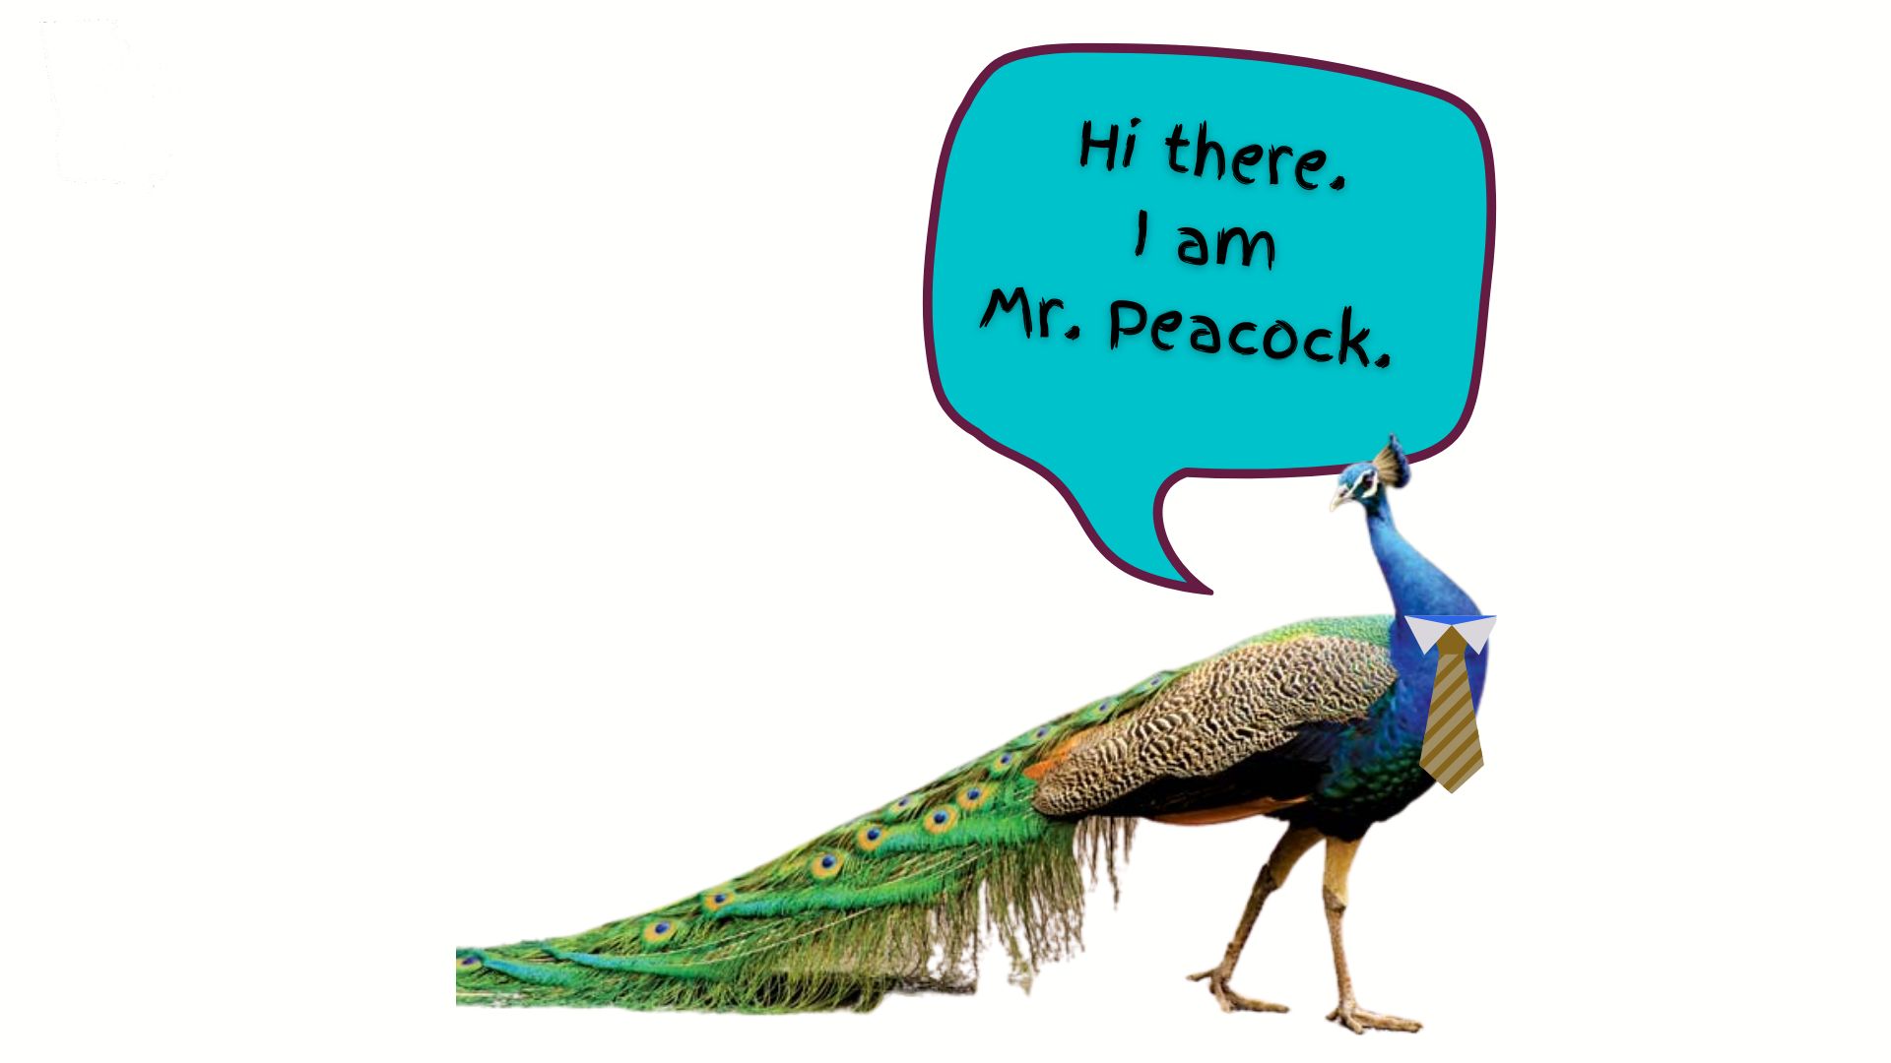
Producers and Consumers

Slide 24
Producers and Consumers

Slide 25
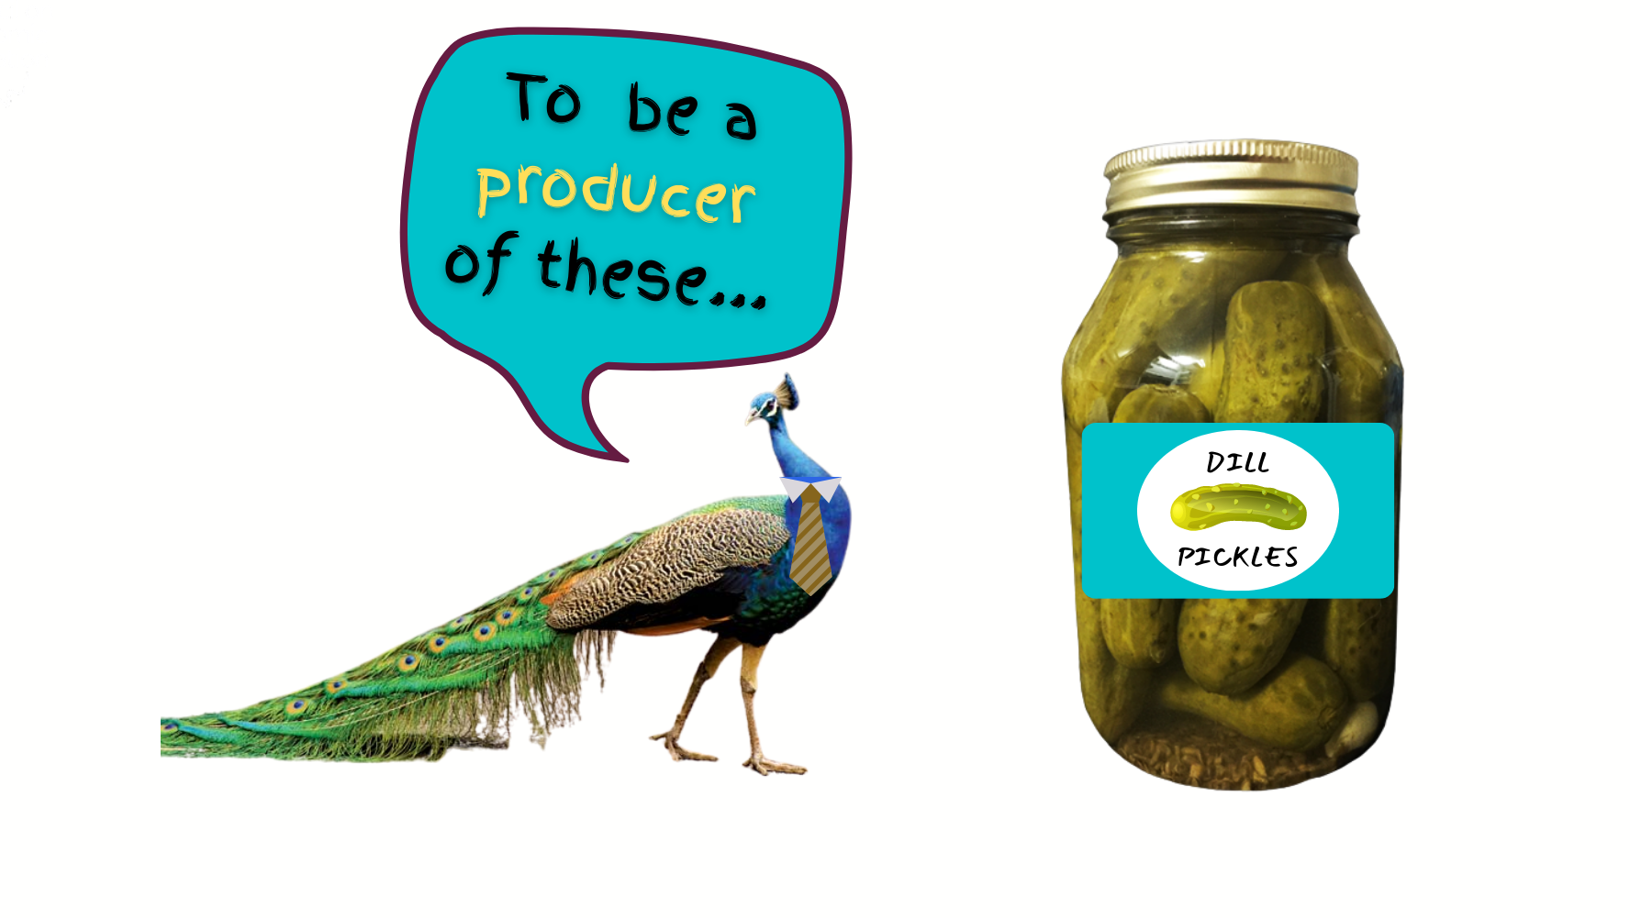
Producers and Consumers

Slide 26
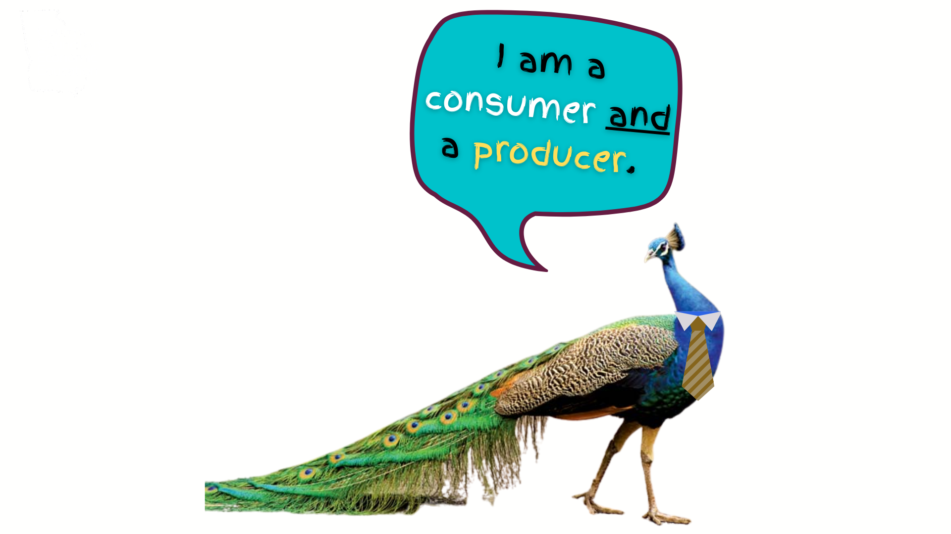
Producers and Consumers

Slide 27
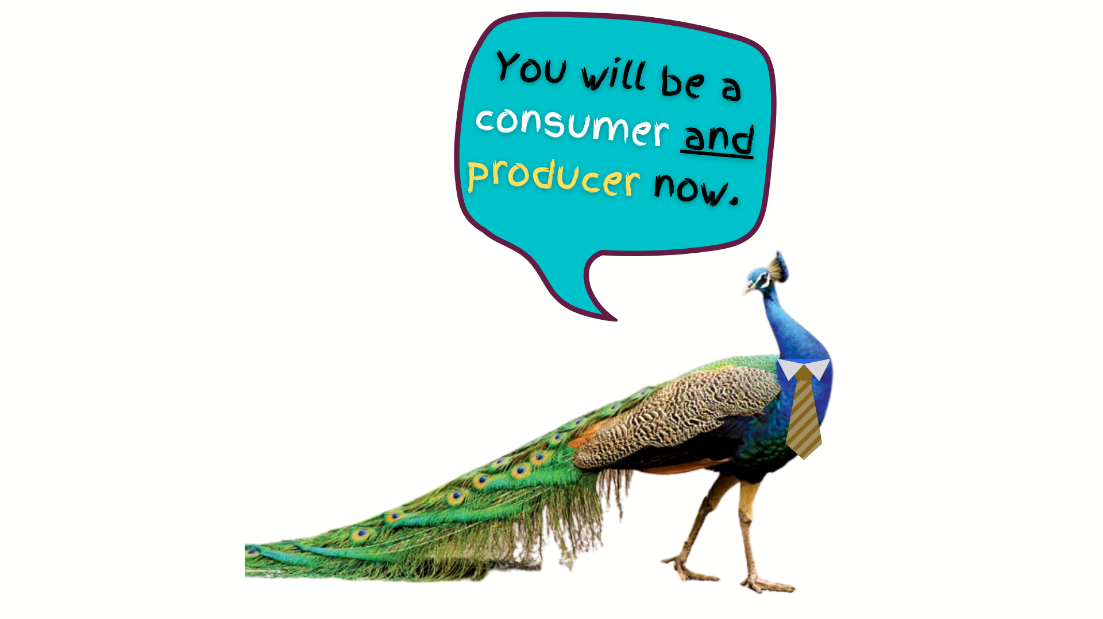
Producers and Consumers

Slide 28
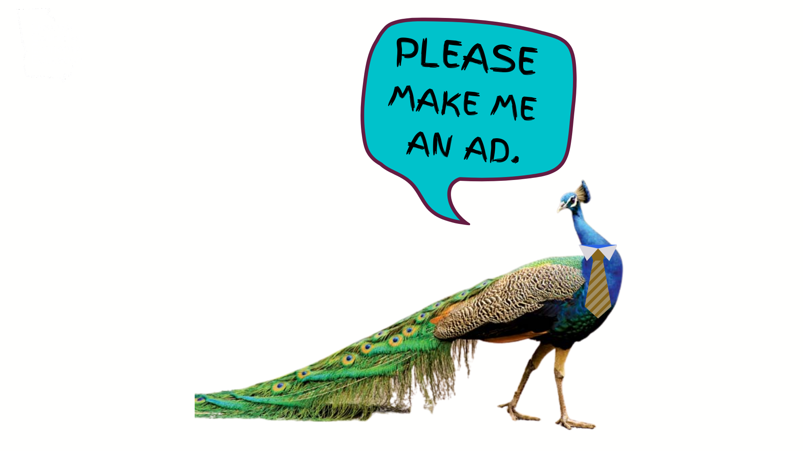
Producers and Consumers

Slide 29
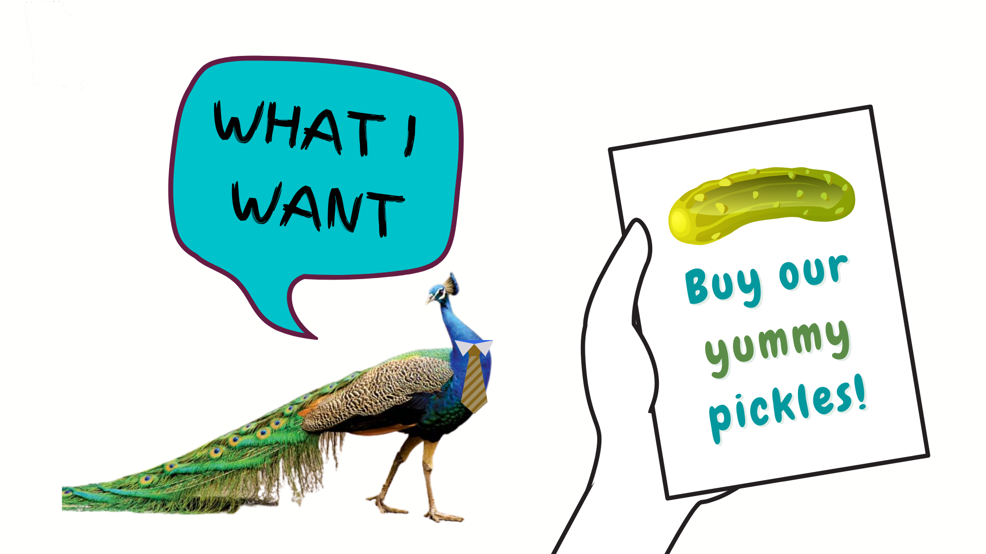
Producers and Consumers

Slide 30
Producers and Consumers

Slide 31
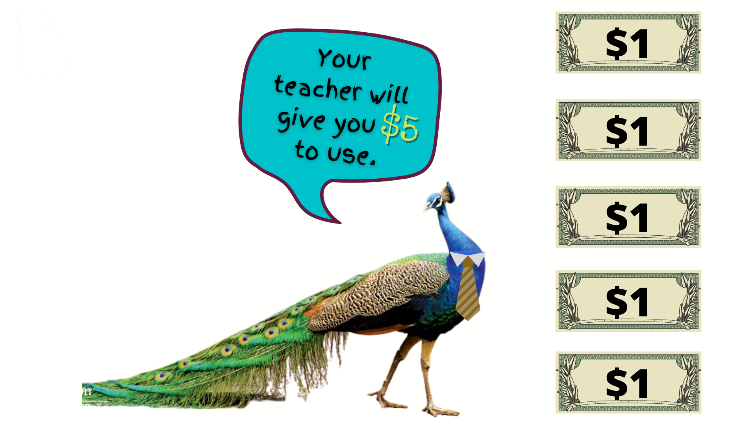
Producers and Consumers

Slide 32
Producers and Consumers

Slide 33
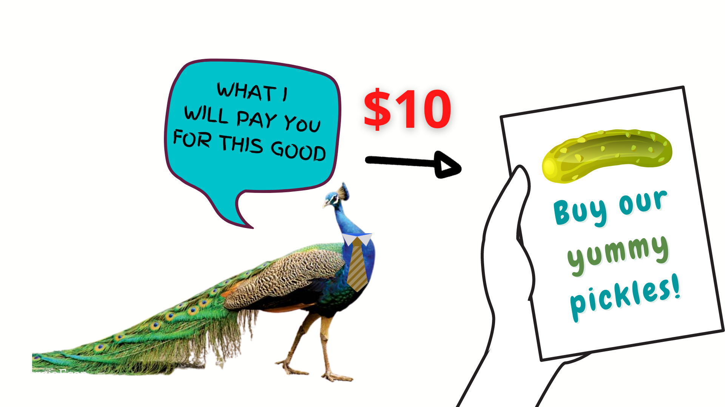
Producers and Consumers

Slide 34
Producers and Consumers

Slide 35
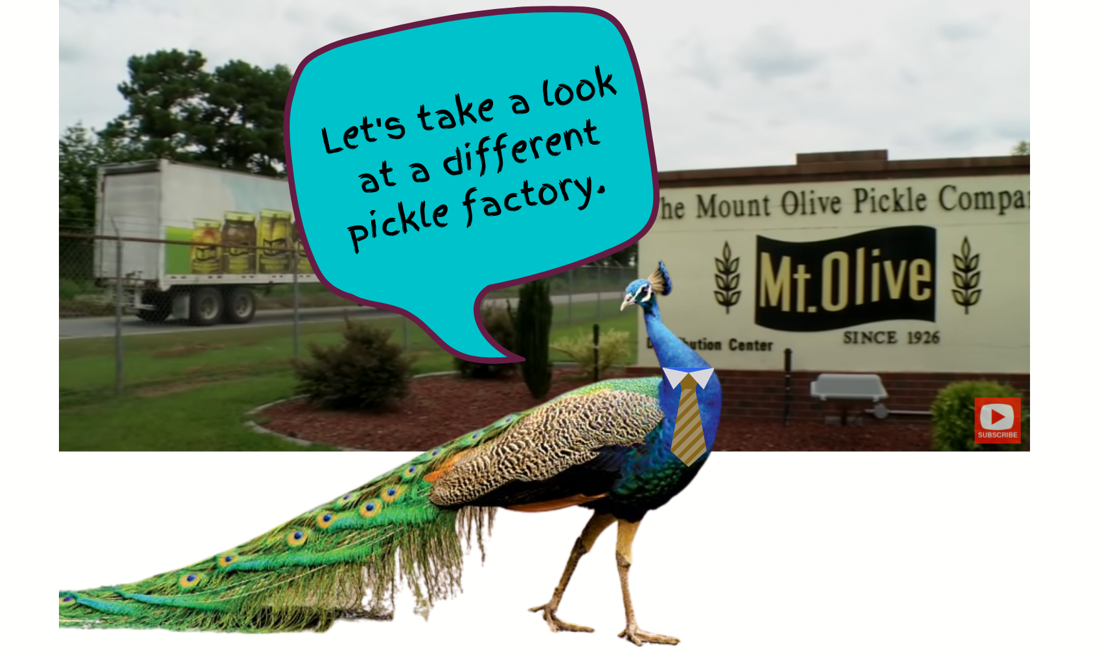
Producers and Consumers

Slide 36
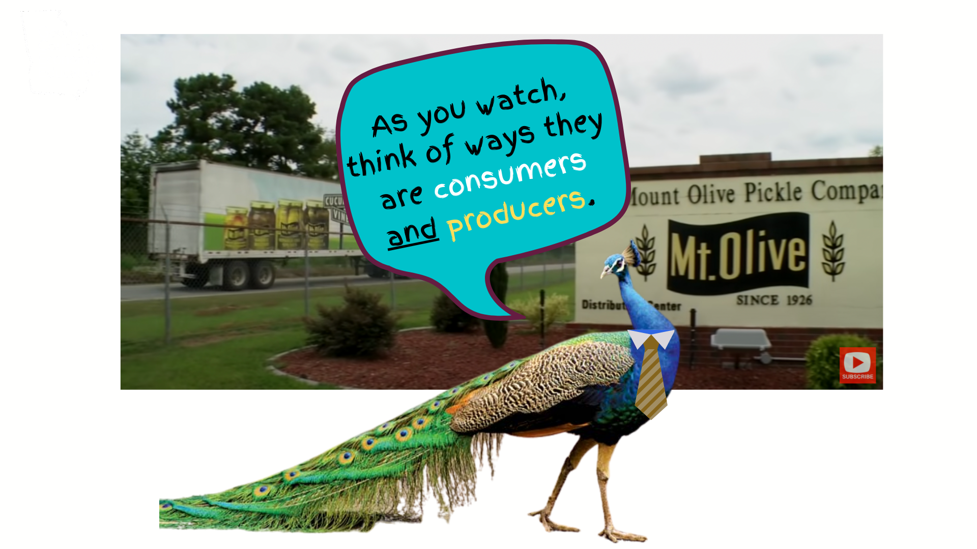
Producers and Consumers

Slide 37
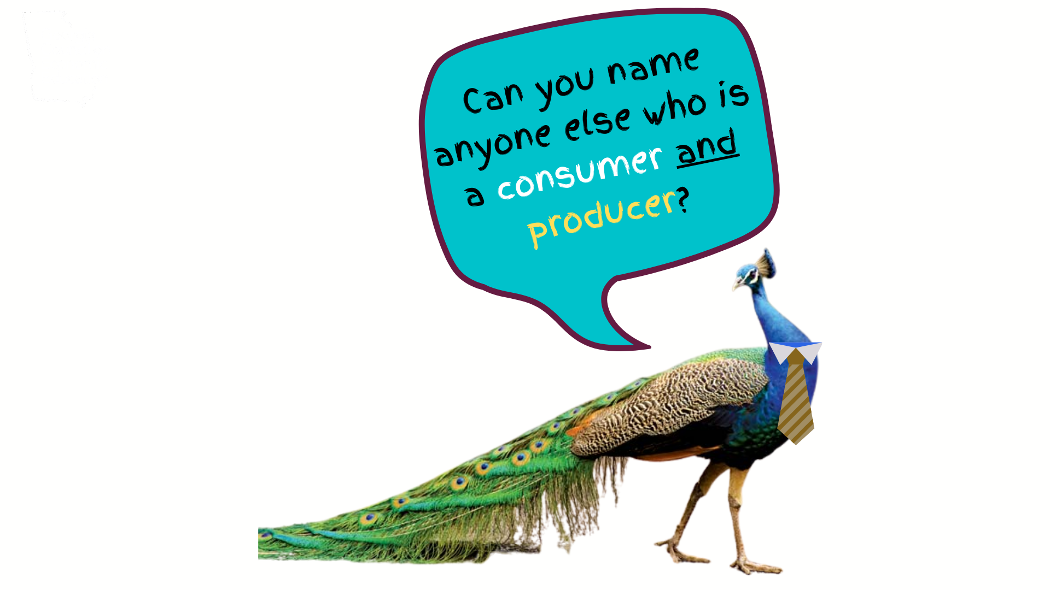
Producers and Consumers

Slide 38
Producers and Consumers
Assessment
Matching producers to goods they use

Slide 39
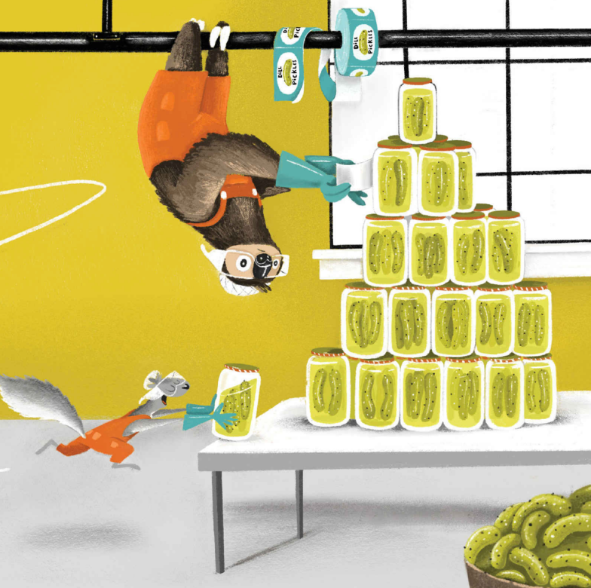
Specialization
Lesson 3: Specialization
When we specialize, we focus on one thing and get really good at it. People
tend to specialize in those things they like doing, find interesting, or have an aptitude for. It is to
be noted that specialization also takes place during the production of goods and services. Work
on a production line is divided and workers perform different jobs. This makes it possible to get
more work done and allows people to specialize in the part of the job they do best.
It’s my turn to tell you about this fantastic lesson!

Slide 40
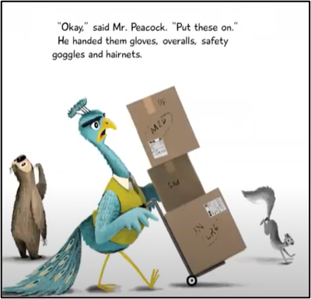
Specialization
Definition
Specialization is a situation in which people produce a narrower range of goods and services than they consume. Specialization increases productivity; it also requires trade and increases interdependence.

Slide 41
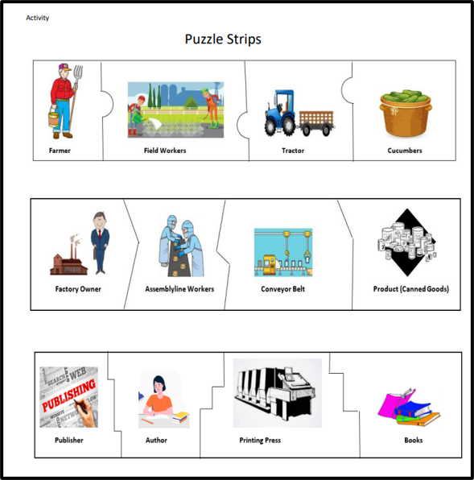
Specialization
Lesson Plan
Putting the Pieces Together Puzzle Strip

Slide 42
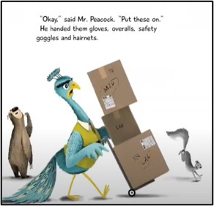
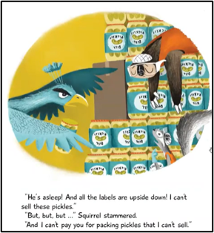
Specialization
Discussion Questions
Who was the “doer” in this story?
Who was the “thinker”?

Slide 43
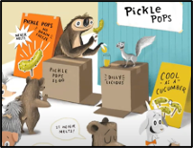
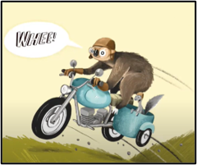
Specialization
Discussion Questions
Why is it possible for friends to be different than each other?

Slide 44
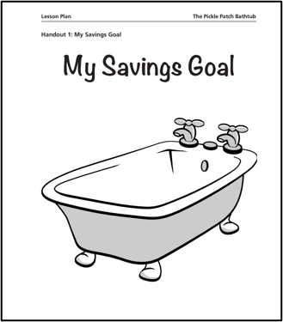
Saving
Lesson Plan by St. Louis Federal Reserve Bank
The Pickle Patch Bath Tub
Students learn about opportunity cost, saving, savings goals and a savings plan by reading The Pickle Patch Bathtub. Students will develop savings plans that lead to their own savings goals.

Slide 45
Extra Yummies
Activities for Pickles, Pickles, I Like Pickles
https://docs.google.com/document/d/1G55BlbTnvZN5YFy_SmFrbSVupkCyyobkVj72tb4qYyY/edit?usp=sharing

Slide 46
3 - Resources and Support Materials

Slide 47
Reading Makes Cents
A List of K-5 Personal Finance Resources
Reading Makes Cents Program
RMC Sloth and Squirrel Lessons
Find More Lessons and Activities by Virginia Council on Economic Education

Slide 48
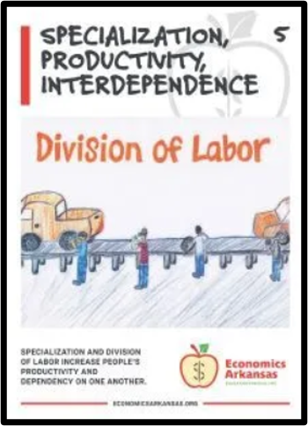
Grab and Go Economic Concepts
A List of K-5 Economics Resources
Reading Makes Cents Program
RMC Sloth and Squirrel Lessons
Find More Lessons and Activities by Virginia Council on Economic Education

Slide 49
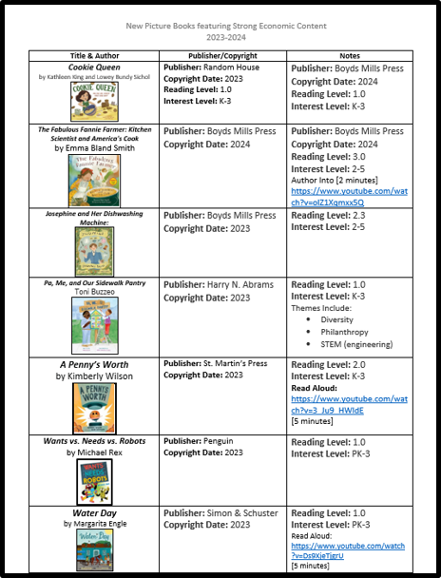
Picture Books
A List of Books with Economic Concepts
[Short description of what teachers can expect to find in books or concepts covered]

Slide 50
4 - Conclusion

Slide 51
Open for Discussion
Sloth & Squirrel is recommended for the primary grades. Do you think it could be used with upper elementary and middle school students?​
This picture book is packed with economic and financial literacy concepts. Can you think of any other content area it could be used for?​
Do you know of any other new picture books that could be used to teach economics and personal finance?

Slide 52
Find A Local State Program
CEE's affiliated network of 200 organizations educates the educators: providing the curriculum tools, the pedagogical support, and the community of peers that instruct, inspire, and guide. They are the ears on the street and a voice in the community for our programs.
Search our Directory
https://www.councilforeconed.org/about/state-affiliates/

Slide 53
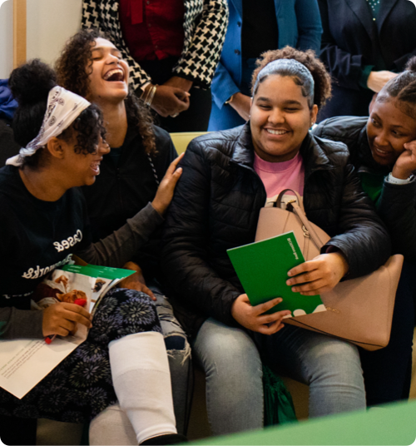
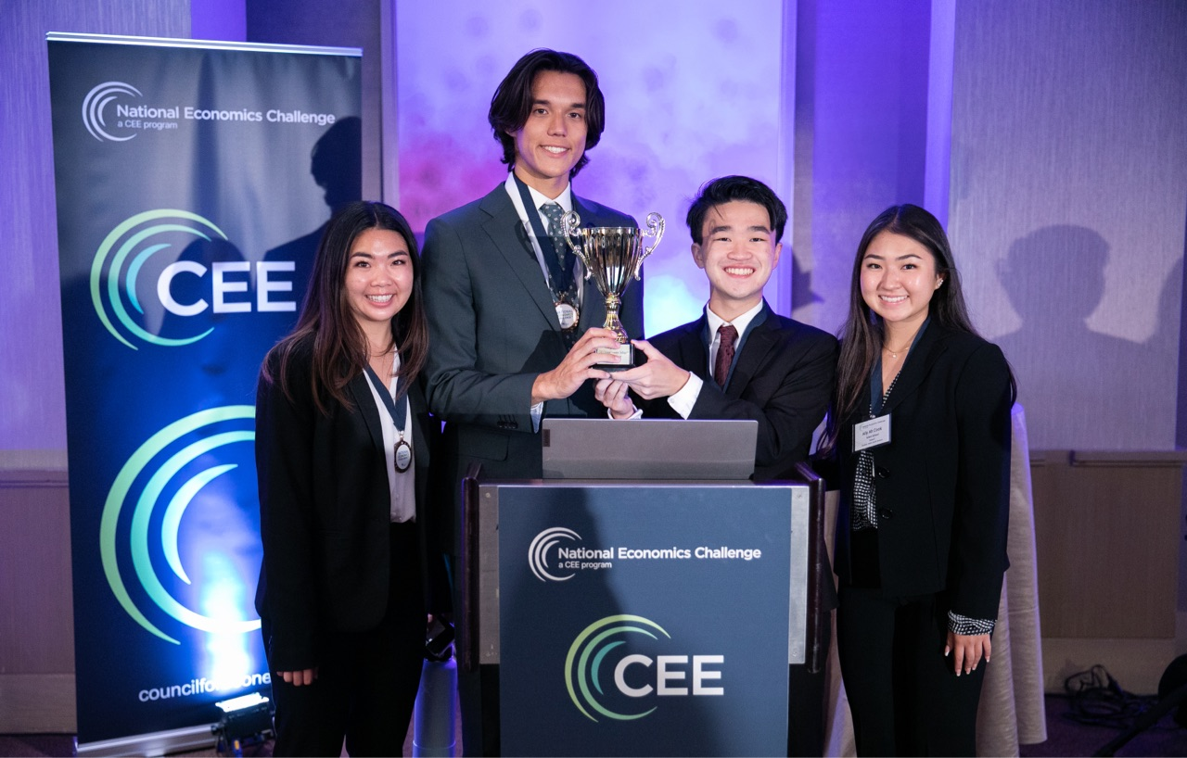
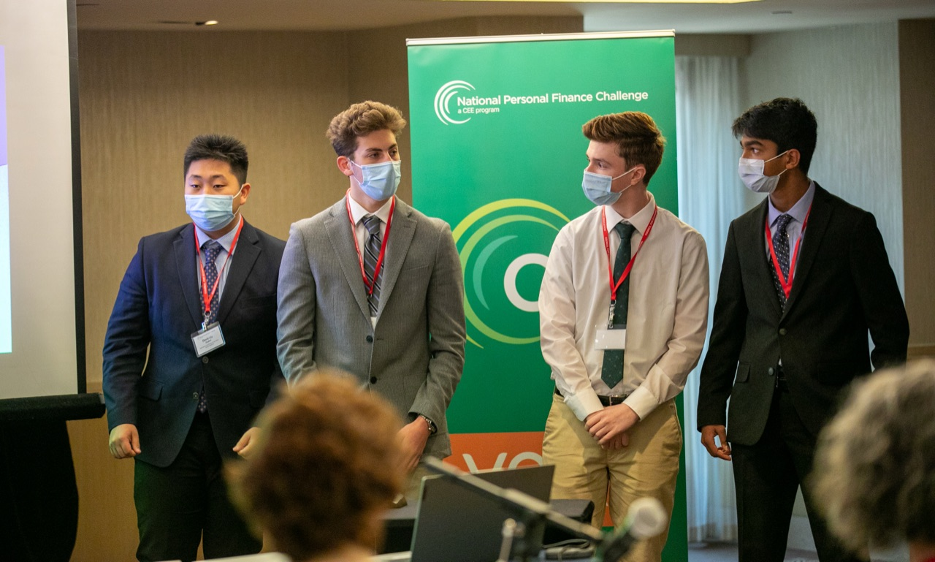
CEE Student Programs
Invest in Girls
National Economics Challenge
National Personal Finance Challenge

Slide 54
Our Generous Sponsors and Partners

Slide 55
Contact Us
Angie Battle
jbattle15@gsu.edu
Marsha Masters
marsha@economicsarkansas.org
Lynne Farrell Stover
stoverlf@jmu.edu

Slide 56
Thank you

