Slide 1
Personal Finance Bootcamp:
Session 1

Slide 2
EconEdLink Membership
Enjoy the perks of being an EconEdLink (EEL) member:
New webinars, lesson plans, and activities added every month
Learn from personal finance and economics experts in K-12 education
Easily download free high-quality presentations, lessons, and activities
Instant downloads of your webinar certificates for PD hours
Get 20% discount at CEE's Store to purchase our bestsellers, Financial Fitness for Life and AP Economics. Use the code: EEL20

Slide 3
Certificate Requirements
To earn professional development hours for webinars, you must:
Watch a minimum of 45-minutes and you will automatically receive a professional development certificate via e-mail within 24 to 48 hours.

Slide 4
Presenter
Amanda Stiglbauer
River Bluff High School
econstig@gmail.com

Slide 5
Tell us about you!
-Name
-Location
-What do you teach?
Notes:
Summarize
Have students write a quick, 1-2 sentence summary of the information they’ve just learned.
🍐 This is a Pear Deck Text Slide
🍐 To edit the type of question, go back to the "Ask Students a Question" in the Pear Deck sidebar.

Slide 6
Session Agenda
01
02
Investing
Credit
03
04
Insurance
Activities & Games

Slide 7
Objectives
You will be able to:
Investing:
Calculate the impact of time on long-term investments.
Evaluate the benefits of investing early for retirement.
Credit:
Describe what a credit report is and how it is used.
Summarize the information used to calculate a credit score.
Explain the factors that improve a credit score.
Insurance:
Determine the cost of financing based on credit scores.
Identify key types of insurance such as health, auto, homeowners, renter’s, life, and disability.
Explain the costs and benefits of purchasing the key types of insurance.

Slide 8
National Standards
12-1 A person’s investment risk tolerance depends on factors such as personality, financial resources, investment experiences, and life circumstances.
12-7 Lenders assess creditworthiness of potential borrowers by consulting credit reports compiled by credit bureaus.
12-2 The decision to buy insurance depends on perceived risk exposure, the price of insurance coverage, and individual characteristics.
https://www.councilforeconed.org/policy-advocacy/k-12-standards/

Slide 9
01
EconEdLink Lesson​
The Benefits of Investing Early

Slide 10
Investing – Question 1
Suppose Andrea and Chris are the same age. If Andrea saves $24,000 for retirement and Chris saves $72,000 toward retirement, and they both earn the same rate of return, which one will have more money at retirement?
Notes:
🍐 This is a Pear Deck Text Slide
🍐 To edit the type of question, go back to the "Ask Students a Question" in the Pear Deck sidebar.

Slide 11
Which strategy wins?
Suppose Amanda and Cheidy both invest $24,000, but Amanda starts investing at age 25 and Cheidy starts investing at age 55. If they both earn the same rate of return, who will have more money at age 65?
Notes:
🍐 This is a Pear Deck Text Slide
🍐 To edit the type of question, go back to the "Ask Students a Question" in the Pear Deck sidebar.

Slide 12
Meet Mia Saver and Ima Spender
Mia Saver and Ima Spender are two 23-year-old women who recently graduated from college. For a couple of years after graduation, neither of them saves any money for retirement. Both are focused on establishing their careers and purchasing household items. At age 25, both decide it’s time to start a retirement account.

Slide 13
Mia Saver and Ima Spender
Age 25: Mia Spender starts to save money for retirement by investing $200 per month into an account paying 7% annual interest compounded annually. Ima Spender continues to spend all of her money.
Ages 25 to 35: Ima drives a nicer car than Mia and takes a more elaborate vacation each year.​
Age 35: Mia chooses to work only part time and not invest more money into her retirement fund. However, she leaves it invested in the account paying 7% annually. Ima begins investing $200 per month toward retirement. Her account also pays a 7% rate of return compounded annually. Ima invests $200 per month for 30 years, until age 65.

Slide 14
Calculating Investments
Mia Saver |  |  | Rate of Return | Ima Spender
Age | Total invested to date | Accumulated Balance | 7% | Age | Total invested to date | Accumulated Balance
Age 25 | $0.00 | 0 |  | Age 25 | $0.00 | 0
Age 35 | $24,000.00 | $34,404 |  | Age 35 | $0.00 | 0
Age 45 | $24,000.00 | $67.678 |  | Age 45 | $24,000.00 | $34,404
Age 55 | $24,000.00 | $133,133 |  | Age 55 | $48,000.00 | $102.082
Age 65 | $24,000.00 | $261,893 |  | Age 65 | $72,000.00 | $235,215

Slide 15
Calculating Investments Results
Mia Saver |  |  | Rate of Return | Ima Spender
Age | Total invested to date | Accumulated Balance | 8% | Age | Total invested to date | Accumulated Balance
Age 25 | $0.00 | 0 |  | Age 25 | $0.00 | 0
Age 35 | $24,000.00 | $36,257 |  | Age 35 | $0.00 | 0
Age 45 | $24,000.00 | $78,275 |  | Age 45 | $24,000.00 | $36,257
Age 55 | $24,000.00 | $168,992 |  | Age 55 | $48,000.00 | $114,533
Age 65 | $24,000.00 | $364,841 |  | Age 65 | $72,000.00 | $283,525

Slide 16
Resources on Investing
Financial Fitness for Life
EconEdLink
Lesson 21: There is No Free Lunch in Investing
Lesson 22: Financial Investing
The Benefits of Investing Early
There is No Free Lunch in Investing
Stock Market Price History
Stock Prices and the Super Bowl
Here’s Your Chance to Make Millions in the Stock Market

Slide 17
02
Financial Fitness for Life: Lesson 13
Credit Reports and Scores

Slide 18
Assume a person has approached you asking to borrow a large sum of money. What would you want to know about this person before you determine whether to lend the money?

Slide 19
What are lenders looking for?
3 C's of Credit
Capacity
Character
Collateral

Slide 20
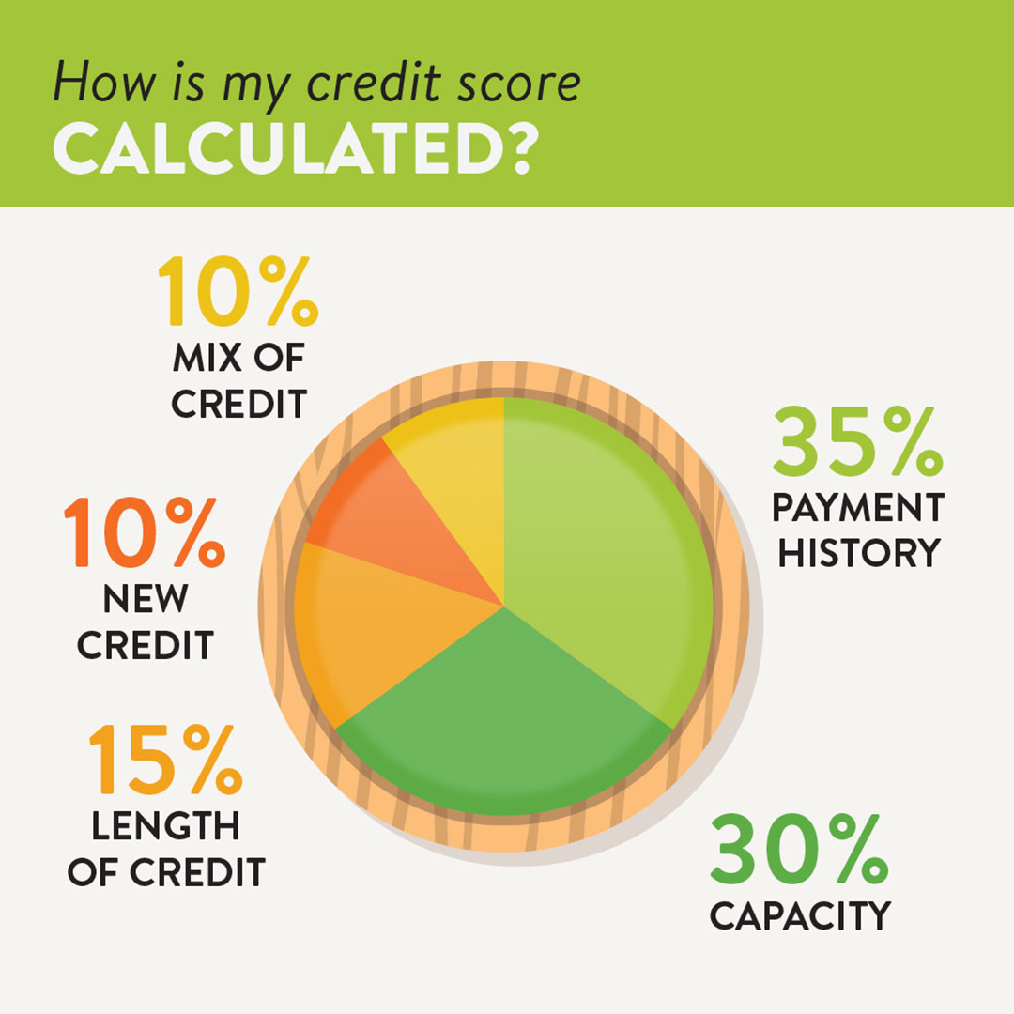
What makes up a credit score?
• 35% Payment history • 30% Managing your debt • 15% Length of credit history • 10% Diversity of accounts • 10% Number of credit applications

Slide 21
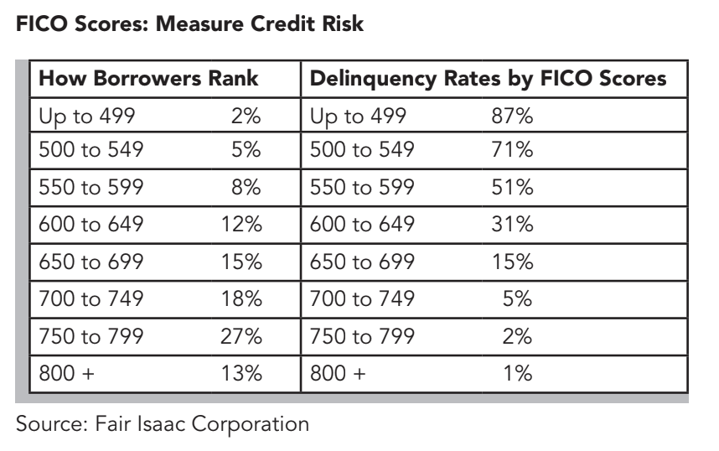
What is your credit score?
Summary of your credit report into a score → think of it as a report card!
Fair Isaac Corporation → Computes your FICO score
Range 300 - 850; median score is 723.

Slide 23
What do you know about Credit Reports?
Notes:
https://create.kahoot.it/share/t-f-credit-reports/9eb71cc0-bd50-4f5c-bd2b-9c11d3fac3e6

Slide 24
Who uses credit scores?
Lenders
Insurance Companies
Landlords
Employers

Slide 25
How can I establish a good score?
Always pay your bills on time.
Borrow only what you can comfortably pay back.
Contact lenders immediately if you expect to have a payment problem.
Report lost or stolen cards immediately.
Never give your card number or personal information over the phone or internet unless for a transaction.
Do not apply for too many credit cards.

Slide 26
Why is a good credit score important?
Can mean the difference between getting a loan or not
Impacts your interest rate
Checked by potential landlords and often employers, too
Speaks to your financial reputation

Slide 27
Resources on Credit
Financial Fitness for Life
EconEdLink
Lesson 11: What is Credit?
Lesson 12: Managing Credit Choices
Lesson 13: Credit Reports and Credit Scores
Lesson 14: All About Interest
Lesson 15: Shopping for a Credit Card
Analyzing a Credit Report & Score (Intuit)
Evaluating Credit Card Offers
Should I Use Cash or Credit?
Video: Credit Score

Slide 28
03
Financial Fitness for Life Lesson
Managing Risk

Slide 29
To begin, let's check your understanding with a Kahoot! On Choices and Risks
Notes:
https://create.kahoot.it/share/duplicate-of-choices-and-risks/45bd16a6-402c-4384-9673-0c70c3ab5f29

Slide 30
What are some low-risk choices that people make?
What are some high-risk choices that people make?
Notes:
🍐 This is a Pear Deck Text Slide
🍐 To edit the type of question, go back to the "Ask Students a Question" in the Pear Deck sidebar.

Slide 31
Why do I need Insurance?
Purpose
Common Types
To help reduce the potential of financial loss.
Pools risk so that it is spread over more than one person or incident.
By purchasing insurance, you reduce your individual risk by sharing it with the insurance company.
Car
Homeowners
Health
Life
Renters

Slide 32
Types of Insurance
Auto
Collision: Provides for the repair or replacement of the policy owner’s car damaged in an accident.
Liability: Covers the cost of property damage or injuries to others caused by the policy owner.
Comprehensive: Covers the cost of damage to an automobile as a result of fire, theft, or storms.
Uninsured and underinsured motorist: Covers the cost of property damage or injuries to the policy holder when the driver at fault is uninsured or doesn’t have sufficient coverage to pay for all the expenses related to the accident.

Slide 33
Types of Insurance
Life
Term life: Offers protection for a specified period of time; the policy must be renewed if coverage is desired for another period of time.
Whole life: Provides cash value and financial protection during the lifetime of the policy holder.
Universal life: Provides term policy protection with an investment feature of a whole life policy; the face value of the policy can change during the time of the policy.

Slide 34
Types of Insurance
Homeowners
Physical damage: Reimburses for fire or water damage to the house, its contents, or other structures on the property.
Loss or theft: Reimburses for personal property damaged or stolen.
Liability: Protects against loss from a lawsuit for injuries to invited or uninvited guests.

Slide 35
Types of Insurance
Renters
Reimburses the policy owner for loss of possessions in a rental unit caused by fire, theft, water damage, etc. Also provides liability protection for bodily injuries of guests that occur in the rental unit.

Slide 36
Types of Insurance
Health
Traditional health insurance: Provides reimbursement for hospital, surgical, medical, and other expenses; plans can include deductible and copayments of 20 percent or more.
HMOs: Cover hospital, surgical, and medical services through a group of physicians; fees based on a monthly charge whether or not services are used.
High deductible health care: Covers hospital, surgical, and medical services through either an HMO or traditional health care plan; consumers pay much higher deductibles in exchange for lower premiums; these policies are often used to insure against catastrophic health events.
Health savings accounts (HSAs): Provide a tax-sheltered account where consumers can save for their medical expenses.

Slide 37
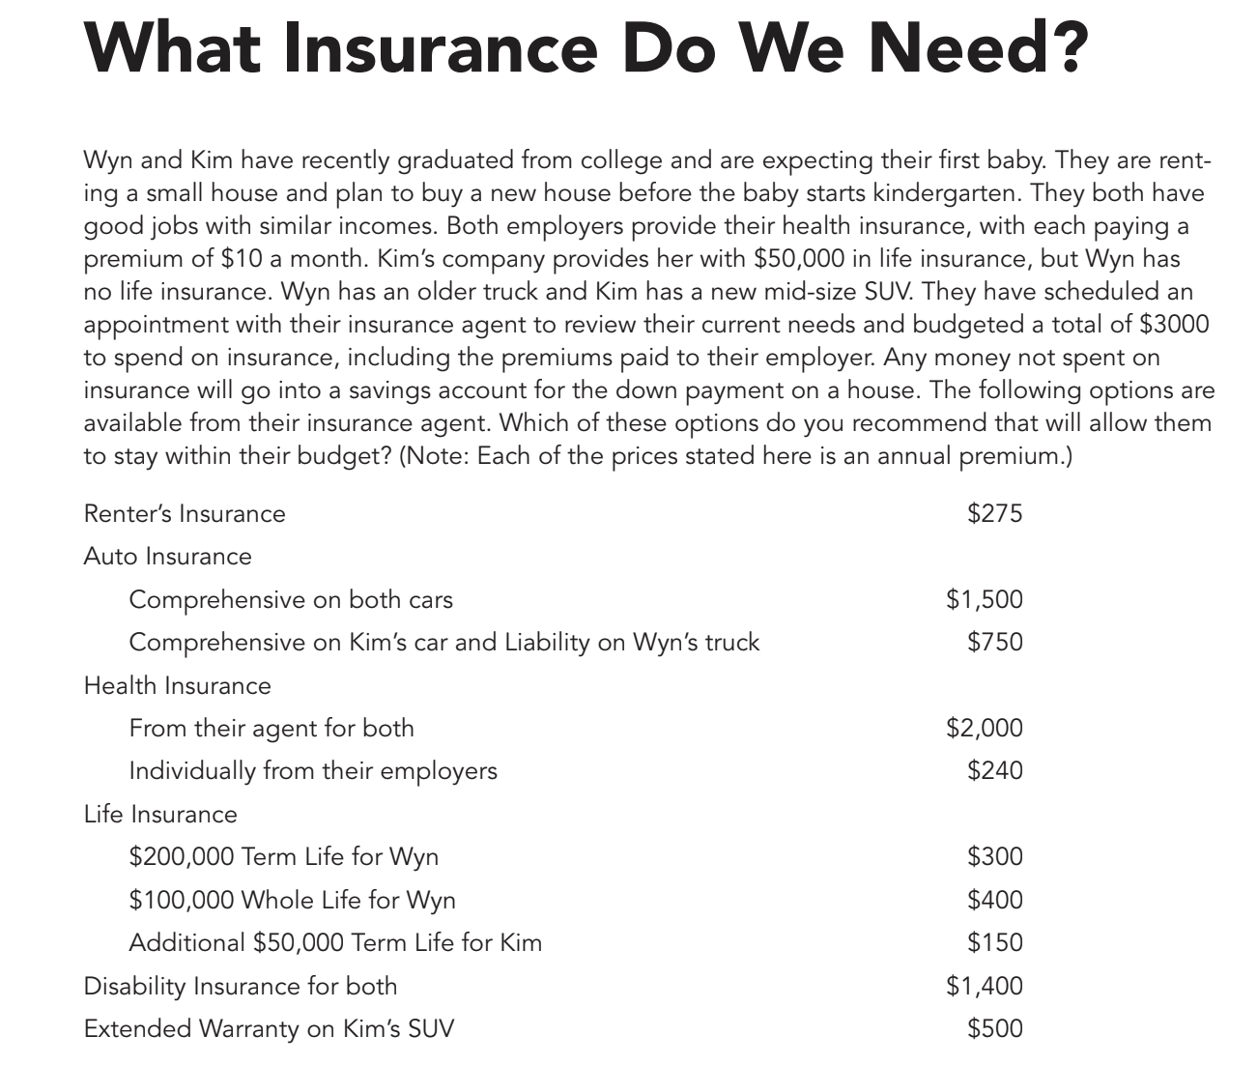
Which choices do you recommend for this family? Rank your options and explain why you selected each.
Notes:
🍐 This is a Pear Deck Text Slide
🍐 To edit the type of question, go back to the "Ask Students a Question" in the Pear Deck sidebar.

Slide 38
True or False: Insurance is only helpful for the wealthy.
True
False
Notes:
True or False
Use this template to do a quick check of students’ perceptions during your lesson.
🍐 This is a Pear Deck Multiple Choice Slide. Your current options are: A: True, B: False,
🍐 To edit the type of question or choices, go back to the "Ask Students a Question" in the Pear Deck sidebar.

Slide 39
True or False: If you’re smart enough and have the right insurance agent, you can get enough insurance to eliminate all risks in your life.
True
False
Notes:
True or False
Use this template to do a quick check of students’ perceptions during your lesson.
🍐 This is a Pear Deck Multiple Choice Slide. Your current options are: A: True, B: False,
🍐 To edit the type of question or choices, go back to the "Ask Students a Question" in the Pear Deck sidebar.

Slide 40
True or False: Purchasing insurance is an individual decision and may vary from family to family.
True
False
Notes:
True or False
Use this template to do a quick check of students’ perceptions during your lesson.
🍐 This is a Pear Deck Multiple Choice Slide. Your current options are: A: True, B: False,
🍐 To edit the type of question or choices, go back to the "Ask Students a Question" in the Pear Deck sidebar.

Slide 41
Resources on Managing Risk
Financial Fitness for Life
EconEdLink
Lesson 10: Managing Risk
Choosing Sides: Which Drivers Would You Insure?
Discover How Two Way Tables Are Used to Determine Auto Insurance Deductibles and Premiums
The History of Medicare

Slide 42
15 Minute Break!

Slide 43
Activity
Stock Prices and the Super Bowl

Slide 44
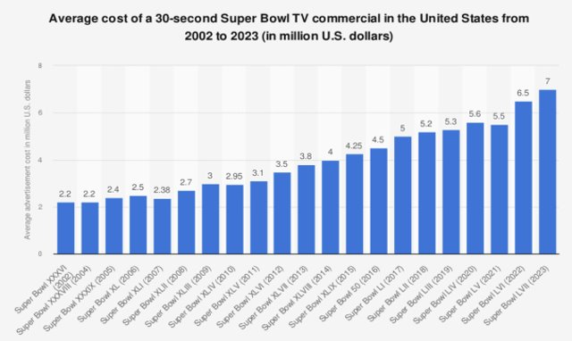
Super Bowl Commercials

Slide 45
Advertising and the Super Bowl
Does advertising during the Super Bowl impact stock prices?
Is the benefit worth the cost?

Slide 46
Break Out Room Jigsaw
Choose two companies from the list on the next slide.
Even rooms choose from the top half, odd rooms choose from the bottom half.
Research the information listed on the next slide and use the data to answer this question:
Does advertising during the Super Bowl positively impact stock prices?

Slide 47
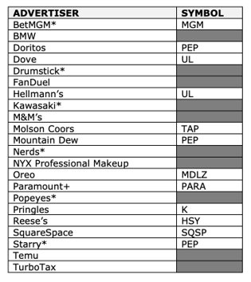
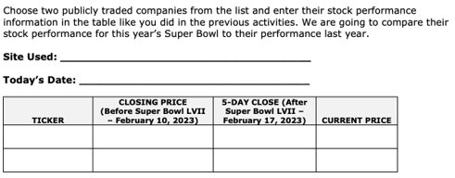
Break Out Room Jigsaw
Does advertising during the Super Bowl positively impact stock prices?
Notes:
https://econedlink.org/resources/stock-prices-and-the-super-bowl/

Slide 48
Does advertising during the Super Bowl positively impact stock prices?
Notes:
Summarize
Have students write a quick, 1-2 sentence summary of the information they’ve just learned.
🍐 This is a Pear Deck Text Slide
🍐 To edit the type of question, go back to the "Ask Students a Question" in the Pear Deck sidebar.

Slide 49
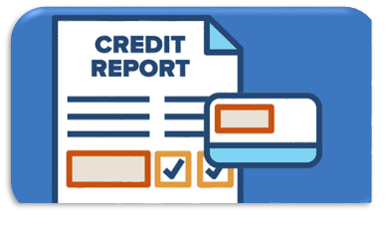
Kahoot - Reading a Credit Report
Go to Kahoot.it and enter the game pin!
Notes:
https://create.kahoot.it/share/reading-a-credit-report/30824e6c-f7e8-4278-9c02-f4257c27ca0f

Slide 50
Personal Finance Bootcamp:
Session 2

Slide 51
EconEdLink Membership
Enjoy the perks of being an EconEdLink (EEL) member:
New webinars, lesson plans, and activities added every month
Learn from personal finance and economics experts in K-12 education
Easily download free high-quality presentations, lessons, and activities
Instant downloads of your webinar certificates for PD hours
Get 20% discount at CEE's Store to purchase our bestsellers, Financial Fitness for Life and AP Economics. Use the code: EEL20

Slide 52
Certificate Requirements
To earn professional development hours for webinars, you must:
Watch a minimum of 45-minutes and you will automatically receive a professional development certificate via e-mail within 24 to 48 hours.

Slide 53
Presenter
Amanda Stiglbauer
River Bluff High School
econstig@gmail.com

Slide 54
Objectives
You will be able to:
distinguish among various types of spending: regular (variable and fixed), irregular, and future.
Follow a process to establish a budget.
Implement a research process for evaluating a career using the Occupational Outlook Handbook.
Identify the costs and benefits of a career, based on different aspects of an occupation.
Explain how to determine if someone is suited for an occupation.
Explain how a career interest survey helps students identify careers for which they may be suited.
Identify sources of information for finding a job.
Summarize the PACED model.
Apply the PACED model to decision making.

Slide 55
Session Agenda
01
02
Budgeting
Earning Income
03
04
Spending
Activities & Games

Slide 56
National Standards
Earning Income 12-1
Compensation for a job or career can be in the form of wages, salaries, commissions, tips, or bonuses, and may also include contributions to employee benefits, such as health insurance, retirement savings plans, and education reimbursement programs.
Spending 12-1
A budget helps people achieve their financial goals by allocating income to necessary and desired spending, saving, and philanthropy.
Spending 12-2
Consumer decisions are influenced by the price of products or services, the price of alternatives, the consumer’s budget and preferences, and potential impact on the environment, society, and economy.
https://www.councilforeconed.org/policy-advocacy/k-12-standards/

Slide 57
05
Budgeting
Making a Budget - It is All Spending!

Slide 58
Budgeting Video
Notes:
https://player.vimeo.com/video/239510067

Slide 59
Go to Kahoot.it and enter the game pin!
Notes:
https://create.kahoot.it/share/duplicate-of-money-management-budgeting-video-and-quiz/711c4e76-914b-4a4d-a185-1288444a4a0b

Slide 60
Elements of Budget/Spending Plan
What is a budget? Just a plan for spending income!
Gross income – Deductions = Net income
Net income = Regular spending + Irregular spending ( Short-term savings) + Future spending (Long-term savings)

Slide 61
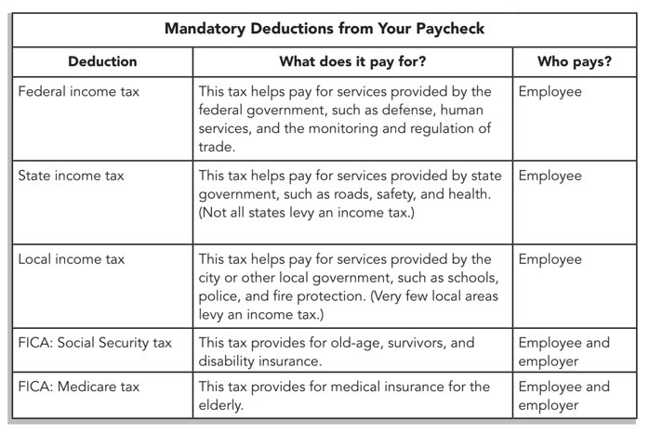
Mandatory Deductions

Slide 62
Elements of Budget/Spending Plan
Housing (e.g., rent or mortgage)
Food (e.g., groceries and dining out)
Transportation (e.g., car payment, gas, or bus pass)
Utilities (e.g., electric, water/sewer, phone, cable, and oil/gas)
Personal (e.g., apparel and personal care items)
Entertainment (e.g., movies, hobbies, and sports)
Miscellaneous)

Slide 63
Irregular Yearly Spending
Insurance (e.g., life, medical, home, and auto)
Taxes and fees (e.g., property taxes and auto registration)
Expected expenses (e.g., health care, education, vacations, gifts, home maintenance, and charity)
Unexpected expenses (e.g., car repairs, health care, and home repairs)
Near-term goals (e.g., car, home addition, and education)

Slide 64
Irregular Yearly Spending
Retirement
Other long-term goals (e.g., starting your own business)

Slide 65
The Budget Process
Step 1. Determine Your Monthly Net Income
Gross monthly income – Deductions = Net income
Gross income: $54,000/yr., or $4,500/mo.
Deductions: $1,000/mo.
$4,500/mo. – $1,000/mo. = $3,500/mo.

Slide 66
The Budget Process
Step 2. Plan Future Spending (Long-Term Savings)
Long-term savings is determined by your financial plan.
Long-term savings: $500/mo.
$3,500/mo. – $500/mo. = $3,000/mo.

Slide 67
The Budget Process
Step 3. Plan Irregular Spending (Short-Term Savings)
Determine yearly short-term savings and divide by 12
Insurance/taxes ................................ $1,500/yr.
Expected expenses ........................... $2,500/yr.
Charity .............................................. $1,000/yr.
Unexpected expenses ....................... $ 500/yr.
Near-term goals ................................ $ 500/yr.
Short-term savings ........................... $6,000/yr./12 = $500/mo.
$3,000/mo. – $500/mo. = $2,500/mo.

Slide 68
The Budget Process
Step 4. Plan Regular Spending (Fixed and Variable)
Housing …….................................. $ 800/mo.
Transportation .................................. $ 500/mo.
Food .................................................. $ 400/mo.
Utilities ............................................. $ 300/mo.
Personal/health care ......................... $ 200/mo.
Entertainment ................................... $ 200/mo.
Miscellaneous ................................... $ 100/mo.
Regular Spending .............................. $2,500/mo.

Slide 69
Activity
Student Budget Analysis Calculator
Notes:
https://econedlink.org/resources/student-budget-analysis-calculator/
https://www.stlouisfed.org/-/media/project/frbstl/stlouisfed/education/curriculum/pdf/making-personal-finance-decisions-lesson-5a.pdf

Slide 70
Resources on Budgeting
Financial Fitness for Life
EconEdLink
Lesson 8: Managing Your Own Money
Lesson 9: Financial Institutions and Services
Making a Budget: It Is All Spending!
Home Rent vs. Buy Calculator
Budgeting for Income and Expenses
Lights, Camera, Budget!
How Will I Pay for College?
The Basics of Spending and Budgeting

Slide 71
06
Earning Income
Financial Fitness for Life Lesson 4: Choosing a Career

Slide 72
Choosing a Career
Find an occupation to research.
Check out occupational profiles:
Summary
What they do
Work environment
How to become one
Pay
Job Outlook
Similar Occupations

Slide 73
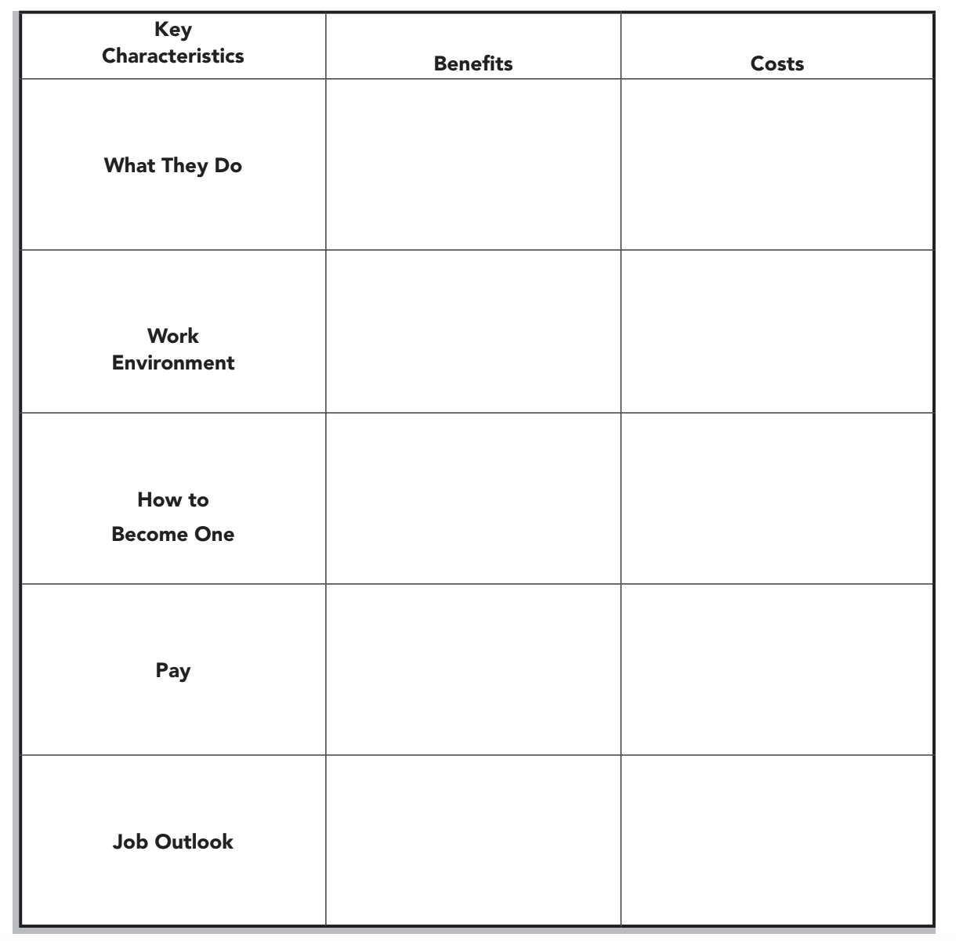
Researching an Occupation
A cost/benefit analysis may be used to weigh the benefits and costs of a decision to determine
its feasibility.
Using the Occupational Outlook Handbook, determine the main benefits and costs of choosing this occupation as a career.
List the benefits (or pros) in the left column and the costs (or cons) in the right column. Write the name of the occupation in the blank space of the title
Notes:
https://docs.google.com/document/d/1dRuuQqmQI2WOOiR4-ciYb6VU4g3ytjihqpxVv4p5QiY/edit?usp=sharing

Slide 74
Why do people earn more income from their labor than others?
Notes:
🍐 This is a Pear Deck Text Slide
🍐 To edit the type of question, go back to the "Ask Students a Question" in the Pear Deck sidebar.

Slide 75
Lesson Plan
Should I be a Professional Basketball Player?

Slide 76
People earn income from their resources.
*Natural resources such as timber to sell.
*Capital resources such apartments to rent.
*Entrepreneurial skills to start a business.
*Labor to employ.
The income people earn depends on the quantity and quality of the resources they have to offer, and on the supply and demand for those resources.
Most people earn income from their labor. They get a job and they get paid for the work.

Slide 77
Some stats...
In 2023, 573,573 high school boys and 507,506 high school girls participated in high school basketball in the U.S.
Each year, approximately 60 players join the National Basketball Association and 36 are drafted into the WNBA.
The NBA has 30 teams with 15 players on their roster, for a total of 450 positions.
The WNBA has 12 teams with 12 players on their roster for a total of 144 positions.
In 2023, there were a record 125 international players drafted.
In 2023, 26 college freshmen and sophomores were drafted.

Slide 78
A few more stats...
The average work-life of a professional basketball player is about 4 - 5 years. (A pro usually begins around the age of 22 and is over around 27. 60% last less than 2 seasons.)
The average salary (as of 2023) is $7 million for the NBA, for the WNBA the average is $147,745.
Minimum salary (2023) is $1.1 million for NBA players, $62,000 for WNBA players.

Slide 79
What are the costs and benefits of choosing to prepare for a high-paying professional basketball career?
Notes:
🍐 This is a Pear Deck Text Slide
🍐 To edit the type of question, go back to the "Ask Students a Question" in the Pear Deck sidebar.

Slide 80
The Productivity Factor
When employers have a choice, they would like to hire the person who is going to create the most value, the person who can produce the most in a given period.
Employers can’t afford to pay a person more than the income they can generate from the work that person does.

Slide 81
Resources on Earning Income
Financial Fitness for Life
EconEdLink
Lesson 1: How to Become A Millionaire
Lesson 4: Choosing a Career
Lesson 5: Making Your Own Job
Lesson 6: Why Some Jobs Pay More Than Others
Wages and Me
Exploring Taxes
Uncle Sam Takes a Bite
How to Become a Millionaire
College: Learning the Skills to Pay the Bills

Slide 82
06
Spending
Using the PACED Model

Slide 83
Identify the PROBLEM
PACED Model for Decision Making
List ALTERNATIVES
State CRITERIA
EVALUATE Alternatives
Make a DECISION

Slide 84
PACED Model

Slide 85
Resources on Spending
Financial Fitness for Life
EconEdLink
Lesson 2: The Economic Way of Thinking
Lesson 3: Decision Making
Lesson 8: Managing Your Own Money
Can You Be Fashionable and Ethical?
Comparing Pizza Prices
Planning an International Trip
What Car Should I Buy?

Slide 86
15 Minute Break!

Slide 87
Activities!

Slide 88
Let's Have Some Fun!

Slide 89
The Millionaire Game
Notes:
https://create.kahoot.it/share/acs-the-millionaire-game/8ac279c8-35a4-4efb-8df5-4c05a30cda43

Slide 90
Break Out Room - Jigsaw Scavenger Hunt
Select a Break Out Room to join based on topic.
Work with your teammates to locate an additional lesson/activity you can use TOMORROW if you were teaching this topic.
Place the lesson/activity, brief description, and link in the shared Google Doc.
Select a teammate to share with the group.

Slide 91
Contact Me
Amanda Stiglbauer
River Bluff High School
econstig@gmail.com

Slide 92
Find A Local State Program
CEE's affiliated network of 200 organizations educates the educators: providing the curriculum tools, the pedagogical support, and the community of peers that instruct, inspire, and guide. They are the ears on the street and a voice in the community for our programs.
Search our Directory
https://www.councilforeconed.org/about/state-affiliates/

Slide 93
CEE Student Programs
Invest in Girls
National Economics Challenge
National Personal Finance Challenge

Slide 94
Our Generous Sponsors and Partners

