Slide 1
Where Does the Price of Pizza Come From?

Slide 2
Learning Objectives
Construct a graph using tabular data for buyers and sellers.
Compare and contrast two specific linear functions.
Explain how prices are determined in a market.

Slide 3
Warm Up #1
At a baseball stadium, the vendors start out with 24,000 slices of pizza. They know they will sell about 4,000 during each 30-minute segment of the game.
Make a table showing the decline in the number of pizza slices in thousands as the game goes on until there are no slices of pizza remaining.
Next, plot your information on a coordinate graph with the slices of pizza on the y-axis (in thousands) and time on the x-axis.
Determine the equation of the line in the slope-intercept form.
What is the slope of the line? What is the y-intercept?

Slide 4
Warm Up #1 (Solutions)
At a baseball stadium, the vendors start out with 24,000 slices of pizza. They know they will sell about 4,000 during each 30-minute segment of the game. Make a table showing the decline in the number of pizza slices in thousands as the game goes on until there are no slices of pizza remaining.
Slices of Pizza | 20,000 | 16,000 | 12,000 | 8,000
Time (from start of game) | 30 minutes | 60 minutes | 90 minutes | 120 minutes

Slide 5
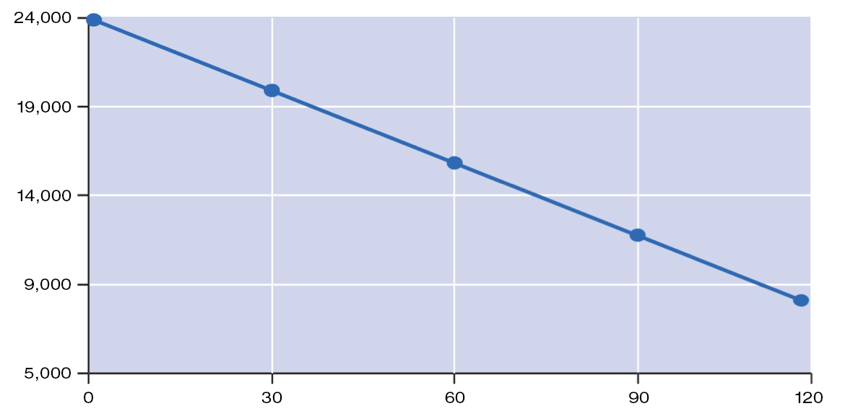
SLICES OF PIZZA
NUMBER OF MINUTES
Equation for the line: y=(-4,000/30)(x) + 24,000
Slope –4,000/30
y-intercept is 24,000

Slide 6
Warm Up #2
Customers in Pizzaville enjoy ordering pizza for delivery on Friday nights. Delivery charges in Pizzaville are $2.00 plus $1.00 for per mile.
Create a table showing the cost of ordering pizza delivery in Pizzaville for 5 miles, 10 miles and 15 miles.
Use the information from your table to graph the data on a coordinate graph. Price should be listed be on the y-axis and miles on the x-axis.
Determine the equation of the line in the slope-intercept form.
What is the slope of the line? What is the y-intercept?

Slide 7
Warm Up #2 (Solutions)
Customers in Pizzaville enjoy ordering pizza for delivery on Friday nights. Delivery charges in Pizzaville are $2.00 plus $1.00 for per mile.
Miles | 5 | 10 | 15
Price | $7.00 | $12.00 | $17.00

Slide 8
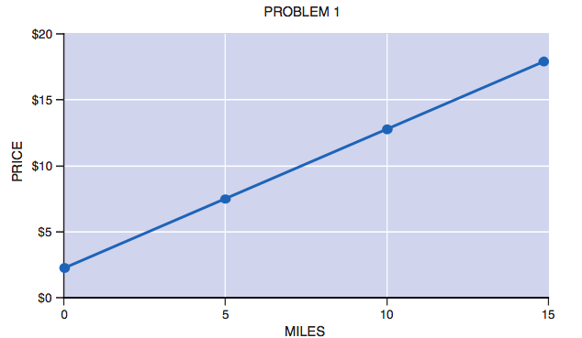
MILES
Equation for the line: y = (1/1)(x) + 2
Slope is 1
y-intercept is $2.00

Slide 9
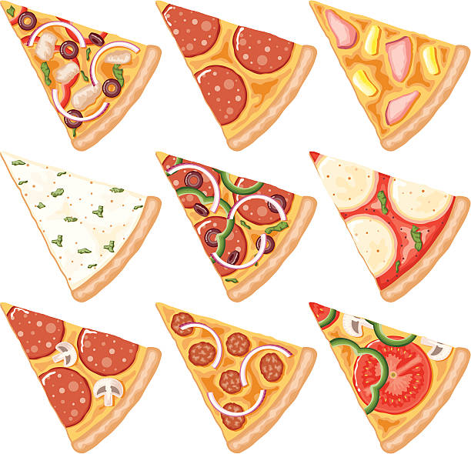
Let's dig deeper into the price of pizza

Slide 10
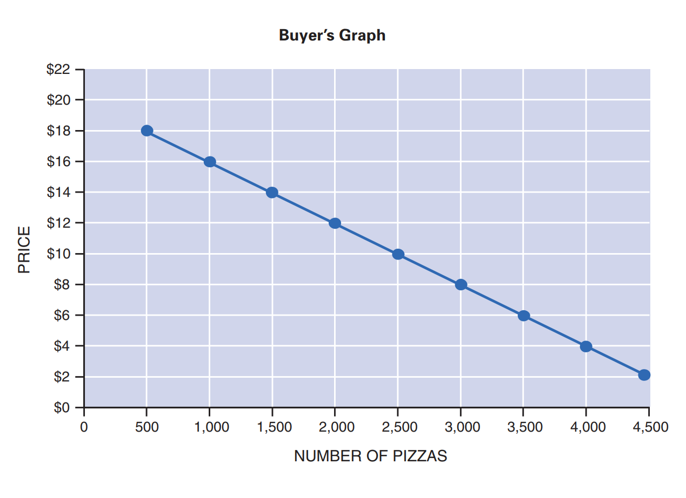
Equation of the line: y = (–1/250)(x) + 20

Slide 11
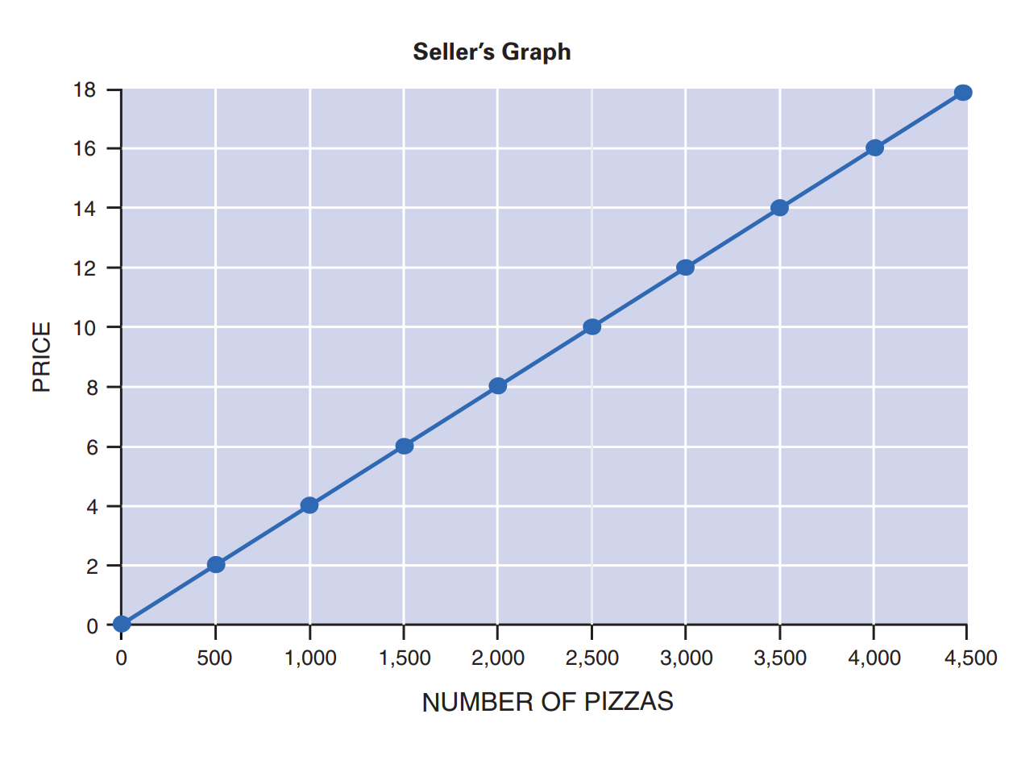
Equation for line: y = (1/250)(x)

Slide 12
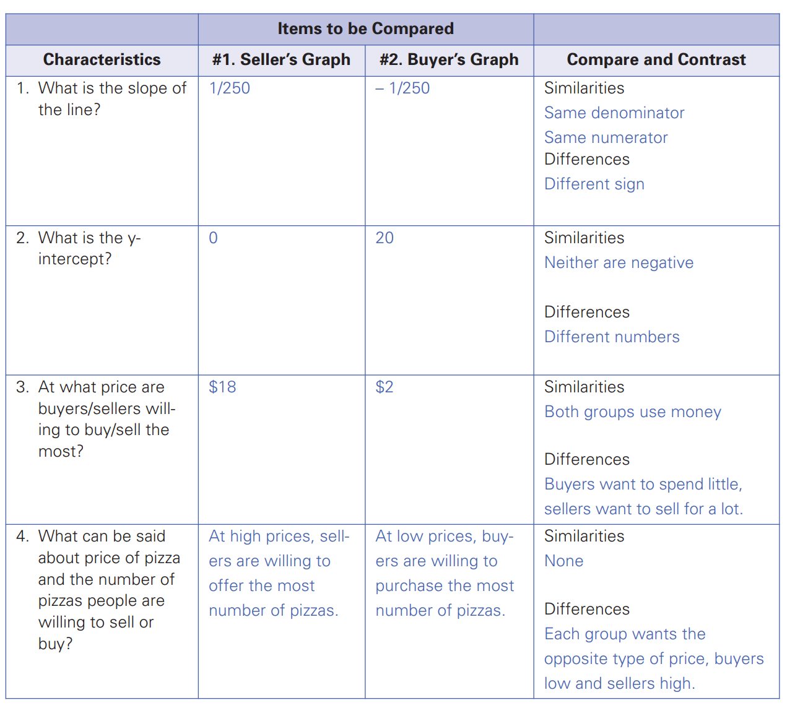

Slide 13
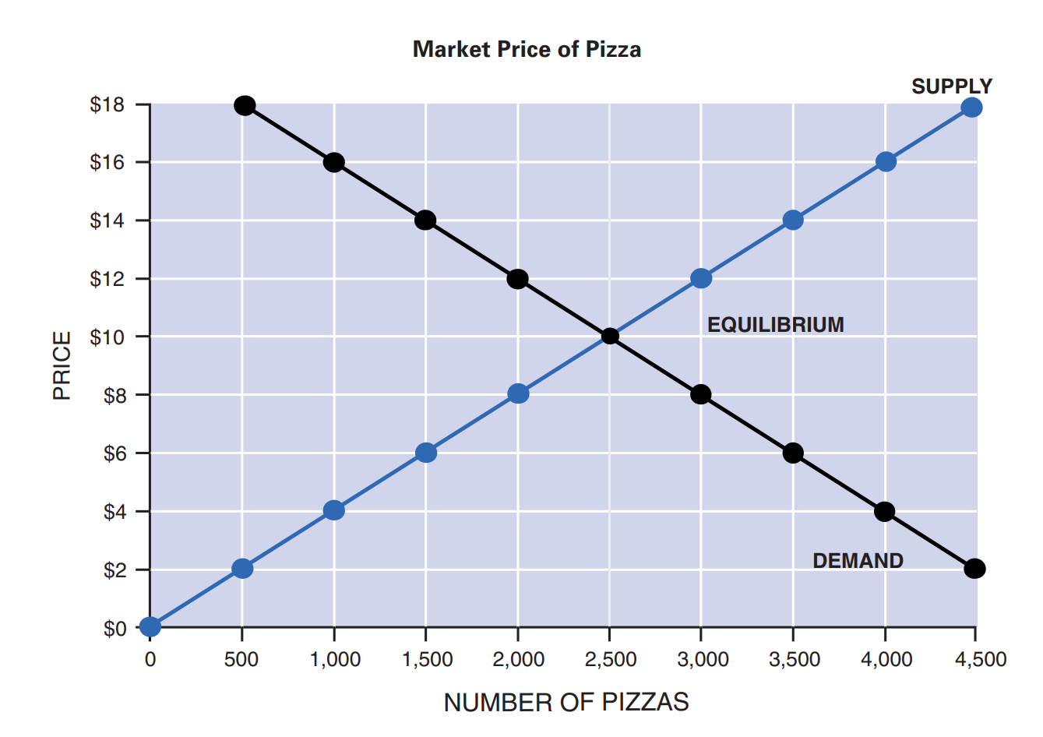
Where does the price of pizza come from?

Slide 14
Debrief
________are looking to spend as little as possible for pizza and ___________ are looking to sell at as high a price as possible.
_________ emerges from the interaction of buyers and sellers.
___________ refers to the intersection of supply and demand.

Slide 15
Debrief
Buyers are looking to spend as little as possible for pizza and sellers are looking to sell at as high a price as possible.
Price emerges from the interaction of buyers and sellers.
Equilibrium refers to the intersection of supply and demand.

