Slide 1


Level Up Your
Graphing Skills
for Investing Gains

Slide 2
EconEdLink Membership
Enjoy the perks of being an EconEdLink (EEL) member:​
​
New webinars, lesson plans, and activities added every month​
Learn from personal finance and economics experts in K-12 education​
Easily download free high-quality presentations, lessons, and activities​
Instant downloads of your webinar certificates for PD hours​
Get 20% discount at CEE's Store to purchase our bestsellers, Financial Fitness for Life and AP Economics. Use the code: EEL20​
​

Slide 3
Certificate Requirements
To earn professional development hours for webinars, you must:
Watch a minimum of 45-minutes and you will automatically receive a professional development certificate via e-mail within 24 to 48 hours.

Slide 4

Presenter
  Maria Michelsson
  Mcsmcm@gmail.com

Slide 5
Objectives
You will be able to:
Define terms such as principle, interest – simple interest and compound interest.
Graph functions and write equations representing investment trends.
Explore the similarities and differences in various types of growth (decay) curves.

Slide 6

National Standards
Savings
4-5: Financial institutions often pay interest on deposit accounts to attract customers to deposit money in their institution.
8-3: Financial institutions pay interest to depositors and loan out the money to borrowers who pay interest on their loans.
8-4: Interest earned on savings is the interest rate multiplied by the balance in the account, which includes the original amount saved (principal) and previously earned interest.
Investing
8–1: Investors in financial assets expect an increase in value over time (capital gain) and/ or receipt of regular income, such as interest or dividends.
12 -5: The prices of financial assets change in response to market conditions, interest rates, company performance, new information, and investor demand.
https://www.councilforeconed.org/policy-advocacy/k-12-standards/

Slide 7

Session Agenda
Fry's Bank Acts
Gradients and Linears
Gradients and Exponential Logarithmic Functions
Other Growth and Decay Curves
Rule 72 and Growth

Slide 8

Which coupon should be used?
Decide which coupon you would use and justify your choice with mathematical reasoning.
Notes:
Use as an intro- use waterfalling in the chat

Slide 9
Key Terms
Principal
Interest Rate
Simple Interest
Compound Interest

Slide 10
Definitions for Key Terms
Principal: The amount of money upon which interest is paid.
Interest Rate: In savings, an interest rate is the price a financial institution pays for using a saver's money and is normally expressed as an annual percentage of the amount saved.
Simple Interest: Simple interest is earned on the principal amount only.
Compound Interest: Compound interest is earned on the principal amount plus the interest already earned.

Slide 11
Fry's Bank Acts

Slide 12

ACT ONE - Fry's Bank
https://www.youtube.com/watch?v=ll0IkTKzjG8
Notes:
Introduce by sharing this is one of the 3 –Acts designed by Dan Meyers
Act 1 –poses the question
Act 2 – is working towards the solution
Act 3 – shares the solution

Slide 13
Fry's Bank Questions
How much money does
Fry have in his
bank account right now?
Think of an answer
Type a guess in the chat. ​
Include an answer that is too high and one that is too low
Activity from https://threeacts.mrmeyer.com/frysbank/

Slide 14
ACT TWO
What do you need to know to answer the question?
Seek the necessary information and the possible formulas that might be used to answer the questions.

Slide 15

ACT THREE - Fry's Bank
https://youtu.be/g9Z4d5EOjGs?feature=shared&t=45

Slide 16
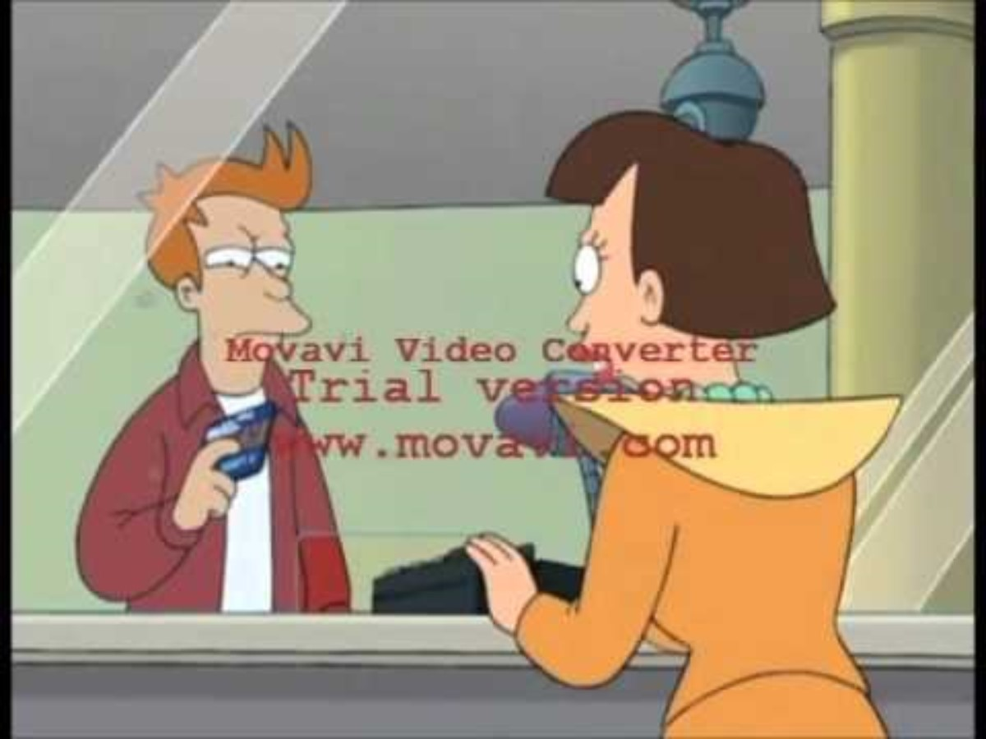
ACT THREE - Fry's Bank - Answer
Over a period of 1000 years, with an interest of 2.25%, Fry learns that the balance has compounded from less than a buck to the staggering sum of $4.3 billion.
https://www.youtube.com/watch?v=L7DvEV9kSeE&t=41s

Slide 17
Extension Questions
It took Fry 1,000 years to get that much money. How many more years will it take him to double it?
2. How long will it take him to get a trillion dollars?
We will address these questions later – once we have more information
Activity from https://threeacts.mrmeyer.com/frysbank/

Slide 18
Gradients and Linears

Slide 19


Question 1
Janeria is working 6 hours a week at $15.00 per hour. Her earnings are computed after taxes. When she gets her paycheck, she cashes it and puts the money into her piggy bank in her room (no interest).
How much does she make each week?
Write an equation that can represent the amount of money in her piggy bank If it starts with $30.00 in it, after several weeks?

Slide 20
Question 1 – Solution
Janeria is working 6 hours a week at $15.00 per hour. Her earnings are after taxes. When she gets her paycheck, she cashes it and puts the money into her piggy bank in her room (no interest).
How much does she make each week?
6 hours * $15.00 = $90.00 per week
2. Write an equation that can represent the amount of money
in her piggy bank If it starts with $30.00 in it, after several weeks?
A = $30.00 + $90.00 x;
where x represents the number of weeks

Slide 21
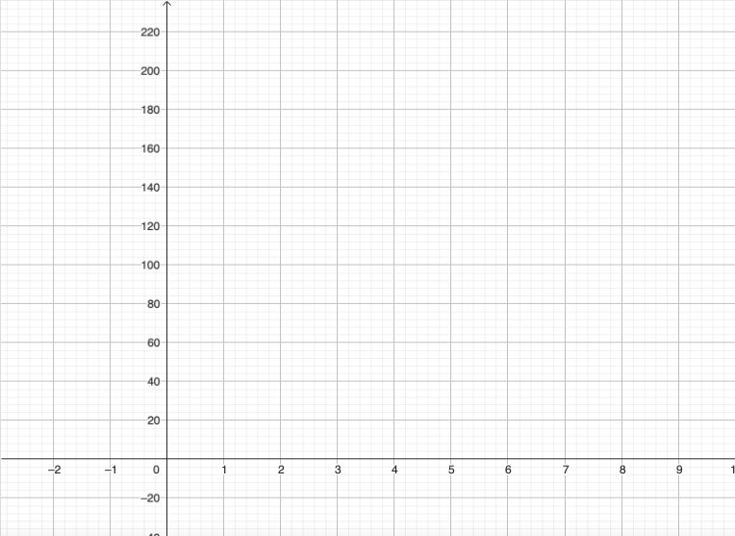

Question 1
What might the graph of that function look like?
And why?
CAREFUL!

Slide 22
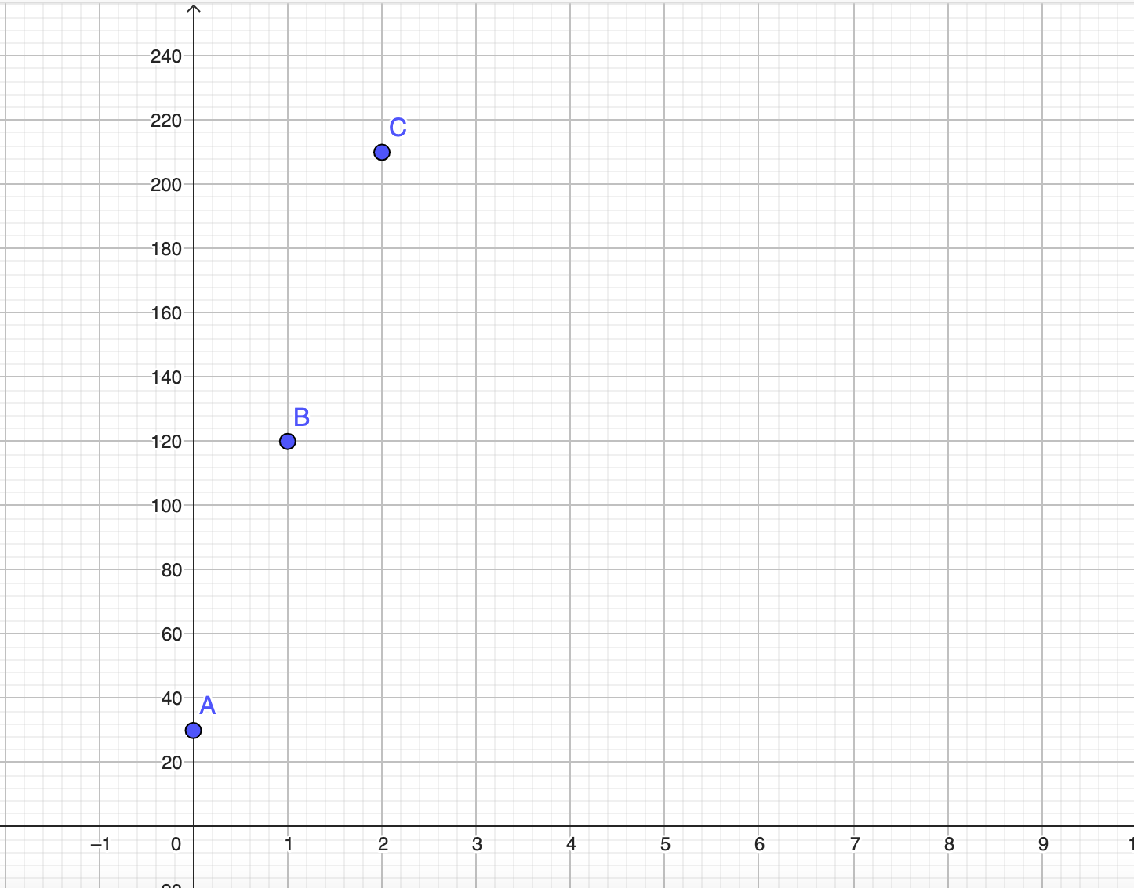
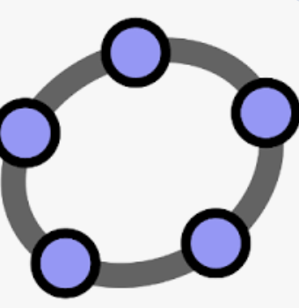
Question 1 – Solution
Question 1 – Solution
What might the graph of that function look like? And why?
SOLUTION
GeoGebra
CAREFUL!

Slide 23
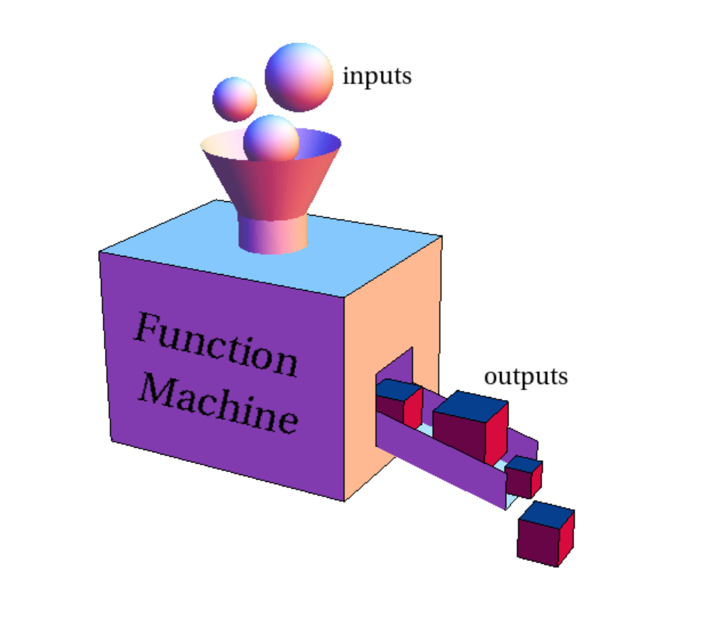
A Mathematical Function
A function, in mathematics, is an expression, rule, or law that defines a relationship between one variable (the independent variable, sometimes called "x") and another variable (the dependent variable, sometimes
called "y").
The equation can be written as y = f(x)

Slide 24

Question 2
Now, suppose Janeria wants to buy a new
television set which sells for $1,200.00.
When will she have enough money in her piggy bank to buy that T.V.?
How can you use the graph/function to help answer the question or make a prediction?
(one method to solve)

Slide 25
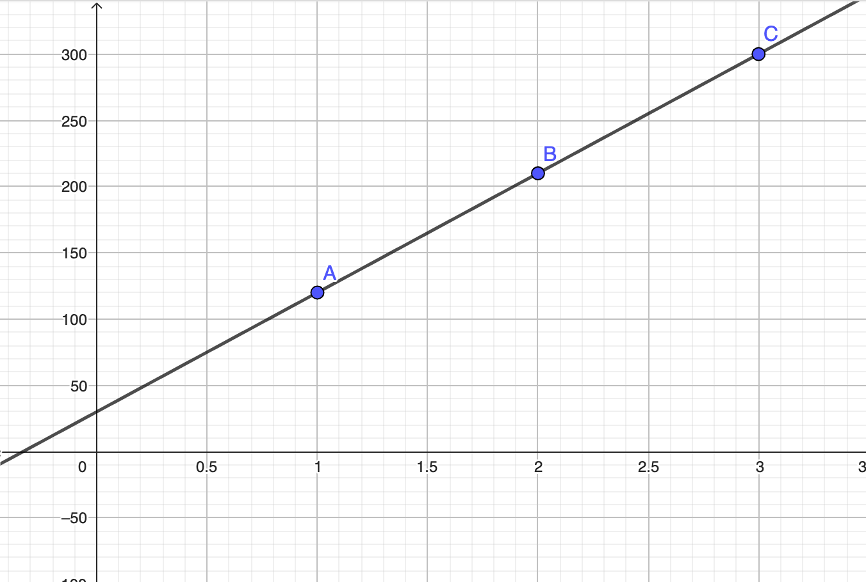
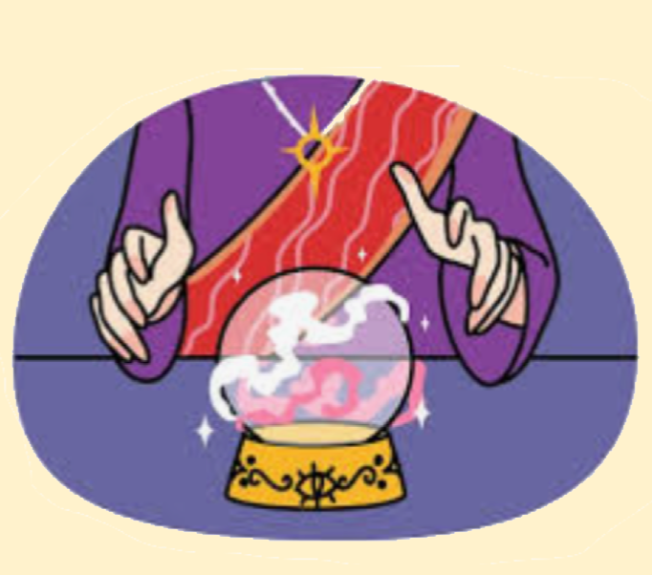
Write a function and draw a graph to help
make a prediction
SOLUTION
F(x) = 30 + 90x
GeoGebra
https://www.geogebra.org/classic/qmjrgvny

Slide 26
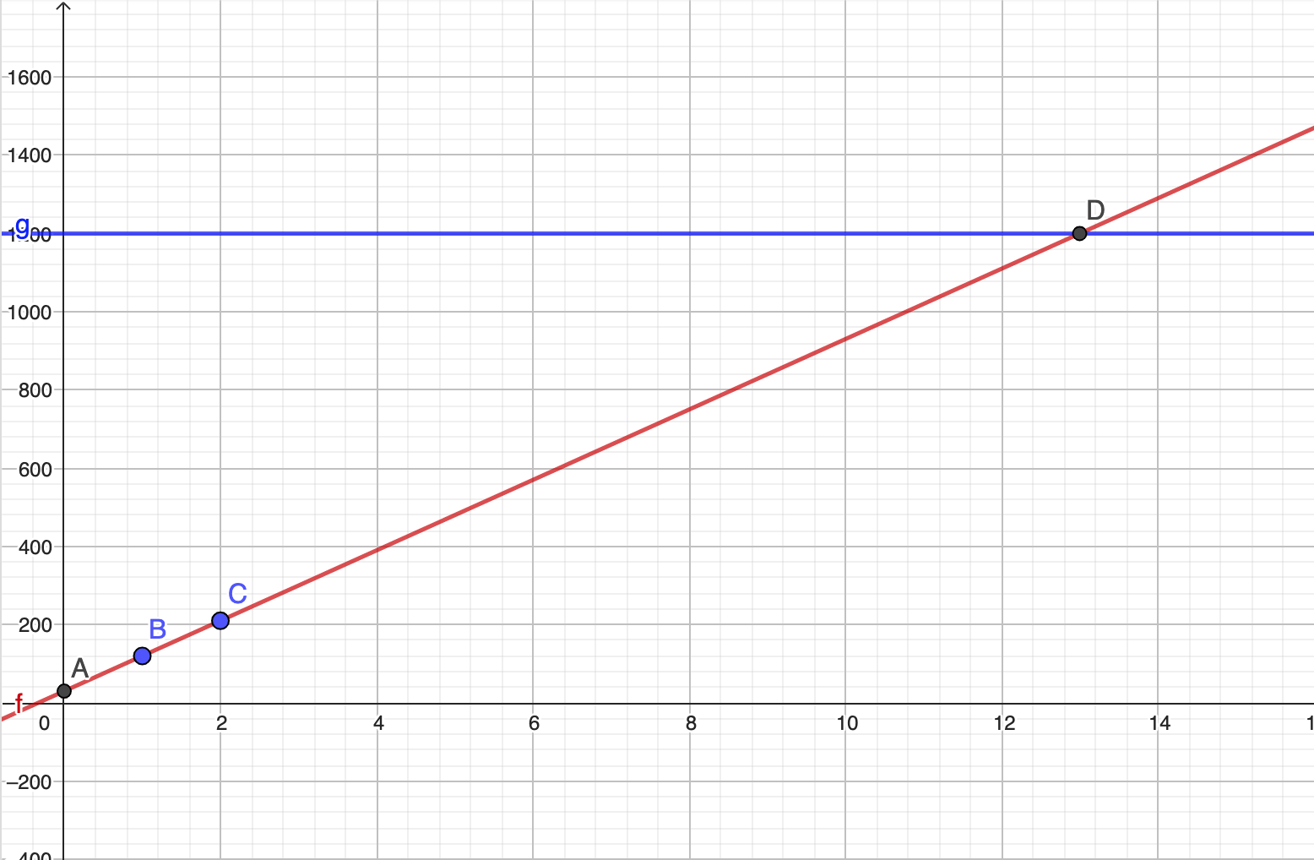
On the same set of axes,
draw another function:
g(x) = 1,200
Look at the intersection
SOLUTION
https://www.geogebra.org/classic?lang=en

Slide 27

Question 3
Next, suppose Janeria is still working 6 hours a week at $15.00 per hour. But this time when she gets her paycheck, she deposits it into her BANK, with interest.
If she wants to buy that new television that sells for $1,200.00, when will she have enough money in the bank to buy that T.V.?

Slide 28

Is there enough info given?
What else needs to be known?
Take 20 seconds to think
about what info may be helpful.

Slide 29
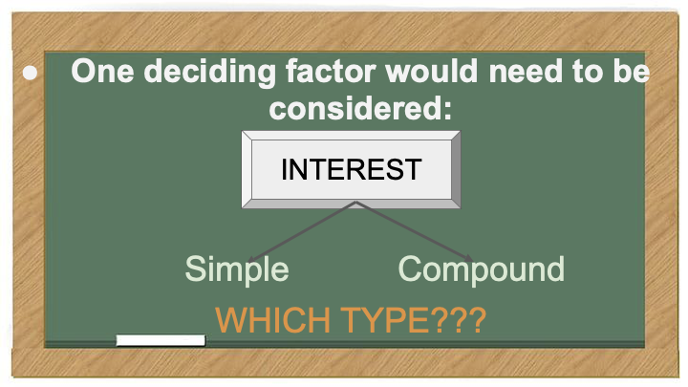

Slide 30
Question 4
Suppose Janeria deposits $4000.00 into a savings account, at the bank, which earns 6% simple interest per year.
What effect does the amount of simple interest have on the amount of money in Janeria’s account?
How much would Janeria have in the bank after one year in her account?
Be sure to read the question carefully!

Slide 31
Question 4
A few considerations...
Is it simple or compound?
How often is the interest granted?
What function(s) (formula) could be used to help answer the question?
What does the gradient(slope) tell us?

Slide 32
Question 4
Suppose Janeria deposits $4,000.00 into a savings account, at the bank, which earns 6% simple interest per year.
What might be a function to describe the amount of money in her account over “T” years?
What would the graph look like? Are the points connected? Why? What can the trend line tell you ?

Slide 33
Question 4
Suppose Janeria deposits $4,000.00 into a savings account, at the bank, which earns 6% simple interest per year.
What might be a function to describe the amount of money in her account over “T” years?
A = PRT
A = 4,000.00(.06)T
2. What would the graph look like?
Are the points connected? Why?
What can the trend line tell you ?

Slide 34
Question 4
What might be a function to describe the amount of money in her account over “T” years? (6% simple interest per year).
Year | Beginning Am't | Interest A = PRT | Final Am't
1
2
3
T |  |  | Trend?
$4000.00
4000 x 0.06 x 1
$4240.00
$4000.00
4000 x 0.06 x 2
$4480.00
$4000.00
4000 x 0.06 x 3
$4720.00
$4000.00
4000 x 0.06 x T

Slide 35
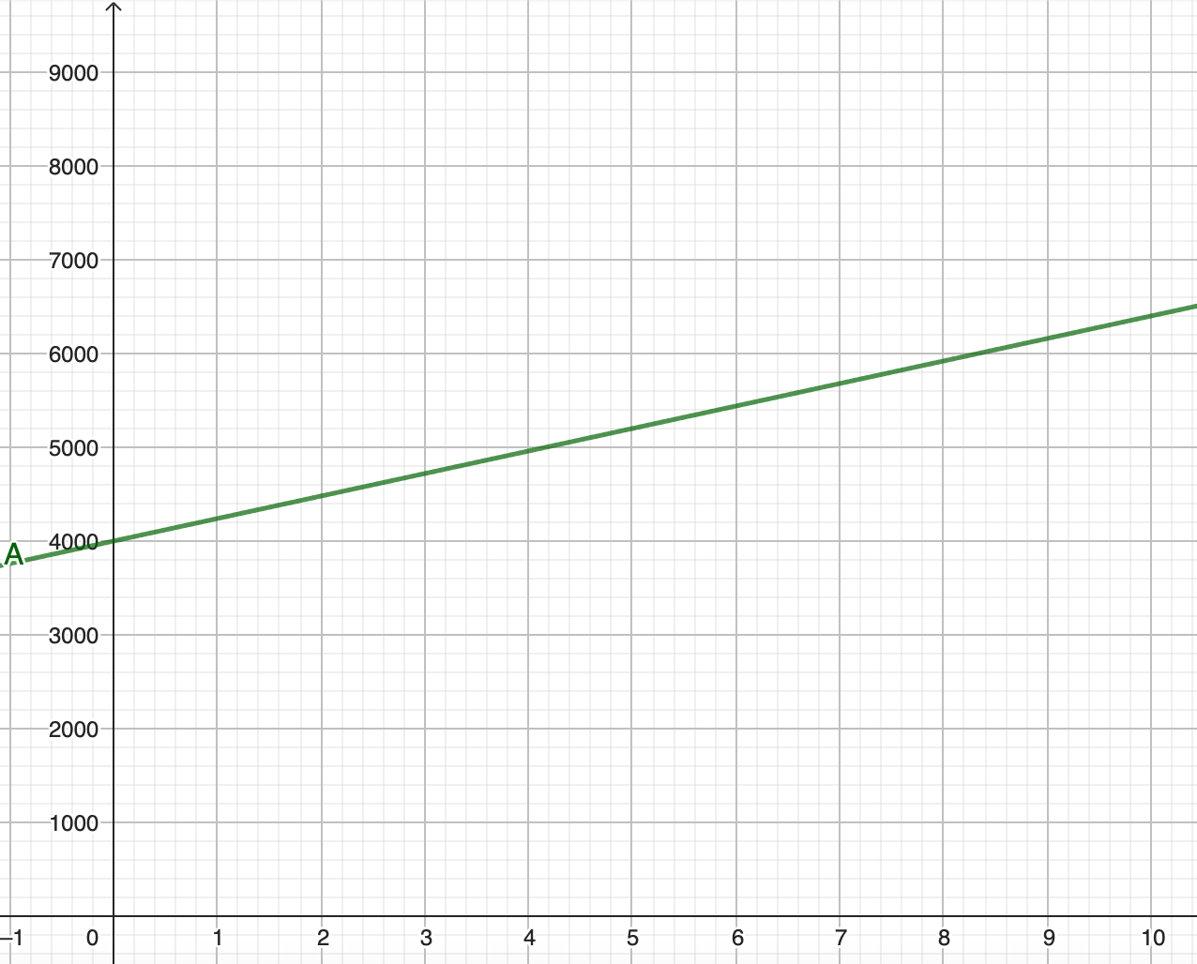
Question 4
Trend –
As the years increase what happens?
What is the amount increased at the time?
trend

Slide 36
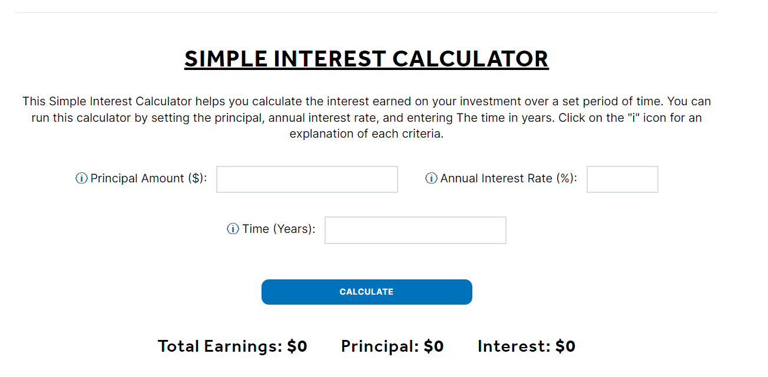
Simple Interest Calculator
GO TO https://econedlink.org/resources/simple-interest-calculator/

Slide 37
Gradients and Exponential Logarithmic Functions

Slide 38
Another Type of Interest
COMPOUND INTEREST
What is the difference between simple interest and compound interest?
2. What are some terms associated with “Compound Interest”?
3. Is the graph still linear?

Slide 39
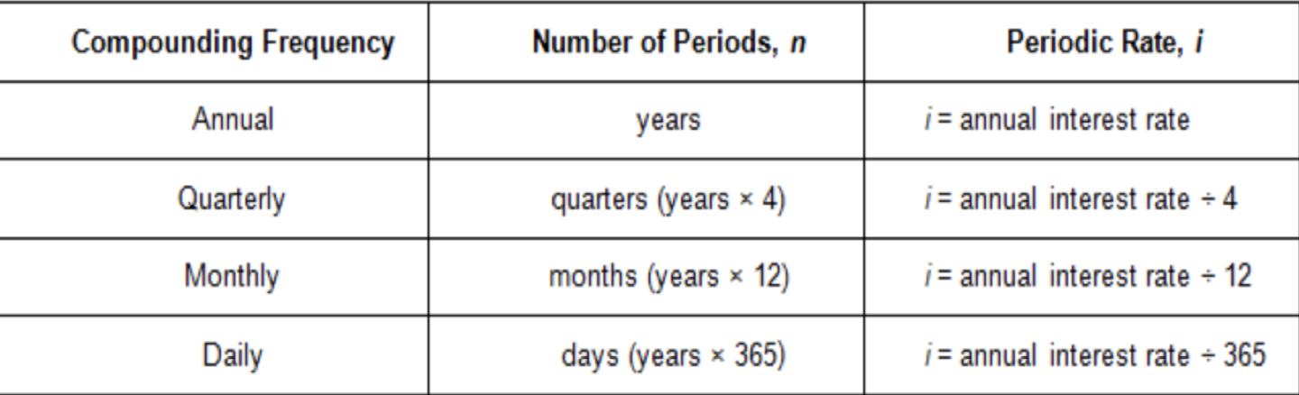
Compound Interest
Terms associated with "Compound Interest"

Slide 40
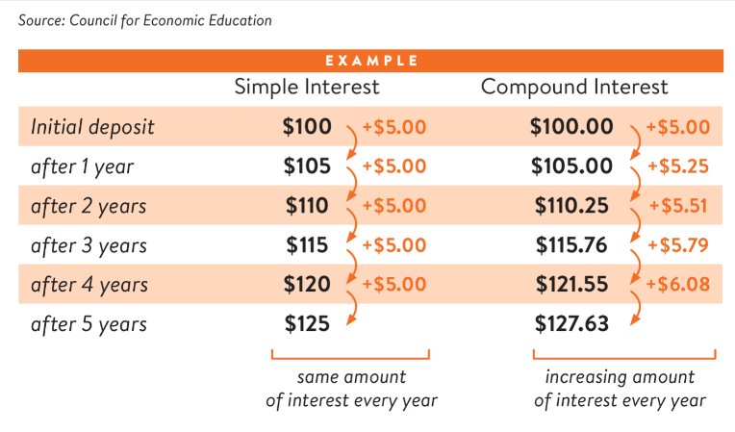
Compare

Slide 41
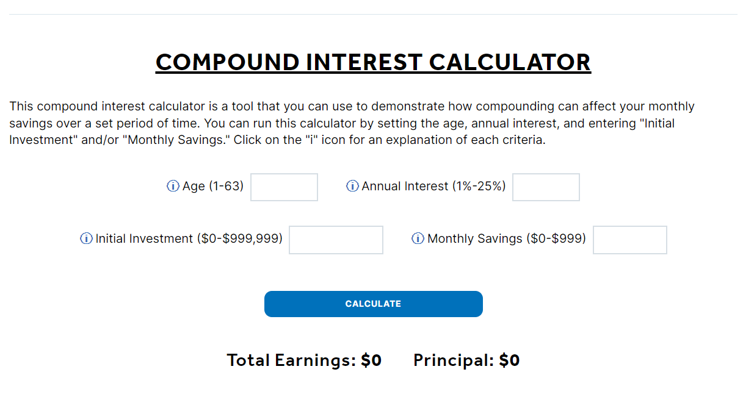
Compound Interest Calculator
GO TO https://econedlink.org/resources/compound-interest-calculator/

Slide 42
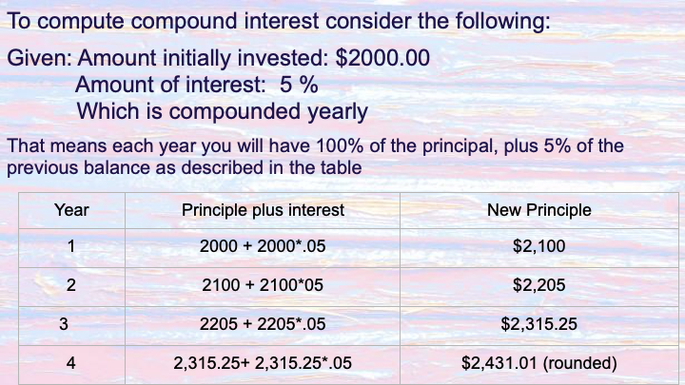
How do you calculate compound interest?
Amount initially invested: $2,000.00
Amount of interest compounded yearly: 5%
That means you will have 100% of the principal each year, plus 5% of the previous balance as described in the table.

Slide 43
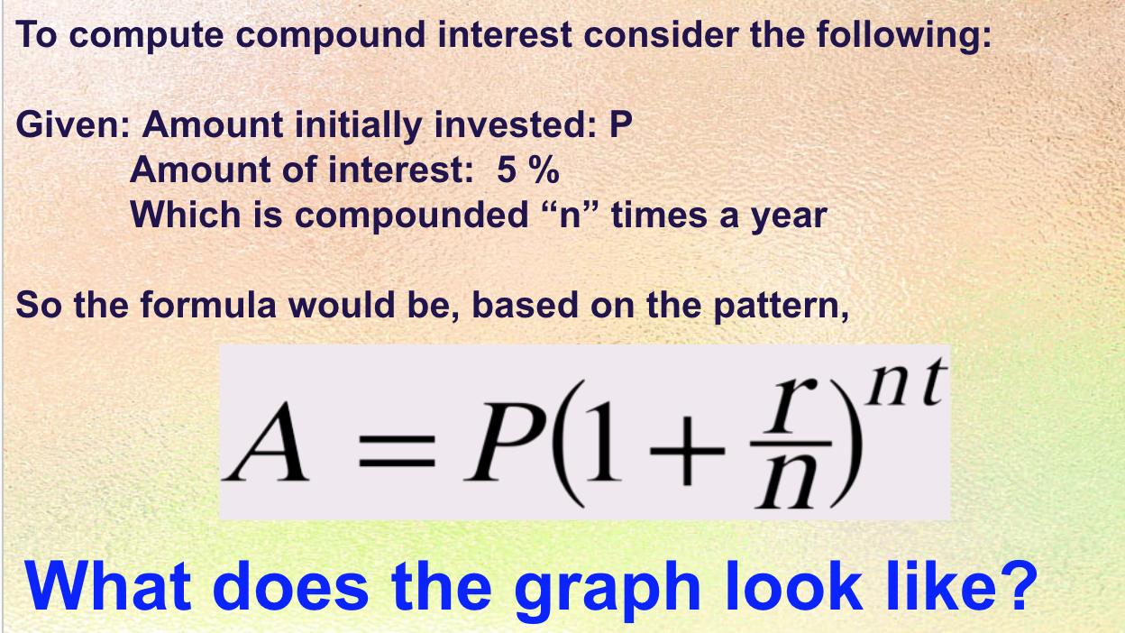
What is the formula?
Amount initially invested: P
Amount of interest compounded "n" times a year: 5%
Careful -> rate is expressed as a percent in the question but must use a fraction or decimal in the formula
The formula would be based on the pattern.

Slide 44
Question 1
Jason invested $5000.00 in an account that gives 6% with interest compounded _____ for “x” years.
Annually A = 500(1+.06/1)^(1*x)
Semi- Annually A = 500(1+.06/2)^(2*x)
Monthly A = 500(1+.06/12)^(12*x)
GEOGEBRA
Let's graph it ---->
https://www.geogebra.org/classic/nha3nhrh

Slide 45
Question 2 – Compare the Graphs
What is the same?
What is different?
SAME BUT DIFFERENT MATH

Slide 46
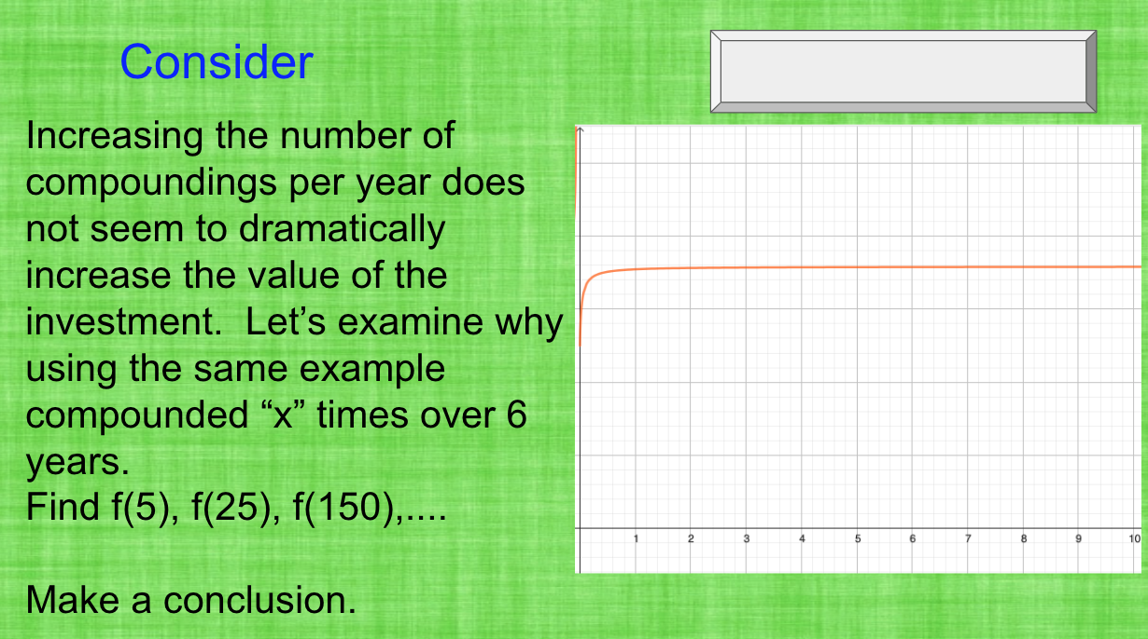
Question 4
Now, consider increasing the number of compounding per year. It does not seem to dramatically increase the value of the investment.
Let's examine why using the same example compounded "x" times over 6 years.
Find f(5), f(25), f(15)…
Make a conclusion.
GEOGEBRA

Slide 47
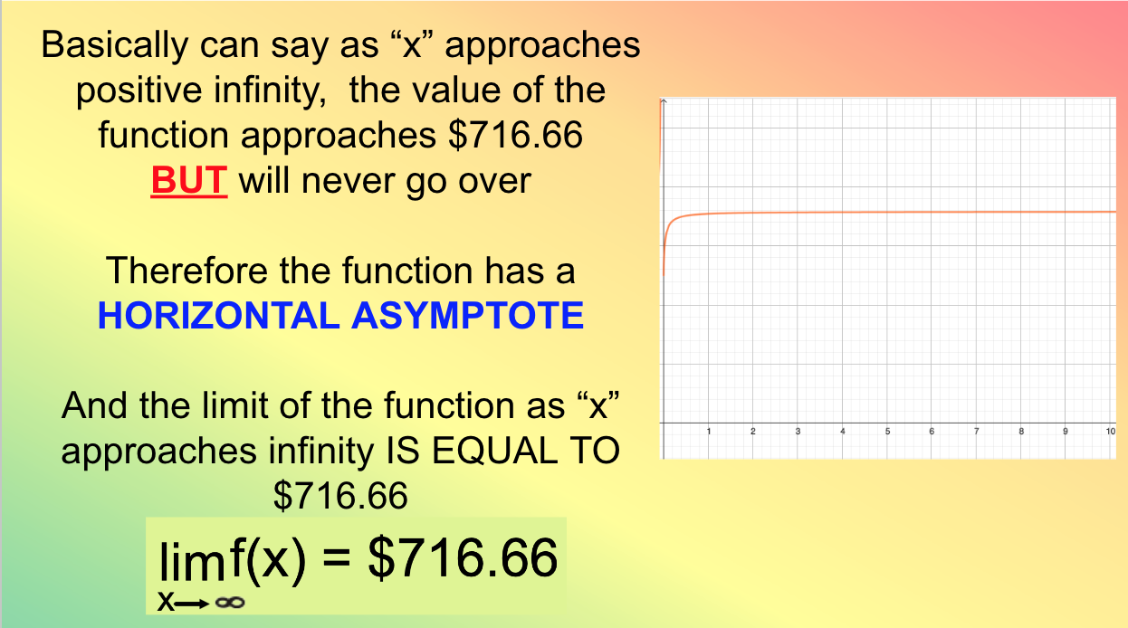
Question 4
As "x" approaches positive infinity, the value of the function approaches $716.66 BUT will never go over
Therefore, the function has a HORIZONTAL ASYMPTOTE
The limit of the function as "x" approaches infinity IS EQUAL TO $716.66
GEOGEBRA
https://www.geogebra.org/classic/n6hypzmx

Slide 48
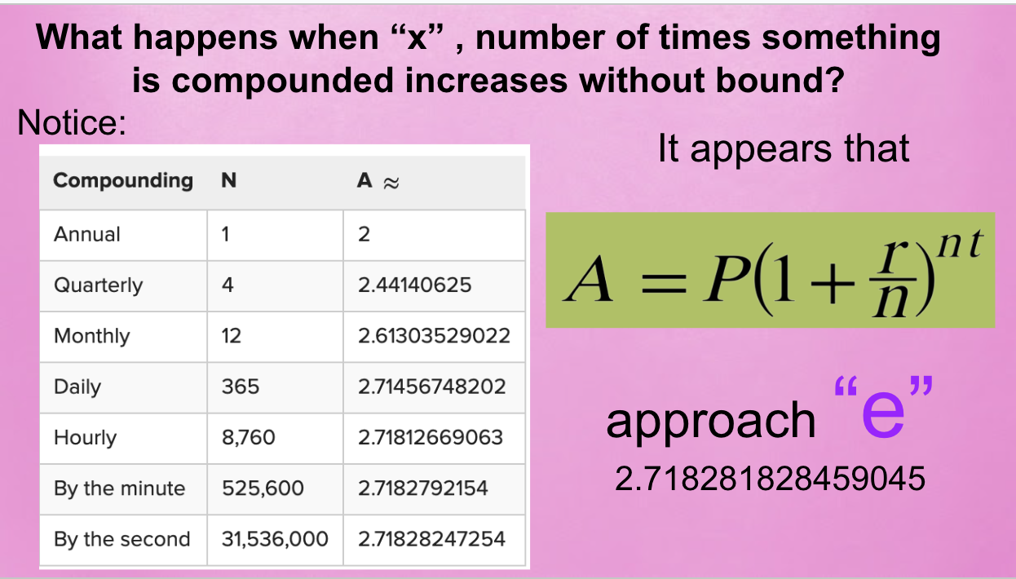
Question 5
What happens when "x" number of times something is compounded increases without bound?

Slide 49
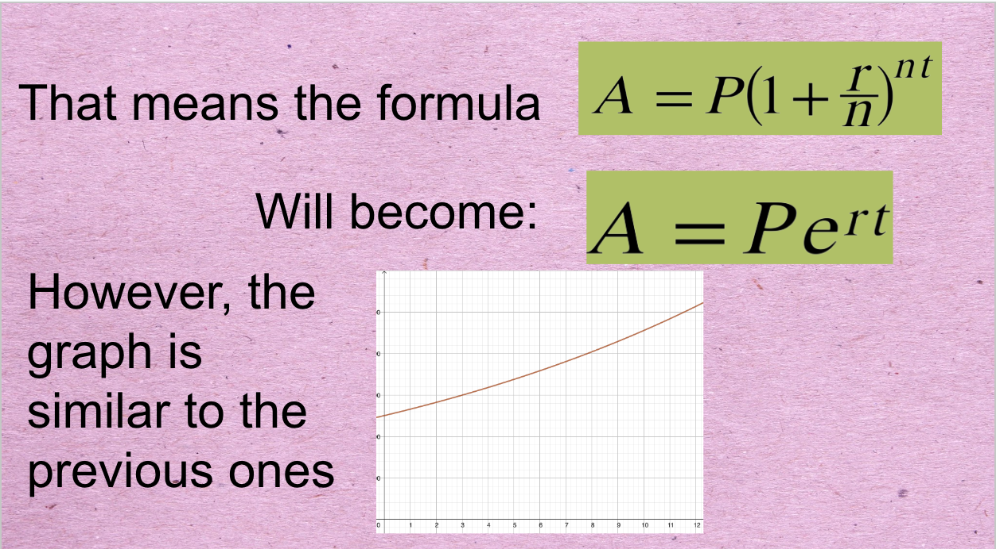
Question 5
This means the formula is
Then will become
Notice that this graph is similar to the previous ones

Slide 50
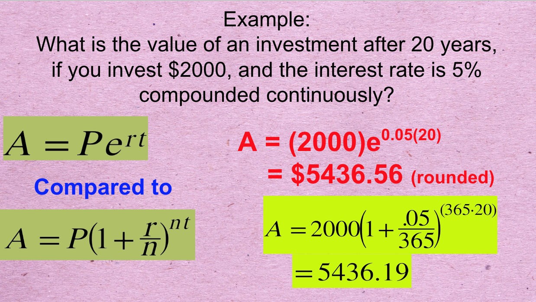
Question 6
What is the value of an investment after 20 years if you invest $2,000, and the interest rate is 5% compounded continuously?

Slide 51
Other Growth and Decay Curves

Slide 52
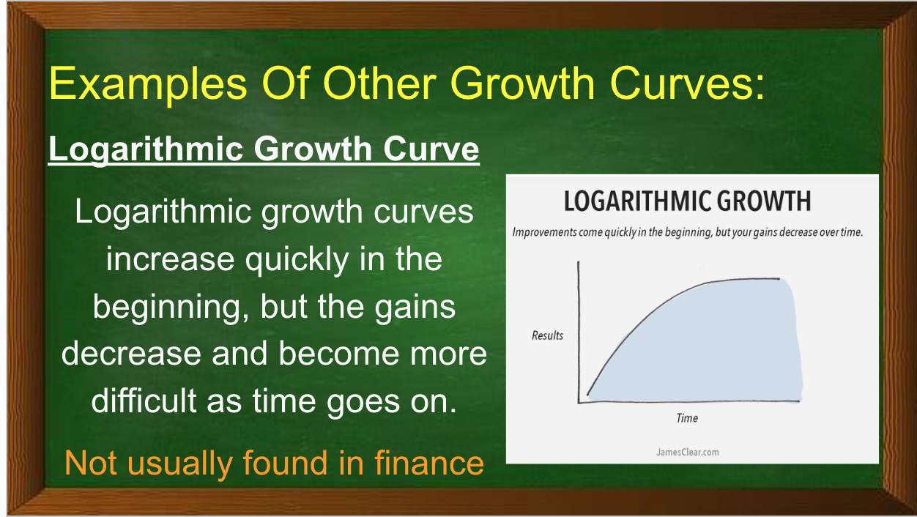
Examples of Other Growth Curves
Logarithmic Growth Curve
As "x" approaches positive infinity, the value of the function approaches $716.66 BUT will never go over
Therefore, the function has a HORIZONTAL ASYMPTOTE
The limit of the function as "x" approaches infinity IS EQUAL TO $716.66

Slide 53
Examples of Other Growth Curves
Logarithmic Growth Curve
Logarithmic growth curves increase quickly in the beginning, but the gains decrease and become more difficult as the time goes on.
*This is not usually found in finance.

Slide 54
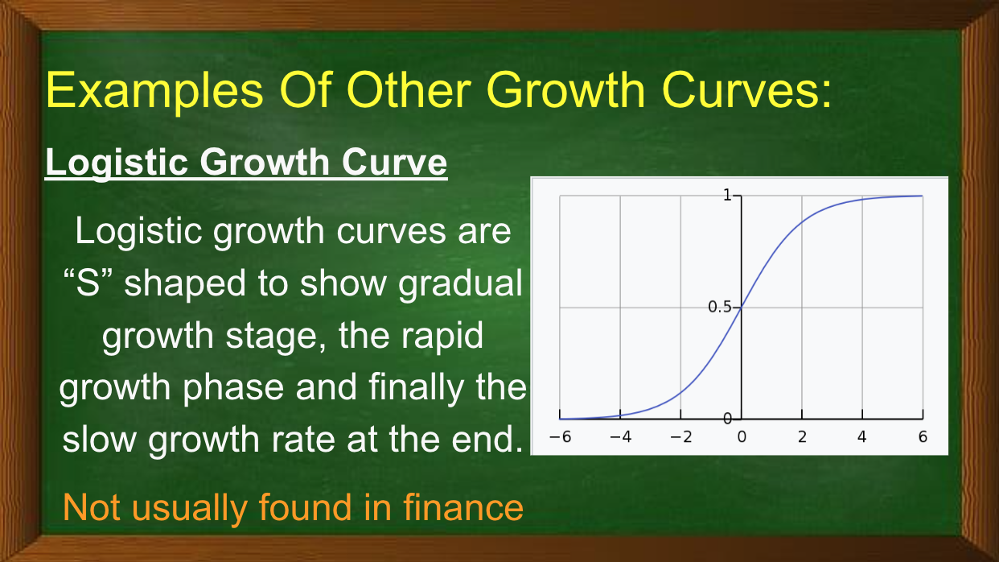
Examples of Other Growth Curves
Logistic Growth Curve
Logistic growth curves are "S" shaped to show gradual growth stage, the rapid growth phase and finally the slow down growth rate at the end.
*This is not usually found in finance.

Slide 55
Examples of Other Growth Curves
In All Growth Curves...
The gradient (slope) helps to determine the rate of the growth:
The smaller the slope = the slower the growth or decay, the slower the rate of change
The rate of change tells us how much change there is over a single unit of measure. It can also help us forecast what will happen in the future

Slide 56
Rule 72 and Growth

Slide 57
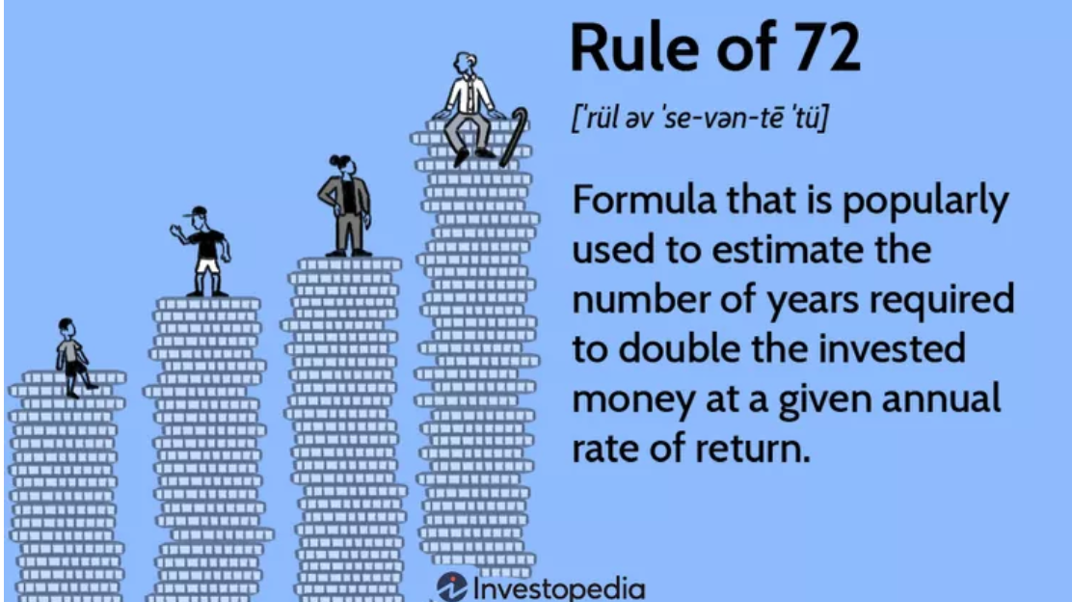
The Rule of 72
The Rule of 72 could apply to anything that grows at a compounded rate.

Slide 58
How to use the "Rule of 72"
If an investment has an 8% annual compounded rate of return, when will that investment amount double?
Divide 72 by the percent: 72/8
72/8 = 9
Therefore, it will take approximately 9 years for the initial amount invested to double

Slide 59
Extension Questions
It took Fry 1,000 years to get that much money. How many more years will it take him to double it?
We can use the Rule of 72 to approximate the time needed. (one method)
2. How long will it take him to get a trillion dollars?
Activity from https://threeacts.mrmeyer.com/frysbank/

Slide 60
The Rice and Chessboard Story
There's a famous legend about the origin of chess that goes like this:
When the inventor of the game showed it to the emperor of India, the emperor was so impressed by the new game, that he said to the man:
"Name your reward!"

Slide 61
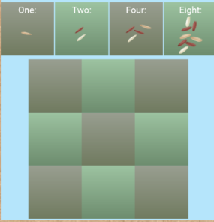
The Rice and Chessboard Story
The man responded,
"Oh emperor, my wishes are simple. I only wish to this. Give me one grain of rice for the first square of the chessboard, two grains for the next square, four for the next, eight for the next, and so on for all 64 squares, with each square having double the number of grains as the square before."

Slide 62
The Rice and Chessboard Story
The emperor agreed, amazed that the man had asked for such a small reward – or so he thought.
After a week, his treasurer came back and informed him that the reward would add up to an astronomical sum, far greater than all the rice that could conceivable be produced in many, many centuries!
Can use the geometric sequences/series too

Slide 63

Another 3 – Acts
NIGHT EYES
https://www.youtube.com/watch?v=Ns7o5x4V6gY&t=2s

Slide 64
Take Aways:
The Strong Connection between Investment Growth And The Gradient Of The Function Describing That Growth
The Practical Application Of A Mathematical Concept
Graphic Representation of Growth
How To Set Up A Function To Describe Certain Types Of Growth
Similarities And Differences

Slide 65
Contact Me
  Maria Michelsson
  Mcsmcm@gmail.com

Slide 66


Slide 67
Find A Local State Program
CEE's affiliated network of 200 organizations educates the educators: providing the curriculum tools, the pedagogical support, and the community of peers that instruct, inspire, and guide. They are the ears on the street and a voice in the community for our programs.
Search our Directory
https://www.councilforeconed.org/about/state-affiliates/

Slide 68





Our Generous Sponsors and Partners

Slide 69

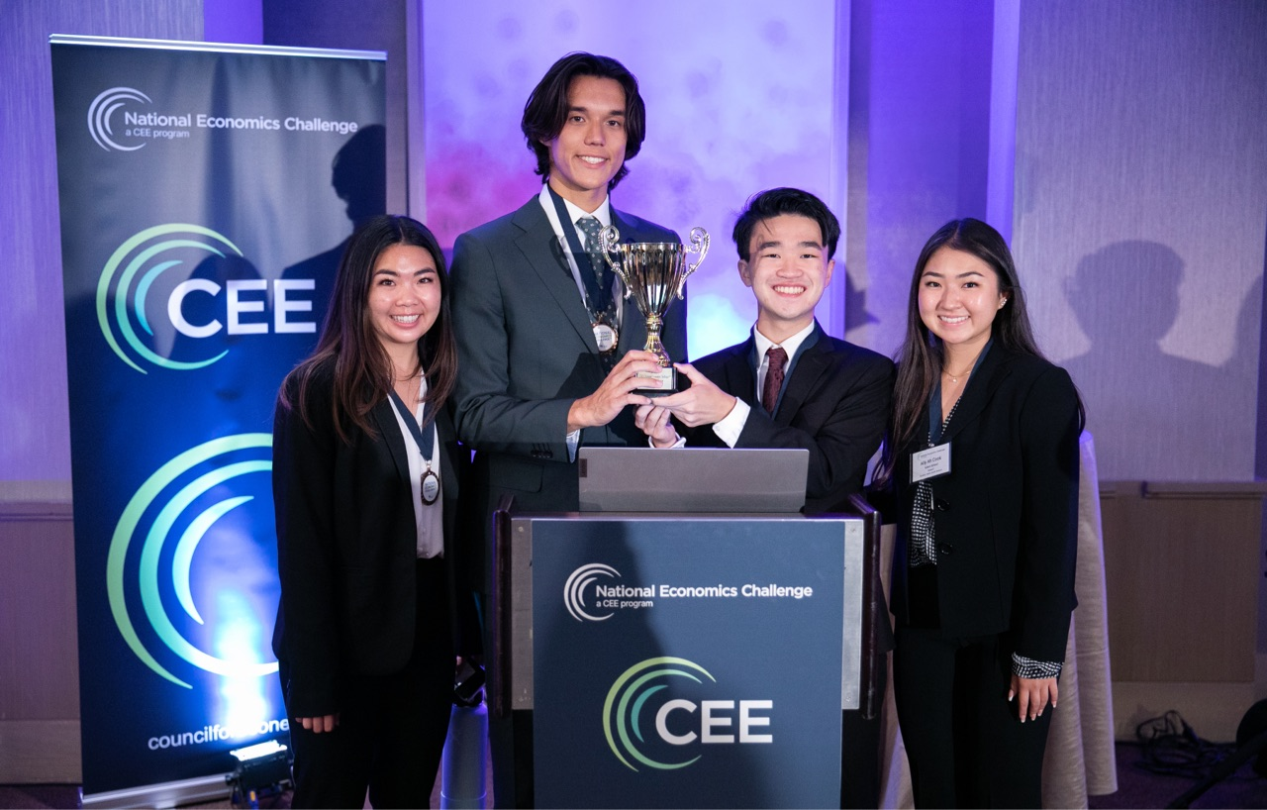

CEE Student Programs
Invest in Girls
National Economics Challenge
National Personal Finance Challenge

Slide 70
Thank you!

