Slide 1


AP MICROECONOMICS
POST-EXAM ANALYSIS
DISCLAIMER: This presentation is not sponsored by the College Board, and only reflects the presenter’s analysis of the 2024 AP Micro free response questions.

Slide 2
EconEdLink Membership
Enjoy the perks of being an EconEdLink (EEL) member:​
​
New webinars, lesson plans, and activities added every month​
Learn from personal finance and economics experts in K-12 education​
Easily download free high-quality presentations, lessons, and activities​
Instant downloads of your webinar certificates for PD hours​
Get 20% discount at CEE's Store to purchase our bestsellers, Financial Fitness for Life and AP Economics. Use the code: EEL20​
​

Slide 3
Certificate Requirements
To earn professional development hours for webinars, you must:
Watch a minimum of 45-minutes and you will automatically receive a professional development certificate via e-mail within 24 to 48 hours.

Slide 4

Presenter
Name: Kathleen Brennan
Email Address: kmbrennan108@gmail.com
Social Handles X : @econkate
Instagram: @kmbrennan108

Slide 5
Objectives
Review the 2024 AP Microeconomics Free- Response Questions (FRQ’s).
Learn effective strategies to explain the answers to the FRQ’s.

Slide 6

Session Agenda
FRQ’s- Set 1 Analysis
2. FRQ’s- Set 2 Analysis

Slide 7
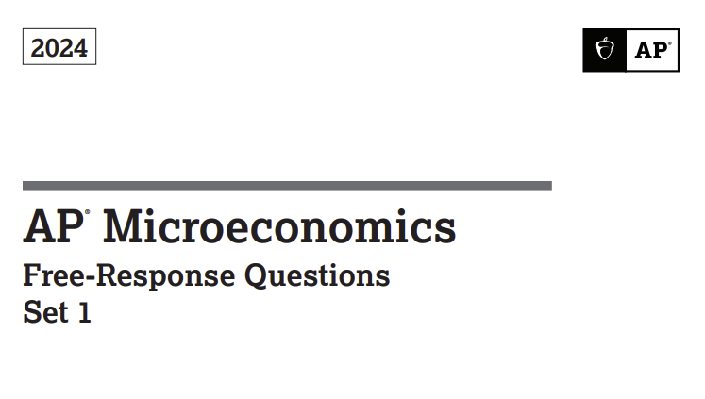

Slide 8
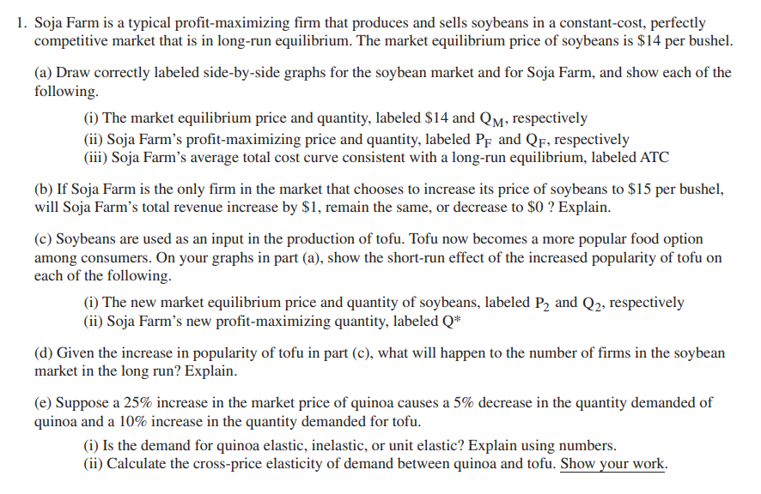
Set 1: Question 1

Slide 9
1a. Draw a correctly labeled side-by-side graph for the Soybean Market and Soja Farm.
P
S
P
MC
ATC
$14
Pf
MR=D= AR= P
D
Qm
Q
Qf
Q
Soybean Market
Soja Farm
9

Slide 10
1b. If Soja is the only firm that increases price to $15 per bushel, will Soja’s total revenue increase by $1, remain the same, or decrease to $0? Explain.
Decrease to $0 since demand for Soja Farm’s soybeans is perfectly elastic, meaning that Soja can sell all they want at $14/bushel and nothing if they raise the price to $15.
Decrease to $0 since Soja is a price taker.

Slide 11
1c. Soybeans are used as an input to tofu and tofu’s popularity has increased. Show the short-run effect of the increased
popularity on the graphs in part (a).
P
S
P
MC
ATC
P2
MR₁=D₁
$14
$14
MR=D= AR = P
D2
D
Q
Q
Qm Q2
Qf
Q*
Soybean Market
Soja Farm
11

Slide 12
1d. Given the increase in popularity of tofu in part (c), what will happen to the number of soybean farms in the long-run? Explain.

Slide 13
1e. Suppose a 25% increase in the market price of quinoa causes a 5% decrease in the quantity demanded of quinoa & a 10% increase in the quantity demanded for tofu.
Is the demand for quinoa, elastic, inelastic, or unit elastic? Explain using numbers.
  Elasticity of demand = %Δ Qd / %Δ P
  = - 5%/+25%
  = -0.20
  Absolute value = 0.20 < 1, inelastic
  (ii.) Calculate the cross-price elasticity of demand between quinoa and tofu. Show your work.
  Cross-price elasticity= %Δ Qd of good A / %Δ P of good B
  = +10%/+25%
  = 0.40

Slide 14
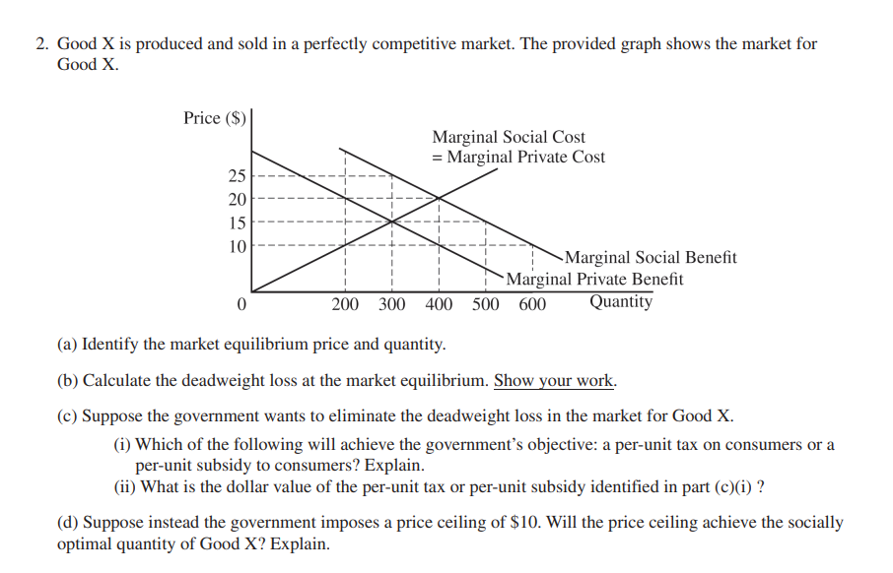
Set 1: Question 2

Slide 15
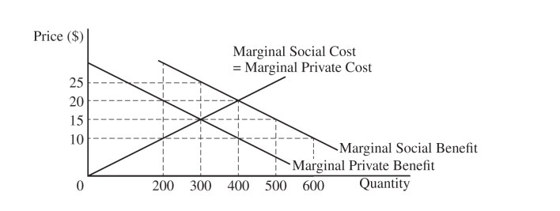

2. Good X is produced and sold in a perfectly competitive market. The provided graph shows the market for Good X.
Identify the market equilibrium price and quantity.
P=$15, Q= 300
(b) Calculate the deadweight loss at the market equilibrium. Show your work.
DWL= ½ (bxh)
= ½ (25-15)(400-300)
= ½ (10)(100)
= 500

Slide 16
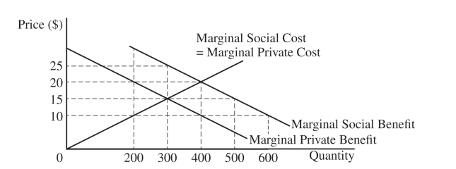
2c. Suppose the government wants to eliminate the deadweight loss in the market for Good X.
i. Which of the following will achieve the government’s objective: a per-unit tax or a per-unit subsidy to consumers? Explain.
A per-unit subsidy is appropriate. Since MSB>MPB, the market equilibrium is less than the socially optimal quantity. To eliminate the DWL, the government should provide a per-unit subsidy to consumers so that the MPB shifts to MSB.
ii. What is the total value of the per-unit tax or per-unit subsidy identified above?
The per-unit subsidy is equal to the vertical distance between the MSB and MPB-- e.g. $20-$10 = $10.

Slide 17


2d. Suppose the government imposes a price ceiling of $10. Will the price ceiling achieve the socially optimal quantity? Explain.
No. At the price ceiling of $10, consumers will demand the socially optimal quantity of 400, but producers will only be willing to supply 200, resulting in a shortage of 200.
Additionally, the price ceiling results in 200 units being provided which is 100 less than the 300 the private market would provide in the absence of the ceiling.
The price ceiling increases the DWL by moving the amount exchanged further away from the socially optimal amount.
Qs= 200 Qd= 400

Slide 18
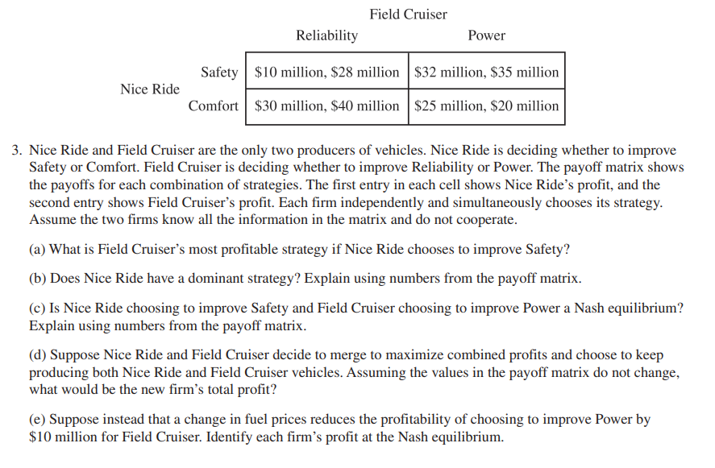
Set 1: Question 3

Slide 19
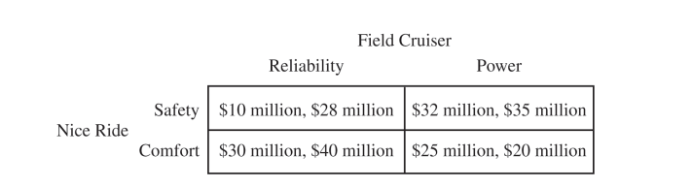




3a. What is Field Cruiser’s most profitable strategy if Nice Ride chooses to improve safety?
If Nice Ride chooses safety, Field Cruiser should improve power, since their profits will be higher. ($35 mill>$28 mill).

Slide 20
3b. Does Nice Ride have a dominant strategy? Explain using numbers from the matrix.
No. If Field Cruiser chooses Reliability, Nice Ride should choose Comfort since their profits are higher ($30 mil>$10 mil).
If Field Cruiser chooses Power, then Nice Ride should choose Safety since their profits are higher ($32 mil>$25).
Since Nice Ride’s decision depends on what Field Cruiser does, Nice Ride does not have a dominant strategy.

Slide 21


3c. Is Nice Ride choosing to improve Safety and Field Cruiser choosing to improve Power a Nash equilibrium?
Explain using numbers.
Yes, that combination of choices is a Nash equilibrium. There is no incentive for either one of them to change their decision.
Given that Field Cruiser chooses power, Nice Ride will have no incentive to alter its decision to focus on Safety since it will make $32 mil in profits vs. $25 mil if it focuses on Comfort.
Similarly, Field Cruiser will have no incentive to change its decision to focus on Power rather than Reliability. It will make $35 mil in profit vs. only $28 mil in profits if it switches to Reliability.

Slide 22
3d. Assume the firms merge to maximize profits and choose to continue producing both vehicles. Assuming the numbers in the matrix don’t change, what would be the new firm’s total profit?
$10+$28 = $38 | $32+$35 = $67
$30+$40 = $70 | $25+$20= $45
The new firm’s total profits would be $70 million.

Slide 23
3e. Suppose instead that a change in fuel prices reduces the profitability of choosing to improve Power by $10 mil for Field Cruiser. Identify each firm’s profit at the Nash equilibrium.
$10mil $28mil | $32mil $25mil
$30mil $40mil | $25mil $10mil
There is now only one Nash equilibrium that’s different from the one in 3c.
The Nash equilibrium is where Nice Ride chooses Comfort and Field Cruiser chooses Reliability. Neither firm has an incentive to change from this position.
Nice Ride’s profits are $30 mil, and Field Cruiser’s profits are $40 mil.

Slide 24
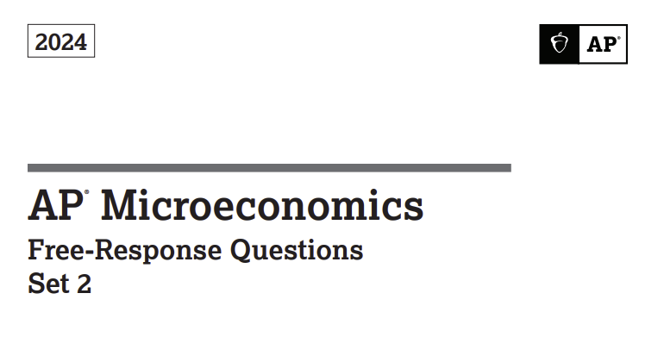

Slide 25
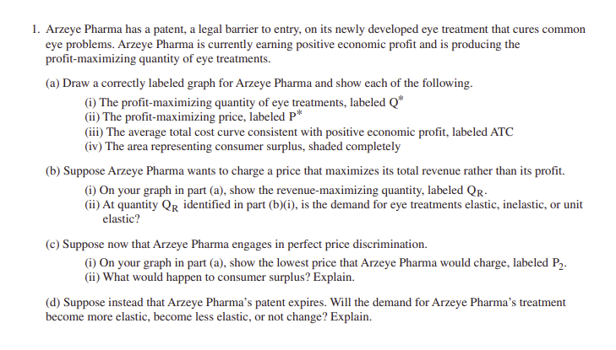

Slide 26









1a. Draw a correctly labeled graph for Arzeye Pharma and show each of the following—Q*, P*, ATC with positive economic profit, consumer surplus.
P, $
MC
ATC
P*
P2
D
Q*
MR
Q
26

Slide 27










1b. Suppose Arzeye wants to charge a price that maximizes its total revenue.
(i.) Label the revenue-maximizing quantity as QR.
P, $
MC
ATC
P*
] [
P2
D
Q*
QR
MR
Q
27

Slide 28
P
Elastic
Inelastic
b (ii) At the quantity QR, is the demand for eye treatment elastic, inelastic, or unit elastic?
Unit elastic
D
Q
TR
MR
TR
Q
28

Slide 29
1c. Suppose that Arzeye engages in perfect price discrimination.
(i) Show the lowest price Arzeye would charge, labeled as P2.
(ii) What happens to consumer surplus?
Consumer surplus decreases to 0 since each person would pay a price equal to their maximum willingness to pay.
P, $
MC
ATC
P*
P2
D
Q*
MR
Q
29

Slide 30
1d. Suppose that the patent expires. Will the demand for Arzeye’s eye treatment become more elastic, less elastic, or not change?
Demand will become more elastic since other firms will provide eye treatment substitutes.

Slide 31
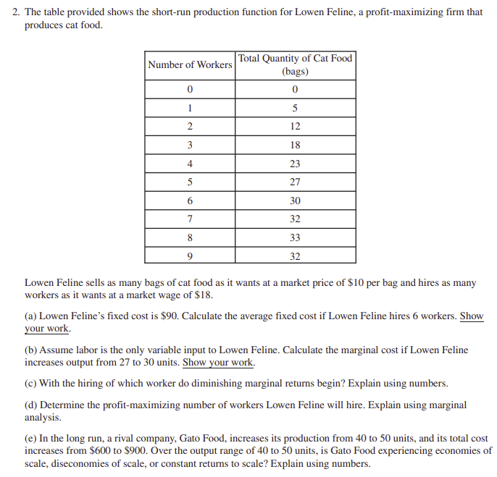

Slide 32
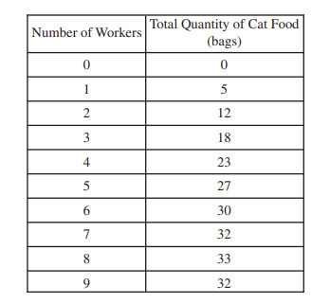
Lowen’s fixed cost is $90. What is the average fixed cost if Lowen hires 6 workers?
6 workers produce 30 bags of cat food.
AFC = TFC/Q
= 90/30
= $3
b. Calculate the marginal cost if Lowen increases output from 27 to 30 bags.
To increase production from 27 to 30 bags, Lowen will hire one more worker at an additional cost of $18.
MC= ΔTC/ΔQ
= 18/(30-27)
= 18/3
= 6

Slide 33
# of workers | # of bags | Marginal Product (MP) | Marginal Revenue (MR) | Marginal Revenue Product (MRP)
0 | 0 | 0 | 10 | 0
1 | 5 | 5 | 10 | 50
2 | 12 | 7 | 10 | 70
3 | 18 | 6 | 10 | 60
4 | 23 | 5 | 10 | 50
5 | 27 | 4 | 10 | 40
6 | 30 | 3 | 10 | 30
7 | 32 | 2 | 10 | 20
8 | 33 | 1 | 10 | 10
9 | 32 | -1 | 10 | -10
c. With the hiring of which worker do diminishing returns begin? Explain using numbers.
Diminishing returns start at the 3rd worker.
MP of 1st worker: (5-0)/1 = 5
MP of 2nd worker: (12-5)/(2-1) = 7
MP of 3rd worker: (18-12)/(3-2) = 6
d. Determine the profit-maximizing number of workers hired. Use marginal analysis.
Hire as long as MRP > MFC.
MFC = $18
For worker 7: MRP> MFC (20>18)
For worker 8: MRP< MFC (10<18)
The profit-maximizing number of workers is 7.

Slide 34
2e. In the long run, a rival company increases its production from 40 to 50 units, and its total cost increases from $600 to $900. Over the output range of 40 to 50 units, is the company experiencing economies of scale, diseconomies of scale, or constant returns to scale? Explain using numbers.
ATC = TC/Q
At 40 units: 600/40 = 15
At 50 units: 900/50 = 18
Diseconomies– as output increases, ATC is increasing.

Slide 35
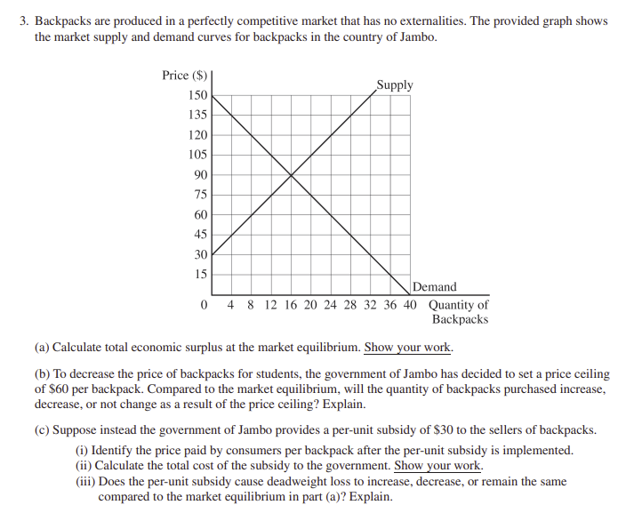

Slide 36
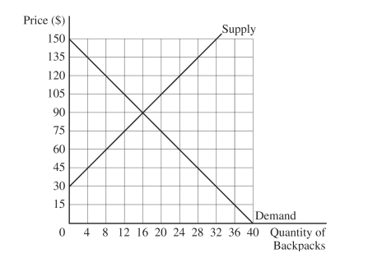
3a. Calculate the consumer surplus at market equilibrium. Show your work.
Economic Surplus = CS +PS
= ½ (base)(height)
= ½ (150-30)(16-0)
= ½ (120)(16)
=960
b. To decrease the price of backpacks, the government sets a price ceiling of $60/backpack. Compared to the market equilibrium, will the quantity of backpacks purchased increase, decrease, or not change? Explain.
At the price ceiling, Qd is 24, but Qs is 8. Only 8 backpacks will be purchased under the price ceiling which is less than the 16 backpacks purchased in the market equilibrium.

Slide 37
c. The government provides a per-unit subsidy of $30 to the sellers of backpacks.
(i) Identify the price paid by consumers after the subsidy is implemented.
$75
(ii) Calculate the total cost of the subsidy to the government. Show your work.
$30/unit x 20 backpacks sold = $600
(iii) Does the subsidy cause deadweight loss to increase, decrease, or remain the same? Explain.
Increase since the backpacks are produced in a perfectly competitive market with no externalities. (DWL shown on graph.)

Slide 38
2024 AP Micro Questions
Set 1 Questions tested concepts from:
Unit 2 (elasticity, S/D)
Unit 3 (perfect competition)
Unit 4 (game theory)
Unit 6 (externalities, DWL, and per-unit tax and subsidies).
Set 2 Questions tested concepts from:
Unit 2 (elasticity, surplus, government intervention)
Unit 3 (production, costs)
Unit 4 (monopoly, price discrimination)
Unit 5 (factor markets)
Unit 6 (externalities, per-unit subsidy)

Slide 39
Contact Information
Name: Kathleen Brennan
Email Address: kmbrennan108@gmail.com
Social Handles X : @econkate
Instagram: @kmbrennan108
Thank You!

Slide 40
Find A Local State Program
CEE's affiliated network of 200 organizations educates the educators: providing the curriculum tools, the pedagogical support, and the community of peers that instruct, inspire, and guide. They are the ears on the street and a voice in the community for our programs.
Search our Directory
https://www.councilforeconed.org/about/state-affiliates/

Slide 41





Our Generous Sponsors and Partners

Slide 42



CEE Student Programs
Invest in Girls
National Economics Challenge
National Personal Finance Challenge

