Slide 1



Willy Wonka’s
Whimsical
Entrepreneurial
Adventures
Presented by Lynne Farrell Stover

Slide 2
Certificate Requirements
To earn professional development hours for webinars, you must:
Watch a minimum of 45-minutes and you will automatically receive a professional development certificate via e-mail within 24 to 48 hours.

Slide 3

Presenter
Lynne Farrell Stover is currently a Teacher Consultant at the James Madison University Center for Economic Education. Prior to this, she spent thirty-three years in public education where she enjoyed various teaching assignments including classroom teacher, gifted education specialist, and librarian. She is the author of over fifty educational articles and eight teacher resource books. She is the recipient of the 2022 NAEE Platinum Curriculum Award for her lessons developed for Virginia’s Reading Makes Cents Program.
stoverlf@jmu.edu

Slide 4

National Standards in Economics
STANDARD 1: SCARCITY
STANDARD 2: DECISION MAKING
STANDARD 3: ALLOCATION
STANDARD 7: MARKETS AND PRICES
STANDARD 9: COMPETITION AND MARKET STRUCTURE
STANDARD 14: ENTREPRENEURSHIP
https://www.councilforeconed.org/policy-advocacy/k-12-standards/

Slide 5
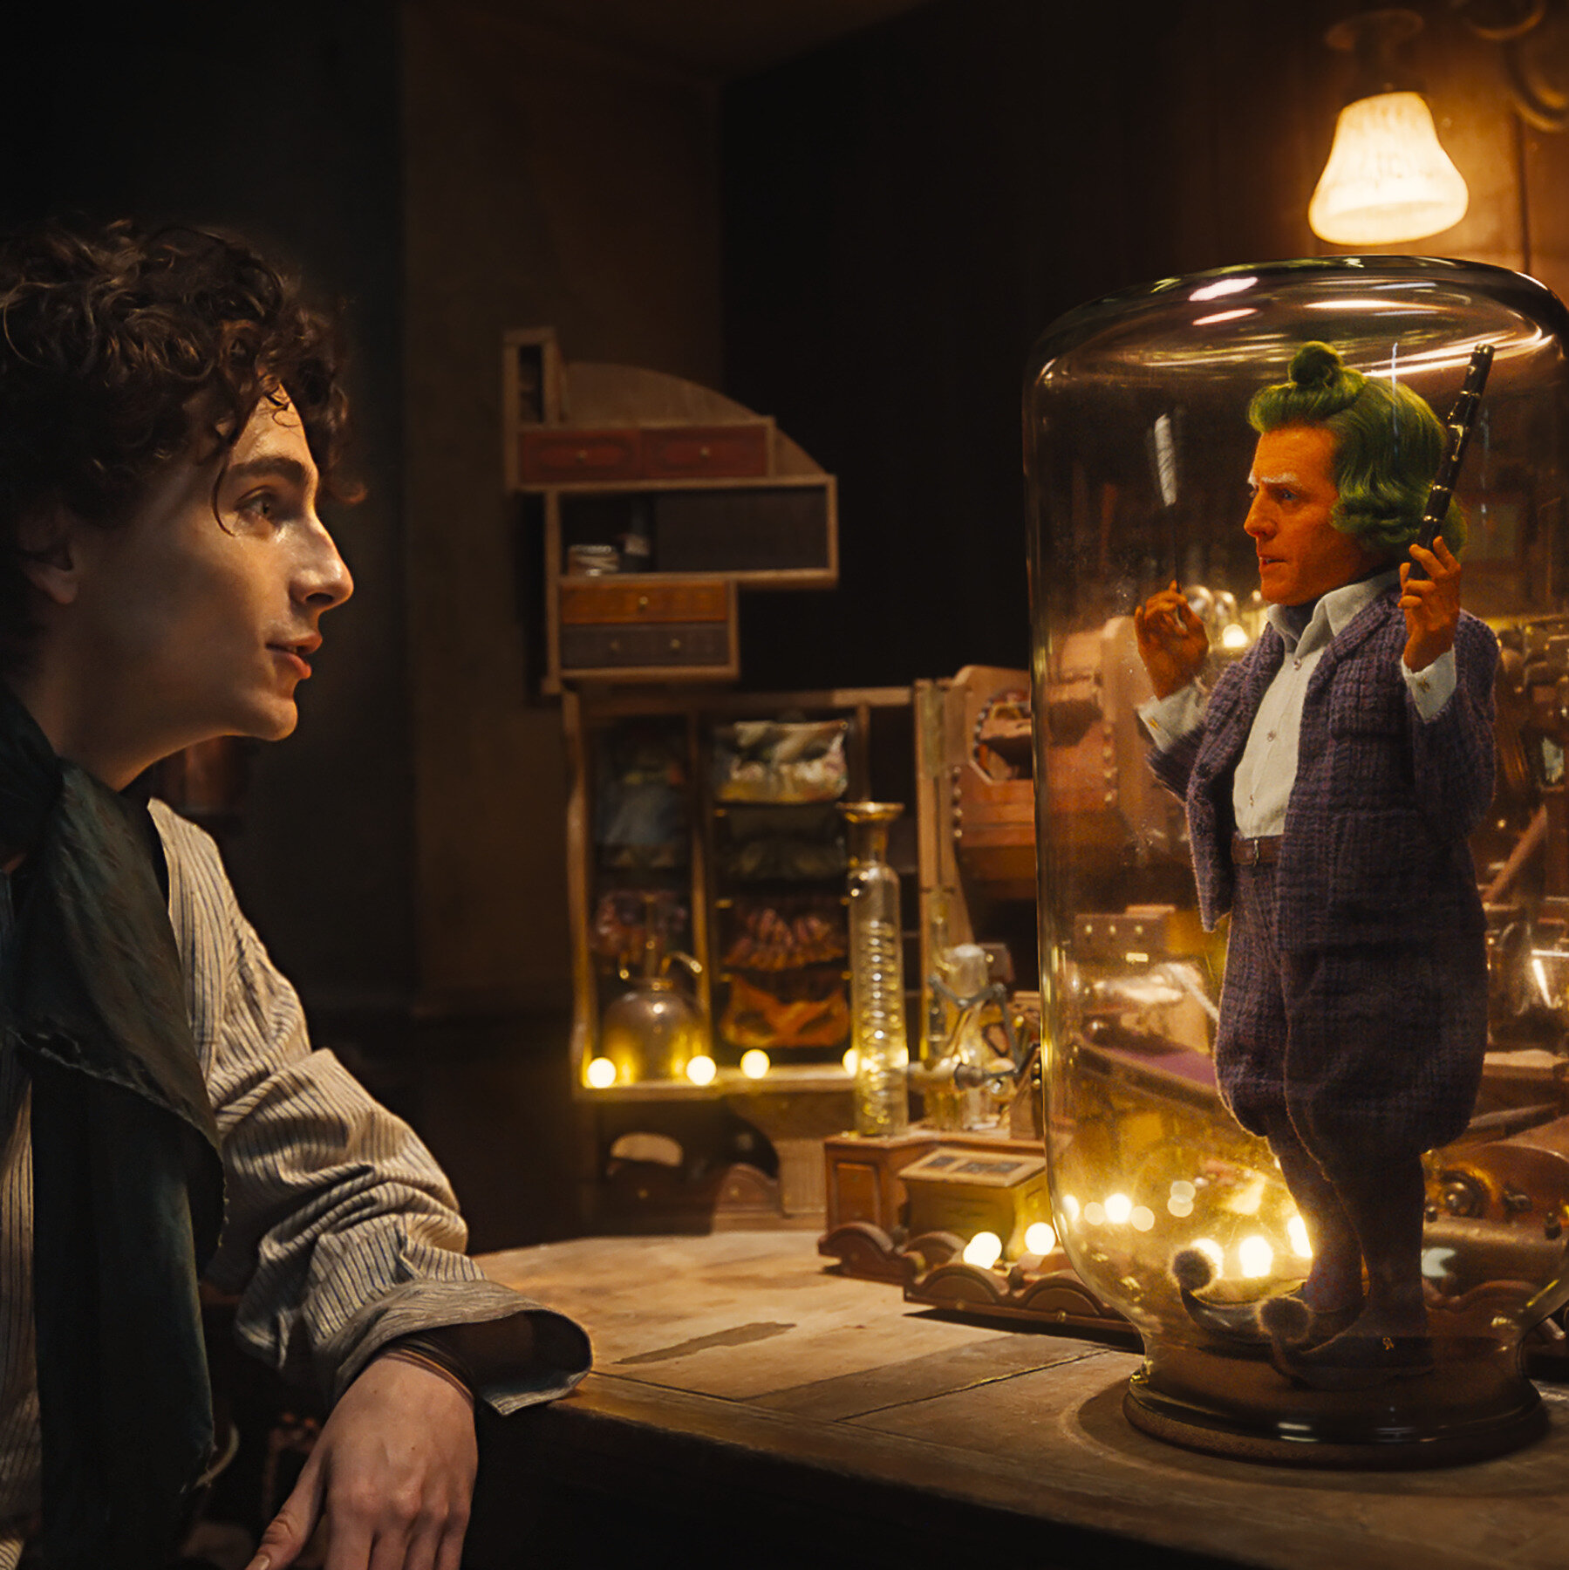
Session Agenda
Introduction
Book Background and Concept Connections
Lesson Plans and Activities
Resources and Support Materials
Conclusion and Survey

Slide 6
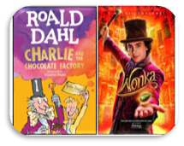
Objectives
You will be able to:
Explore the merits of using children’s picture books that have been made into movies to teach economics and financial literacy.
Examine the lessons and activities provided to support the presented material.
Discuss social issues featured in books by Roald Dahl.
It is to be noted that the students do not need to have read the ​
books or seen the movies to successfully complete the lessons.​

Slide 7
Book Background and Concept Connections

Slide 8

Movie Popularity
"Never judge a book by its movie."
-J.W. Eagan
But be an opportunist –
A popular movie will generate interest in a book. It’s not a coincidence that The Hunger Games Trilogy was on the USA Today Bestseller List six straight weeks before the movie release date.

Slide 9
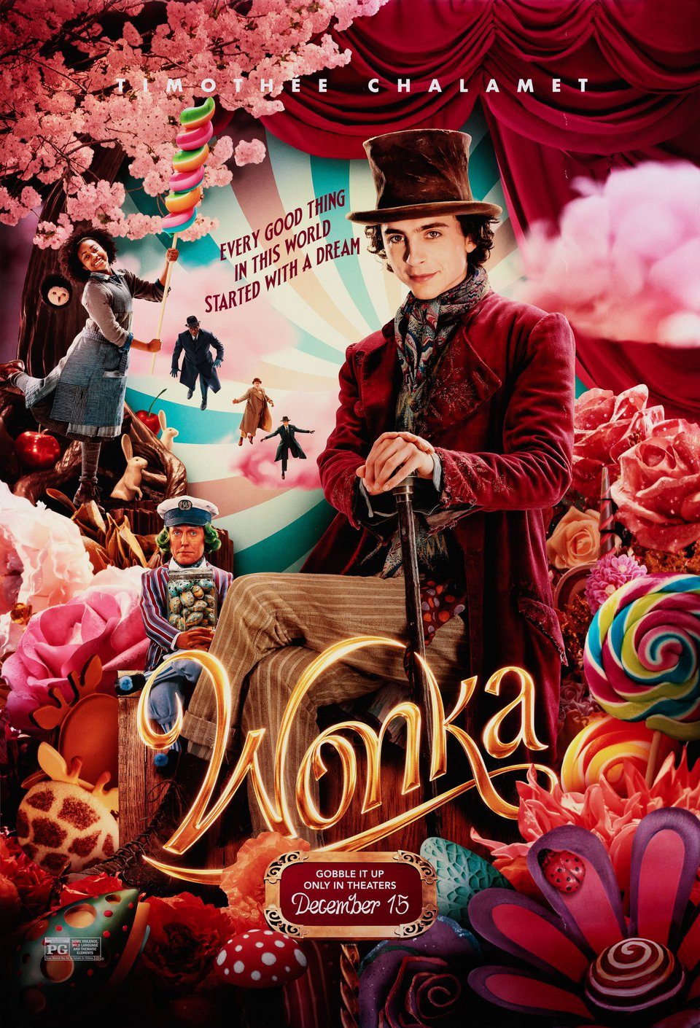


Movie Popularity
The movie WONKA received generally positive reviews from critics and was a commercial success, grossing $632 million worldwide against a $125 million budget and becoming the eighth-highest-grossing film of 2023.

Slide 10
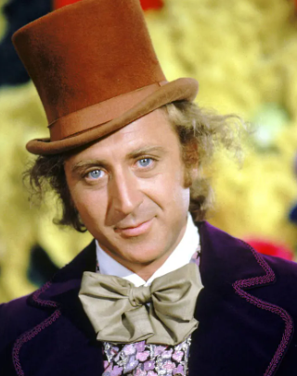
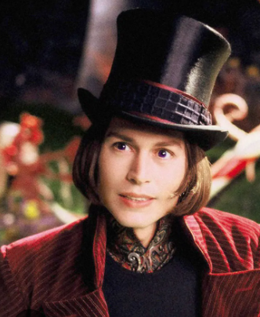
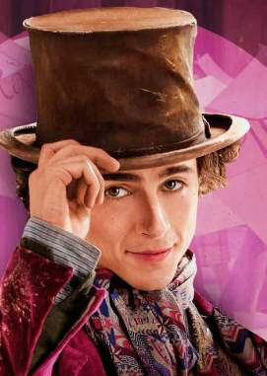
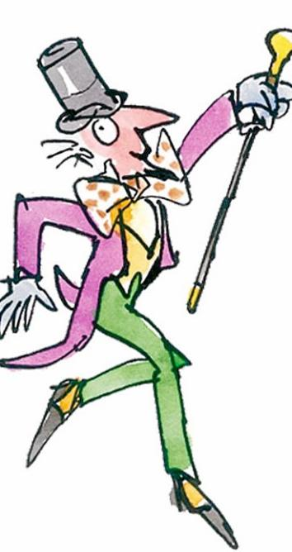
Who is your favorite Willy Wonka?
1964 1971 2005 2023
A. B. C. D.
Type your answer in the chat!

Slide 11
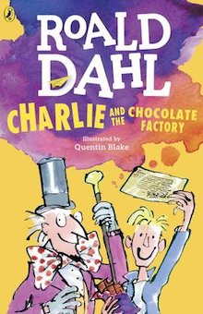
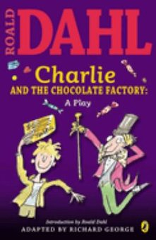
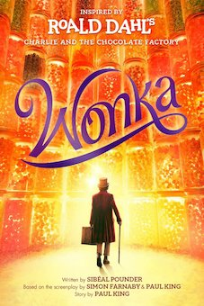

1964 and 2023
Publisher: Penguin
Copyright: 1964
Reading Level: 4.8
Interest Level: 4-7
Publisher: Penguin
Copyright: 2023
Reading Level: 4.0
Interest Level: 4-7

Slide 12

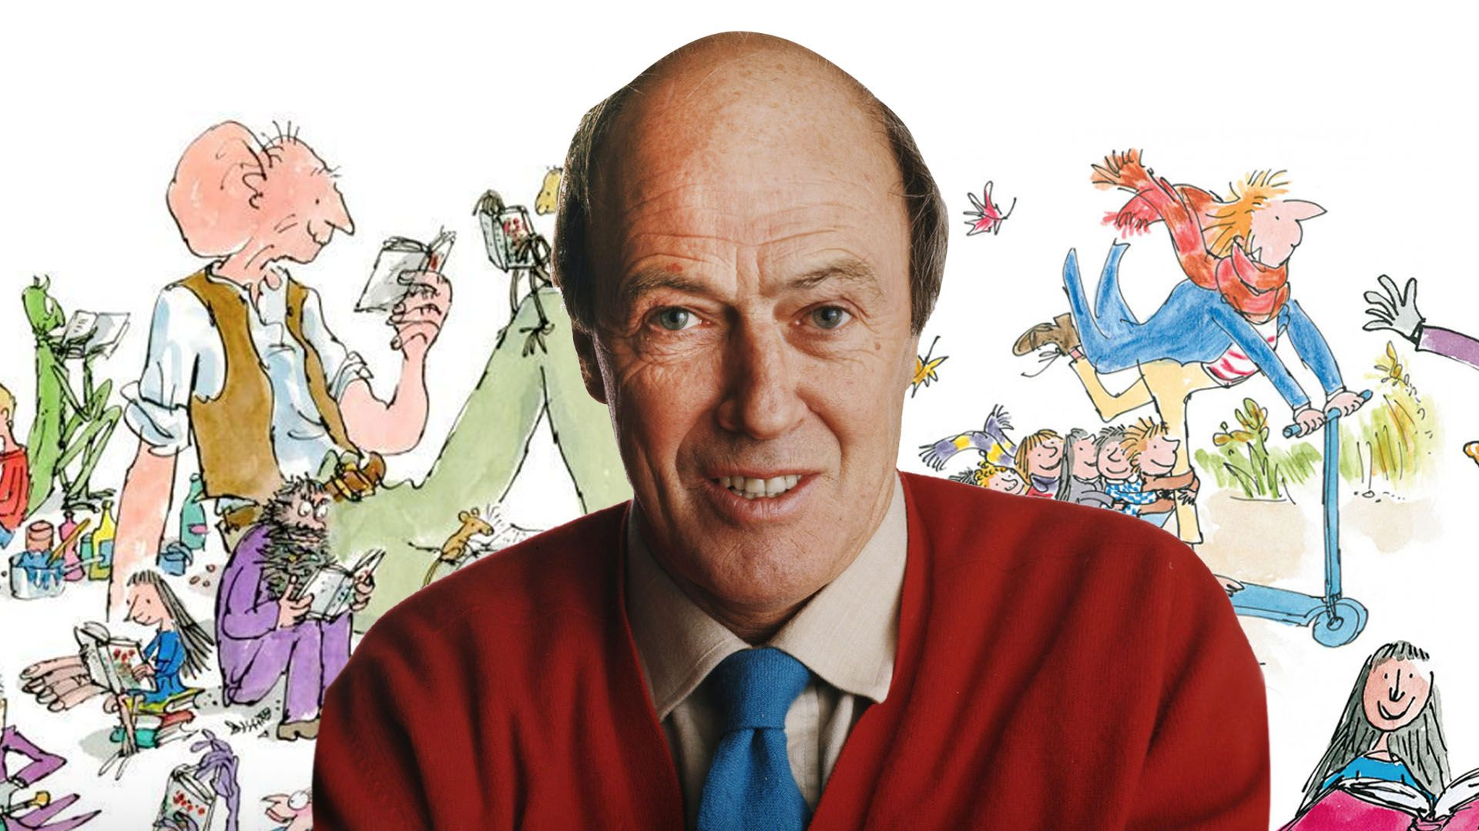
Roald Dahl was a British author of popular children’s books and short stories, a poet, screenwriter and a wartime fighter pilot. His books have sold more than 300 million copies. He has been called "one of the greatest storytellers for children of the 20th century".
September 13, 1916 – November 23, 1990

Slide 13
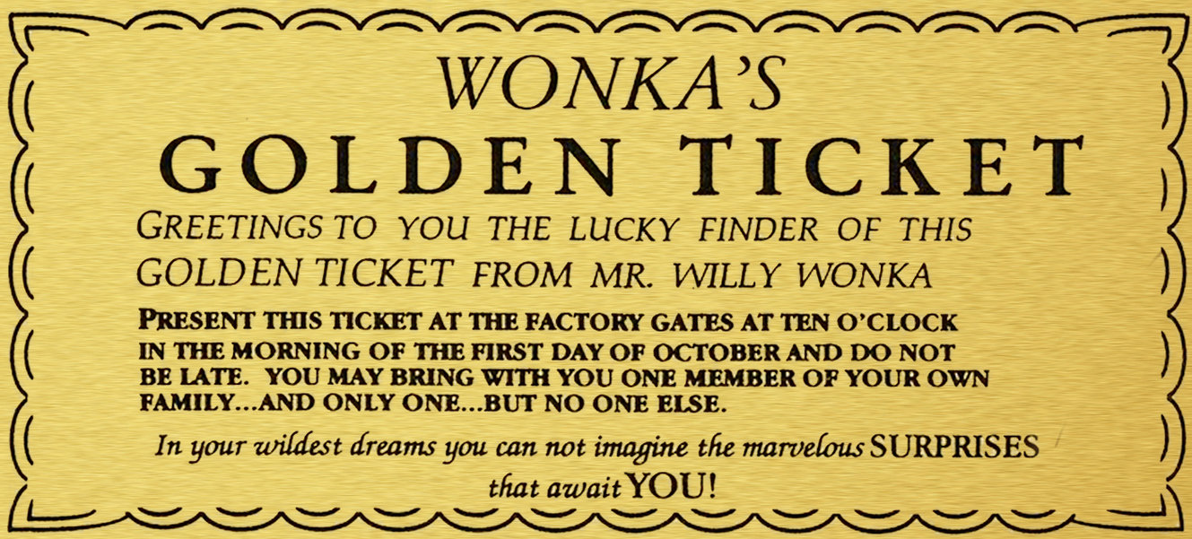
Opportunity Cost
In the movie, Charlie had an option of either keeping the golden ticket or selling it. Had he chosen to sell it, he would have earned some much needed money for his poverty- stricken family. However, he decided to keep the ticket. The money that he could have earned by selling the ticket was his opportunity cost.
Opportunity Cost
The best thing given up when a choice is made; the second choice.

Slide 14
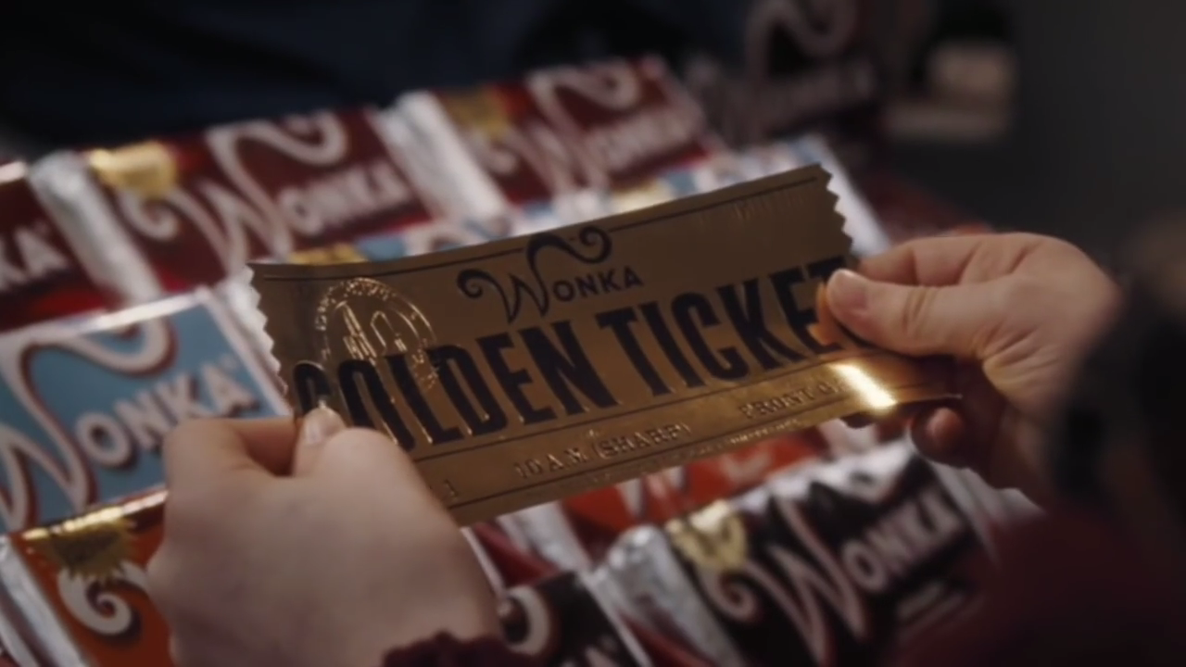
Scarcity
Scarcity
The condition that exists because there are not enough resources to produce everyone's wants.
The compelling situation that defines the plot of the Willy Wonka stories.
There are only 5 golden tickets hidden in millions of Wonka Bars. It is the scarcity of these coveted tickets that creates the frenzied search among eager children and their parents.

Slide 15

Monopoly
Monopoly
A market for a good or service where there is only one supplier, or that is dominated by one supplier. Barriers prevent entry to the market and there are no close substitutes for the product.
Willy Wonka was an innovator in the candy industry. He was the sole producer of sweets such as Everlasting Gobstoppers and Golden Chocolate Eggs. With Wonka being the sole person with the knowledge of the secrets behind such novel and highly-desired products, the candy market has extremely high barriers to entry.

Slide 16

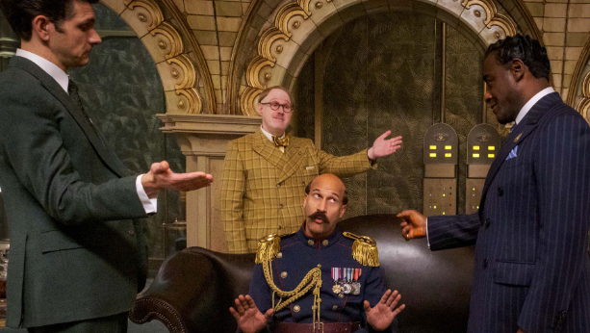
Oligopoly
Oligopoly
A market structure in which a few large firms (sellers) dominate a market.
The “Chocolate Cartel” of Slugworth, Fickelgruber, and Prodnose produced all the chocolates in the market. They controlled the price and the quality. They were willing to do anything to stop Willy Wonka and his innovative sweet treats from becoming competition.

Slide 17
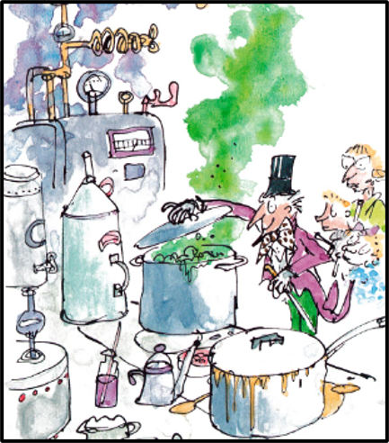
Lesson Plans and Activities

Slide 18
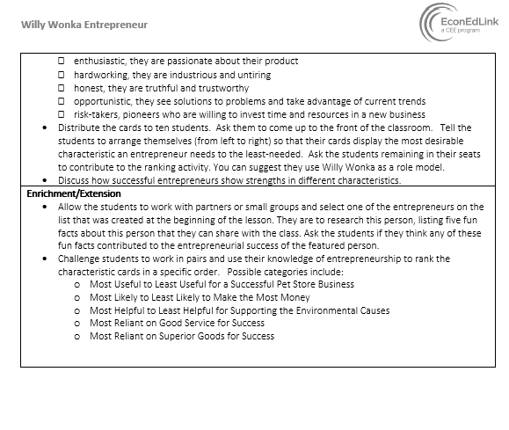
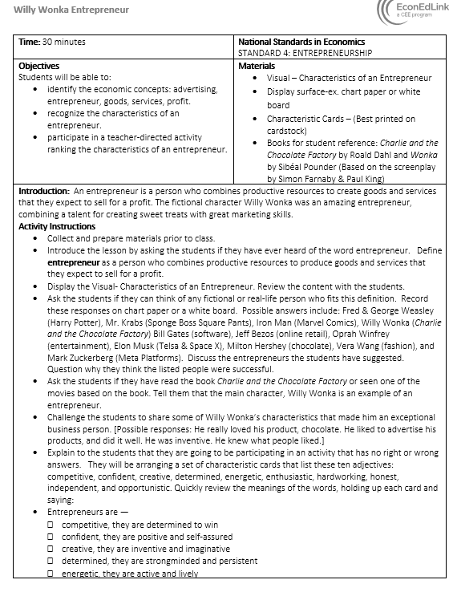
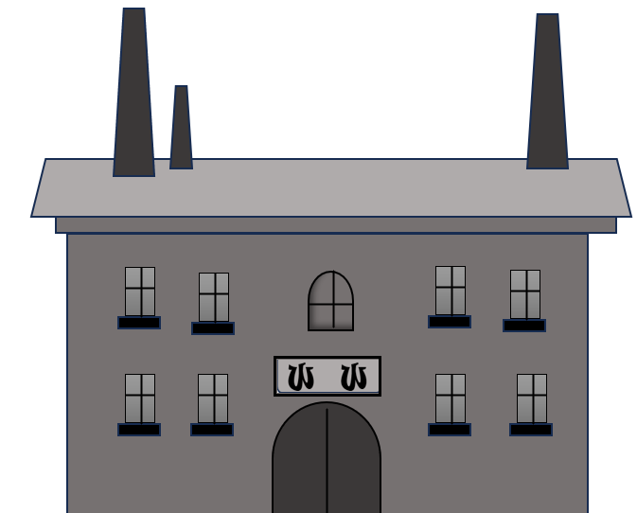
Lesson: Willy Wonka Entrepreneur

Slide 19
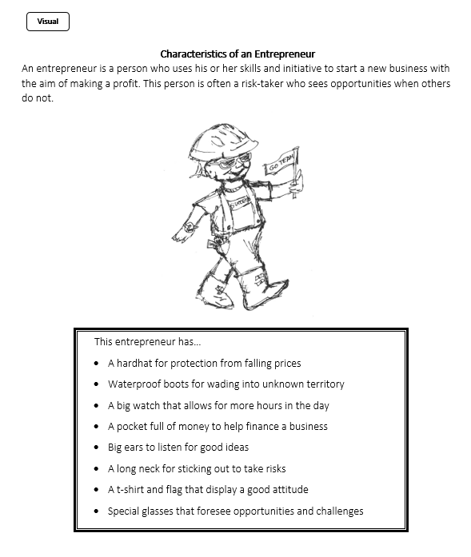
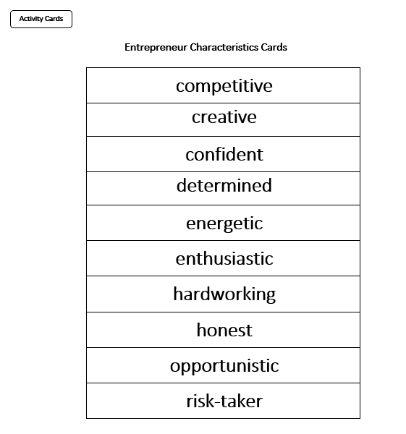

Slide 20
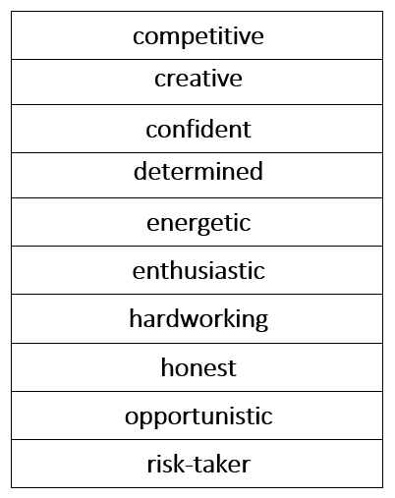
How would you rank the cards when considering the entrepreneur, Willy Wonka, as portrayed in these two movies?
Type your answer in the chat!

Slide 21
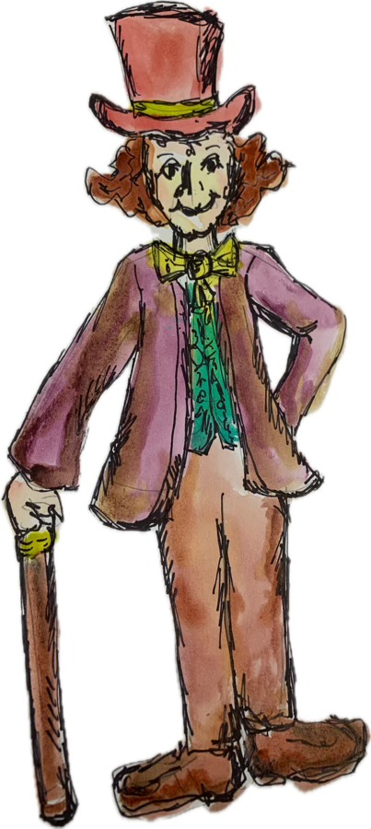
Lesson: Willy Wonka and Allocation Methods
Willy Wonka, the world-famous chocolatier, is opening his mysterious candy factory for the first time in many years and devises the perfect promotional plan. He announces that “I, Willy Wonka, have decided to allow five children – just five, mind you, and no more – to visit my factory this year.” These lucky children will be the finders of one of five Golden Tickets, found inside the wrapper of a normal-looking Wonka Candy Bar. This is a worldwide contest. The winners get a special tour of the candy factory and a lifetime supply of chocolate.

Slide 22
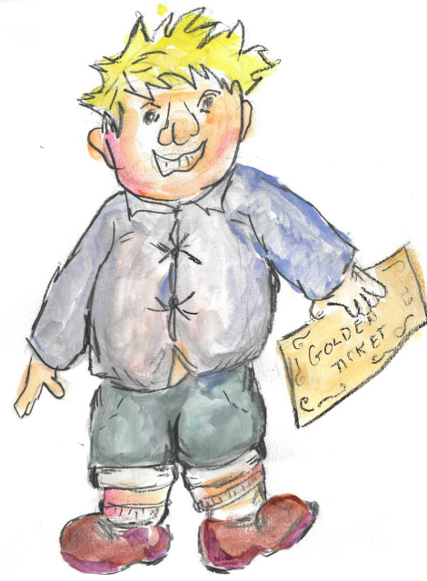
Augustus Gloop
Age: 9
Nationality/Economic Status: German/Middle-Class [Father is a butcher]
Physical and Personality Traits: Large, Overweight, Disobedient, Selfish, Gluttonous

Slide 23
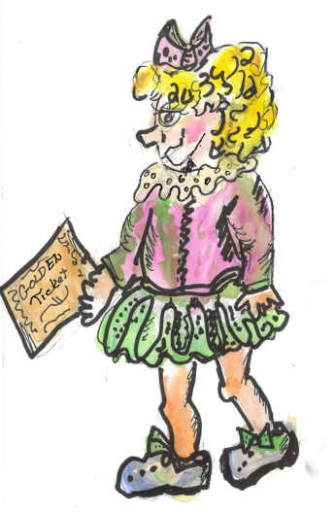
Veruca Salt
Age: 9
Nationality/Economic Status: English/Very Wealthy
[Lives in a mansion with her indulgent parents]
Physical and Personality Traits: Pretty, Greedy, Disrespectful, Self-centered

Slide 24
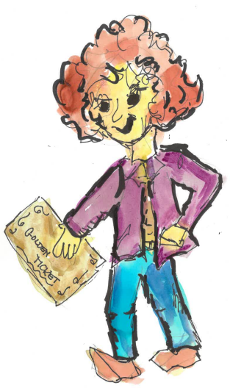
Violet Beauregarde
Age: 12
Nationality/Economic Status: American/Middle-Class
[Father is a used car salesman]
Physical and Personality Traits: Athletic, Competitive, Malicious, Prideful, Obsessed with chewing gum

Slide 25
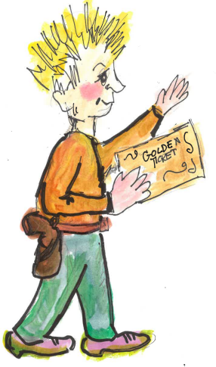
Mike Teavee
Age: 9
Nationality/Economic Status: American/Middle-Class
[Spends most of his time watching cowboy shows on television]
Physical and Personality Traits: Wears cowboy clothes, Intelligent, Lazy, Reckless, Dislikes Chocolate, Obsessed with technology

Slide 26
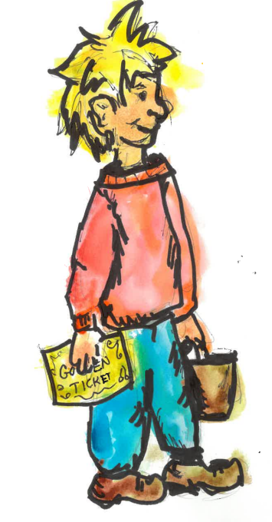
Charlie Bucket
Age: 11
Nationality/Economic Status: English/Extremely Poor
[Lives in a tiny house with his parents and grandparents]
Physical and Personality Traits: Thin, Friendly,
Loving, Humble, Curious, Helpful

Slide 27
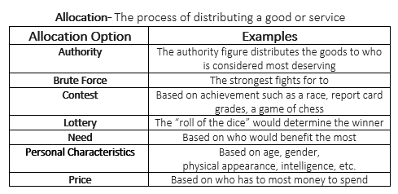
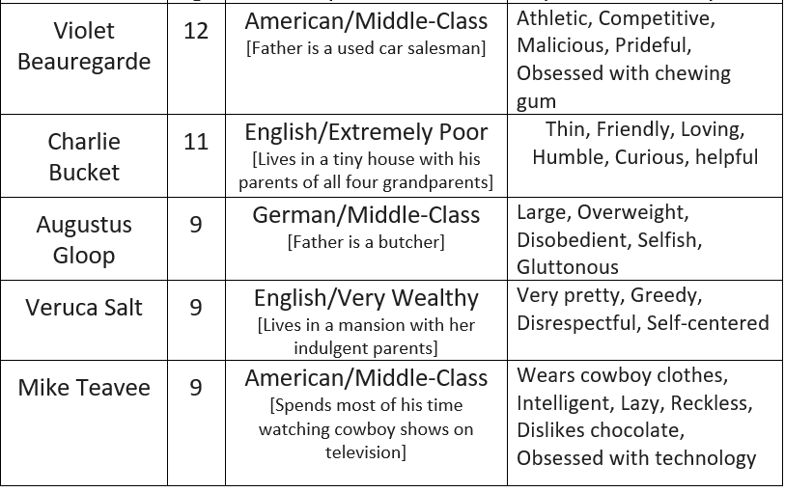

Slide 28
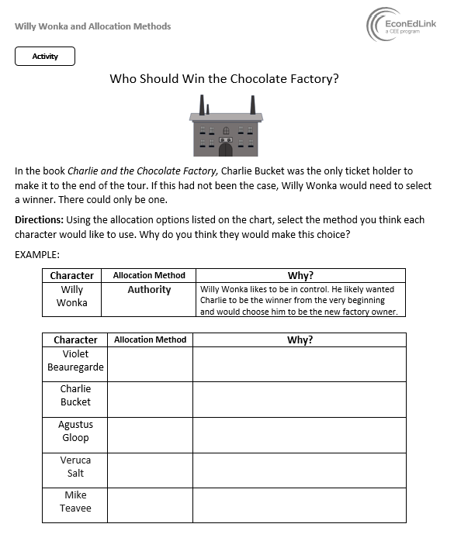
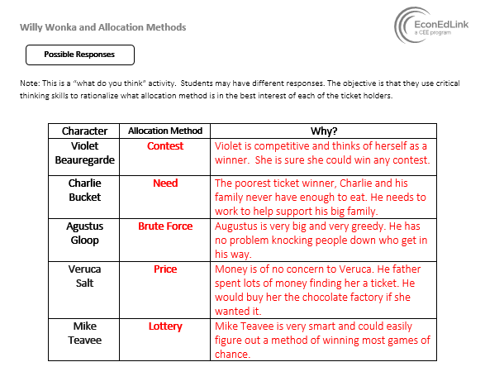

Slide 29
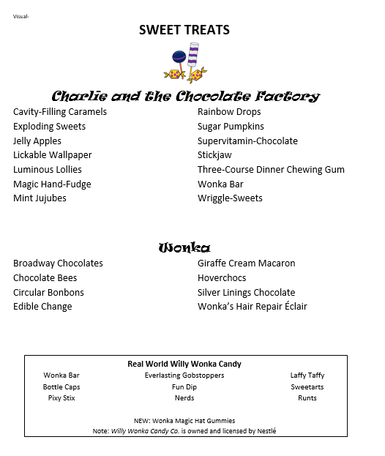
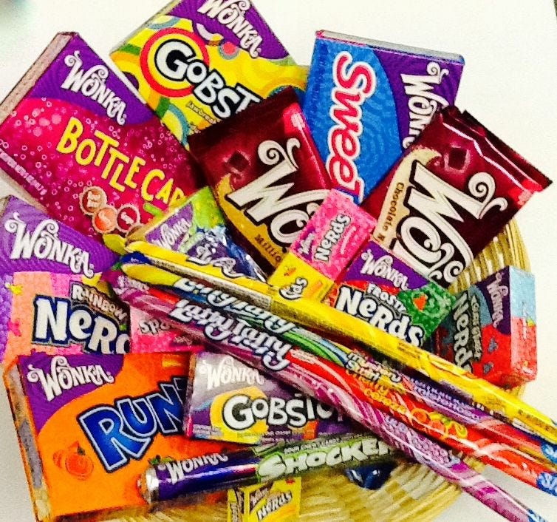
Enrichment Activities
Roald Dahl loved candy.
In fact, while attending boarding school he and his classmates were taste-testers for Cadbury’s Chocolates. This delicious experience left a lasting impression.

Slide 30
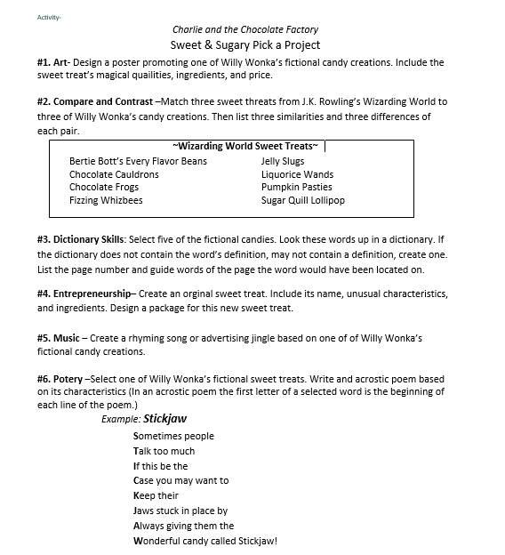
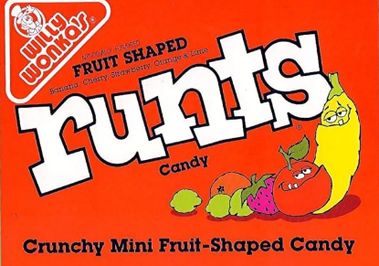


Slide 31
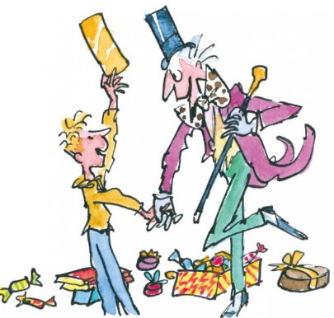
Support Materials and Fun Stuff

Slide 32
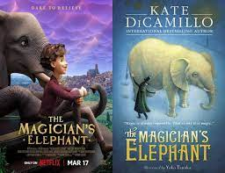
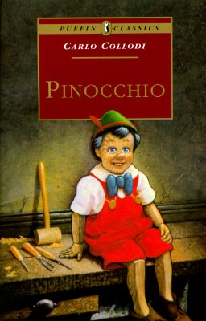
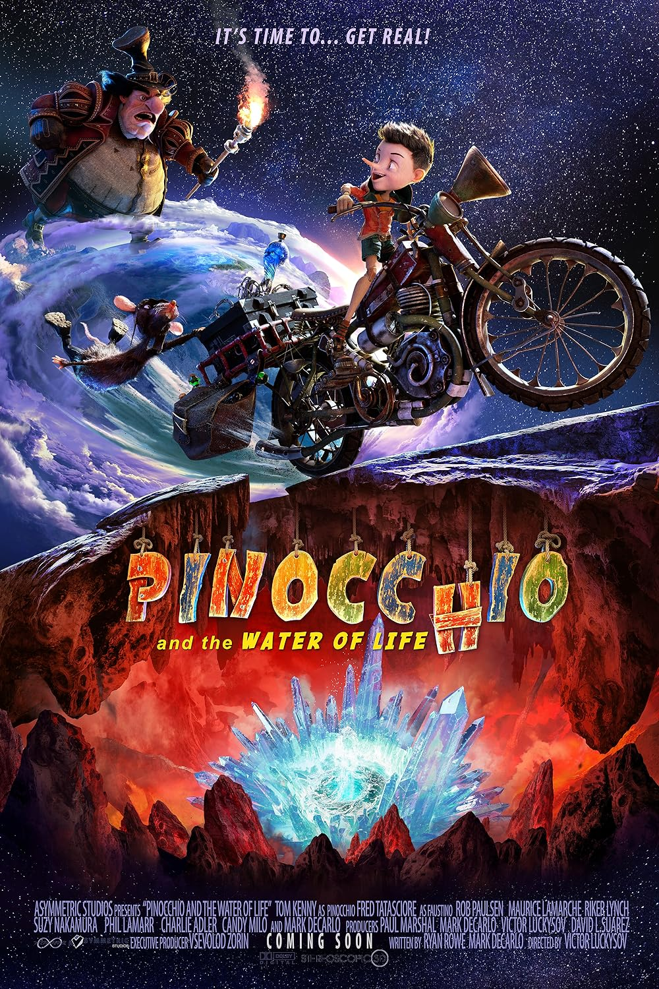
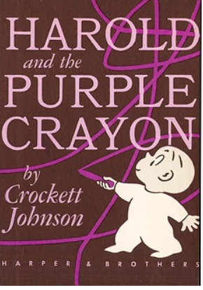
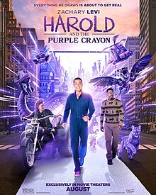
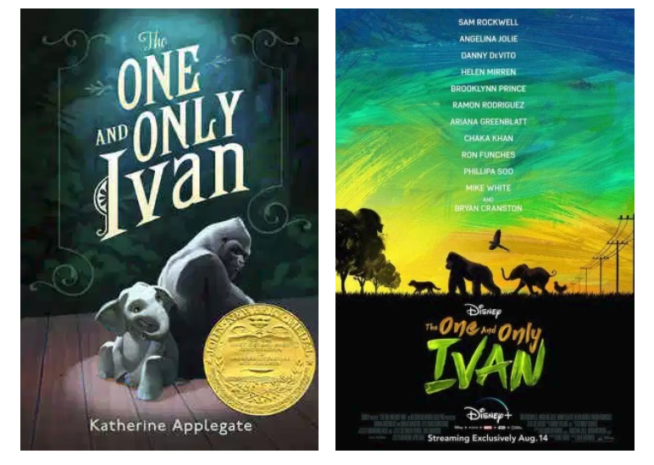
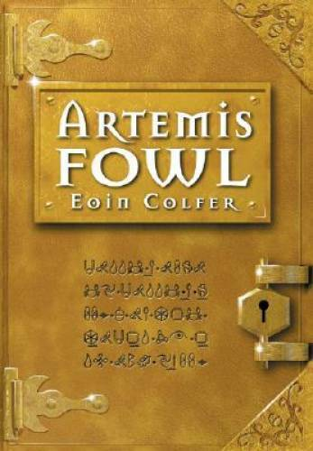
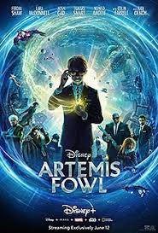
Possible “Books to Movies” Lesson Plans For Consideration
Type your choice in the chat!

Slide 33
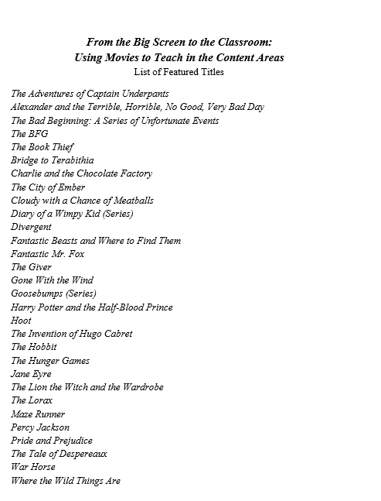




CHOICES!
https://piecesoflearning.com/product/from-the-big-screen-to-the-classroom-6th/

Slide 34
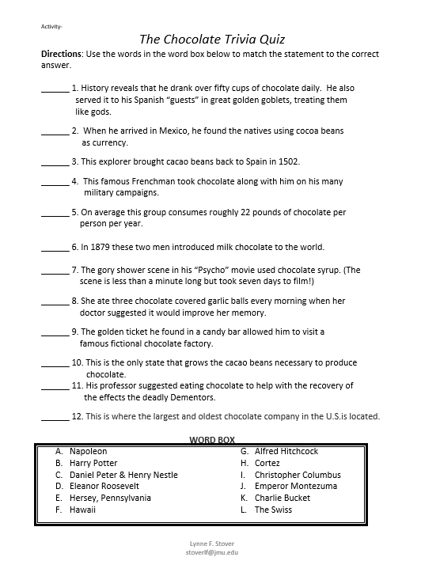
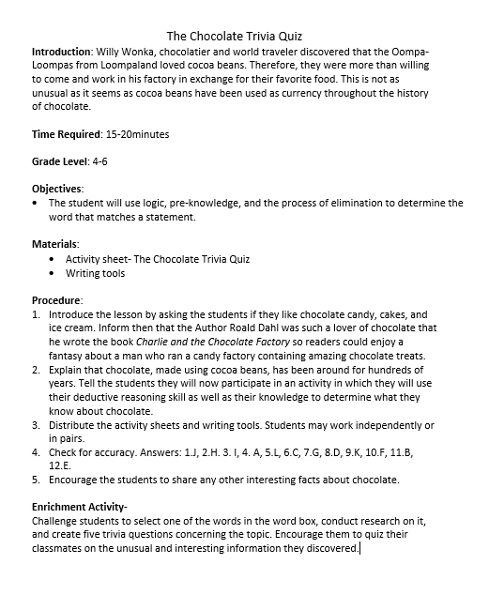

Fun Trivia

Slide 35

Willy Wonka and the Chocolate Factory appears to be a rags-to-riches story. Charlie Bucket, a poor boy, gets a lucky break, and through his moral righteousness makes all his dreams come true.
In the last line of the movie, Willy Wonka says:
“But Charlie...don't forget what happened to the man who suddenly got everything he always wanted. He lived happily ever after.”
Consider this:
King Midas wanted everything he touched to turn to gold, then found he couldn't eat or give his daughter a hug.

Slide 36
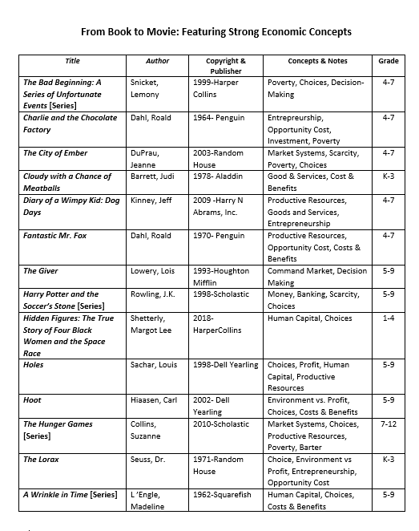

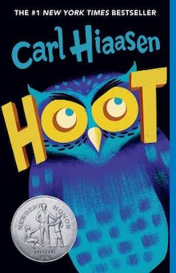
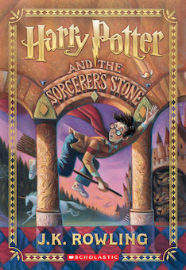




Slide 37

Thank you

