Slide 1

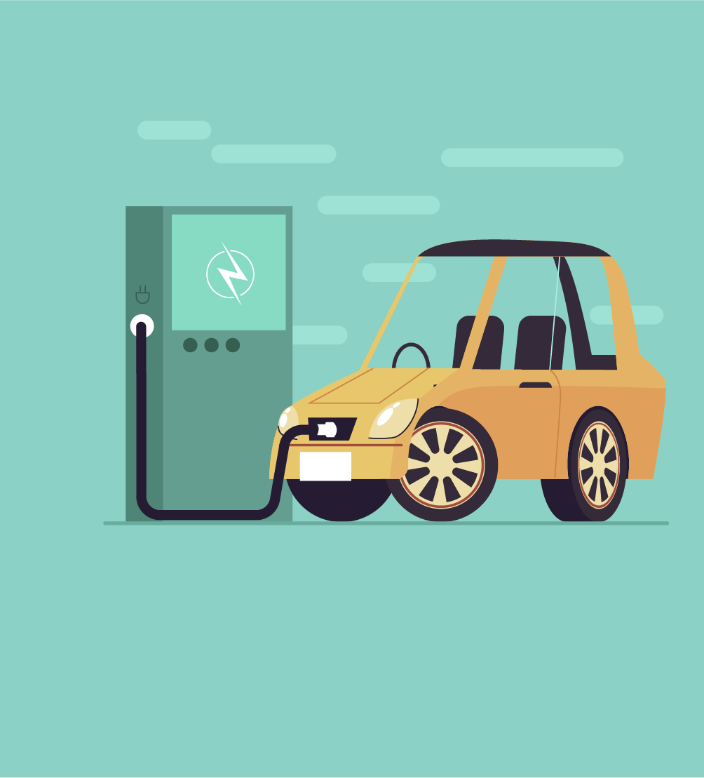

Should the U.S. Ban
Gas-Powered Cars?
Making Decisions Like an Economist

Slide 2


What is economics?
Economics is the study of choices.
A policy can be thought of as a choice by a lawmaker.
Economists regularly examine policies such as the one in California by weighing the costs against the benefits.
Costs are things unfavorable to a decision maker
Benefits are things favorable to a decision maker

Slide 3

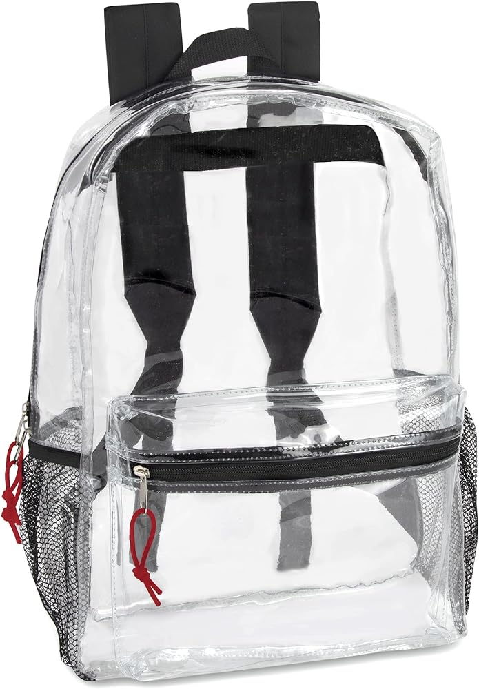
New policy: All students must
carry see-through backpacks!
The school board is considering a new policy requiring all students to carry a see-through backpack.
              What are the costs for students, teachers, or
              parents associated with this policy?
What are the benefits for students, teachers,
or parents associated with this policy?
Notes:
What are the costs for students, teachers, or parents associated with this policy? (Answers will vary but may include: students not liking the style or lack of privacy for items in their backpacks. Parents or students will have to spend money to buy the new item. Teachers might have to check that students are following the new policy including potential discipline.)
What are the benefits for students, teachers, or parents associated with this policy? (Answers will vary but may include: increased level of safety as you cannot hide things in your backpack, students will all have similar backpacks so there is less competition for fashionable or desirable items, etc.)

Slide 4


Is this a good policy or a bad policy?
California and several other states are banning the sale of new gas-powered vehicles by 2035. This means that consumers will look to electric vehicles, or EVs, as their main vehicle option.
What does it mean to be a good policy
or bad policy?
Notes:
Is this a good policy or bad policy? Why? (Answers will vary widely, especially given your geographical location, but many students will say yes, this is a good policy because gas powered vehicles are part of the climate change problem. Others might say that this is not a good policy because there are still other things causing climate change or that oil is not going to go away. Accept all answers and listen to what the students are saying regardless of their supporting evidence, or lack thereof.)
What do we mean when we say good policy or bad policy? (Answers will vary again but students will likely talk about how many people the policy can help or hurt, the cost of the policy being worth it, etc.)

Slide 5
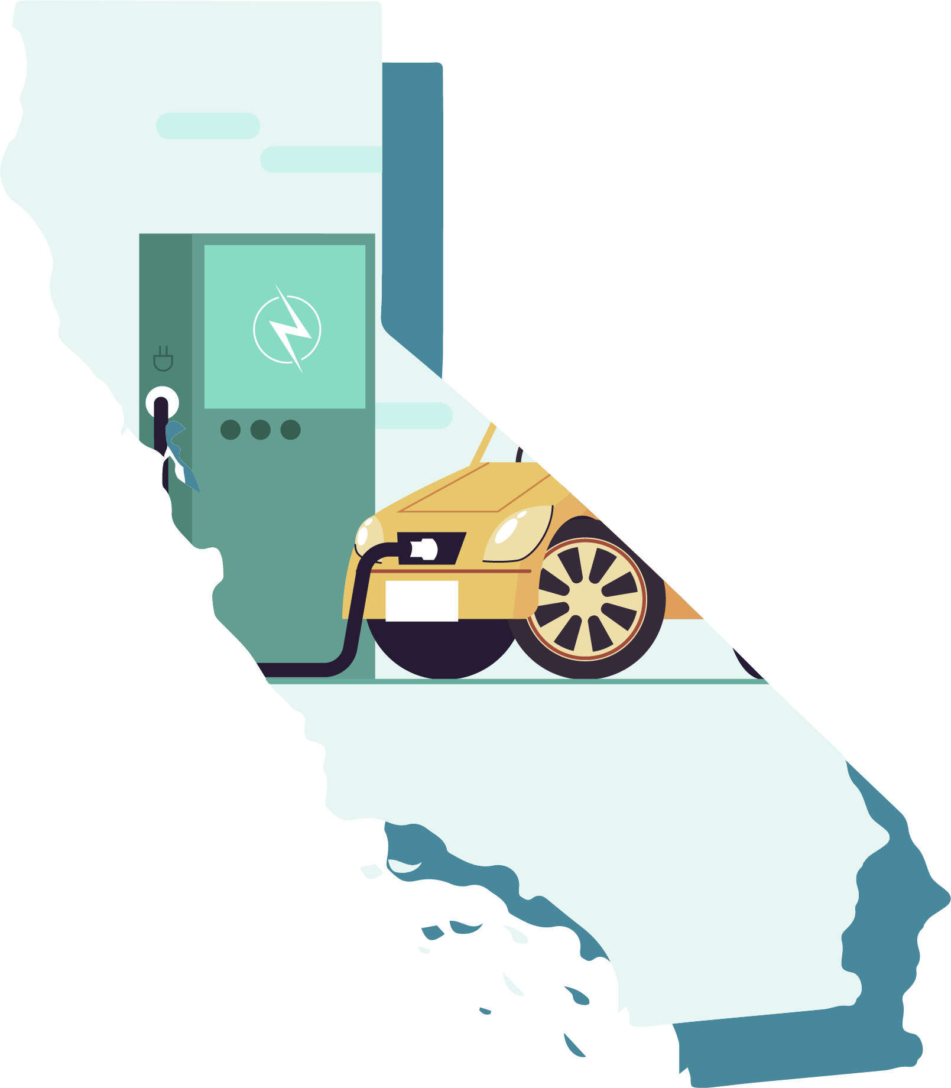
Activity 2.1: Thinking about policies like an economist
List 2-3 benefits of implementing a policy such as California’s ban on the sale of new gas-powered vehicles by 2035.
List 2-3 costs of implementing a policy such as California’s ban on the sale of new gas-powered vehicles by 2035.

Slide 6
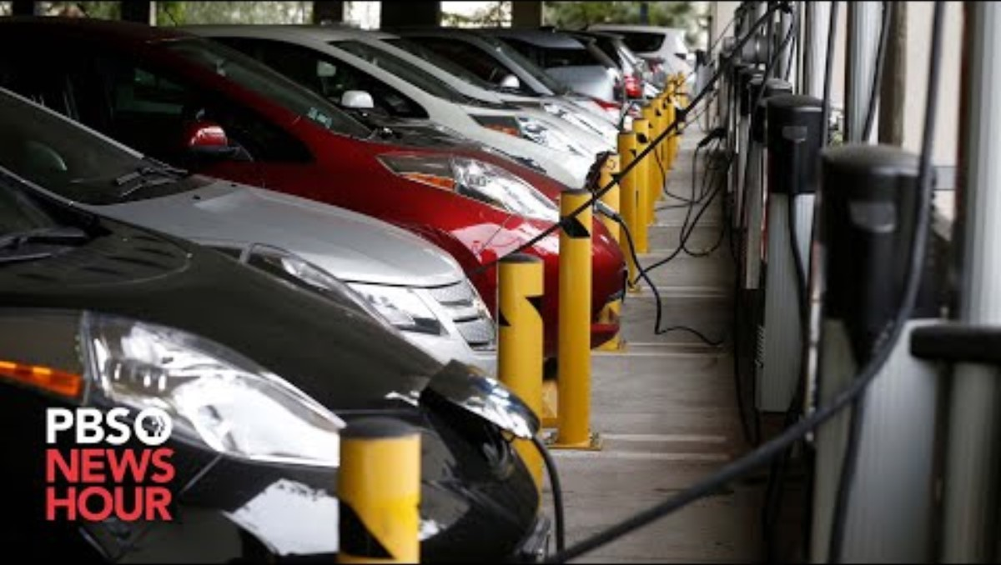
Notes:
PBS News Hour Video: https://www.pbs.org/newshour/show/californias-move-to-ban-sales-of-new-gasoline-fueled-cars-could-spread-to-other-states (7:56)
Youtube link: https://www.youtube.com/watch?v=q1QdkPmWcHM

Slide 7
Activity 2.1: Thinking about policies like an economist (cont.)
List 2-3 people or groups of people that might be affected by a policy such as California’s ban on the sale of new gas-powered vehicles by 2035.

Slide 8

Opportunity Costs
In addition to looking at the benefits and costs of a
policy, economists must also take into account opportunity costs.
Opportunity cost is the value of the next-best
alternative when a decision is made; it's what is given up.
  If a state requires a certain amount of their land to be dedicated to a solar farm there are costs beyond the dollar amount of this project. What must be given up to make the solar farm?

Slide 9
Activity 2.2: Policy Stakeholder Roles
You have been given a role as 1 of 5 policy stakeholders
  Consumer
  City planners in California
  Car companies (i.e General Motors, Ford, Honda, Fiat Chrysler)
  California Utility Companies
  Lithium battery producers
In a moment you will get together in a group composed of other students with your role.
In your groups, read through the information on your card. Answer the questions at the bottom of the sheet of paper. You have 10 minutes.
Stakeholders within the group do not all have to agree on
question 3.

Slide 10
Activity 2.2: Policy Stakeholder Roles (cont.)
In your groups, read through the information on your card.
Answer the following questions as a group on the back of your sheets. You have 10 minutes. (Stakeholders within the group do not have to all agree on question 3.)
What benefits would the policy have for someone in this role?
What costs would the policy have for someone in this role?
In general, how would someone with this role feel about banning gas-powered vehicles? Explain. Be sure to identify the most important benefits and/or costs in your decision.

Slide 11
Activity 2.4:
Policy discussion and decisions
Next, get into groups of 5 with 1 role in each group.
Your group should have at least 1 person from each of the following policy stakeholders
  Consumer
  City planners in California
  Car companies (i.e General Motors, Ford, Honda, Fiat Chrysler)
  California Utility Companies
  Lithium battery producers
In your groups use Activity 2.4: Policy discussion and decisions to take notes about each stakeholder as they explain their role and the costs and benefits the ban on new-gas powered vehicles as it pertains to them.
Next answer the questions as a group.

Slide 12
How does one energy policy affect so
many people differently?
With every policy there are costs and benefits. As you’ve discussed in your groups many times, different groups of people have different costs and benefits.
How did your groups vote overall?
Which role had the most influence or was the most important in your decision? Explain why.
What opportunity costs does a bill like this have?

Slide 13
How does one energy policy affect so
many people differently? (cont.)
There are no perfect policies out there.
There are policies which are better and worse and even those assessments are highly subjective depending on the groups being affected.
Every policy can be improved because often there are unseen consequences or groups of people who might be drastically hurt by a policy.
Therefore, it is important for us to think about ways to improve a policy.

Slide 14
How does one energy policy affect so
many people differently? (cont.)
Regardless of how you voted, what improvements could be made to the policy to either
make it feasible to pass (if your group was not in favor)
or
make it so more roles within the group were in favor of the bill (if you were in favor but some roles were against).
Think about the costs from the different roles.
Are there ways to reduce the costs to those groups?

Slide 15
Assessment: Analyzing a policy
Brief description of the Policy:

Slide 16
Assessment: Analyzing a policy
Based on the Policy think of 5 groups of people that might be affected.
For each stakeholder answer the following questions:
What are the costs of adopting the policy for this group?
What are the benefits of adopting the policy for this group?
Is this group likely to vote for or against the policy? Explain.

Slide 17
Assessment: Analyzing a policy
Based on your table in question 1, should this policy be passed? Why or why not?
Regardless of how you voted, what improvements could be made to the policy to either
make it feasible to pass (if your group was not in favor)
or
make it so more roles within the group were in favor of the bill (if you were in favor but some roles were against).
Think about the costs from the different roles.
Are there ways to reduce the costs to those groups?

