Slide 1
The Costs and Benefits of Hosting the Olympics

Slide 2
What’s Your Favorite Olympic Sport to Watch?

Slide 3
Warm Up: Benefits of Hosting: LA
What interesting facts did you hear?
Why might a city want to host the Olympics?
Notes:
https://www.youtube.com/watch?v=GbWrEu2NnIk&t=59s 3:31 minutes total

Slide 5
Warm Up: Costs
1. What interesting facts
did you hear?
2. What might discourage a city from hosting an Olympics?
Notes:
https://www.youtube.com/watch?v=GYnZkFVXvts End at 2:11

Slide 6
Background: Cost-Benefit Analysis
A process used to evaluate the potential costs and benefits of a proposed project or policy
If TB > TC or if positive net benefit, then complete
Total Benefits:
The improvements in wellbeing or financial impacts on
markets from the choice
Total Costs:
The explicit and implicit costs of the decision
Explicit: physical receipts
Implicit: next best use of the money

Slide 7
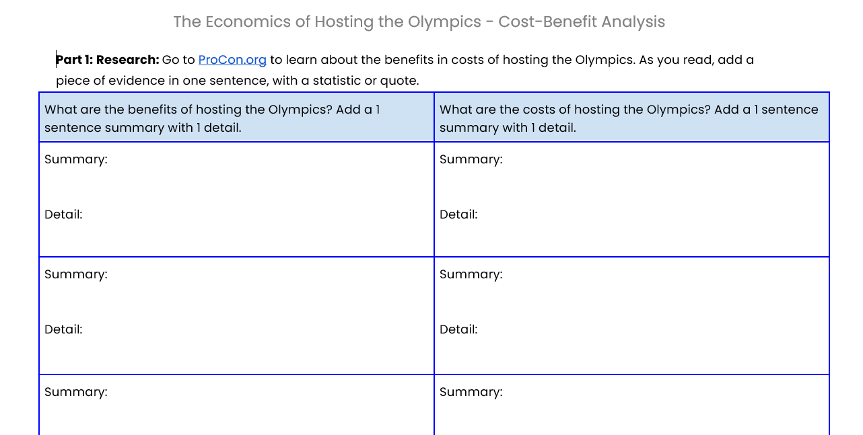
Activity: The Economics of Hosting the Olympics – Cost-Benefit Analysis

Slide 8
Exit Slip
Your state could receive a $5 Billion Dollar grant from the federal government to host the 2036 Summer Games or the 2038 Winter Games.
What would you advise your governor to do?
Host or not? Why or why not?

